Slide 1

Improving the hospital experience
An analysis of the key factors that improve the patient experience the most
By Will Carnevale

Slide 2
The Client: Government-run State Hospitals
Desired Impact: assess the performance of hospitals according to patient data to better accommodate future patients
Impact Hypothesis: several features identified in the data will have significant impact on the patient experience
Solution Path: build a classification model to show the importance of each feature relative to another

Slide 3
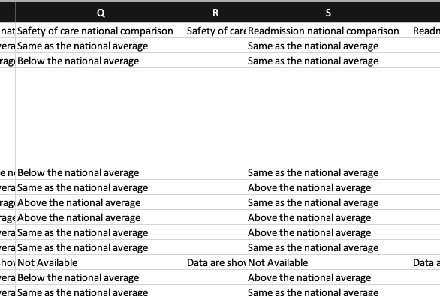
The Data
Target variable for model = “Patient experience national comparison”
Target variable had 1 of three string entries
“Below the national average”
“Same as the national average” ~ score or 3 out of 5
“Above the national average”

Slide 4
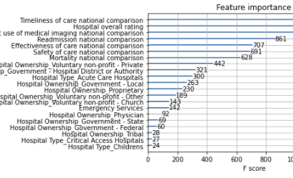

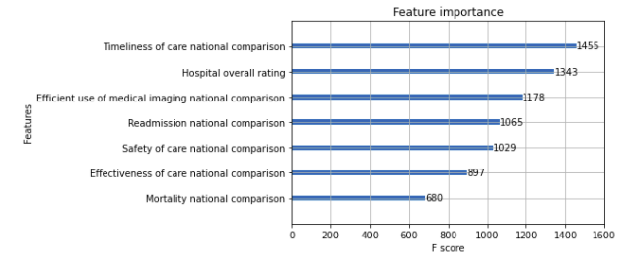

Rudimentary Model - Pandas

Slide 5
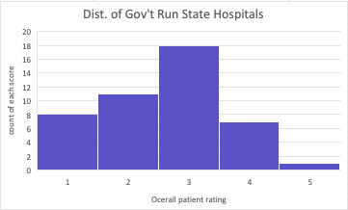
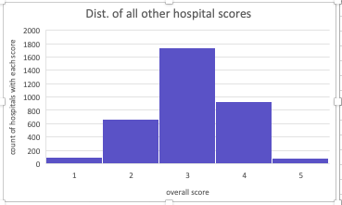
Sheets EDA
---> filtered data on ownership type ---> Government run state hospital average overall rating = 2.6 < 3 (national average)

Slide 6
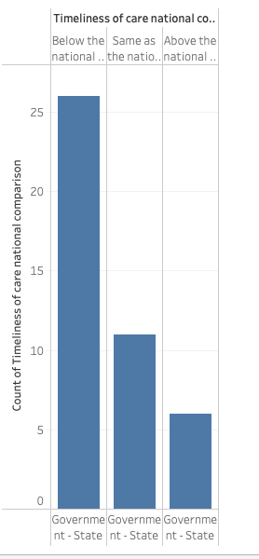
Tableau

Slide 7
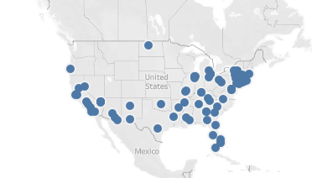
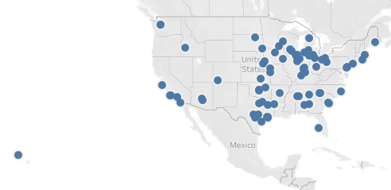
Tableau - Part 2
Location of hospitals with scores of 1
Location of hospitals with scores of 5

Slide 8
Conclusions
Government owned state run Hospitals are “slower” than average (nationally), causing them to have lower ratings by patients
Further work should go into determining regional trends in patient ratings data

