Slide 1

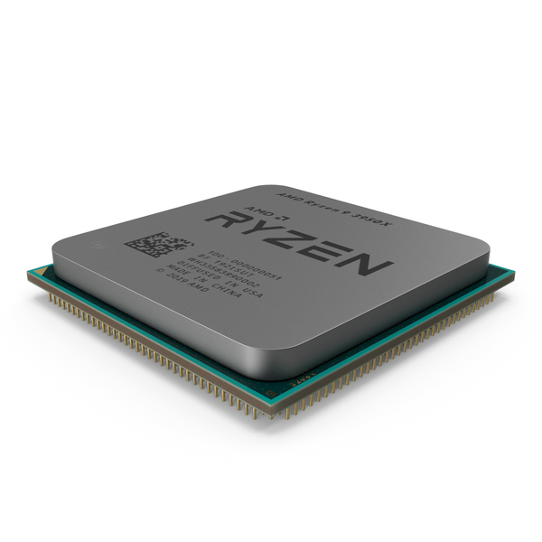
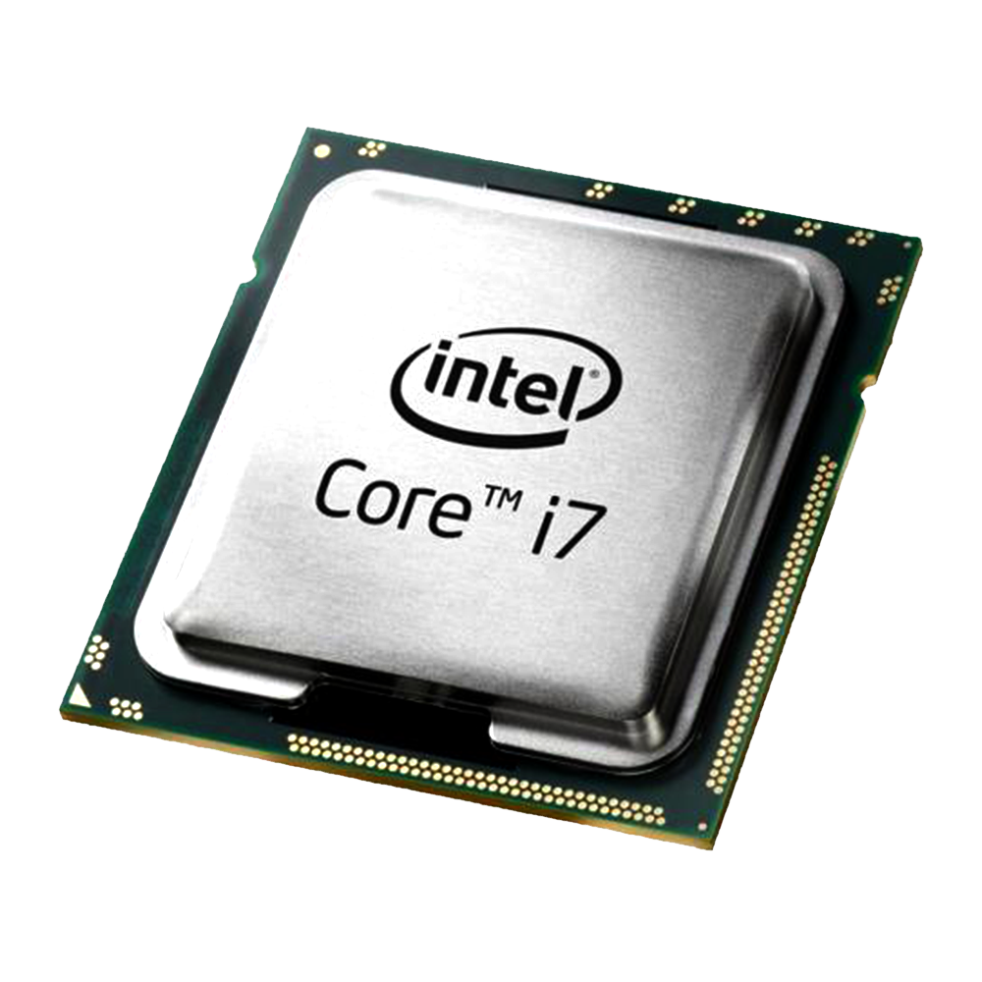

Project 1 - CPU Monitoring (Linux) [Team 11]
Chong Yihui, Gan Wan Cheng Isaac, Kenneth Goh Zhen Hao, Manish Kumar, Soedarsono
Notes:
Good Evening, My name is Kenneth. I’m from team 11 and my team members are YiHui, Soedar, Issac and Manish. We are working on Project 1, CPU Monitoring. We will be focussing on the Intel CPU.
When identifying bottlenecks and find solutions to help the operating system surpass them, the main subsystems that you should think of when tuning are CPU, Memory, I/O and Network. CPU Bound - performance is limited by the CPU. Requires heavy use of the CPU (e.g. for batch processing, mathematical operations, etc)

Slide 2
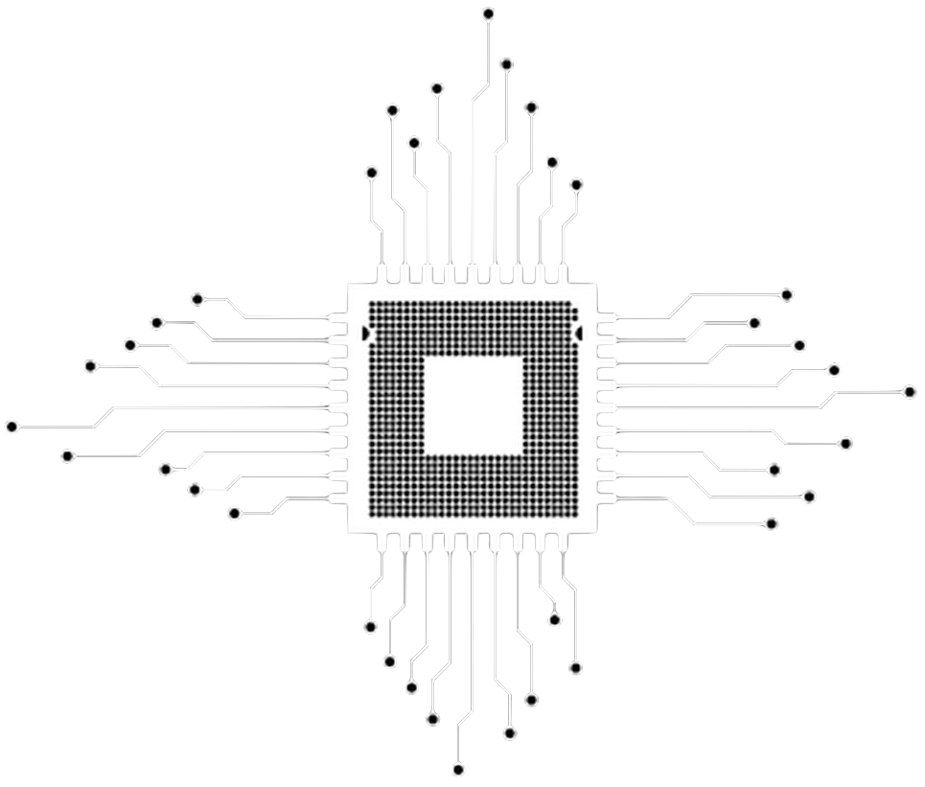

Goals
Use various tools to monitor performance (vmstat, htop, mpstat, uptime, iostat etc.) of the CPU and interpret the various metrics (User time, System time, Waiting I/O, Idle Time, Nice Time).
Understand the x86 Hardware Performance Counters
Learn how to optimise a program
Notes:
*If there’s someone watching* Our goal is to familiarize ourselves with performance monitoring tools,interpretation of various metrics, Hardware Performance Counters and how to optimise the program.
The kernel contains a scheduler which is in charge of scheduling two types of resources: interrupts and threads. When a new process is scheduled all current data will be saved and stored and the new required data will be restored to registers, this process is called context switching. Context switching is an overhead which we will touch on later.

Slide 3
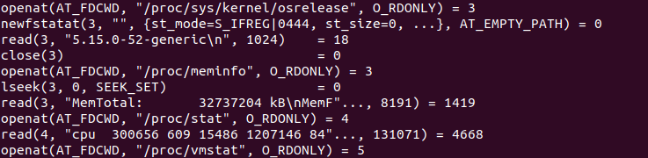
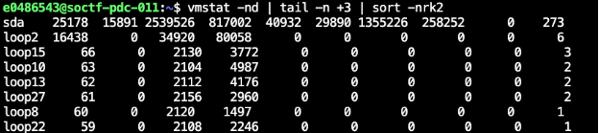
vmstat
vmstat gets its value from system calls to the proc file system
Disk statistics sorted by descending order of total reads
Notes:
The first tool we used is vmstat, this reports virtual memory statistics, it gets the value from systems calls from the proc file system.
The proc filesystem is a special filesystem. It's sometimes referred to as a process information pseudo-file system. It doesn't contain 'real' files but runtime system information (e.g. system memory, devices mounted, hardware configuration, etc).
/proc/stat
kernel/system statistics. Varies with architecture.
/proc/vmstat (since Linux 2.6.0)
This file displays various virtual memory statistics.
/proc/meminfo
This file reports statistics about memory usage on the system. It is used by free(1) to report the amount of free and used memory (both physical and swap) on the system as well as the shared memory and buffers used by the kernel.

Slide 4
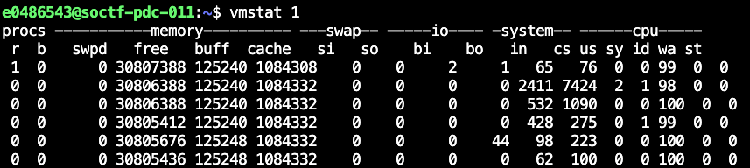
Time spent running kernel code
No. of Runnable process
Time spent running non-kernel code
Time spend idle
No. of process in uninterrupted sleep
No. of contexts switched per second
Time spent waiting for i/o
Amount of virtual memory used
No. of interrupts per second
Amount of ideal memory
Amount of buffer memory
Amount of cache memory used
Time stolen from virtual memory
Amount of Virtual memory swapped in and out from the swap space
Blocks received and send from/to a block device
Notes:
Here are some descriptions for the vmstats output.

Slide 5
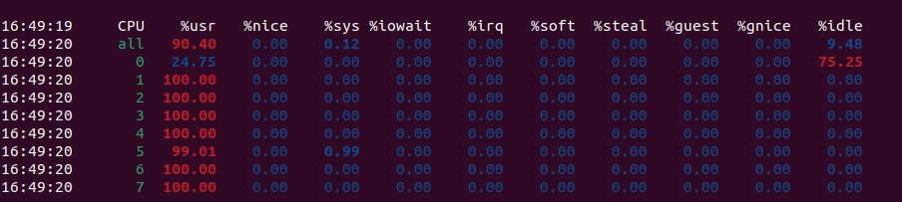
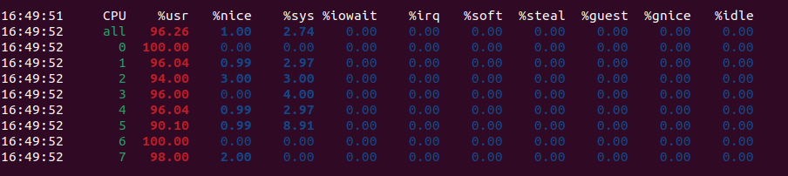
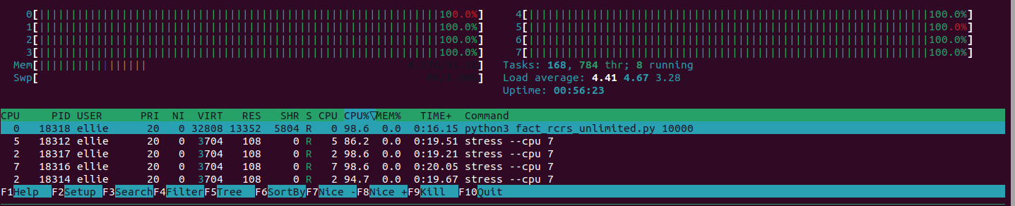
mpstat
def factorial(n):
sys.setrecursionlimit(sys.getrecursionlimit() + 1)
return 1 if n == 0 \
else n * factorial(n - 1)
nw=$((`nproc` - 1)) && taskset -c 1-$nw stress --cpu $nw
htop
Without fixing the script to run on CPU 0, we occasionally get this:
To binds CPU stress workers on your odd-numbered cores: taskset -c 1-`nproc`:2 stress --cpu $((nproc/2))
Notes:
Next we used Mpstat, and HTOP. Mpstats reports processors related statistics and HTOP, an interactive process viewer.
In this task we were to run a recursive factorial function. Occasionally without setting the affinity of the task to a specific core, we observe some context switching overheads.
Above you will see that we set a stress test to cpu index 1-7 and re-ran the script. This time the script performs only on cpu index 0.
Next were tasked to run a Python recursion of a factorial function, which by default, will crash due to default max recursion depth of 1000. We readjusted the recursion limit. The one with close to 100% load will be the one running our script. Then we ran a stress command on cpu 1-7 and reran the script. Now the script is scheduled to run on cpu0. To get the best performance when running a process, make sure that it stays on the same core for as long as possible. Don’t let the scheduler decide this for you, if you can help it.

Slide 6
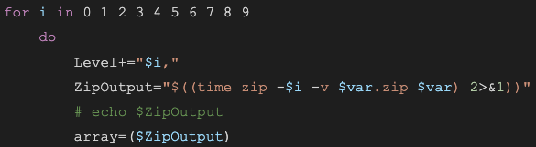
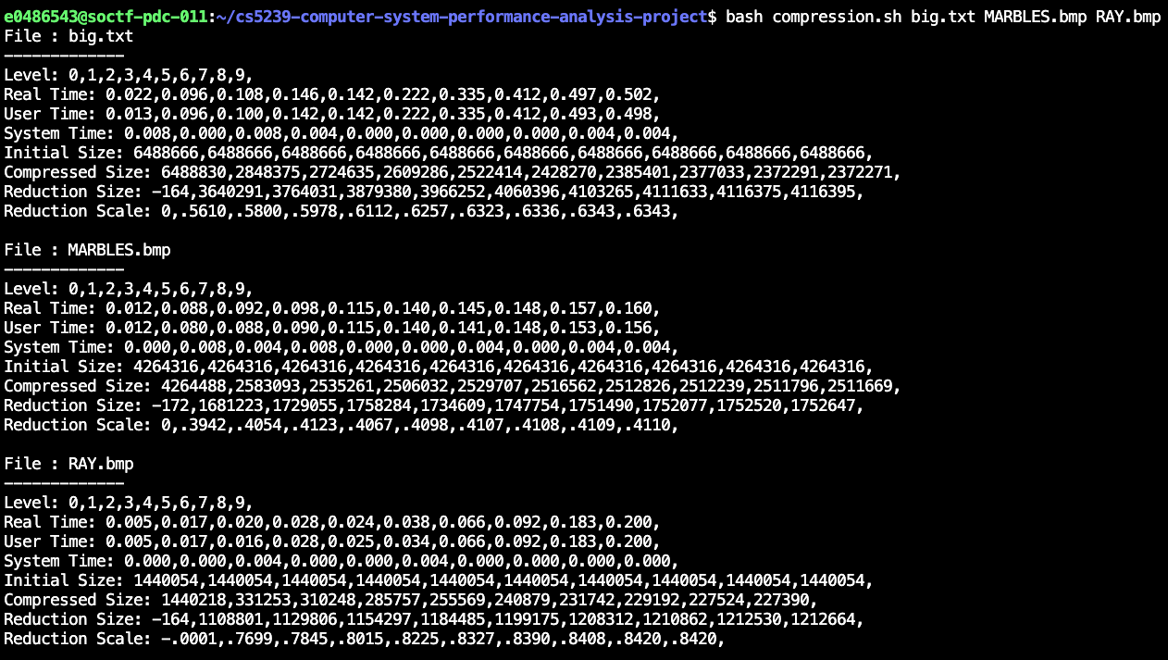
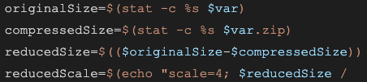
Measurements
Write a script to measure the compression rate and the time required for each level
[Code Snippet]
[Output]
Notes:
In the next task, we were to measure the time and compression size for the 10 levels of zip command execution.
On the right you will see our detailed output. Something quite interesting is that for level 0 zip, instead of no change in size it actually adds additional overheads and increases the file size.
The graph shows the Adjusted Size in Red and Time in Blue. We see that the knee point of the size is at zip level 1

Slide 7
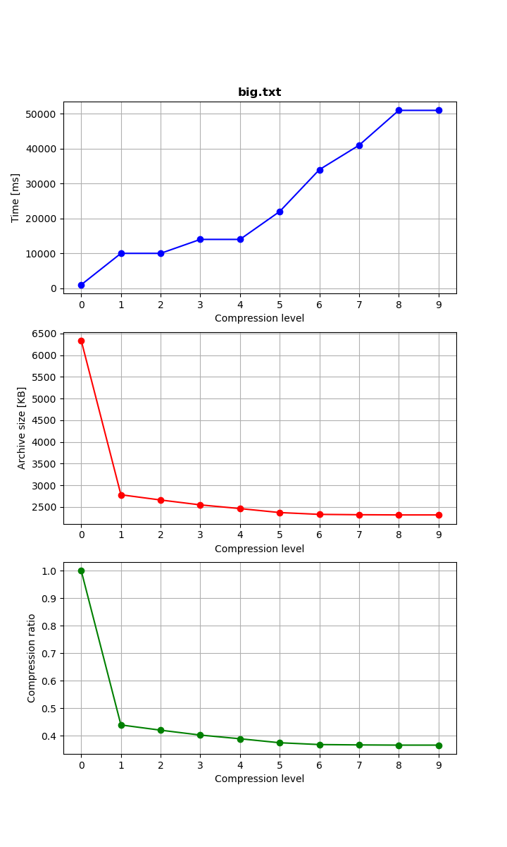
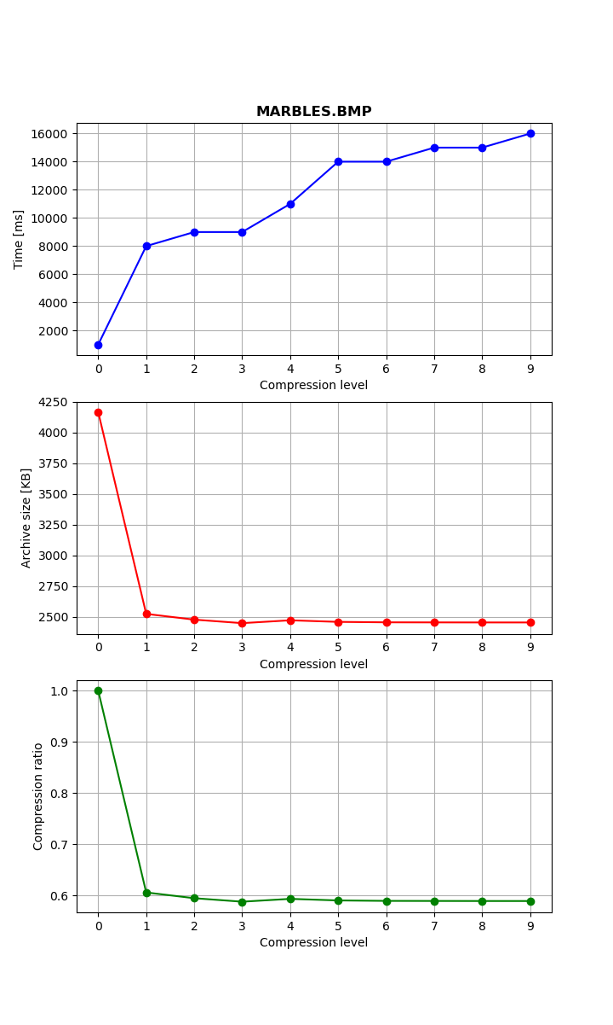
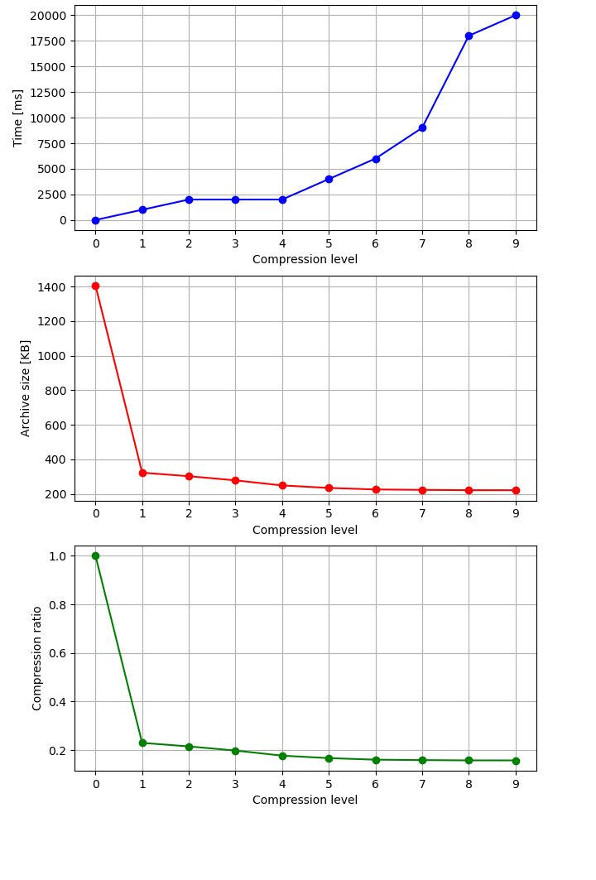
Measurements
BIG
MARBLES
RAY
Notes:
Here, we see the graph of the various compression levels. Blue represents the real time taken. Red representing the Achieve Size and green representing the compression ratio.
We observe a knee point at compression level 1. The default compression level is 6.

Slide 8
Hardware Counters
CPUID.EAX = 0AH (* Returns Architectural Performance Monitoring leaf. *)
Command: cpuid -r
CPUID.0AH:EAX[15:8]: number of general purpose counters: 0x04: 4
CPUID.0AH:EAX[7:0] : version ID: 0x04: 4
CPUID.0AH:EDX[7:0] : number of fixed function counters: 0x03: 3
To start tracking L2 Misses
sudo wrmsr -a 0xc1 0x00
sudo wrmsr -a 0x186 0x413f24
Notes:
Our final major tasks is about hardware performance counters. Here we use the cpuid command to understand the specifications of the CPU.
We make use of the write model specific register commands to set the performance counter 0 to zero value and instruct the performance event register, x186 to measure the L2 cache miss event.
Set IA32_PMC0 (0xc1) to 0 value.
Set IA32_PERFEVENTSELx (0x186) (sets what the general purpose counter is doing) to 0x413F24 for read L2 cache misses

Slide 9
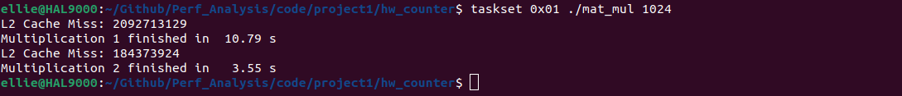
Hardware Counters
[Naive (IJK) Matrix Multiplication]
for (uint32_t i=0; i<N; i++) /* line */
for (uint32_t j=0; j<N; j++) /* column */
for (uint32_t k=0; k<N; k++)
r[i*N + j] += m1[i*N + k] * m2[k*N + j];
[Code Snippets]
rdpmc(0, eax, edx);
start_cnt = ((int64_t)eax) | ((int64_t)edx << 32);
<< Naive Results
<< Better Loops Results
Notes:
In this task we were to work on matrix multiplication. Here you can see the standard naive approach where we loop through each line, i, then column, j, and then update the results. The naive approach finishes at about 10s and has 2 billion cache miss while the Faster Approach, KIJ, given in the assignment has about cache miss 200 million and finishes at about 3.5s.
Naive iteration
For our final task we are to work on a matrix multiplication, count the number of L2 misses and try optimize the approach.

Slide 10
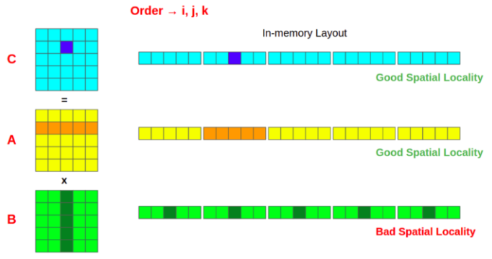
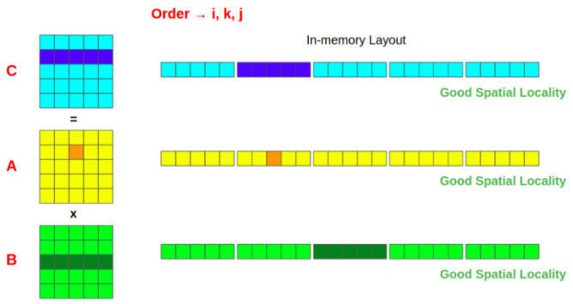
Optimising with Better Loops
/* perform fast(er) multiplication */
for (uint32_t i=0; i<N; i++)
for (uint32_t k=0; k<N; k++) /* line */
for (uint32_t j=0; j<N; j++) /* column */
r[i*N + j] += m1[i*N + k] * m2[k*N + j];
[Results]
Order | ijk | ikj | jik | jki | kij | kji
Time (s) | 17.63 | 3.74 | 10.23 | 36.15 | 3.76 | 29.83
L2 Cache miss | 2,146,934,417 | 179,497,619 | 2,287,344,732 | 4,260,117,593 | 184,105,100 | 4,305,142,993
[Standard Approach - IJK]
[Best Loop Approach - IKJ]
References: The impact of cache locality on performance in C through matrix multiplication
Notes:
Our first optimization exploration is with better loops.
In C, the two-dimensional arrays are stored in row-major order in the RAM.
This means that consecutive elements of a row reside next to each other in the memory.
A column-major order consecutive elements of a column reside next to each other in the memory.
The data to be processed is loaded into the cache from the RAM.
Cache memory reads one cache line worth of data at a time from the RAM.
From the naive approach accessing the 2nd row of Matrix A provides good spatial locality. However, in Matrix B, we need to access different cache lines for each column value, which would result in a higher cache miss rate.
Compared to the Best loop approach, we get a good spatial locality in all three cases, reducing the cache miss rate for each operation.

Slide 11
Optimising with Better Loops (Transpose)
/* Transpose M2 */
for (uint32_t i=0; i<N; i++) /* line */
for (uint32_t j=0; j<N; j++) /* column */
m2_t[j*N + i] = m2[i*N + j];
/* perform transpose multiplication */
for (uint32_t i=0; i<N; i++) /* line */
for (uint32_t j=0; j<N; j++) /* column */
for (uint32_t k=0; k<N; k++)
rBlk[i*N + j] += m1[i*N + k] * m2_t[j*N + k];
 | Time (s) | L2 Cache Miss
IJK | 10.889 | 2,095,685,036
KIJ | 3.559 | 184,501,076
Transpose | 3.567 | 181,702,620
Notes:
We also experimented on transposing the second matrix to convert the columns into rows, this results has slightly lesser L2 cache miss than the KIJ Faster method but takes slightly longer time due to the cost of transposing the M2.

Slide 12
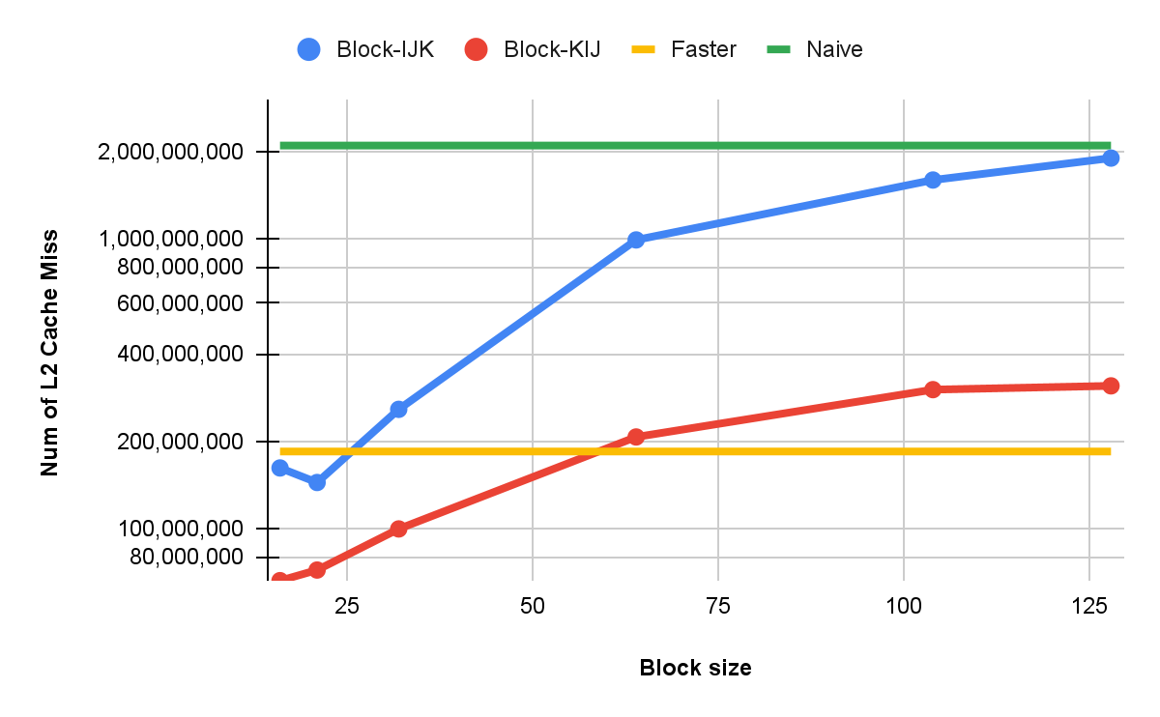
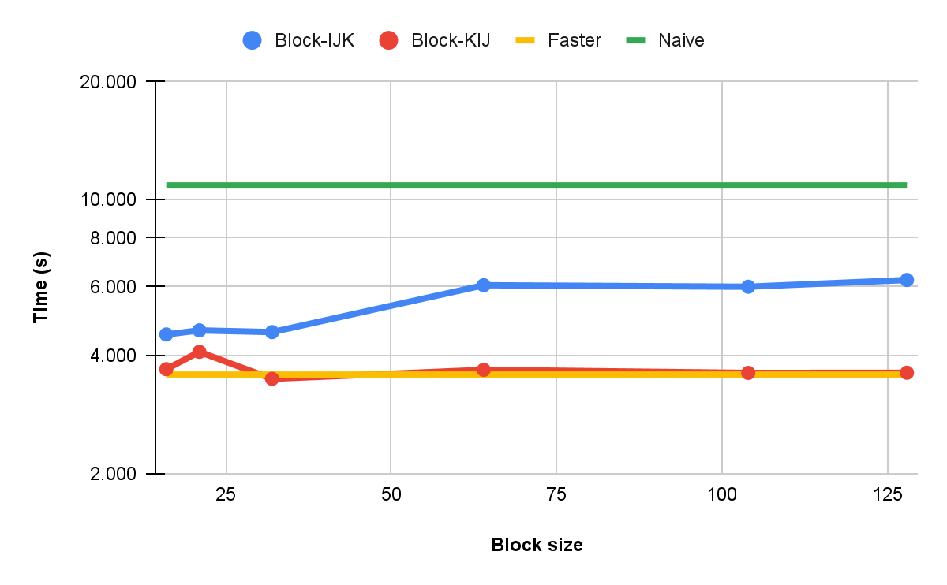
Blocked (Tiling) Matrix Multiplication
Partition matrices into smaller blocks that can be wholly fitted into cache
⇒ Loop order should not matter
⇒ Reduces cache miss
[Limitation] Need to tune block size based on matrix size and CPU cache size
Notes:
The next optimization method will be Blocked Matrix Multiplication aka The Tiling approach. This methods partitions the matrices into smaller blocks of sub-matrices that can wholly fit into the cache.
The green line represents the naive approach, the blue and red represents IJK and KIJ block approaches and Yellow represents the better loops approach. The multiplication isnt easy to comprehend at the start, it will be better understood when you map and draw out the matrices.
Our 1st Observation is that when block size increases, the block matrices cant fit into cache
⇒ performance degrades to non-block matrix multiplications (or even worst due to using extra loops for blocks).
The 2nd Observation is that the Loop order should not matter theoretically (since the whole block matrix is loaded into cache) but it still does based on our experiments. KIJ order is better than IJK.
The next Observation is that Block multiplication loops are not better than Faster loop approach despite having significantly lesser L2 cache miss; might be due to additional control flow costs for the block multiplication loops.
This method requires us to tune block size based on CPU cache size and matrix size.

Slide 13
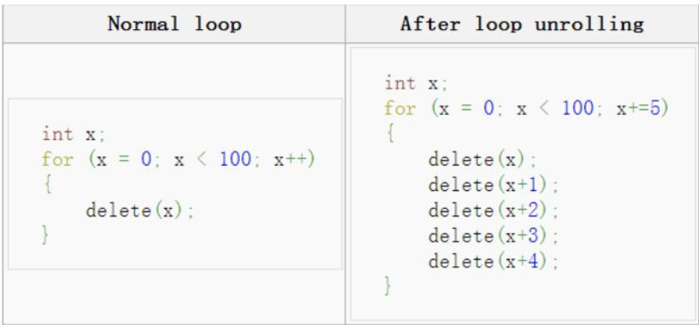
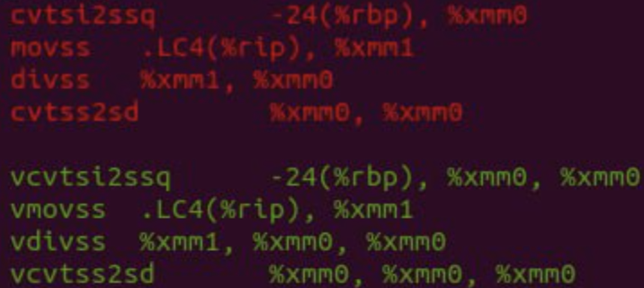
Optimising with Compiler
Compiler Optimization | Time Improvement
Auto-unrolling (-funroll-loops) | 25.6 %
Auto-vectorization (-ftree-vectorize) | 29.0 %
Math operation optimizations (-ffast-math) | 30.5 %
Leveraging on AVX2 (-march=native) | 38.9 %
Example of loop unrolling
Default instructions in RED
AVX instruction set in green
Notes:
The next optimization method tries to make use of the GCC compiler.
The first method, Auto-unrolling, Increases a program's speed by reducing or eliminating instructions that control the loop, such as end of loop tests on each interaction.
Auto Vectorization, uses vector operations instead of loops.
Math operation optimization by instructional reordering, such as skipping NaN checks.
Advanced Vector Extensions 2 tells the compiler to tune generated code for ISA of the host CPU. AVX2 also offers the ability to issue one instruction that would then carry out two operations which hugely beneficial in doing vector/matrix math. Compiler optimization still bottlenecked by cache misses.
GCC offers a slew of optimization options and flags to improve the performance and/or code size at the expense of compilation time and possibly the ability to debug the program. We explored the following compiler optimizations :
Auto-unrolling: Increase a program's speed by reducing or eliminating instructions that control the loop, such as pointer arithmetic and "end of loop" tests on each iteration; including the delay in reading data from memory
Auto Vectorization: works similar to SIMD - vector operations instead of loops
Math operation optimization by instructional reordering, Skips checks for for NaN and approximations for division
Advanced Vector Extensions 2: tells the compiler to tune generated code for ISA of host CPU - AVX able with work with 3 values at the time as seen in the image. AVX2 also offers the ability to issue one instruction that would then carry out two operations which hugely beneficial in doing vector/matrix math
Strongest performance increase from leveraging on native hardware (AVX2) 38.9 % improvement
Compiler optimization still bottlenecked by cache misses

Slide 14
Optimising with Compiler
Optimisation Levels | Time (s) | L2 Cache Miss
Naive | 10.889 | 2,095,685,036
O1-Naive | 2.407 | 1,462,736,895
O2-Naive | 2.273 | 1,489,176,762
O3-Naive | 2.410 | 1,461,982,966
Ofast-Naive | 2.187 (~5x faster) | 1,496,253,025
Optimisation Levels | Time (s) | L2 Cache Miss
Faster | 3.559 | 184,501,076
O1-Faster | 1.020 | 181,810,513
O2-Faster | 0.947 | 182,316,248
O3-Faster | 0.893 | 182,334,093
Ofast-Faster | 0.873 (~4x faster) | 182,119,835
[Next Steps]
Loop interchange
Other compilers (ICC, Clang)
Notes:
From the results, there are No drastic change in L2 cache miss but significant improvement in runtime.
Our next steps for this approach is to use Loop interchange, where the compiler attempts to improve cache performance on nested loop without needing to manually reorder the loop And explore other compilers.
No drastic change in L2 cache miss but significant improvement in runtime.
We can use Loop interchange: compiler attempts to improve cache performance on nested loop and - similar to to the loop reordering in mat_mul however without needing code change which would deal with cache miss issue
Caveat seems that GCC only do loop interchange optimization when the number of loops int is a compile-time constant
Explore using other compilers such as ICC and clang

Slide 15
Multi-threading
[OpenMP]
Need to optimize parallel code carefully
Matrix Size (N) | 256 | 512 | 1024 | 2048 | 4096
IJK | 0.089 | 0.761 | 10.889 | 183.748 | 1691.498
KIJ | 0.050 | 0.406 | 3.559 | 28.216 | 233.656
OMP1 (KIJ) | 0.232 | 1.491 | 11.391 | 92.151 | 742.021
OMP2 (KIJ) | 0.115 | 0.583 | 4.977 | 40.125 | 330.648
(~2x)
CPU Time (s)
[OMP1 (Faster)] Uses shared variable (atomic) for array update
[OMP2 (Faster)] Uses reduction for array update
Notes:
Our final optimization method in this presentation will be making use of multi-threads. Here we use OpenMP API for parallel programming. By taking advantage of multithreading approaches, intuitively, the execution should be more efficient as the matrix size increases. We have implemented two OpenMP approaches, OMP1 and OMP2.
OMP1 uses a shared variable to store the resultant array, while OMP2 uses reduction method for the resultant array after the parallel execution. To prevent race condition for OMP1, the atomic directive would ensure that only one thread can update to the resultant array. Whilst for OMP2, each thread has their own private data for the resultant array, which are reduced at the end of the execution.
We see that OMP2 is 2 times faster than OMP1 and they are both still better than the naive approach. Note that here, CPU time is measured as the total CPU time for all cores.
CPU time: Time of all the threads. For multiple cores, CPU time is measured as the total CPU time for all cores. CPU time for OMP always longer than sequential due to parallelization overhead and certain compiler optimisation might have been disabled. OMP2 has 2x speed up as compared to OMP1 with only slight change in code.

Slide 16
Multi-threading
[OpenMP]
Need to optimize parallel code carefully
Incorrect result or segmentation fault
Race conditions
Stack size limits
Time (s) | 256 | 512 | 1024 | 2048 | 4096 | 8192
IJK | 0.087 | 0.733 | 9.467 | 167.595 | 1491.353 | 14433.110
KIJ | 0.050 | 0.396 | 3.218 | 26.411 | 211.032 | 1766.091
OMP (IJK) | 0.044 | 0.210 | 1.988 | 42.144 | 469.860 | 3618.094
OMP1 (KIJ) | 0.033 | 0.222 | 1.635 | 12.639 | 100.208 | 801.639
OMP2 (KIJ) | 0.025 | 0.126 | 0.977 | 7.404 | 62.220 | 476.490
 | (~3x) | (~6x) | (~10x) | (~23x) | (~24x) | (~30x)
4 hrs
8 mins
Wall Clock Time (s)
Notes:
So in order to properly evaluate time we have to use the Wall Clock Time, the real time taken to complete the task. Parallelization enjoys better speedup with larger matrix even with the naive method. Cache misses still affects the run time but to a lesser extend. However, working with parallelization methods is like a walk on eggshells. They are hard to implement and hard to debug. Segmentation faults can be due to race conditions or some ill-specified parameters, for example, the default stack size. Race conditions can also cause wrong resultant matrix and we may end up with a slower implementation with coarser forms of synchronization, as shown in the case of OMP1 with atomic updates.
due to hard-to-debug error (at least due our lack of experience). Segmentation faults can be due to race conditions or some ill-specified parameters (e.g. default stack size). Race conditions can also cause wrong resultant matrix and if you add too many checks you will end up with a slower implementation. Can be quite time-consuming.
Parallelization enjoys better speedup with larger matrix even with the naive method.
Cache misses still affects the run time but to a lesser extend.

Slide 17
[Best Techniques Yet]
IKJ-order multiplication
Block matrix multiplication
Optimising w/ AVX2
Ofast GCC optimization level
Multi-threading w/ OpenMP
[Challenges]
Requires Intel CPU and sudo rights
Unfamiliarity in Computer Organisation, OS, Parallel Programming and ASM
Long runtime for experiments w/ larger matrix
[Future Directions]
Better loops
Loop interchange and other compilers (ICC, Clang)
Multi-threading w/ pthreads
Combining techniques
Conclusion
Notes:
Conclusion, as of now, the better techniques are the IKJ reordering, block matrix multiplications, compiler optimization with AVX2, Ofast GCC optimization and multi-threading methods with OpenMP.
For future works, we think that it will be worthwhile to combine various techniques and make use of multiple cores and multi-threading for larger datasets.
When working on this project we faced multiple challenges. It requires a native intel CPU with sudo rights. Some of us are unfamiliar with Computer Organization, Operating System, parallel programming and ASM.

