Slide 1
Use Case: A Credit Card Company identifying precise customer for their product Customer Complaints Analysis ADTA 5240 | Harvesting, Storing and Retrieving Data
Team Indigo
Sumana Sree Nandala
Mani Chandra Navuluri
Varun Kumar Chennuri
Rachana Bairi
Venu Gopal Krishnagiri Tuppal

Slide 2
Contents
Generation
Collection
Processing
Storage
Management
Analysis
Visualization
Interpretation
GCP Operations
Hadoop Implementation
Conclusion

Slide 3
Data Generation
Complaints Data
Consumer Complaint Database
Published by CFPB
For Public Access
Notes:
Firstly, the Complaints Data covers Banking and Financial Sectors and records the complaints of Consumers on various Products of Finance Service Like Loans, Bank Accounts, Credit Card, etc.
This data belongs to Consumer Complaint database which is Published and Managed by Consumer Financial Protection Bureau. These complaints are published when the company responds to the complaint or 15 days later
This data is available for public access and use.

Slide 4
Data Collection
Collected from data.gov
Collected on daily basis
complaints.csv - CSV Format from the Source
Contains 18 Variables
based on Financial Products and Issues
Notes:
Even though the dataset is from CFPB, we got this from DATA dot GOV website.
The website stated that the data was collected and published on daily basis.
The dataset is a Coma Separated Value File with name complaints.csv which has 18 Variables.
These variables include Product, Issue, State, ZIP Code ID, Company and other columns that describe the complaints in detail.

Slide 5

Data Processing
Used R and RStudio
Selecting 16 Columns
Filtered based on Product (opting only Credit)
Exported the data to TSV
Nulls not Removed/Replaced
Notes:
As stated by <Name> earlier,
The dataset complaints.csv had 18 variables and was huge that it didn’t open using Excel and OpenRefine
So, we used R and R Studio to Open and process the CSV File.
Out of the 18 Columns, we had 2 columns that had Description of Complaint provided by the Consumer
and detailed response provided by the Finance Company. We considered not using these Variables for analysis and planned to use Issue and Sub-Issue instead.
Also, the dataset consists of 21 Products that included Loans, Study Finance, Bank and Account details along with Credit Card and Reporting.
To meet the requirements of the Use case, we used Products that has word Credit like Credit card or Credit Reporting
We have 5 Products in total. These will be shown in the next slide.
Further, we exported the dataset to Tab Separated Value File because Company has comma in its data which caused challenge when exporting the data to BigQuery . So, Tab-Separated is used instead of Comma Separated
Also, Even though columns had null values, we did not delete any row because all the complaints were unique and has unique Complaint ID.
This suggests that data did not have any duplicates even though it had null values

Slide 6
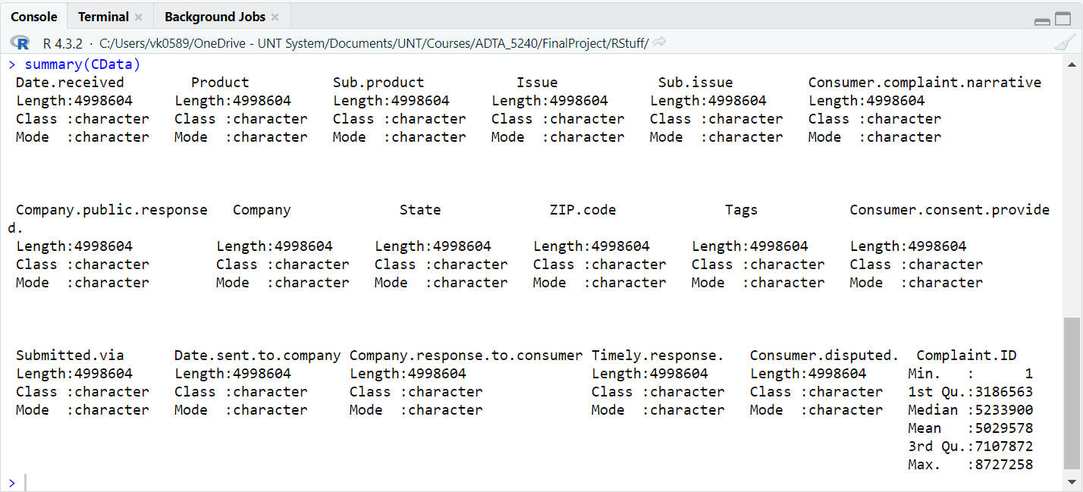
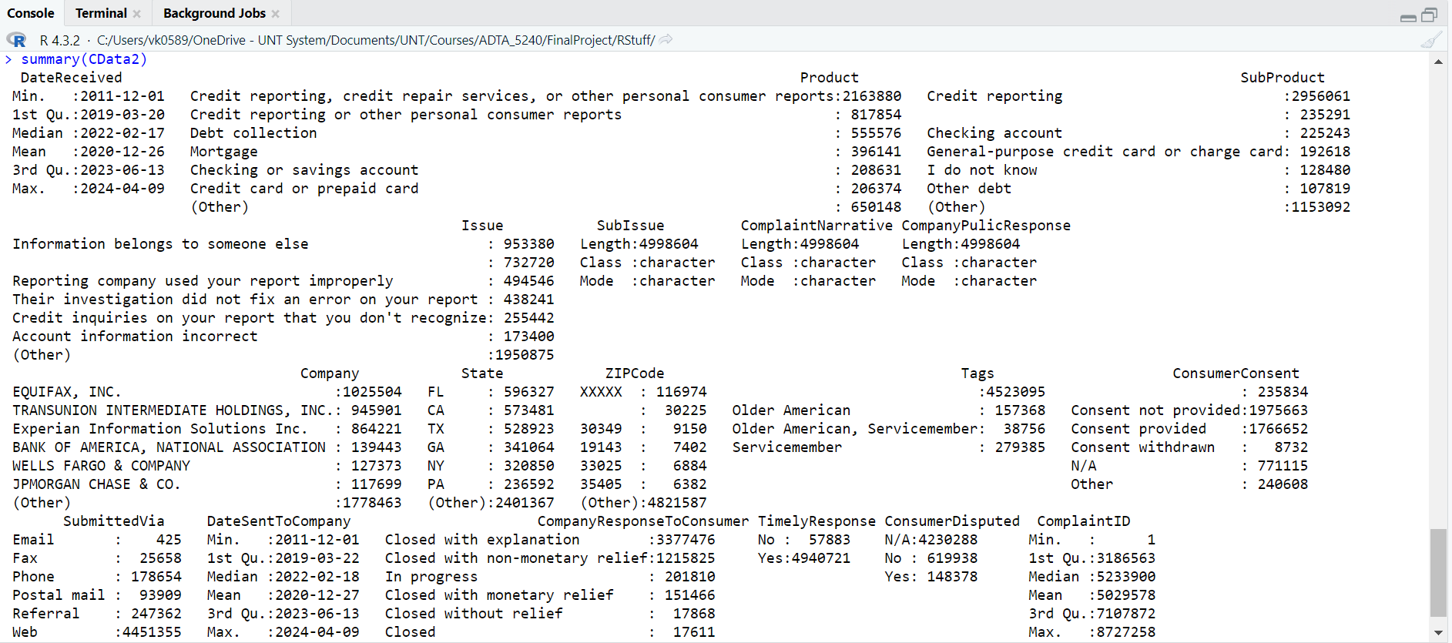
Categorized
Data
Original
Data
Notes:
This slide shows the description of the dataframe created in R Studio.
On the Left Top we have original data with 18 columns and on the Right, we have Columns after renaming and converting to categorical variables
You can see the categories in Product other than Credit Card like Mortgage and Debt Collection.
This dataframe is used to further filter the Product to get Credit Related information

Slide 7
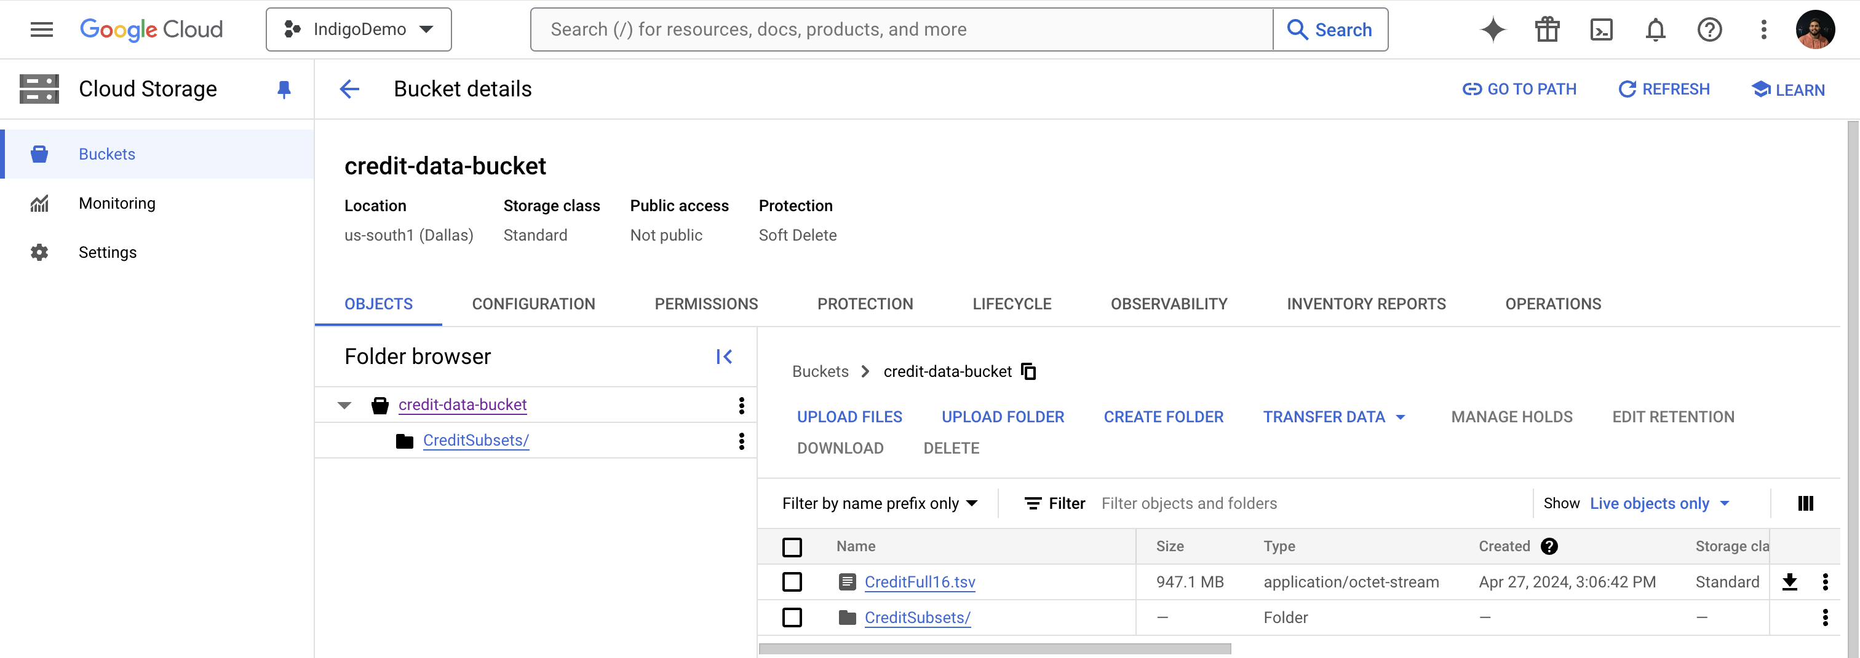
Data Storage and Data Management
Using GCP for Storage and Operations
Data stored in credit-data-bucket
Has folder for other partitioned data
Notes:
To Store the generated TSV and perform Analysis using Google Cloud Platform,
We created bucket under GCP Cloud Storage Application. This Cloud Storage is later used for running Big Query and Hadoop Tasks
After creating the Bucket, TSV File is uploaded into Cloud Storage.
The Files can be managed in Cloud Storage by creating folders and further providing accesses based on requirements
You can see the screenshot of credit-data-bucket which was created for storing the files. It also has a folder which has partition or subset of Credit Data with only Credit information and filtered Other Credit Products. But we will be using the full file in the image with name CreditFull16 dot TSV

Slide 8
Data Analysis
Loading Data to BigQuery Dataset and HDFS
Analysis of Credit Information to find more about complaints
Executed Queries using BigQuery and Hadoop Distributed File System (Hive and Spark)
Focused on Products, Issues, State, and other Variables
Understanding of Complaints and Issue types with the Queries
Notes:
With the uploaded into Cloud Storage, firstly we loaded the data from Cloud Storage to BigQuery Dataset in Form of a Table.
This table was named Credit All and was used to execute 5 different Queries to understand the Data. These queries were to get Highest number of Complaints under each company,
Complaints under each Product Type based on State, Late Responding Companies, Mode of Complaint Submission and Dispute Rate for Each Company (Sample Screenshots will be shown further). Also, TSV file was copied from Cloud Storage to Hadoop File Systems. This was achieved with Dataproc Clusters in GCP. File was Transferred to HDFS through Virtual Machine.
This file was used to create a Table and Perform Hive and Spark Queries. Hive and Spark were used to Focus on Issue, Sub Issue and Finding Ration of Timely Response by the Companies for the Complaints. Sample Screenshot are shared in further slides.

Slide 9
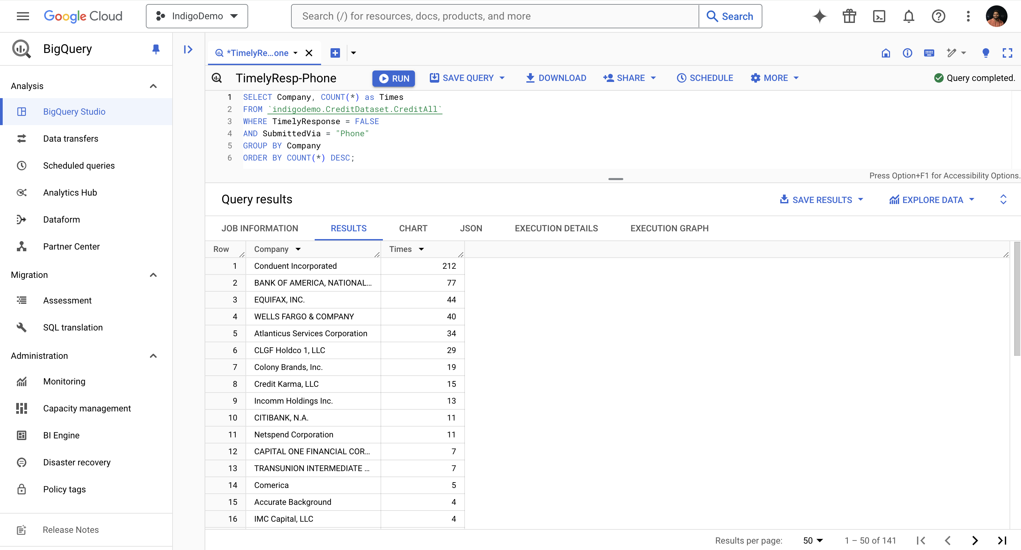
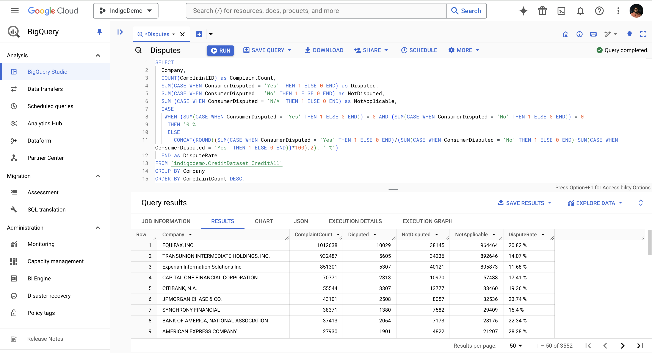
Dispute Rate based on Companies
Late Response Companies
Based on Phone Submissions
Notes:
On the left we have a Sample Big Query which gives the list of Companies which gave late response to consumers when consumers contacted through Phone.
On the Right, we have a BigQuery result for Dispute Rate which is calculated by number of complaints with disputes divided by all dispute applicable Complaints

Slide 10
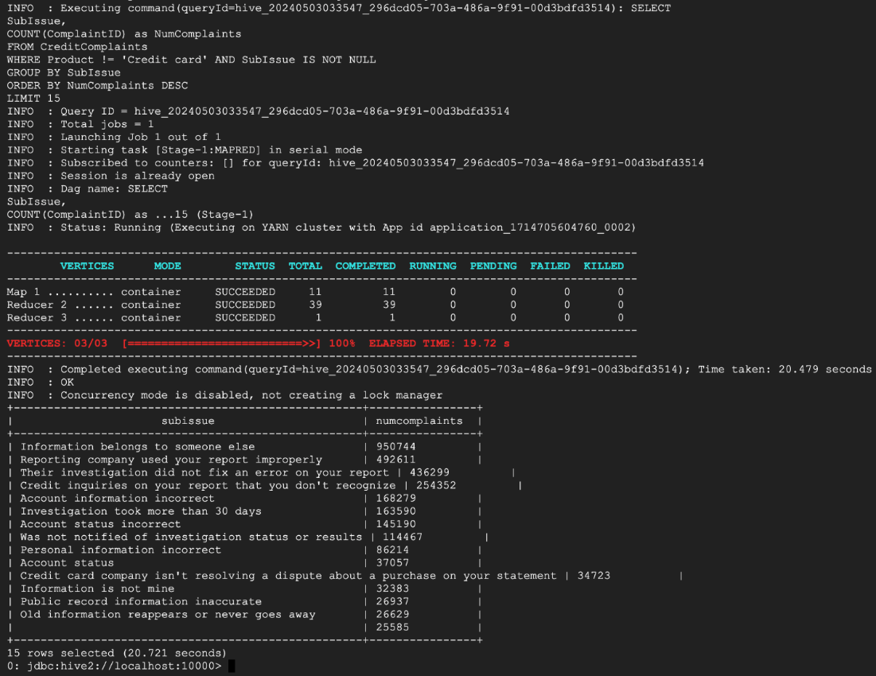
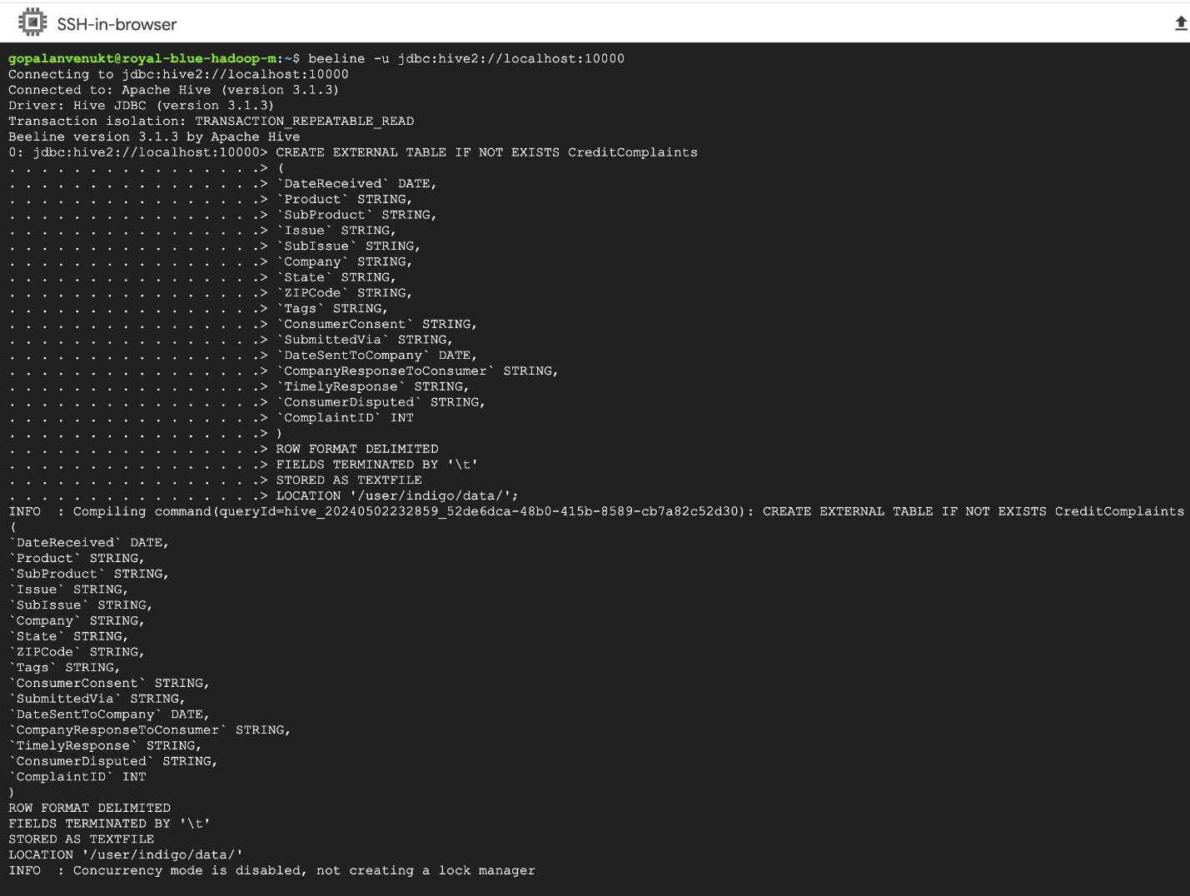
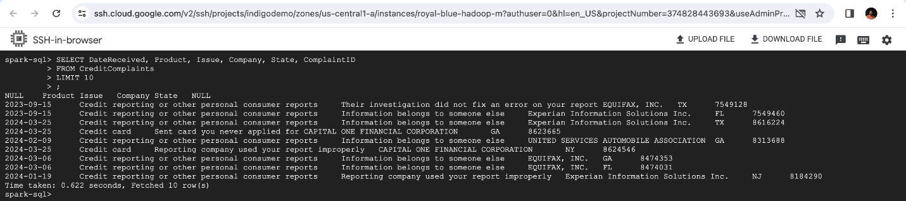
Hive Example - SubIssues
Spark Implementations – Filtered Columns
HDFS Table Creation
(Using Hive)
Notes:
On the left we have SSH Terminal of Master Node. A new Table is created based on the File copied into HDFS using the command shown in the screenshot.
On the Right Top, we have Hive Sample Query that gives the count of complaints for each Sub-Issue Type
On the Right Bottom, we have Spark Query that gives Top 10 Rows of the Table with selected Columns

Slide 11
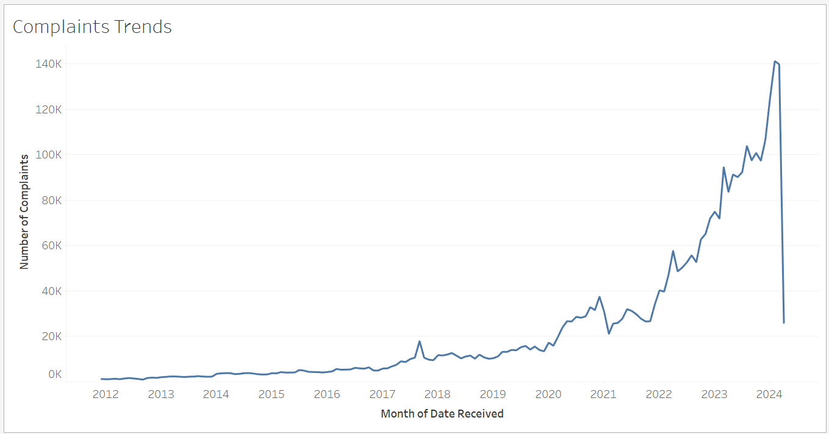
Data Visualization
Visualization performed using Tableau
Plotted Graphs to further understand data in pictorial form
Number of Complaints over Time
Notes:
For Visualization, we used Tableau Desktop to get MapPlot, Line and Bar Graphs.
These graphs were plotted to understand data more clearly and to observe patterns if any.
The Graph in the above slide shows the count of complaints present in CreditFull16.tsv over the time of 2012 till Apr 2024

Slide 12
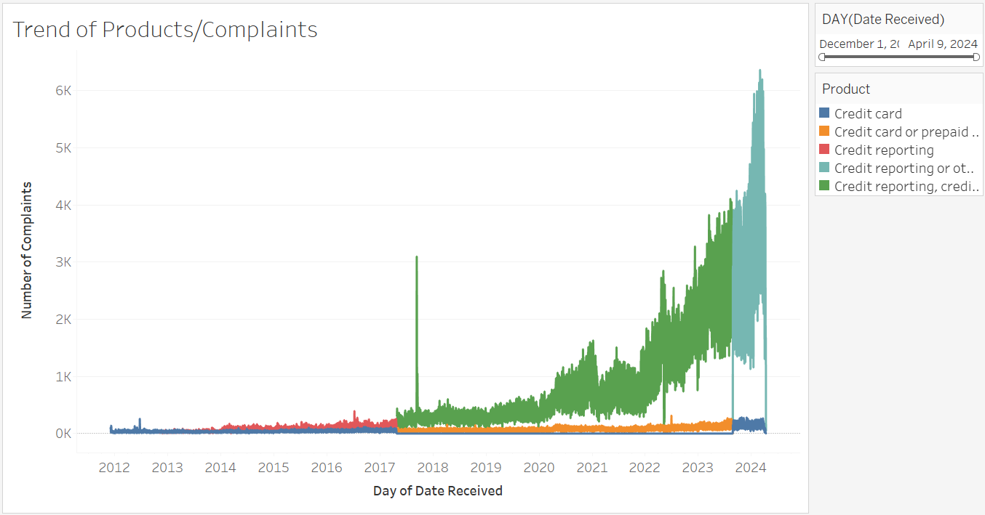
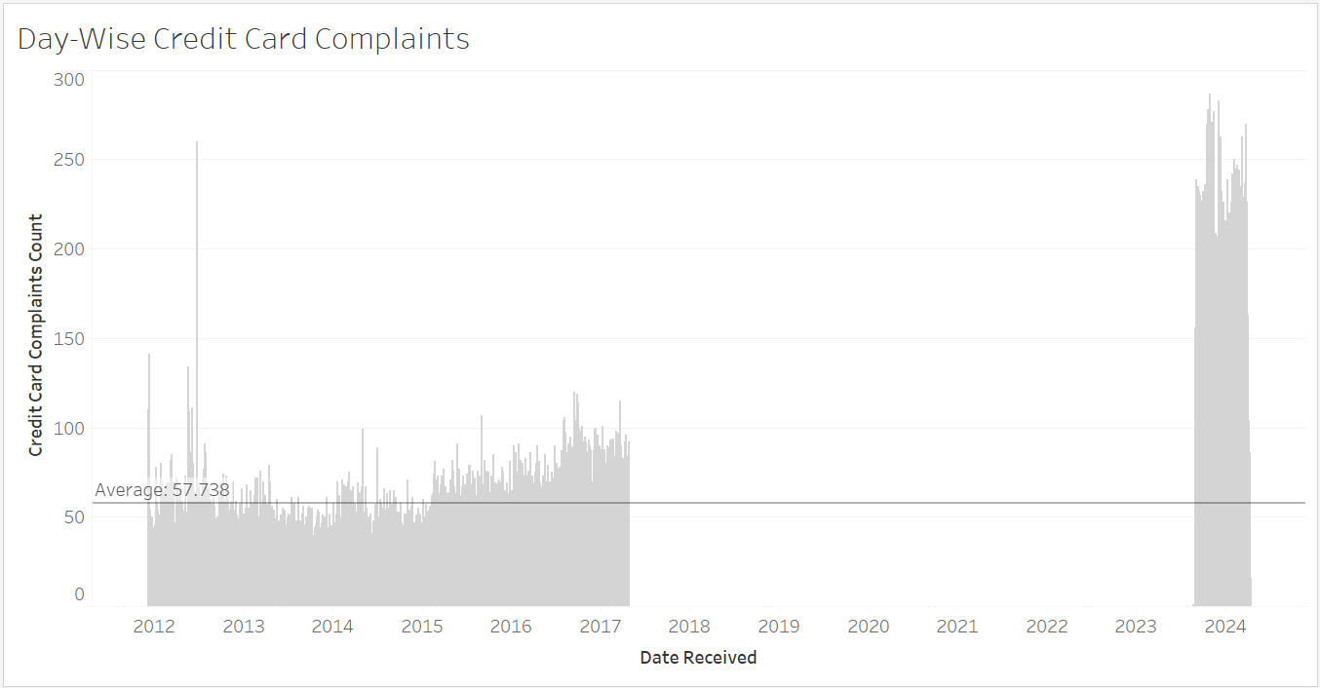
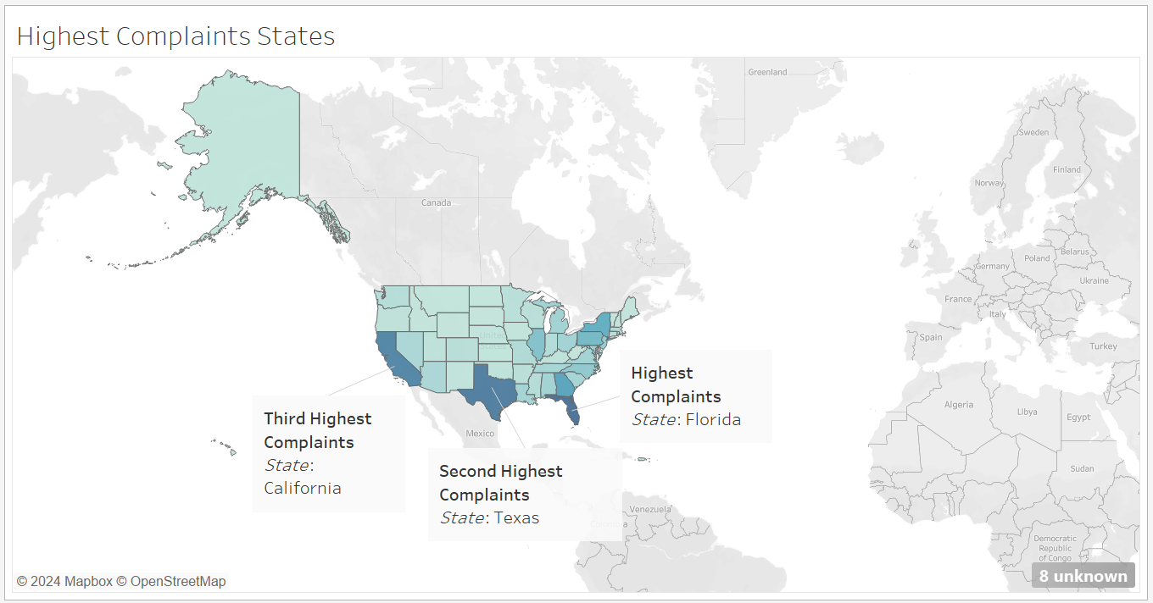
Notes:
On the Top Left, we have Complaints Graph under each Product. A pattern is visible for the raise of complaints count due to change in the Product Type.
On the Top Right, we have Day wise Count for Complaints received for Credit Card Only. This Graph has tells us that complaints for Credit Card only were not recorded from 2018 to 2023. This is in the same time of new Product which is in Green Color on Left. This Product is ”Credit Reporting, Credit Card, or Other Consumer Complaint”. So we can assume that People opted for this instead of Credit Card when filling a Complaint.
As for the bottom, it’s a map that shows complaints received based on each state. Highest Complaints was Received by Florida, followed by Texas, then followed by California

Slide 13
Data Interpretation
Inconsistency
Challenging to Analyze
Difference for Null and N/A
Graphs Insights
Notes:
As explained earlier, Due to new Product, Data was missing of Credit Card. This could cause change in analysis. The Average Line also slightly higher that what was actually expected. This can lead to challenges when further analyzing the data.
We have few columns with Not Application as Option (for Dispute). It should not be considered as Null and must be used as one of the category as implemented in BigQuery
Using Graphs, we gained much understand of Complaint Count and it was easy to interpret rather than the table data that was obtained from BigQuery, Hive and Spark. Yet these can be used to Create new View and Get better Graphs and Visuals (Like calculating Response Ratio or Dispute Rate)

Slide 14
GCP Operations
Creation of IndigoDemo Project
Creating Storage Bucket – credit-data-bucket
Creating CreditDataset and CreditAll Table for BigQuery
Creating Dataproc Cluster for HDFS Systems
Running Linux Commands on VM for Data Transfer and Query Exevcution
Notes:
As stated earlier, Google Cloud Process was used to work for this Project. Following are the operations performed using GCP for Credit Complaint Analysis
First Creating a new Project IndigoDemo in GCP
Next Creating a Storage Bucket credit-data-bucket to store the TSV files that are obtained after running R Script
Next Creating CreditDataset and CreditAll Table for BigQuery. Using this table to Run 5 Queries and understanding the Data
Next, we created a Cluster using Dataproc API with Hadoop Hive and Spark features and used this cluster to connect to a Virtual Machine and Run Linux commands.
With these commands, we connected to Hive and Spark to Run SQL Queries on Data after copying it from Cloud Storage

Slide 15
Hadoop Implementation
Hive and Spark Implemented
Results as follows:
Query | Hive | Spark
Top 10 Rows | 39.473 | 7.172
Top 10 Rows + Selected Columns | 23.397 | 0.622
Response Ratio | 21.114 | 21.681
Most Common Issues in Credit Cards | 20.317 | 22.611
Most Common SubIssue in Other Products | 20.721 | 14.464
Notes:
As stated earlier, Google Cloud Process was used to work for this Project. Following are the operations performed using GCP for Credit Complaint Analysis
First Creating a new Project IndigoDemo in GCP
Next Creating a Storage Bucket credit-data-bucket to store the TSV files that are obtained after running R Script
Next Creating CreditDataset and CreditAll Table for BigQuery. Using this table to Run 5 Queries and understanding the Data
Next, we created a Cluster using Dataproc API with Hadoop Hive and Spark features and used this cluster to connect to a Virtual Machine and Run Linux commands.
With these commands, we connected to Hive and Spark to Run SQL Queries on Data after copying it from Cloud Storage
It can be observed that Spark has better performance that Hive. The 2 cases when Spark was Slow was due to Warnings and Java Errors

Slide 16
Conclusion
Changes of Product affect number of complaints received
Tables and Visualizations are needed for analysis
GCP BigQuery is efficient for BigData (~1GB for CreditFull.tsv)
Spark is quick when compared to Hive
Complaints can be used to analyze the Customer Requirements
Notes:
Through this project, we can conclude that with increase in the scope of products and introducing new product, changing the existing one, there has been increace in Complaints received that covered other areas of Banking and Finance along with Credit Card
Tables and Graphs both are to be used to understand, analyze and interpret data efficiently
Even though the Dataset was ~1GB and was not accessible through OpenRefine / Excel, BigQuery was able to smoothly execute queries and provide results.
Spark provided results quickly and efficiently when compared to Hive for the same query executed
To understand the products, issues faced by consumers and upgrading a product or introducing a new product, we can use this dataset and perform analysis.

Slide 17
Thank You

