Slide 1
Prediction of Heart Disease based on Clinical Factors
By Team 6
Masimukku, Satya Aditya
Nalamothu, Prathyusha
Nandala, Sumana Sree
Krishnagiri Tuppal, Venu Gopalan
Notes:
Our Project is
Prediction of Coronary Heart Disease based on Diabetes and other Clinical Factors.
I’m Satya Adithya and My Team members are
Pratyusha
Sumana
And Venu Gopalan

Slide 2
Introduction
Aim of Paper
Predict the possibility of a person getting Heart Disease based on Clinical Factors
Scope
Understanding of Occurrence of Cardiac Arrest as per Clinical Factors
Purpose
Heart Attack – increased rate
Habits and way of living
Notes:
In modern society, technology has advanced so much that everything can be brought to our doorstep. There is literally no effort required from anyone to get the things done such as getting the groceries, paying bills etc. Mostly in the jobs related to academics and technology everyone is confined to their workspace and spends all day behind a desk. Many health-related issues arises due to this. We may think this is just the case with employed adults. But students also neglect exercise as well and are affected by it. A recent study shows that people between the ages 25 to 44 saw a nearly 30% increase in heart attack deaths over the last 2 years. This is a raging issue that needs to be addresses immediately as it is affecting even the youngsters . There can be many reasons as to why a heart disease is caused. It can depend on many factors in the body such as preexisting medical condition, blood related diseases etc. Hence our models aims to predict the possibility of a person getting a heart disease by considering many clinical factors such as diabetes, cholesterol etc.

Slide 3
Data Collection and Processing
Data Collection
Based on Paper – Prediction of Clinical Risk Factors of Diabetes using Multiple Machine Learning Techniques Resolving Class Imbalance
Data Source – Kaggle | Cardiac Data NHanes 65c8df6e-2
51 Attributes with 37079 Observations
NHANES – Survey between 1999 to 2015
Sample of 5000 people/year
Data Processing
No missing values
Using 18 out of 51 columns
Changing Type 3 Diabetes to Type 2
Finding correlation among variables
Notes:
We took a paper - Prediction of Clinical Risk Factors of Diabetes using Multiple Machine Learning Techniques Resolving Class Imbalance. This paper used Random Forest Algorithm to draw conclusions on Risks of Diabetes. Considering this paper as reference, we are also finding the impact of Diabetes and other clinical factors that could relate to Coronary Heart Disease. To collect the data, we browsed through various sources and found a dataset that matches our requirement in Kaggle. This dataset was assembled form government hosted website NHANES(National Health and Nutrition Examination Survey), where they collect 5000 samples per year on various clinical factors.
The dataset has 51 attributes with 37079 observations, and we don’t have any missing values in our dataset. We will be using 18 key attributes for our goal out of these 51 attributes. For Diabetes Type, we had 1, 2 and 3. Type 3 Diabetes can be ignored at it occurs at the time of pregnancy, but we considered it as Type 2 because there are chances that Type 3 evolves into Type 2 Diabetes. We also tried to find the relation between the attributes which will be explained further by Sumana.

Slide 4
EDA Descriptive Statistics
Gender Ratio – 19032:18047
Age, 20-85 Years, Avg = 48
Diabetic Type
Type-1: 4144
Type-2: 32227
Type-3: 708
BMI – Min: 13.18, Max: 130.21, Mean: 28.23
Cholesterol - Min: 1.53, Max: 14.09, Mean: 5.08 mmol/L
Glucose - Min: 1.05, Max: 34.25, Mean: 5.6 mmol/L
Patients affected by HD - 1508
Notes:
As we explored the data, the following results were obtained that describes the whole dataset of NHANES. Our dataset is a good dataset that helps us in focus on our Aim.
While performing the Exploratory Data Analysis, we obtained the following results that describe the data.
We have a total of 19032 Men and 18047 Women. I couldn’t find the HCF of those, so we can in general consider the ration of 19:18.
The age group that the survey covered was from 20 Years to 85 Years and the Average age of people is 48
The Count based on the Diabetic Type are as follows:
Type 1 is 4 Thousand 1 Hundred Forty 4
Type 2 is 32 Thousand 2 Hundred 27
And Type 3 is 7 Hundred 8
This Slide also gives the general description of other clinical factors.
For our complete data, out of 37 Thousand 79 people, only 15 Hundred 8 people are affected by CAD

Slide 5
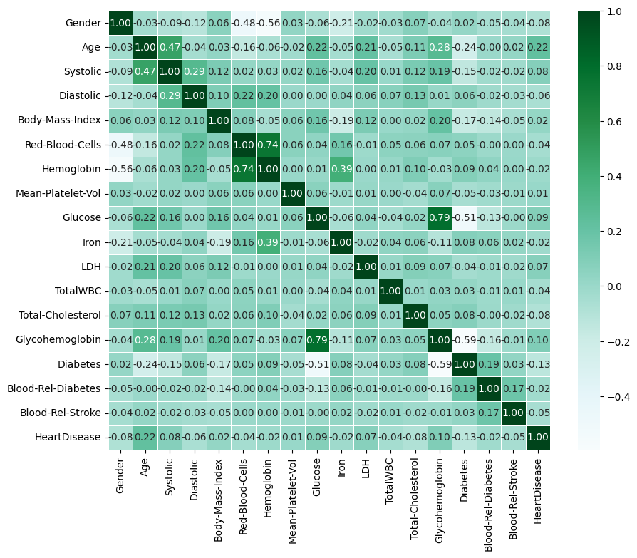
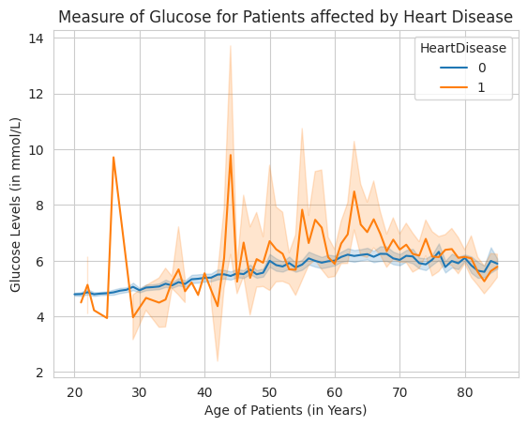
EDA Visualization
Correlation Matrix
Notes:
On your left, you will see a graph that shows the Glucose Levels of the patients of all Ages who are affected and not affected by Heart Disease. If you see the graph, you can observe that the people who are affected by the Heart Disease have high glucose levels, supporting our aim that Heart Disease is affected by parameters such as Glucose. On to your Right, we have Co-relation matrix that shows that most of the variables that we considered using for our project are not closely related and are independent to each other.

Slide 6
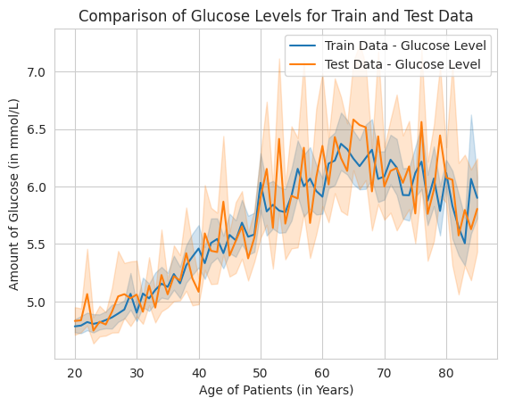
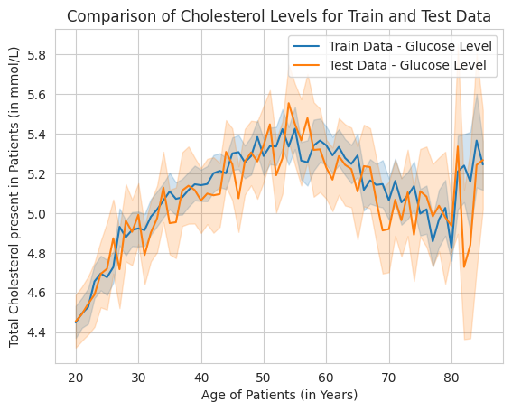
Train and Test Data
Data is divided into Train and Test data which has following distribution :
Following graphs show the Distribution of key factors b/w Train and Test Data:
Notes:
After dividing the data into Train and Test data, we explored and compared the Train and Test data to see if we have any bias or not. Thankfully, we didn’t find any bias that could affect the models and following were our observations. The Ratio of Affected and Not Affect people with Heart Disease is 28 Thousand 4 Hundred 38 to 12 Hundred 25 for Train Data And 7 Thousand 1 Hundred 33 to 2 Hundred 83 for Test Data. Both the ratios are nearly equal. The Graphs plotted shows the comparison of Train and Test Data for Glucose Levels and Cholesterol Levels across ages. These also suggest that the data is not biased and can be used for models

Slide 7
Models and Results
Data focused on Decision Making
Models used – Decision Tree Classifier and Random Forest Classifier Algorithms
No additional parameters passed
Decision Tree achieved – Accuracy 92.5 %
Random Forest achieved – Accuracy 96.2%
Notes:
As our main aim is to come up with a decision on what are the factors that can affect the Heart Disease and how they affect it, we are using decision-making classification algorithms Decision Trees and Random Forest Algorithms. After we trained these algorithms with the train data and cross-validated with the Test Data, we achieved the following accuracies. Decision Tree was 92.5 percent accurate and Random Forest Algorithm was 96.2 percent accurate.
The conclusions drawn from these 2 models will be further explained by Pratyusha.

Slide 8
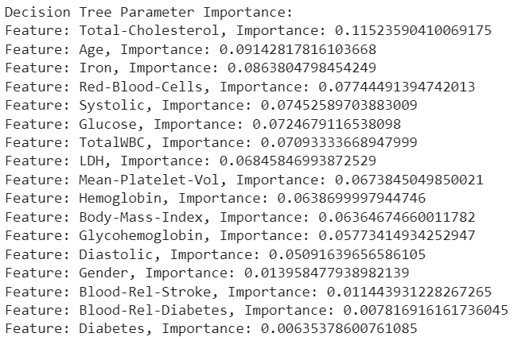
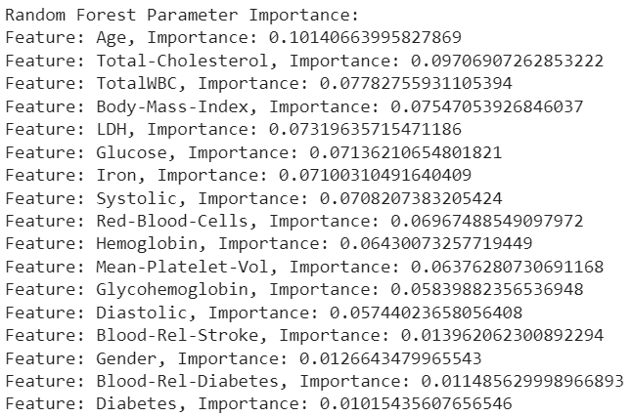
Conclusion
Both Decision Tree and Random Forest provided importance to different parameters as follows:
Main Parameters that affect : Age, Total-Cholesterol and Glucose
Diabetes is given least importance for both the Algorithms
Notes:
As we looked into the models and try to understand how the parameters are prioritized, we observed that both Decision Tree and Random Forest Algorithms had different approaches on importance. If we look at the left, we see the list of how the parameters are ranked by Decision Tree and how Random Forest Ranked them is on the Right side. If we look at the top parameters, Age and Cholesterol play key role for both Random Forest and Decision Trees. Mid Levels Priories are focused on Glucose and LDH (Lactate Dehydrogenase) which also plays important roles that influences Heart Diseases. Mainly, high levels of LDH indicate muscle damage and possibility of Heart Attack. This was an interesting find that Diabetes and Blood Related Diabetes are least priority for both Random Forest and Decision Tree. Even though Glucose has 6th priority, Diabetes which is directly related to Glucose has the least importance.
With this we can conclude that people who are older or people who have high levels of cholesterol, sugar, high BMI or Iron LDH values or other parameters stated here are prone to heart disease and should re-evaluate themselves and focus on their health so that they can reduce the risk of getting a heart attack.

Slide 9
Future Improvements
Use more features and focus on features that directly affect Heart
Implement SVM and other Decision-Making Algorithms
Use parameters while building algorithms to improve accuracy
Notes:
This study helped us to find a certain relation among the parameters and how they affect heart disease. We could have used other parameters that could affect Heart along with the existing parameters. Possibility of using other Decision-making algorithms such as SVM can also improve accuracy and yield better results.
Combining medical knowledge with this study and arranging or modifying the priorities of the factors can make the model obtain more accurate results. This helps in identifying the people who are prone to heart disease based on the blood tests

