Slide 1
/Branching
Policies
Àngel Cónsola López

Slide 2
<Concept>
YOUR LOGO HERE
Branching Policies are rules that are
established to maintain control over the project
INDEX.HTML

Slide 3
/Why use Branching Development Policies
/Organize
/Workflow
/Administrators

Slide 4
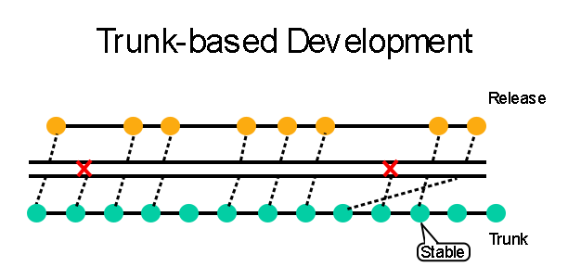
/Trunk-Based Development

Slide 5
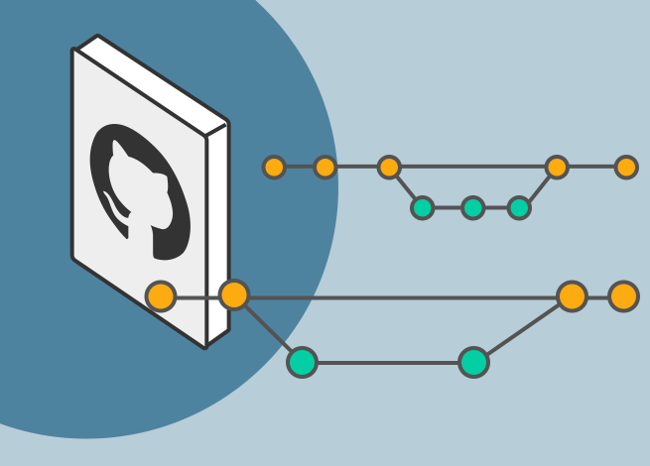
/Feature Branching Development

Slide 6
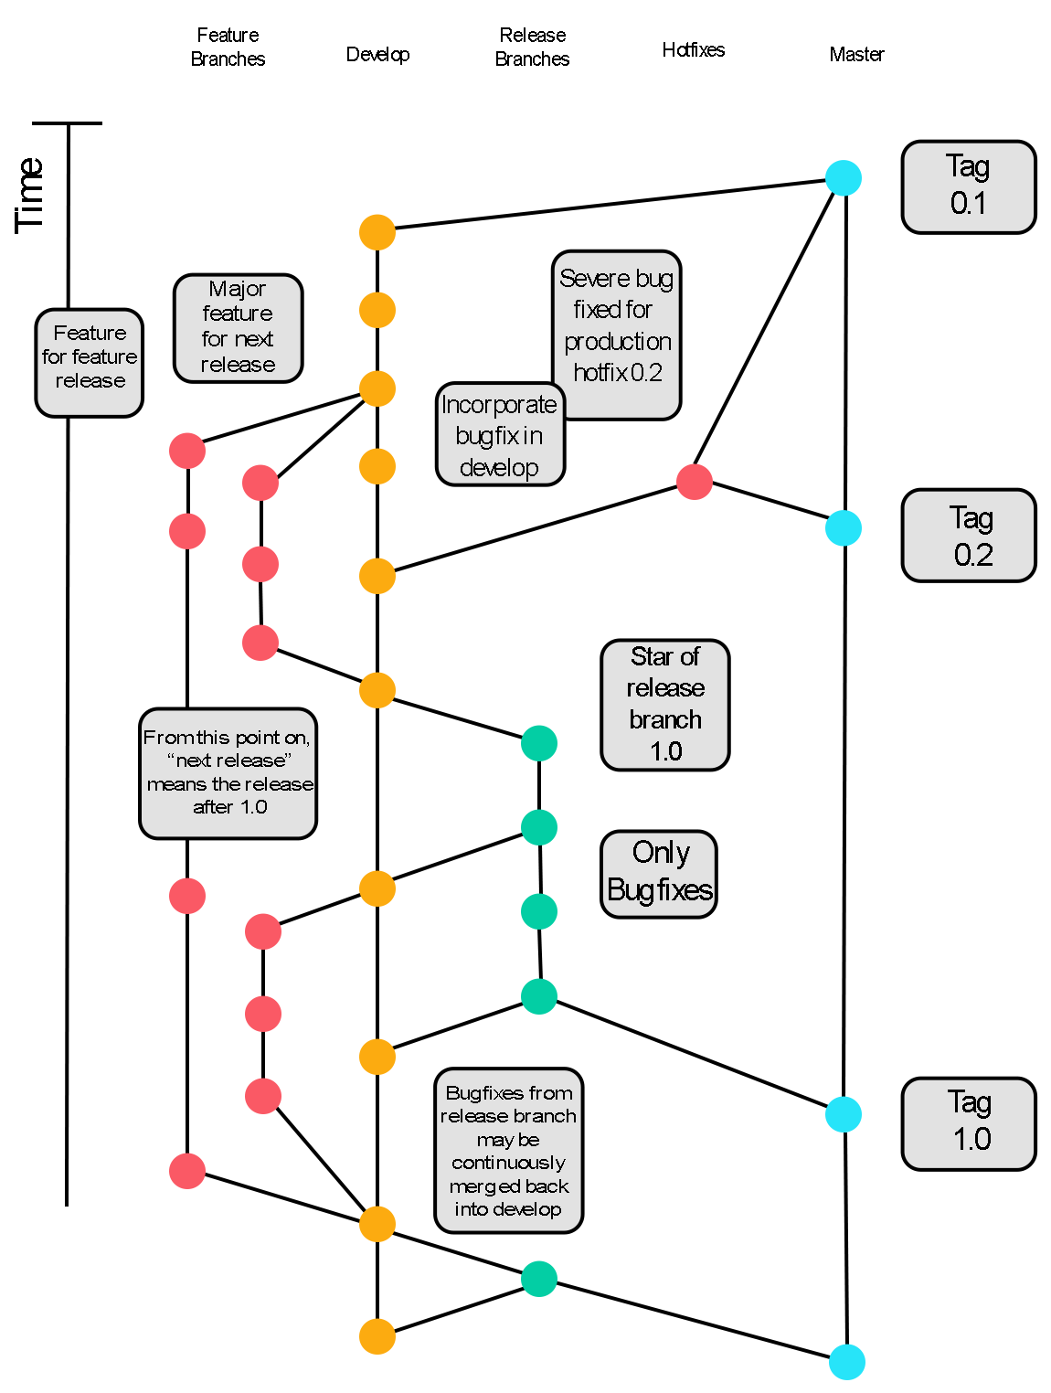
/Git Flow

Slide 7
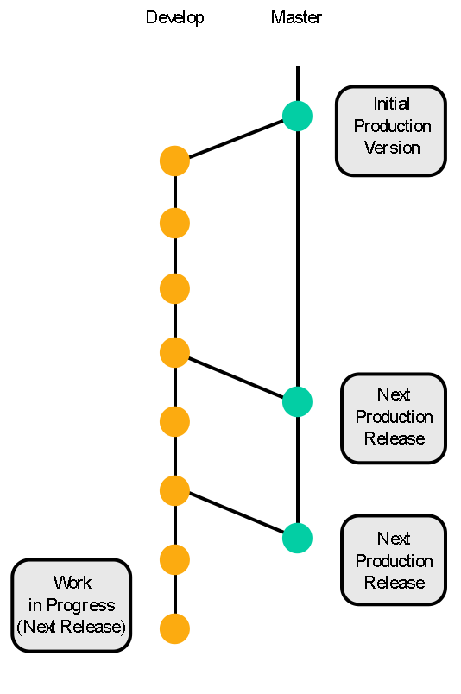
/Main Branches
/Master
/Develop
Contains every release of the project.
Administrator: QA Lead
Contains the current state of the project
Administrator: Code Lead

Slide 8
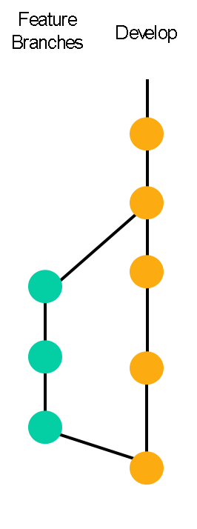
/Feature
The feature branch is used to develop specific tasks

Slide 9
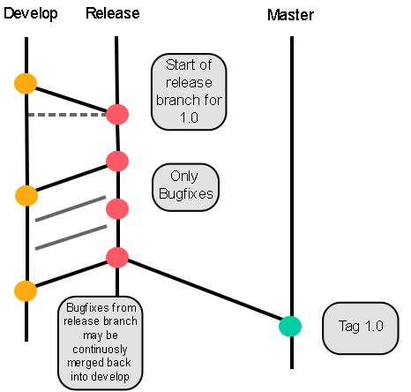
/Release
Release branes are used as preparation for new production releases
Administrator: QA Lead

Slide 10
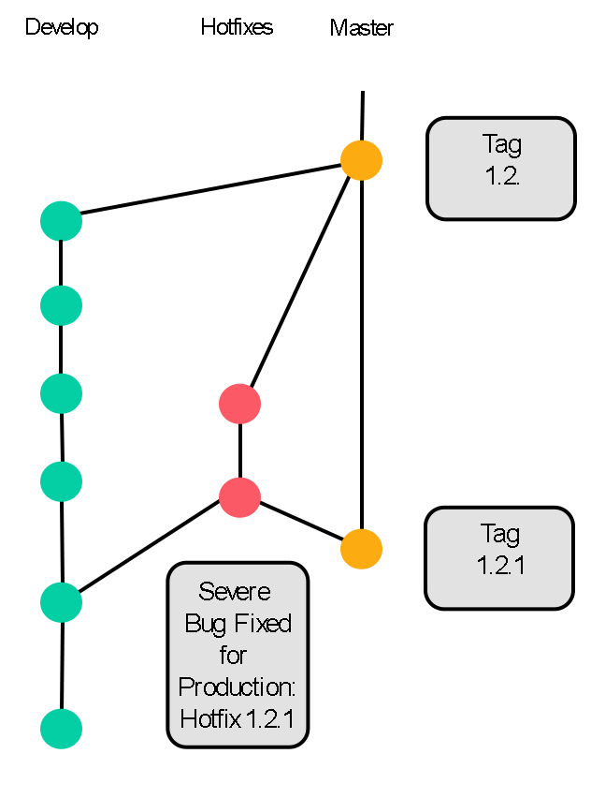
/Hotfix
Critical errors are fixed in this branch
Administrator: Code Lead

Slide 11

/AppVeyor
/Easy to connect
/Configuration
/Build
/Administrator
Easy to connect with Github
Configure AppVeyor to create the builds for specific branches
Will generate a build for each commit
The QA lead should be the administrator

Slide 12
/TO DO 1
/01
/Github
/02
/New Branch
/03
/Create Branch
At the top of the app click Current Branch
Create a New Branch
Create your first Branch

Slide 13
/TO DO 2
/01
/Appveyor
/02
/Link
/03
/Create
Create an Appveyor
Account
Link your Github Account with Appveyor
Create your first build

Slide 14
<Contact>
YOUR LOGO HERE
Email: angel.consola@estudiantat.upc.edu
CITM: angelcl3
INDEX.HTML

