Slide 1









CSV CONSULTANT
Upgrades or Changes in Existing Systems
Implementation of new Systems
Implementation of Regulatory Updates
Risk Management Support
CSV Training
Preparation for Inspection
Addressing Inspection Findings

Slide 2






Regulatory Compliance
Validation Documentation
CSV Basics
Risk Assessment
Data Integrity
Change Control
Periodic Review
Vendor Assessment
Training

Slide 3



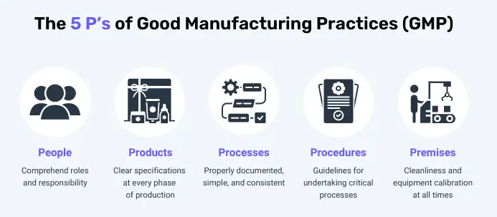
GMP Key Points
Product Effectiveness
Patient Safety
Quality Control

Slide 4
System Lifecycle Phases
Concept
Project
Operation
Retirement
Planning
Change
Updates
Incident
Data Migration
Overall Requirements
Validation Master Plan
Configuration
Business Continuity
Archiving
Categorization
Performance
Installation
Operational
Build
Backup Restore
Archiving
Data Destruction
Suppliers Selection
Training
Periodic Review
Security
SOPs
Risk Assessment

Slide 5





DATA INTEGRITY
Attributable
Data should be attributable to the person and/or to the system generating the data.
Legible
Data should be maintained in a readable form to allow review in its original context.
Contemporraneous
Data should be generated by a system or captured by a person at the time of the observation.
Original
Data should be the original first generation/capture of the observation and mustn’t be altered.
Accurate
Data and metadata should be an accurate representation of the observations made.
+ Complete | Consistent | Enduring | Available + Tracability

Slide 6
Electronic Records And Electronic Signature Requirements
Access limited to authorized users
Security code issue and reissue
Manually locking PCs
Automated locking of PCs after a defined period of inactivity
Disabling of user accounts following a defined number of failed login attempts

