Slide 1
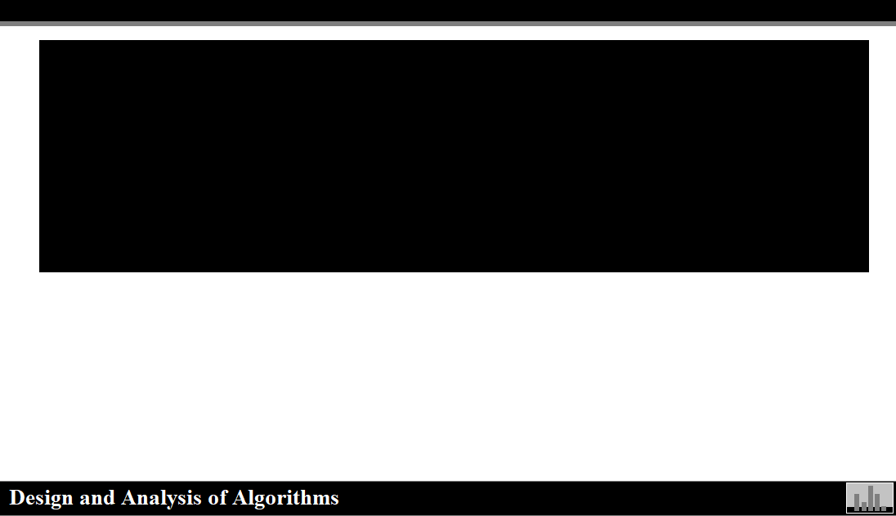
Design and Analysis of Algorithms
Complete Introduction to Algorithms

Slide 2
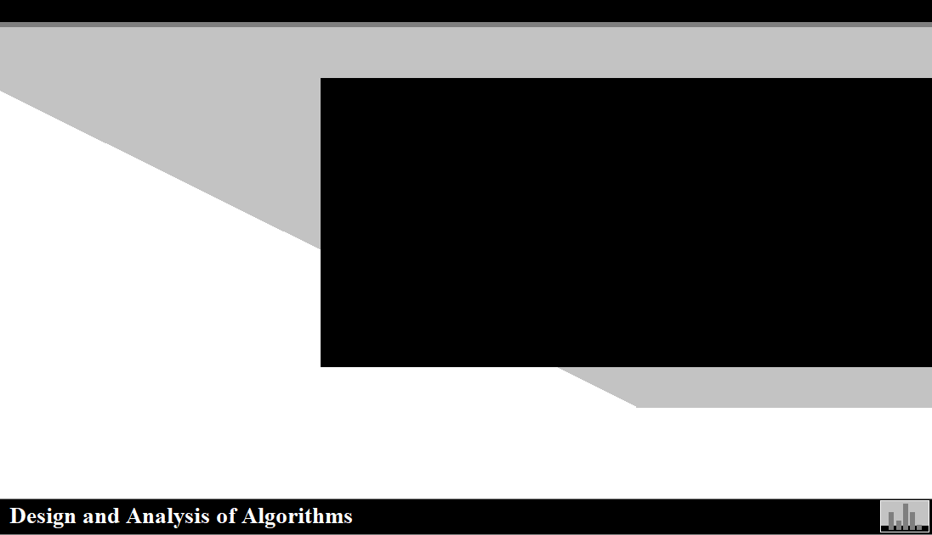
Algorithmic
Skill Training

Slide 3
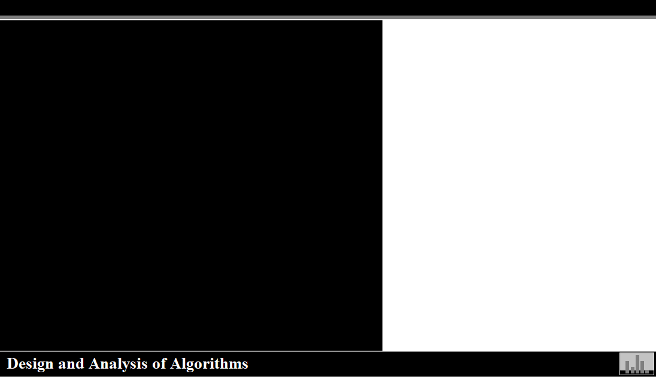

Course Description
Introduction to Algorithms
Brief History Lesson
Data Structures and Mathematical Notation
Proof Solving Techniques
Solving Recurrence Relations
Brute Force Search Algorithms
Number Theory Algorithms
Greedy Strategy
Divide-N-Conquer
Dynamic Programming
Approximation Algorithms
Intractability

Slide 4
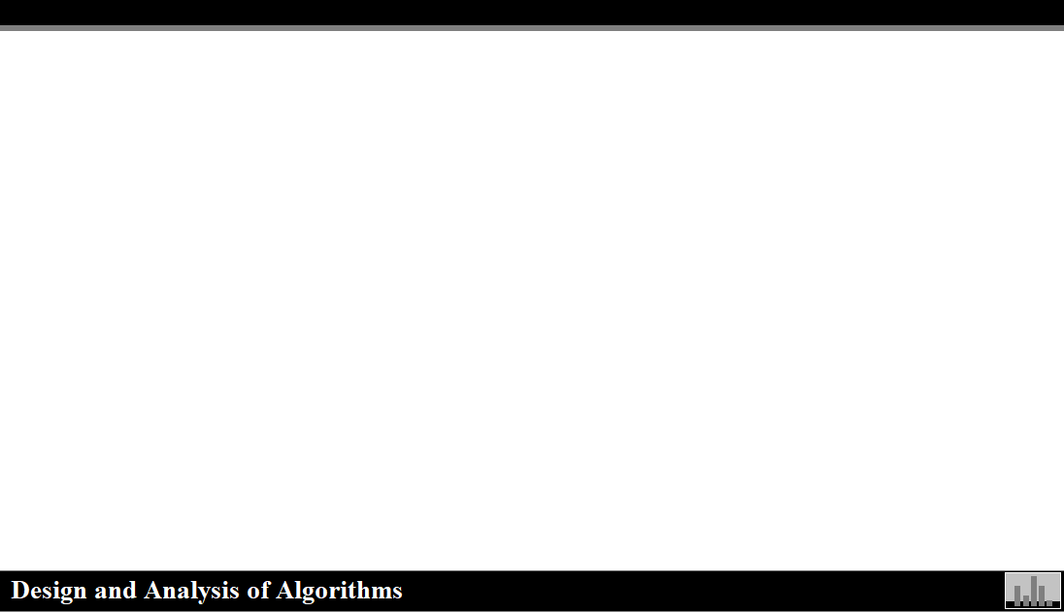
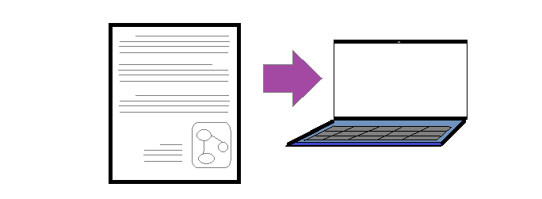
Programming Languages
C++
Java
Python
Javascript

Slide 5
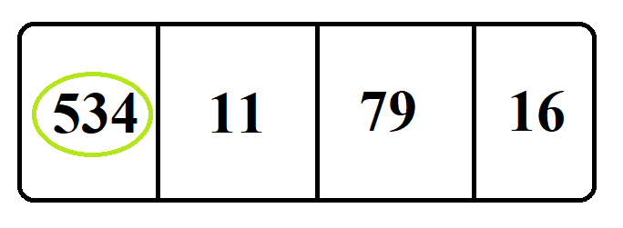
Sorting Algorithms
Selection Sort
Bubble Sort
Insertion Sort
Merge Sort
Quick Sort
Heap Sort
Counting Sort
Radix Sort
Bucket Sort
Bingo Sort Algorithm
ShellSort
TimSort
Comb Sort
Pigeonhole Sort

Slide 6
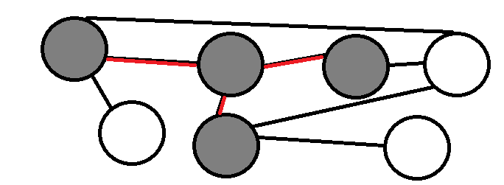
Graph Search Algorithms
Abstract Data Type
Linked Lists
Stack
Queue
Recursion
Disjointed Sets
Red-Black Trees
Minimal Spanning Tree(MST)
Binary Search
Uniform Cost Search

Slide 7

Intractability
P vs NP Problem
Proof Techniques
Pspace
NP-Complete
NP-Hard
NP
P

Slide 8
Other Topics
Backtracking Algorithms
Running Time
Connectivity
Linear Search
Las Vegas Algorithm
Tree Node Operations
Priority Queue
Hash Map
Hamiltonian Cycles
Bin Packing
Cliques
B trees
Independent Set
Hash Table
Adjacency Matrix
Adjacency List
Heuristic
Hill Climbing
3-Sat
K-Sat
Vertex Cover Problem
Oracles
Co-NP
Hamiltonian Path Problem
Circuit Satisfiability Problem
NP-Complete
Turing Machine
Decidability
Gadget
Certificates
BlackBox Reductions
Poly-Time Reducability
Cook-Levin Theorem
The Bin Packing Problem
Representative Problems
Exchange Arguments
Dijkstra's Algorithm
Mathematical Induction
A Star Search Algorithm
Asymptotic Analysis
Coin Exchange Problem
Telephone Pole Placement Problem

