Slide 1
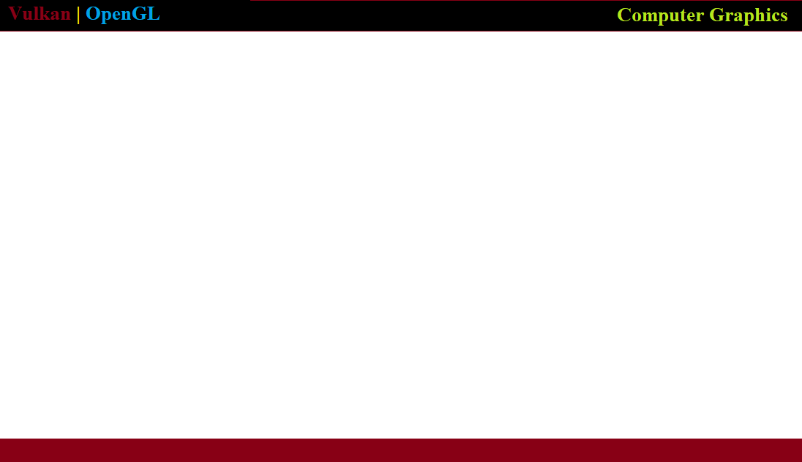
Computer Graphics in Vulkan and Modern OpenGL

Slide 2

https://www.vulkan.org/

Slide 3
Computer Graphics Course Overview
Create a project using APIs used for graphics programming or game design in C++
Review mathematics concepts from Linear Algebra, Discrete Math, Physics , etc.
Construct a scene and apply Light, Shadows ,Reflections and other effects using Shaders
Discuss the history of the field and developmental 3D Graphics Techniques and Algorithms
Answer interview and exam questions common in a typical university course
Live Programming along with a detailed explanation of the Vulkan SDK and tool chain.
What are some of the latest advancements in Computer Graphics and Image Processing?

Slide 4
Agenda
CG Concept Lectures
Vulkan Tutorial
Programming Assignments

Slide 5
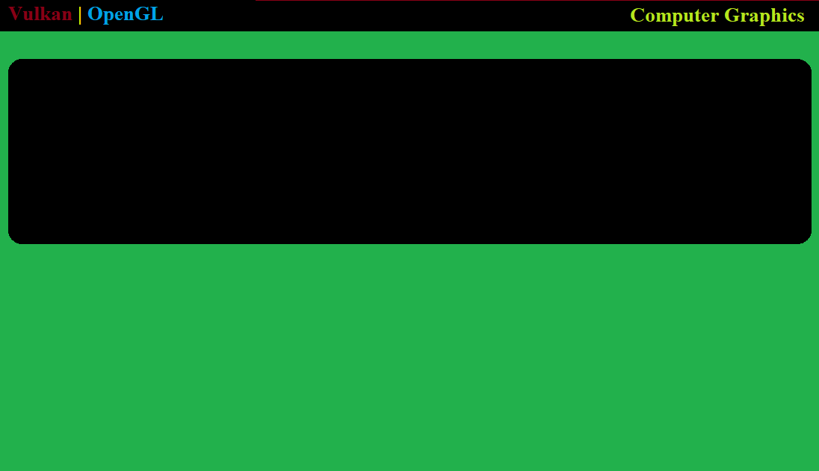
Computer Graphics

Slide 6
Vectors

Slide 7
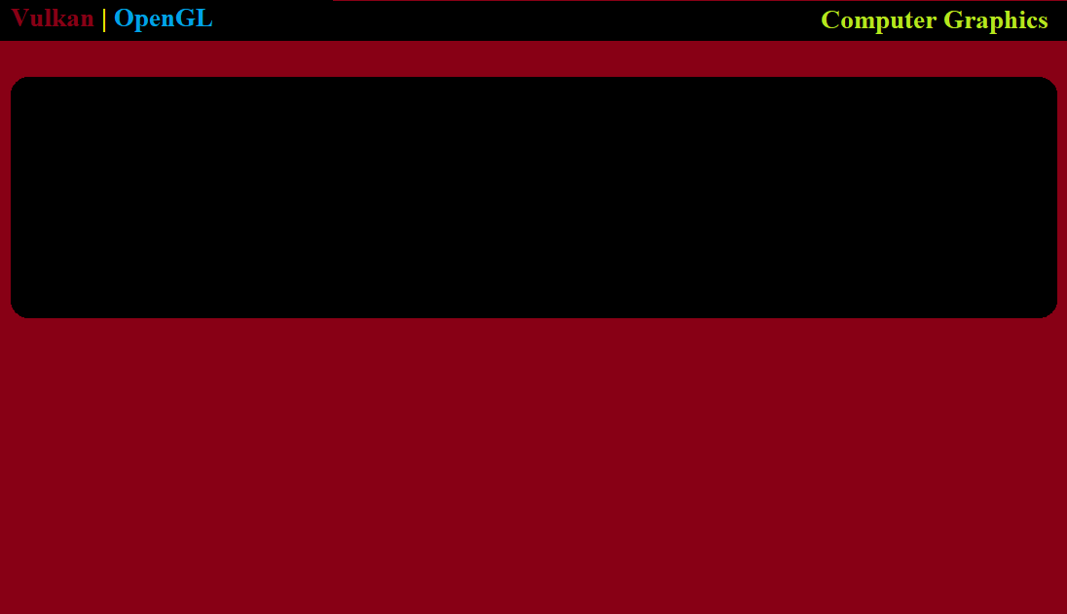
Vulkan

Slide 8
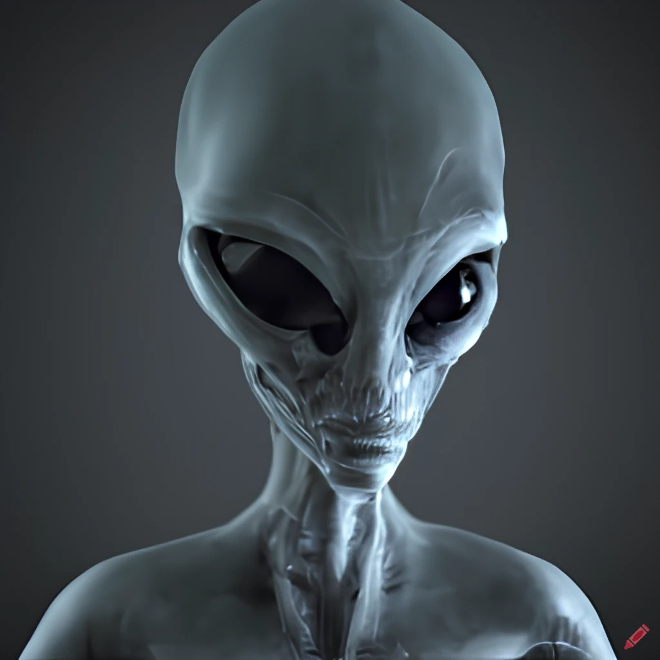
Game Engine
void GreysEngine::init_display()
{
init_vulkan_opengl_SDL();
init_swapchain();
init_commands();
}

Slide 9
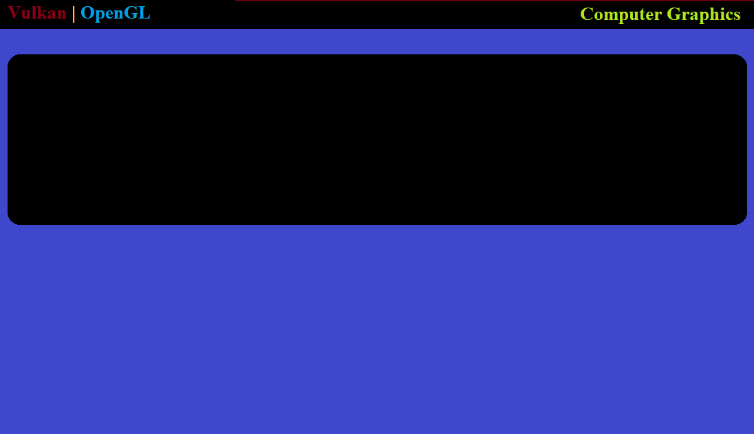
Modern OpenGL

