Slide 1
Thanksgiving and Christmas stores
GROUP 4: BRANDON FORSTER AND PATRICK DELVA

Slide 2
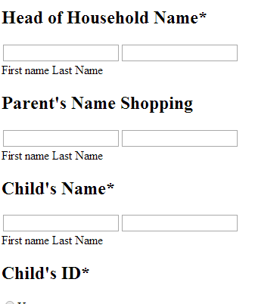
Presentation layer
HTML5
No ugly CSS to confuse the user
Simple, minimalistic interface
Compliant with all web browsers
Thin, efficient client

Slide 3
Application layer
Javascript and PHP
Validate input
Protect users from themselves
Send data to database
Redirect users to correct form
Only runs locally so it’s perfectly secure

Slide 4
Database layer
Stores user data
Saved for future generations
Uses industry standard MySQL
No SQL injection checking so users can update on the fly

Slide 5
Why you should choose our project
Uses the least proprietary technology
Simple to use, simple to maintain
Streamlined efficiency

Slide 6
Thanksgiving and Christmas stores
GROUP 4: BRANDON FORSTER AND PATRICK DELVA

