Slide 1
Thanksgiving and Christmas stores
GROUP 4: BRANDON FORSTER AND PATRICK DELVA

Slide 2
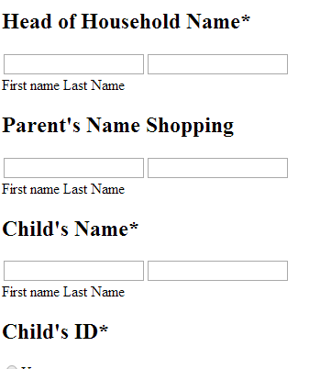
Presentation layer
HTML5
No ugly CSS to confuse the user
Simple, minimalistic interface
Compliant with all web browsers
Thin, efficient client

Slide 3
Application layer
Javascript and PHP
Validate input
Protect users from themselves
Send data to database
Redirect users to correct form
Only runs locally so it’s perfectly secure

Slide 4
Database layer
Stores user data
Saved for future generations
Uses industry standard MySQL
No SQL injection checking so users can update on the fly

Slide 5
Why you should choose our project
Uses the least proprietary technology
Simple to use, simple to maintain
Streamlined efficiency

Slide 6

Project sustainability
No licenses to worry about
Uses Apache and MySQL
Project built with free and open source software
All technology available to set up and run at no cost

Slide 7
Thanksgiving and Christmas stores
GROUP 4: BRANDON FORSTER AND PATRICK DELVA

