Slide 1
Test #1

Slide 2
Profile
Age:
2. Gender: F / M
3. Eye sight: normal or corrected-to-normal___ other_____
4. Color blind: yes___ no____
5. Academic studies:
a) Science/Engineering
b) Humanities and Social sciences
c) Others
6. Academic Level:
a) Undergraduate
b) Post graduate (MSc, PhD)
c) Other
7. Assess your experience in Data Visualization
a) None
b) Little
c) Medium or pretty good
d) Very good

Slide 3
Scatterplot Introduction

Slide 4
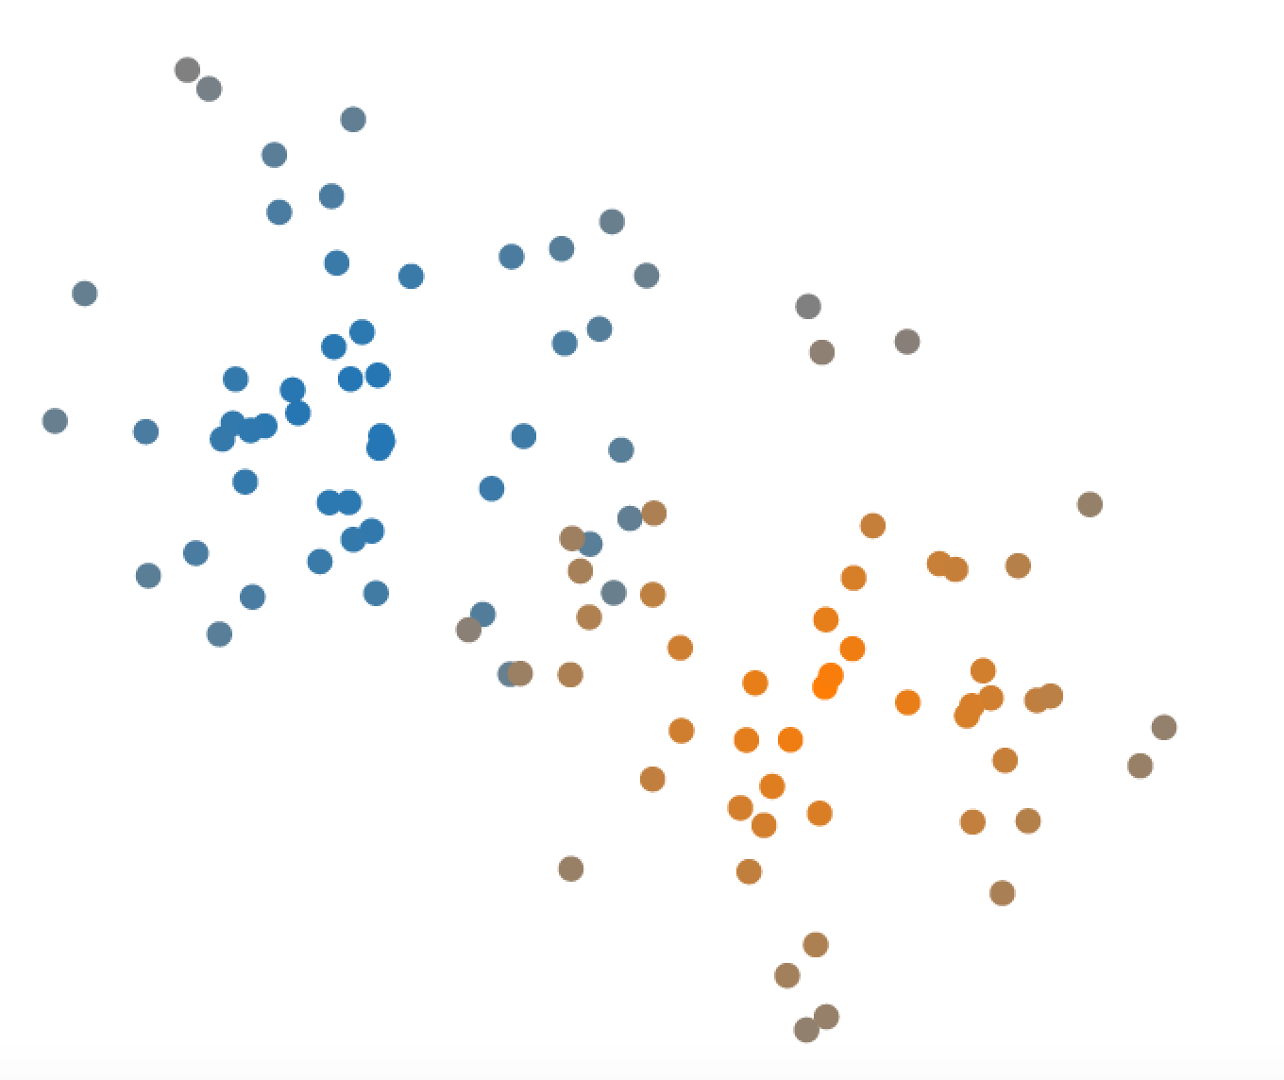
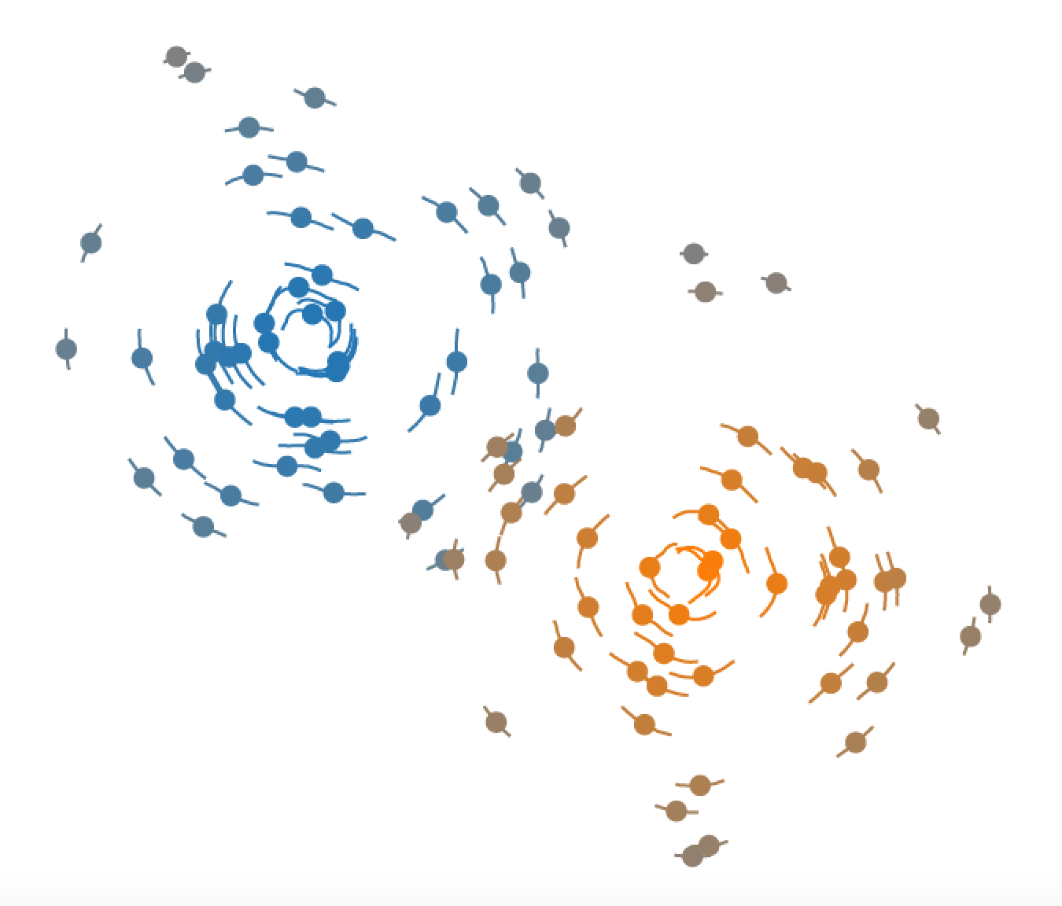
* Cluster * Belonging Certainty * Cluster’s Average Certainty
Type I
Type II

Slide 5
Exercise I

Slide 6
How many clusters in the scatterplot?

Slide 7
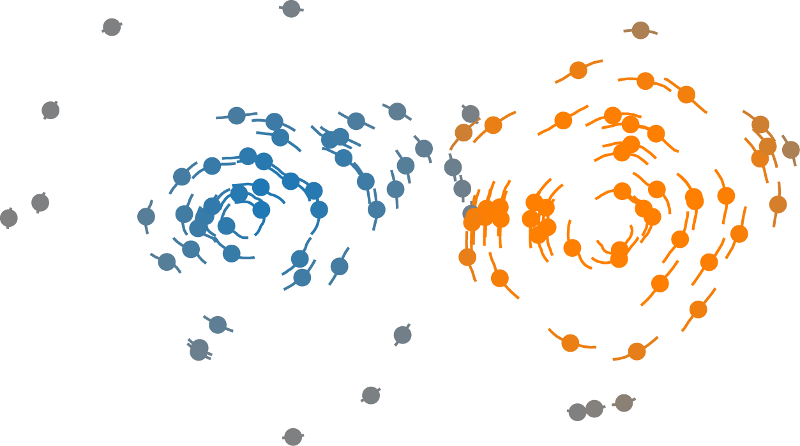
How many clusters in the scatterplot? 1, 2, 3
next

Slide 8
Which cluster has larger average certainty, cluster 1 or cluster 2?

Slide 9

Cluster 1
Cluster 2
Which cluster has larger average certainty, cluster 1 or cluster 2? 1 , 2
next

Slide 10
How many clusters in the scatterplot?

Slide 11
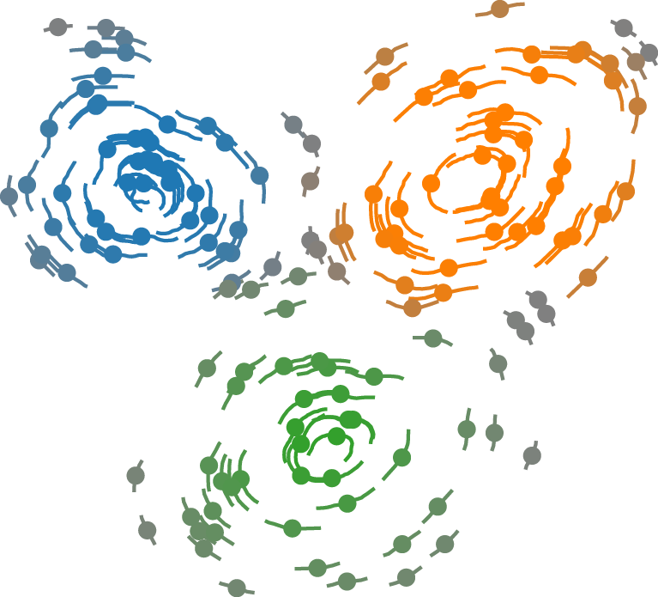
How many clusters in the scatterplot? 1, 2, 3, 4
next

Slide 12
Which cluster has larger average certainty, cluster 1 or cluster 2?

Slide 13
Cluster 1
Cluster 2
Which cluster has larger average certainty, cluster 1 or cluster 2? 1 , 2
next

Slide 14
How many clusters in the scatterplot?

Slide 15
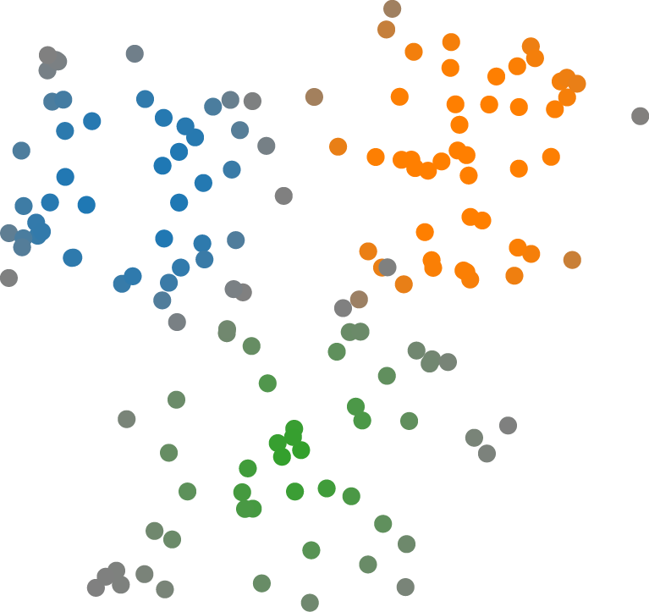
How many clusters in the scatterplot? 1, 2, 3, 4
next

Slide 16
Which cluster has larger average certainty, cluster 1 or cluster 2?

Slide 17
Cluster 1
Cluster 2
Which cluster has larger average certainty, cluster 1 or cluster 2? 1, ,2
next

Slide 18
How many clusters in the scatterplot?

Slide 19
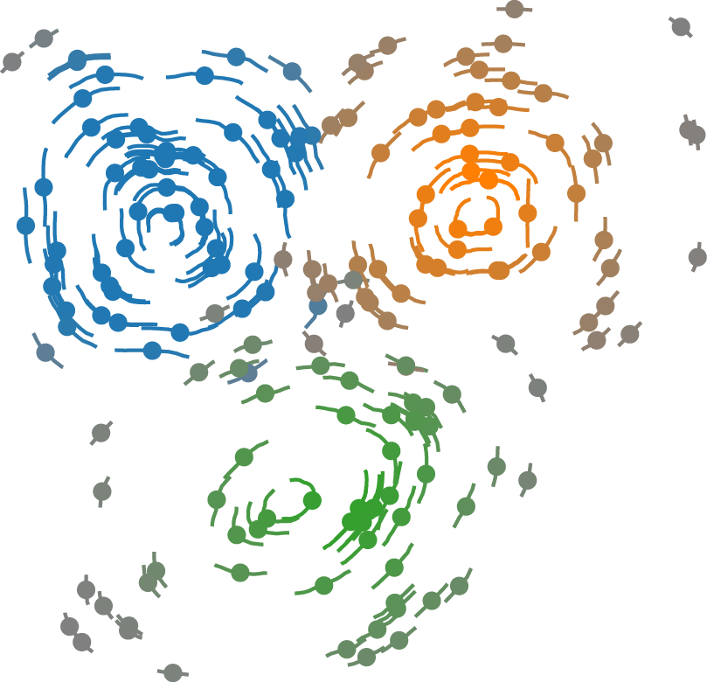
How many clusters in the scatterplot? 1, 2, 3, 4
next

Slide 20
Which cluster has larger average certainty, cluster 1 or cluster 2?

Slide 21
Cluster 1
Cluster 2
Which cluster has larger average certainty, cluster 1 or cluster 2? 1 , 2
next

Slide 22
How many clusters in the scatterplot?

Slide 23
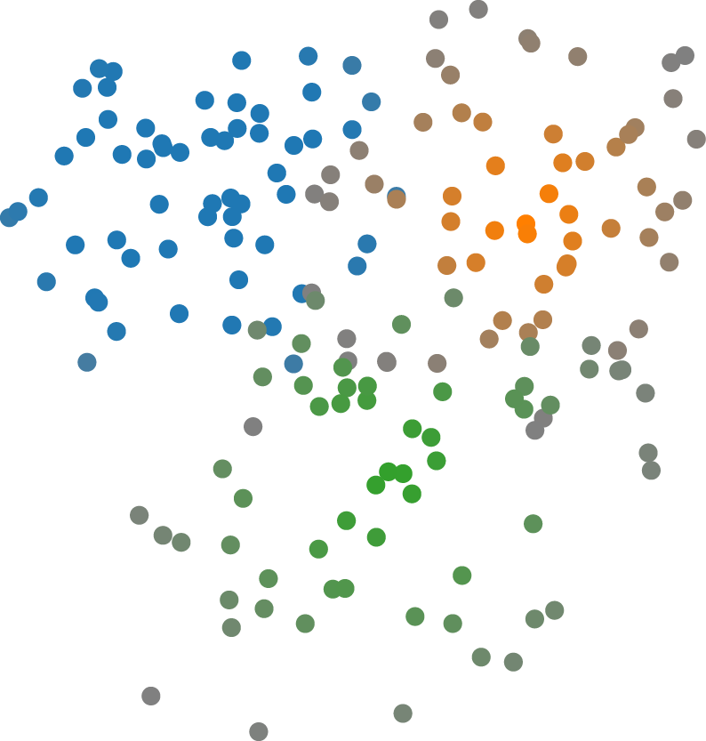
How many clusters in the scatterplot? 1, 2, 3, 4
next

Slide 24
Which cluster has larger average certainty, cluster 1 or cluster 2?

Slide 25
Cluster 1
Cluster 2
Which cluster has larger average certainty, cluster 1 or cluster 2? 1, ,2
next

Slide 26
How many clusters in the scatterplot?

Slide 27
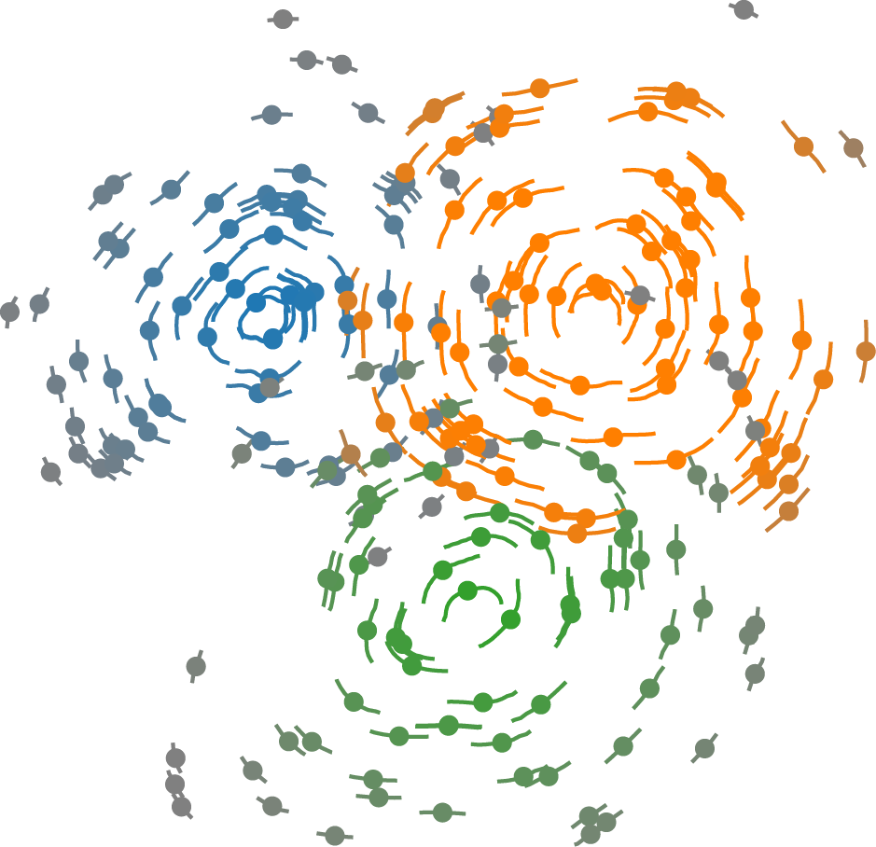
How many clusters in the scatterplot? 1, 2, 3, 4
next

Slide 28
Which cluster has larger average certainty, cluster 1 or cluster 2?

Slide 29
Cluster 1
Cluster 2
Which cluster has larger average certainty, cluster 1 or cluster 2? 1 , 2
next

Slide 30
How many clusters in the scatterplot?

Slide 31
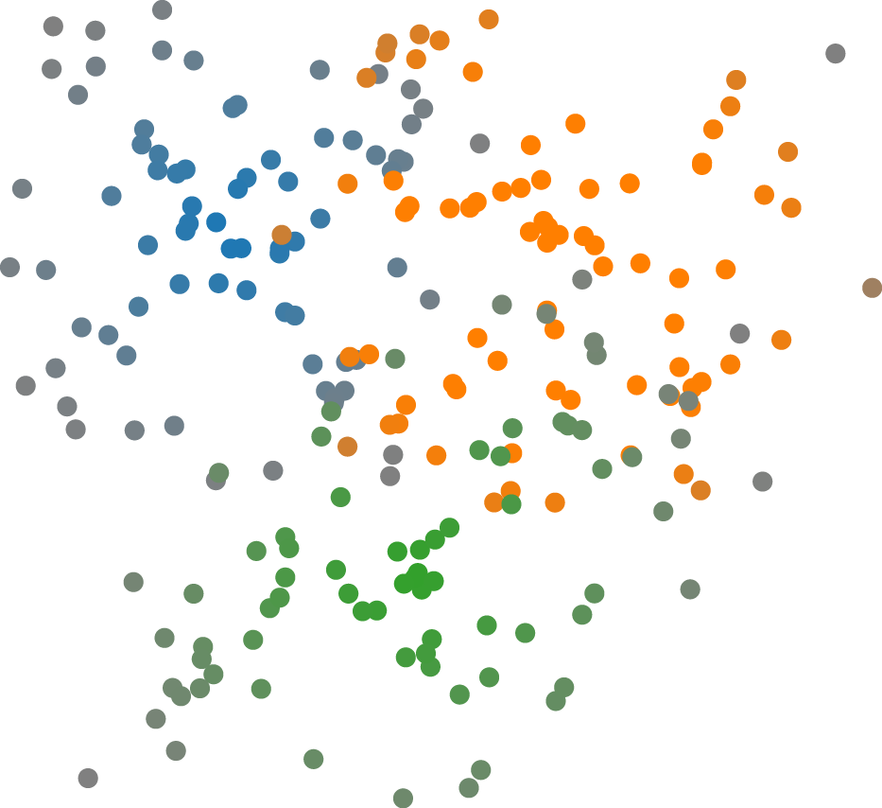
How many clusters in the scatterplot? 5, 6, 7
next

Slide 32
Which cluster has larger average certainty, cluster 1 or cluster 2?

Slide 33
Cluster 1
Cluster 2
Which cluster has larger average certainty, cluster 1 or cluster 2? 1, ,2
next

Slide 34
How many clusters in the scatterplot?

Slide 35
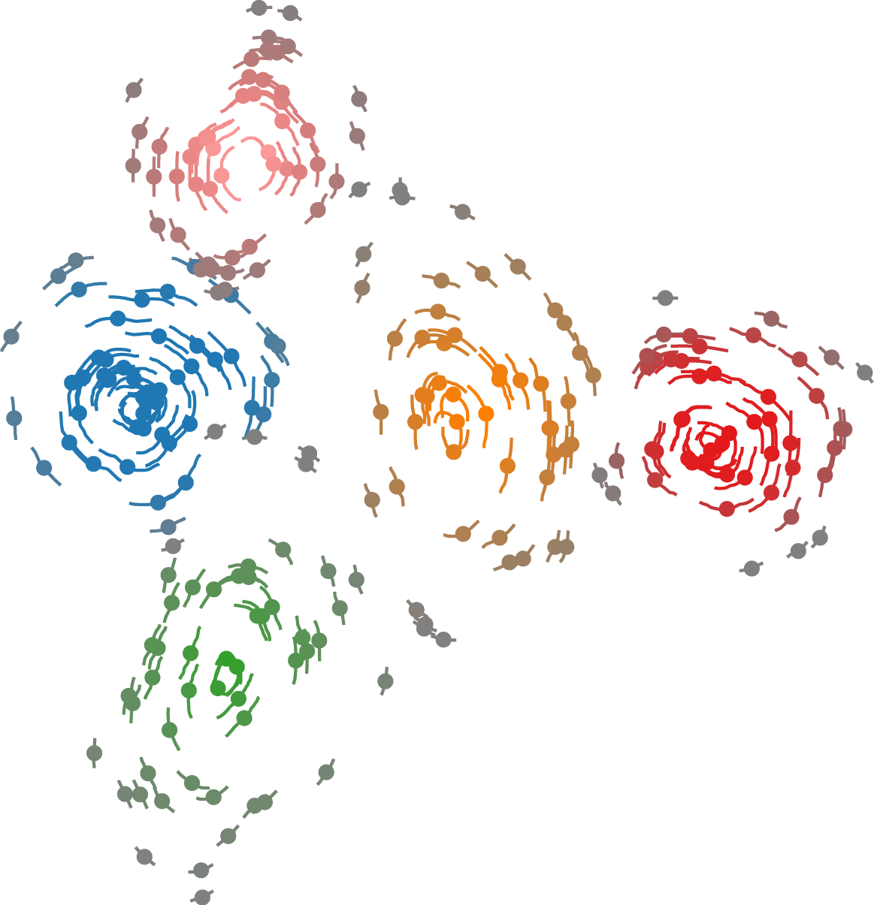
How many clusters in the scatterplot? 5, 6, 7
next

Slide 36
Which cluster has larger average certainty, cluster 1 or cluster 2?

Slide 37
Cluster 2
Cluster 1
Which cluster has larger average certainty, cluster 1 or cluster 2? 1 , 2
next

Slide 38
How many clusters in the scatterplot?

Slide 39
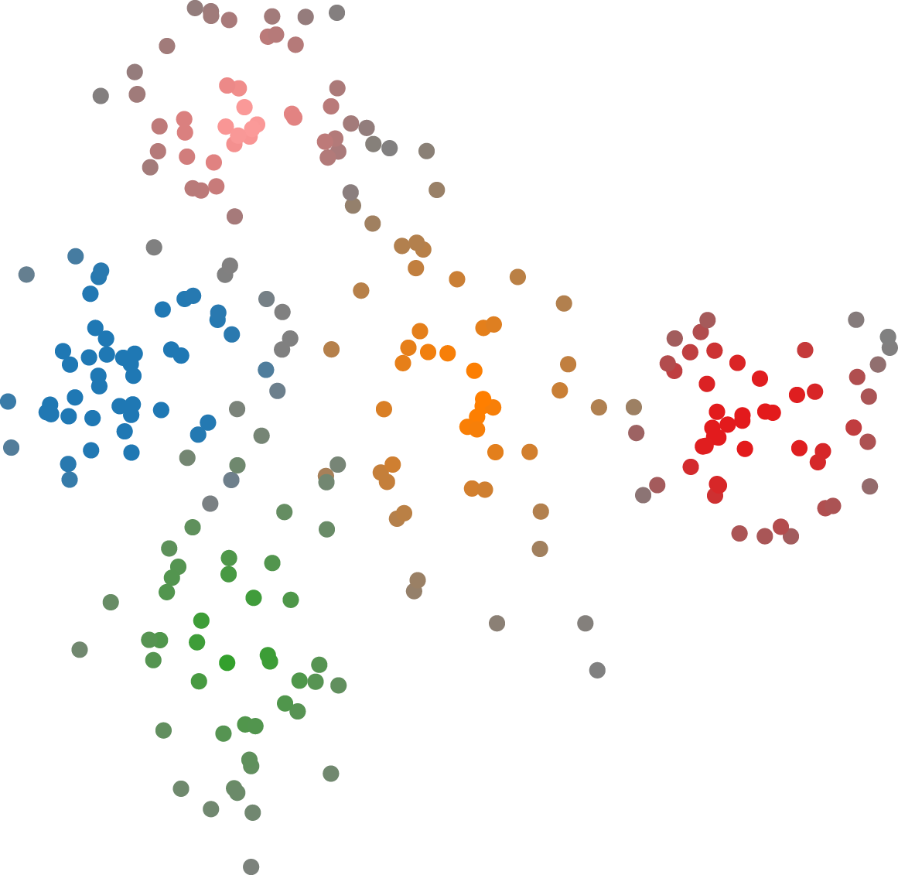
How many clusters in the scatterplot? 5, 6, 7
next

Slide 40
Which cluster has larger average certainty, cluster 1 or cluster 2?

Slide 41
Cluster 1
Cluster 2
Which cluster has larger average certainty, cluster 1 or cluster 2? 1, ,2
next

Slide 42
How many clusters in the scatterplot?

Slide 43
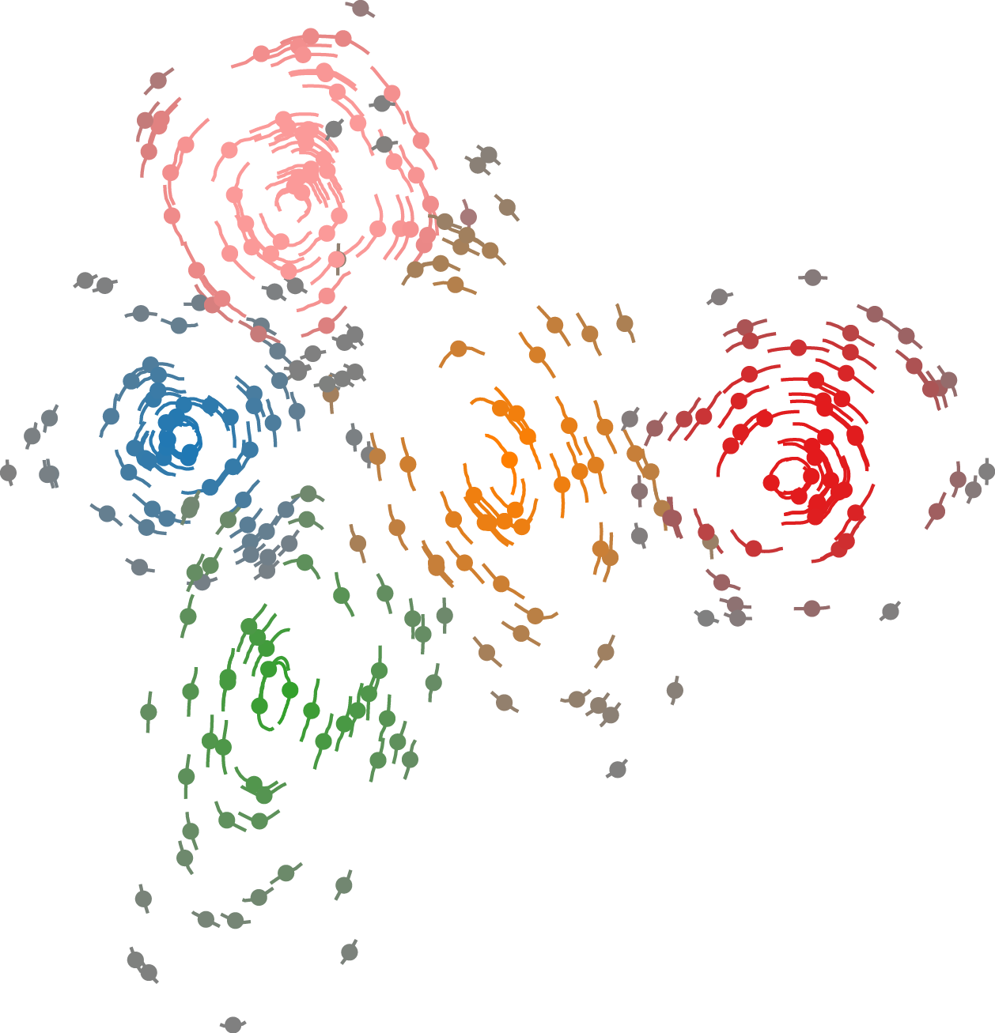
How many clusters in the scatterplot? 5, 6, 7
next

Slide 44
Which cluster has larger average certainty, cluster 1 or cluster 2?

Slide 45
Cluster 1
Cluster 2
Which cluster has larger average certainty, cluster 1 or cluster 2? 1 , 2
next

Slide 46
How many clusters in the scatterplot?

Slide 47
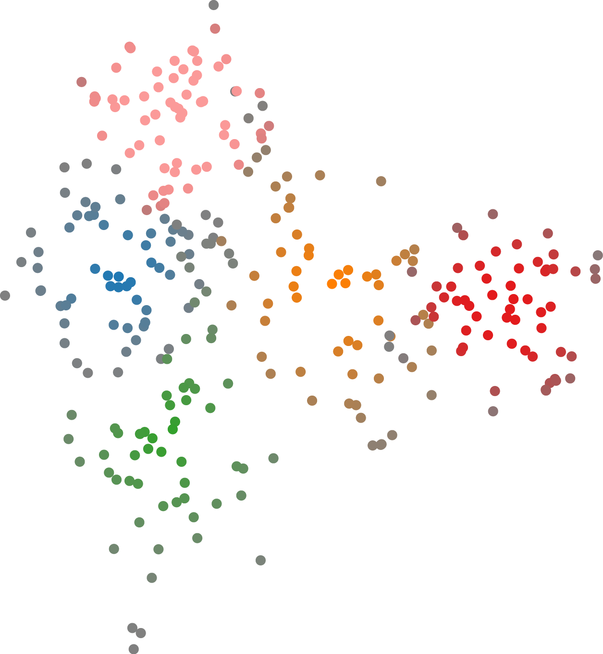
How many clusters in the scatterplot? 5, 6, 7
next

Slide 48
Which cluster has larger average certainty, cluster 1 or cluster 2?

Slide 49
Cluster 1
Cluster 2
Which cluster has larger average certainty, cluster 1 or cluster 2? 1, ,2
next

Slide 50
How many clusters in the scatterplot?

Slide 51
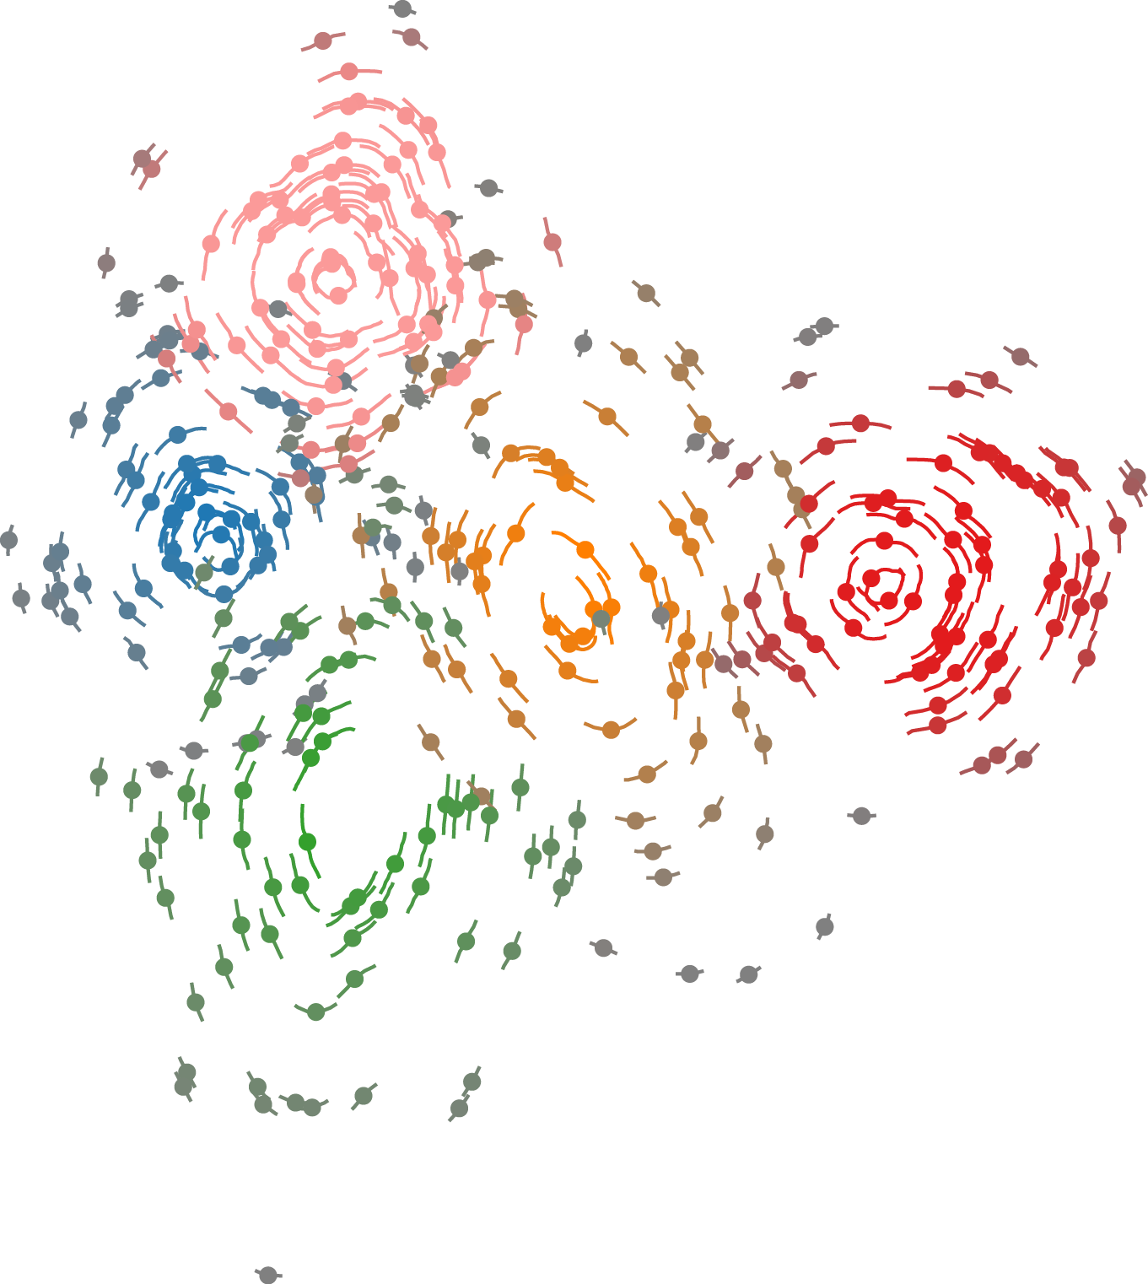
How many clusters in the scatterplot? 5, 6, 7
next

Slide 52
Which cluster has larger average certainty, cluster 1 or cluster 2?

Slide 53
Cluster 1
Cluster 2
Which cluster has larger average certainty, cluster 1 or cluster 2? 1 , 2
next

Slide 54
How many clusters in the scatterplot?

Slide 55
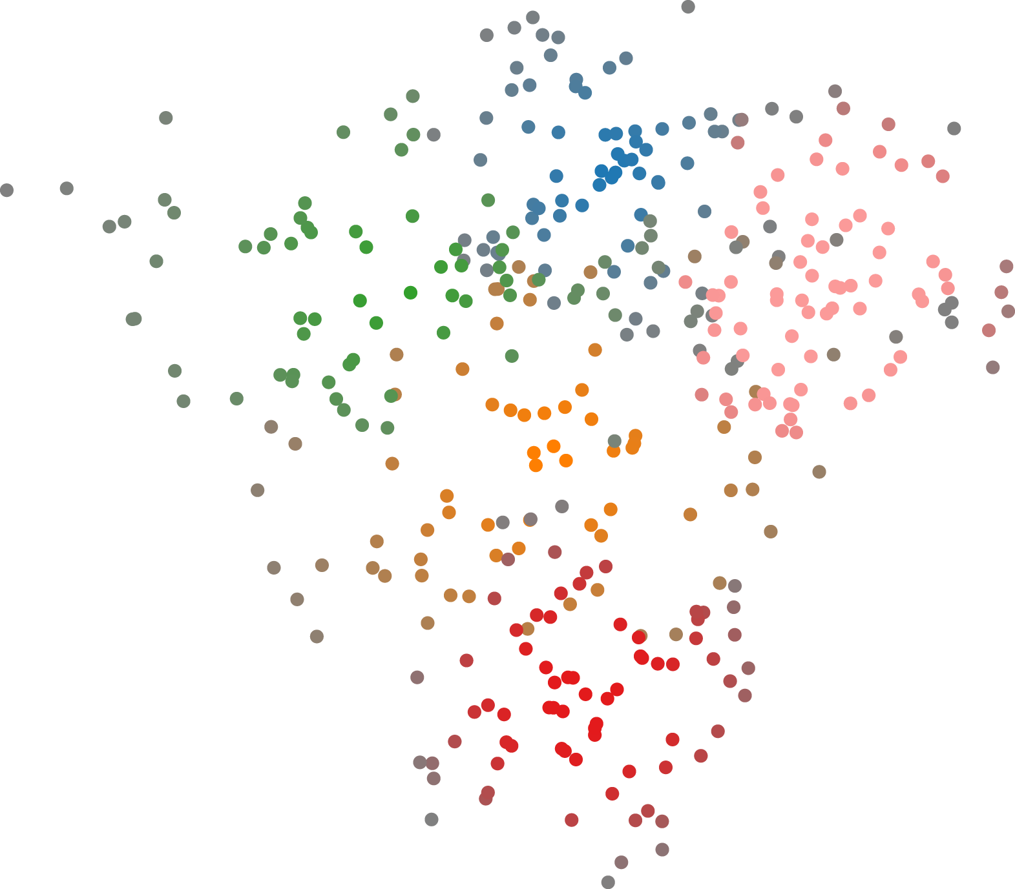
How many clusters in the scatterplot? 5, 6, 7
next

Slide 56
Which cluster has larger average certainty, cluster 1 or cluster 2?

Slide 57
Cluster 1
Cluster 2
Which cluster has larger average certainty, cluster 1 or cluster 2? 1, ,2
next

Slide 58
How many clusters in the scatterplot?

Slide 59
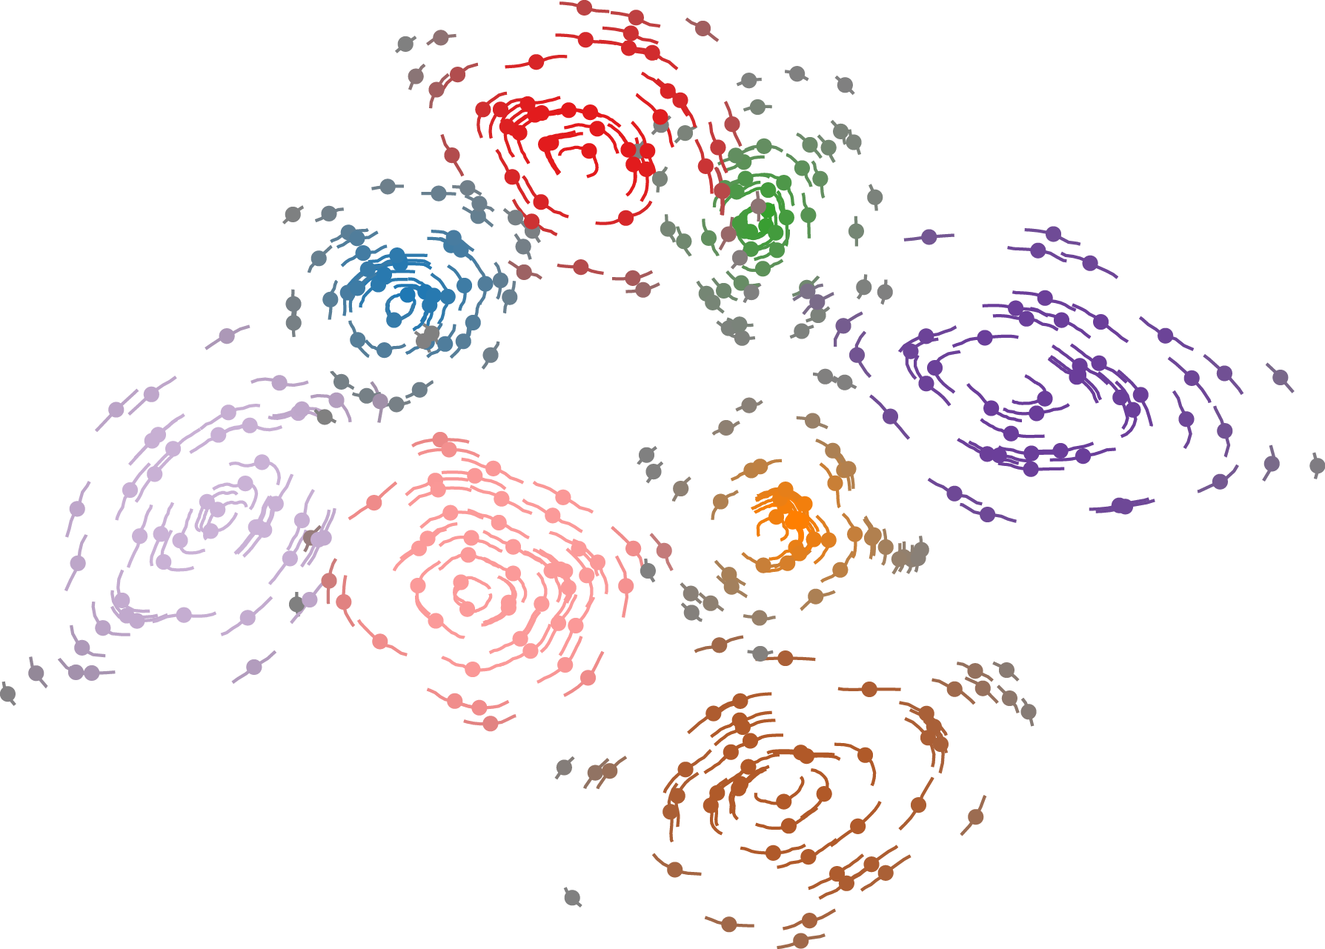
How many clusters in the scatterplot? 7, 8, 9
next

Slide 60
Which cluster has larger average certainty, cluster 1 or cluster 2?

Slide 61
Cluster 1
Cluster 2
Which cluster has larger average certainty, cluster 1 or cluster 2? 1 , 2
next

Slide 62
How many clusters in the scatterplot?

Slide 63
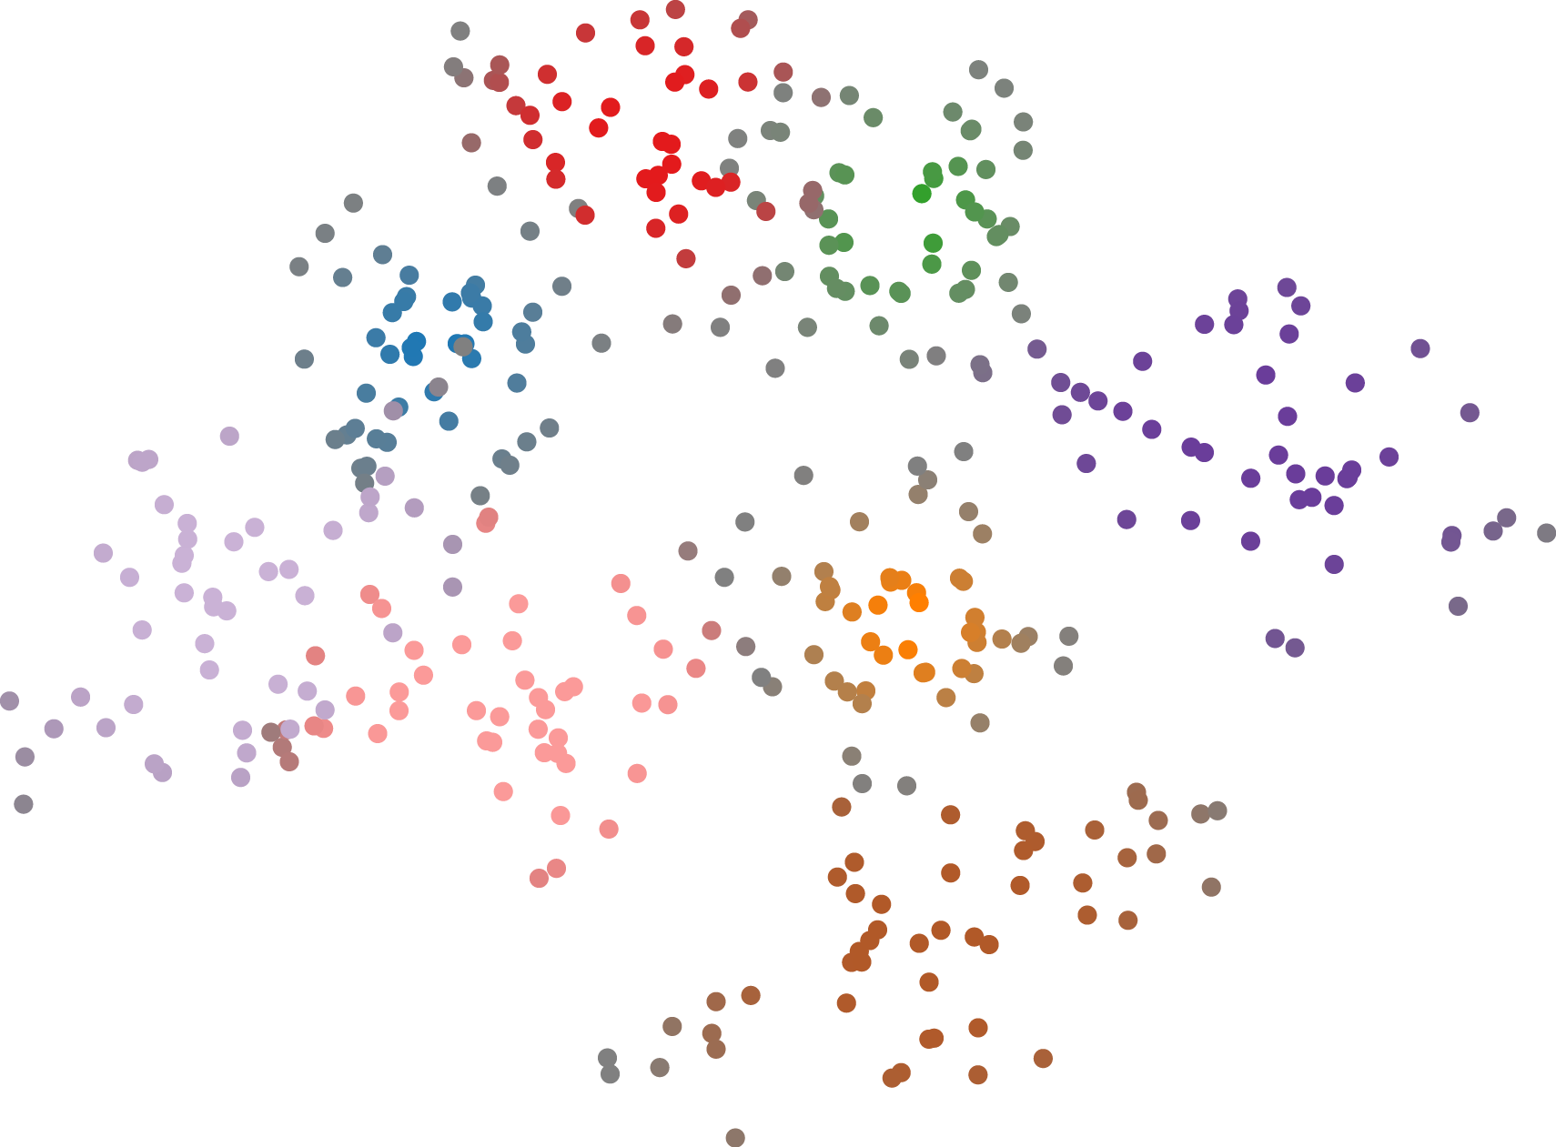
How many clusters in the scatterplot? 5, 6, 7
next

Slide 64
Which cluster has larger average certainty, cluster 1 or cluster 2?

Slide 65
Cluster 2
Cluster 1
Which cluster has larger average certainty, cluster 1 or cluster 2? 1, ,2
next

Slide 66
How many clusters in the scatterplot?

Slide 67
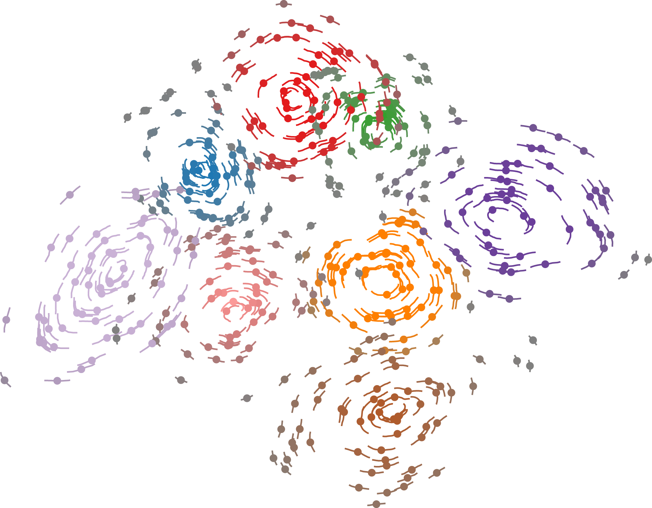
How many clusters in the scatterplot? 7, 8, 9
next

Slide 68
Which cluster has larger average certainty, cluster 1 or cluster 2?

Slide 69
Cluster 1
Cluster 2
Which cluster has larger average certainty, cluster 1 or cluster 2? 1 , 2
next

Slide 70
How many clusters in the scatterplot?

Slide 71
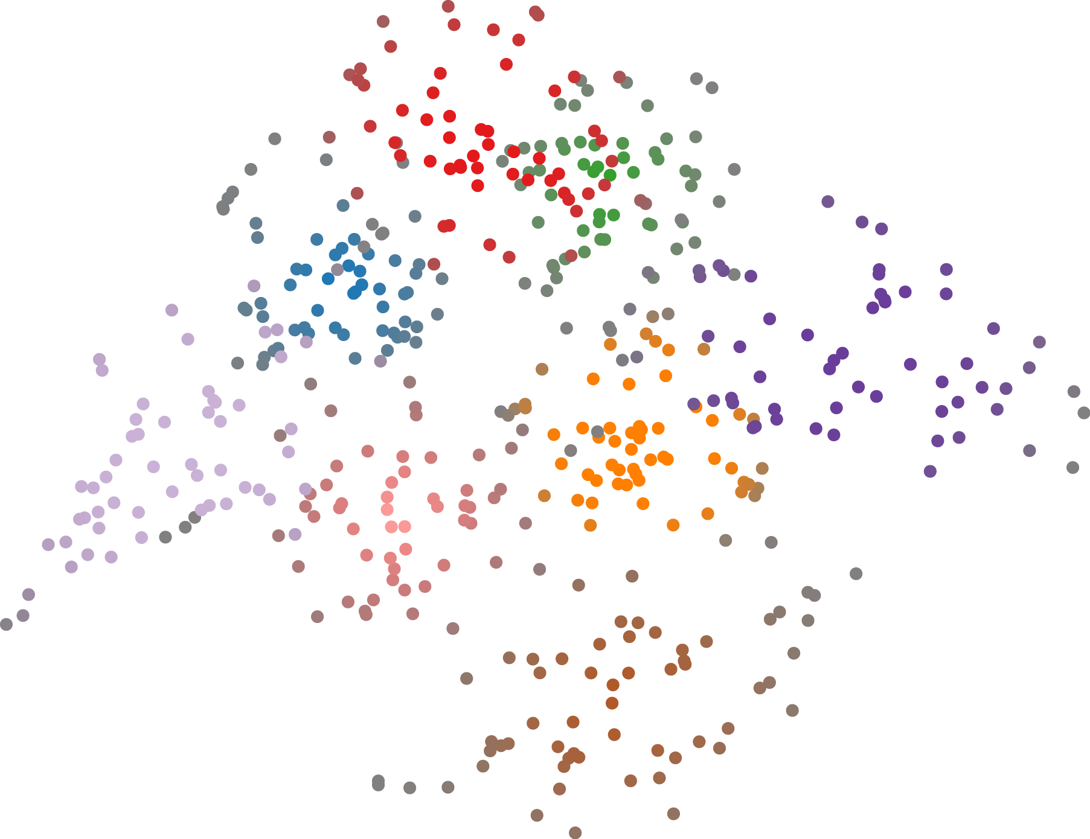
How many clusters in the scatterplot? 7, 8, 9
next

Slide 72
Which cluster has larger average certainty, cluster 1 or cluster 2?

Slide 73
Cluster 1
Cluster 2
Which cluster has larger average certainty, cluster 1 or cluster 2? 1, ,2
next

Slide 74
How many clusters in the scatterplot?

Slide 75
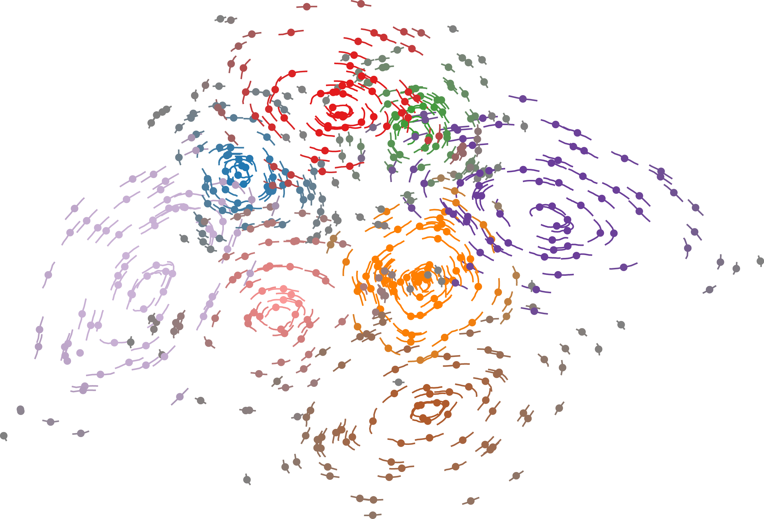
How many clusters in the scatterplot? 7, 8, 9
next

Slide 76
Which cluster has larger average certainty, cluster 1 or cluster 2?

Slide 77
Cluster 2
Cluster 1
Which cluster has larger average certainty, cluster 1 or cluster 2? 1 , 2
next

Slide 78
How many clusters in the scatterplot?

Slide 79
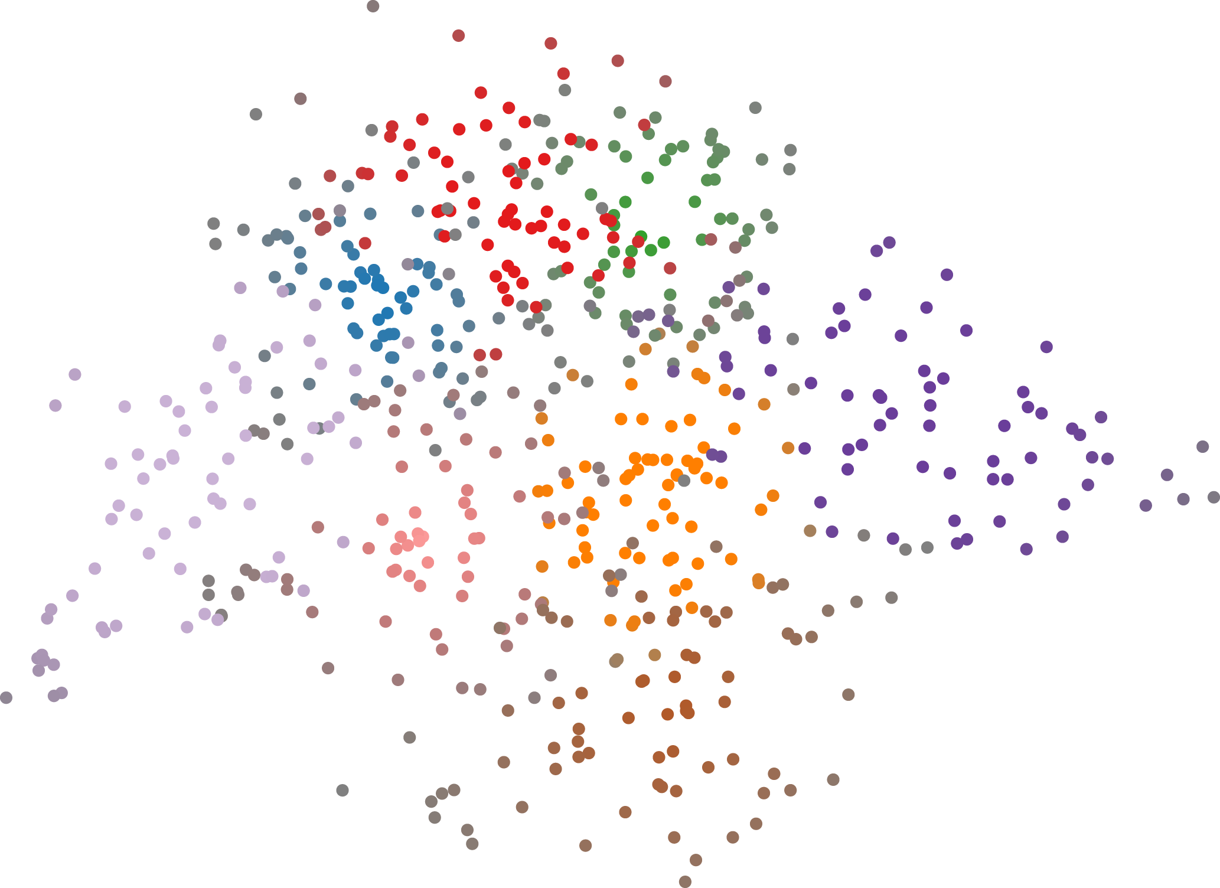
How many clusters in the scatterplot? 5, 6, 7
next

Slide 80
Which cluster has larger average certainty, cluster 1 or cluster 2?

Slide 81
Cluster 2
Cluster 1
Which cluster has larger average certainty, cluster 1 or cluster 2? 1, ,2
next

