Slide 1
Test #1

Slide 2
Profile
Age:
2. Gender: F / M
3. Eye sight: normal or corrected-to-normal___ other_____
4. Color blind: yes___ no____
5. Academic studies:
a) Science/Engineering
b) Humanities and Social sciences
c) Others
6. Academic Level:
a) Undergraduate
b) Post graduate (MSc, PhD)
c) Other
7. Assess your experience in Data Visualization
a) None
b) Little
c) Medium or pretty good
d) Very good

Slide 3
Scatterplot Introduction

Slide 4
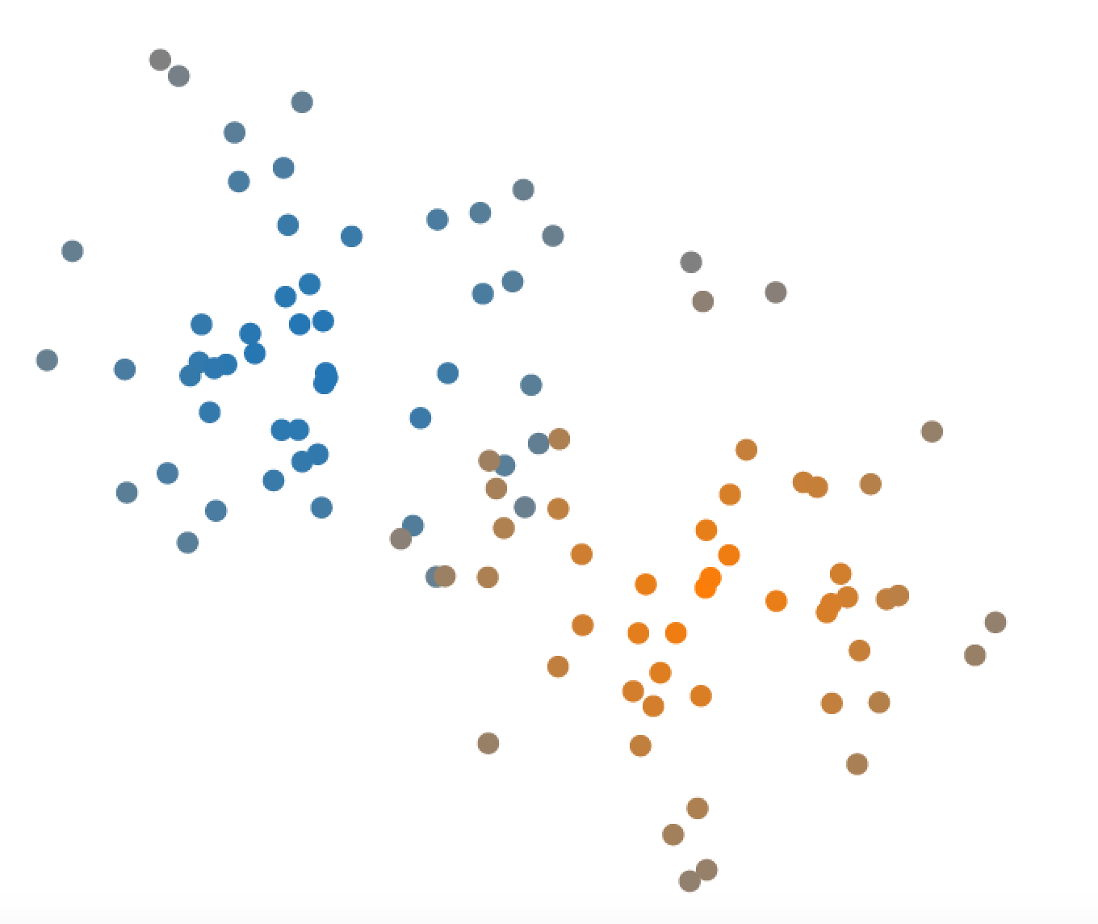
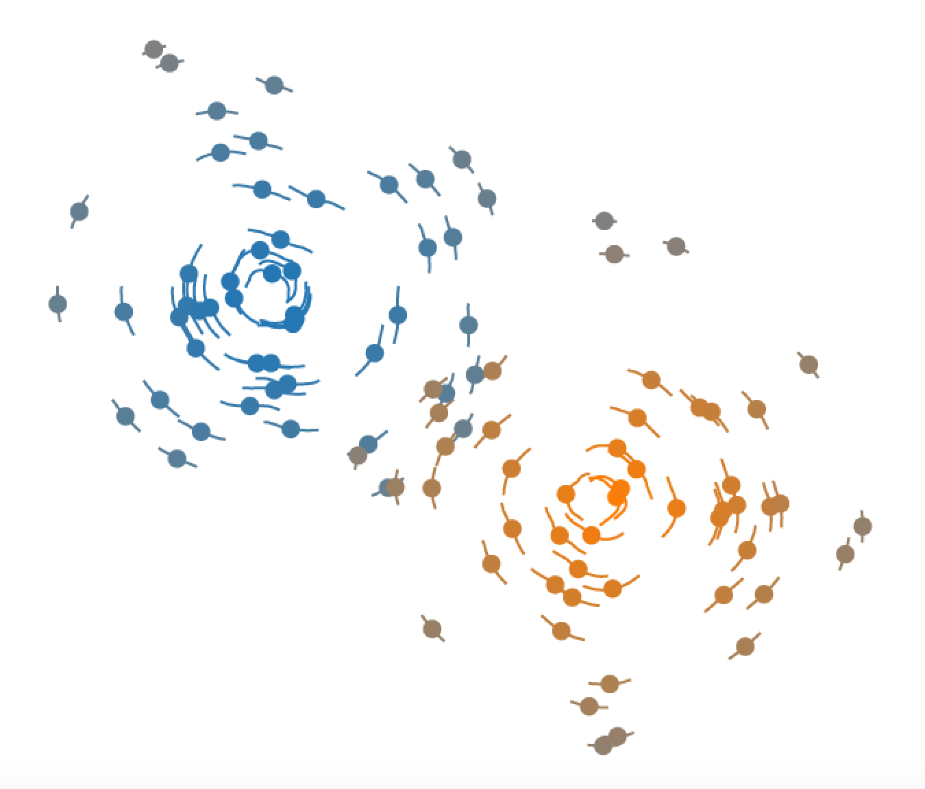
* Cluster * Belonging Certainty * Cluster’s Average Certainty
Type I
Type II

Slide 5
Exercise I

Slide 6
Which cluster the given point belongs to?

Slide 7
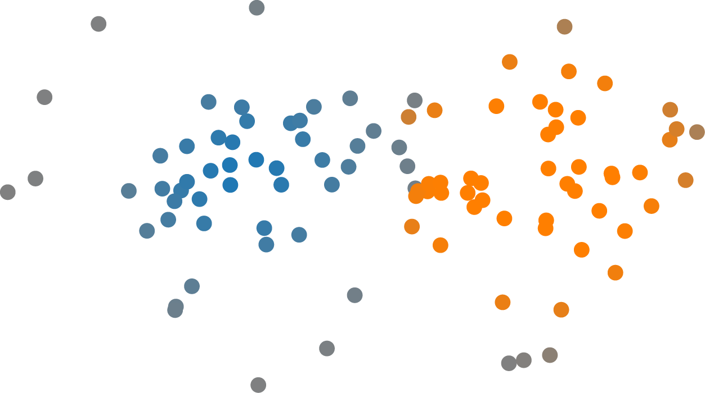
Cluster 1
Cluster 2
Which cluster the given point belongs to? 1, 2
next

Slide 8
Which point belongs to the cluster with a higher certainty, point1 or point2?

Slide 9

P1
P2
Which point belongs to the cluster with a higher certainty, point1 or point2? 1, 2
next

Slide 10
Which cluster the given point belongs to?

Slide 11

Cluster 1
Cluster 2
Cluster 3
Which cluster the given point belongs to? 1, 2, 3
next

Slide 12
Which point belongs to the cluster with a higher certainty, point1 or point2?

Slide 13
p1
p2
Which point belongs to the cluster with a higher certainty, point1 or point2? 1, 2
next

Slide 14
Which cluster the given point belongs to?

Slide 15
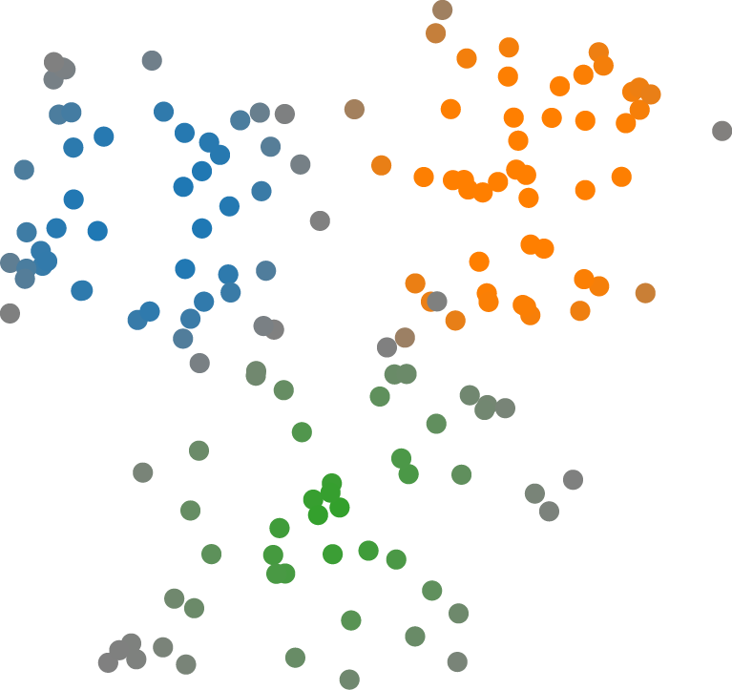
Cluster 3
Cluster 1
Cluster 2
Which cluster the given point belongs to? 1, 2, 3
next

Slide 16
Which point belongs to the cluster with a higher certainty, point1 or point2?

Slide 17
P2
P1
Which point belongs to the cluster with a higher certainty, point1 or point2? 1, 2
next

Slide 18
Which cluster the given point belongs to?

Slide 19
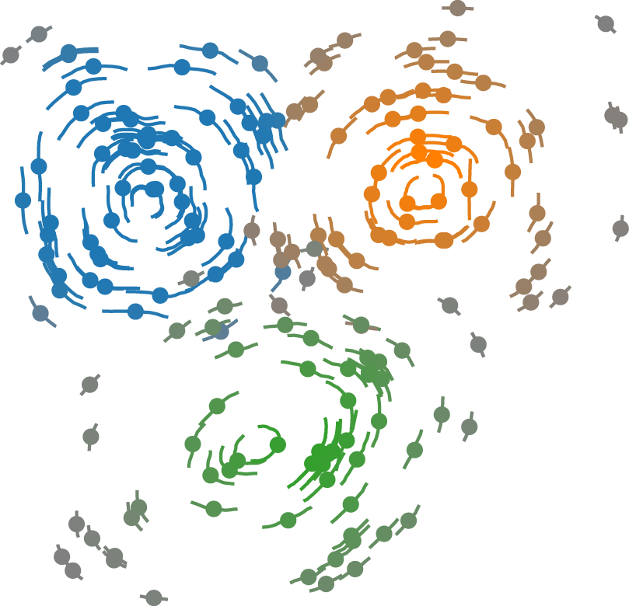
Cluster 1
Cluster 3
Cluster 2
Which cluster the given point belongs to? 1, 2, 3
next

Slide 20
Which point belongs to the cluster with a higher certainty, point1 or point2?

Slide 21
p2
p1
Which point belongs to the cluster with a higher certainty, point1 or point2? 1, 2
next

Slide 22
Which cluster the given point belongs to?

Slide 23
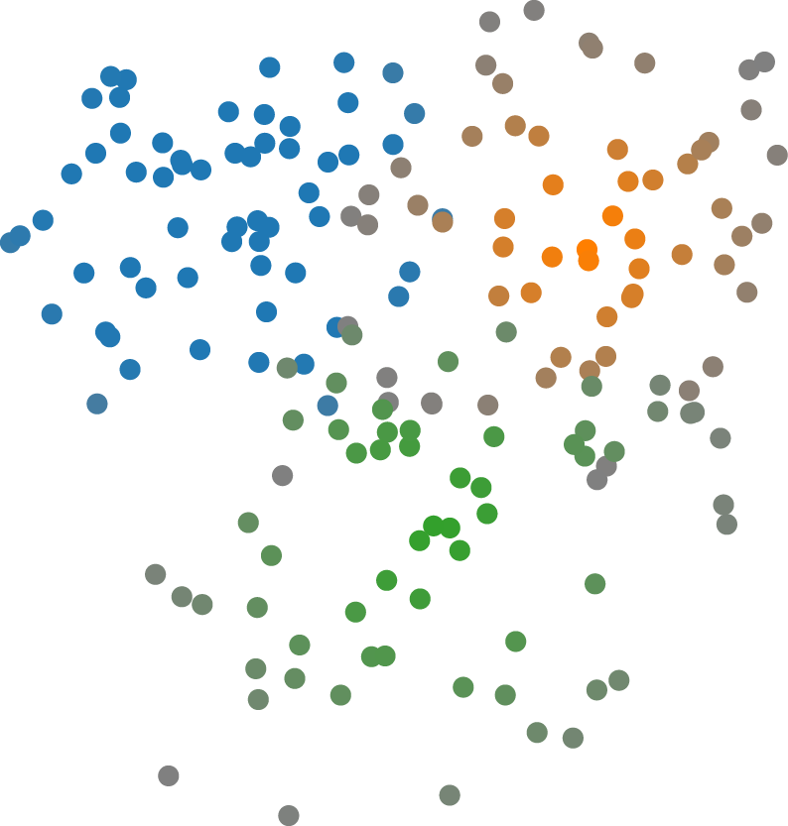
Cluster 3
Cluster 2
Cluster 1
Which cluster the given point belongs to? 1, 2, 3
next

Slide 24
Which point belongs to the cluster with a higher certainty, point1 or point2?

Slide 25
P1
P2
Which point belongs to the cluster with a higher certainty, point1 or point2? 1, 2
next

Slide 26
Which cluster the given point belongs to?

Slide 27
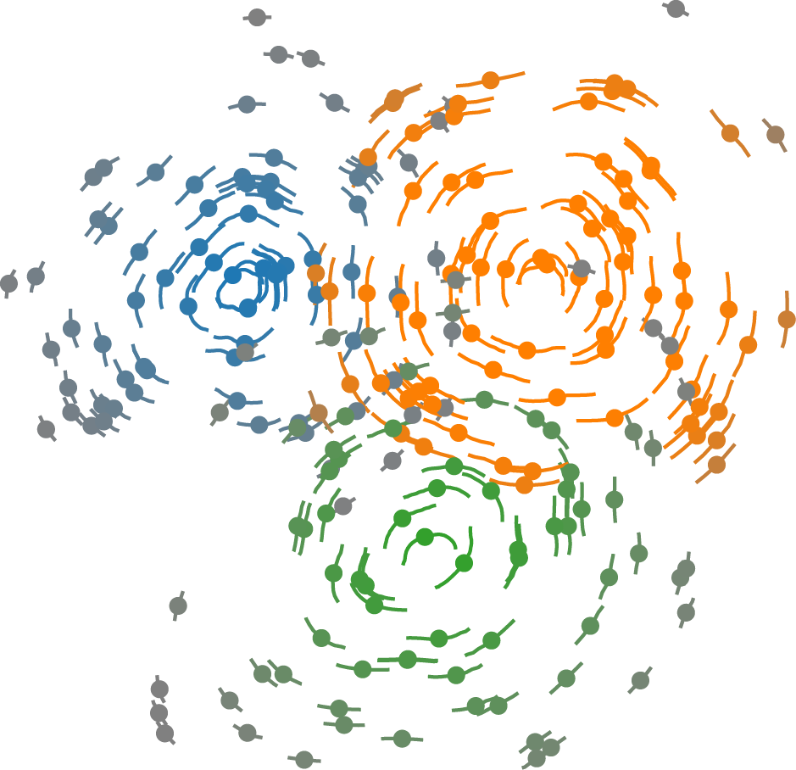
Cluster 1
Cluster 2
Cluster 3
Which cluster the given point belongs to? 1, 2, 3
next

Slide 28
Which point belongs to the cluster with a higher certainty, point1 or point2?

Slide 29
p1
p2
Which point belongs to the cluster with a higher certainty, point1 or point2? 1, 2
next

Slide 30
Which cluster the given point belongs to?

Slide 31
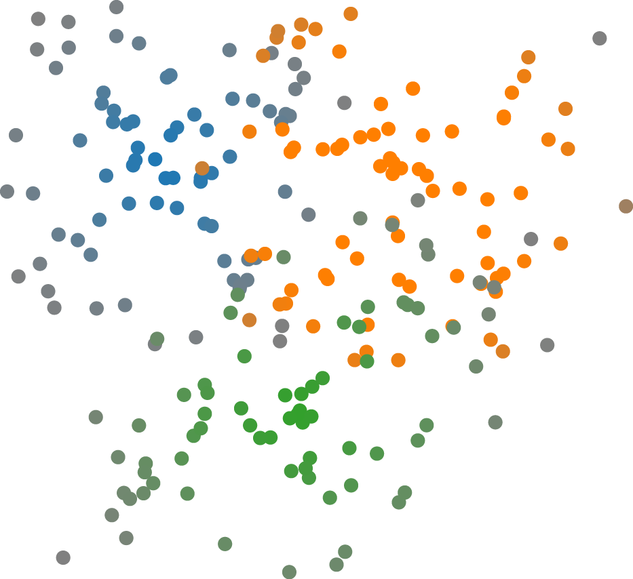
Cluster 3
Cluster 1
Cluster 2
Which cluster the given point belongs to? 1, 2, 3
next

Slide 32
Which point belongs to the cluster with a higher certainty, point1 or point2?

Slide 33
P2
P1
Which point belongs to the cluster with a higher certainty, point1 or point2? 1, 2
next

Slide 34
Which cluster the given point belongs to?

Slide 35
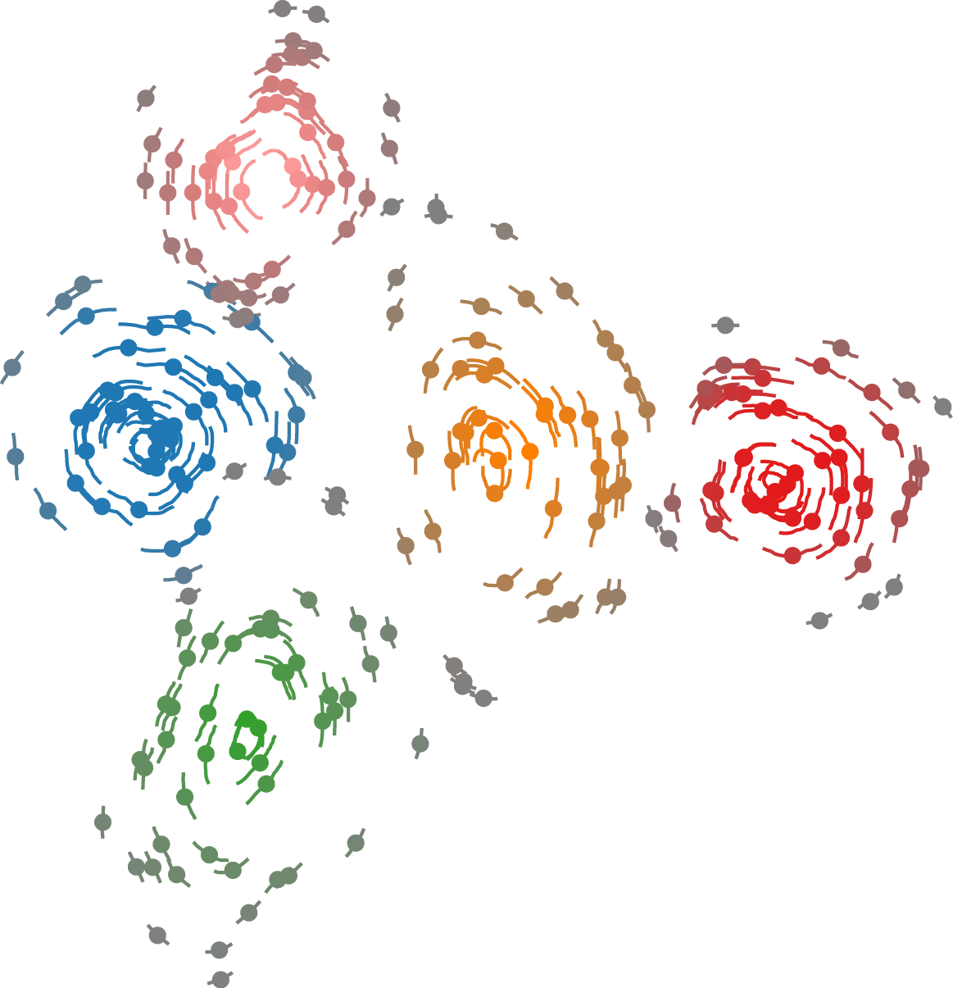
Cluster 5
Cluster 2
Cluster 4
Cluster 1
Cluster 3
Which cluster the given point belongs to? 1, 2, 3,,4, 5
next

Slide 36
Which point belongs to the cluster with a higher certainty, point1 or point2?

Slide 37
p2
p1
Which point belongs to the cluster with a higher certainty, point1 or point2? 1, 2
next

Slide 38
Which cluster the given point belongs to?

Slide 39
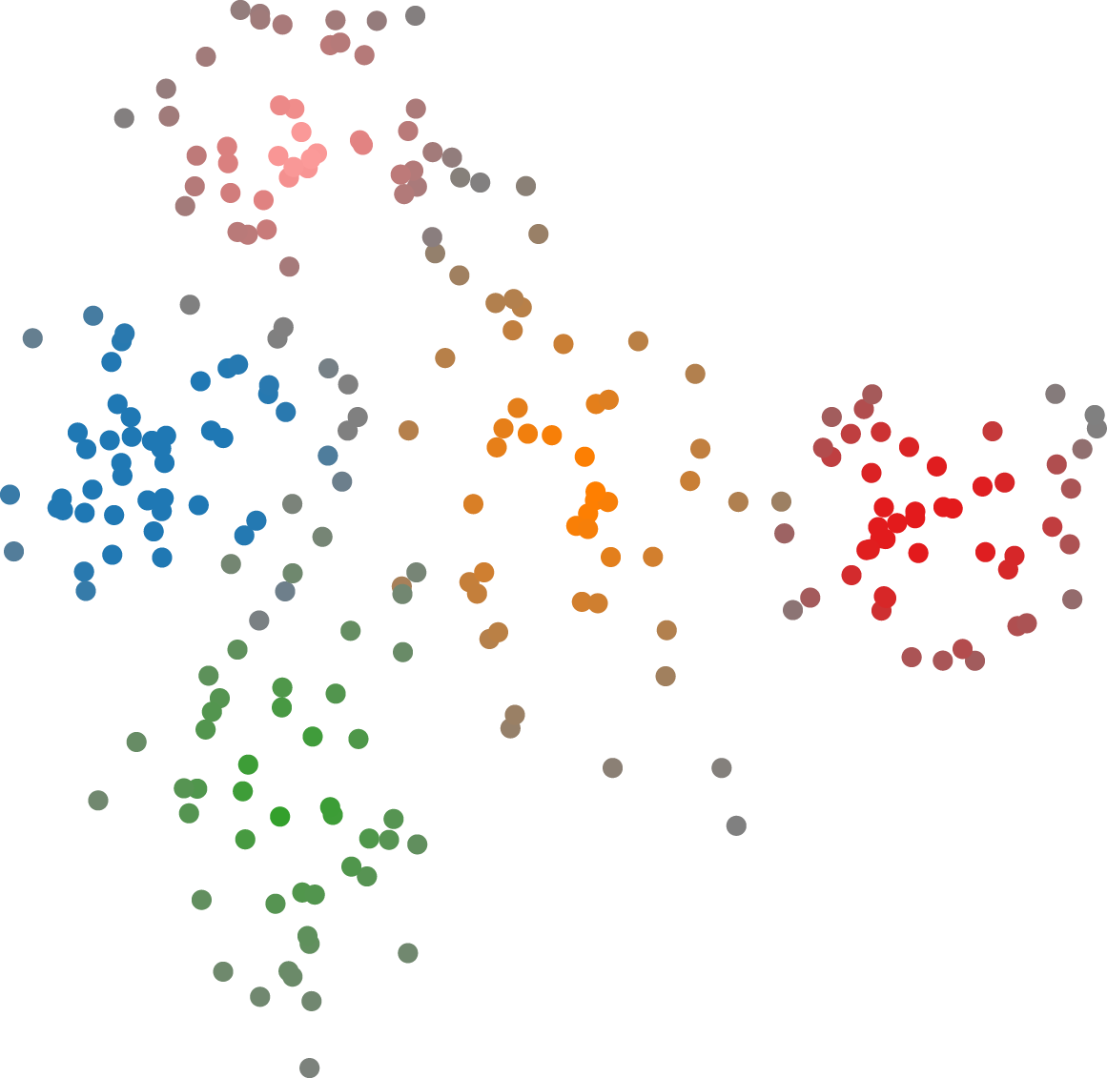
Cluster 1
Cluster 2
Cluster 5
Cluster 3
Cluster 4
Which cluster the given point belongs to? 1, 2, 3, 4, 5
next

Slide 40
Which point belongs to the cluster with a higher certainty, point1 or point2?

Slide 41
P2
P1
Which point belongs to the cluster with a higher certainty, point1 or point2? 1, 2
next

Slide 42
Which cluster the given point belongs to?

Slide 43
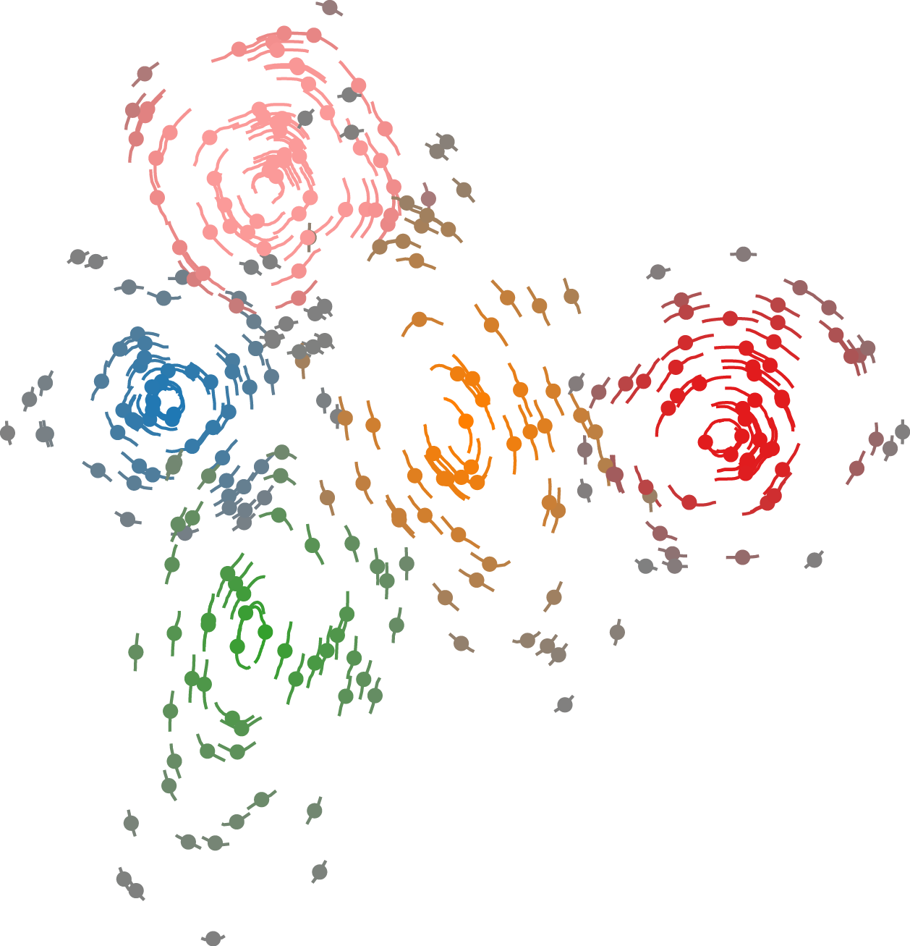
Cluster 1
Cluster 5
Cluster 4
Cluster 2
Cluster 3
Which cluster the given point belongs to? 1, 2, 3, 4, 5
next

Slide 44
Which point belongs to the cluster with a higher certainty, point1 or point2?

Slide 45
p2
p1
Which point belongs to the cluster with a higher certainty, point1 or point2? 1, 2
next

Slide 46
Which cluster the given point belongs to?

Slide 47
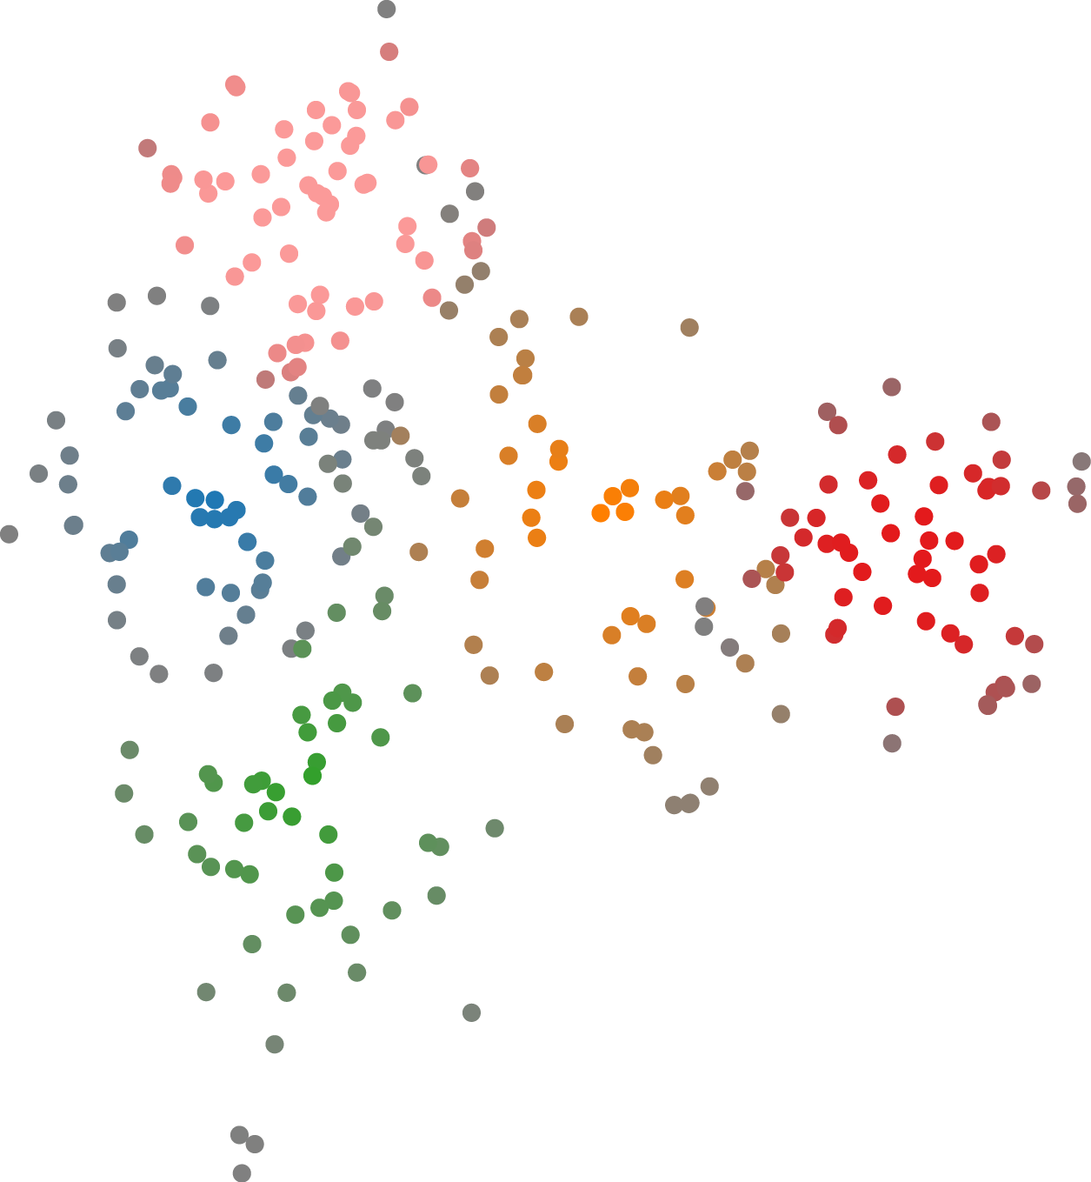
Cluster 1
Cluster 5
Cluster 4
Cluster 2
Cluster 3
Which cluster the given point belongs to? 1, 2, 3, 4, 5
next

Slide 48
Which point belongs to the cluster with a higher certainty, point1 or point2?

Slide 49
P2
P1
Which point belongs to the cluster with a higher certainty, point1 or point2? 1, 2
next

Slide 50
Which cluster the given point belongs to?

Slide 51
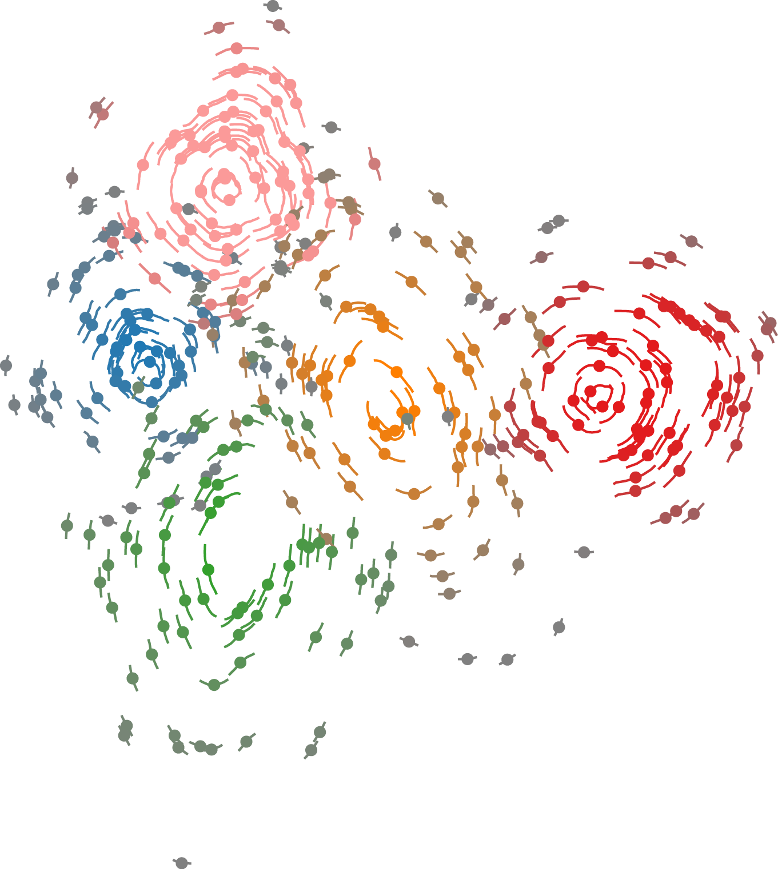
Cluster 1
Cluster 5
Cluster 2
Cluster 4
Cluster 3
Which cluster the given point belongs to? 1, 2, 3, 4, 5
next

Slide 52
Which point belongs to the cluster with a higher certainty, point1 or point2?

Slide 53
p1
p2
Which point belongs to the cluster with a higher certainty, point1 or point2? 1, 2
next

Slide 54
Which cluster the given point belongs to?

Slide 55
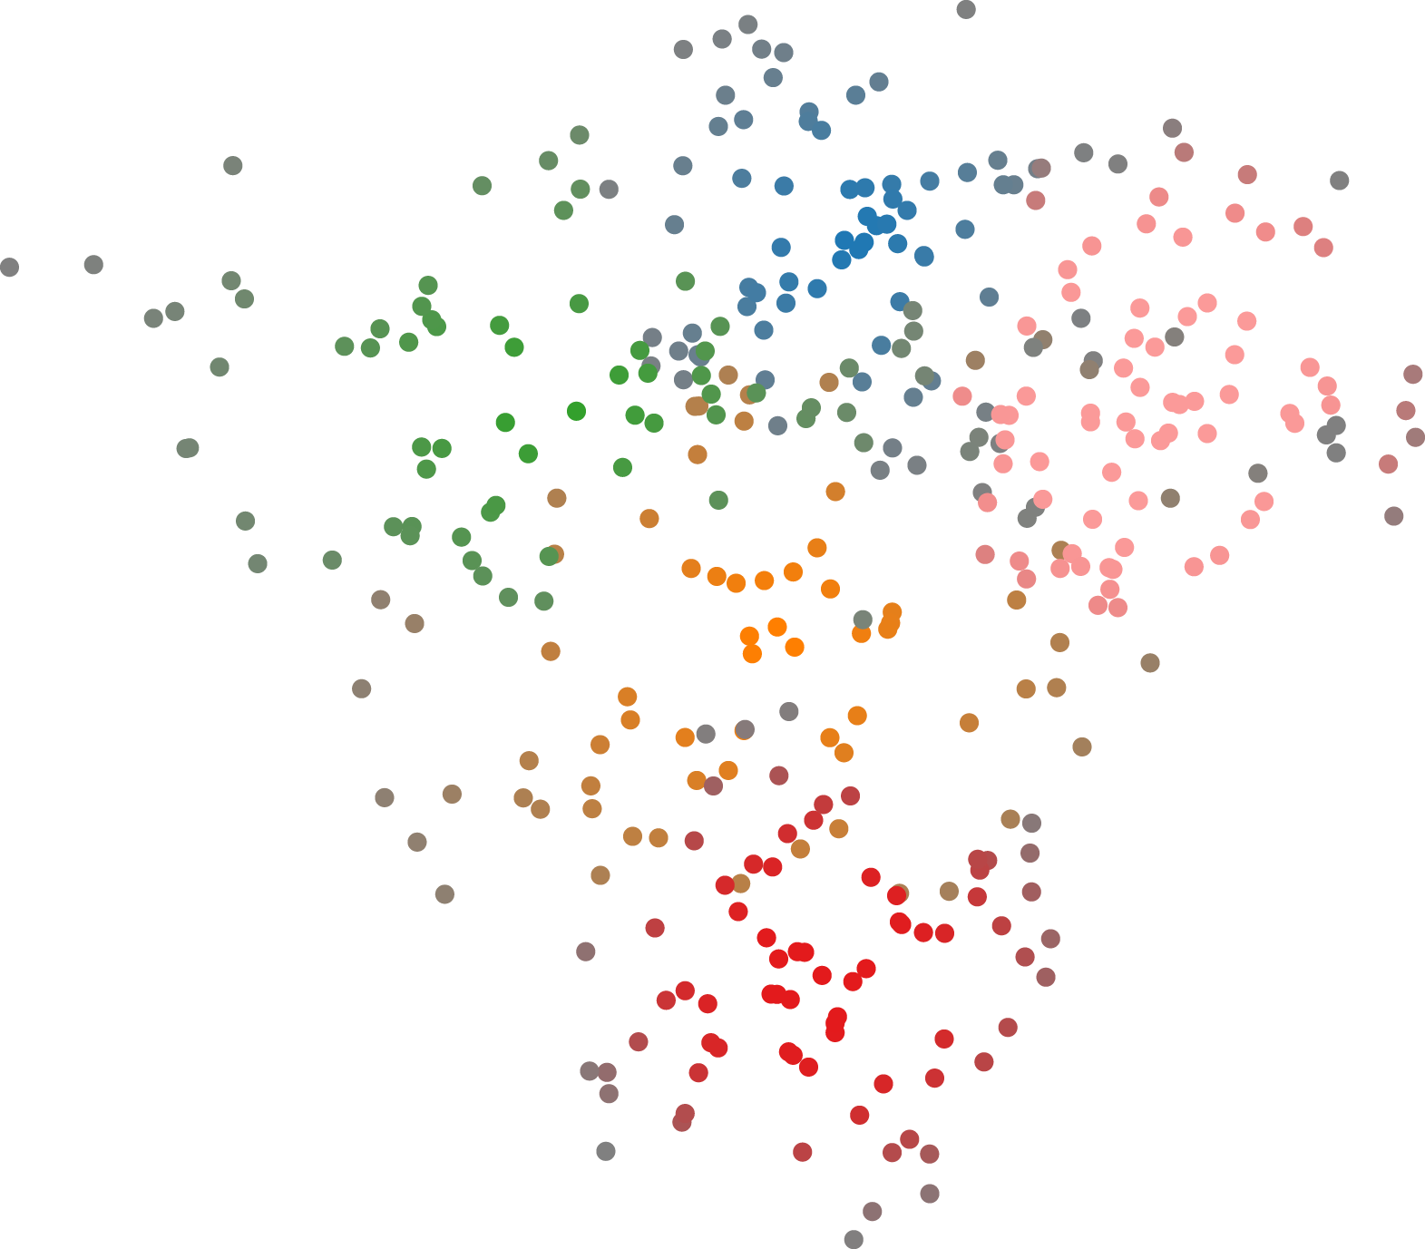
Cluster 5
Cluster 4
Cluster 1
Cluster 3
Cluster 2
Which cluster the given point belongs to? 1, 2, 3, 4, 5
next

Slide 56
Which point belongs to the cluster with a higher certainty, point1 or point2?

Slide 57
P1
P2
Which point belongs to the cluster with a higher certainty, point1 or point2? 1, 2
next

Slide 58
Which cluster the given point belongs to?

Slide 59
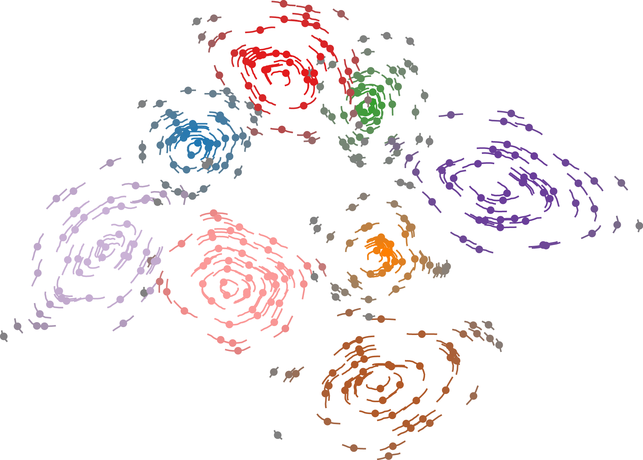
Cluster 1
Cluster 2
Cluster 8
Cluster 3
Cluster 7
Cluster 4
Cluster 6
Cluster 5
Which cluster the given point belongs to? 1, 2, 3, 4, 5
next

Slide 60
Which point belongs to the cluster with a higher certainty, point1 or point2?

Slide 61
p2
p1
Which point belongs to the cluster with a higher certainty, point1 or point2? 1, 2
next

Slide 62
Which cluster the given point belongs to?

Slide 63
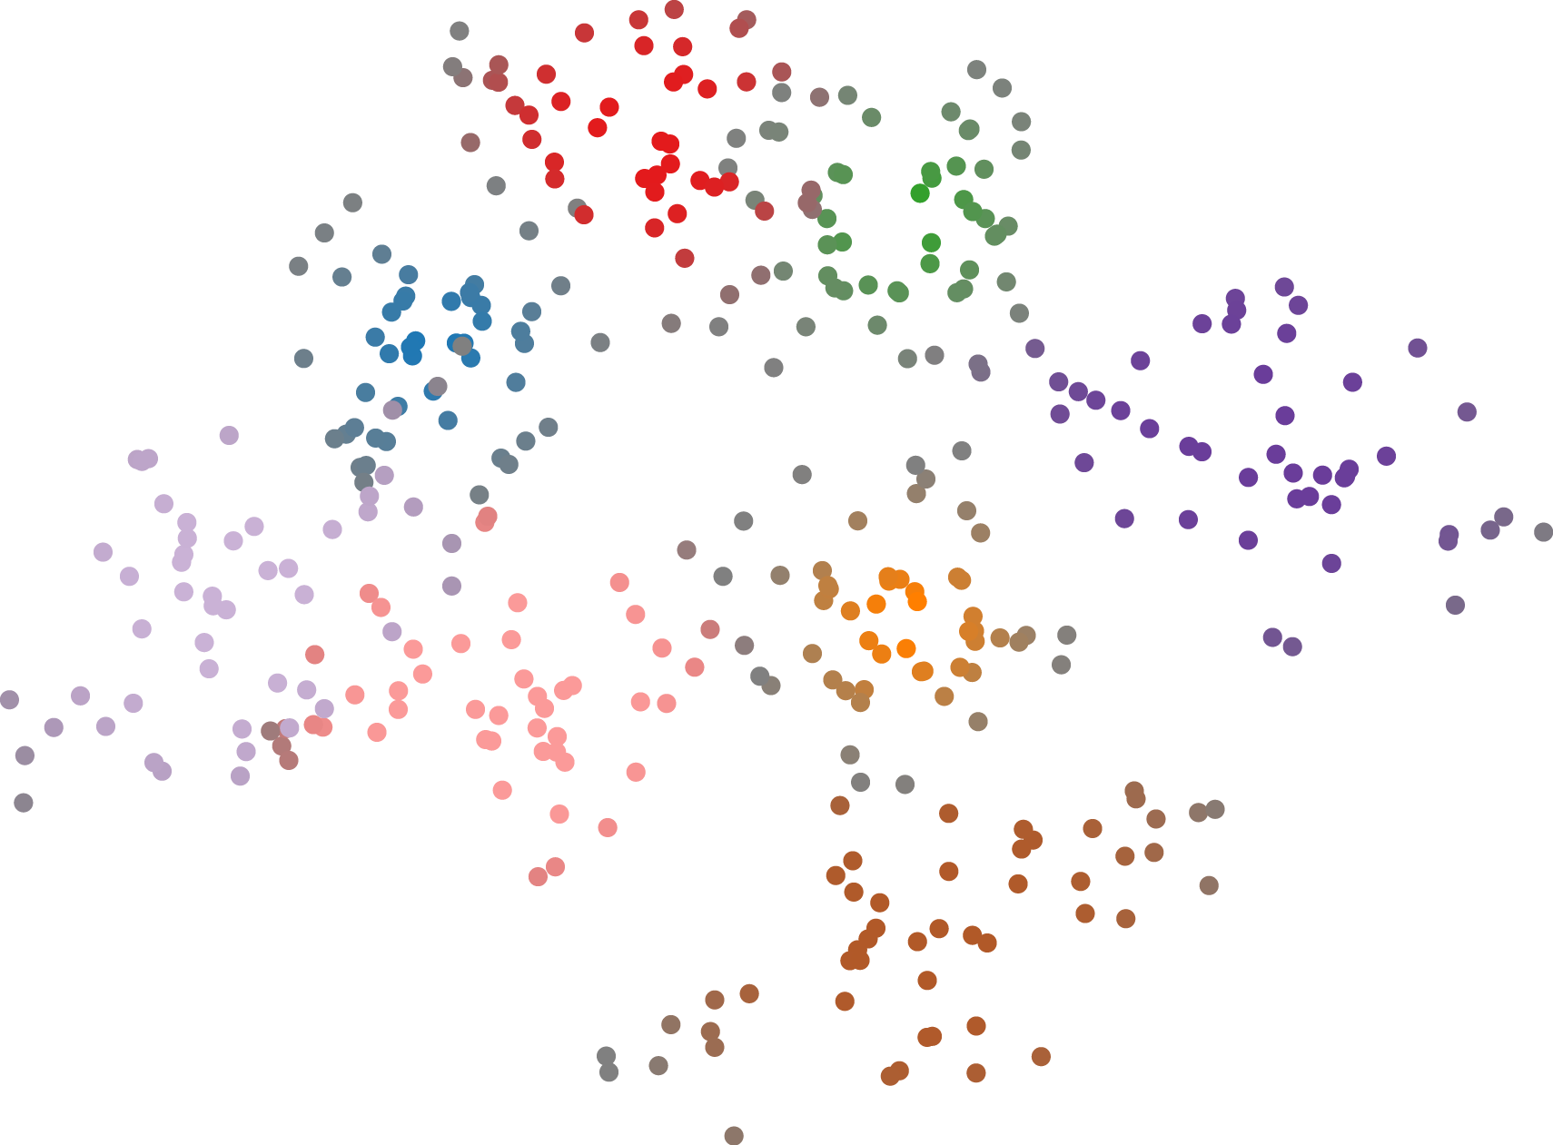
Cluster 2
Cluster 1
Cluster 8
Cluster 3
Cluster 4
Cluster 7
Cluster 5
Cluster 6
Which cluster the given point belongs to? 1, 2, 3, 4, 5
next

Slide 64
Which point belongs to the cluster with a higher certainty, point1 or point2?

Slide 65
P1
P2
Which point belongs to the cluster with a higher certainty, point1 or point2? 1, 2
next

Slide 66
Which cluster the given point belongs to?

Slide 67
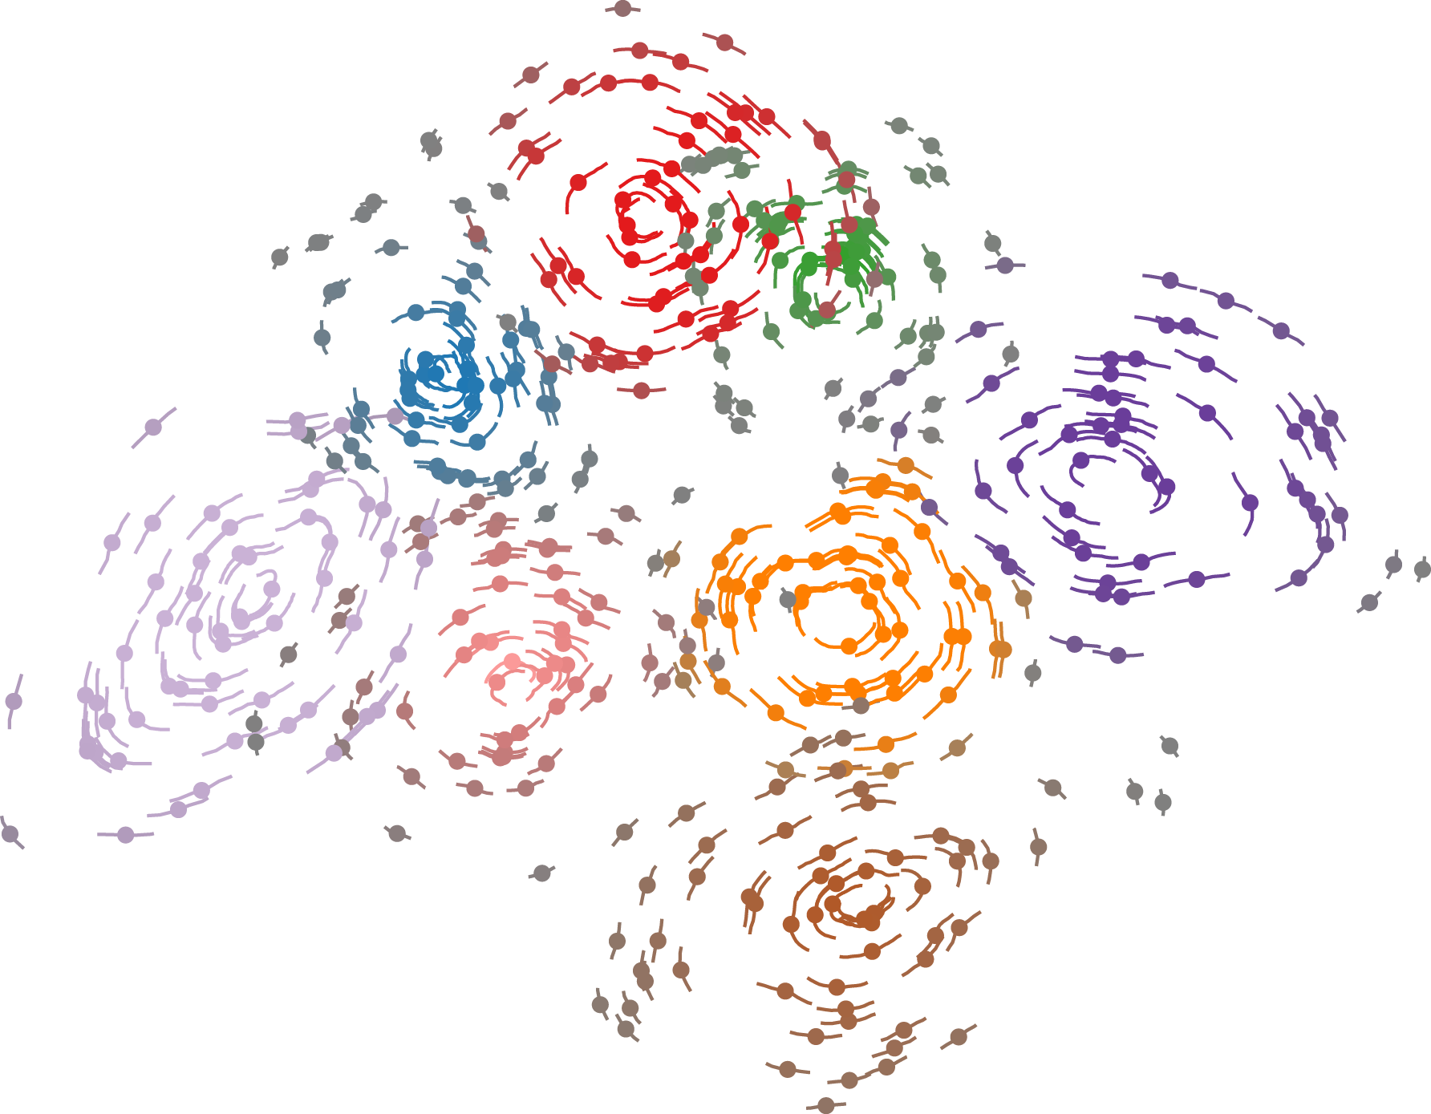
Cluster 6
Cluster 7
Cluster 8
Cluster 5
Cluster 4
Cluster 1
Cluster 3
Cluster 2
Which cluster the given point belongs to? 1, 2, 3, 4, 5
next

Slide 68
Which point belongs to the cluster with a higher certainty, point1 or point2?

Slide 69
p2
p1
Which point belongs to the cluster with a higher certainty, point1 or point2? 1, 2
next

Slide 70
Which cluster the given point belongs to?

Slide 71
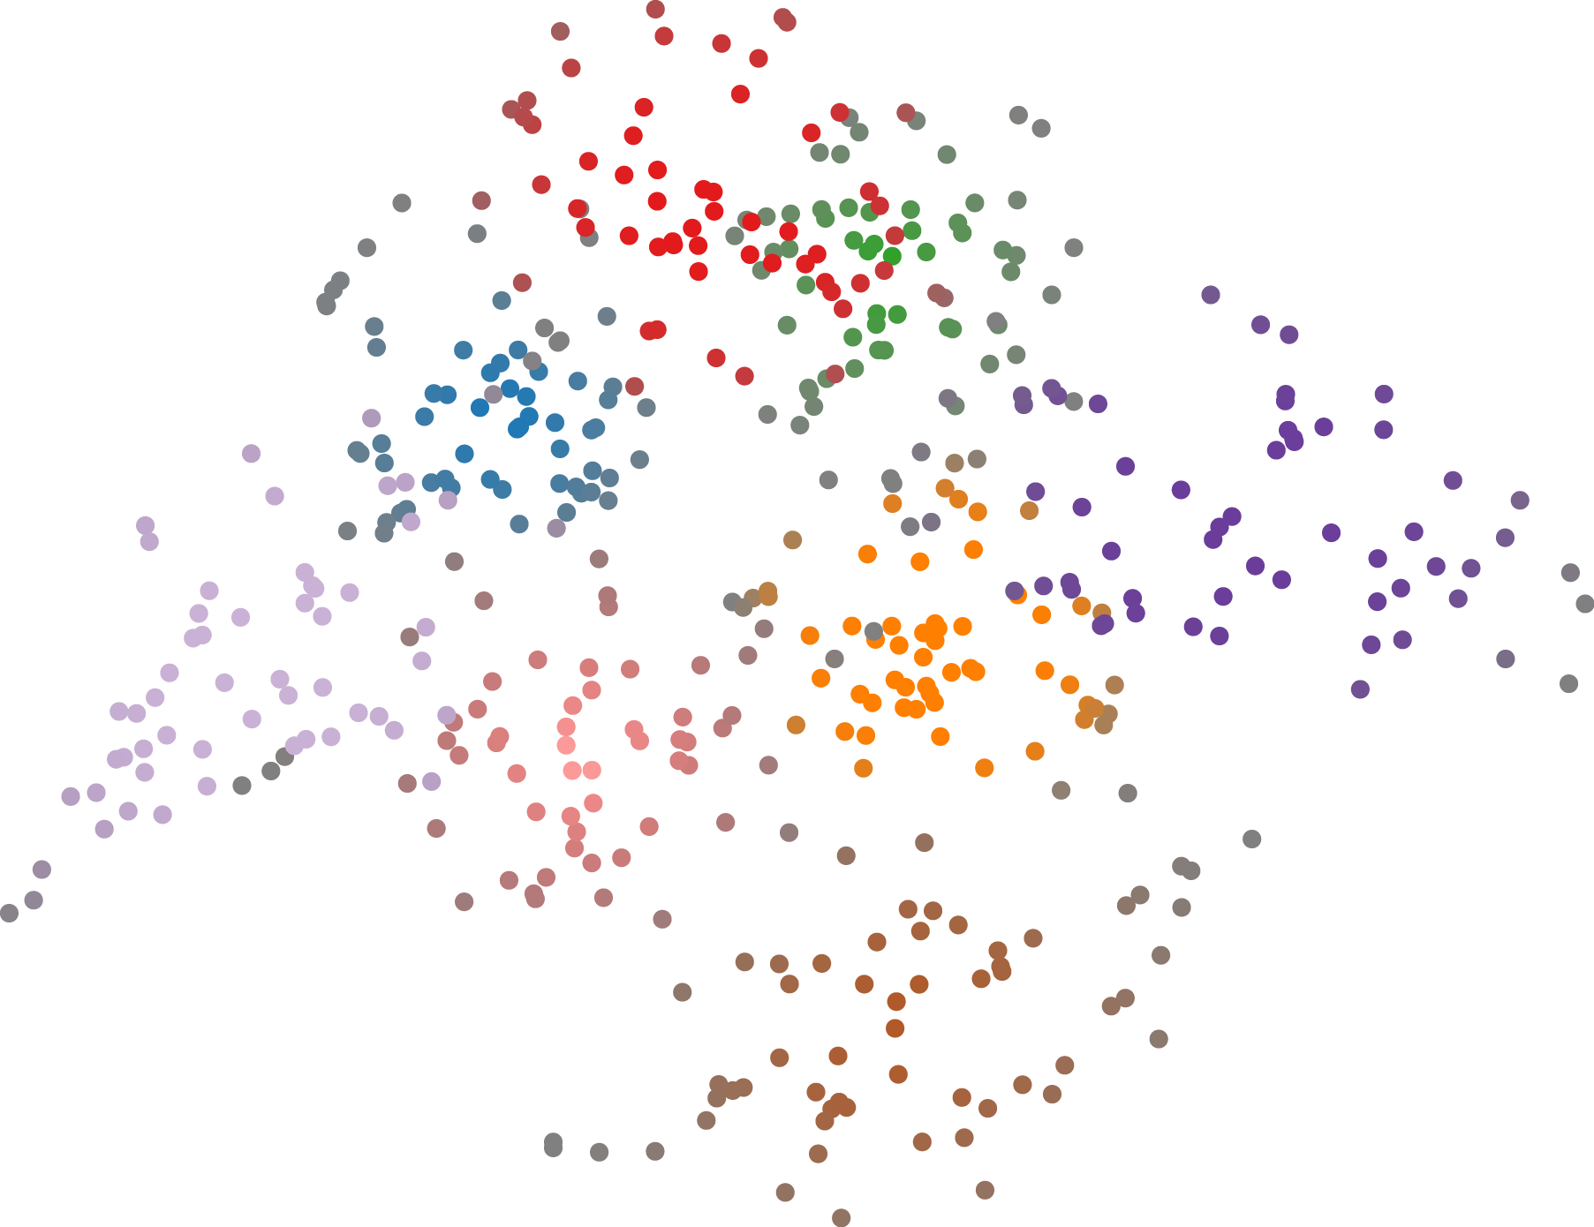
Cluster 5
Cluster 4
Cluster 3
Cluster 6
Cluster 1
Cluster 7
Cluster 2
Cluster 8
Which cluster the given point belongs to? 1, 2, 3, 4, 5
next

Slide 72
Which point belongs to the cluster with a higher certainty, point1 or point2?

Slide 73
P1
P2
Which point belongs to the cluster with a higher certainty, point1 or point2? 1, 2
next

Slide 74
Which cluster the given point belongs to?

Slide 75
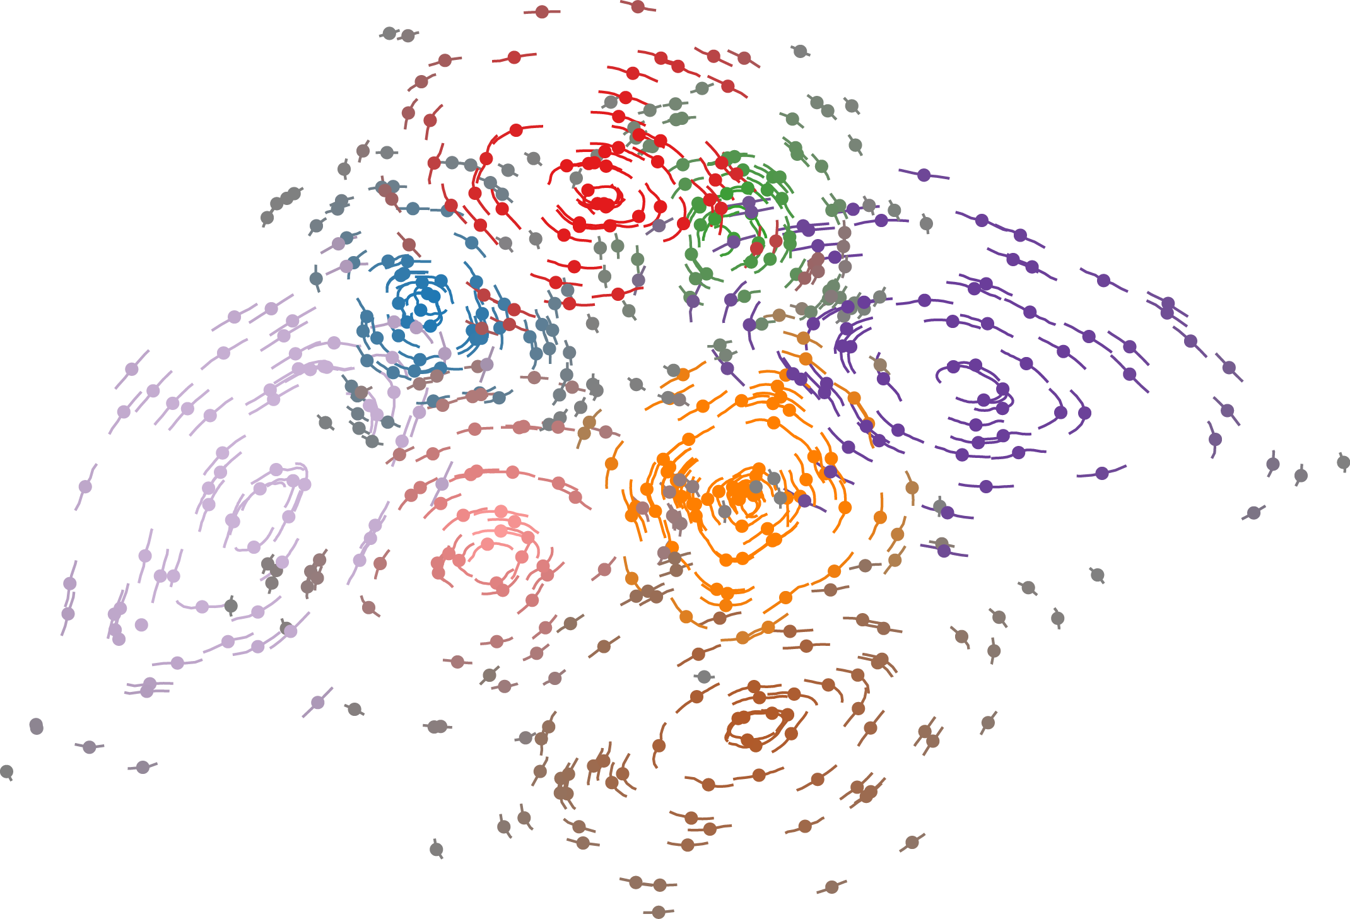
Cluster 2
Cluster 3
Cluster 4
Cluster 1
Cluster 5
Cluster 8
Cluster 7
Cluster 6
Which cluster the given point belongs to? 1, 2, 3, 4, 5
next

Slide 76
Which point belongs to the cluster with a higher certainty, point1 or point2?

Slide 77
p1
p2
Which point belongs to the cluster with a higher certainty, point1 or point2? 1, 2
next

Slide 78
Which cluster the given point belongs to?

Slide 79
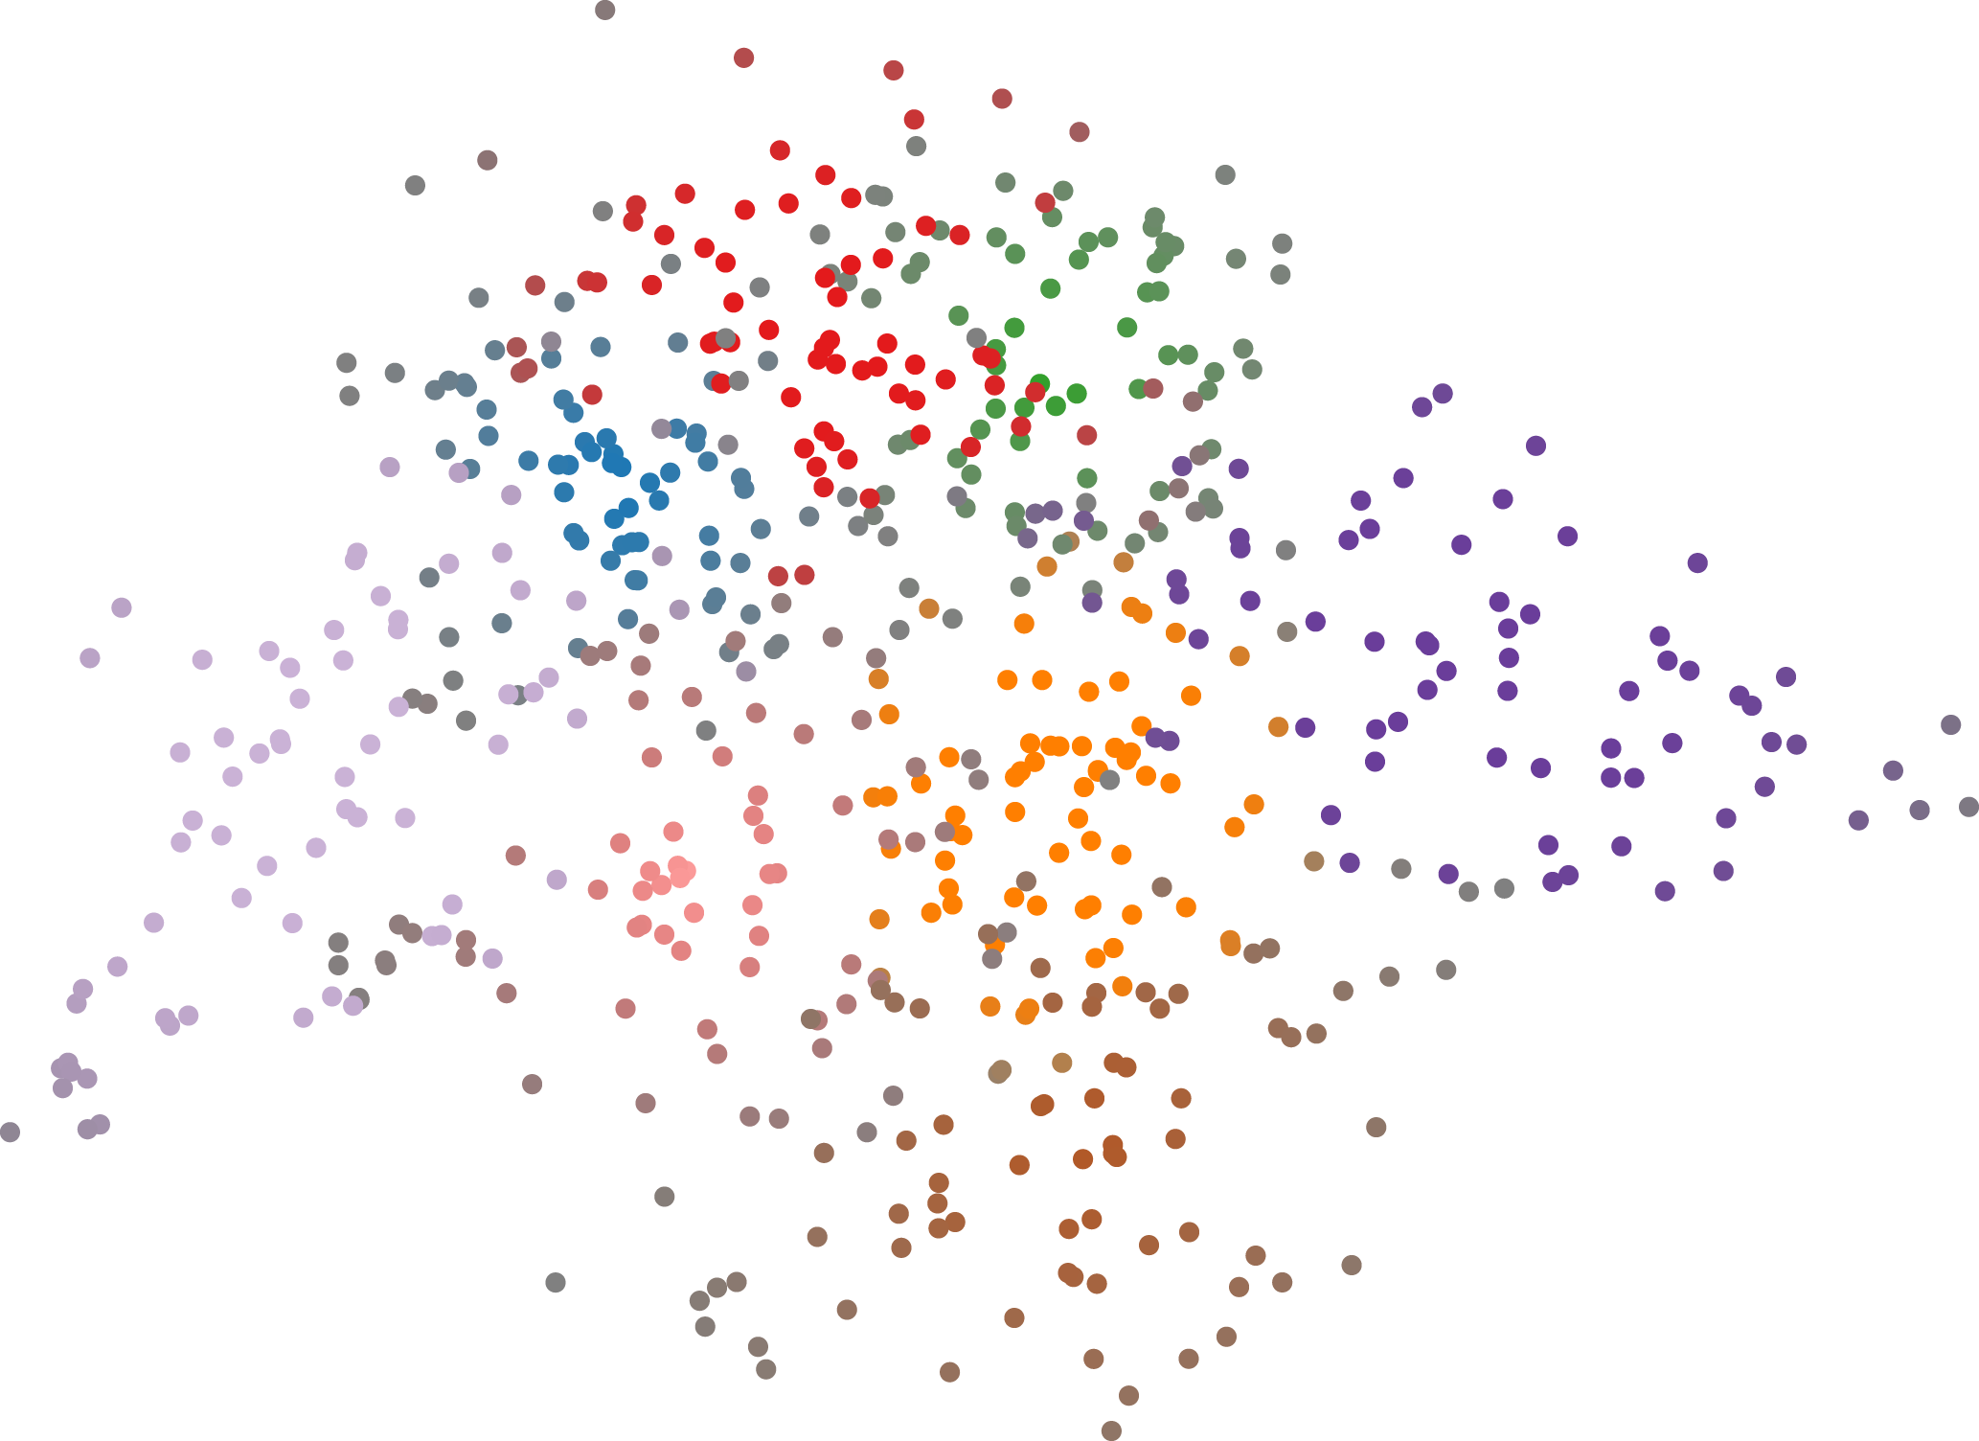
Cluster 4
Cluster 5
Cluster 3
Cluster 6
Cluster 2
Cluster 7
Cluster 1
Cluster 8
Which cluster the given point belongs to? 1, 2, 3, 4, 5
next

Slide 80
Which point belongs to the cluster with a higher certainty, point1 or point2?

Slide 81
P1
P2
Which point belongs to the cluster with a higher certainty, point1 or point2? 1, 2
next

