Slide 2
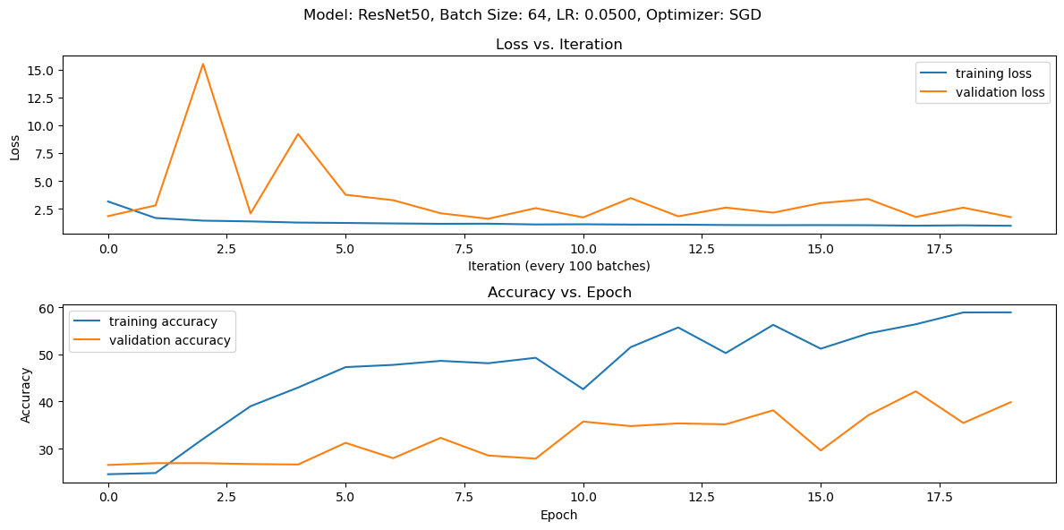
ResNet 50, Batch 128, LR 0.05, Mo 0.9, SGD 20 Epoch

Slide 3
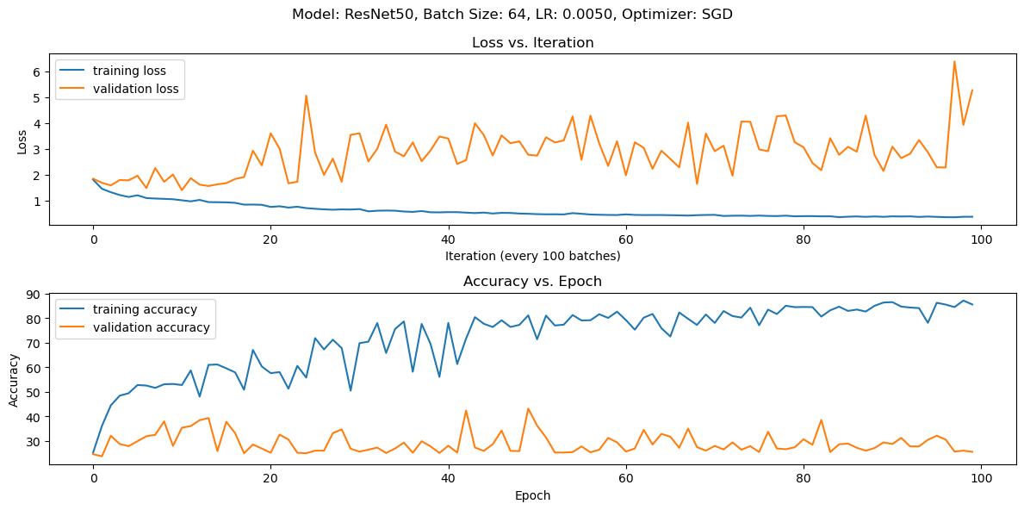
ResNet 50, Batch 64, LR 0.005, Mo 0.9, SGD, 100 Epoch

Slide 4
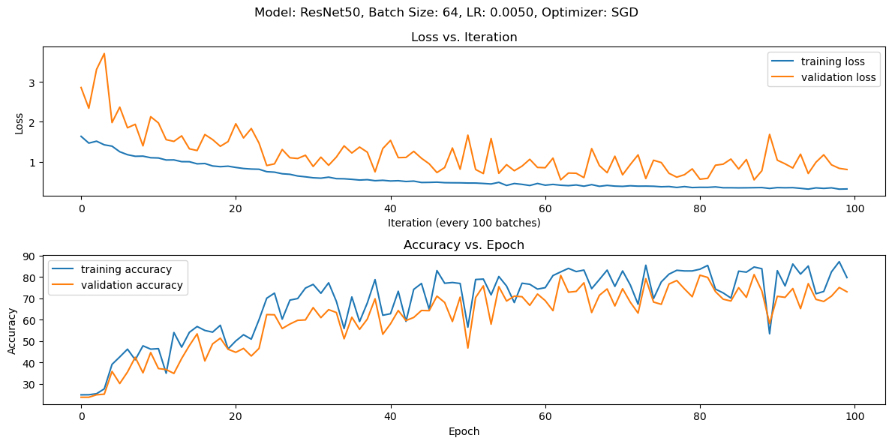
No Vertical Flip or Random Rotation, Mo 0.5

Slide 5
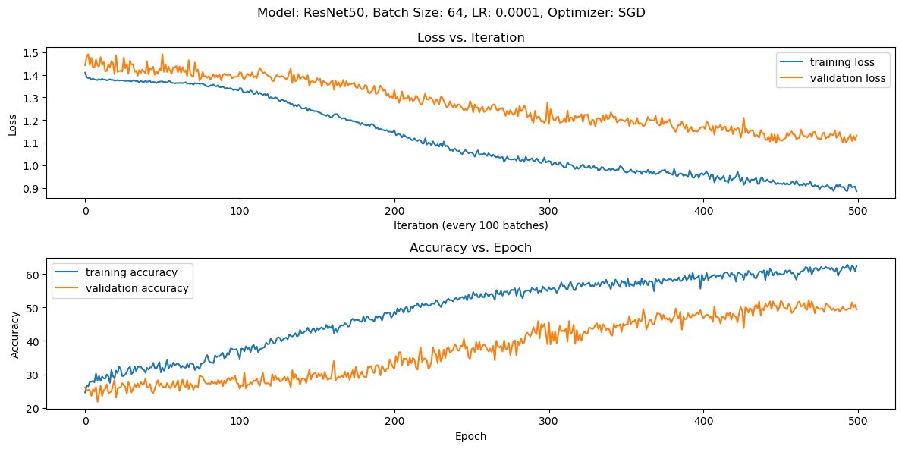
No Vertical Flip or Rand Rotation, Mo 0.5

Slide 6
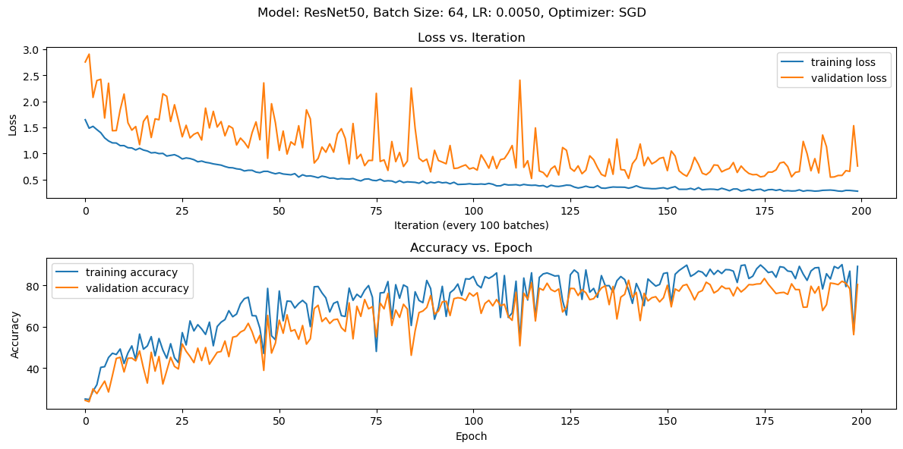
No Horizontal Flip or Rand Rotation, Mo 0.5

