Slide 2
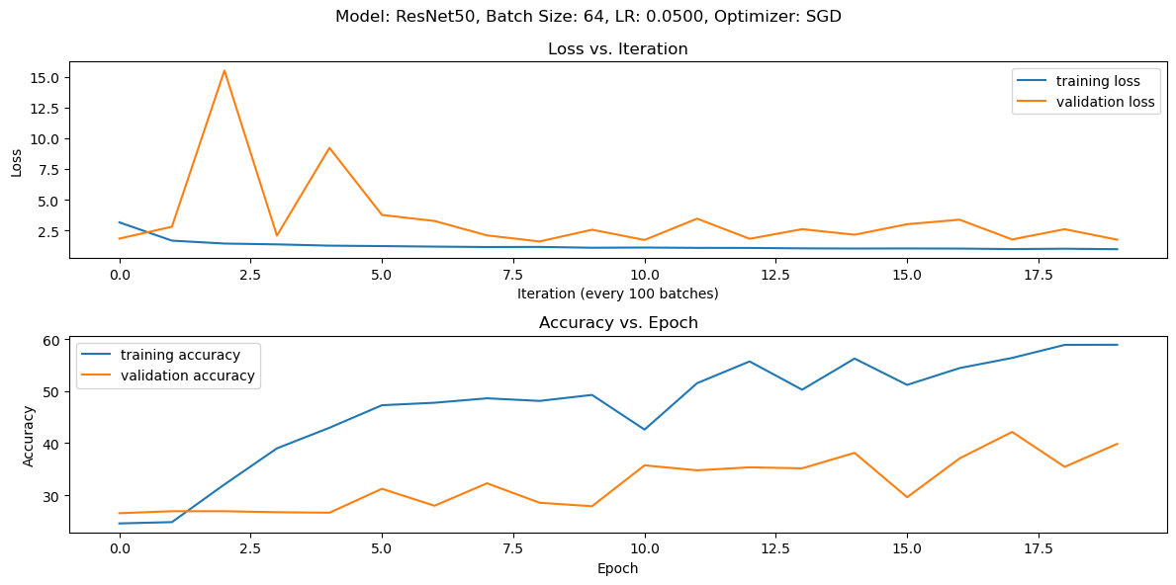
ResNet 50, Batch 128, LR 0.05, Mo 0.9, SGD 20 Epoch

Slide 3
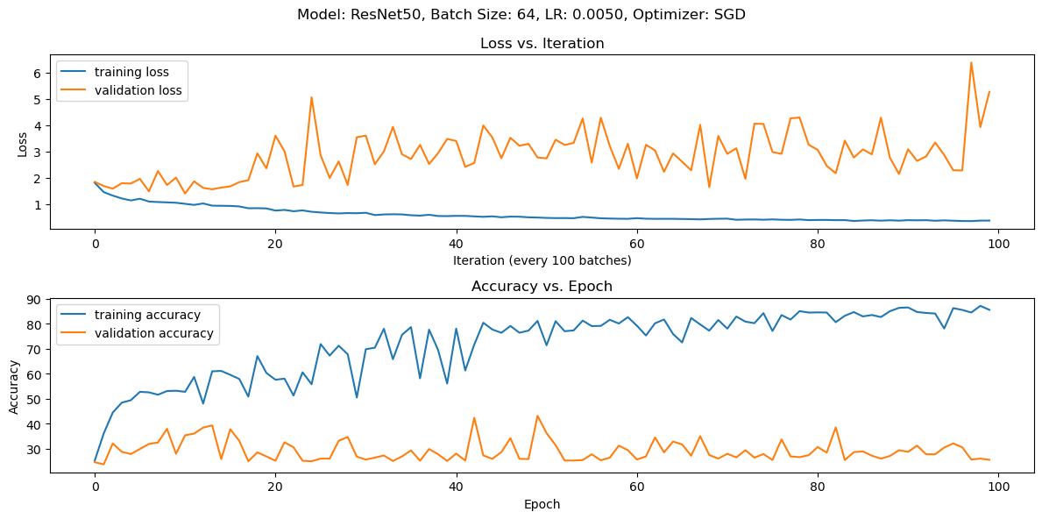
ResNet 50, Batch 64, LR 0.005, Mo 0.9, SGD, 100 Epoch

Slide 4
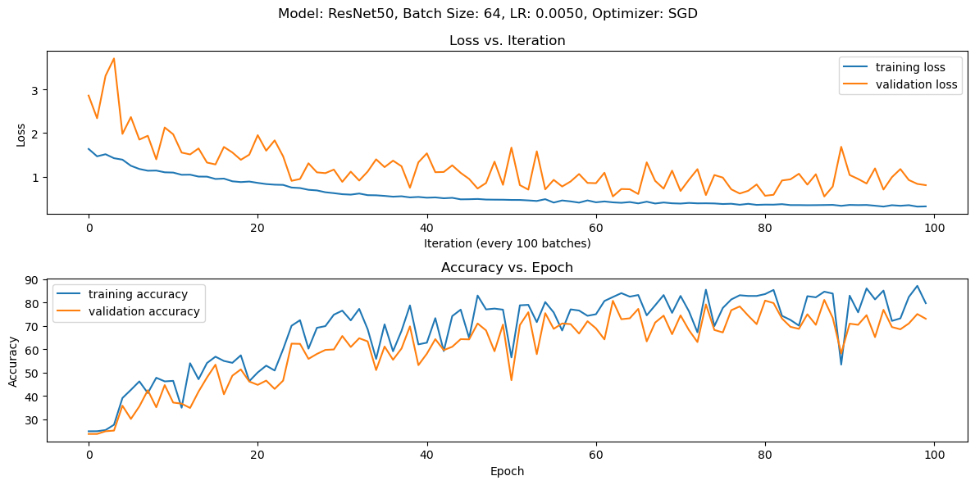
No Vertical Flip or Random Rotation, Mo 0.5

Slide 5
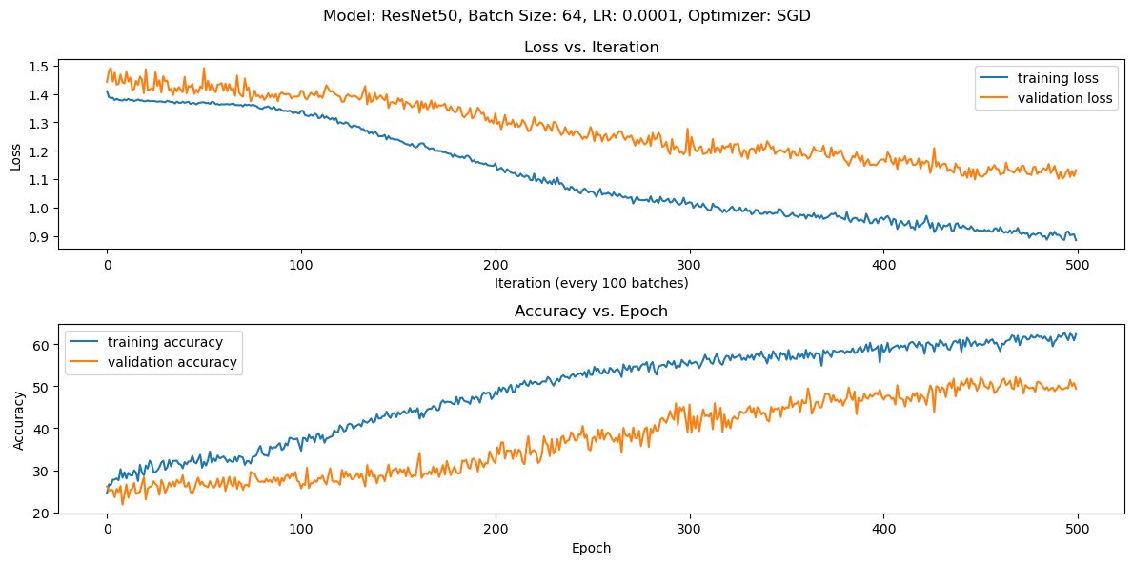
No Vertical Flip or Rand Rotation, Mo 0.5

Slide 6
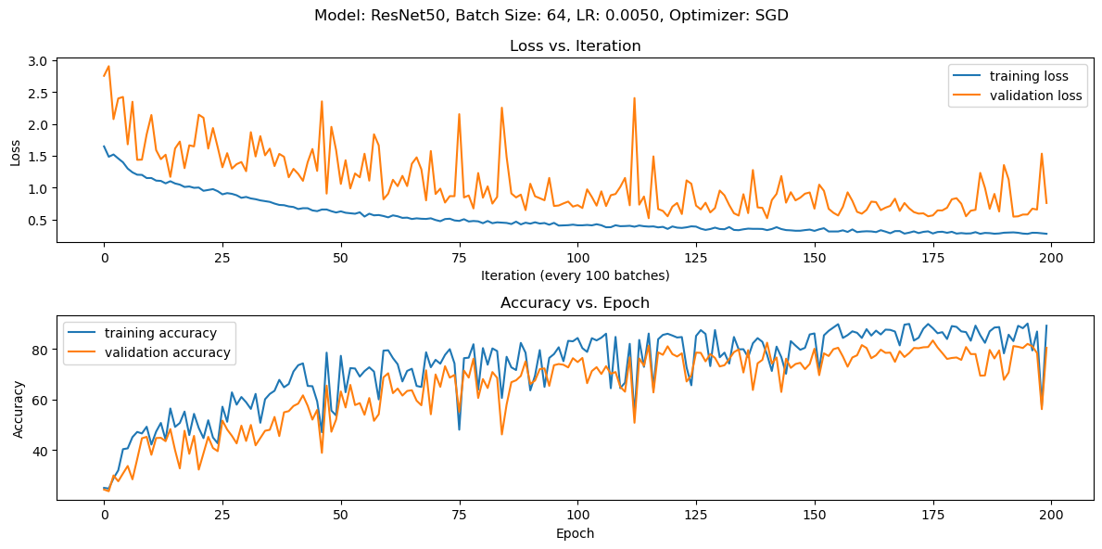
No Horizontal Flip or Rand Rotation, Mo 0.5

Slide 7
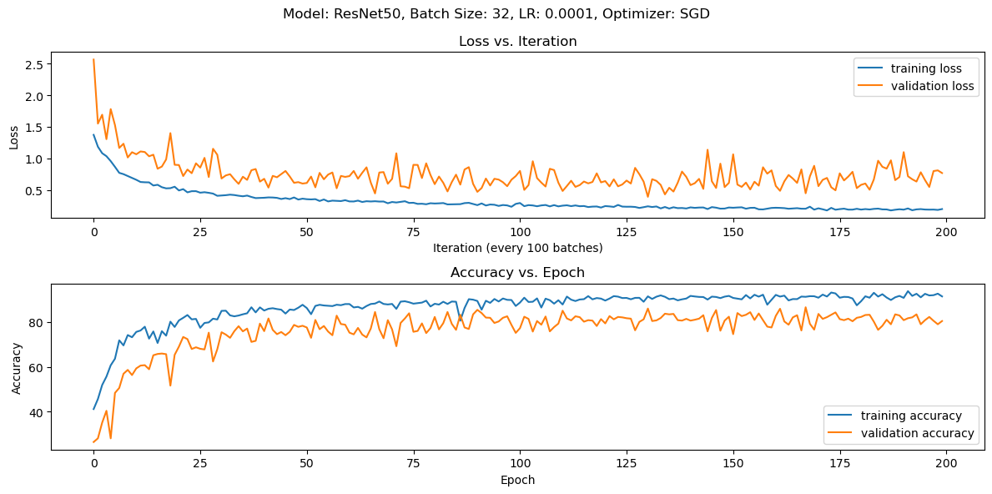
No Horizontal Flip or Rand Rot, Adam

Slide 8
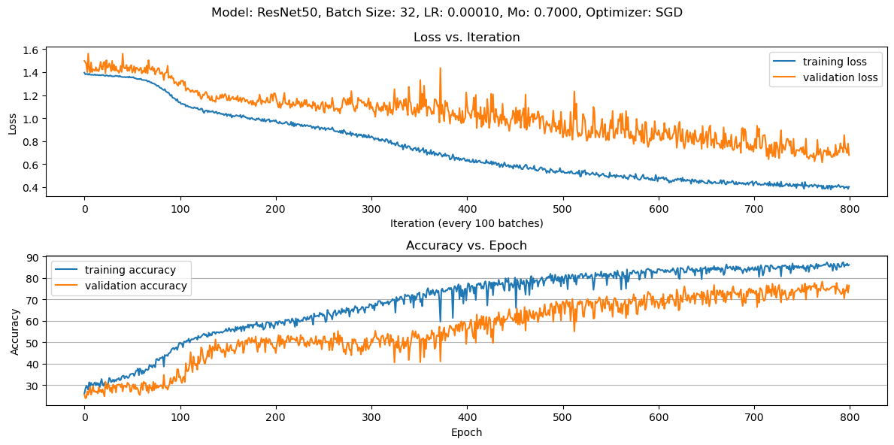
No Horiz Flip or Rand Rot

Slide 9
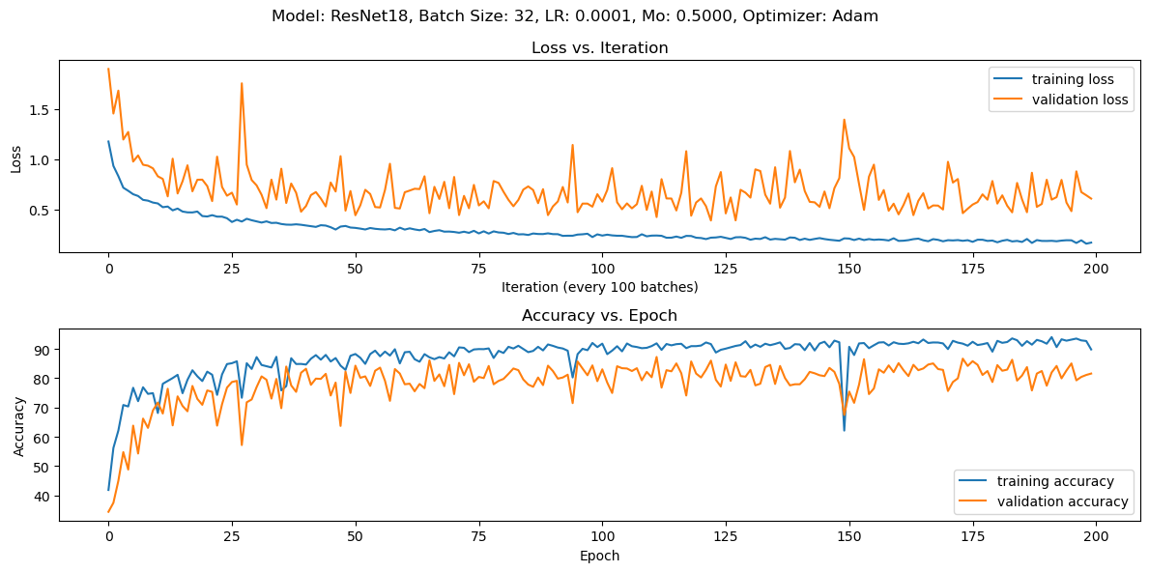
No Horizontal Flip or Rand Rot, Adam

Slide 10
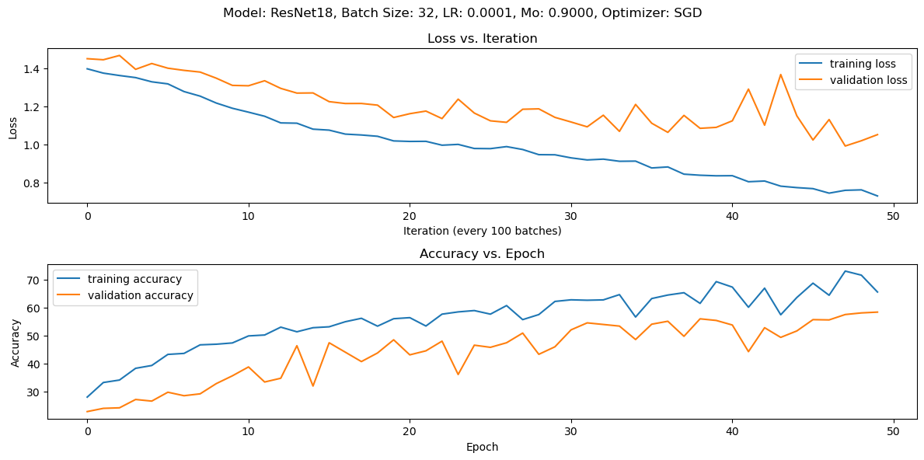
No Horizontal Flip, or Rand Rot, SGD

Slide 11
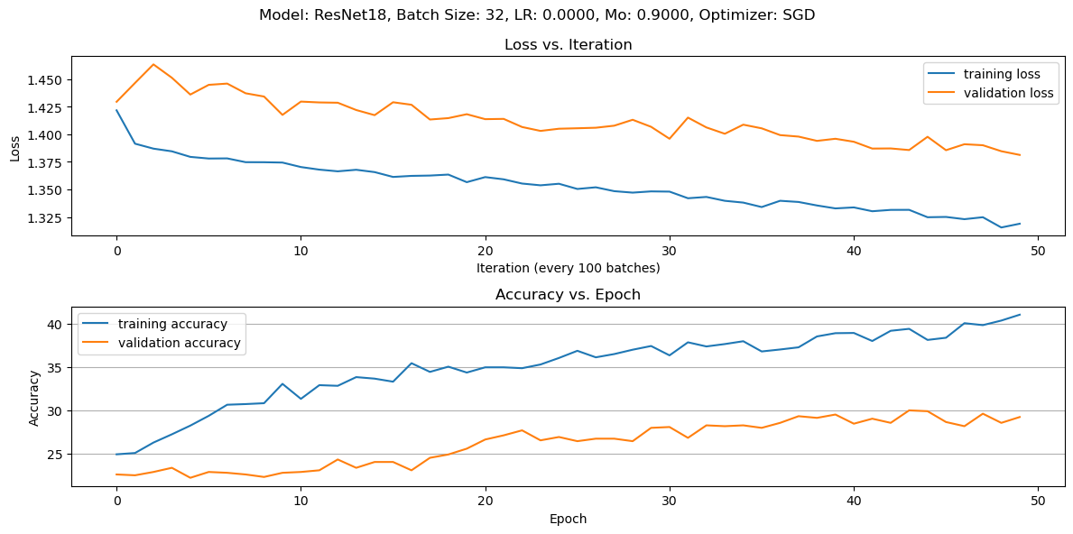
No Horizontal Flip, or Rand Rot, LR 0.00001

Slide 12
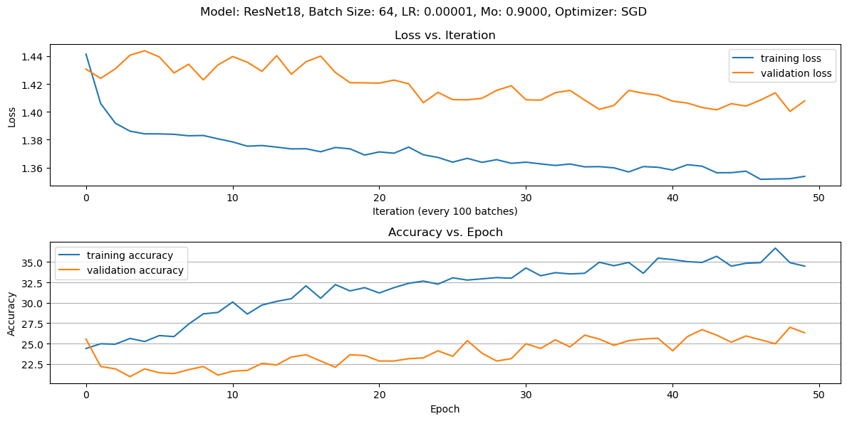
No Horizontal Flip, or Rand Rot

Slide 13
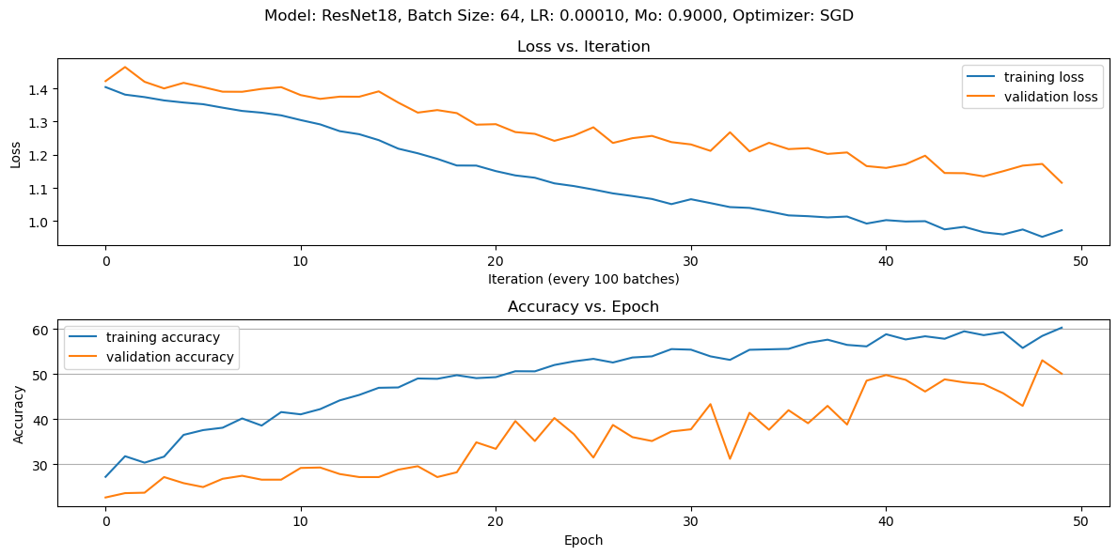
No Horiz Flip, or Rand Rot

Slide 14
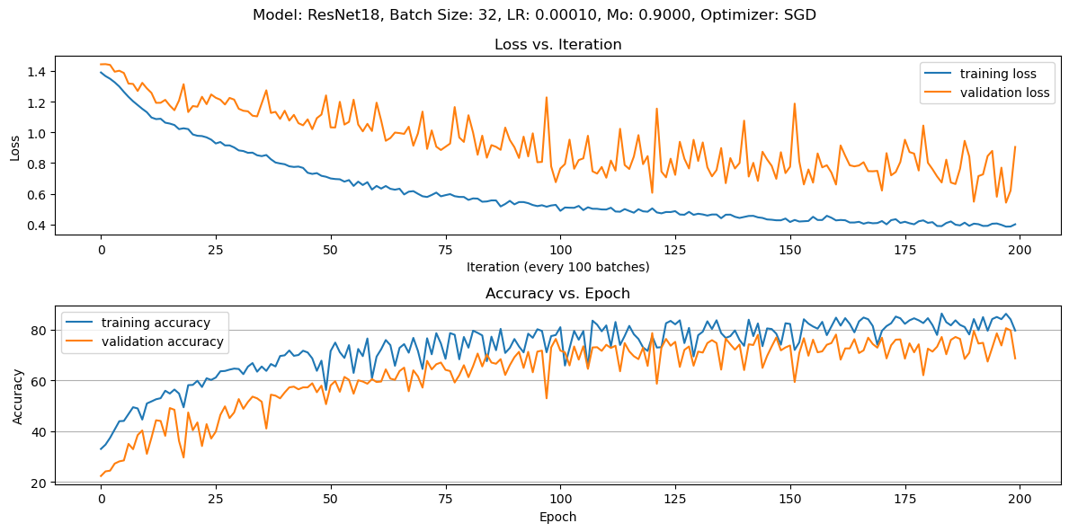
No Horiz Flip, or Rand Rot

Slide 15
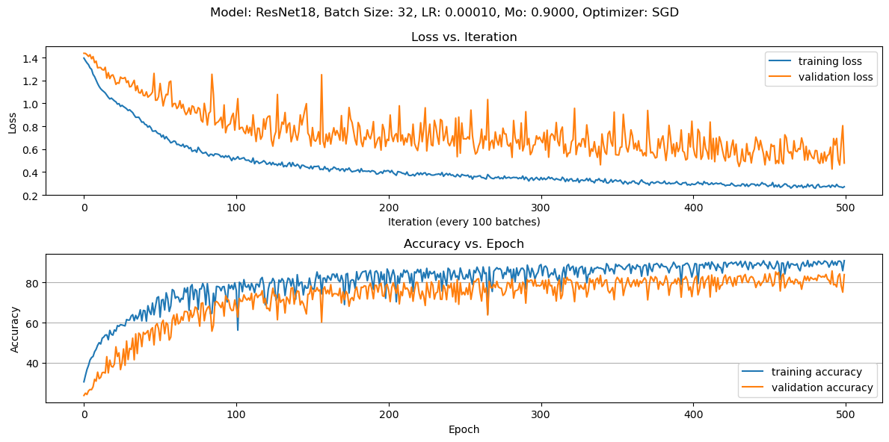
No Horiz Flip, or Rand Rot

Slide 16
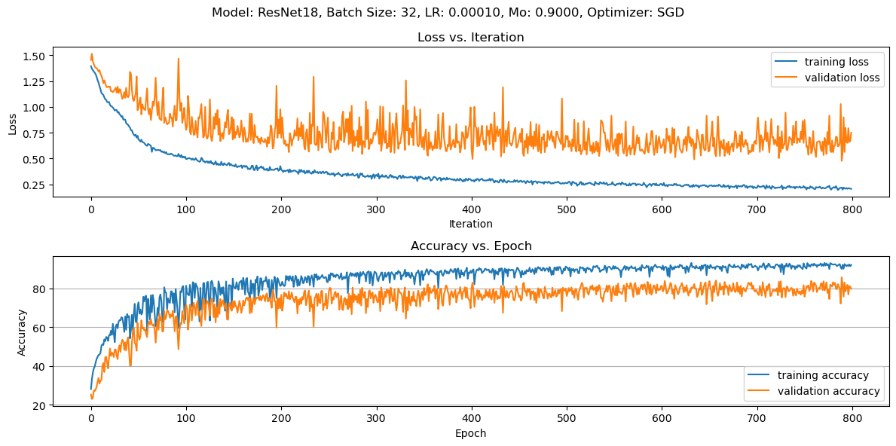
No Horiz Flip or Rand Rot

Slide 17
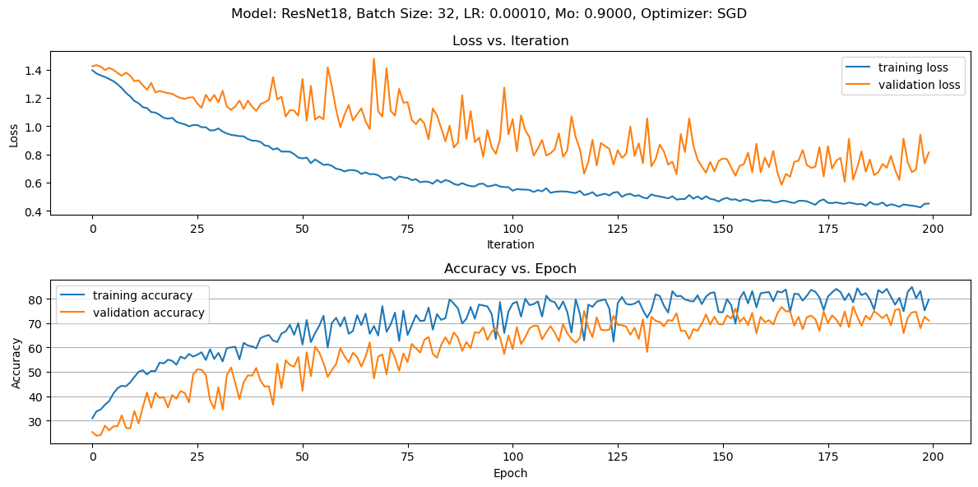
Everything Enabled + ElasticTransform

Slide 18
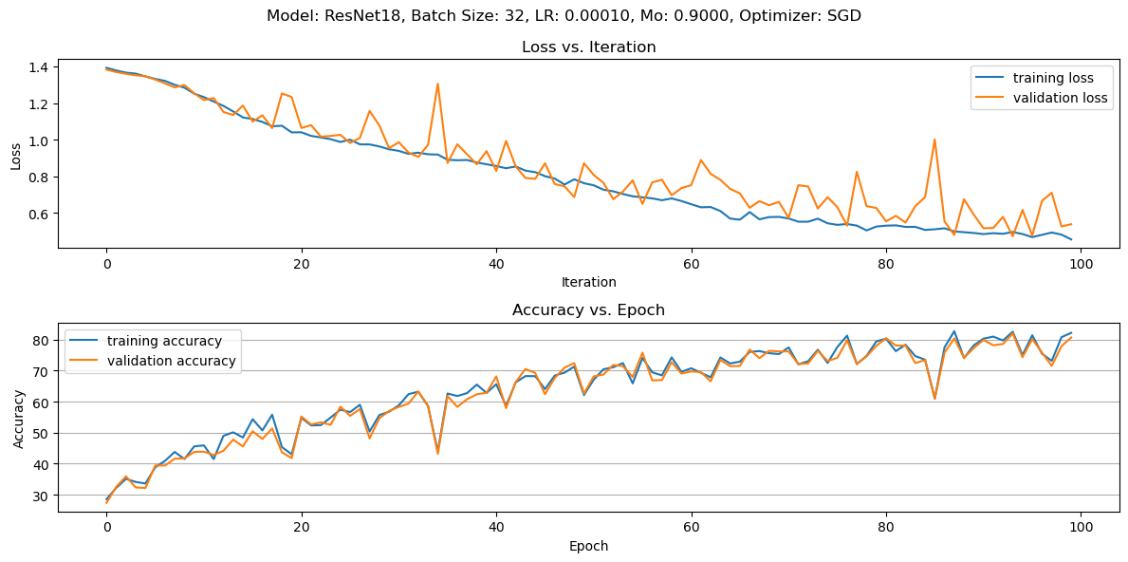
No ElasticTransform

Slide 19
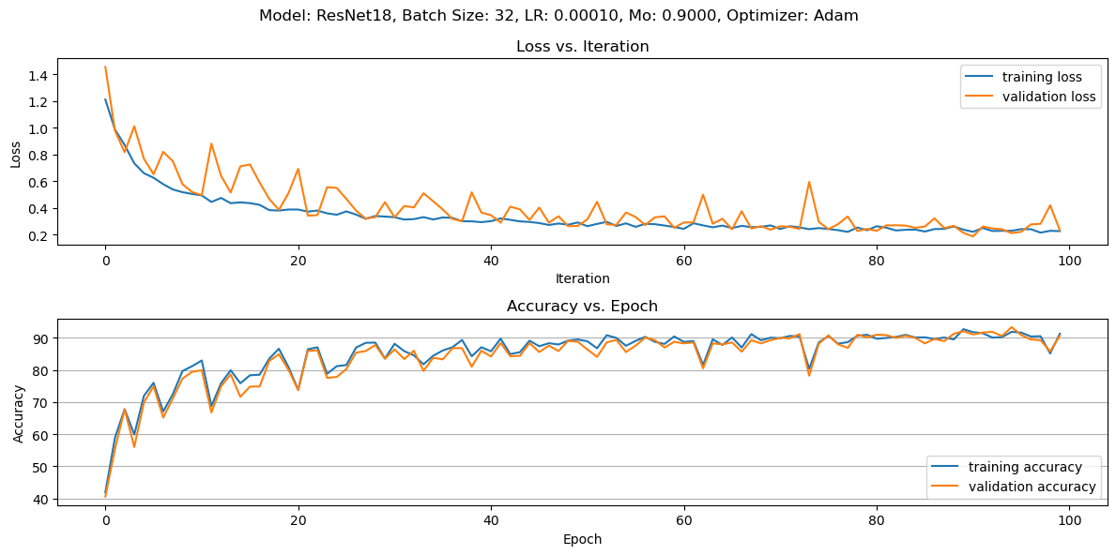
No ElasticTransform, Adam

Slide 20
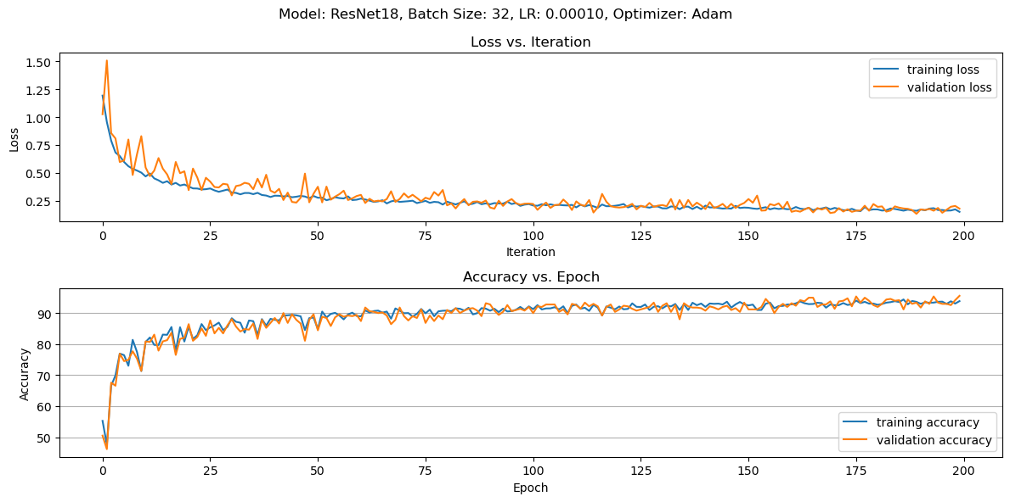
No ElasticTransform, Adam, 10 Fold

Slide 21
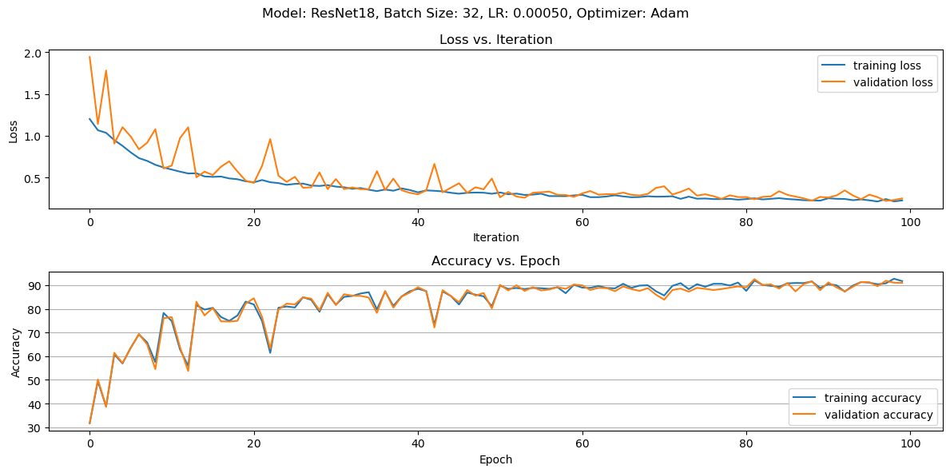
No ElasticTransform, Adam, 5 Fold

Slide 22
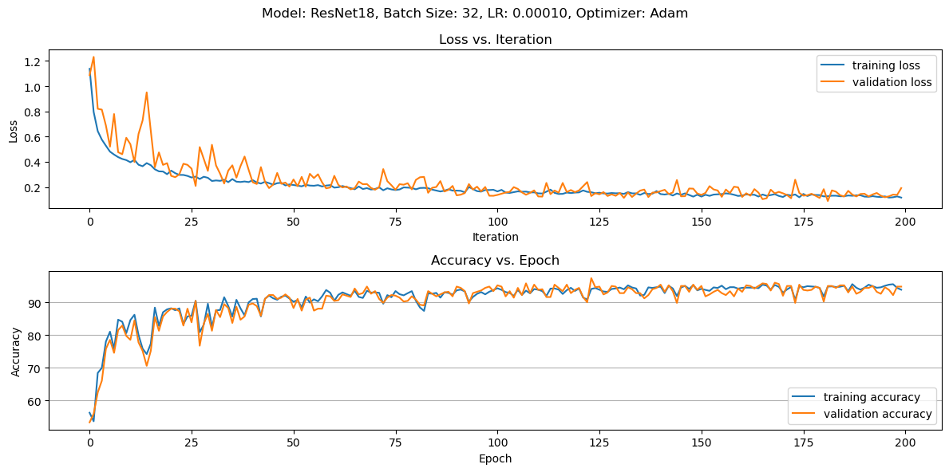
No ElasticTransform, Vertical T, Adam, 10 Fold

Slide 23
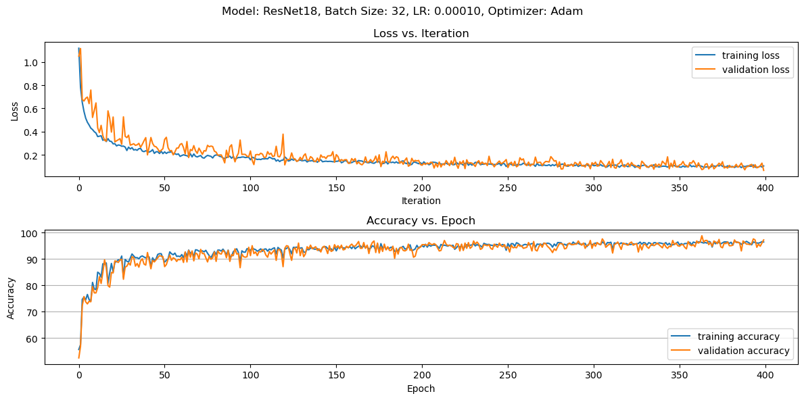
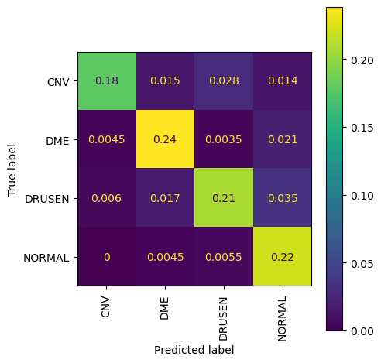
No ElasticTransform, Vertical T, Adam, 10 Fold
84.63% Accuracy

Slide 24
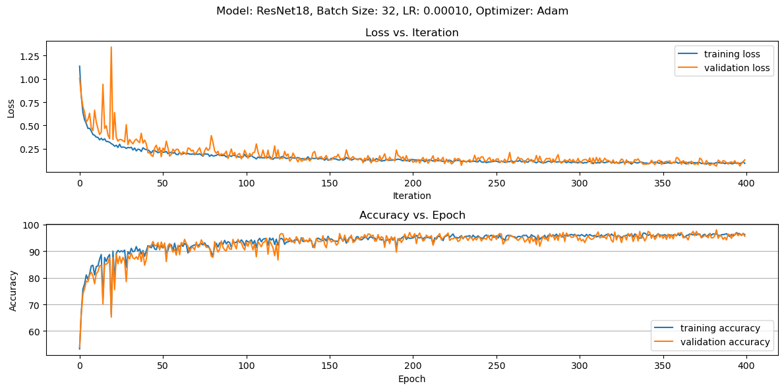
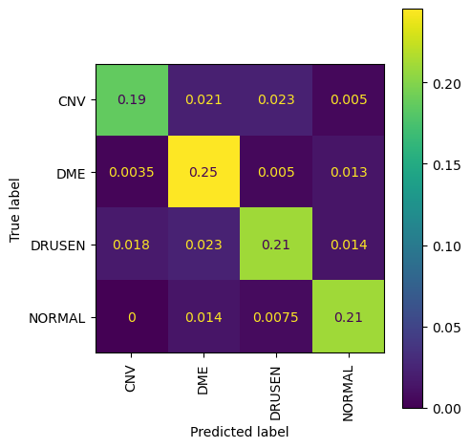
No ElasticTransform, Vertical T, Adam, 10 Fold
85.23% Accuracy

Slide 25
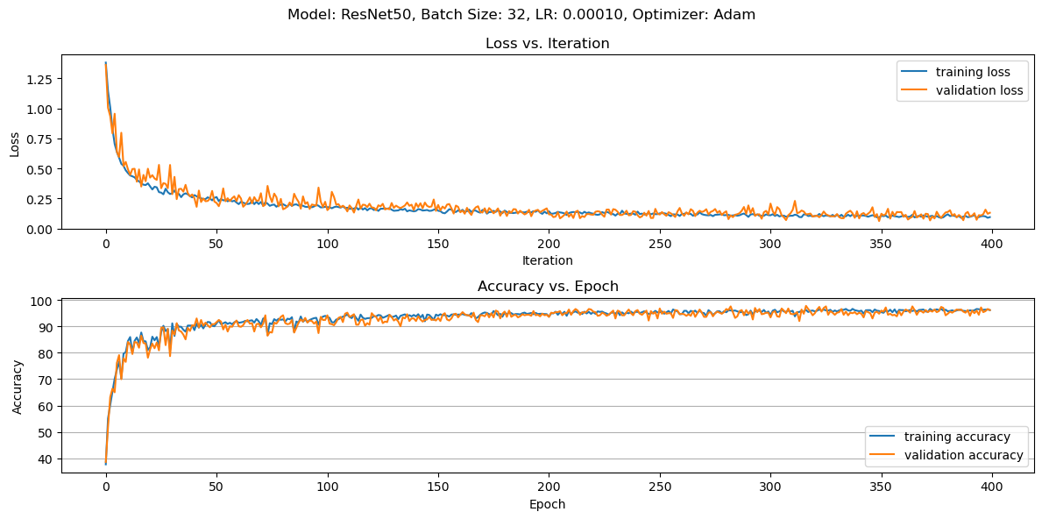
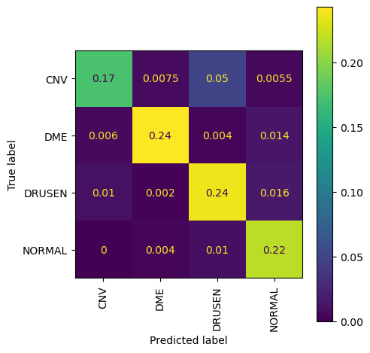
No ElasticTransform, Vertical T, Adam, 10 Fold
87.01% Accuracy

