Slide 1
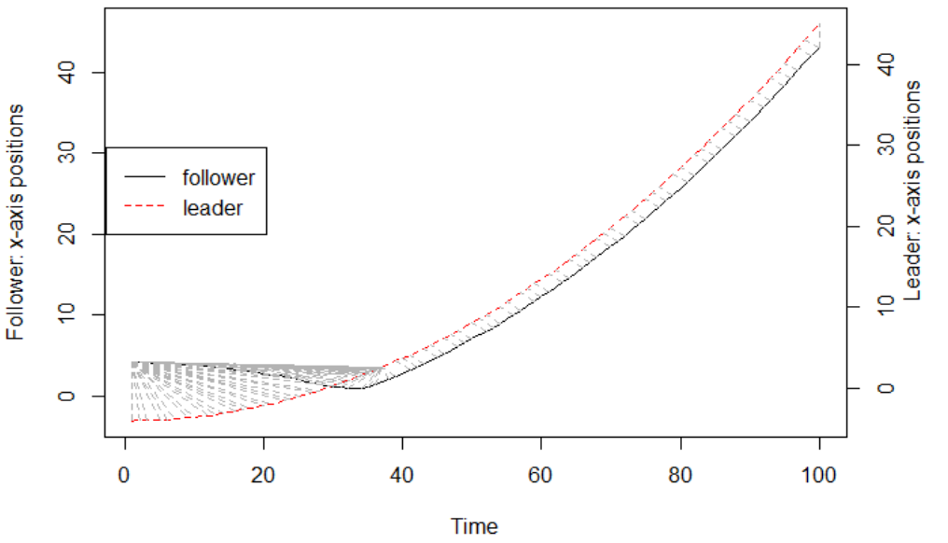
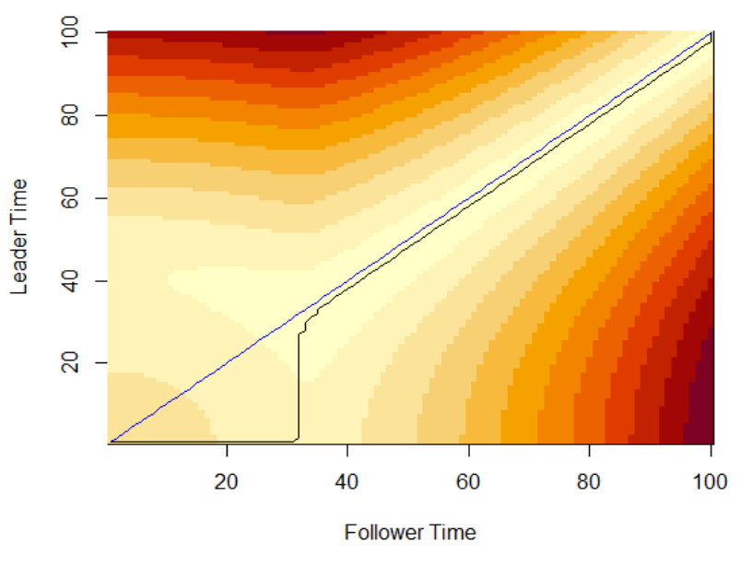
Positions of leader and follower in x-axis
DTW cost matrix
(a)
(b)

Slide 2
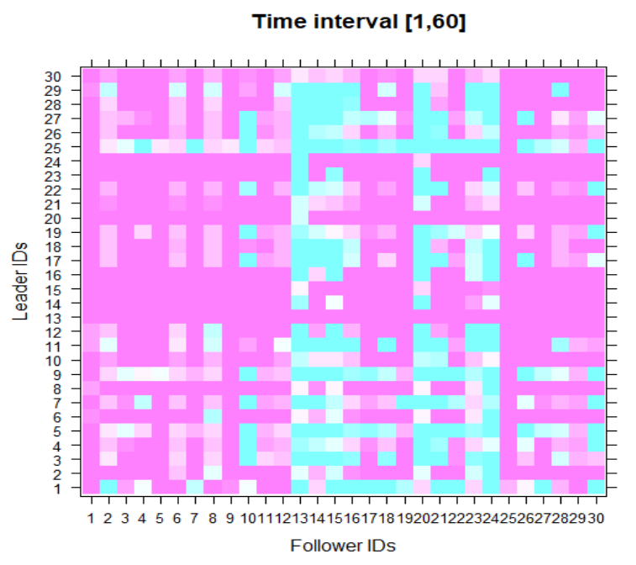
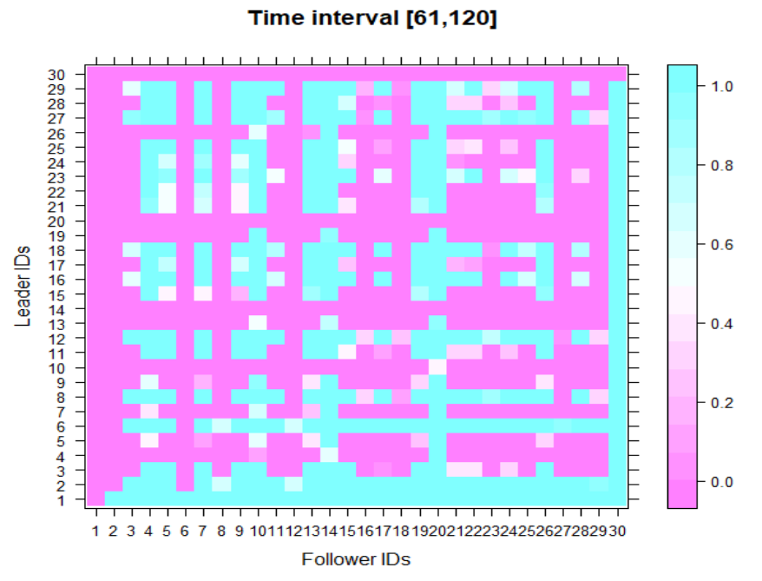
(a)
(b)

Slide 3
Input: Set of time series Output:
Dynamic following network
Network densities
Input: Set of time series Output:
Following network
Network density
Input: Pair of time series
Output: Following relation
mFLICA()
getDynamicFollNet()
followingNetwork()
followingRelation()
Input: Set of time series Output:
Dynamic following network
Network densities
Faction leaders
Faction members
Faction size ratios
getFactions()
getReachableNodes()
Input: Dynamic following network
Output:
Faction leaders
Faction members
Faction size ratios
Input:
Following network
Faction leader
Output: Faction members

