Slide 1

STEGANOGRAPHY
By,
Team 14
Ganesh K.
Mohammad Salamuddin

Slide 2

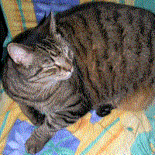
What is Steganography?
Steganography is the practice of concealing a file, message, image, or video within another file, message, image, or video.
Steganography achieves Security through Obscurity.
Image of a tree with a steganographically hidden image.

Slide 3

Steganography vs Cryptography
,
In steganography, the secret message is hidden.
In cryptography, communication message is visible.
Being visible attracts more attacks than being invisible.
The image below may or may not have hidden message, we do not know!

Slide 4
Hiding methods
01 Insertion-Based
02 Substitution-Based
03 Generation-Based

Slide 5

Why modify LSB?
Changing saturation of a color by 1 degree is not noticeable to the human eye.
RGB (0 ,0 , 255)
RGB (0 ,0 , 254)

Slide 6
Methods of Audio Steganography
LSB coding
Phase coding
Spread Spectrum
Echo hiding

Slide 7
Audio Steganography

Slide 8
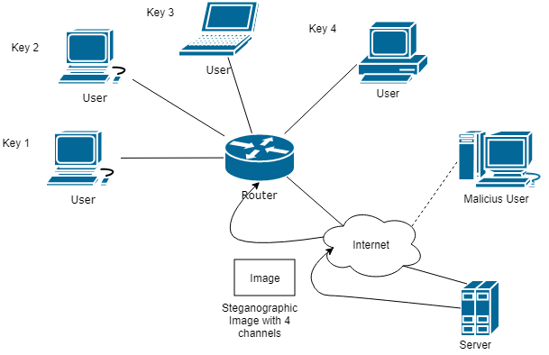
Architecture
The architecture supports multiple users to interact with a single server.
It guarantees end to end confidentiality which means:
No user in same network can decrypt others messages.
No outsider can decrypt any of the messages.

Slide 9
Working Demo

Slide 10
How the algorithm works
LSB method needs a particular set of pixels to be manipulated.
Thus if we modify a known sequence of bits, we can create n such unique sequences.
Some properties the sequences must include are:
No collisions in pixel numbers.
Must be a random sequence which cannot be guessed.
The sequence must be reproducible when needed independent of the machine.
Hence we’ll include n messages using n sequences and broadcast the image.
The receiver will only be able to decrypt his/her message by reading the binary values of the pixels generated using the unique key value.

Slide 11
More on the Architecture
The end-to-end confidentiality is achieved by two main values:
Key: Supplied by the server which helps in reproducing the pseudo-random sequence. (Explained on later slides)
N value: This N denotes the number of users connected in the network which is essential for making collision free sequences.
Sample sequence (n=3): [1, 4, 7, 10…];[2, 5, 8, 11…];[3, 6, 9, 12…];
Now the above sequence will be scrambled. By:
Random(key).scramble([1, 4, 7, 10...]) = [10, 4, 7, 1…] (Random).
Now 1st bit of data goes to 10th pixel, 2nd to 4th and so on.
Each time an user connects, he gets a unique key.
Each time a user connects, N value is updated on all devices.

Slide 12
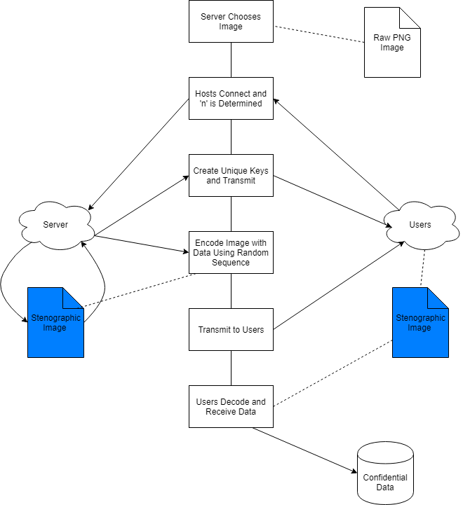

Slide 13
Performance Upgrade and Conclusion
Method (on 4k image) | Time (in seconds)
Single Encode | 3.516
Multiple Channel for n=100 | 68.610
Multiple Single Encode for n=100 | 367.234
Single Decode | 0.247

Slide 14
Refrences
1. Papers on steganography
http://www.ijera.com/papers/Vol4_issue6/Version%205/P0460594100.pdf
https://pdfs.semanticscholar.org/60b3/5d171d352597e6735c30b3c45a44afaa1b5e.pdf
2. Audio steganography
http://aircconline.com/ijma/V3N3/3311ijma08.pdf
https://www.irjet.net/archives/V3/i4/IRJET-V3I4117.pdf
3. Misc:
Nosrati, Masoud, Ronak Karimi, and Mehdi Hariri. "Audio steganography: A survey on recent approaches." world applied programming 2.3 (2012): 202-205.

Slide 15


