Slide 1

Pytest (Unit Testing)
SUT: Distributed Contour Extraction System
Jan. 6. 2021
Team Monday
Presented To:
Dr. Ahmed Adel Sobih
Eng. Ali ElSeddeek

Slide 2
Pytest (Unit Testing)
SUT: Distributed Contour Extraction System
Jan. 6. 2021
Ahmed Mohamed Zakaria SEC.1 BN.3
Remonda Talaat Eskarous SEC.1 BN.19
Mohamed Ahmed Mohamed Ahmed SEC.2 BN.10
Mohamed Shawky Zaky SEC.2 BN.15
Mohamed Ramzy Helmy SEC.2 BN.13

Slide 3
Agenda
SUT Overview
Pytest Overview
Assert Statements
Exceptions and Warnings
Fixtures
Skip and Xfail
Plugins
Hooks
Mock Property

Slide 4
SUT Overview

Slide 5
SUT Overview
Distributed system that produces contours for a video on frame level.
Frames are read from producers and are passed to consumers.
Consumers apply OTSU threshold on frames and send them to collectors.
Consumers receive binarized frames from collectors and calculate contours for each frame.
Contours are send to the final collector to be written in the output file.

Slide 6
Pytest Overview

Slide 7
Pytest Overview
Pytest is a python unit testing framework that makes it easy to write small tests, yet scales to support complex functional testing for applications and libraries.
A command line-based tool that can run huge number of tests and report the test output using a set of different features.
Pytest has plugins for different python development environments.

Slide 8
Pytest Installation
1 - To install pytest on your system you need to meet the following dependencies :
Python version: 3.6, 3.7, 3.8, 3.9, PyPy3
Platform: Linux and Windows
2 - Install pytest using the following command :
pip install pytest
3 - Test installation and check the current installed version by running :
pytest --version

Slide 9
Assert Statements

Slide 10
Assert Statements
pytest allows you to use the standard python assert for verifying expectations and values in Python tests. For example, you can write the following:
# content of test_assert1.py
def test_function():
x = 3
assert x == 4
Run the test using the following command, Then assertion error will be encountered:
pytest test1_assert.py

Slide 11
Exceptions and Warnings

Slide 12
Exceptions Testing
PyTest provides functionalities to test whether specific Exceptions and Warnings are occurred using the keyword pytest.raises()
For example:
import pytest
def test_zero_division():
with pytest.raises(ZeroDivisionError):
1 / 0

Slide 13
Exceptions Testing
In SUT, When nodes are not alive and sockets can’t be read from. A ZMQError exception is raised when trying to receive data from the socket.
It is tested by passing invalid input and asserting if ZMQError exception will be raised as follows for otsu and contours nodes:
def test_otsu_no_recieve(self):
with pytest.raises(zmq.ZMQError):
………
in_message = { 'frame' : 0.5}
………
ret_message = self.out_socket.recv_pyobj(flags = zmq.NOBLOCK)

Slide 14
Warnings Testing
Following a similar way that PyTest uses to test Exceptions. The occurrence of warnings can be asserted by the keyword pytest.warns()
For example:
def test_warning():
with pytest.warns(UserWarning):
warnings.warn("my warning", UserWarning)

Slide 15
Warning Testing
In SUT, The nodes operates on just numpy arrays. If any different type of input is received a UserWarning will be generated. This behaviour is tested in otsu and contour nodes as follows:
def test_contour_user_warning(self):
with pytest.warns(UserWarning):
...
in_message = { 'binary' : 0.5}
...

Slide 16
User-Defined explanation of failed assertions.
Pytest enables the user to specify his special definition for failed assertions by specifying this in conftest.py as follows:
class Foo:
def __init__(self, val):
self.val = val
def __eq__(self, other):
return self.val == other.val
def pytest_assertrepr_compare(op, left, right):
if isinstance(left, Foo) and isinstance(right, Foo) and op == "==":
return [
"Comparing Foo instances:",
" vals: {} != {}".format(left.val, right.val),
]

Slide 17
User-Defined explanation of failed assertions.
In SUT, When 2 contours lists are compared we can have 2 explanations for failed assertions:
The 2 lists doesn’t have the same size
The 2 lists matches in size but contour values doesn’t match
These explanations is defined as follows:
def pytest_assertrepr_compare(op, left, right):
...
elif isinstance(left, Contour) and isinstance(right, Contour) and op == "==":
if(len(left.contour_array) != len(right.contour_array)):
return ["equality of 2 contour lists", "Lengths: {} of contour 1 != {} of contour 2".format(len(left.contour_array), len(right.contour_array))]
else:
return ["equality of 2 contour lists", "Contour inner values are different"]

Slide 18
Fixtures

Slide 19
Fixtures
Fixtures provide a fixed baseline so that tests execute reliably and produce consistent and repeatable results.
Fixture management scales from simple unit to complex functional testing.
Fixtures are implemented in a modular manner, as each fixture can use other fixtures.

Slide 20
Fixtures
Node Termination
Node sends Terminations to parents then dies
Children send terminations to node

Slide 21
Fixtures
Node Termination
Test
Node sends Terminations to Test then dies
Test sends terminations to node
Test

Slide 22
Fixtures
Node Termination
Autouse fixtures: called by default with each test function
@pytest.fixture(autouse=True)
def _init_sockets(...):
...
Test
Sockets Initialization is Common
Test

Slide 23
Fixtures
Node Termination
introspect the requesting test context: called by default with each test function
def init_sockets(request):
socket_type = request.node.get_closest_marker("type")
@pytest.mark.type('connect')
def test_input_terminate(...):
...
Test
Different types of sockets in different nodes (bind/connect)
Test

Slide 24
Fixtures
Node Termination
Fixture scope, sharing fixtures: called by default with each test function
@pytest.fixture(scope = 'module')
def context():
...
@pytest.fixture(scope = 'function')
def init_sockets(...):
...
Other scopes : class, package, session
Test
Scope:
Context(defined once) vs Socket(defined with each test)
Test

Slide 25
Fixtures
Node Termination
Fixture finalization and teardown code
Code to be executed with destroying of fixture
def init_sockets(...):
yield sockets
sockets.in_socket.close()
sockets.out_socket.close()
Test
Sockets closing to be reused
Test

Slide 26
Skip and Xfail

Slide 27
Skip and Xfail
Pytest can deal with tests that cannot run on a certain platform or are expected to fail due to unsolved bugs or software migration.
Skip marker is used to mark a specific test or set of tests as skippable given a certain condition.
Xfail marker is used to show that a specific test is expected to fail for some reason, so that the test suite remain green. In case of pass, the test case will be marked as xpassed.

Slide 28
Skip and Xfail
Skip marker is defined using “skip” and “skipif” decorators :
@pytest.mark.skip(reason="no way of currently testing this")
def test_the_unknown():
…
@pytest.mark.skipif(sys.version_info < (3, 7), reason="requires python3.7 or higher")
def test_function():
…
Xfail marker is defined using “xfail” decorator :
@pytest.mark.xfail(sys.platform == "win32", reason="bug in a 3rd party library")
def test_function():
…

Slide 29
Skip and Xfail
Skip and Xfail marker are used in our test scripts in the following ways :
@pytest.mark.skip(reason="The connection test is skipped as it's already included in output test")
@pytest.mark.skipif(cv2.__version__ != '4.4.0', reason="Requires OpenCV version '4.4.0'")
@pytest.mark.xfail(strict=False, reason="This test can pass or fail based on termination implementation")
@pytest.mark.xfail(port_counter != 3, reason="This test cannot pass as port counter is wrong" ,raises=RuntimeError)
@pytest.mark.xfail(run=True, reason="This test cannot succeed as no output socket is given")

Slide 30
Plugins

Slide 31
Plugins
Usages:
Extend PyTest core functionalities. Ex. pytest-cov
Integrate with other frameworks. Ex. pytest-django

Slide 32
Plugins
User can either:
Define their own plugin for their projects.
Install plugins through PyPI.

Slide 33
Writing Plugins
A plugin contains one or multiple hook functions.
Ex. “testplan” plugin:
Enumerates tests into a csv file with their descriptions and types without running them.
Used for reports and documentations of tests.

Slide 34
“testplan” plugin
The plugin can be used by specifying a csv file name while running the tests:
python -m pytest test_scripts/ --testplan=<filename>.csv
The plugin uses two hook functions:
“Pytest_addoption”: used to define the “--testplan" parameter while running the tests.
“Pytest_collection_modifyitems”: which is called on tests by pytest before they are run.

Slide 35
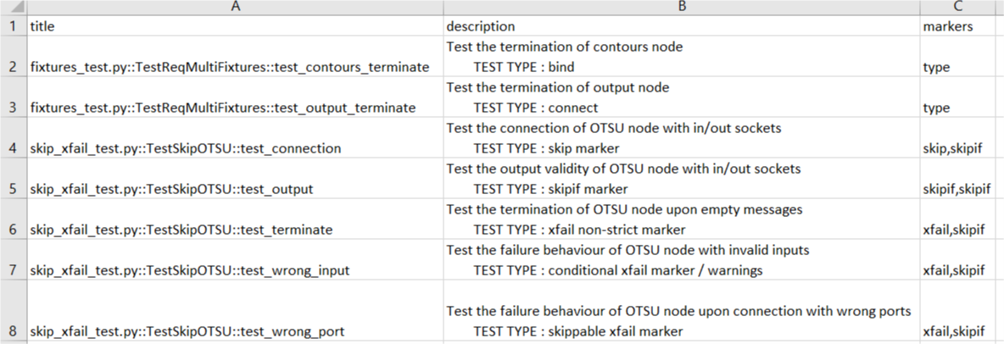
“testplan” plugin sample output

Slide 36
Third-party Plugins
Installation:
Plugins can be installed using PyPI:
pip install pytest-NAME
Plugins are automatically integrated.
Usage:
User can require plugins in a test module or a conftest file through pytest_plugins variable:
pytest_plugins = ("myapp.myplugin",)

Slide 37
“pytest-html” plugin
Reports the test results into an html report.
Can be used for documentation of the test process and its progress.
Installation:
Pip install pytest-html
Usage:
python -m pytest test_scripts/ --html=<filename>.html

Slide 38
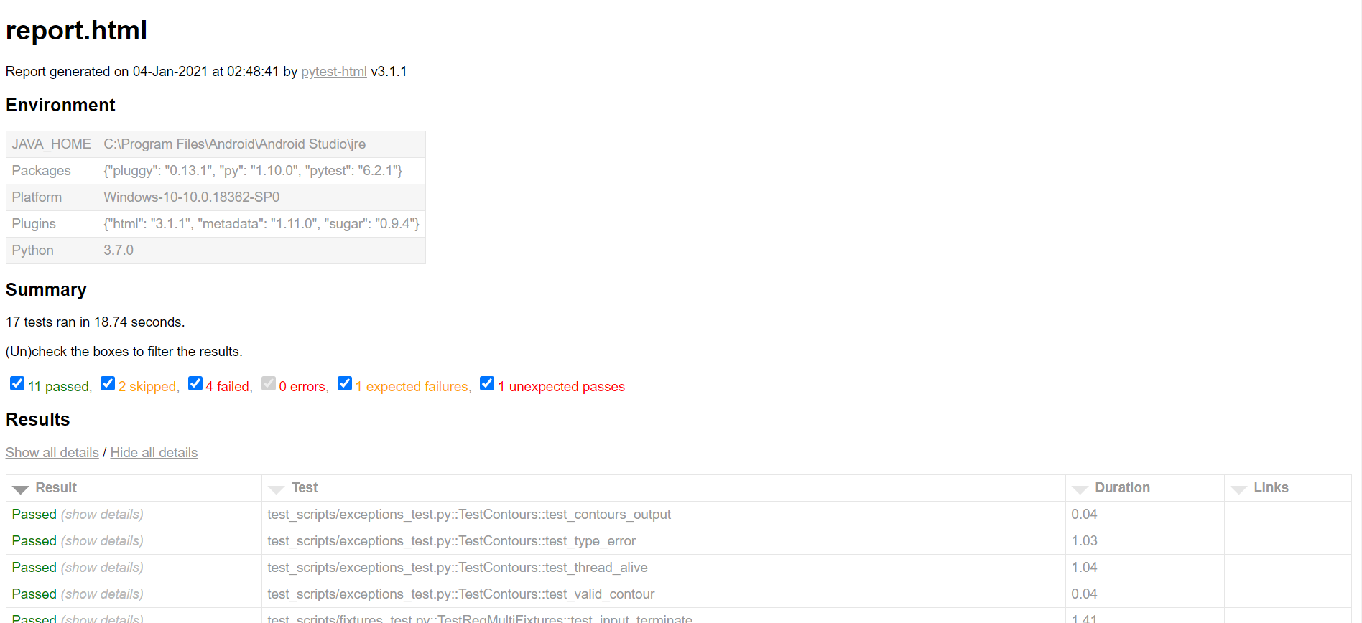
“pytest-html” plugin sample output

Slide 39
Hooks

Slide 40
Hooks
Pytest test suite reports all test results, whether it is a pass or a failure.
Pytest provides hook functions that can be used to organize tests execution.
More importantly, it can be used to dump all test failures into failures.txt file, which can be much easier to search through.

Slide 41
Hooks
Hook functions are defined in pytest configuration file, which is named conftest.py.
Mainly, @pytest.hookimpl() decorator is used as follows :
@pytest.hookimpl()
def pytest_sessionstart(session: Session):
…
@pytest.hookimpl(hookwrapper=True)
def pytest_runtest_makereport(item: Item, call: CallInfo):
…

Slide 42
Mock Property

Slide 43
Mock Property
In Python, an API function call can 1,000 seconds to run.
Consequently, testing an interface (or wrapper) that calls an API function consumes a lot of time to perform a simple test.
This is the main use of the mocks in Pytest, which allow the tester to set a fixed return of the API calls.

Slide 44
Mock Property
We can define mocks for Pytest by using @mock.patch() python decorator.
The following code snippet shows how mocks are integrated to out scripts :
@mock.patch("back_machine.ostu_node.cv2.threshold" ,autospec = True)
def test_otsu_threshold_fail(self ,mock_threshold):
#set the mock side effects
mock_threshold.side_effect = [[150,self.binary1], [255, self.binary2]]

Slide 45
Thanks!

