Slide 1
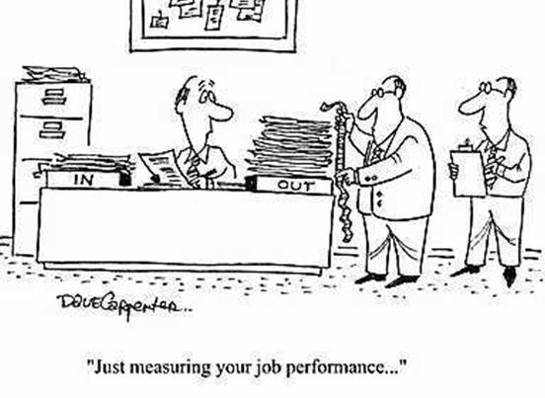
How PowerShell’s AST can make you more productive

Slide 2
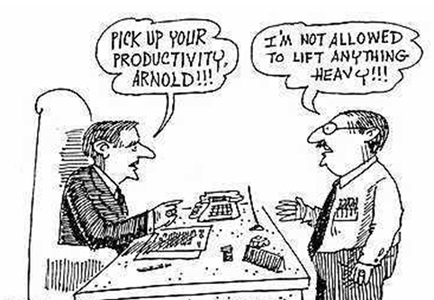
What we’ll talk about
What is an AST
Token parsing
AST parsing
Select-ViaAst, like Select-String and more
PSharp

Slide 3
An abstract syntax tree (AST), or just syntax tree, is a tree representation of the abstract syntactic structure of source code written in a programming language.

Slide 4
Each node of the tree denotes a construct occurring in the source code. The syntax is "abstract" in that it does not represent every detail appearing in the real syntax.

Slide 5
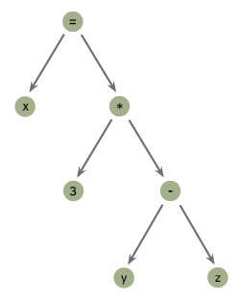
$x=3*($y-$z)
{$x=3*($y-$z)}.Ast.EndBlock.Statements.Right.Expression
Operator : Multiply
Left : 3
Right : ($y-$z)
ErrorPosition : *
StaticType : System.Object
Extent : 3*($y-$z)
Parent : 3*($y-$z)

Slide 6
Demo

Slide 7
In Closing
I want to thank Jason Shirk of the PowerShell Team – creator of the AST and these (both on GitHub)
TabExpansion++
PSReadline
Google PowerShell AST, these MVPs have more on the AST
Adam Driscoll
Ravikanth Chaganti
Bartek Bielawski
Victor Vogelpoel just wrote Measure-ScriptCode
Number of Lines of Code, Comments, Functions, filters and workflow and more
Email me finked@hotmail.com

