Slide 1
Spring J2EE Framework
Ram A. Rao
May 15th ‘05

Slide 2
Agenda – Spring Framework
Introduction to Spring Framework, Dependency
Injection/Inversion of Control and AOP
Spring usage scenarios and initializing. Spring in J2EE applications
Spring in Web tier. Spring with Struts.
Spring with EJBs and declarative transactions
Using Spring for persistence
Using Spring AOP interceptors
Using other Spring supported functions (JNDI, Mail, JMS, WebServices)
Testing using Spring

Slide 3
Spring
A lightweight non-intrusive framework which addresses various tiers in a J2EE application.
  Presentation layer: Integrates with Struts to initialize action classes
  Business layer: Lightweight IoC container with support for AOP-driven interceptors and transaction.
  Persistence layer – DAO template support for Hibernate, SQLMaps and JDBC
  Factory implementation to abstract and integrate various other facets of enterprise applications like E-mails, JMS, WebServices, etc.
Helps integrates tiers together using XML configuration instead of hard-coding.
Substantially reduces code, speeds up development, facilitates easy testing and improves code quality.
Notes:
Spring MVC
– a single shared controller instance handles a particular request type
- controllers, interceptors run in the IoC container
- allows multiple DispatcherServlets that can share an “application context”
- Interface based not class-based

Slide 4
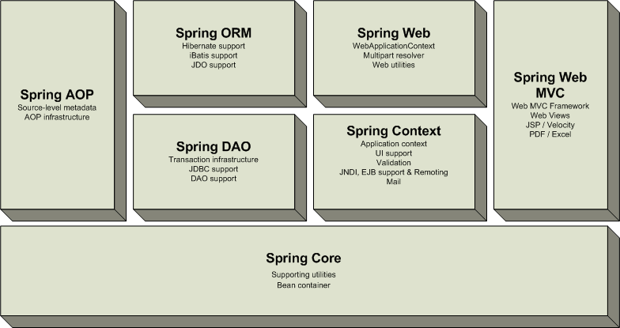
Spring Stack
Source: Spring Docs
Notes:
Provides a good alternative to EJB for most applications
Provides end-to-end framework for applications.

Slide 5
Spring Benefits
Not a J2EE container. Doesn’t compete with J2EE app servers. Simply provides alternatives.
POJO-based, non-invasive framework which allows a la carte usage of its components.
Promotes decoupling and reusability
Reduces coding effort and enforces design discipline by providing out-of-box implicit pattern implementations such as singleton, factory, service locator etc.
Removes common code issues like leaking connections and more
Support for declarative transaction management
Easy integration with third party tools and technologies.
Notes:
Provides a good alternative to EJB for most applications
Provides end-to-end framework for applications.

Slide 6
Fundamentals Concepts
Spring largely built around
Inversion of Control (IoC) or Dependency Management
Aspect Oriented Programming (AOP)

Slide 7
Inversion of Control
Instead of objects invoking other objects, the dependant objects are added through an external entity/container.
Also known as the Hollywood principle – “don’t call me I will call you”
Dependency injection
  Dependencies are “injected” by container during runtime.
  Beans define their dependencies through constructor arguments or properties
Prevents hard-coded object creation and object/service lookup.
Loose coupling
Helps write effective unit tests.

Slide 8
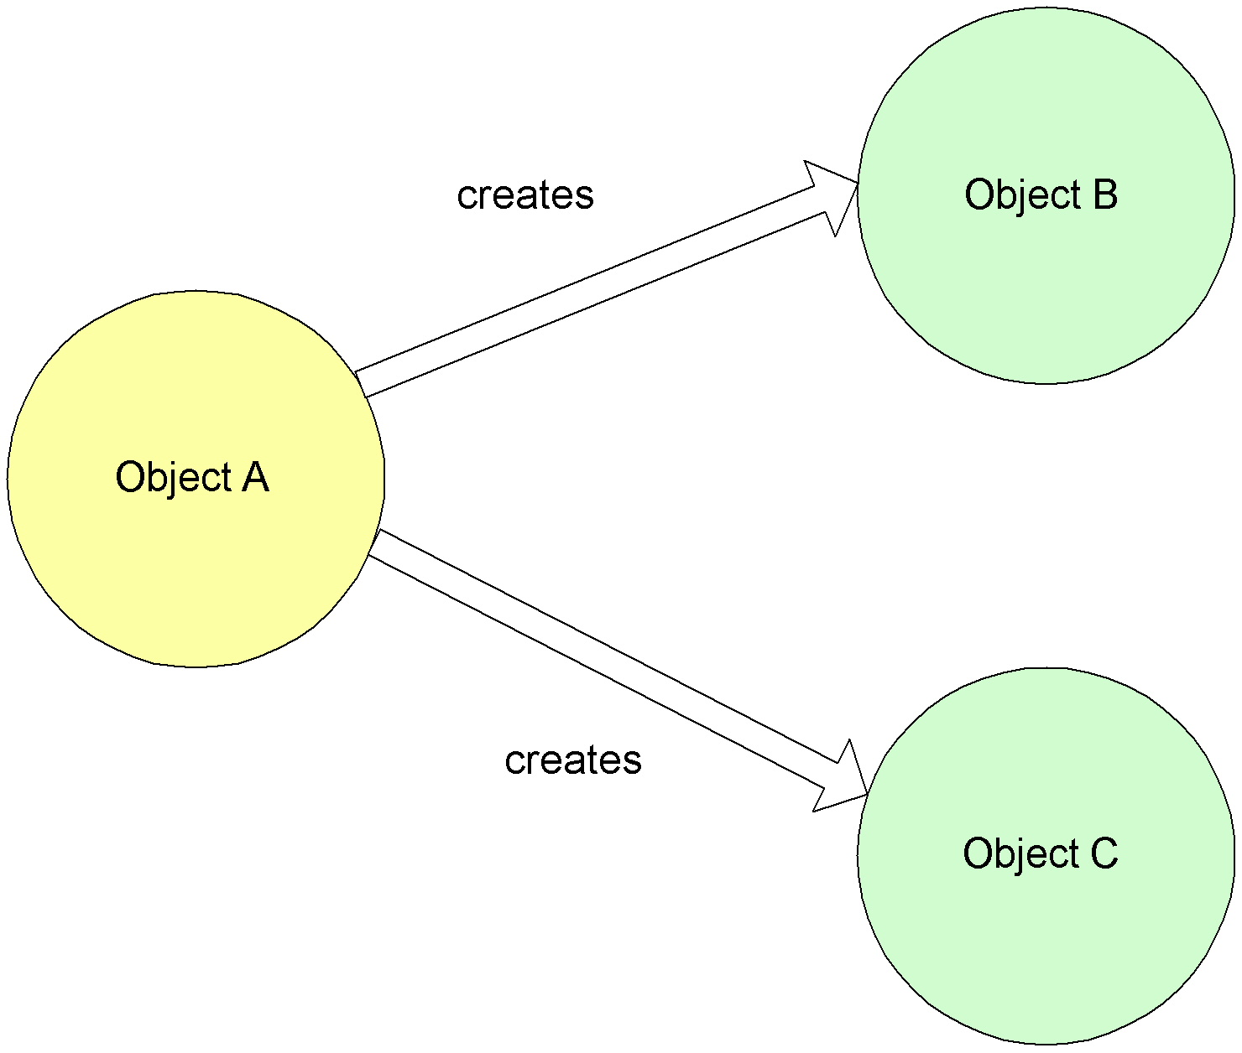
Non-IoC / Dependency Injection
Source: Spring Documentation

Slide 9
Non-IoC Service Object
public class CampaignServiceImpl implements CampaignService {
public Campaign updateCampaign(Campaign campaign) throws CampaignException{
try{
  CampaignDAO campaign = new CampaignDAOImpl();
  ..
  OpportunityDAO oppDAO = new OpportunityDAOImpl();
  // Alternatively, initialize thru factory
  // OpportunityDAO oppDAO = OppFactory.getOpp();
  oppDAO.save(campaign);
  ..
}catch(Exception e){
}
}
Code is tightly coupled or interspersed with Factory code!

Slide 10
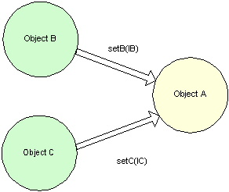
IoC / Dependency Injection
Source: Spring Documentation

Slide 11
IoC Service Object
public class CampaignServiceImpl implements CampaignService {
public Campaign updateCampaign(Campaign campaign) throws CampaignException{
try{
oppDAO.save(campaign);
}catch(Exception e){
}
}
// Spring sets the value thru runtime injection!
private setOpportunityDAO(OpportunityDAO oppDao){
this.oppDAO = oppDao;
}
Notes:
The DAO would be injected with a Session/Connection object

Slide 12
Spring Usage Scenarios
Following are the typical usage scenarios for Spring
  Presentation layer
    Integrates with Struts to initialize action classes and its dependencies.
    Facilitates presentation-tier testing
  Business layer
    Integrates with EJBs
    Provides integration with components using IoC.
    Transaction (declarative and programmatic)
  Persistence layer
    DAO pattern implementation
    Template support for Hibernate, iBatis DataMapper and JDBC
    Transaction management, Exception translation, connection management.
  General
    Email, JNDI, WebServices

Slide 13
Spring Bean Definition
The bean class is the actual implementation of the bean being described by the BeanFactory.
Bean examples – DAO, DataSource, Transaction Manager, Persistence Managers, Service objects, etc
Spring config contains implementation classes while your code should program to interfaces.
Bean behaviors include:
  Singleton or prototype
  Autowiring
  Initialization and destruction methods
    init-method
    destroy-method
Beans can be configured to have property values set.
  Can read simple values, collections, maps, references to other beans, etc.

Slide 14
Simple Spring Bean Example
<bean id=“CampaignServiceTarget"
class="com.corp.CampaignServiceImpl">
<property name=“promotionService">
<ref bean=“promotionService" />
</property>
<property name=“count">2</property>
</bean>
public class CampaignServiceImpl implements CampaignService{
…
public void setCount(int c){
this.count = c;
}
public void setPromotionService(PromotionService pServ){
this.promotionService = pServ;
}
}

Slide 15
Spring BeanFactory
BeanFactory is core to the Spring framework
  Lightweight container that loads bean definitions and manages your beans.
  Configured declaratively using an XML file, or files, that determine how beans can be referenced and wired together.
  Knows how to serve and manage a singleton or prototype defined bean
  Responsible for lifecycle methods.
  Injects dependencies into defined beans when served
Removes the need for ad-hoc singletons and factories

Slide 16
Spring ApplicationContext
A Spring ApplicationContext allows you to get access to the objects that are configured in a BeanFactory in a framework manner.
ApplicationContext extends BeanFactory
  Adds services such as international messaging capabilities.
  Add the ability to load file resources in a generic fashion.
Several ways to configure a context:
  XMLWebApplicationContext – Configuration for a web application.
  ClassPathXMLApplicationContext – standalone XML application context
  FileSystemXmlApplicationContext
Allows you to avoid writing Service Locators

Slide 17
Struts Support
ContextLoaderPlugin
  Loads a Spring application context for the Struts ActionServlet.
  Struts Actions are managed as Spring beans.
ActionSupport and DispatchActionSupport
  Pre-built convenience classes to provide access to the context.
  Provides methods in superclass for easy context lookup.

Slide 18
Configuring Context – Option 1
<plug-in className="org.springframework.web.struts.ContextLoaderPlugIn">
<set-property property="contextConfigLocation"
value="/WEB-INF/applicationContext.xml"/>
</plug-in>

Slide 19
Configuring Context – Option 2
<context-param>
<param-name>contextConfigLocation</param-name>
<param-value>
/WEB-INF/applicationContext.xml
</param-value>
</context-param>
<!-- listener>
<listener-class> org.springframework.web.context.ContextLoaderListener
</listener-class>
</listener -->
<servlet>
<servlet-name>context</servlet-name>
<servlet-class> org.springframework.web.context.ContextLoaderServlet
</servlet-class>
<load-on-startup>1</load-on-startup>
</servlet>
Notes:
WebSphere initializes Listeners after Servlets are loaded, hence not preferred

Slide 20
Locating a Bean with Struts
public abstract class BaseAction extends ActionSupport {
protected CampaignService getCampaignService() {
return (CampaignService) getWebApplicationContext()
.getBean(“campaignService");
}
}
<bean id=“campaignService" class=“com.corp.CampaignServiceImpl">

Slide 21
Spring with EJB
Implements service locator and code-less business delegate.
Configurable EJB lookup for remote and local EJBs
Supports POJO business tier with EJB façade
Easier EJB development with helper classes
Supports SLSBs and MDBs
Implement “Business Interface” pattern
  EJB classes and POJO implementation extend a common interface
  Common interface defines all methods

Slide 22
Spring and EJB
Spring promoted as an alternative to the relatively “complex” EJBs
Provides few comparable features, if not all
EJBs are a must for
  Distributed transactions
  Cluster-safe remoting of services
  Container managed component security
  High availability services
Using Spring with EJBs moves implementation to a POJO model
Positions applications to a easier transition into the new EJB 3.0 spec.

Slide 23
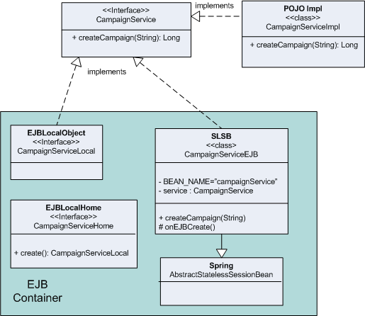
Spring with EJB

Slide 24
Spring EJB Declaration – ejb-jar.xml
<session id=“CampaignService">
  <ejb-name>CampaignService</ejb-name>
  <local-home>com.corp.ejb.CampaignServiceLocalHome</local-home>
  <local>com.corp.ejb.CampaignServiceLocal</local>
  <ejb-class>com.corp.ejb.CampaignServiceBean</ejb-class>
  <session-type>Stateless</session-type>
  <transaction-type>Bean</transaction-type>
  <env-entry>
  <env-entry-name>ejb/BeanFactoryPath</env-entry-name>
  <env-entry-type>java.lang.String</env-entry-type>
  <env-entry-value>ejbContext.xml</env-entry-value>
  </env-entry>
  <ejb-local-ref id="EJBLocalRef_1136316508000">
  <ejb-ref-name>ejb/CampaignService</ejb-ref-name>
  <ejb-ref-type>Session</ejb-ref-type>
  <local-home>com.corp.ejb.services.CampaignServiceLocalHome</local-home>
  <local>com.corp.ejb.services.CampaignServiceLocal</local>
  <ejb-link>CampaignService</ejb-link>
  </ejb-local-ref>
</session>

Slide 25
Spring EJB Declaration
<bean id="accountService" class=“LocalStatelessSessionProxyFactoryBean">
<property name="jndiName">
<value>ejb/CampaignServiceHome</value>
</property>
<property name="businessInterface">
<value>com.corp.services.CampaignService</value>
</property>
</bean>

Slide 26
EJB Client with Spring Helper
EJB Local:
/**
* Local interface for Enterprise Bean: CampaignService.
*/
public interface CampaignServiceLocal extends javax.ejb.EJBLocalObject, CampaignService {
}

Slide 27
EJB class with Spring Helper
/**
* Bean implementation class for Enterprise Bean: CampaignService
*/
public class CampaignServiceBean extends
AbstractStatelessSessionBean
implements CampaignService {
private static final String BEAN_NAME=
“campaignService";
private Campaign service;
protected void onEjbCreate() throws CreateException {
service = (CampaignService)
getBeanFactory().getBean(BEAN_NAME);
}
}

Slide 28
Delegated POJO Service Implementation
/**
* POJO implementation class for Enterprise Bean: CampaignServiceBean
*/
public class CampaignServiceImpl implements CampaignService {
public Long createCampaign(String c) throws AppException {
..
}
}
applicationContext.xml
<bean id=“campaignServiceTarget"
class="com.corp.services.CampaignServiceImpl">
  <property name=“promoDAO">
  <ref bean=“promoDAO" />
  </property>
</bean>

Slide 29
Transaction Management With Spring
Choice of two transaction managers
  DataSourceTransactionManager for Local Transactions
  JtaTransactionManager for using container transactions manager
Choice of two transaction
  Declarative (preferred); Declarations are in Spring context.
  Programmatic; only for scenarios when declarative doesn’t work. Custom Spring API
Notes:
DataSourceTransactionManager - PlatformTransactionManager implementation for single JDBC data sources. Binds a JDBC connection from the specified data source to the thread, potentially allowing for one thread connection per data source.
JtaTransactionManager - PlatformTransactionManager implementation for JTA, i.e. J2EE container transactions. Can also work with a locally configured JTA implementation. This transaction manager is appropriate for handling distributed transactions, i.e. transactions that span multiple resources, and for managing transactions on a J2EE Connector (e.g. a persistence toolkit registered as JCA Connector).

Slide 30
Transaction Management With Spring
Local Transactions:
<bean id=“localTransactionManager"
class="org.springframework.jdbc.datasource.DataSourceTransactionManager">
<property name="dataSource">
<ref local="springContainerDataSource" />
</property>
</bean>
JTA Transactions (Using Websphere):
<bean id="wsJtaTm" class="org.springframework.transaction.jta.WebSphereTransactionManagerFactoryBean"/>
<bean id=“distTransactionManager" class="org.springframework.transaction.jta.JtaTransactionManager">
<property name="transactionManager" ref="wsJtaTm" />
<property name="userTransactionName"><null /></property>
</bean>
Notes:
DataSourceTransactionManager - PlatformTransactionManager implementation for single JDBC data sources. Binds a JDBC connection from the specified data source to the thread, potentially allowing for one thread connection per data source.
HibernateTransactionManager- PlatformTransactionManager implementation for single Hibernate session factories. Binds a Hibernate Session from the specified factory to the thread, potentially allowing for one thread Session per factory. SessionFactoryUtils and HibernateTemplate are aware of thread-bound Sessions and participate in such transactions automatically. Using either is required for Hibernate access code that needs to support this transaction handling mechanism.
JdoTransactionManager - PlatformTransactionManager implementation for single JDO persistence manager factories. Binds a JDO PersistenceManager from the specified factory to the thread, potentially allowing for one thread PersistenceManager per factory. PersistenceManagerFactoryUtils and JdoTemplate are aware of thread-bound persistence managers and take part in such transactions automatically. Using either is required for JDO access code supporting this transaction management mechanism.
JtaTransactionManager - PlatformTransactionManager implementation for JTA, i.e. J2EE container transactions. Can also work with a locally configured JTA implementation. This transaction manager is appropriate for handling distributed transactions, i.e. transactions that span multiple resources, and for managing transactions on a J2EE Connector (e.g. a persistence toolkit registered as JCA Connector).

Slide 31
Enabling Transactions on Services
Transactions are typically enabled at the business tier level and not in the DAO
Spring transactions are an alternative to EJB transactions; for both declarative and programmatic
Have to be enabled after disabling EJB CMT. No point in having both

Slide 32
Enabling Declarative Transactions on Services
<bean id=“campaignServiceTxn"
class="org.springframework.transaction.interceptor.TransactionProxyFactoryBean">
<property name="transactionManager">
<ref bean="distTransactionManager" />
</property>
<property name="target">
<ref bean=“campaignServiceTarget" />
</property>
<property name="transactionAttributes">
  <props>
  <prop key="update*">
  PROPAGATION_REQUIRED, -com.corp.common.exception.NWException
  </prop>
  <prop key="*">
  PROPAGATION_REQUIRED,readOnly,-com.corp.common.exception.NWException
  </prop>
  </props>
</property>
</bean>

Slide 33
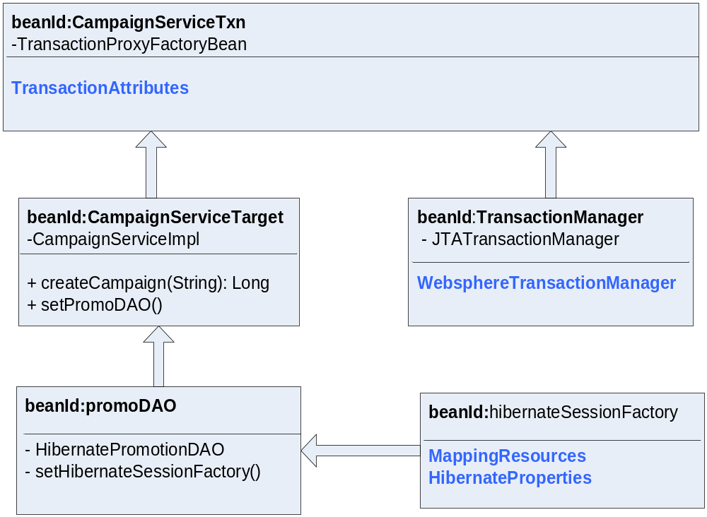
Dependency Injection

Slide 34
Persistence With Spring
Provides DAO implementation
Data access templates/helper classes.
Exception handling and translation. try/catch/finally blocks are not required anymore.
Connection management and implicit passing of datasource to DAO
Traditional problem of connection leaking etc. no more a concern

Slide 35
Defining Datasource
<bean id="springContainerDataSource" class="org.springframework.jndi.JndiObjectFactoryBean">
<property name="jndiName">
<value>jdbc/CustomerDB</value>
</property>
</bean>

Slide 36
Defining Persistence and wiring Datasource
<bean id=“hibernateSessionFactory" class=
“org.springframework.orm.hibernate.LocalSessionFactoryBean“>
<property name="dataSource">
<ref local="springContainerDataSource” />
</property>
  <property name="mappingResources">
  <list> <value>com/corp/orm/Customer.hbm.xml</value>
  <value>com/corp/orm/Account.hbm.xml</value>
  </list>
  </property>
  <property name="hibernateProperties">
  <props>
  <prop key="hibernate.dialect">
  net.sf.hibernate.dialect.DB2Dialect
  </prop>
  <prop key="hibernate.show_sql">false</prop>
  <prop key="hibernate.autocommit">false</prop>
  <prop key="cache.provider_class">
  org.hibernate.cache.OSCacheProvider
  </prop>
  </props>
  </property>
</bean>
Notes:
Remember to discuss how the names of the xml tags map to the Javadoc setters.

Slide 37
Defining Persistence Beans
<bean id=“promoDao"
class="com.corp.dao.HibernatePromotionDao">
  <property name="sessionFactory">
  <ref local="hibernateSessionFactory" />
  </property>
</bean>
Notes:
Remember to discuss how the names of the xml tags map to the Javadoc setters.

Slide 38
DAO Support classes
Support for
JdbcDaoSupport
  Provides callback methods for row iteration
HibernateDaoSupport
  Initializes Hibernate session factory
  Provides templates to invoke Hibernate API or the session
SqlMapDaoSupport
  Provides template for iBatis SQLMaps
  Support similar to Hibernate template

Slide 39
JDBC Code without a template
public class JDBCPromotionDAO implements PromotionDAO {
public Order savePromotion(Promotion promo) throws PromoException{
Transaction tx = null;
try{
s = ... // get a new datasourceobject
tx = s.beginTransaction();
s.save(promo);
tx.commit();
} catch (SQLException sqle){
// log, rollback, and convert to OrderException
} finally {
s.close(); // needs a try/catch block
}
return promo;
}

Slide 40
Spring JDBC DAO Template
public class JDBCPromotionDAO implements PromotionDAO extends JDBCDaoSupport{
public Order savePromotion(Promotion promo) throws DataAccessException{
Transaction tx = null;
// get a new datasourceobject
templ = new JdbcTemplate(this.appDataSource);
templ.update(promo);
return promo;
}
public void setAppDataSource (DataSource ds) {
this.appDataSource = ds;
}

Slide 41
Hibernate Code without a template
public class HibernatePromotionDAO implements PromotionDAO {
public Order savePromotion(Promotion promo) throws PromoException{
Session s = null;
Transaction tx = null;
try{
s = ... // get a new Hibernate Session object
tx = s.beginTransaction();
s.save(promo);
tx.commit();
} catch (HibernateException he){
// log, rollback, and convert to DomainException
} catch (SQLException sqle){
// log, rollback, and convert to DomainException
} finally {
s.close(); // needs a try/catch block
}
return promo;
}

Slide 42
Spring Hibernate DAO Template Example
public class PromotionHibernateDAO extends HibernateDaoSupport
implements PromotionDAO {
...
public Order savePromotion(final Promotion promo) {
return (Order) getHibernateTemplate().execute(new HibernateCallback() {
public Object doInHibernate(Session session)
throws HibernateException, SQLException {
session.save(promo);
return promo;
}
});
}
...
}

Slide 43
Spring Hibernate DAO Template Example
public class PromotionHibernateDAO extends HibernateDaoSupport
implements PromotionDAO {
...
public List findOrdersByCustomerId(int id) {
return getHibernateTemplate()
.findByNamedQuery(“OrdersByCustomerID”,
new Integer(id));
}
public Order findOrderById(int orderId ) {
return (Order) getHibernateTemplate().load(
Order. class,
new Integer(orderId));
}
...
}

Slide 44
Consistent Exception Handling
Exception logic is managed by Spring using its own exception hierarchy.
Exceptions from JDBC, Hibernate, SQLMaps, are wrapped up into an appropriate, and consistent, DataAccessException and thrown.
Cleaner separation of tiers.
These exceptions are treated as unchecked exceptions that can be handled in business tier.
Own exception translation can be defined by sub-classing classes such as SQLErrorCodeSQLExceptionTranslator

Slide 45
Spring AOP
Provides a non-intrusive solution to common OO limitation for easily implementing cross cutting concerns.
Used effectively for functions such as declarative transaction management, declarative security, profiling, logging, etc.
Supports AOPAlliance out-of-box. Supports AspectJ for added features and compile time weaving.
Supports standard “advices”
  method before
  method after returning
  throws advice
  around advice

Slide 46
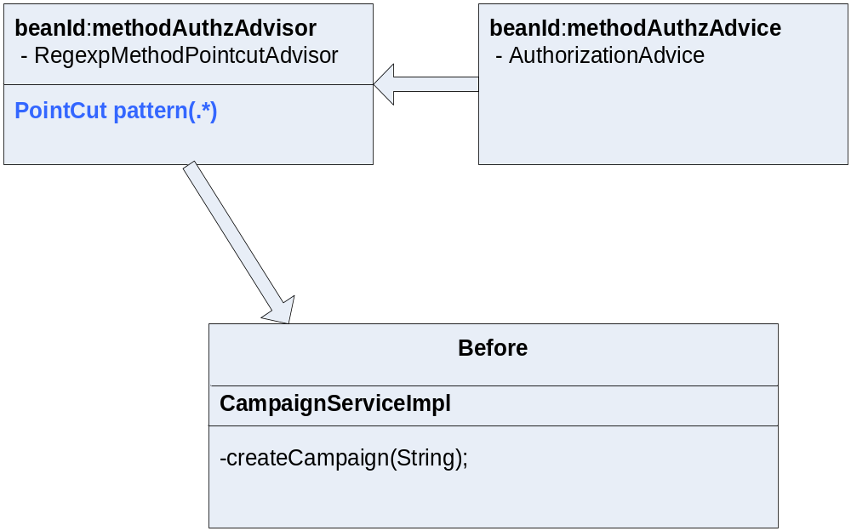
Spring AOP Runtime Weaving

Slide 47
Spring AOP Advice for Component Authorization
<!-- Advisor pointcut definition for before advice -->
<bean id="methodAuthzAdvisor“ class="org.springframework.aop.support.RegexpMethodPointcutAdvisor">
<property name="advice">
<ref local="methodAuthzAdvice"/>
</property>
<property name="pattern">
<value>.*</value>
</property>
</bean>
<!-- Advice classes -->
<bean id="methodAuthzAdvice" class="com.corp.marketlink.aspects.AuthorizationAdvice"/>

Slide 48
Spring AOP Before Advice Example
public class AuthorizationAdvice implements MethodBeforeAdvice {
..
public void before(Method method, Object[] args, Object target) throws Throwable {
//Implement user authorization
CtxAwareReqData reqData = (CtxAwareReqData) args[0];
List allowedRoles = getAllowedRoles(reqData);
boolean isValidAccess = checkAccess(reqData, allowedRoles);
if (!isValidAccess) {
//Unauthorized user access, do not process any further.
throw new Exception();
}
}
..
}

Slide 49
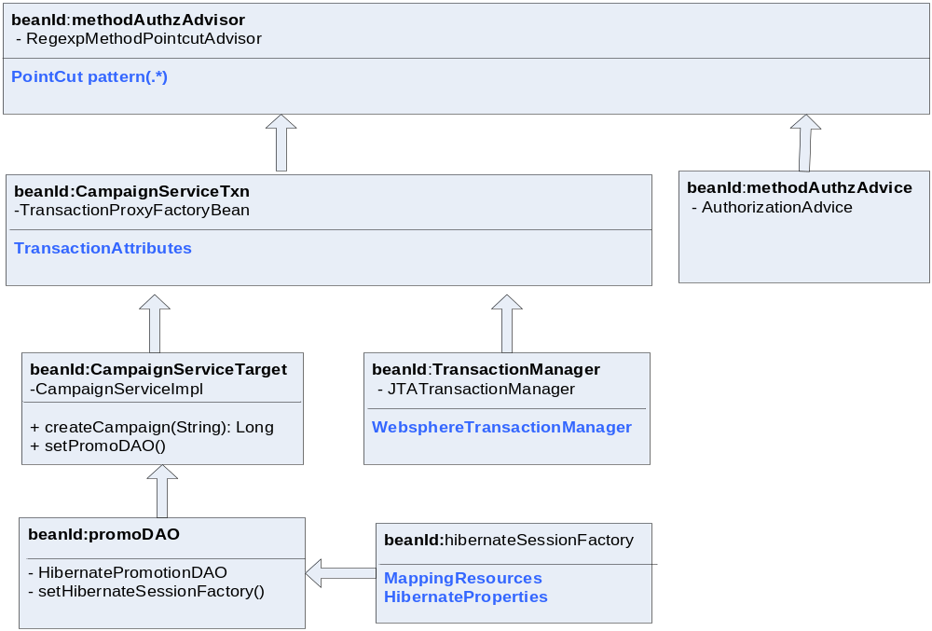
Spring Interceptor Injection

Slide 50
Incorporating Advice in Service
<bean id=“promotionService" class="org.springframework.aop.framework.ProxyFactoryBean">
<property name="proxyInterfaces"> <value>com.corp.CampaignService</value>
</property>
<property name="target">
<ref local=“CampaignServiceTxn"/>
</property>
<property name="interceptorNames">
<list>
<value>methodAuthzAdvisor</value>
</list>
</property>
</bean>

Slide 51
Spring and Testing
Easier test driven development
Integration testing
  Can use a standalone Spring configuration with mock objects for testing.
  XMLApplicationContext or FileSystemApplicationContext to initialize Spring
Unit testing
  Dependency injection setter makes its very easy to perform unit tests.
  Allows tests outside the container without using the Spring container.
  Provides mock objects for Struts and DB tests

Slide 52
Other Spring Components
JavaMail helpers
JMS implementation
JNDI lookup
Integration with iText for PDF generation
Helper classes for Http Invocation and WebServices
.. and a whole lot of other abstractions

Slide 53
Resources/References
Spring – www.springframework.org
Inversion of Control - http://www.martinfowler.com/articles/injection.html
Java Development With Spring Framework – Johnson, Hoeller et al.
Spring in Action – Walls, Breidenbach

