Slide 1
Intro to Spring
CJUG - January 2013

Slide 2
What is Spring?
“The Spring framework provides central transaction control of various objects.”
This means that any number of diverse systems, platforms, environments can be centrally managed – very appealing in today’s complicated development stack environment.

Slide 3
How does Spring do it?
Spring controls instantiation of all the objects and passes a Spring reference to these objects using various DI – Dependency Injection techniques like getter/setter injection, and constructor injection (aka IoC - Inversion of Control).

Slide 4
Any other benefits?
Hot swapping, efficient testing, faster coding, and does not require complex JNDI code!
Spring has layered architecture. Use what you need and leave you don't need now.
Spring Enables POJO Programming, thus POJO programming enables continuous integration and testability.
Dependency Injection and Inversion of Control Simplifies JDBC
Open source and no vendor lock-in.

Slide 5
Spring Features
Spring is lightweight when it comes to size, processing overhead and transparency (basic version is around 1Meg.
Loose coupling is achieved in Spring using Inversion of Control. The objects give their dependencies instead of creating or looking for dependent objects.
Spring supports Aspect oriented programming and enables cohesive development by separating application business logic from system services.
Spring contains and manages the life cycle and configuration of application objects.
Spring comes with MVC web application framework, built on core Spring functionality. This framework is highly configurable via strategy interfaces, and accommodates multiple view technologies like JSP, Velocity, Tiles, iText, and POI. But other frameworks can be easily used instead of Spring MVC Framework.
Spring framework provides a generic abstraction layer for transaction management. This allowing the developer to add the pluggable transaction managers, and making it easy to demarcate transactions without dealing with low-level issues. Spring's transaction support is not tied to J2EE environments and it can be also used in container less environments.
The JDBC abstraction layer of the Spring offers a meaningful exception hierarchy, which simplifies the error handling strategy. Integration with Hibernate, JDO, and iBATIS: Spring provides best Integration services with Hibernate, JDO and iBATIS

Slide 6
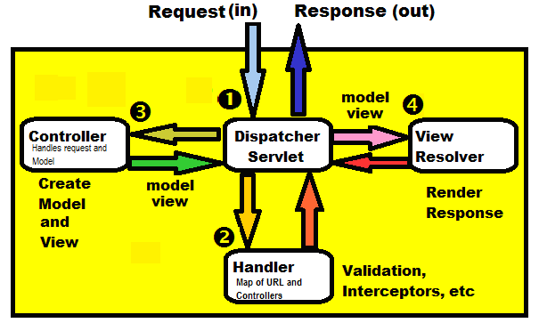
Spring MVC
Spring MVC operates via 4 key steps…

Slide 7
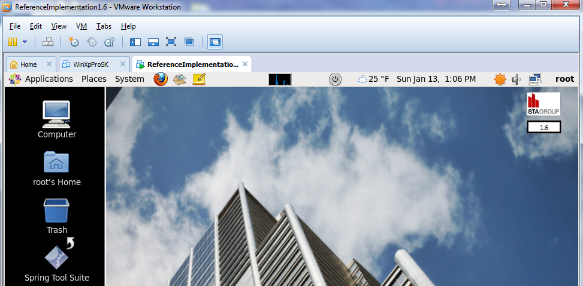
Spring JPetstore MVC Sample
Based on today’s schedule, we only have enough time to review a quick Spring sample. We will use the CJUG Reference Implementation a fully functional Sandbox for many Java technologies. Spring provides JPetstore sample app.

Slide 8
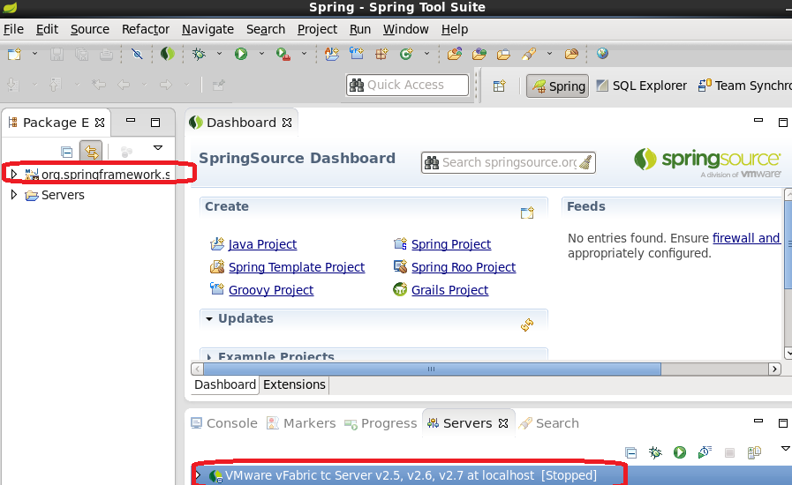
Spring JPetstore MVC Sample
Starting Spring Tool Source, you need to start up the tcServer

Slide 9
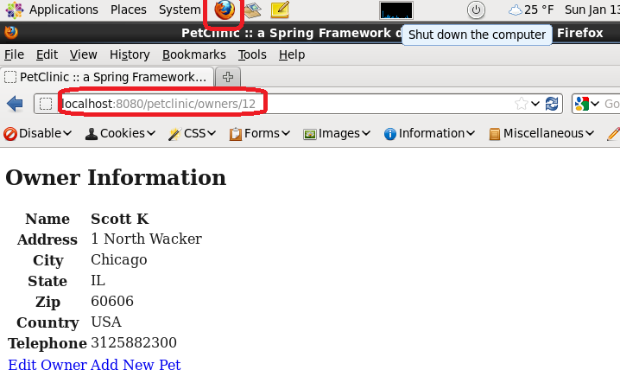
Spring JPetstore MVC Sample
Test out the example by opening Firefox and loading up a few sample pages (example: owner)

Slide 10
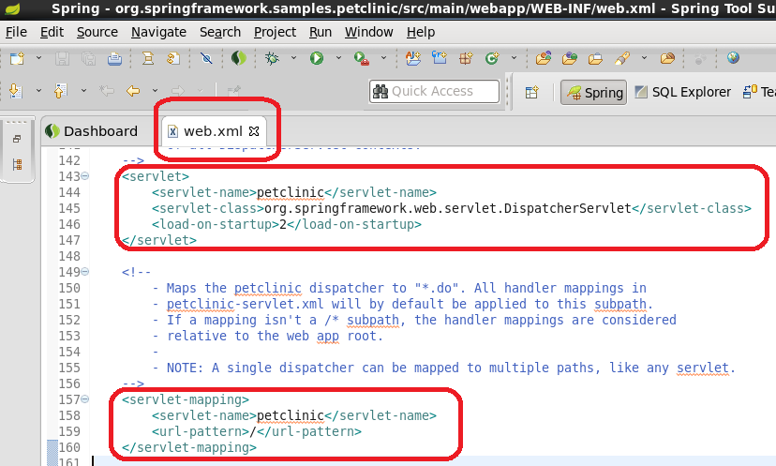
Spring JPetstore MVC Sample
In the web.xml, implement Spring MVC first with the Spring “DispatcherServlet”

Slide 11
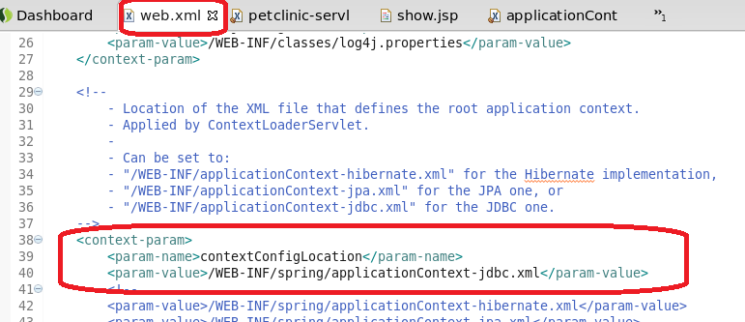
Spring JPetstore MVC Sample
In the web.xml, add any additional XML files spring needs.

Slide 12
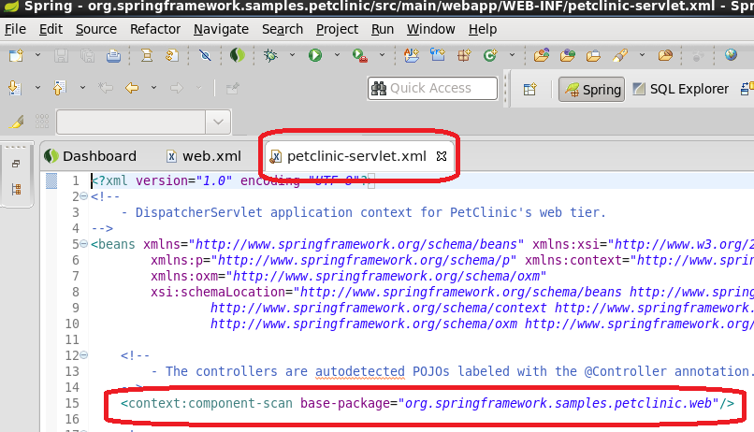
Spring JPetstore MVC Sample
The web.xml petclinic servlet will automatically look for the petclinic-servlet.xml file

Slide 13
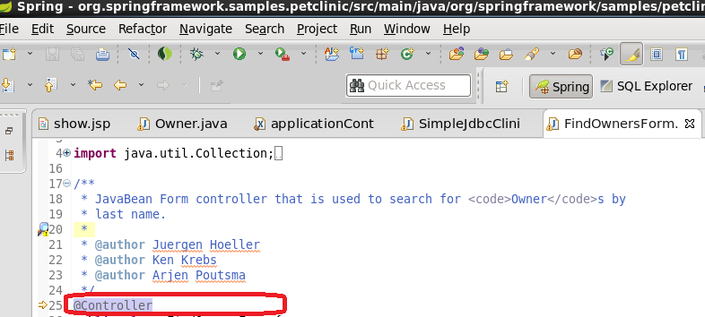
Spring JPetstore MVC Sample
Found Owner Controller…

Slide 14
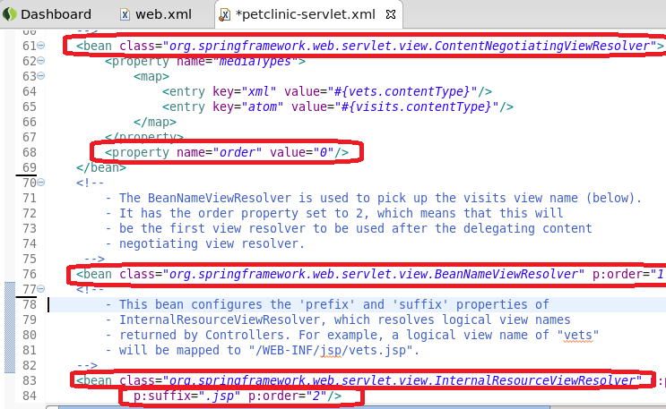
Spring JPetstore MVC Sample
Handle View Resolving…

Slide 15
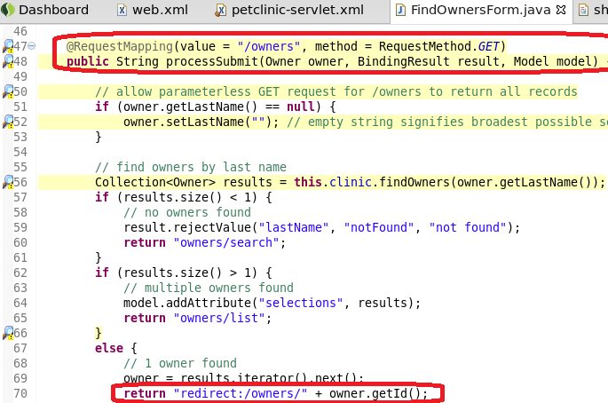
Spring JPetstore MVC Sample
Controller redirect to owners…

