Slide 1
SignalR
Alexander Yonchev
Gencho Draganov
Svetozar Mitrov

Slide 2
What is SignalR and what problems does it solve?

Slide 3
Good candidates for SignalR
Applications that require high frequency updates from the server.
Dashboards and monitoring applications.
Collaborative applications.
Applications that require notifications.

Slide 4
Connection types

Slide 5
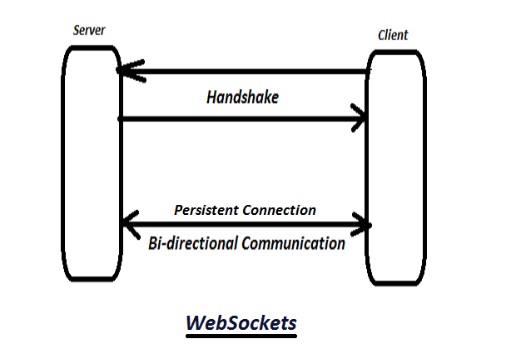
WebSockets

Slide 6
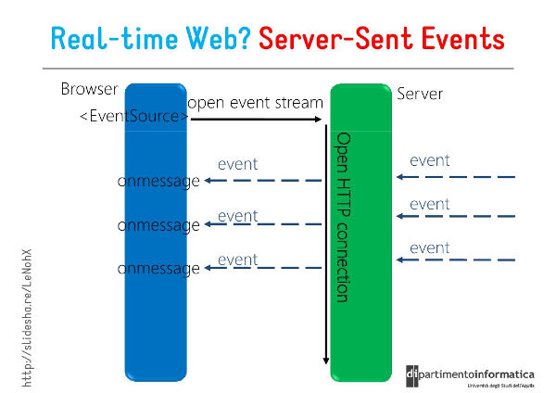
Server-Sent Events

Slide 7
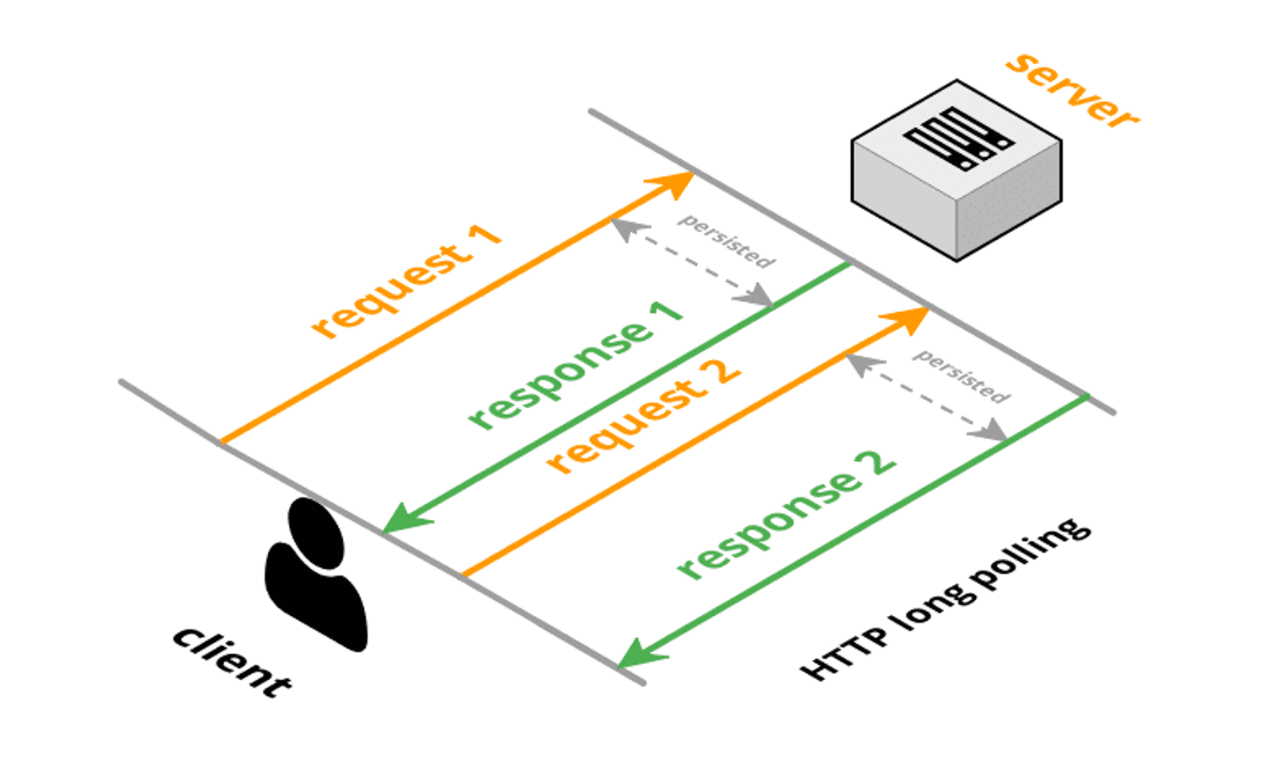
Long Polling

Slide 8
Hubs
SignalR uses hubs to communicate between clients and servers.
What exactly are Hubs?
JSON and Massage Pack
How Hubs work?

Slide 9
Demo – Bull Market

Slide 10
Core features
Starting the connection
Events on the server
Events on the client
Notifying all clients
Notifying groups
Notifying users
Strongly typed hubs
Authorization
Hub life cycle events

Slide 11
Thank you for your time!

