Slide 1
DarkLight Weekly Report
March 3, 2026
Dean Reiter

Slide 2
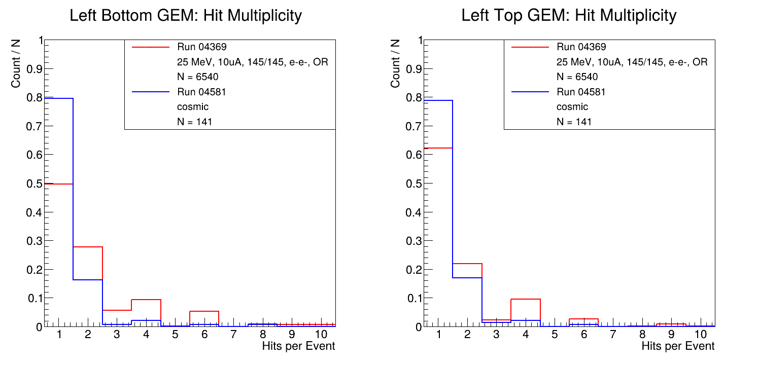
Last week

Slide 3
Last week

Slide 4
Last week
Questions
Why are there consistently fewer events with 3, 5, 7 hits?
Why does GEMTrack save a small fraction of events from each run?

Slide 5
Summary
Read through most of the GEMini code
Solved question 1
Probably solved question 2
Still working on histograms to compare
  Hit multiplicity in cosmic vs beam data
  GEM vs trigger hits
  GEM hits before vs after track selection

Slide 6
GEM Analysis Overview
GEMini
GEMTrack
Raw Data
Clusters
Tracks

Slide 7
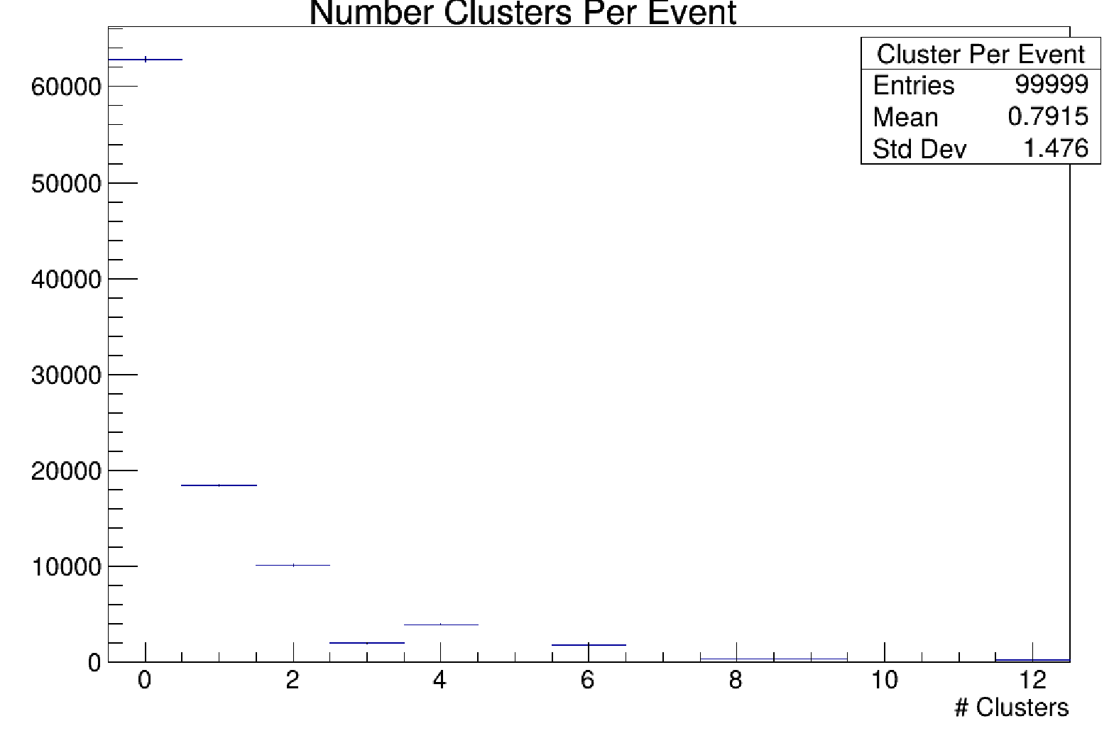
Question 1
Similar pattern observed before track selection

Slide 8
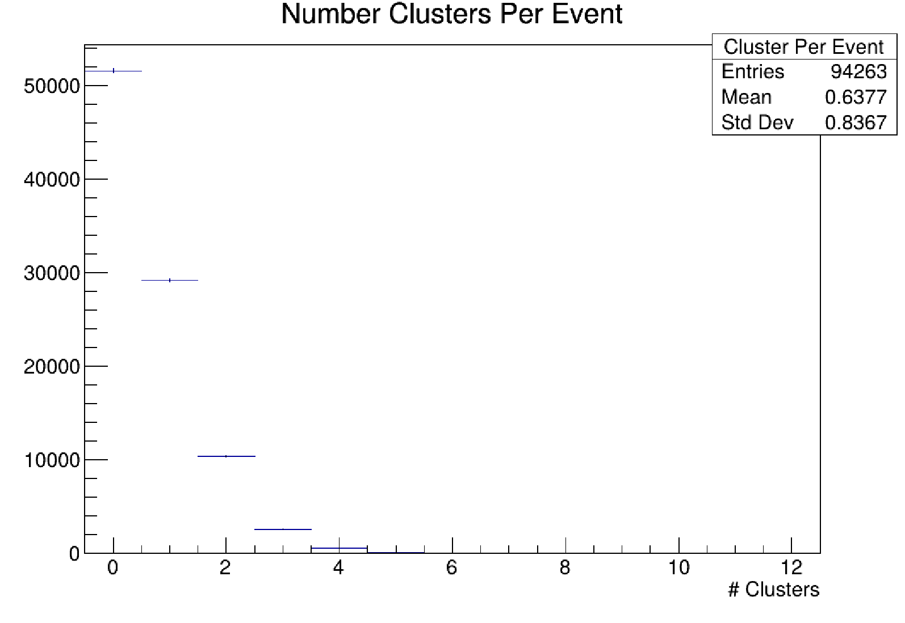
Pattern does not appear when you look at number of clusters on one axis
X axis

Slide 9
Question 1
GEM signals on X axis and Y axis are not correlated
3 Hits

Slide 10
Question 1
We do not know exact number or position of hits
3 Hits → 6 Hits
3 Hits

Slide 11
Question 1
5 hits is unlikely

Slide 12
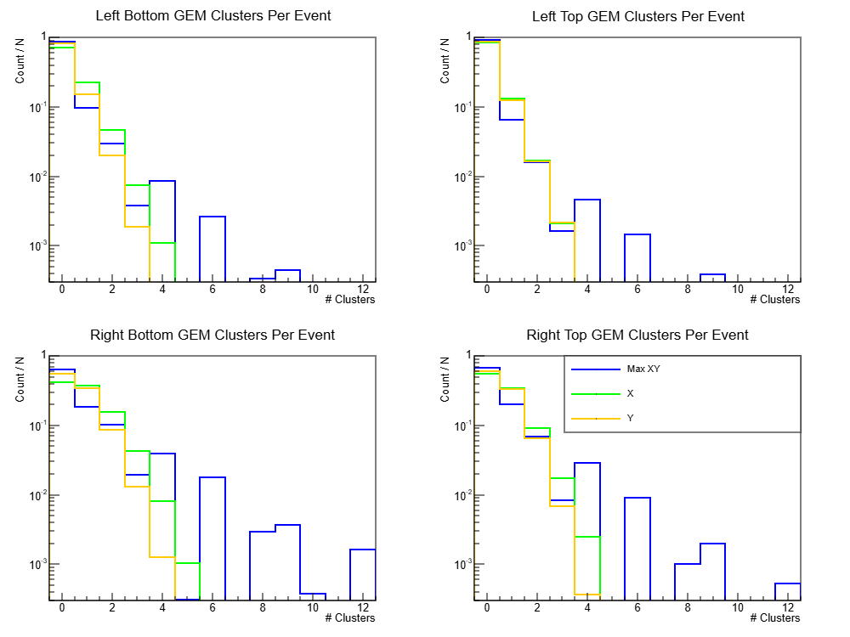
Question 1

Slide 13
Question 2
Self explanatory
Not all triggered events will have hits in both GEMs (needed for good track)

