Slide 1
DarkLight Trigger System’s MIDAS Controls
A super brief crash course by Gabby Gelinas

Slide 2
Accessing MIDAS
Link: https://daq17.triumf.ca
Username: dldaq
Password: 1eanpk_dl
If it doesn’t work, try using Google Chrome on TRIUMF Secure.

Slide 3
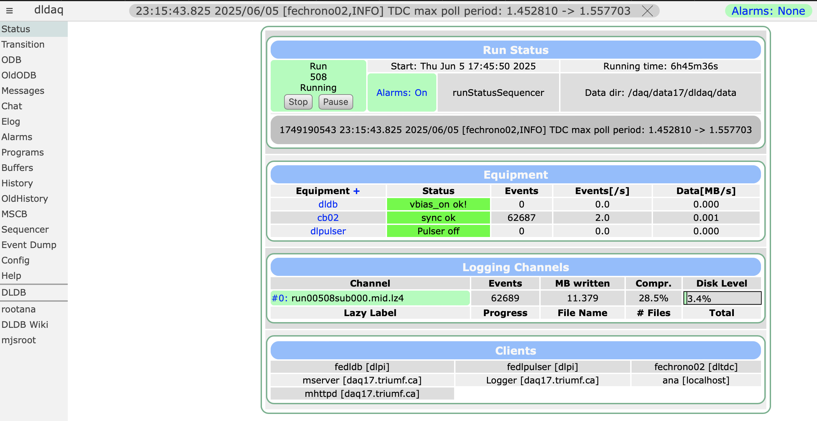
Landing page
Start and stop runs
DarkLight :)
Full error messages
Restart components if they crash (if you see red on this screen for example)
Rates, temperature and bias voltage plots
Controls panel. Low voltage and distribution board
View root plots for the current run. Only available when a run is active

Slide 4
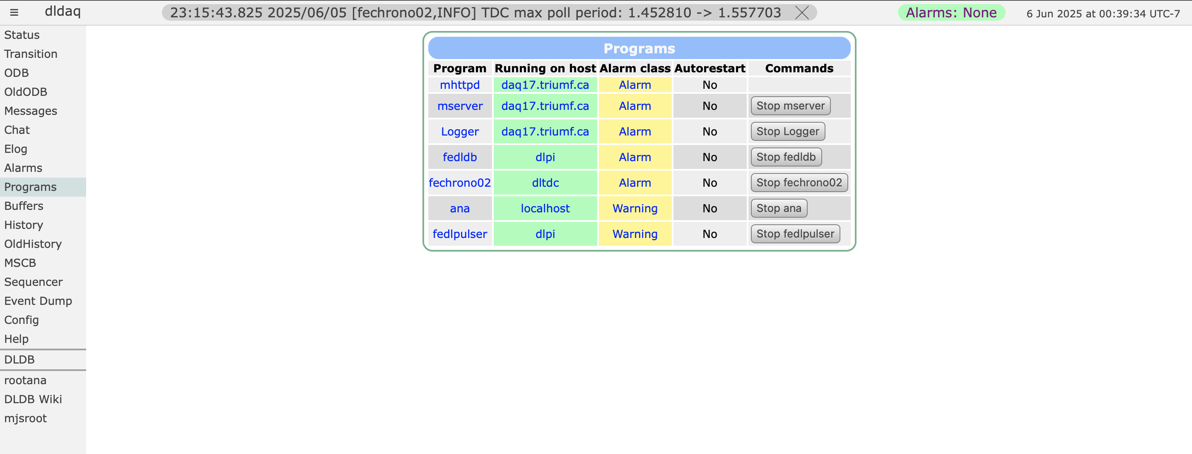
Programs Page
Everything should be green/yellow exactly like this when everything is working! If one thing is red you can try restarting just that component, but usually we would restart everything leading up to it to.

Slide 5
History
Rates should be less than 10 when using cosmic rays. If they are much higher, it means you forgot to set the threshold (see later slides).
Temperatures are not calibrated right now. Sidney is going to do that once we start plugging in the 8 scintillator frames in the GEMs lab.
This means do not take absolute temperatures seriously until Sidney is done (except for 5E and 14N since they are calibrated).
Bias shows you the bias at each board (eB1-8 and pB1-8) and at the distribution board (vbias), and the current at the distribution board (ibias). Vbias and ibias should match what you see at the high voltage power supply.
Rates_A and rates_B show the rates for the electron (A) and positron (B) arms separately

Slide 6
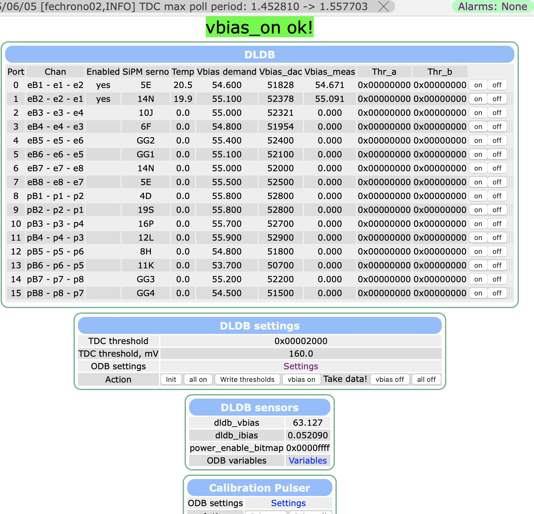
DLDB
Board. Format of board ID- scintillator ID – scintillator ID. Compare to TDC mapping file for reference.
Thresholds can be applied commonly to all boards, or you can give a different one to one board. This is a per board threshold. A for electron, B for positron. Entered in a number that converts to hex. Our standard starting point is 80 mV (enter “4096”).
Must be set to “yes” to use the board. Will give an error if you try to send voltage to a board that’s not enabled.
Board serial number. Labelled on the back of the board. Needs to be updated based on how the frames are installed (i.e. make the serial number match the chan column). Labels of the form “GG#” were temporary and you won’t see them on the filled frames.
Voltage measured at the boards. I am going to teach Sidney and Andy how to do this on June 6.
Voltage you asked for in “ODB settings”
Temperature

Slide 7
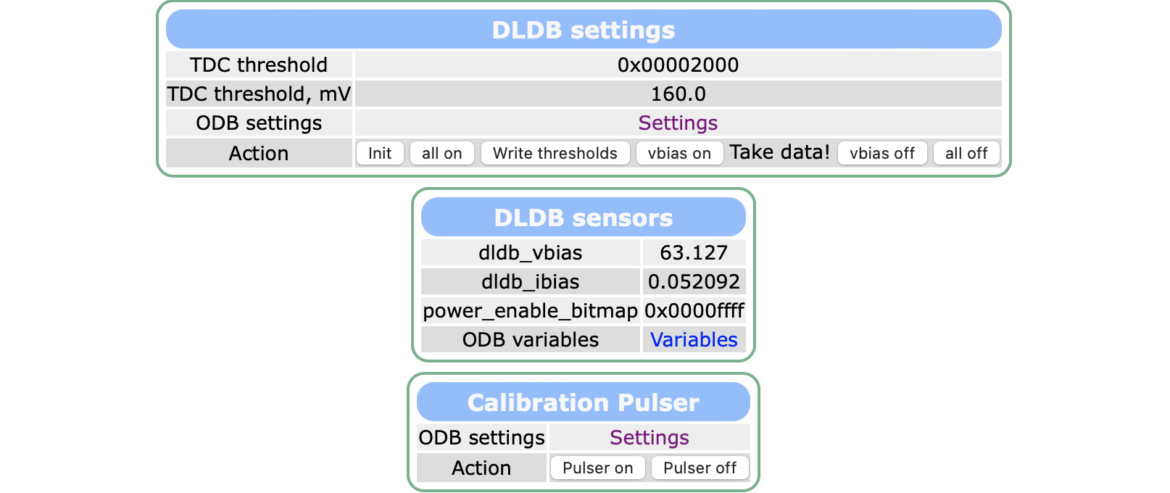
DLDB
Where you go to change voltage, threshold, serial number, enabled, and calibration settings. Shown on the next slide.
Common threshold
Whole row is on/off controls
Voltage (V) and current (A) at the distribution board. Should match high voltage power supply.
Calibration pulse on and off

Slide 8
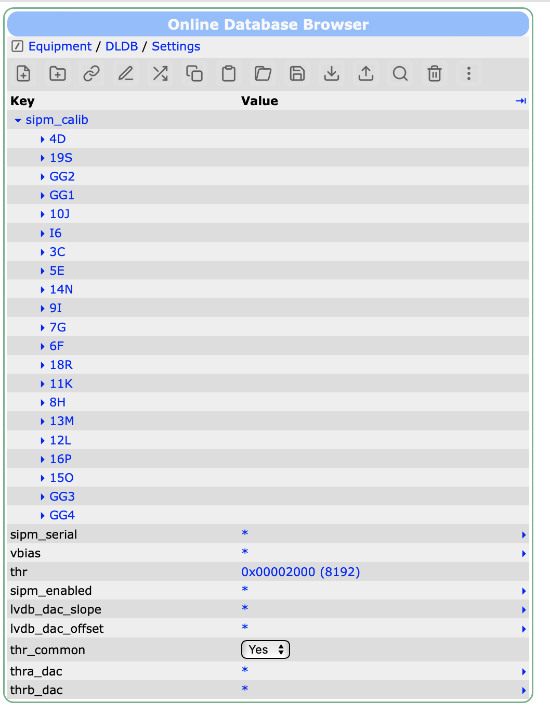
DLDB: ODB Settings
Open The “settings” link from the “ODB settings” row of “DLDB settings”
All of these will give you a drop-down menu so you can make edits per board. With the exception of sipm_calib, all of them will be ordered as eB1, eB2, eB3, .., eB8, pB1, pB2, …, pB8. sipm_enabled doesn’t have numbers beside each option like the vbias list does, but it counts the same way.
Where you enter temperature and voltage calibration information
To edit a value, all you need to do is edit it and then click outside of the box for it to be saved. To apply a vbias or threshold change to the system you need to go back to the main DLDB page using the side bar on the left and press “vbias on” to apply voltage changes, and “write thresholds” to apply threshold changes (assuming the system is already running).
Common threshold
Individual thresholds

Slide 9
Turning on
Turn low voltage power supply on
Open DLDB page and identify the row labelled “Action”. All of the buttons I am referring to are there.
Click “init” to initialize the system. If you get an error, press it again.
Click “all on” to send low voltage power to all enabled boards. Boards should read a vbias_meas of less than 2 V. Don’t worry if they are negative, it’s just from calibration offsets since we don’t calibrate near zero.
Click “write thresholds”.
Turn on the high voltage power supply. Using the voltage knob only, bring it to 30-40 V. Press the green “output” button
Click “vbias on”.
Increase the voltage on the high voltage power supply to 63 V.
Make sure vbias_meas is approximately equal to vbias_demand.
Go to the history tab and make sure the rates are reasonable.
Take data or do what you need to do.

Slide 10
Turning it off
In the action row of DLDB, click “vbias off”.
Click “all off”
Turn the high voltage power supply down to 30-40 V and stop the output. Turn it off if needed.
Turn the low voltage power supplies off if needed.
The power supplies only need to be turned off if you are physically interacting with the hardware.

