Slide 1
Introduction
By Ms. Ankita S Joshi

Slide 2
Database System Architectures
The Database Management System (DBMS) architecture shows how data in the database is viewed by the users. It is not concerned about how the data are handled and processed by the DBMS.
It helps in implementation, design, and maintenance of a database to store and organize information for companies. The concept of DBMS depends upon its architecture. The architecture can be designed as centralized, decentralized, or hierarchical.

Slide 3
Centralized Architecture
In Centralized Architecture, the mainframe computers are used for processing all system functions including User application Programs and User Interface Programs as well as DBMS functionalities. This is because in earlier days, most users accessed such systems via Computer Terminals, which can’t Process and they have only display capability. Therefore the Processing used to takeplace in these Computer Systems and the display information is sent to display terminals and these terminals are connected to mainframe computers via various kinds of Networks.

Slide 4
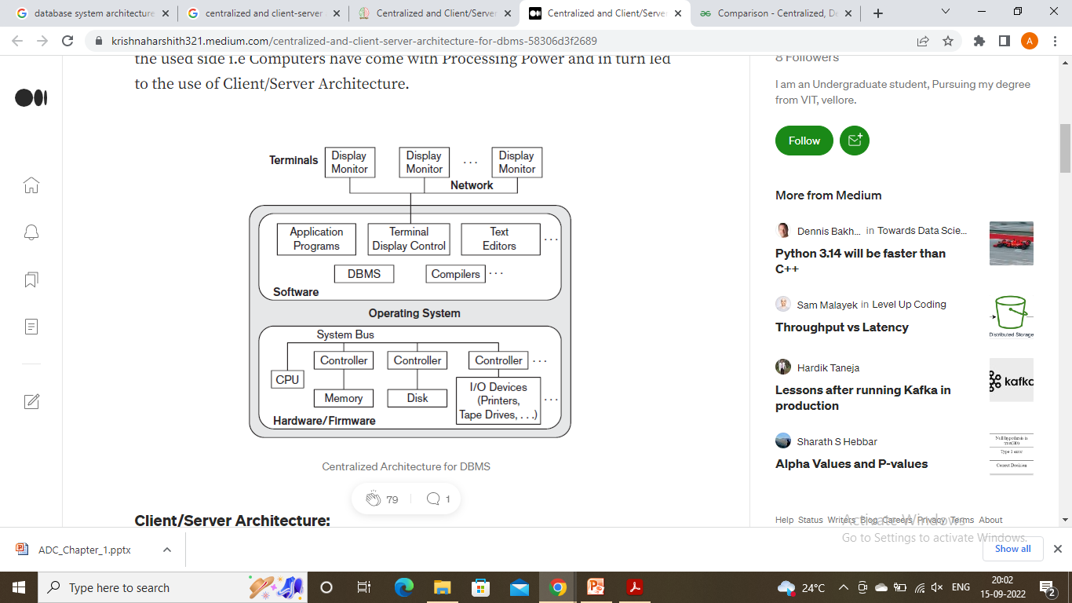
Centralized Architecture

Slide 5
Database System Architectures
Database architecture can be seen as a single tier or multi-tier. But logically, database architecture is of three types like: 1-tier architecture, 2-tier architecture and 3-tier architecture.
1-Tier Architecture
In this architecture, the database is directly available to the user. It means the user can directly sit on the DBMS and uses it.
Any changes done here will directly be done on the database itself. It doesn't provide a handy tool for end users.
The 1-Tier architecture is used for development of the local application, where programmers can directly communicate with the database for the quick response.

Slide 6
2-Tier Architecture
The 2-Tier architecture is same as basic client-server. In the two-tier architecture, applications on the client end can directly communicate with the database at the server side. For this interaction, API's like: ODBC, JDBC are used.
The user interfaces and application programs are run on the client-side.
The server side is responsible to provide the functionalities like: query processing and transaction management.
To communicate with the DBMS, client-side application establishes a connection with the server side.

Slide 7
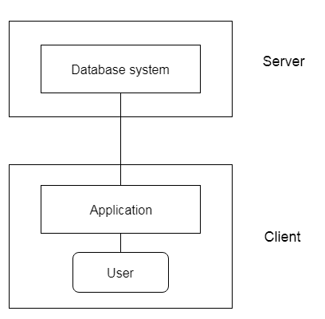
2-Tier Architecture

Slide 8
3-Tier Architecture
The 3-Tier architecture contains another layer between the client and server. In this architecture, client can't directly communicate with the server.
The application on the client-end interacts with an application server which further communicates with the database system.
End user has no idea about the existence of the database beyond the application server. The database also has no idea about any other user beyond the application.
The 3-Tier architecture is used in case of large web application.

Slide 9
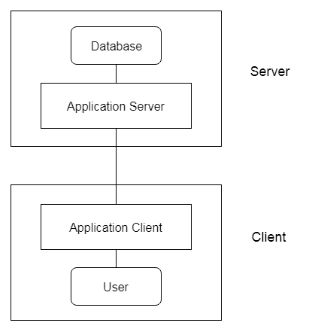
3-Tier Architecture

Slide 10
Database System Architectures
The architecture of DBMS can be defined at three levels as follows −
External levels.
Conceptual levels.
Internal levels.
The main objective of the three level architecture is nothing but to separate each user view of the data from the way the database is physically represented. The database internal structure should be unaffected while changes to the physical aspects of storage.
The DBA should be able to change the conceptual structure of the database without affecting all other users.

Slide 11
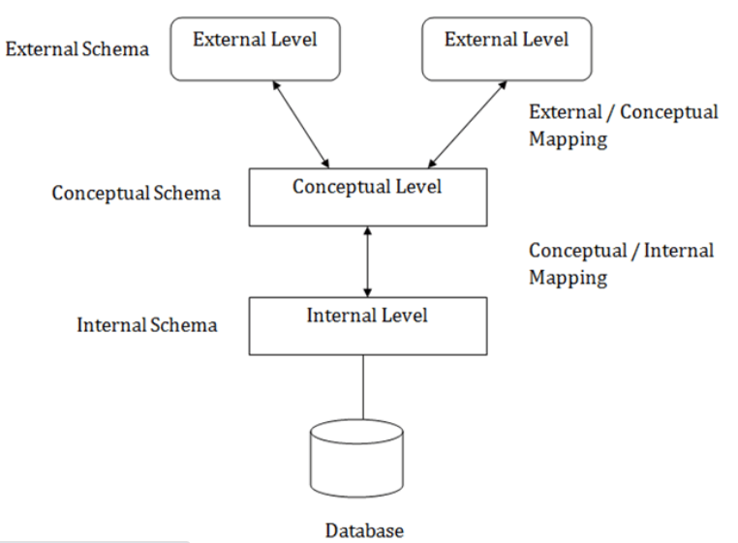

Slide 12
Server System Architecture
It is broadly categorized into two kinds:
Transaction servers: which are widely used in RDBMS.
Data servers: used in object oriented database systems.

Slide 13
Parallel Databases
A parallel DBMS is a DBMS that runs across multiple processors and is designed to execute operations in parallel, whenever possible. The parallel DBMS link a number of smaller machines to achieve the same throughput as expected from a single large machine.
There are parallel working of CPUs
It improves performance
It divides large tasks into various other tasks
Completes works very quickly

Slide 14
Goals of Parallel Databases
Improve performance:
The performance of the system can be improved by connecting multiple CPU and disks in parallel. Many small processors can also be connected in parallel.
Improve availability of data:
Data can be copied to multiple locations to improve the availability of data.
Improve reliability:
Reliability of system is improved with completeness, accuracy and availability of data.
Provide distributed access of data:
Companies having many branches in multiple cities can access data with the help of parallel database system.

Slide 15
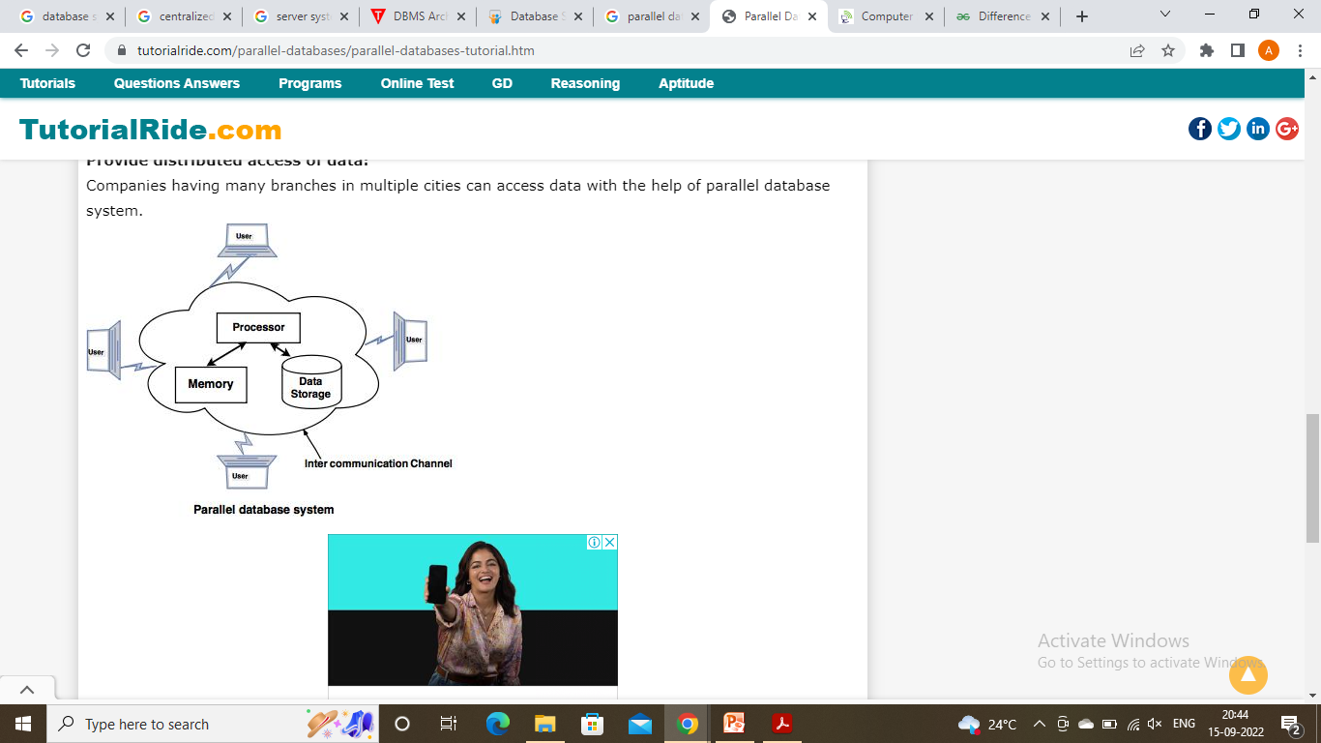
Parallel Databases

Slide 16
Shared Memory Architecture
In Shared Memory architecture, single memory is shared among many processors. several processors are connected through an interconnection network with Main memory and disk setup. Here interconnection network is usually a high speed network (may be Bus, Mesh, or Hypercube) which makes data sharing (transporting) easy among the various components (Processor, Memory, and Disk).

Slide 17
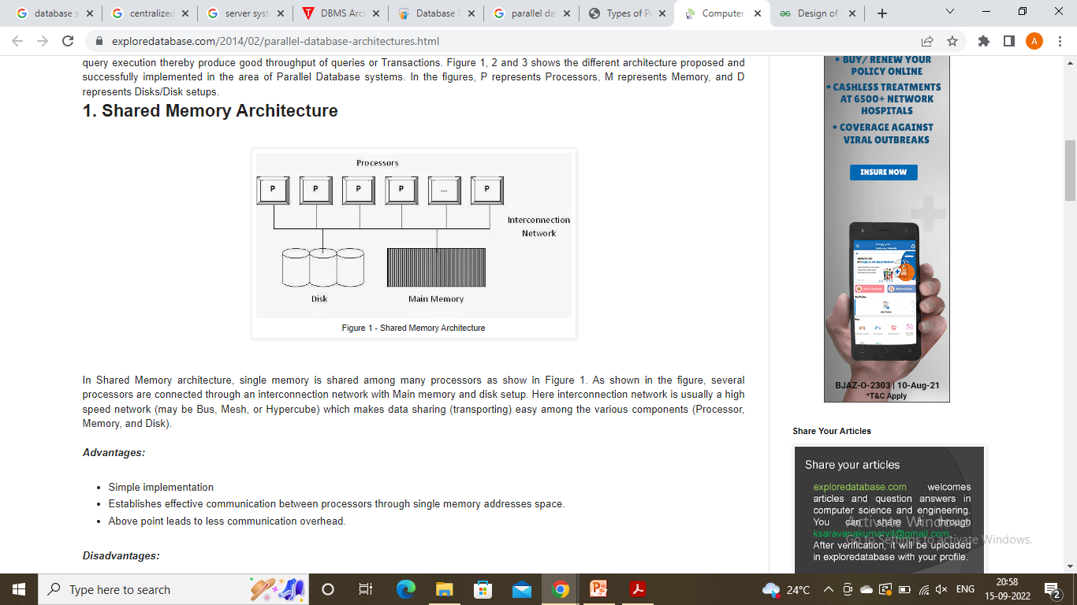
Shared Memory Architecture

Slide 18
Shared Memory Architecture
Advantages:
Simple implementation
Establishes effective communication between processors through single memory addresses space.
Above point leads to less communication overhead.
Disadvantages:
Higher degree of parallelism (more number of concurrent operations in different processors) cannot be achieved due to the reason that all the processors share the same interconnection network to connect with memory. This causes Bottleneck in interconnection network (Interference), especially in the case of Bus interconnection network.
Addition of processor would slow down the existing processors.
Cache-coherency should be maintained. That is, if any processor tries to read the data used or modified by other processors, then we need to ensure that the data is of latest version.
Degree of Parallelism is limited. More number of parallel processes might degrade the performance.

Slide 19
Shared Disk architecture
Single disk or single disk setup is shared among all the available processors and also all the processors have their own private memories.
Advantages:
Failure of any processors would not stop the entire system (Fault tolerance)
Support larger number of processors (when compared to Shared Memory architecture)
Disadvantages:
Inter-processor communication is slow. The reason is, all the processors have their own memory. Hence, the communication between processors need reading of data from other processors’ memory which needs additional software support.

Slide 20
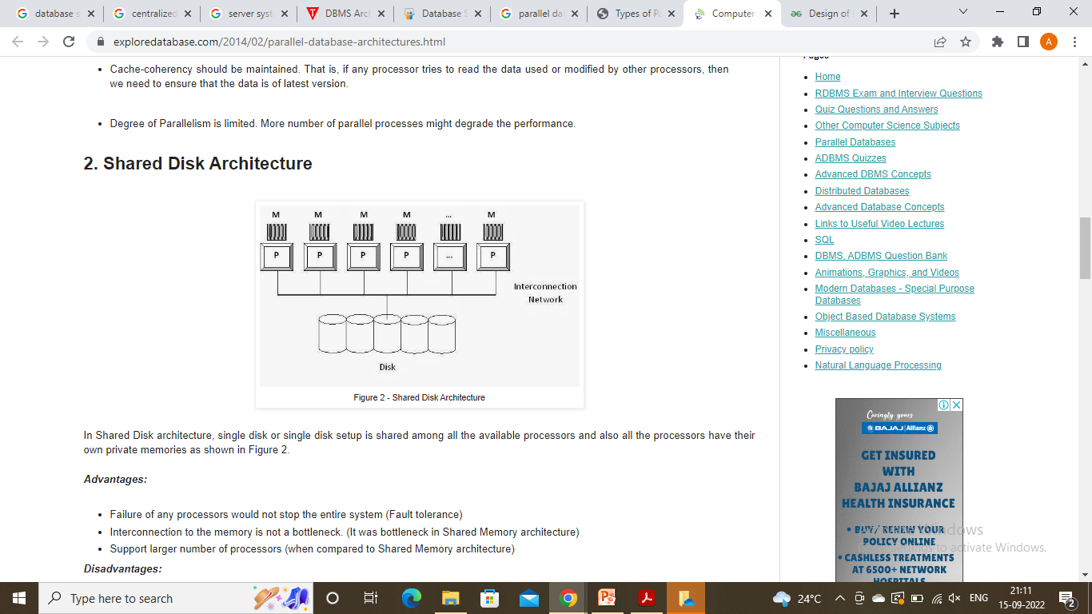
Shared Disk architecture

Slide 21
Shared Nothing architecture
Every processor has its own memory and disk setup. This setup may be considered as set of individual computers connected through high speed interconnection network using regular network protocols and switches for example to share data between computers. (This architecture is used in the Distributed Database System). In Shared Nothing parallel database system implementation, we insist the use of similar nodes that are Homogenous systems. (In distributed database System we may use Heterogeneous nodes)

Slide 22
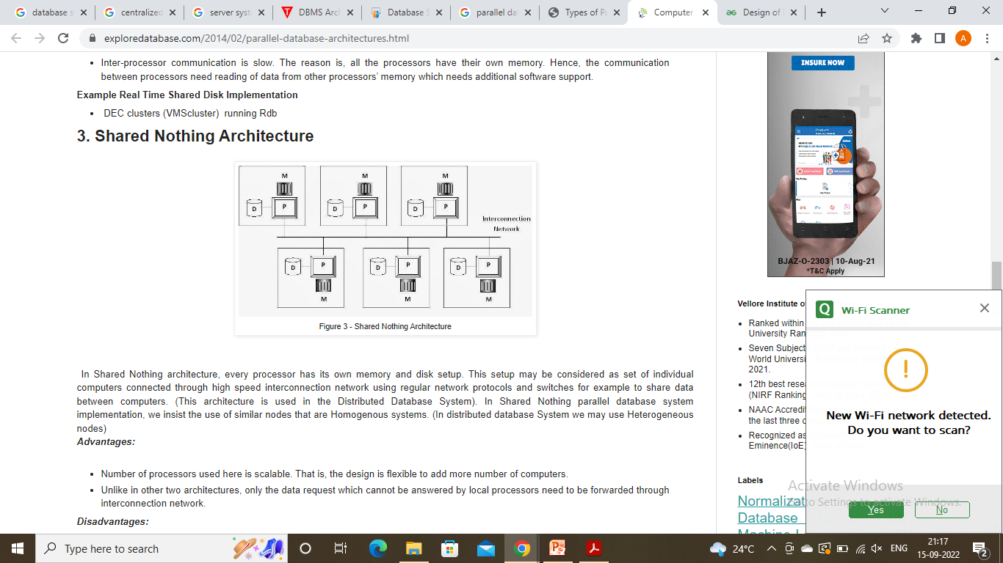
Shared Nothing architecture

Slide 23
Shared Nothing architecture
Advantages:
Number of processors used here is scalable. That is, the design is flexible to add more number of computers.
Unlike in other two architectures, only the data request which cannot be answered by local processors need to be forwarded through interconnection network.
Disadvantages:
Non-local disk accesses are costly. That is, if one server receives the request. If the required data not available, it must be routed to the server where the data is available. It is slightly complex.
Communication cost involved in transporting data among computers.

Slide 24
Distributed Database System
A distributed database is basically a database that is not limited to one system, it is spread over different sites, i.e, on multiple computers or over a network of computers. A distributed database system is located on various sites that don’t share physical components. This may be required when a particular database needs to be accessed by various users globally. It needs to be managed such that for the users it looks like one single database.

Slide 25
Types
Homogeneous Database: In a homogeneous database, all different sites store database identically. The operating system, database management system, and the data structures used – all are the same at all sites. Hence, they’re easy to manage.
Heterogeneous Database: In a heterogeneous distributed database, different sites can use different schema and software that can lead to problems in query processing and transactions. Also, a particular site might be completely unaware of the other sites. Different computers may use a different operating system, different database application. They may even use different data models for the database. Hence, translations are required for different sites to communicate.

Slide 26
Thank you…..

