Slide 1
Distributed Databases
By Mrs. Ankita Joshi

Slide 2
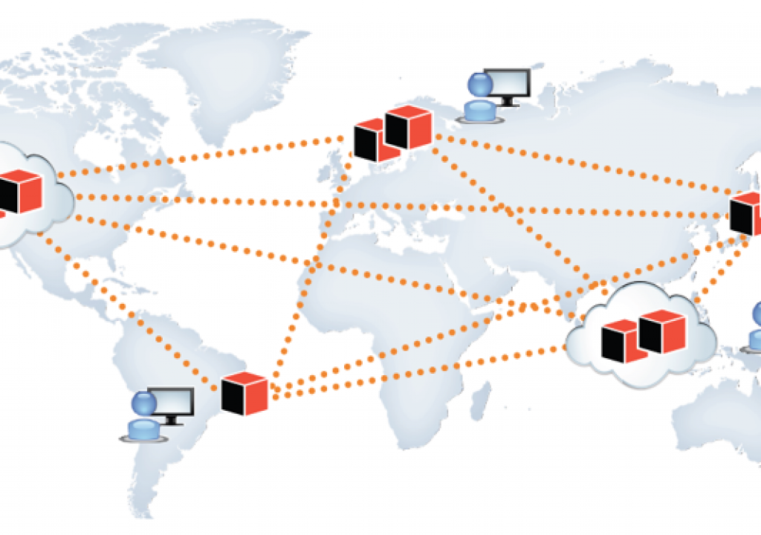

Slide 3
Data center
https://www.datacenters.com/facebook-data-center-locations?page=1&per_page=40&query=&withProducts=false&showHidden=false&radius=50&bounds=&circleBounds=&polygonPath=
https://aws.amazon.com/about-aws/global-infrastructure/

Slide 4
Distributed Database
A distributed database is a database that consists of two or more files located in different sites either on the same network or on entirely different networks. Portions of the database are stored in multiple physical locations and processing is distributed among multiple database nodes.
In a distributed database, there are a number of databases that may be geographically distributed all over the world. A distributed DBMS manages the distributed database in a manner so that it appears as one single database to users.

Slide 5
Distributed Database
A distributed database is a collection of multiple interconnected databases, which are spread physically across various locations that communicate via a computer network.

Slide 6
Features
Databases in the collection are logically interrelated with each other. Often they represent a single logical database.
Data is physically stored across multiple sites. Data in each site can be managed by a DBMS independent of the other sites.
The processors in the sites are connected via a network. They do not have any multiprocessor configuration.
A distributed database is not a loosely connected file system.
A distributed database incorporates transaction processing, but it is not synonymous with a transaction processing system.

Slide 7
Distributed Database Management System
A distributed database management system (DDBMS) is a centralized software system that manages a distributed database in a manner as if it were all stored in a single location.
The DDBMS synchronizes all the data periodically and ensures that data updates and deletes performed at one location will be automatically reflected in the data stored elsewhere.
By contrast, a centralized database consists of a single database file located at one site using a single network.

Slide 8
Features
It is used to create, retrieve, update and delete distributed databases.
It synchronizes the database periodically and provides access mechanisms by the virtue of which the distribution becomes transparent to the users.
It ensures that the data modified at any site is universally updated.
It is used in application areas where large volumes of data are processed and accessed by numerous users simultaneously.
It is designed for heterogeneous database platforms.
It maintains confidentiality and data integrity of the databases.

Slide 9
Commercial Distributed DBMS Software
Apache Cassandra
Apache Cassandra is an open-source, NoSQL, distributed database management system that provides high scalability and high availability.
Apache HBase
Apache HBase is also an open-source, NoSQL, distributed database management system used for Big Data storage. It is written in Java.
Amazon SimpleDB
Amazon SimpleDB is a NoSQL, distributed database which is available as a part of Amazon Web Services. It is written in Erlang.

Slide 10
Commercial Distributed DBMS Software
Clusterpoint
Clusterpoint is a schema-less database that allows the distribution of data. It also provides cross-platform support.
FoundationDB
FoundationDB is a NoSQL, distributed database that stores ordered key-value pairs. It was designed and developed by Apple.

Slide 11
Advantages of Distributed Databases
Modular Development − If the system needs to be expanded to new locations or new units, in centralized database systems, the action requires substantial efforts and disruption in the existing functioning. However, in distributed databases, the work simply requires adding new computers and local data to the new site and finally connecting them to the distributed system, with no interruption in current functions.
More Reliable − In case of database failures, the total system of centralized databases comes to a halt. However, in distributed systems, when a component fails, the functioning of the system continues may be at a reduced performance. Hence DDBMS is more reliable.

Slide 12
Advantages of Distributed Databases
Better Response − If data is distributed in an efficient manner, then user requests can be met from local data itself, thus providing faster response. On the other hand, in centralized systems, all queries have to pass through the central computer for processing, which increases the response time.
Lower Communication Cost − In distributed database systems, if data is located locally where it is mostly used, then the communication costs for data manipulation can be minimized. This is not feasible in centralized systems.

Slide 13
Disadvantages
Need for complex and expensive software − DDBMS demands complex and often expensive software to provide data transparency and co-ordination across the several sites.
Processing overhead − Even simple operations may require a large number of communications and additional calculations to provide uniformity in data across the sites.
Data integrity − The need for updating data in multiple sites pose problems of data integrity.
Overheads for improper data distribution − Responsiveness of queries is largely dependent upon proper data distribution. Improper data distribution often leads to

Slide 14
Goals of Distributed Databases
Reliability
Distributed database management system is more reliable if any of the connected computer system is failed to perform then other computers can complete the task without delay.
Availability
If a computer server fails to perform and stopped working in any time the other computer servers can perform the task as requested.
Performance
The data and information can be accessed from distributed database management systems from different locations. It is very easy to handle and maintain.

Slide 15
Types of Distributed Databases
Homogenous distributed database
Heterogeneous distributed database

Slide 16
Homogenous distributed database
A Homogenous distributed database is a network of identical databases stored on multiple sites. All databases stores data identically, the operating system, DDBMS and the data structures used – all are same at all sites, making them easy to manage.
Homogeneous DDBMS are much simpler to design, manage and add new a new site. Homogeneous DDBMS can also improve the parallel processing capabilities of multiple sites.

Slide 17
Homogenous distributed database
There are two types of homogeneous distributed database −
Autonomous − Each database is independent that functions on its own. They are integrated by a controlling application and use message passing to share data updates.
Non-autonomous − Data is distributed across the homogeneous nodes and a central or master DBMS co-ordinates data updates across the sites.

Slide 18
Heterogeneous distributed database
It is the opposite of a Homogenous distributed database. It uses different schemas, operating systems, DDBMS, and different data models causing it difficult to manage.
In the case of a Heterogeneous distributed database, a particular site can be completely unaware of other sites. This causes limited cooperation in processing user requests, this is why translations are required to establish communication between sites.
Designing a heterogeneous DDBMS is much harder since the system must provide interoperability between different databases which may have different database management software and hardware.

Slide 19
Heterogeneous distributed database
Federated − The heterogeneous database systems are independent in nature and integrated together so that they function as a single database system.
Un-federated − The database systems employ a central coordinating module through which the databases are accessed.

Slide 20
Types of DDBMS
There are mainly 3 ways of storing the data in a distributed database.
Data Replication
Data Fragmentation
Hybrid

Slide 21
Data Replication
The same data is stored at more than one site. This improves the availability of the data as even if one site goes down, the data will still be available on the other sites.
It can also improve performance by providing faster access and reducing the need for data to travel over the network and hence improving performance.
However, replication does have the disadvantage of requiring more space to store duplicate data and when one table is updated all the copies of it must also be updated to maintain consistency.

Slide 22
Data Replication
Some commonly used replication techniques are −
Snapshot replication
Near-real-time replication
Pull replication

Slide 23
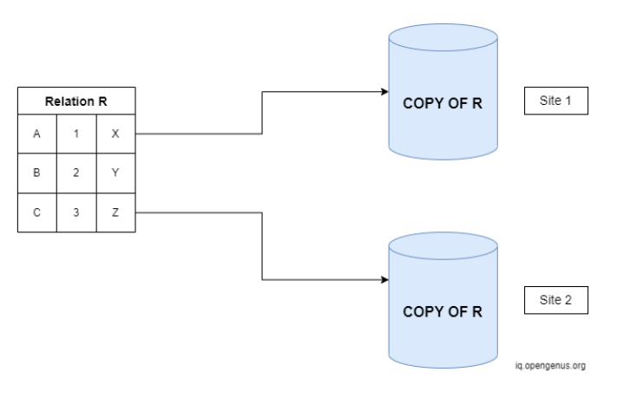
Data Replication

Slide 24
Advantages of Data Replication
Reliability
In case of failure of any site, the database system continues to work since a copy is available at another site(s).
Reduction in Network Load
Since local copies of data are available, query processing can be done with reduced network usage, particularly during prime hours. Data updating can be done at non-prime hours.
Quicker Response
Availability of local copies of data ensures quick query processing and consequently quick response time.
Simpler Transactions
Transactions require less number of joins of tables located at different sites and minimal coordination across the network. Thus, they become simpler in nature.

Slide 25
Disadvantages of Data Replication
Increased Storage Requirements
Maintaining multiple copies of data is associated with increased storage costs. The storage space required is in multiples of the storage required for a centralized system.
Increased Cost and Complexity of Data Updating
Each time a data item is updated, the update needs to be reflected in all the copies of the data at the different sites. This requires complex synchronization techniques and protocols.
Undesirable Application – Database coupling
If complex update mechanisms are not used, removing data inconsistency requires complex co-ordination at application level. This results in undesirable application – database coupling.

Slide 26
Data Fragmentation
The system fragments the relation into smaller parts and each part is stored at a different site. Usually, fragments are stored at sites where they are most accessed.
When a query is made, first the local database in the site is checked. If the data is not available on the local site then all the other sites are checked.
Fragmentation is the task of dividing a table into a set of smaller tables. The subsets of the table are called fragments.

Slide 27
Data Fragmentation
Fragmentation can be of three types: horizontal, vertical, and hybrid (combination of horizontal and vertical).
Horizontal fragmentation can further be classified into two techniques: primary horizontal fragmentation and derived horizontal fragmentation.
Fragmentation should be done in a way so that the original table can be reconstructed from the fragments. This is needed so that the original table can be reconstructed from the fragments whenever required. This requirement is called “re-constructiveness.”

Slide 28
Advantages of Fragmentation
Since data is stored close to the site of usage, efficiency of the database system is increased.
Local query optimization techniques are sufficient for most queries since data is locally available.
Since irrelevant data is not available at the sites, security and privacy of the database system can be maintained.

Slide 29
Disadvantages of Fragmentation
When data from different fragments are required, the access speeds may be very low.
In case of recursive fragmentations, the job of reconstruction will need expensive techniques.
Lack of back-up copies of data in different sites may render the database ineffective in case of failure of a site.

Slide 30
Vertical Fragmentation
In vertical fragmentation, the fields or columns of a table are grouped into fragments. In order to maintain re-constructiveness, each fragment should contain the primary key field(s) of the table. Vertical fragmentation can be used to enforce privacy of data.

Slide 31
Vertical Fragmentation
For example, let us consider that a University database keeps records of all registered students in a Student table having the following schema.
Now, the fees details are maintained in the accounts section. In this case, the designer will fragment the database as follows −
CREATE TABLE STD_FEES AS SELECT Regd_No, Fees FROM STUDENT;
Regd_No | Name | Course | Address | Semester | Fees | Marks

Slide 32
Horizontal fragmentation
Horizontal fragmentation groups the tuples of a table in accordance to values of one or more fields. Horizontal fragmentation should also confirm to the rule of re-constructiveness. Each horizontal fragment must have all columns of the original base table.

Slide 33
Horizontal fragmentation
For example, in the student schema, if the details of all students of Computer Science Course needs to be maintained at the School of Computer Science, then the designer will horizontally fragment the database as follows −
CREATE COMP_STD AS SELECT * FROM STUDENT WHERE COURSE = "Computer Science";

Slide 34
Hybrid Fragmentation
In hybrid fragmentation, a combination of horizontal and vertical fragmentation techniques are used. This is the most flexible fragmentation technique since it generates fragments with minimal extraneous information. However, reconstruction of the original table is often an expensive task.
Hybrid fragmentation can be done in two alternative ways −
At first, generate a set of horizontal fragments; then generate vertical fragments from one or more of the horizontal fragments.
At first, generate a set of vertical fragments; then generate horizontal fragments from one or more of the vertical fragments.

Slide 35
Hybrid
Hybrid data storage combines both data replication and fragmentation to get the benefits of both models.

Slide 36
Distribution transparency
Distribution transparency is the property of distributed databases by the virtue of which the internal details of the distribution are hidden from the users. The DDBMS designer may choose to fragment tables, replicate the fragments and store them at different sites. However, since users are oblivious of these details, they find the distributed database easy to use like any centralized database.

Slide 37
Distribution transparency
The three dimensions of distribution transparency are −
Location transparency
Fragmentation transparency
Replication transparency

Slide 38
Location Transparency
Location transparency ensures that the user can query on any table(s) or fragment(s) of a table as if they were stored locally in the user’s site.
The fact that the table or its fragments are stored at remote site in the distributed database system, should be completely oblivious to the end user. The address of the remote site(s) and the access mechanisms are completely hidden.
In order to incorporate location transparency, DDBMS should have access to updated and accurate data dictionary and DDBMS directory which contains the details of locations of data.

Slide 39
Fragmentation Transparency
Fragmentation transparency enables users to query upon any table as if it were unfragmented. Thus, it hides the fact that the table the user is querying on is actually a fragment or union of some fragments. It also conceals the fact that the fragments are located at diverse sites.
This is somewhat similar to users of SQL views, where the user may not know that they are using a view of a table instead of the table itself.

Slide 40
Replication Transparency
Replication transparency ensures that replication of databases are hidden from the users. It enables users to query upon a table as if only a single copy of the table exists.
Replication transparency is associated with concurrency transparency and failure transparency. Whenever a user updates a data item, the update is reflected in all the copies of the table.
However, this operation should not be known to the user. This is concurrency transparency. Also, in case of failure of a site, the user can still proceed with his queries using replicated copies without any knowledge of failure. This is failure transparency.

Slide 41
Combination of Transparencies
In any distributed database system, the designer should ensure that all the stated transparencies are maintained to a considerable extent.
The designer may choose to fragment tables, replicate them and store them at different sites; all oblivious to the end user. However, complete distribution transparency is a tough task and requires considerable design efforts.

Slide 42
Types of data replication
There are two types of data replication:
1. Synchronous Replication:
In synchronous replication, the replica will be modified immediately after some changes are made in the relation table. So there is no difference between original data and replica.
2. Asynchronous replication:
In asynchronous replication, the replica will be modified after commit is fired on to the database.

Slide 43
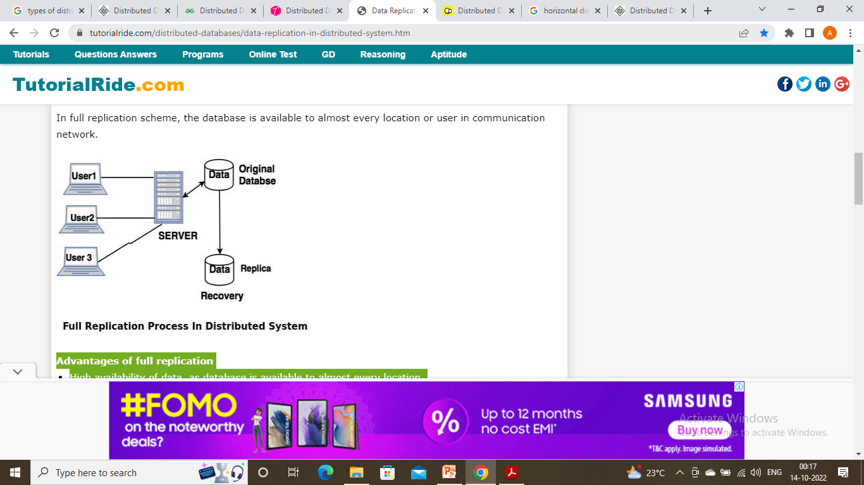
Replication Schemes
Full Replication
In full replication scheme, the database is available to almost every location or user in communication network.

Slide 44
Full Replication
Advantages of full replication
High availability of data, as database is available to almost every location.
Faster execution of queries.
Disadvantages of full replication
Concurrency control is difficult to achieve in full replication.
Update operation is slower.

Slide 45
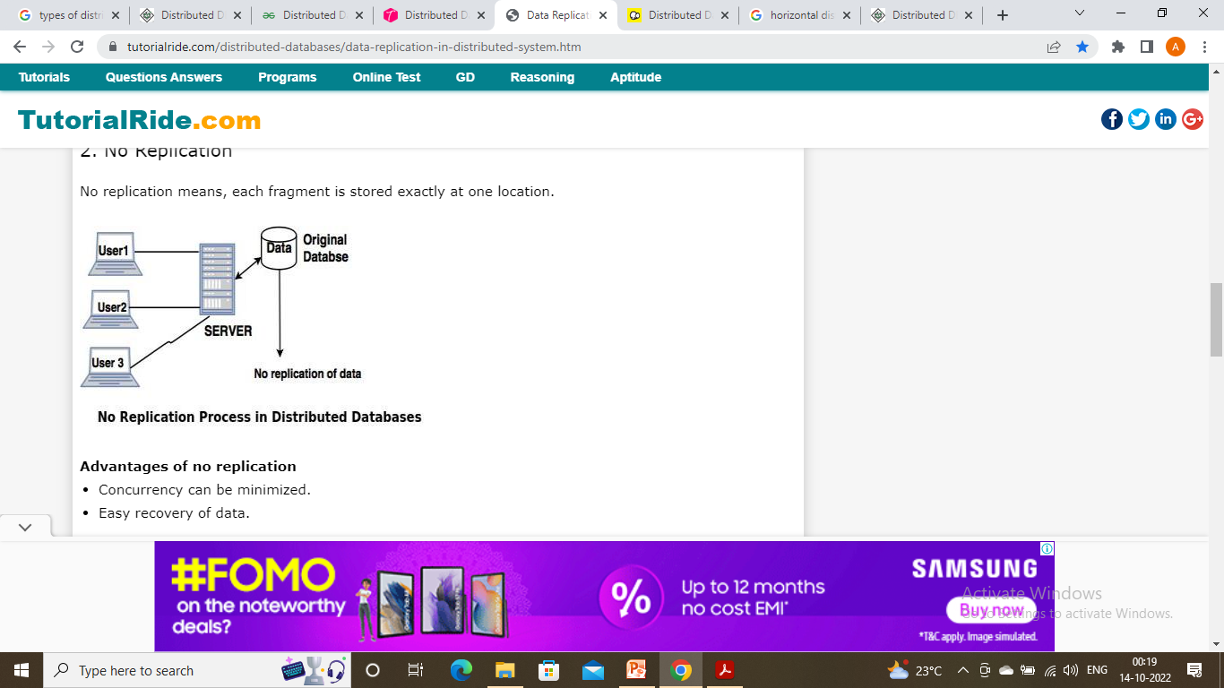
No replication
No replication means, each fragment is stored exactly at one location.

Slide 46
No replication
Advantages of no replication
Concurrency can be minimized.
Easy recovery of data.
Disadvantages of no replication
Poor availability of data.
Slows down the query execution process, as multiple clients are accessing the same server.

Slide 47
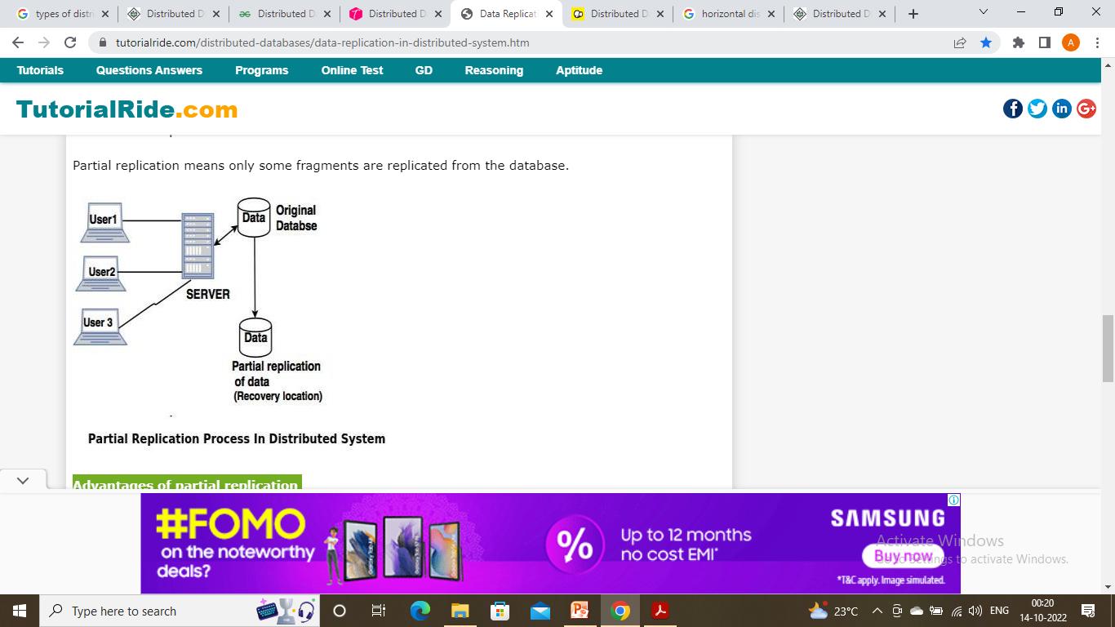
Partial replication
Partial replication means only some fragments are replicated from the database.
Advantages of partial replication
The number of replicas created for fragments depend upon the importance of data in that fragment.

Slide 48
What is recovery in distributed databases?
Recovery is the most complicated process in distributed databases. Recovery of a failed system in the communication network is very difficult.
For example:
onsider that, location A sends message to location B and expects response from B but B is unable to receive it. There are several problems for this situation which are as follows. Message was failed due to failure in the network.
Location B sent message but not delivered to location A.
Location B crashed down.
So it is actually very difficult to find the cause of failure in a large communication network.
Distributed commit in the network is also a serious problem which can affect the recovery in a distributed databases.

Slide 49
Concurrency problems in distributed databases
Failure at local locations When system recovers from failure the database is out dated compared to other locations. So it is necessary to update the database.
Failure at communication location System should have a ability to manage temporary failure in a communicating network in distributed databases. In this case, partition occurs which can limit the communication between two locations.

Slide 50
Concurrency problems in distributed databases
Dealing with multiple copies of data It is very important to maintain multiple copies of distributed data at different locations.
Distributed commit While committing a transaction which is accessing databases stored on multiple locations, if failure occurs on some location during the commit process then this problem is called as distributed commit.
Distributed deadlock Deadlock can occur at several locations due to recovery problem and concurrency problem (multiple locations are accessing same system in the communication network).

Slide 51
Concurrency Controls in distributed databases
Lock based protocol A lock is applied to avoid concurrency problem between two transaction in such a way that the lock is applied on one transaction and other transaction can access it only when the lock is released. The lock is applied on write or read operations. It is an important method to avoid deadlock.

Slide 52
Concurrency Controls in distributed databases
Shared lock system (Read lock) The transaction can activate shared lock on data to read its content. The lock is shared in such a way that any other transaction can activate the shared lock on the same data for reading purpose.

Slide 53
Concurrency Controls in distributed databases
Exclusive lock The transaction can activate exclusive lock on a data to read and write operation. In this system, no other transaction can activate any kind of lock on that same data.

Slide 54
Two-phase commit protocol in Distributed databases
Two-phase protocol is a type of atomic commitment protocol. This is a distributed algorithm which can coordinate all the processes that participate in the database and decide to commit or terminate the transactions. The protocol is based on commit and terminate action.
The two-phase protocol ensures that all participant which are accessing the database server can receive and implement the same action (Commit or terminate), in case of local network failure.

Slide 55
Two-phase commit protocol in Distributed databases
Two-phase commit protocol provides automatic recovery mechanism in case of a system failure.
The location at which original transaction takes place is called as coordinator and where the sub process takes place is called as Cohort.

Slide 56
Two-phase commit protocol in Distributed databases
Commit request: In commit phase the coordinator attempts to prepare all cohorts and take necessary steps to commit or terminate the transactions.
Commit phase: The commit phase is based on voting of cohorts and the coordinator decides to commit or terminate the transaction.

