Slide 1
Project #3 Smart-T-Junction
Spring 2025
0512-4494
AIMAN ABED
EDWARD KHOURY

Slide 2

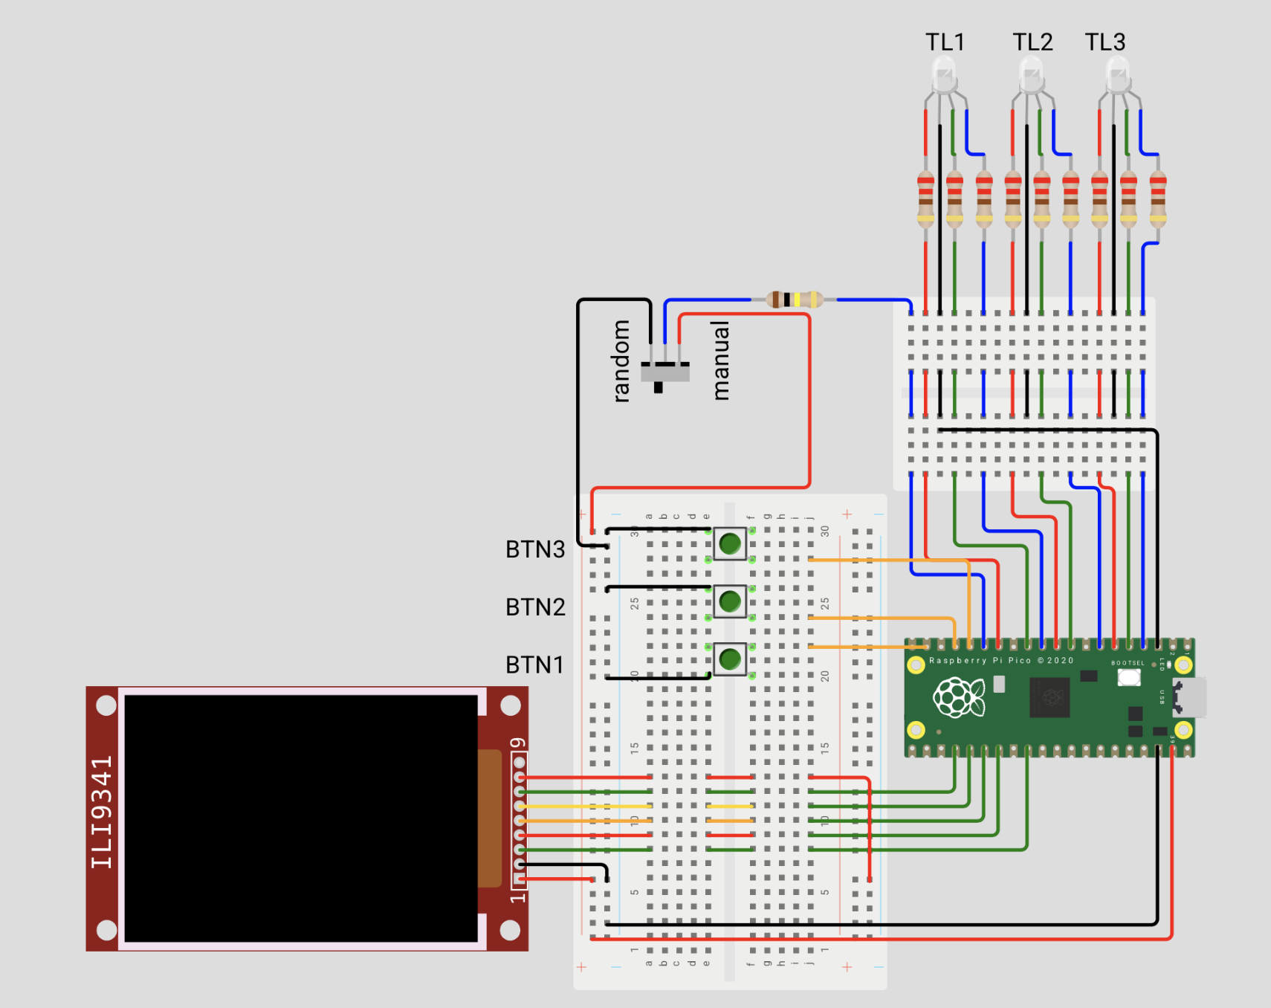
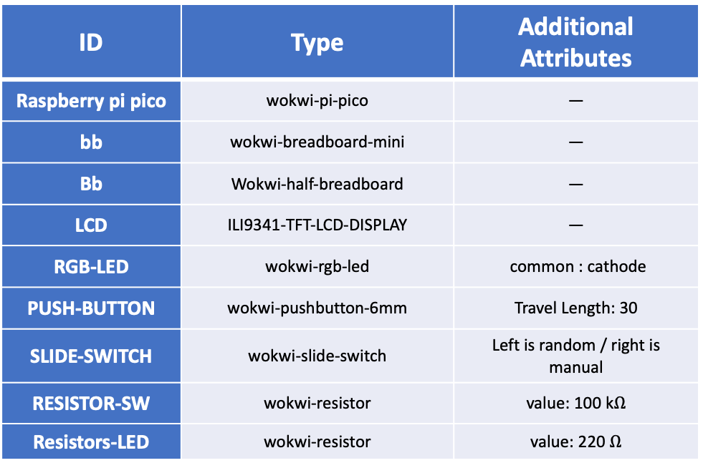
Hardware (Components) Diagram
ID | Type | Additional Attributes
Raspberry pi pico | wokwi-pi-pico | —
bb | wokwi-breadboard-mini | —
Bb | Wokwi-half-breadboard | —
LCD | ILI9341-TFT-LCD-DISPLAY | —
RGB-LED | wokwi-rgb-led | common : cathode
PUSH-BUTTON | wokwi-pushbutton-6mm | Travel Length: 30
SLIDE-SWITCH | wokwi-slide-switch | Left is random / right is manual
RESISTOR-SW | wokwi-resistor | value: 100 k$Ω$
Resistors-LED | wokwi-resistor | value: 220 $Ω$

Slide 3

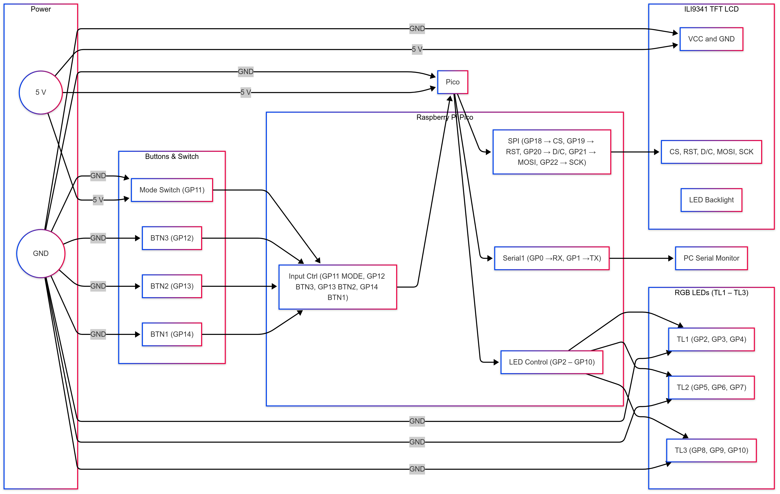
hardware Blocks Diagram

Slide 4
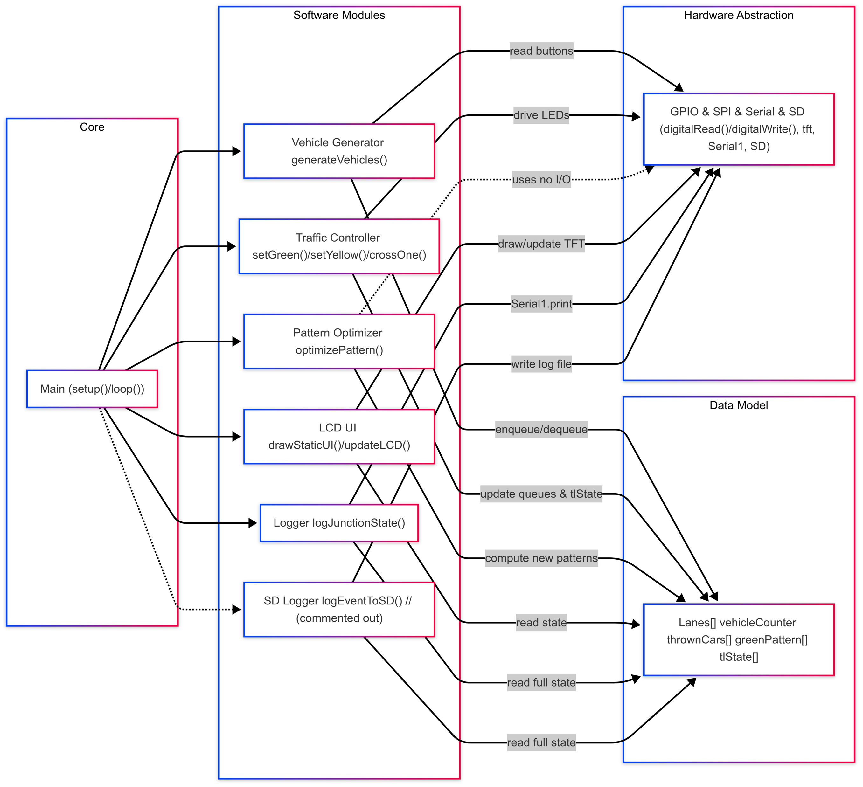
Software Blocks Diagram

Slide 5

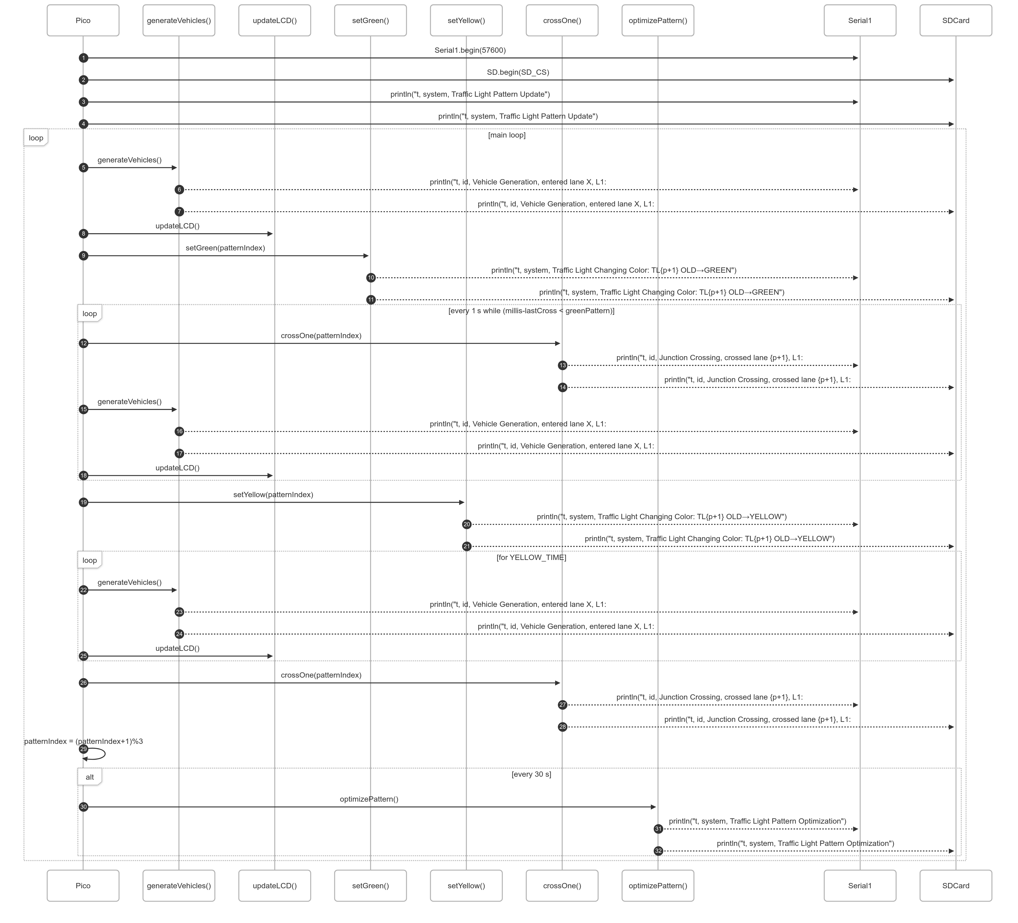
Sequence Diagram

Slide 6

Live Demo
https://wokwi.com/projects/430293286791147521

Slide 7

Conclusions / Future Work
Key Takeaways
Built a cooperative scheduler on the Raspberry pi pico to drive three traffic lights in strict round-robin.
Dual Vehicle Generation: Manual pushbuttons and per-lane Markov-chain randomness
Adaptive timing: 30 sec re-optimization of green durations based on dropped vehicles.
Designed a live TFT dashboard with both text and graphical traffic-light icons.
Logged every event (light change, vehicle arrival, crossing) over Serial (and ready to mirror to my junction.log) .
Challenges
Debounce logic to filter spurious button/switch signals
Non-blocking design to juggle generation, rendering, and logging
Balancing queue capacities to avoid starvation or overflow
Crafting an optimizer that respects min/max green-time constraints
Ideas for Improvement
Sensor Upgrade Replace pushbuttons with ultrasonic/IR car detectors for real traffic data
Persistent Logs: Activate SD-card logging so my_junction.log persists across power cycles.
Smarter Optimization Experiment with reinforcement learning or heuristic algorithms for dynamic traffic prediction
Pedestrian Phase Integrate “walk” signals and scheduling into current round-robin
Remote Monitoring Stream status via Wi-Fi (MQTT/WebSocket) to web or mobile dashboards

