Slide 1
B-Tree
ADT Implementation

Slide 2
What is a Multi-way tree?
A multi-way (or m-way) search tree of order m is a tree in which
  Each node has at-most m subtrees, where the subtrees may be empty.
  Each node consists of at least 1 and at most m-1 distinct keys
  The keys in each node are sorted.
The keys and subtrees of a non-leaf node are ordered as:
T₀, k₁, T₁, k₂, T₂, . . . , k_{m-1}, T_{m-1} such that:
  All keys in subtree T0 are less than k1.
  All keys in subtree T_{i} , 1 <= i <= m - 2, are greater than k_{i} but less than k_{i+1}.
  All keys in subtree T_{m-1} are greater than k_{m-1}

Slide 3
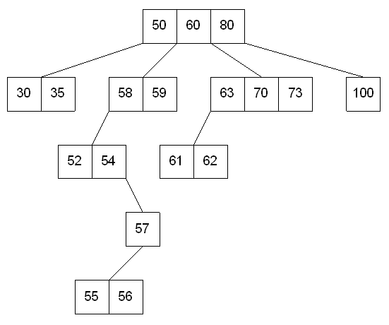
Multi-way tree of order 4

Slide 4
What is B-tree?
B-tree of order m (or branching factor m), where m > 2, is either an empty tree or a multiway search tree with the following properties:
  The root is either a leaf or it has at least two non-empty subtrees and at most m non-empty subtrees.
  Each non-leaf node, other than the root, has at least ⎡m/2⎤ non-empty subtrees and at most m non-empty subtrees. (Note: ⎡x⎤ is the lowest integer > x ).
  The number of keys in each non-leaf node is one less than the number of non-empty subtrees for that node.
  All leaf nodes are at the same level; that is the tree is perfectly balanced

Slide 5
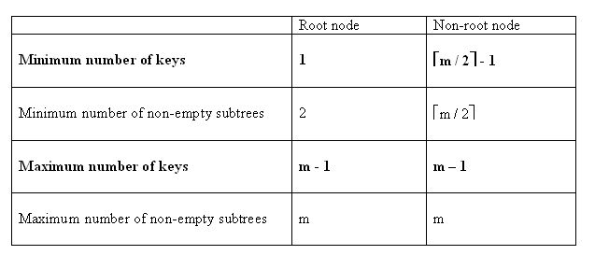
What is a B-tree?
For a non-empty B-tree of order m:

Slide 6
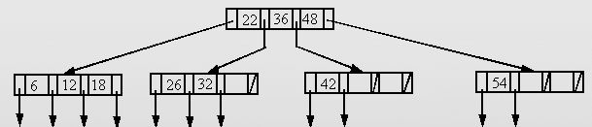
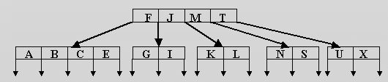
B-Tree Examples
Example: A B-tree of order 4
Example: A B-tree of order 5
Note:
        The data references are not shown.
        The leaf references are to empty subtrees

Slide 7

Height of B-Trees
For n greater than or equal to one, the height of an n-key b-tree T of height h with a minimum degree t greater than or equal to 2

Slide 8
Operations of B-Trees
B-Tree-Search(x, k)
  The search operation on a b-tree is similar to a search on a binary tree. The B-Tree-search runs in time O(log_{t} n).
B-Tree-Create(T)
  The B-Tree-Create operation creates an empty b-tree by allocating a new root node that has no keys and is a leaf node. Only the root node is permitted to have these properties; all other nodes must meet the criteria outlined previously. The B-Tree-Create operation runs in time O(1).

Slide 9
Operations of B-Trees
B-Tree-Split-Child(x, i, y)
  If is node becomes "too full," it is necessary to perform a split operation. The split operation moves the median key of node x into its parent y where x is the ith child of y. A new node, z, is allocated, and all keys in x right of the median key are moved to z. The keys left of the median key remain in the original node x. The new node, z, becomes the child immediately to the right of the median key that was moved to the parent y, and the original node, x, becomes the child immediately to the left of the median key that was moved into the parent. The B-Tree-Split-Child algorithm will run in time O(t) , T is constrain

Slide 10
Operations of B-Trees
B-Tree-Insert(T, k)
B-Tree-Insert-Nonfull(x, k)
  To perform an insertion on a b-tree, the appropriate node for the key must be located using an algorithm similiar to B-Tree-Search. Next, the key must be inserted into the node. If the node is not full prior to the insertion, no special action is required; however, if the node is full, the node must be split to make room for the new key. Since splitting the node results in moving one key to the parent node, the parent node must not be full or another split operation is required. This process may repeat all the way up to the root and may require splitting the root node. This approach requires two passes. The first pass locates the node where the key should be inserted; the second pass performs any required splits on the ancestor nodes. runs in time O(t log_{t} n)

Slide 11
Insertion in B-Trees
OVERFLOW CONDITION:
A root-node or a non-root node of a B-tree of order m overflows if, after a key insertion, it contains m keys.
Insertion algorithm:
If a node overflows, split it into two, propagate the "middle" key to the parent of the node. If the parent overflows the process propagates upward. If the node has no parent, create a new root node.
Note: Insertion of a key always starts at a leaf node.

Slide 12
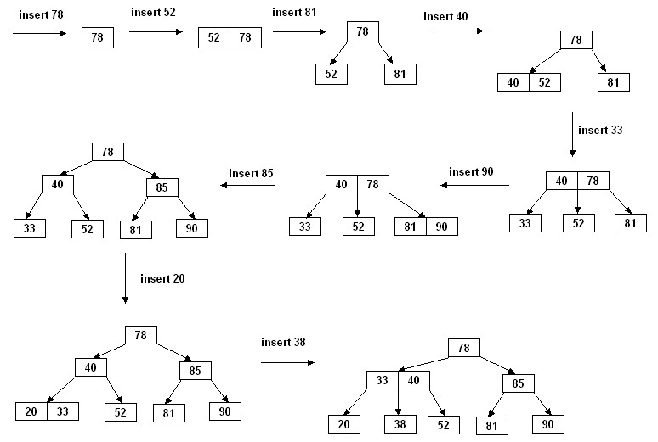
Insertion in B-Trees
Insertion in a B-tree of odd order
Example: Insert the keys 78, 52, 81, 40, 33, 90, 85, 20, and 38 in this order in an initially empty B-tree of order 3

Slide 13
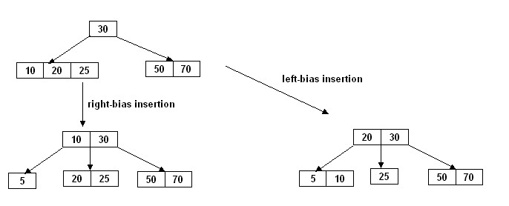
Insertion in B-Trees
Insertion in a B-tree of even order
right-bias: The node is split such that its right subtree has more keys than the left subtree.
left-bias: The node is split such that its left subtree has more keys than the right subtree.
Example: Insert the key 5 in the following B-tree of order 4:
Insertion in B-Trees

Slide 14
Deletion in B-Tree
B-Tree-Delete
  UNDERFLOW CONDITION
  A non-root node of a B-tree of order m underflows if, after a key deletion, it contains ⎡m / 2⎤ - 2 keys
  The root node does not underflow. If it contains only one key and this key is deleted, the tree becomes empty.

Slide 15
Deletion in B-Tree
There are five deletion cases:
  1. The leaf does not underflow.
  2. The leaf underflows and the adjacent right sibling has at least ⎡m / 2 ⎤ keys.
  perform a left key-rotation
  3. The leaf underflows and the adjacent left sibling has at least ⎡m / 2 ⎤ keys.
  perform a right key-rotation
  4. The leaf underflows and each of the adjacent right sibling and the adjacent left sibling has at least ⎡m / 2 ⎤ keys.
  perform either a left or a right key-rotation
  5. The leaf underflows and each adjacent sibling has ⎡m / 2⎤ - 1 keys.
  perform a merging

Slide 16
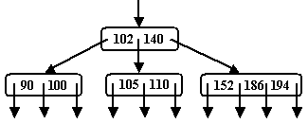
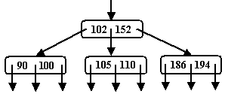
Deletion in B-Tree
Case1: The leaf does not underflow.
Example : B-tree of order 4
Delete 140

Slide 17
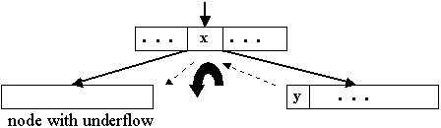
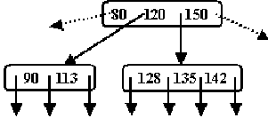
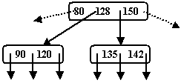
Deletion in B-Tree
Case2: The leaf underflows and the adjacent right sibling has at least ⎡m/2⎤ keys.
Example : B-tree of order 5
Perform a left key-rotation:
1. Move the parent key x that separates the siblings to the node with underflow
2. Move y, the minimum key in the right sibling, to where the key x was
3. Make the old left subtree of y to be the new right subtree of x.
Delete 113

Slide 18
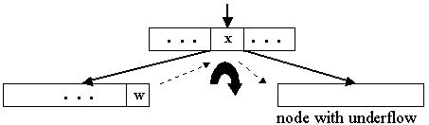
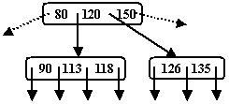
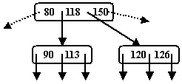
Deletion in B-Tree
Case 3: The leaf underflows and the adjacent left sibling has at least ⎡m / 2⎤ keys.
Example : B-tree of order 5
Perform a right key-rotation:
1. Move the parent key x that separates the siblings to the node with underflow
2. Move w, the maximum key in the left sibling, to where the key x was
3. Make the old right subtree of w to be the new left subtree of x
Delete 135

Slide 19
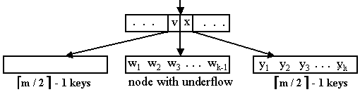
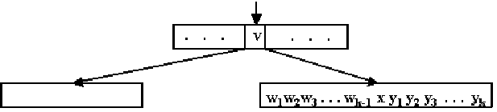
Deletion in B-Tree
Case 5:The leaf underflows and each adjacent sibling has ⎡m / 2⎤ - 1 keys
  If the parent of the merged node underflows, the merging process propagates upward. In the limit, a root with one key is deleted and the height decreases by one

Slide 20
Implementations on B-Tree
In addition to its use in databases, the B-tree is also used in file systems to allow quick random access to an arbitrary block in a particular file. The basic problem is turning the file block i address into a disk block.

Slide 21
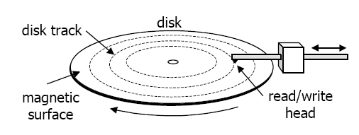
Secondary Storages
MS/Dos - FAT (File allocation table)
entry for each disk block
entry identifies whether its block is used by a file
which block (if any) is the next disk block of the same file
allocation of each file is represented as a linked list in the table

Slide 22
Comparing B-Trees with AVL Trees
The height h of a B-tree of order m, with a total of n keys, satisfies the inequality:
        h <= 1 + log _{⎡m / 2⎤} ((n + 1) / 2)
If m = 300 and n = 16,000,000 then h ≈ 4.
Thus, in the worst case finding a key in such a B-tree requires 3 disk accesses (assuming the root node is always in main memory ).
The average number of comparisons for an AVL tree with n keys is log n + 0.25 where n is large.
If n = 16,000,000 the average number of comparisons is 24.
Thus, in the average case, finding a key in such an AVL tree requires 24 disk accesses.

