Slide 1
EndoInsightDB-----
智能胃肠病预警数据库

Slide 2
目录
数据库初步设计
E-R图

Slide 3
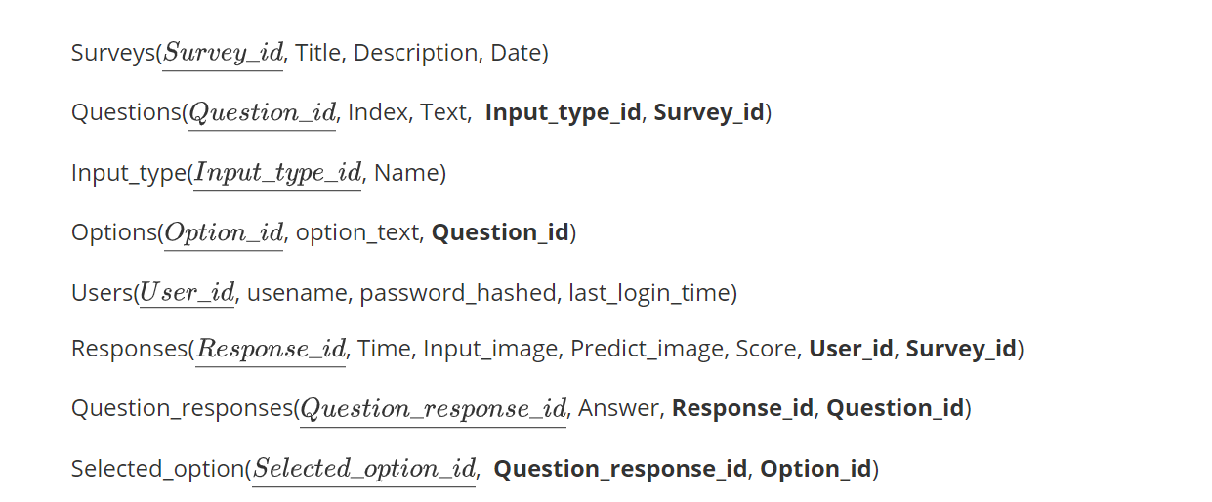
数据库初步设计

Slide 4
Input_image
Image_res
N
Send
Score
1
Predict_image
ID
Users
ID
ID
Title
Description
1
Time
Send
Date
Surveys
1
About
N
N
ID
ID
1
Score
Responses
Contains
ID
1
N
1
Input_type
Input
1
N
N
Questions
About
Contains
Time
Index
N
1
Name
Question_responses
ID
Text
Has
1
N
Contains
Answer
ID
Options
1
N
N
Select
Selected_option
ID
Option_text

Slide 5
Thanks for your listening!

