Slide 1




Complimentary Threat Surface Analysis & Recommendations
ANOOP B

Slide 2

ANOOP B
Junior Penetration Tester and Developer
PGDCA, A+, N+, CEH, MCSA, CCNA, CCNA SECURITY, RHCE, AUTOMATION with BASH & Selenium
2

Slide 3
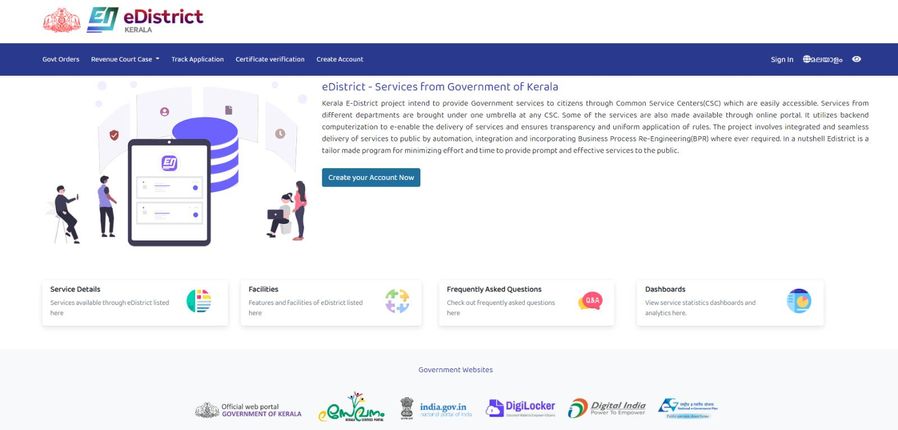
Target Website: https://edistrict.kerala.gov.in
3

Slide 4

My Findings
OWASP TOP 10 BASED VULNERABILITIES FOUND IN WEBSITE
A3-Cross-Site Scripting (XSS)
Cross-Site Scripting (XSS) in HTML tag
A5-Security Misconfiguration
Missing 'Strict-Transport-Security' header
Insecure 'Access-Control-Allow-Origin' header
HTTP TRACE
A8-Sensitive Data Exposure
Cross-Site Request Forgery
4

Slide 5
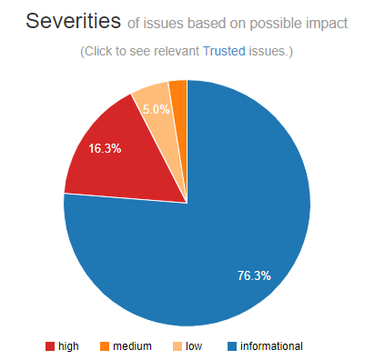
My Findings
High severity
Cross-Site Request Forgery
Cross-Site Scripting (XSS) in HTML tag
Medium severity
Missing 'Strict-Transport-Security' header
HTTP TRACE
Low severity
Missing 'X-Frame-Options' header
Insecure 'Access-Control-Allow-Origin' header
Password field with auto-complete
Informational severity
Interesting response
CAPTCHA protected form
HttpOnly cookie
Insecure cookie
5

Slide 6
OTHER Findings
Informational Findings
The server supports TLS v1.1
The server supports TLS v1.0
Verb tampering
Using Components with Known Vulnerabilities - jQuery.js version less than 3.5.0, bootstrap.js less than 3.4.1
Missing security headers - Cache-Control, X-Frame-Options, X-Content-Type-Options, X-XSS-Protection
Missing Content Security Policy in response header
Insecure CORS
HTTP trace support detected
Autocomplete on sensitive fields
Autocomplete on password fields
Supported HTTP Versions
Old Version of JQuery Detected
Old Version of Bootstrap Detected
Missing header - Permissions-Policy, Expect-CTDNS Map & IP Information
Subdomains
Open Ports
DNS Details
Potential Attack Vectors /Risks
XSS
CSRF
Sensitive data exposure
Information disclosure
Email Address Disclosure
Target Information
TRACE Method Allowed
BREACH attack
Auto Complete Enabled Password Input
6

Slide 7
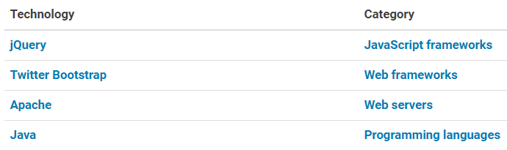
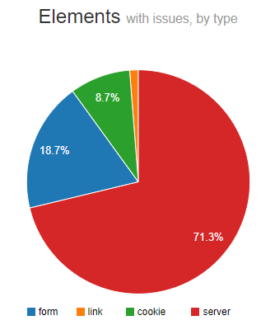
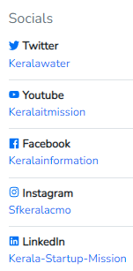
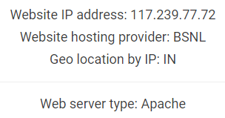
Technology used
7

Slide 8

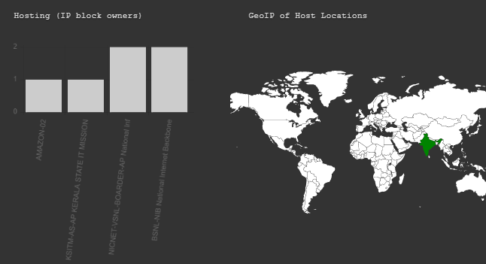

Details of Potentially Actionable Findings
8

Slide 9
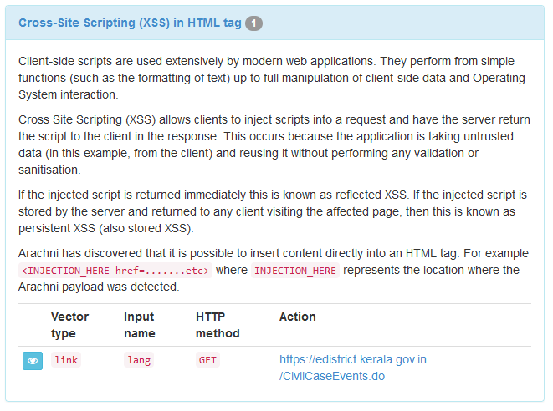
A3-Cross-Site Scripting (XSS)
XSS flaws occur whenever an application takes untrusted data and sends it to a web browser without proper validation or escaping. XSS allows attackers to execute scripts in the victim’s browser which can hijack user sessions, deface web sites, or redirect the user to malicious sites.
References
CWE-79
Secunia
WASC
OWASP
9

Slide 10
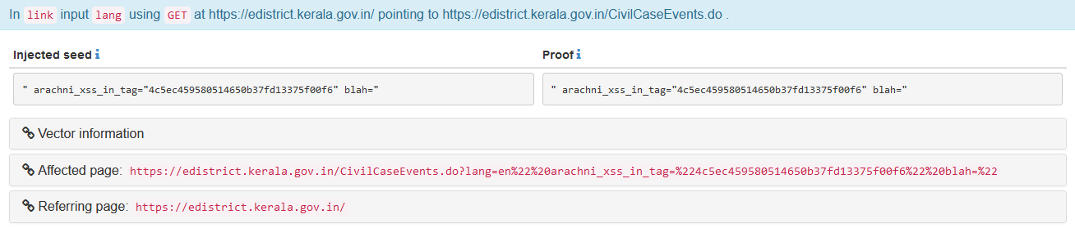
Cross-Site Scripting (XSS)
REMEDIATION GUIDANCE
To remedy XSS vulnerabilities, it is important to never use untrusted or unfiltered data within the code of a HTML page. Untrusted data can originate not only form the client but potentially a third party or previously uploaded file etc.
Filtering of untrusted data typically involves converting special characters to their HTML entity encoded counterparts (however, other methods do exist, see references). These special characters include:
&, <, >, “, ‘, /
10

Slide 11
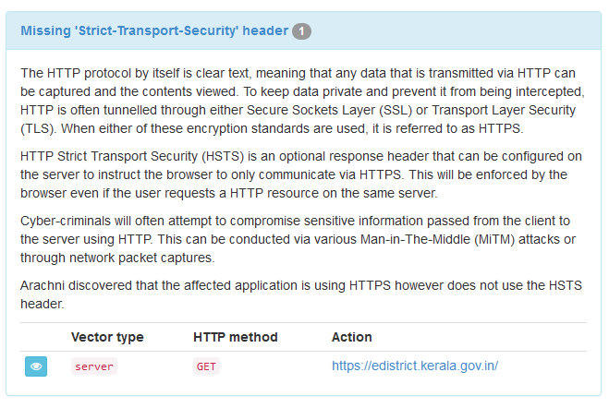
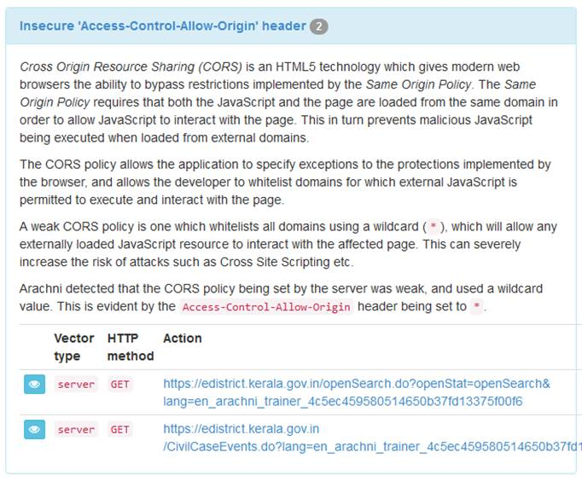
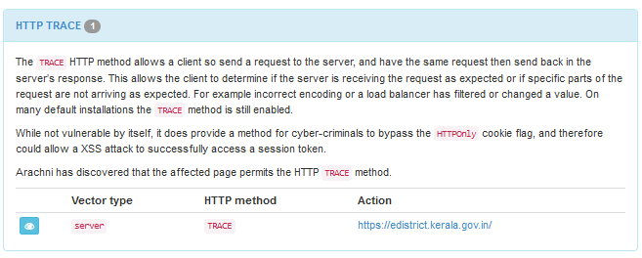
A5-Security Misconfiguration
Good security requires having a secure configuration defined and deployed for the application, frameworks, application server, web server, database server, and platform. Secure settings should be defined, implemented, and maintained, as defaults are often insecure. Additionally, software should be kept up to date.
11

Slide 12
Missing 'Strict-Transport-Security' header
The HTTP protocol by itself is clear text, meaning that any data that is transmitted via HTTP can be captured and the contents viewed. To keep data private and prevent it from being intercepted, HTTP is often tunnelled through either Secure Sockets Layer (SSL) or Transport Layer Security (TLS). When either of these encryption standards are used, it is referred to as HTTPS.
HTTP Strict Transport Security (HSTS) is an optional response header that can be configured on the server to instruct the browser to only communicate via HTTPS. This will be enforced by the browser even if the user requests a HTTP resource on the same server.
Cyber-criminals will often attempt to compromise sensitive information passed from the client to the server using HTTP. This can be conducted via various Man-in-The-Middle (MiTM) attacks or through network packet captures.
It has been discovered that the affected application is using HTTPS however does not use the HSTS header.
12

Slide 13
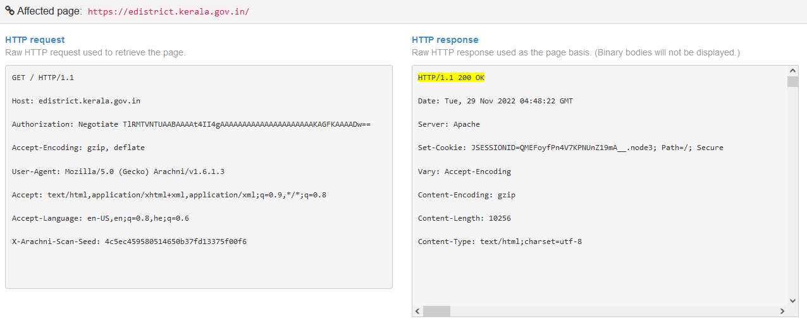
Missing 'Strict-Transport-Security' header
13

Slide 14
REMEDIATION GUIDANCE
Depending on the framework being used the implementation methods will vary, however it is advised that the Strict-Transport-Security header be configured on the server.
One of the options for this header is max-age, which is a representation (in milliseconds) determining the time in which the client’s browser will adhere to the header policy.
Depending on the environment and the application this time period could be from as low as minutes to as long as days.
References
CWE-200
OWASP
Wikipedia
14

Slide 15
Insecure 'Access-Control-Allow-Origin' header
Cross Origin Resource Sharing (CORS) is an HTML5 technology which gives modern web browsers the ability to bypass restrictions implemented by the Same Origin Policy. The Same Origin Policy requires that both the JavaScript and the page are loaded from the same domain in order to allow JavaScript to interact with the page. This in turn prevents malicious JavaScript being executed when loaded from external domains.
The CORS policy allows the application to specify exceptions to the protections implemented by the browser and allows the developer to whitelist domains for which external JavaScript is permitted to execute and interact with the page. A weak CORS policy is one which whitelists all domains using a wildcard (*), which will allow any externally loaded JavaScript resource to interact with the affected page. This can severely increase the risk of attacks such as Cross Site Scripting etc.
Detected that the CORS policy being set by the server was weak and used a wildcard value. This is evident by the Access-Control-Allow-Origin header being set to *
Cross-Origin Resource Sharing policy, prevents accessing web resources from sources other than the server the website is running on for security purposes. Accessing Assets For most websites, all of the assets (images, text, files, etc.) they use are held on the same server the website is hosted on.
References
OWASP
Mozilla Developer Network
CORS
15

Slide 16
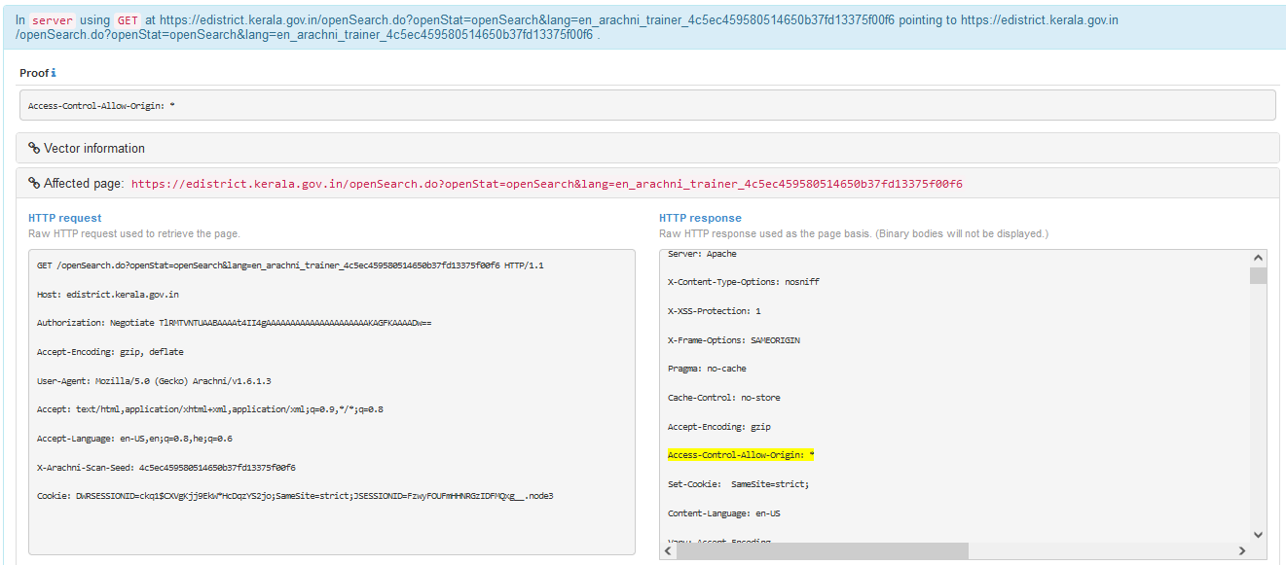
Insecure 'Access-Control-Allow-Origin' header
REMEDIATION GUIDANCE
It is important that weak CORS policies are not used. Policies can be hardened by removing the wildcard and individually specifying the domains where the trusted JavaScript resources are located. If the list of hosts for externally hosted JavaScript resources is excessive, then a whole top-level domain can be whitelisted by using a combination of the wildcard and the domain (example: *.arachni-scanner.com).
16

Slide 17
HTTP TRACE
The TRACE HTTP method allows a client so send a request to the server and have the same request then send back in the server’s response. This allows the client to determine if the server is receiving the request as expected or if specific parts of the request are not arriving as expected. For example, incorrect encoding or a load balancer has filtered or changed a value. On many default installations the TRACE method is still enabled.
While not vulnerable by itself, it does provide a method for cyber-criminals to bypass the HTTPOnly cookie flag, and therefore could allow a XSS attack to successfully access a session token.
It has discovered that the affected page permits the HTTP TRACE method.
References
CWE-693
CAPEC
OWASP
17

Slide 18
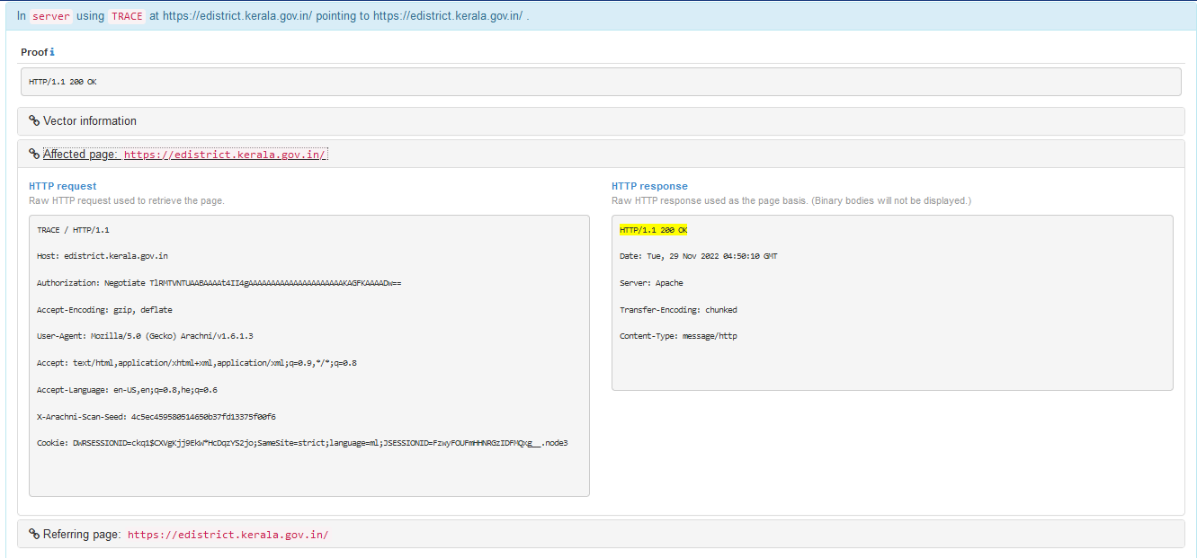
HTTP TRACE
REMEDIATION GUIDANCE
The HTTP TRACE method is normally not required within production sites and should therefore be disabled.
Depending on the function being performed by the web application, the risk level can start low and increase as more functionality is implemented.
The remediation is typically a very simple configuration change and, in most cases, will not have any negative impact on the server or application.
18

Slide 19
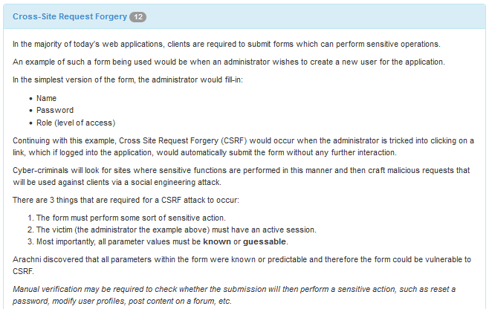
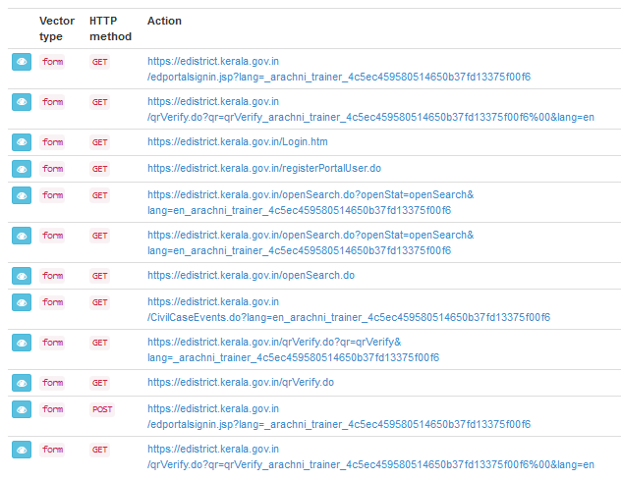
A8-Sensitive Data Exposure
A CSRF attack forces a logged-on victim’s browser to send a forged HTTP request, including the victim’s session cookie and any other automatically included authentication information, to a vulnerable web application. This allows the attacker to force the victim’s browser to generate requests the vulnerable application thinks are legitimate requests from the victim.
19

Slide 20
Cross-Site Request Forgery
In most today’s web applications, clients are required to submit forms which can perform sensitive operations. An example of such a form being used would be when an administrator wishes to create a new user for the application.
In the simplest version of the form, the administrator would fill-in:
Name
Password
Role (level of access)
Continuing with this example, Cross Site Request Forgery (CSRF) would occur when the administrator is tricked into clicking on a link, which if logged into the application, would automatically submit the form without any further interaction.
Cyber-criminals will look for sites where sensitive functions are performed in this manner and then craft malicious requests that will be used against clients via a social engineering attack.
There are 3 things that are required for a CSRF attack to occur:
The form must perform some sort of sensitive action.
The victim (the administrator the example above) must have an active session.
Most importantly, all parameter values must be known or guessable.
Its been discovered that all parameters within the form were known or predictable and therefore the form could be vulnerable to CSRF. Manual verification may be required to check whether the submission will then perform a sensitive action, such as reset a password, modify user profiles, post content on a forum, etc.
20

Slide 21
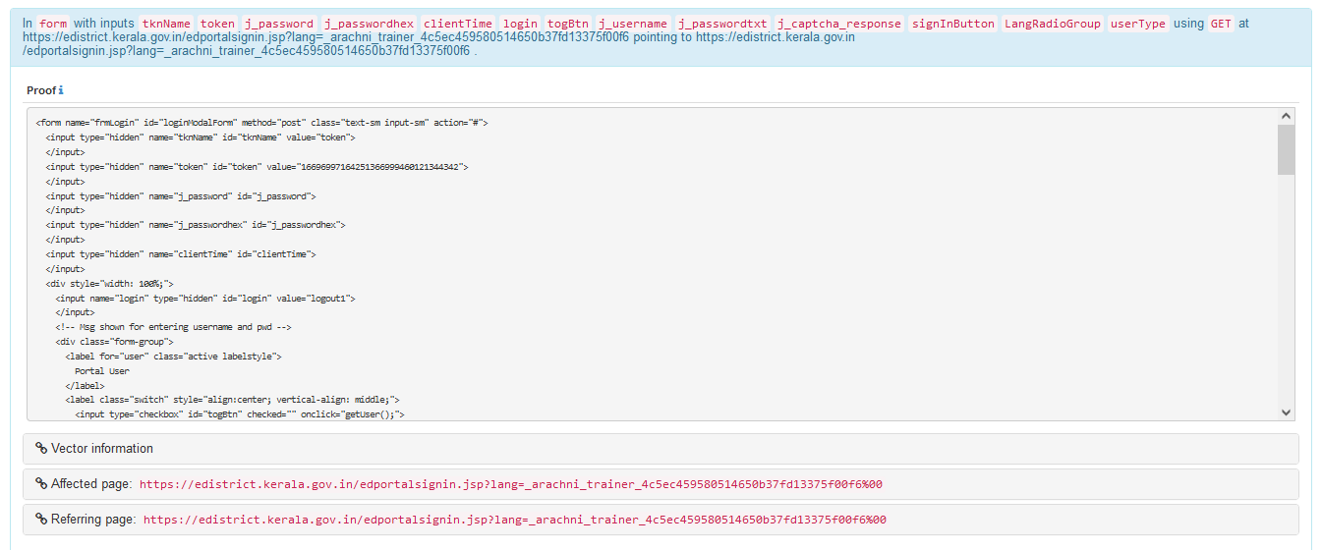
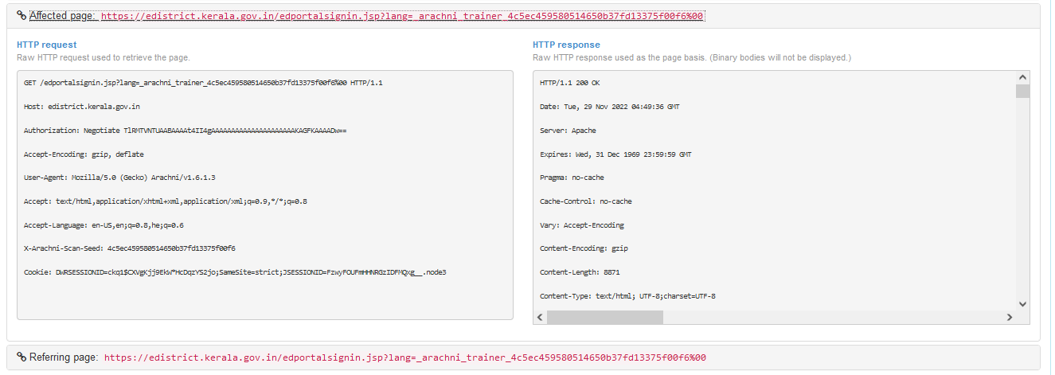
Cross-Site Request Forgery
21

Slide 22
REMEDIATION GUIDANCE
Based on the risk (determined by manual verification) of whether the form submission performs a sensitive action, the addition of anti-CSRF tokens may be required.
These tokens can be configured in such a way that each session generates a new anti-CSRF token or such that each individual request requires a new token.
It is important that the server track and maintain the status of each token (in order to reject requests accompanied by invalid ones) and therefore prevent cyber-criminals from knowing, guessing or reusing them.
For examples of framework specific remediation options, please refer to the references.
References
CWE-352
Wikipedia
OWASP
CGI Security
22

Slide 23
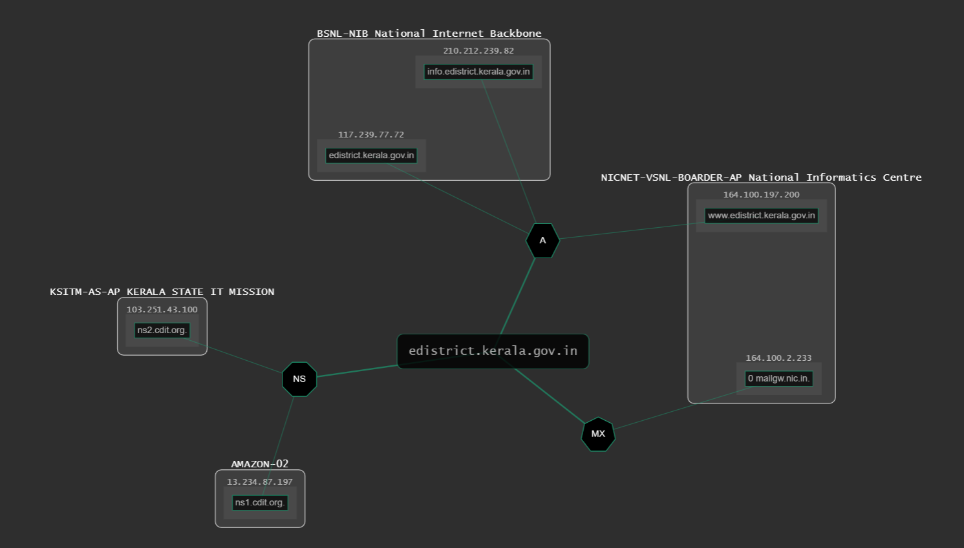
Details of
Informational
Findings
Website DNS Map
23
23

Slide 24
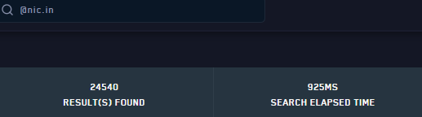
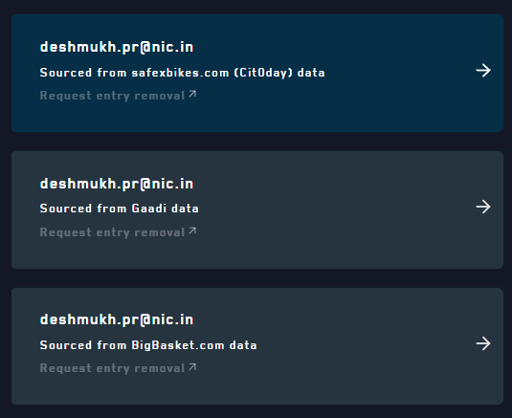
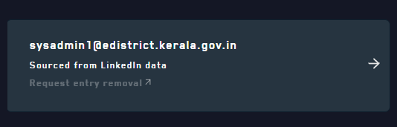
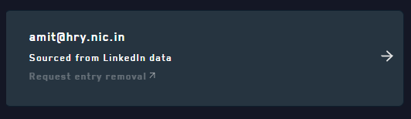
Sensitive Information Leakage
Data Breach
How it's been exploited:
Account take over
Unauthorized information disclosure
Mitigation:
Change passwords frequently, Watch out for Suspicious Emails, Use a VPN for Extra Security
Activate Two-Factor Authentication, Adequate training to users
24

Slide 25
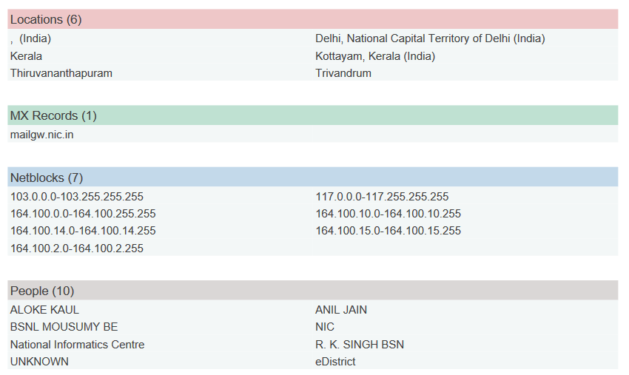
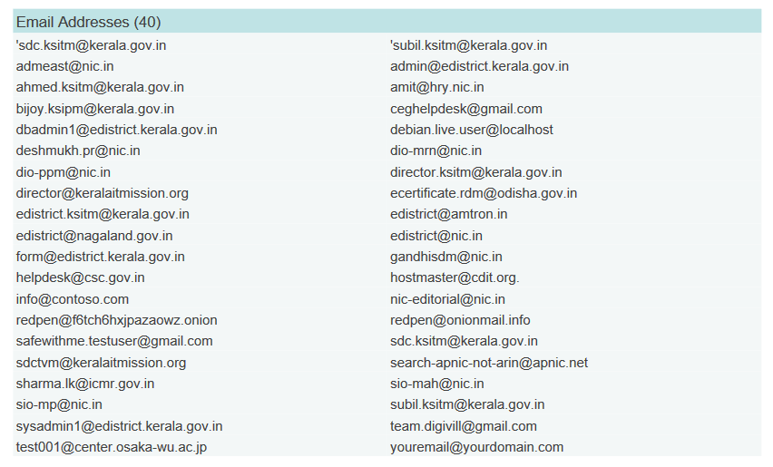
Other Sensitive Information Leakage
How it's been exploited:
Spam & Phishing
Unauthorized information disclosure
Malware
Social engineering
Mitigation:
Change passwords frequently
Implement Management Controls
Secure the Mail Server Application & the Mail Client
Secure the Transmission
25

Slide 26
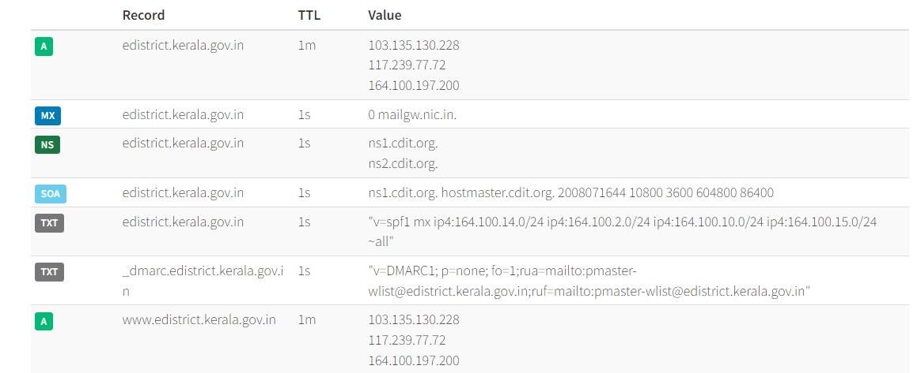
DNS RECORD, IP Information
How it's been exploited:
DoS, DDoS, DNS hijacking
DNS poisoning and cache poisoning
Malware
Identity theft
Mitigation:
Log and monitor DNS queries and response data
Harden your recursive DNS servers
Tighten admin access to your DNS
Update firewall, Use a VPN
26

Slide 27
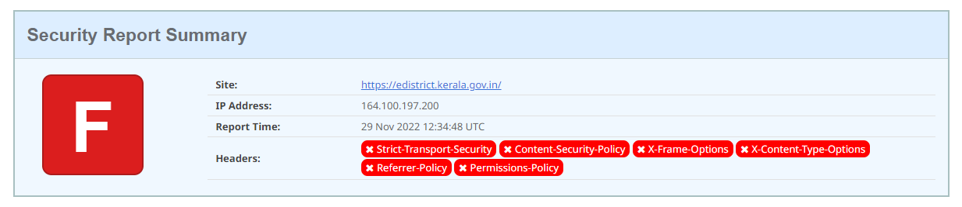
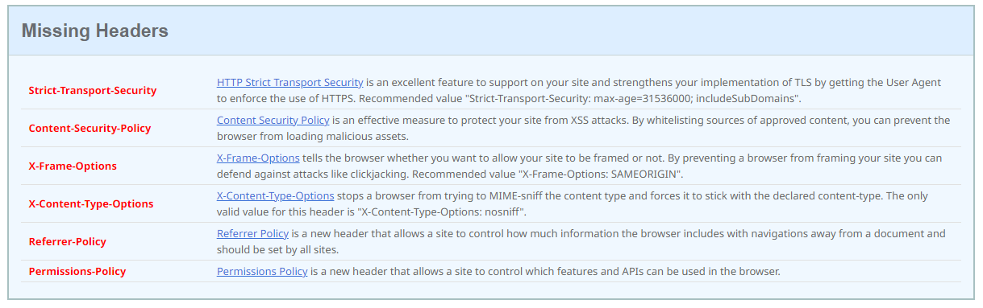
Security Headers Missing
Webpage Security Score- F
27

Slide 28
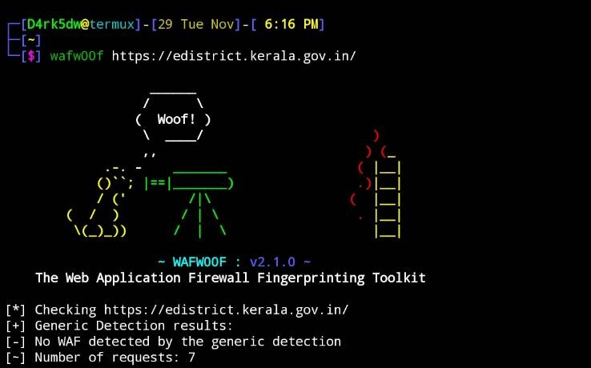
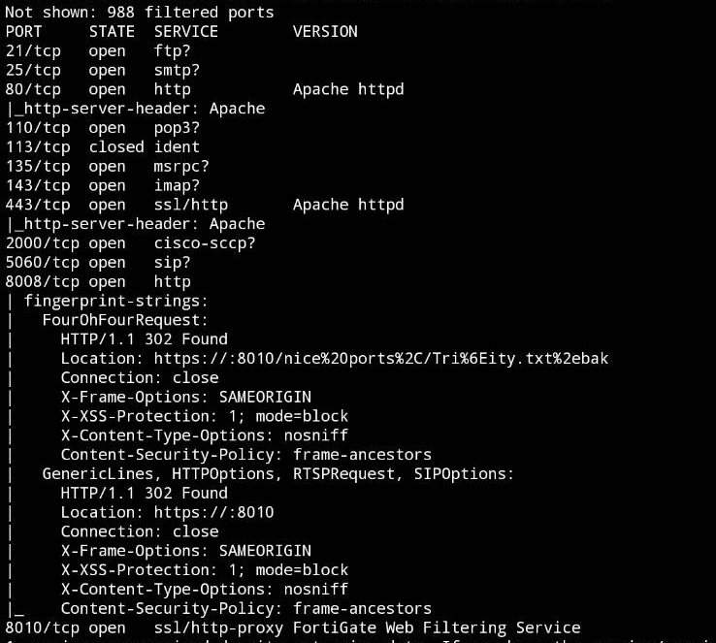
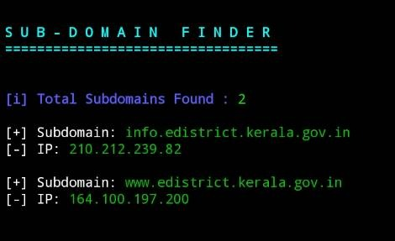
Sub-domains, open Ports and WAF
Mitigation:
Select vendors wisely, Centrally managing your DNS program to ensure all DNS entries are correct.
Scanning your domains and subdomains for DNS pointers to unmanaged domains.
Removing dead DNS entries that point to expired web services and cloud assets.
Working with security researchers to identify and mitigate application vulnerabilities.
Monitor open ports
Identify & Close risky ports
Install Firewalls
28

Slide 29
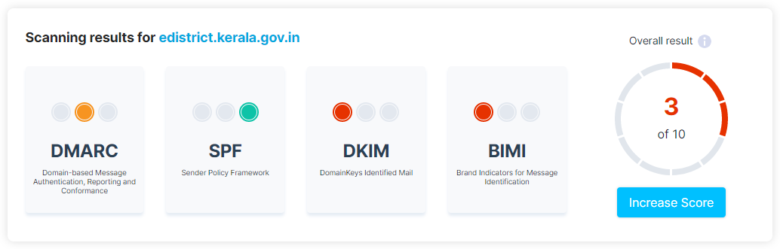
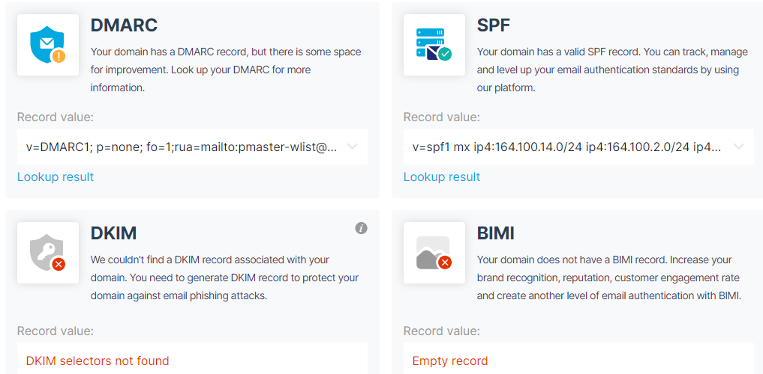
Dmarc, spf, dkim bimi details and score
Sender Policy Framework (SPF) The premise is simple, only allow messages from the listed servers to send emails.
Domain Keys Identified Mail (DKIM) creates a digital signature, allowing the sender mail system to sign the message. The recipient’s mail server then checks that signature to know if it came from an authorized source and is unaltered.
Domain-based message authentication, reporting and conformance (DMARC) is an authentication method for email systems that helps to protect your organization from spoofing, phishing and other cybercrime activities by combining SFP and DKIM with a security policy.
Mitigation:
Set up SPF, your email provider will tell you what to use for DKIM, create your DMARC record with p=none and start monitoring your emails. Once this is complete, and your legitimate emails pass DKIM and SPF change it to p=reject.
Setting up DMARK, DKIM and SPF should only take about an hour, then monitor it for a month, adjusting for any marketing services you may have forgotten.
29

Slide 30
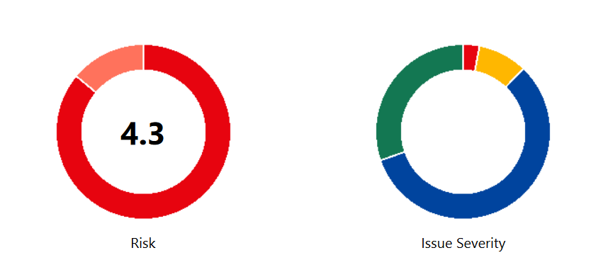
Final ASSESSMENT ON https://edistrict.kerala.gov.in
RISK SCORE: 4.3/5
30

Slide 31
Summary of Findings and Immediate actions Recommended
XSS
CSRF
Unauthorized information disclosure
Undermine the confidentiality and integrity of communications
Spoofing attack
Identity theft
Malware
Spam & Phishing
Data breaches
Mitigation:
Avoid storing sensitive data
Enable Role-Based Access Control
Reduce application’s attack surface
Very carefully manage the settings, management, and handling of privileges
Change passwords frequently
Disable version disclosure
Perform periodic Vulnerability assessment and Penetration testing
Update firewall
Software Updation
31

Slide 32
References
WEBSITES:
https://edistrict.kerala.gov.in (Target Website)
https://www.wappalyzer.com (Technology used)
https://dnsdumpster.com/ (DNS DUMP)
https://easydmarc.com/ (DMRC Record checker)
https://dehashed.com/ (Bleached data check)
https://osintframework.com
https://owasp.org/www-project-top-ten
https://www.arachni-scanner.com/ (web application security scanner framework)
https://hostedscan.com/ (Vulnerability Scanner)
TOOLS USED:
NMAP (Port and vuln scanner)
Maltego (Maps the entire details of Website)
Whois (Details about hosting and domain)
Wafwoof (WAF SCANNER)
32

Slide 33


33
33

Slide 34


34

Slide 35


35
35

