Slide 1


Why Program?
Chapter 1
Python for Informatics: Exploring Information
www.pythonlearn.com
Notes:
Note from Chuck. If you are using these materials, you can remove the UM logo and replace it with your own, but please retain the CC-BY logo on the first page as well as retain the entire last page.

Slide 2

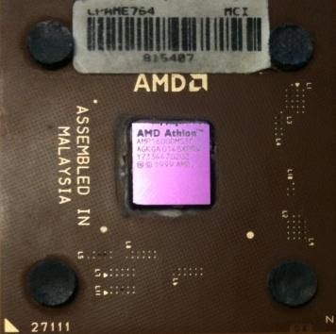
Computers want to be helpful...
What
Next?
Computers are built for one purpose - to do things for us
But we need to speak their language to describe what we want done
Users have it easy - someone already put many different programs (instructions) into the computer and users just pick the ones we want to use
What
Next?
What
Next?
What
Next?
What
Next?
What
Next?
What
Next?
Notes:
Y

Slide 3
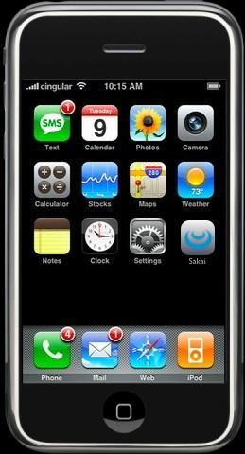
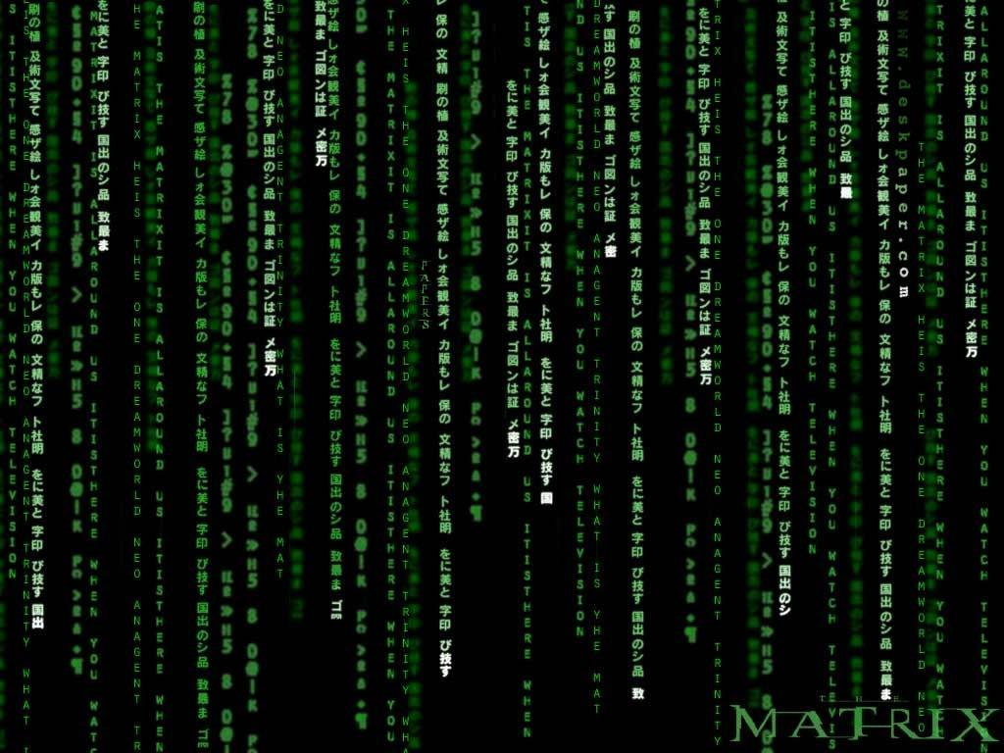
Programmers Anticipate Needs
iPhone Applications are a market
iPhone Applications have over 3 Billion downloads
Programmers have left their jobs to be full-time iPhone developers
Programmers know the ways of the program
Pick
Me!
Pick
Me!
Pick
Me!
Pick
Me!
Pick
Me!
Pay
Me!
Notes:
Y

Slide 4
Users vs. Programmers
Users see computers as a set of tools - word processor, spreadsheet, map, todo list, etc.
Programmers learn the computer “ways” and the computer language
Programmers have some tools that allow them to build new tools
Programmers sometimes write tools for lots of users and sometimes programmers write little “helpers” for themselves to automate a task
Notes:
Y

Slide 5
What Programmers Use
Programmers use the following:
Text Editor:
Sublime Text
Interface:
Mac OS or PC
Repository:
GitHub
Notes:
Y

Slide 6
What Programmers Use
Programmers use the following:
Text Editor:
Sublime Text
Interface:
Mac OS or PC
Repository:
GitHub
Notes:
Y

Slide 7

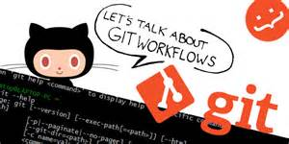
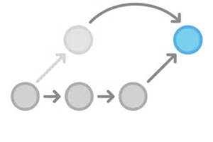
Git
Git is a source control management tool.
Git allows you to store and update your code in a structured way.
Git includes history of changes you make, so you can create "checkpoints" and track your work better over time.
Notes:
Git includes history of changes you make, so you can create "checkpoints" and track your work better over time.

Slide 8
Installing GIT
For windows git can be installed for the cmd line by downloading github for windows.
http://windows.github.com
For Mac
http://mac.github.com
For Linux:
sudo apt-get install git

Slide 9
Installing GIT via Terminal
Type: git config --global user.name “YOUR NAME”
Assures that your commits are under your name
Type: git config --global user.email “YOUR EMAIL ADDRESS”
Make sure it’s the same email address that you used to create GitHub

Slide 10
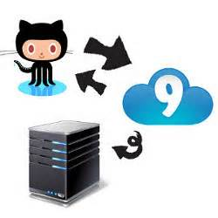
GitHub
GitHub is a service that lets you host Git repositories in the cloud.
Notes:
Point 1) In other words, they are hosted remotely by GitHub, and can be downloaded from / uploaded to over the internet.

Slide 11


GitHub: Benefits
Distribute code to others by sharing your repository
View your code online easily with a web interface
Free Public Use!!!
Notes:
Point 3) Private repositories cost a monthly fee

Slide 12
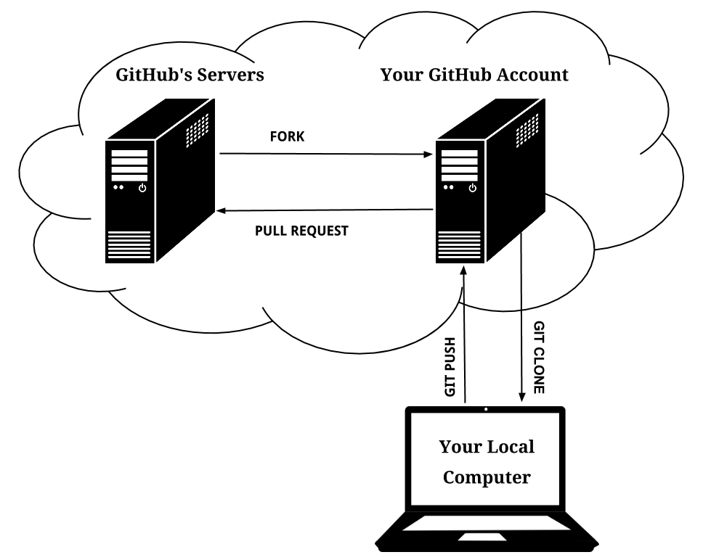
Forking!!!
Notes:
Throughout the course, we will be using GitHub to look at class notes, assignments, pull code and push code back into our repositories.
To ensure that changes you make for your projects do not mix with other students work, you will create a fork of the classes GitHub repository.
You will then make changes to your fork, and pull down changes from the origin class repository.

Slide 13
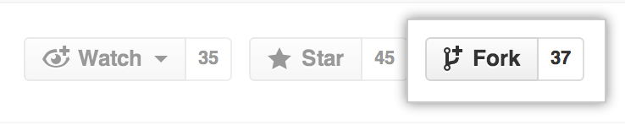
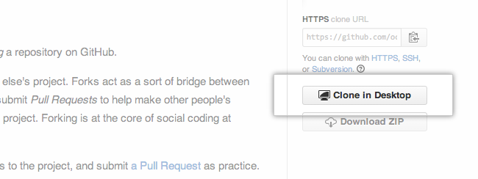
Let’s Get Connected
2. Click Fork
Type: the link of the project repository into the URL Search Bar
Let’s Fork!
3. Let’s Clone
the Fork!
Notes:
Forking a project means to take a copy of a project’s source code for independent development. On GitHub, it means to click the Fork button on a project page. GitHub then creates a clone of the project in your own GitHub account.

Slide 14
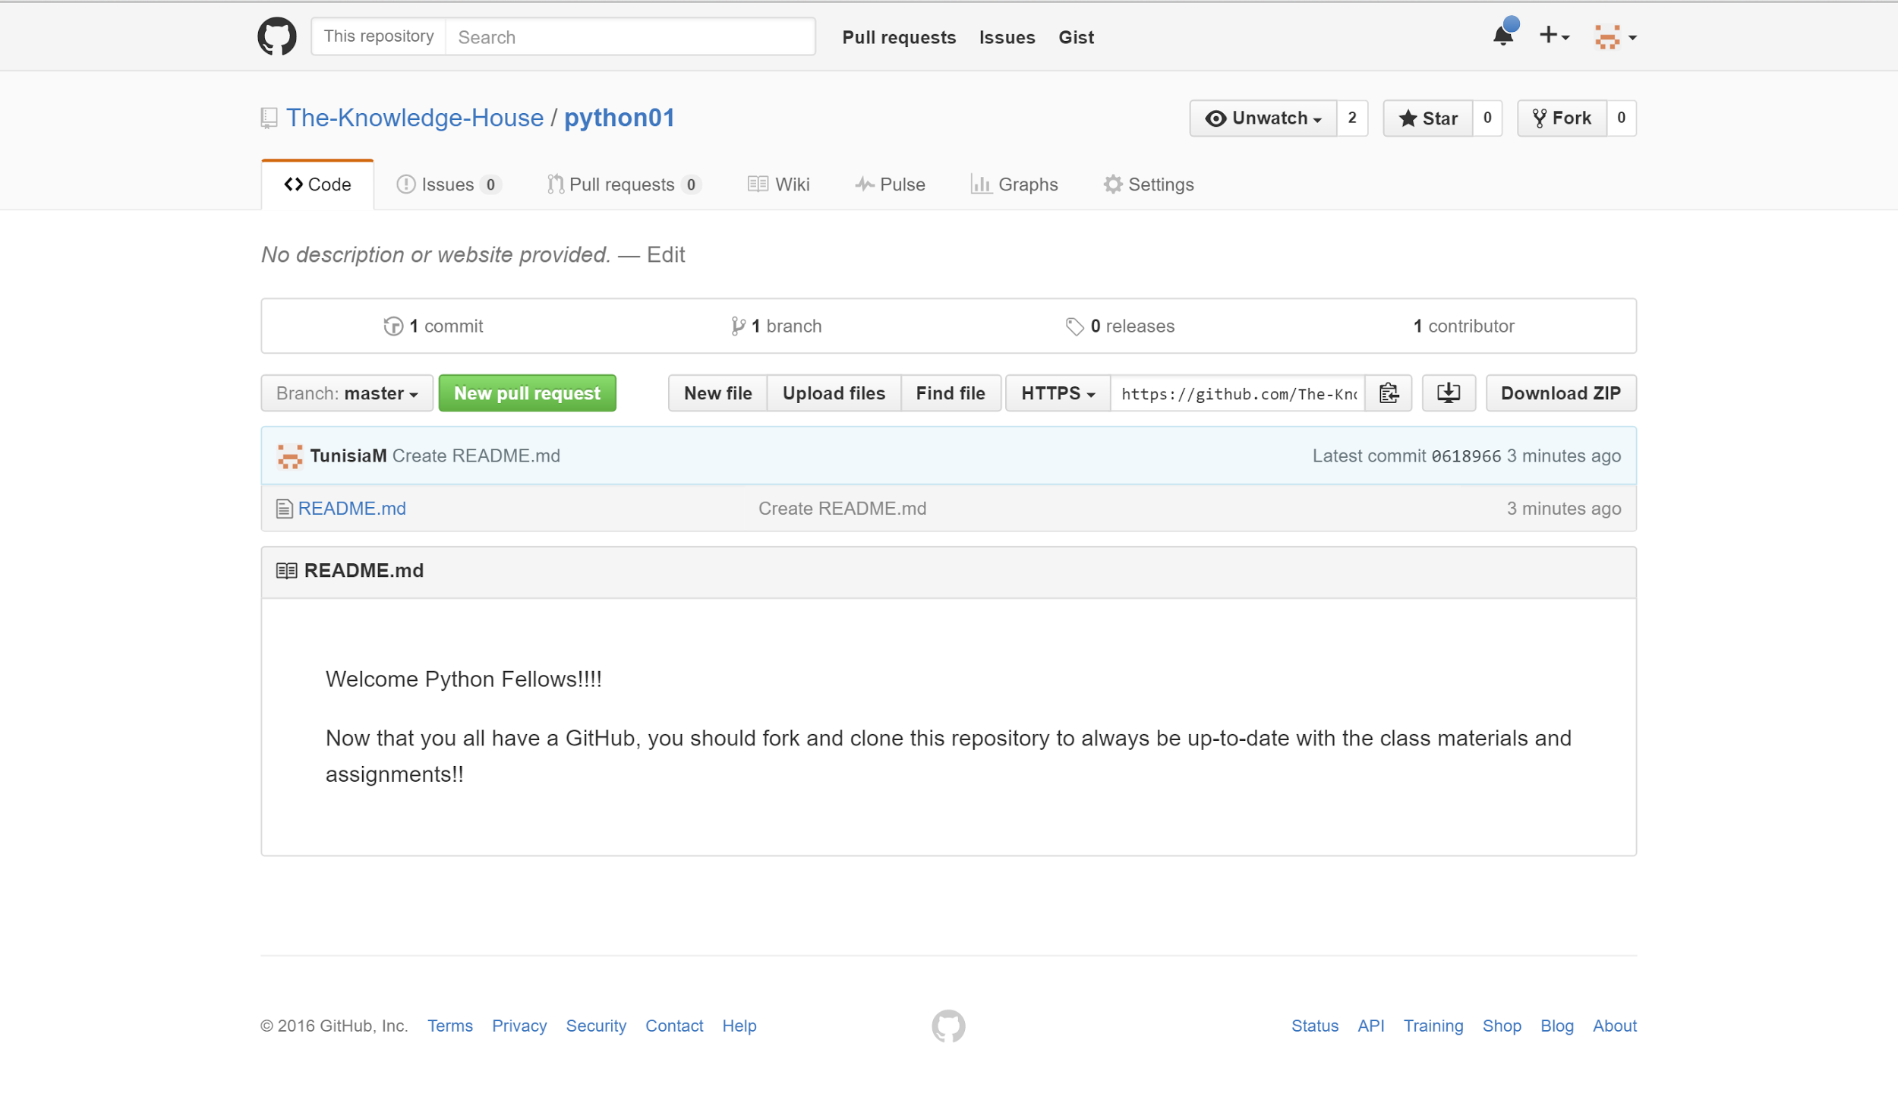
Step 1 and 2: Type Link and Fork

Slide 15
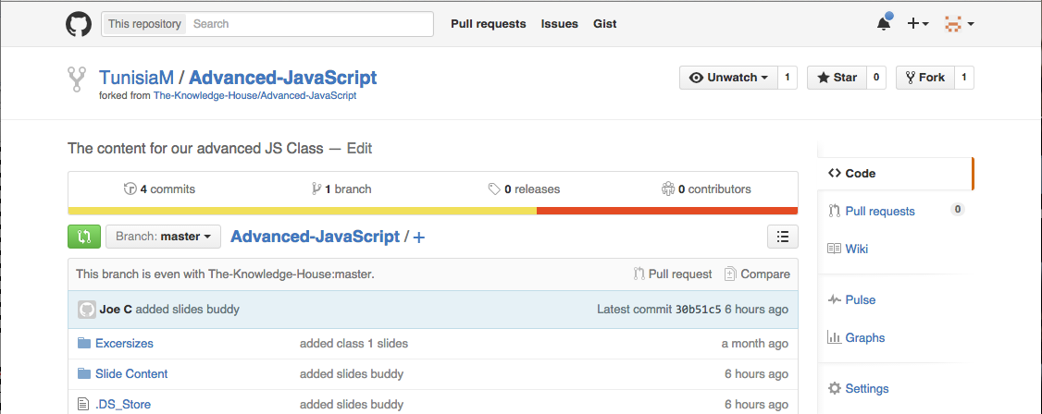
Result
Your profile name
Class Repository
Notes:
Now, on your GitHub account, you will have access to the class materials

Slide 16
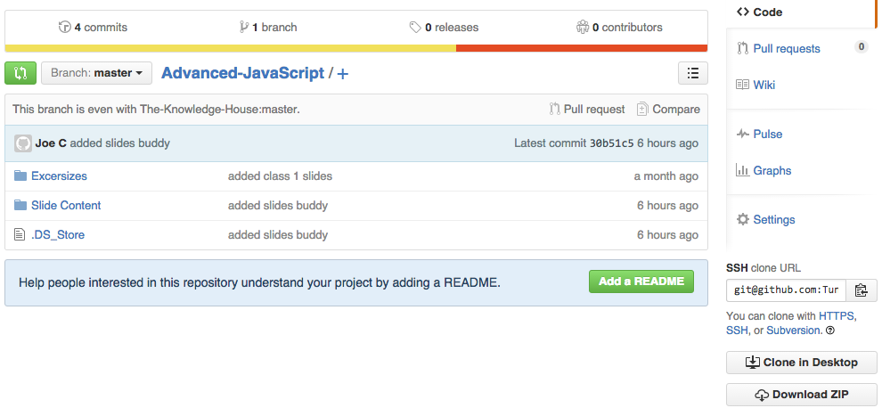
Two Ways to Clone
Type: git clone “SSH clone URL”
Click “Clone in Desktop” to copy the folders and files to your computer

Slide 17
Cloning a local project to GitHub
Create new repo on github
Cd into the directory
Initialize a git repo in the directory: git init
Add & Commit : git add . , git commit -m “first commit”
Connect to your repo: git add remote origin <remote repo url>
Verify URL: git -v
Push: git push origin master
Notes:
Pull what they pushed up

Slide 18
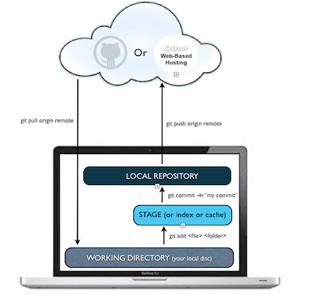
GitHub Workflow
Notes:
Pull class slides onto students’ computers

Slide 19
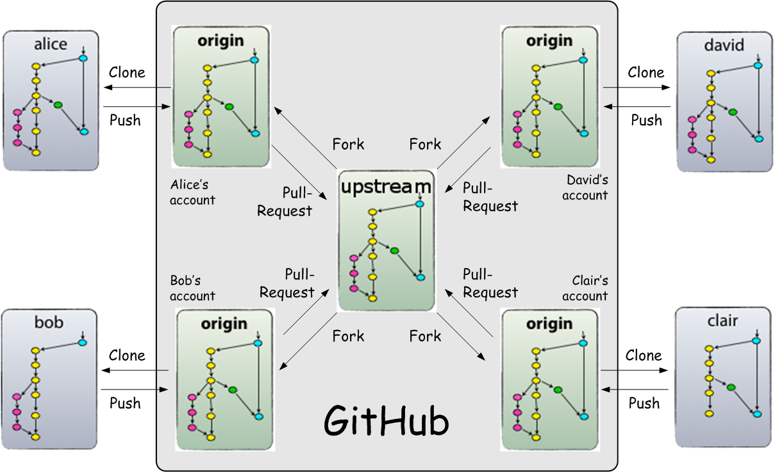
GitHub Workflow w/ Teammates

Slide 20
What is Code? Software? A Program?
A sequence of stored instructions
It is a little piece of our intelligence in the computer
It is a little piece of our intelligence we can give to others - we figure something out and then we encode it and then give it to someone else to save them the time and energy of figuring it out
A piece of creative art - particularly when we do a good job on user experience
Notes:
Y

Slide 21
name = raw_input('Enter file:')
handle = open(name, 'r')
text = handle.read()
words = text.split()
counts = dict()
for word in words:
counts[word] = counts.get(word,0) + 1
bigcount = None
bigword = None
for word,count in counts.items():
if bigcount is None or count > bigcount:
bigword = word
bigcount = count
print bigword, bigcount
python words.py
Enter file: words.txt
to 16
python words.py
Enter file: clown.txt
the 7
Notes:
Y

Slide 22
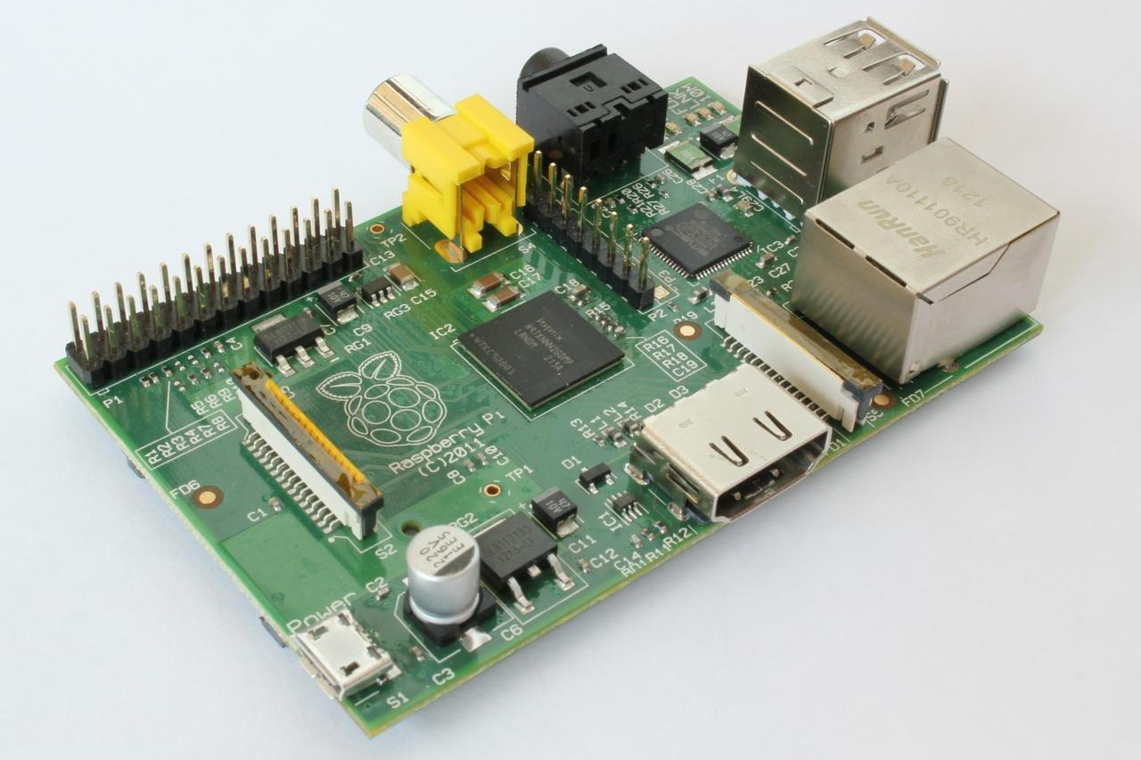
http://upload.wikimedia.org/wikipedia/commons/3/3d/RaspberryPi.jpg

Slide 23
Definitions
What
Next?
Central Processing Unit: Runs the Program - The CPU is always wondering “what to do next”? Not the brains exactly - very dumb but very very fast
Input Devices: Keyboard, Mouse, Touch Screen
Output Devices: Screen, Speakers, Printer, DVD Burner
Main Memory: Fast small temporary storage - lost on reboot - aka RAM
Secondary Memory: Slower large permanent storage - lasts until deleted - disk drive / memory stick
Notes:
Y

Slide 24
Python as a Language
Notes:
Y

Slide 25
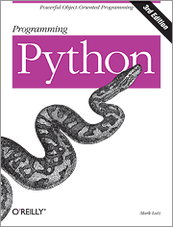
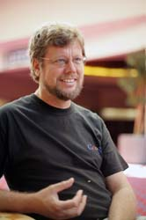
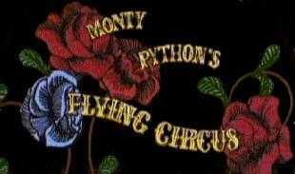
Python is the language of the Python Interpreter and those who can converse with it. An individual who can speak Python is known as a Pythonist. It is a very uncommon skill, and may be hereditary. Nearly all known Pythonists use software initially developed by Guido van Rossum.
Notes:
Y

Slide 26
Early Learner: Syntax Errors
We need to learn the Python language so we can communicate our instructions to Python. In the beginning we will make lots of mistakes and speak gibberish like small children.
When you make a mistake, the computer does not think you are “cute”. It says “syntax error” - given that it knows the language and you are just learning it. It seems like Python is cruel and unfeeling.
You must remember that you are intelligent and can learn. The computer is simple and very fast, but cannot learn. So it is easier for you to learn Python than for the computer to learn English...
Notes:
Y

Slide 27
csev$ python
Python 2.5 (r25:51918, Sep 19 2006, 08:49:13)
[GCC 4.0.1 (Apple Computer, Inc. build 5341)] on darwin
Type "help", "copyright", "credits" or "license" for more information.
>>>
What next?
Notes:
Y

Slide 28
csev$ python
Python 2.5 (r25:51918, Sep 19 2006, 08:49:13)
[GCC 4.0.1 (Apple Computer, Inc. build 5341)] on darwin
Type "help", "copyright", "credits" or "license" for more information.
>>> x = 1
>>> print x
1
>>> x = x + 1
>>> print x
2
>>> exit()
This is a good test to make sure that you have Python correctly installed. Note that quit() also works to end the interactive session.
Notes:
Y

Slide 29
Python Download Help!!
If you don’t have Python Installed, go to the following links:
Windows: https://www.python.org/downloads/
Mac OS: https://www.python.org/downloads/mac-osx/
Linux/UNIX: https://www.python.org/downloads/source/
Notes:
Y

Slide 30
Elements of Python
Vocabulary / Words - Variables and Reserved words (Chapter 2)
Sentence structure - valid syntax patterns (Chapters 3-5)
Story structure - constructing a program for a purpose
Notes:
Y

Slide 31
name = raw_input('Enter file:')
handle = open(name, 'r')
text = handle.read()
words = text.split()
counts = dict()
for word in words:
counts[word] = counts.get(word,0) + 1
bigcount = None
bigword = None
for word,count in counts.items():
if bigcount is None or count > bigcount:
bigword = word
bigcount = count
print bigword, bigcount
A short “story” about how to count words in a file in Python
python words.py
Enter file: words.txt
to 16
Notes:
Y

Slide 32
Reserved Words
You cannot use reserved words as variable names / identifiers
and del for is raise assert elif from lambda return break else global not try class except if or while continue exec import pass yield def ﬁnally in print as with
Notes:
Y

Slide 33
Sentences or Lines
x = 2
x = x + 2
print x
Assignment statement
Assignment with expression
Print statement
Variable
Operator
Constant
Reserved Word
Notes:
Y

Slide 34
Python Scripts
Interactive Python is good for experiments and programs of 3-4 lines long.
Most programs are much longer, so we type them into a file and tell Python to run the commands in the file.
In a sense, we are “giving Python a script”.
As a convention, we add “.py” as the suffix on the end of these files to indicate they contain Python.
Notes:
Y

Slide 35
Interactive versus Script
Interactive
You type directly to Python one line at a time and it responds
Script
You enter a sequence of statements (lines) into a file using a text editor and tell Python to execute the statements in the file
Notes:
Y

Slide 36
Program Steps or Program Flow
Like a recipe or installation instructions, a program is a sequence of steps to be done in order.
Some steps are conditional - they may be skipped.
Sometimes a step or group of steps are to be repeated.
Sometimes we store a set of steps to be used over and over as needed several places throughout the program (Chapter 4).
Notes:
Y

Slide 37
Sequential Steps
x = 2
Program:
x = 2
print x
x = x + 2
print x
Output:
2
4
print x
x = x + 2
print x
When a program is running, it flows from one step to the next. As programmers, we set up “paths” for the program to follow.
Notes:
Y

Slide 38
Conditional Steps
x = 5
x < 10 ?
Yes
Program:
x = 5
if x < 10:
print 'Smaller’
if x > 20:
print 'Bigger'
print 'Finis'
print 'Smaller'
Output:
Smaller
Finis
x > 20 ?
No
print 'Bigger'
print 'Finis'
Notes:
Y

Slide 39
Repeated Steps
n = 5
No
n > 0 ?
Yes
Output:
5
4
3
2
1
Blastoff!
Program:
n = 5
while n > 0 :
print n
n = n – 1
print 'Blastoff!'
print n
n = n -1
print 'Blastoff'
Loops (repeated steps) have iteration variables that change each time through a loop. Often these iteration variables go through a sequence of numbers.
Notes:
Y

Slide 40
name = raw_input('Enter file:')
handle = open(name, 'r')
text = handle.read()
words = text.split()
counts = dict()
for word in words:
counts[word] = counts.get(word,0) + 1
bigcount = None
bigword = None
for word,count in counts.items():
if bigcount is None or count > bigcount:
bigword = word
bigcount = count
print bigword, bigcount
Sequential
Repeated
Conditional
Notes:
Y

Slide 41
name = raw_input('Enter file:')
handle = open(name, 'r')
text = handle.read()
words = text.split()
counts = dict()
for word in words:
counts[word] = counts.get(word,0) + 1
bigcount = None
bigword = None
for word,count in counts.items():
if bigcount is None or count > bigcount:
bigword = word
bigcount = count
print bigword, bigcount
A short Python “Story” about how to count words in a file
A word used to read data from a user
A sentence about updating one of the many counts
A paragraph about how to find the largest item in a list
Notes:
Y

Slide 42
Summary
This is a quick overview of Chapter 1
We will revisit these concepts throughout the course
Focus on the big picture
Notes:
N

Slide 43
Acknowledgements / Contributions
These slides are Copyright 2010- Charles R. Severance (www.dr-chuck.com) of the University of Michigan School of Information and open.umich.edu and made available under a Creative Commons Attribution 4.0 License. Please maintain this last slide in all copies of the document to comply with the attribution requirements of the license. If you make a change, feel free to add your name and organization to the list of contributors on this page as you republish the materials.
Initial Development: Charles Severance, University of Michigan School of Information
… Insert new Contributors and Translators here
...
Notes:
N

