Slide 1
Detection and Prevention of SQL Injection Attacks
Karansinh Vaghela – 18BCP048
Rachit Gadhia – 18BCP089
Vyomesh Jethava – 18BCP152D
CSE 7330

Slide 2
Introduction
What is SQL Injection?
Real World Examples
Important SQL Syntax
Example Website
Prevention

Slide 3
What is SQL Injection?
Code Injection Technique
Exploits Security Vulnerability
Targets User Input Handlers

Slide 4
Real World Examples
On August 17, 2009, the United States Justice Department charged an American citizen Albert Gonzalez and two unnamed Russians with the theft of 130 million credit card numbers using an SQL injection attack.
In 2008 a sweep of attacks began exploiting the SQL injection vulnerabilities of Microsoft's IIS web server and SQL database server. Over 500,000 sites were exploited.

Slide 5
Important Syntax
  COMMENTS: --
  Example: SELECT * FROM `table` --selects everything
  LOGIC: ‘a’=‘a’
  Example: SELECT * FROM `table` WHERE ‘a’=‘a’
  MULTI STATEMENTS: S1; S2
  Example: SELECT * FROM `table`; DROP TABLE `table`;

Slide 6
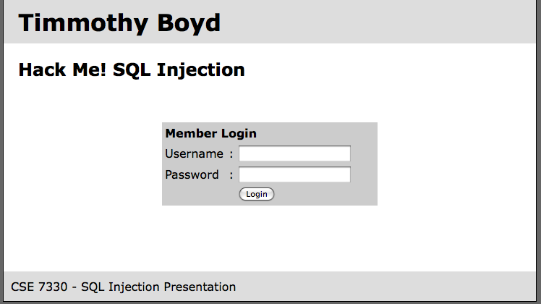
Example Website

Slide 7
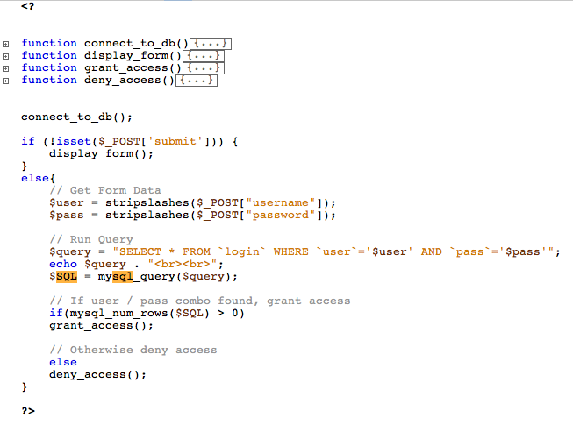

Slide 8

Example Website
timbo317
cse7330
SELECT * FROM `login` WHERE `user`=‘timbo317’ AND `pass`=‘cse7330’

Slide 9
Login Database Table
user | pass
timbo317 | cse7330
What Could Go Wrong??

Slide 10

Example Hack
’ OR ‘a’=‘a
’ OR ‘a’=‘a
SELECT * FROM `login` WHERE `user`=‘’ OR ‘a’=‘a’ AND
`pass`=‘’ OR ‘a’=‘a’

Slide 11


It Gets Worse!
’; DROP TABLE `login`; --
SELECT * FROM `login` WHERE `user`=‘’; DROP TABLE `login`; --’ AND
`pass`=‘’

Slide 12
All Queries are Possible
SELECT * FROM `login` WHERE `user`=‘’; INSERT INTO `login` ('user','pass') VALUES ('haxor','whatever');--’ AND `pass`=‘’
SELECT * FROM `login` WHERE `user`=‘’; UPDATE `login` SET `pass`=‘pass123’ WHERE `user`=‘timbo317’;--’ AND `pass`=‘’

Slide 13
Live Demonstration
How Can You Prevent This??

Slide 14
Prevention
Logic to allow only numbers / letters in username and password.
How should you enforce the constraint?
SERVER SIDE.
‘ESCAPE’ bad characters.
’ becomes \’
READ ONLY database access.
Remember this is NOT just for login areas!
NOT just for websites!!

Slide 15
Thank You

