Slide 1
Passenger Behaviour and Travel Pattern
Name : Vyomesh Jethava
Roll No : 18BCP152D
Group ID : 7

Slide 2
Table Of Content
About Infinity Transoft Solutions Pvt Ltd.
Introduction
Services
Internship Timeline
Objective
Motivation
Working
UI Screen
Conclusion

Slide 3
About Infinity Transoft Solutions Pvt Ltd.
Infinity is highly ranked and successful in terms of: URP - University Resource Planning, Enterprise Resource Planning - ERP/CRM/SCM, ITS - Infinity Travels Solutions.
Infinity is a National Award winner in entrepreneurship and MSE Services, awarded by Mr. Pranav Mukharji (President of India).
Their aim is to serve the best digital solutions to Educational Institutes, Enterprises, and travel industries.

Slide 4
Introduction
The Online Bus Ticket Reservation System is a application that allows visitors to check bus ticket availability, buy bus ticket and pay the bus ticket online.
This Online Bus Booking System provides bus transportation system, a facility to book seats, cancellation of seats and quick booking.
This system can be used by the users to perform online booking via internet for their different purposes or even bulk booking. Users can use this program directly by installing it.

Slide 5
Services
Education ERP
Digital Learning Platform
Online Exam Portal
Industrial ERP
University Resource Planning
Enterprise Resource Planning
Infinity Travels Solutions

Slide 6
Internship Timeline
Working :
Phase - 1 : Learning basics
Phase - 2 : Practise
Phase - 3 : Assinged project
Phase - 4 : Working with team
Phase - 5 : Testing on Live Server

Slide 7
Objective
This helps the company in handling networking part of the project.
Passenger behaviour and Travel Pattern will allow travellers to get better facilities and will to customer satisfaction.
This system is designed such that ultimately all customer will get best facilities available in market compare to other competitors.

Slide 8
The motivation of this system is to provide a system with best networking system for our company.
Motivation

Slide 9
Working
Creation and maintenance of user accounts and contact lists.
Troubleshooting/ helpdesk regarding problems with employees computers.
Use of data transfer and system security diagnostic tools to monitor and address problems within the organisations.
Track data of passengers booking.

Slide 10
UI Screen

Slide 11
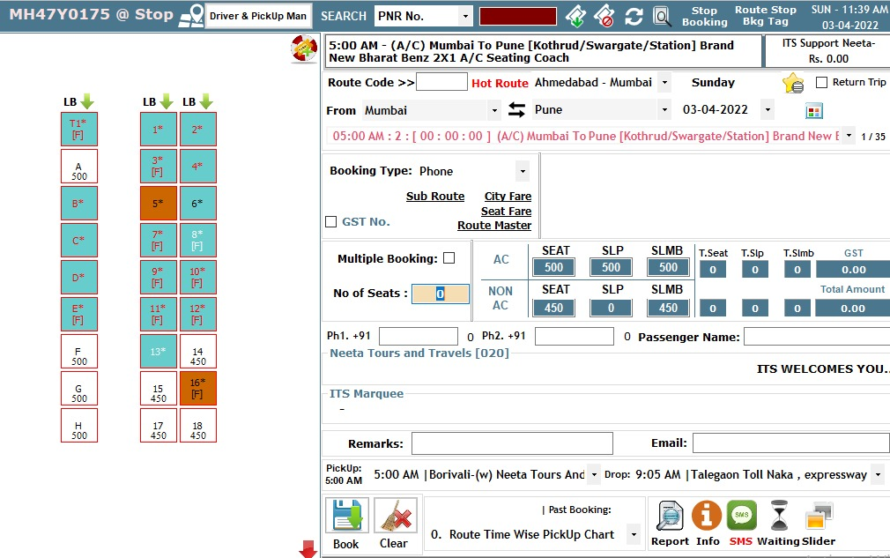

Slide 12
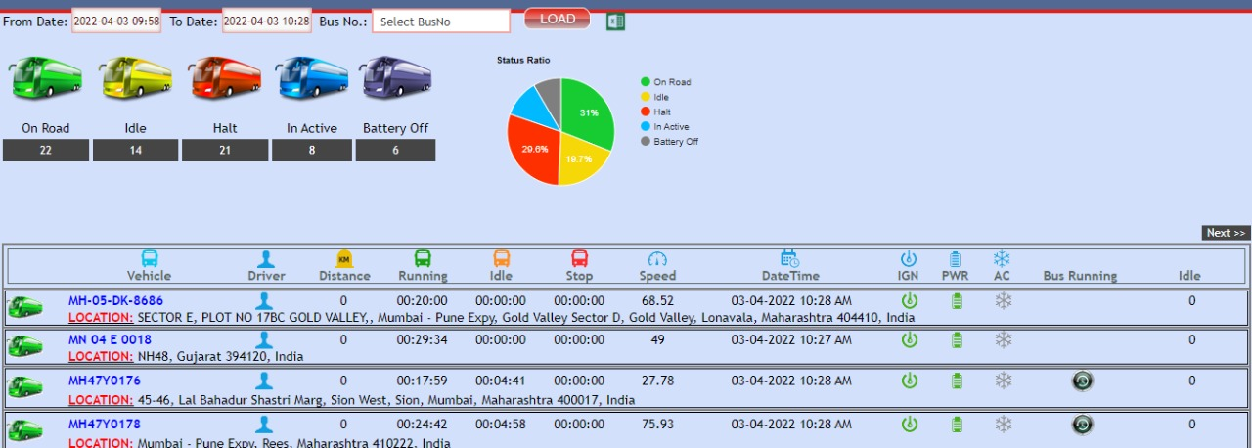

Slide 13
Conclusion

Slide 14
From a proper analysis of positive points and constraints on the component, it can be safely concluded that the product is a highly efficient.
This application is working properly and meeting to all user requirements with dedicated server and best networking facilities.
This component can be easily used for many travelling companies.

