Slide 1
POWER7
E-Commerce Project
P2
SPECIFICATION & PROTOTYPE
Presentation 2
Ponoran Claudiu Mihai • Oprea Iulian Marian
2026 / 2027

Slide 2
Tech stack & product foundation
Backend
Frontend
C# / ASP.NET Core 10
HTML • CSS • Bootstrap 5 • JS
01
02
Database
Payments
SQLite + Entity Framework Core
Stripe Test Mode (Sandbox)
03
04

Slide 3
Discovery & accounts - REQUIREMENTS A1–A4
A1
Catalog
A2
Search
Paginated catalog, max 24 items, category pages.
Basic search via Name attribute.
A3
Cart
A4
Accounts
Persistent cart in DB, server-validated stock.
Registration, login with Identity, address storage.

Slide 4
Checkout & orders - REQUIREMENTS A5–A8
A5
Checkout
A6
Payment
Delivery address, multiple shipping methods, order total.
Stripe sandbox integration via Webhook.
A7
Stock
A8
Order history
Decrement on payment, restore on cancel, pessimistic lock.
Past orders view with status and totals.

Slide 5
Admin, security & quality - REQUIREMENTS A9–A12
A9
Admin panel
A10
Security
Manage products/categories, update order status.
CSRF protection, server-side validation, role-based auth.
A11
Responsive UI
A12
Tests
Mobile-first Bootstrap design down to 360px.
Minimum 10 automated unit/integration tests with xUnit.

Slide 6
Selected bonus features
B1
B6
B1 • Filtered Search
B6 • Transactional Email
Combine category, price-range and sorting options directly in the URL.
Automated order-confirmation emails via Mailtrap after payment success.
Small additions, meaningful impact
Improves product discovery and usability
Extends the checkout workflow beyond payment
Adds realistic e-commerce behaviour for the prototype

Slide 7
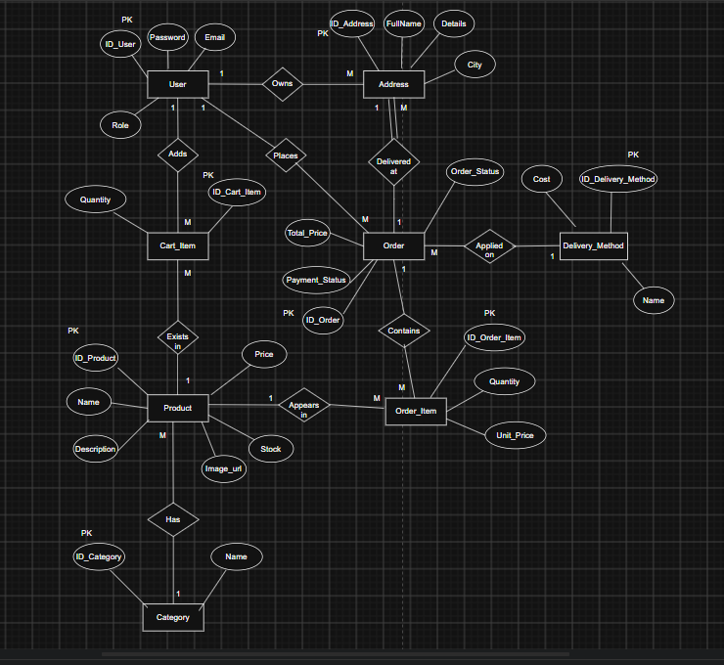
Entity-Relationship Diagram

Slide 8
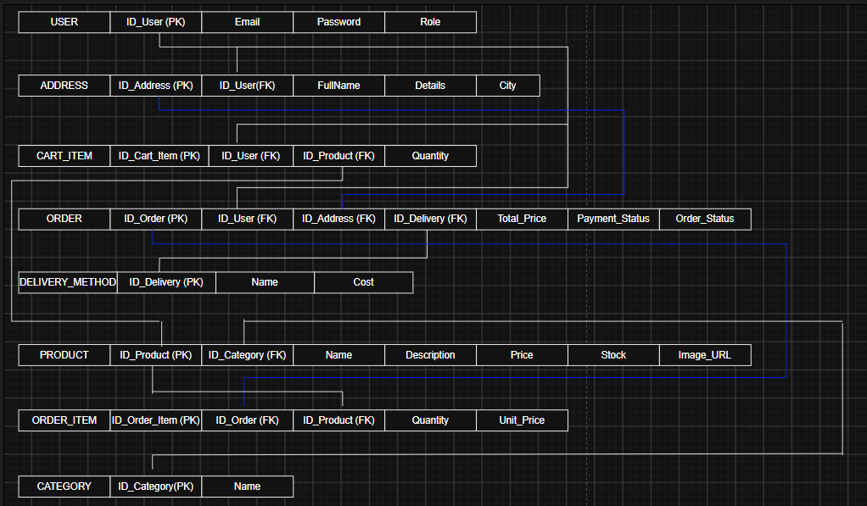
Relational model

Slide 9
System architecture
CLIENT
Browser • HTML / CSS / JS • Bootstrap
↓
SERVER
ASP.NET Core • Controllers • Stripe SDK
↓
DATA
SQLite • Entity Framework Core
↓
EXTERNAL
Stripe API • Webhook validation

Slide 10
Example of endpoints
AREA
ENDPOINT
PURPOSE
PUBLIC
GET /api/products
Product catalog
AUTH
POST /api/auth/register
Create account
AUTH
POST /api/auth/login
Authenticate user
CLIENT
GET /api/cart
Persistent cart
CLIENT
POST /api/checkout/session
Create payment session
CLIENT
GET /api/orders/history
Past orders
ADMIN
/api/admin/products
Manage products
ADMIN
/api/admin/orders/{id}/status
Update order status
EXTERNAL
POST /api/webhook/stripe
Stripe webhook

Slide 11
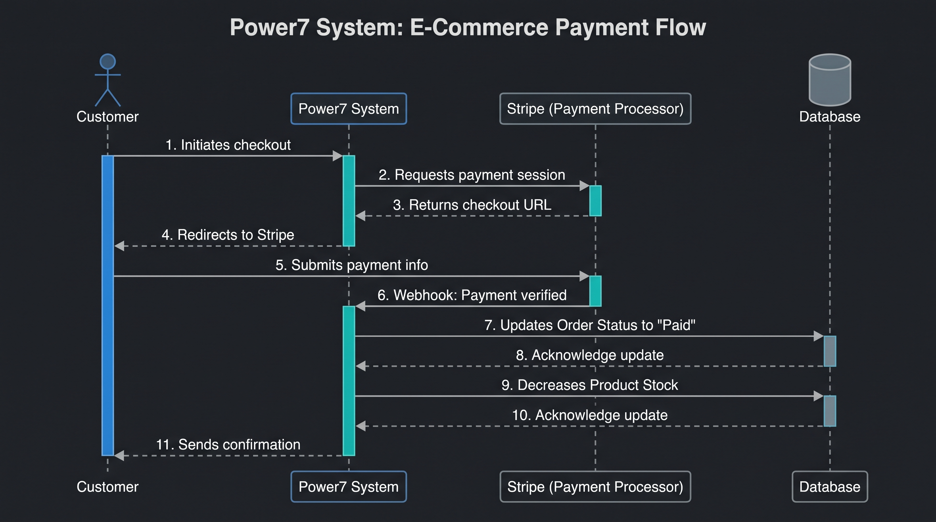
CUSTOMER
STRIPE
DATABASE

Slide 12
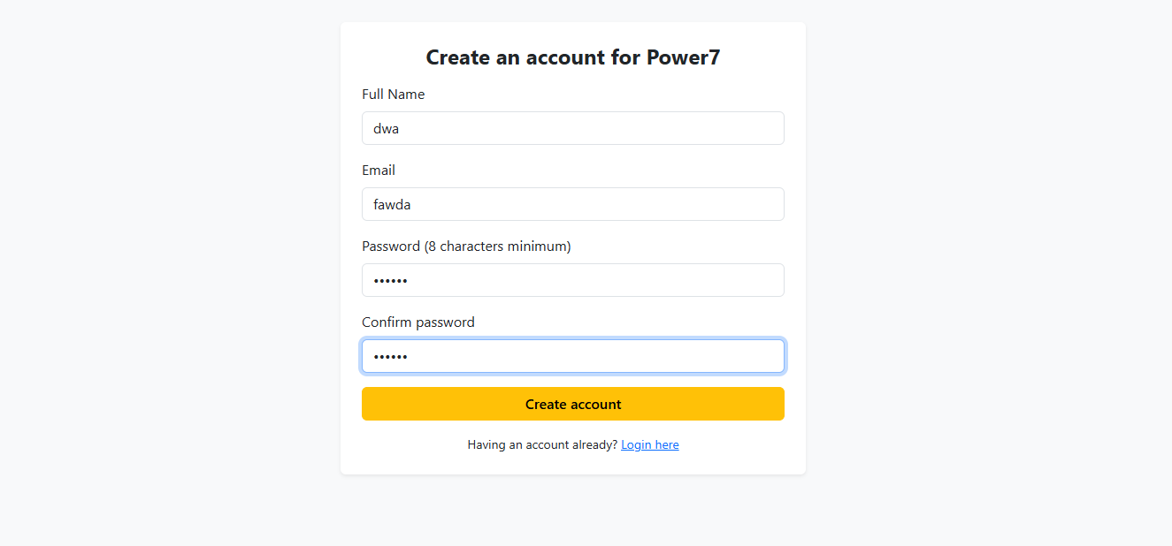
Wireframe example

Slide 13
Team ownership
FRONTEND
BACKEND
Ponoran Claudiu Mihai
Oprea Iulian Marian
Frontend & UI
Backend, DB & Logic
Catalog & product pages
SQLite database & EF Core models
Responsive design
Seed data
Wireframes
Cart logic
Bootstrap implementation
Stripe integration & API endpoints

