Slide 1
Diamond Lightning Node
A Lightning node that is not trusted —
not even by itself
dwdc.club · GPL-3.0

Slide 2
THE PROBLEM
A Lightning node is a hot wallet
with a web server attached
— REST, gRPC, a CLI, macaroons — inbound surface, always listening
— The node holds the very keys it signs with
— Whoever controls the node controls the money
Every common mitigation is a patch on that shape, not a change to it.

Slide 3
AUGUST 2026
A summer of operators afraid of their own nodes
BTCPay Server · funds actually taken
An unauthenticated request could read LND's .macaroon files. Actively
exploited; merchant channels drained. Patching stopped new access — it
did not invalidate the credentials already stolen.
Core Lightning · told to go offline
Multiple critical flaws, source withheld 14 days so they could not be
reverse-engineered. Upgrade, or restart with --offline.
LND · cooperative close
A channel-close flaw putting an entire channel balance at risk.
Two of these are the shape, not the code: a credential that can be stolen, and an interface that can be reached.

Slide 4
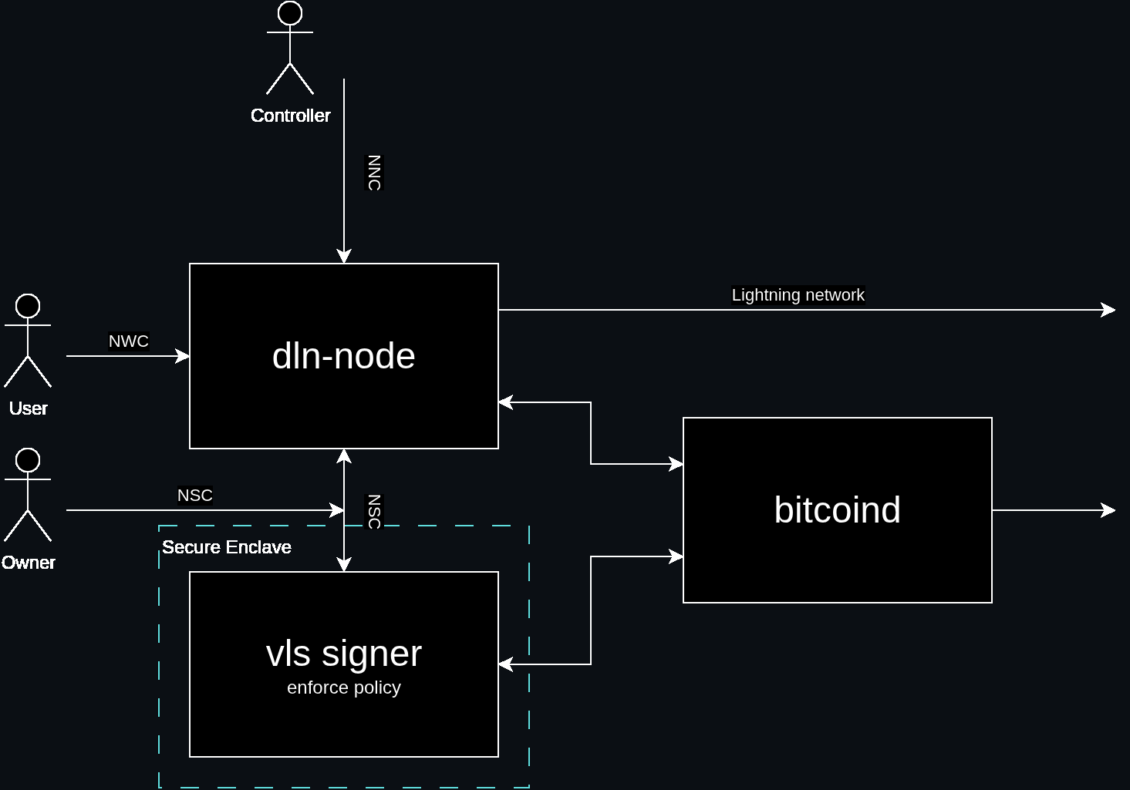
THE ARCHITECTURE
Three roles, three protocols, and a signer the node cannot talk past.

Slide 5
SEPARATION OF POWERS
Three roles, and none of them is trusted twice
Owner
Defines the signing policy. Touches nothing day to day.
User
Spends through the wallet, within the Owner's permissions and limits.
Controller
Operates the node — channels, peers, fees — under the same policy.
A role is a key, not an account. Capabilities are granted per key and per method.

Slide 6
ONE TRANSPORT, THREE PROTOCOLS
Nostr is the only control plane
NWC · the wallet
Invoices, payments, offers, on-chain. Extends NIP-47.
NCC · the node
Channels, peers, fees, routing, network queries.
NSC · the signer
Signing requests, and the policy that governs them.
No CLI. No local socket. Nothing listens for control — the node reaches out to a relay.

Slide 7
WHY THE SHAPE MATTERS
Policy lives in the signer,
not in the node
The keys are not the node's. Every signature is a request the signer
validates against the Owner's policy — and can refuse.
A user or controller cannot make the signer approve an operation
outside that policy merely by controlling dln-node.
— The signer can run inside an attested secure enclave.

Slide 8
WHAT IT UNLOCKS
diamond-x — swapping BTC against BTK
Two chains, two channels, one payment hash.
Neither side can take their leg without enabling the other.
— Hold invoices are the primitive that makes it atomic
— No custody: the exchange relays two parallel legs, holding nothing
3.7 seconds
Measured end to end, on regtest — not projected.

Slide 9
PROVEN WHERE IT IS HARDEST
Across a consensus fork, live
Bitcoin Knots changes the block header: 80 bytes to 164, and a new proof of work.
— v2 header support through the whole Rust stack
— A node follows the chain across activation without losing a channel
— A swap with one leg on BTC and one on a BLAKE2b chain
— BKIP-0001 — the specification that did not exist, checked against Knots' own vectors
And the negative control: without the support, the node stops dead at the fork.

Slide 10
WHERE IT STANDS
Fast is demonstrated.
Safe is not yet.
— Proven — the happy path, end to end, on both chains, across the fork
— Not proven — force closes, HTLC timeouts, on-chain claims
Every scenario so far ends with both parties cooperating. The safety
argument rests entirely on what happens when one of them does not.
That is the next mission, and it is deliberately not claimed yet.

