Slide 1
Sentiment and Reviews Data Analysis
An Analysis of Customer Reviews

Slide 2
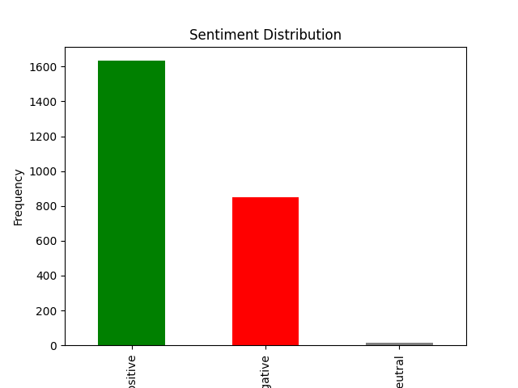
Sentiment Distribution

Slide 3
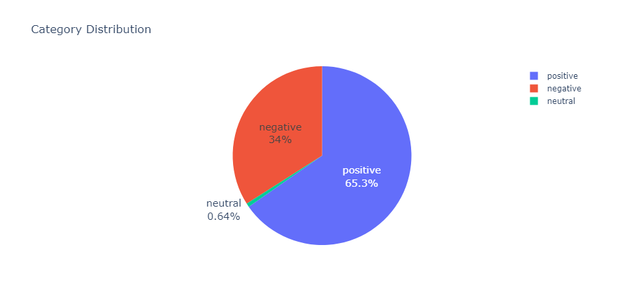






Pie Chart Distribution

Slide 4
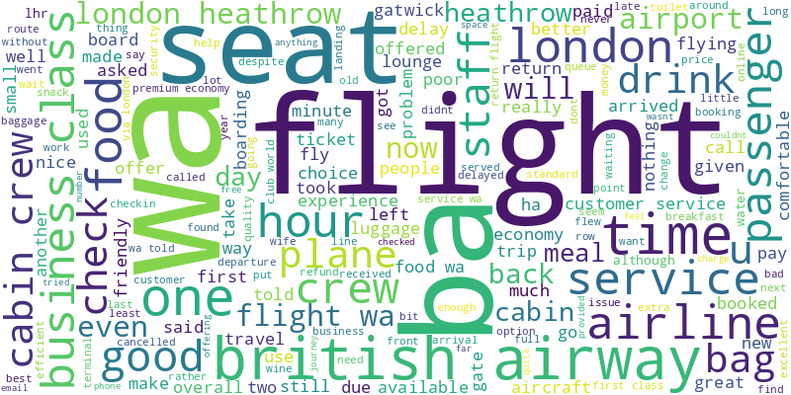
Word Cloud of Frequent Words

