Slide 1
Booking Analysis
With Feature Importance

Slide 2
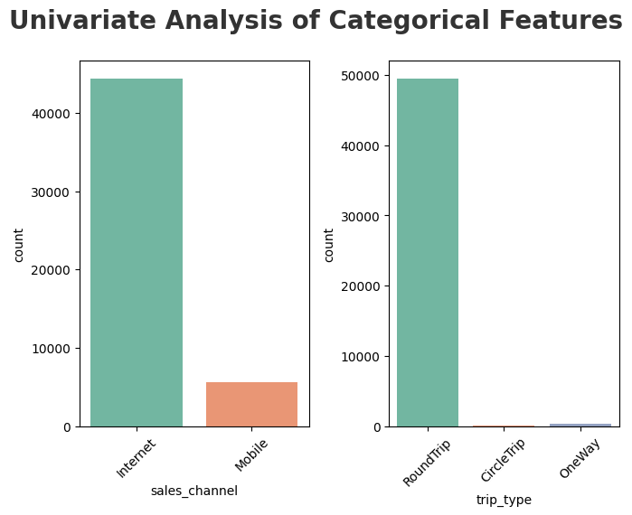
Categorical Analysis

Slide 3
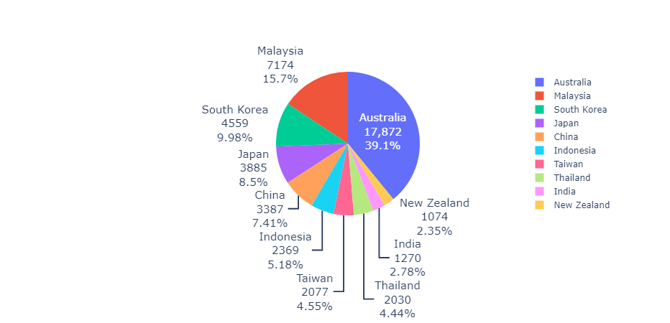
Top 10 Booking Origins

Slide 4
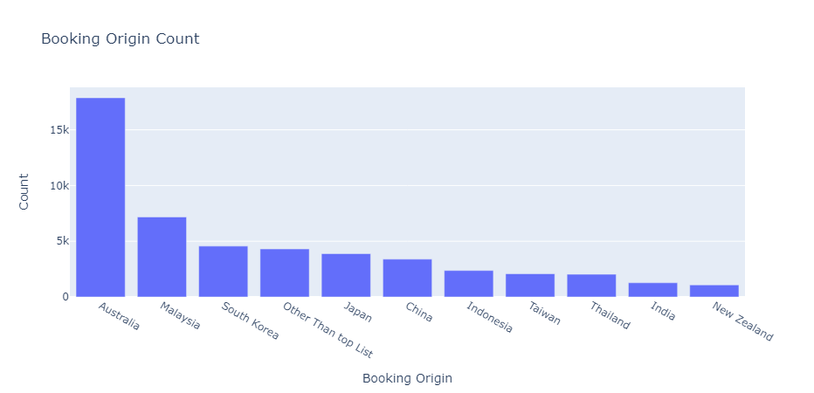

Slide 5
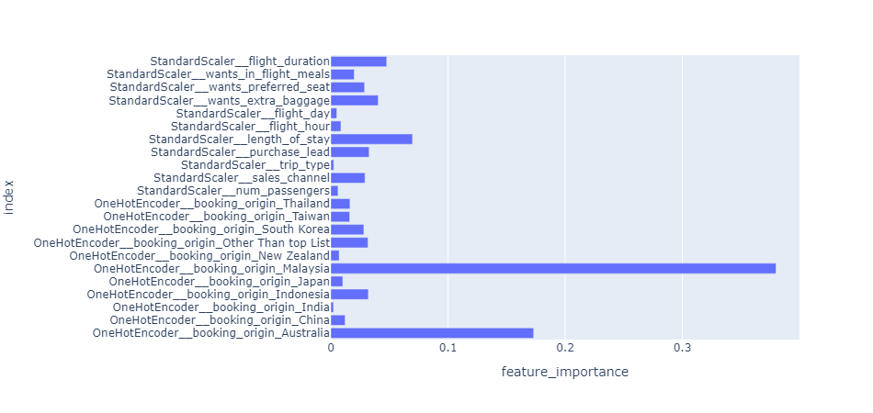
Feature Importance

