Slide 1
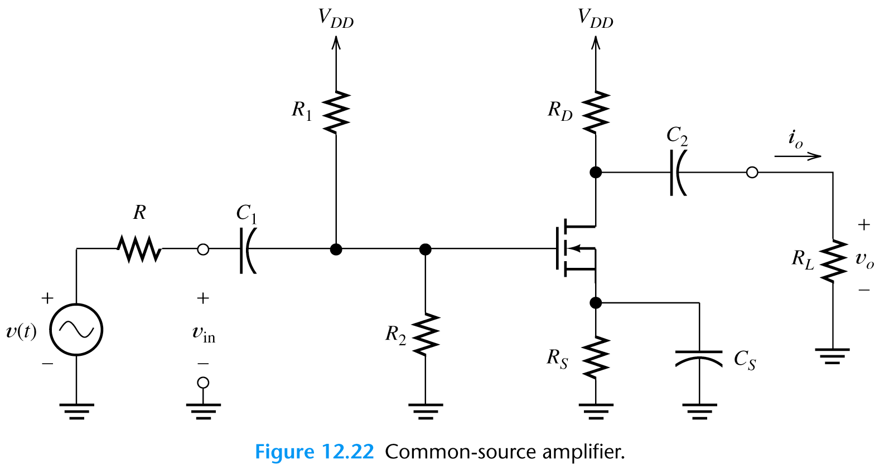
12.5 Common Source Amplifiers
v_{in}?
v_{o}?
Voltage gain
A_{v}=v_{o}/ v_{in}?

Slide 2
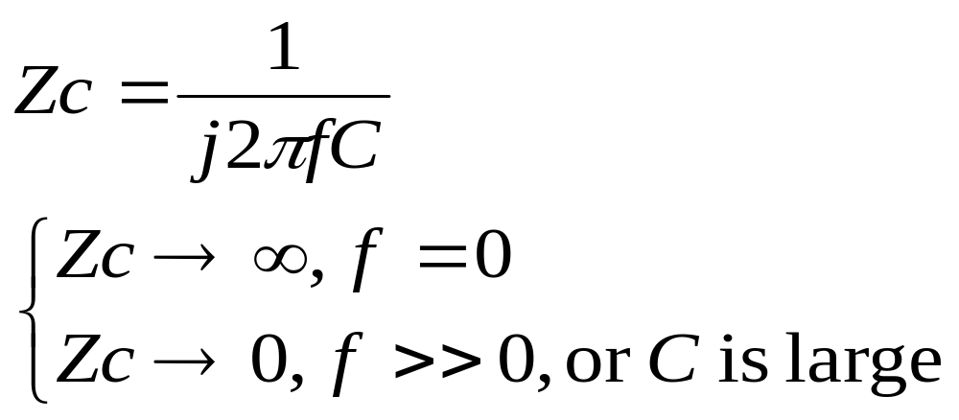
Common-Source Amplifiers
C₁ and C₂ are coupling capacitors and C_{s} is the bypass capacitor. The capacitors are intended to have large impedances for the dc signal and very small impedances for the ac signal.

Slide 3
Common-Source Amplifiers
For DC analysis, the capacitors are replaced by open circuits to determine the quiescent operation point (Q point). The transconductance g_{m} for the small-signal equivalent circuit is also determined.
For AC analysis, the capacitor are replaced by short circuits to determine the ac voltage gain A_{v}=v_{o}/v_{in}.

Slide 4
DC Analysis
DC voltage sources
Coupling capacitors
Bypass capacitors

Slide 5
The Small-Signal Equivalent Circuit
In small-signal midband analysis of FET amplifiers, the coupling capacitors, bypass capacitors, and dc voltage sources are replaced by short circuits.
The FET is replaced with its small-signal equivalent circuit. Then, we write circuit equations and derive useful expressions for gains, input impedance, and output impedance.

Slide 6
AC Analysis
DC voltage sources
Coupling capacitors
Bypass capacitors

Slide 7
DC voltage sources
Coupling capacitors
Bypass capacitors

Slide 8
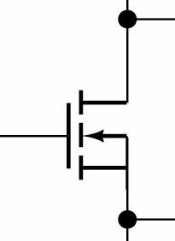
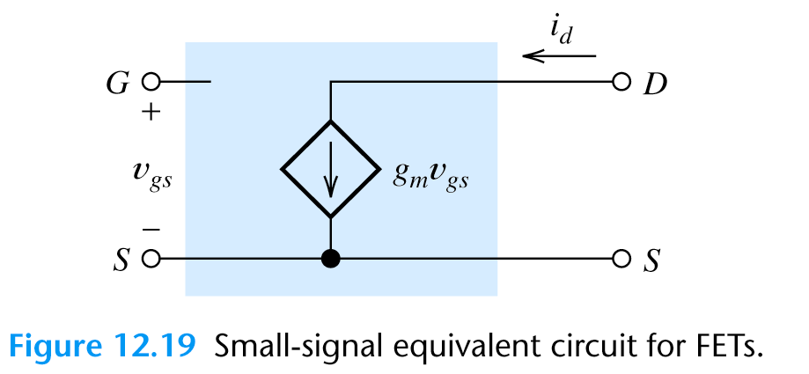

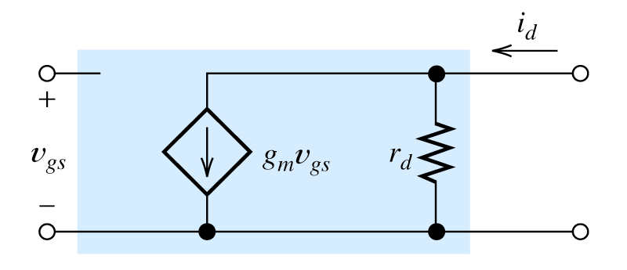
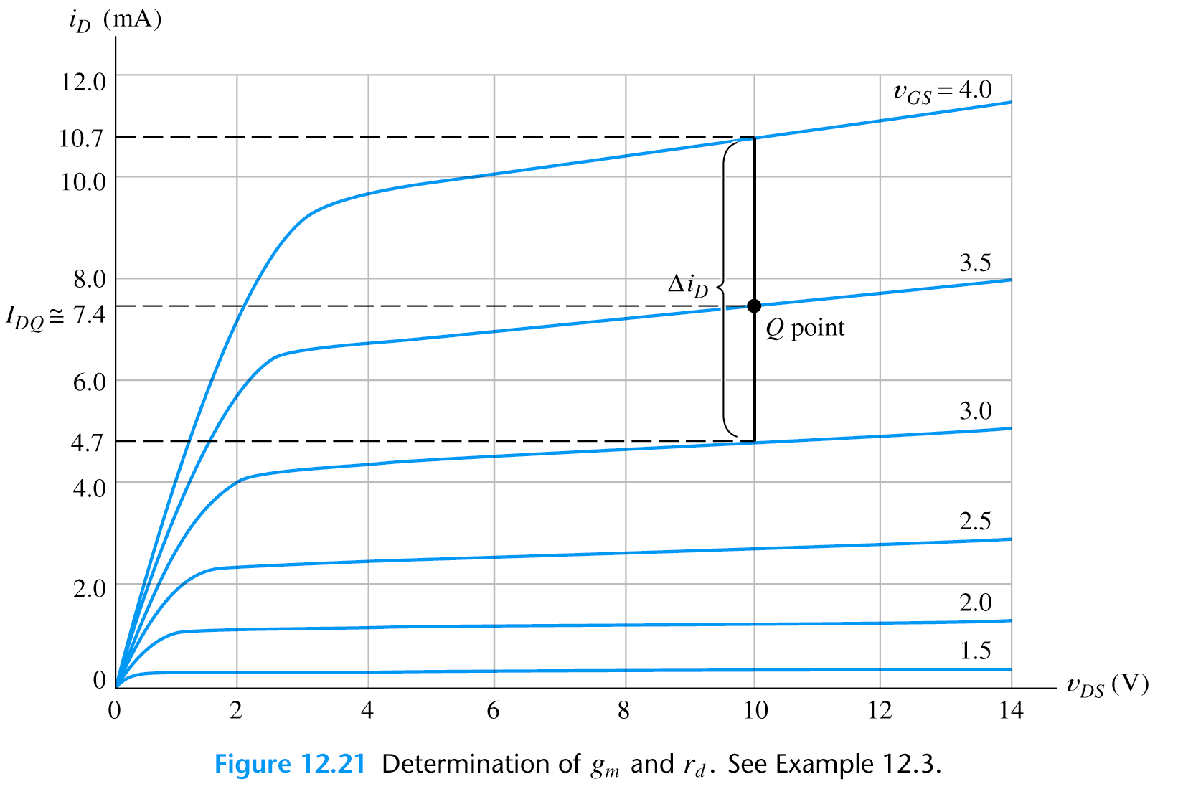
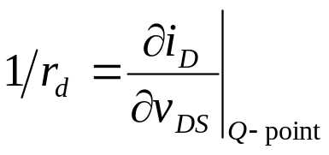
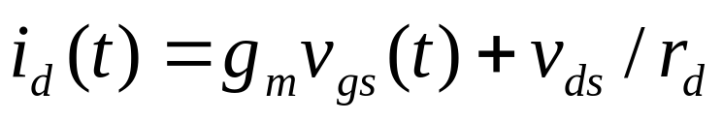
SMALL-SIGNAL EQUIVALENT CIRCUITS (12.4)
A more complex equivalent circuit consider drain resistance r_{d}

Slide 9
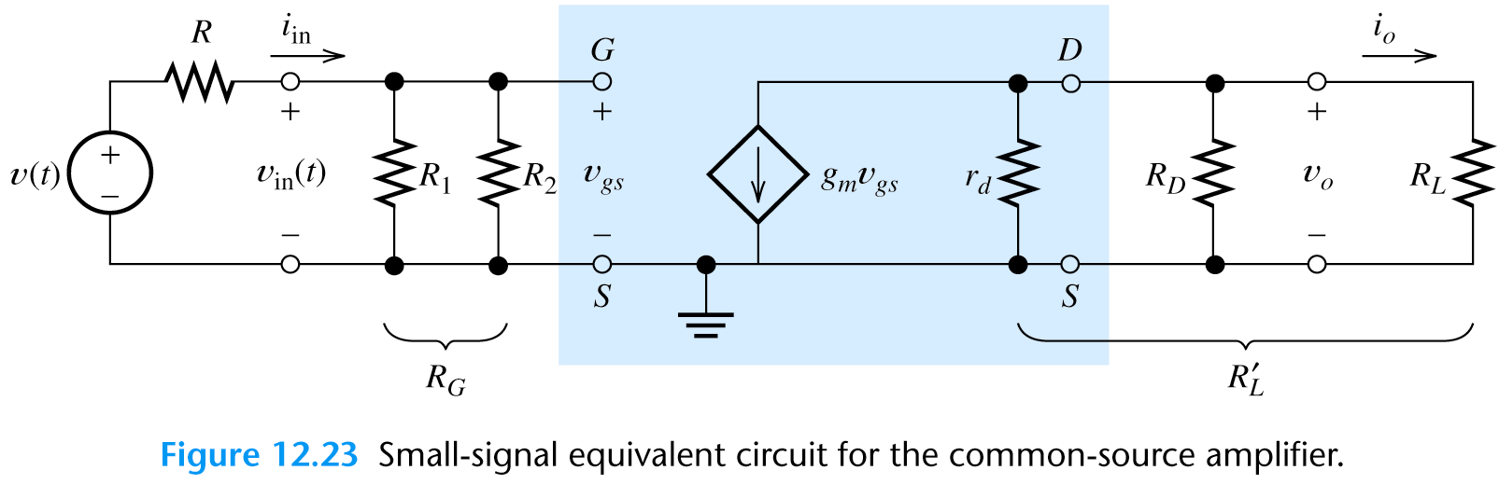
Common Source Amplifiers: FET source 端接ground

Slide 10
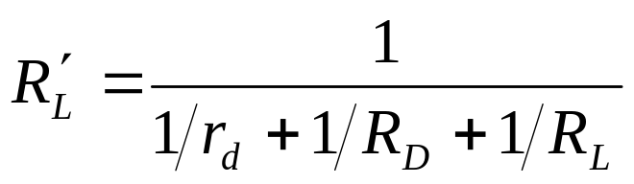
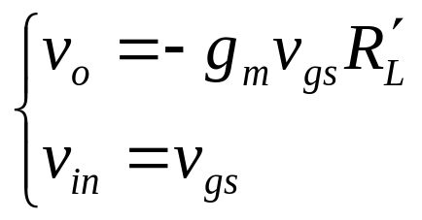
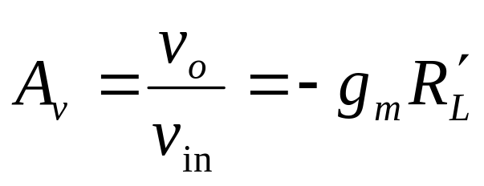
Common Source Amplifiers:
Equivalent load resistance
Input voltage & output voltage
Voltage Gain

Slide 11
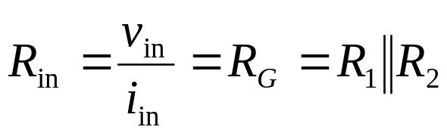
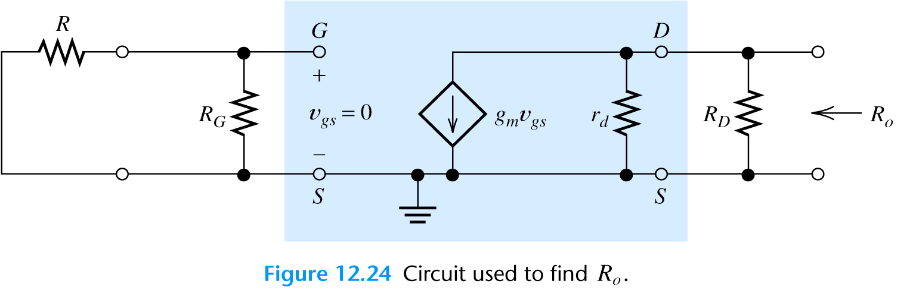
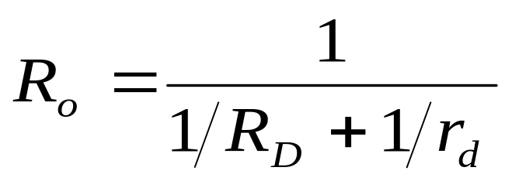
Common Source Amplifiers:
Input Resistance
Output resistance
disconnect the load,
replace the signal source by
the internal resistance,
find the resistance by looking
into the output terminals.

Slide 12
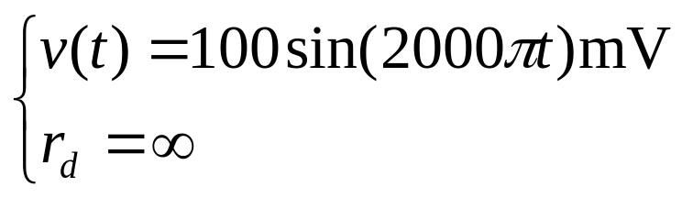
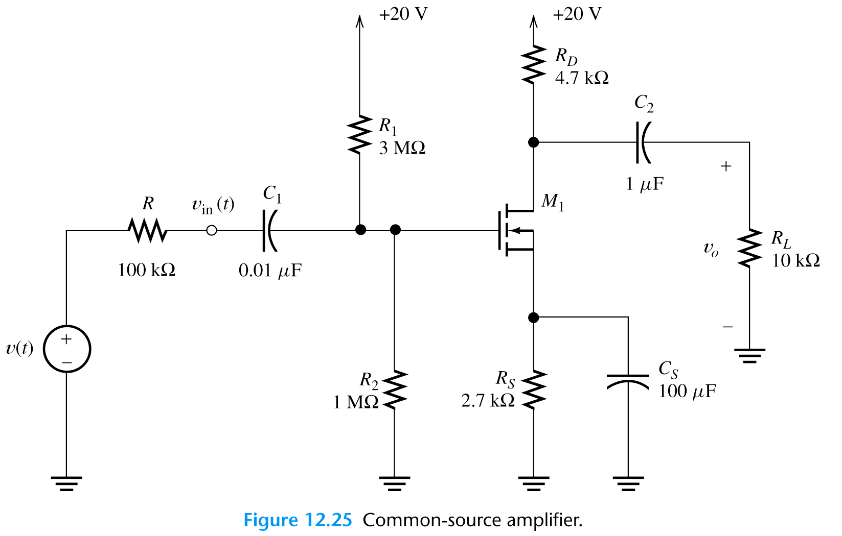
Example 12.4
Analyze the following circuit. KP=50uA/V², V_{to}=2 V, L=10um, W=400um (identical to example 12.2).
Assume
Find
midband voltage gain
input resistance
output resistance
output voltage

Slide 13
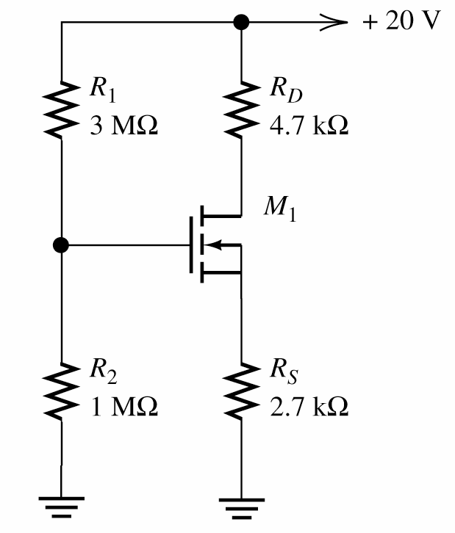
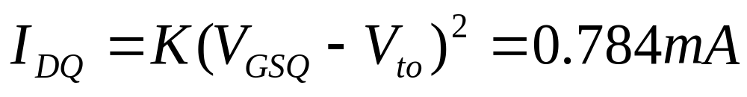
Example 12.4
Analyze the following circuit. KP=50uA/V², V_{to}=2 V, L=10um, W=400um (identical to example 12.2).
DC Analysis
Fine Q point (see example 12.2)

Slide 14
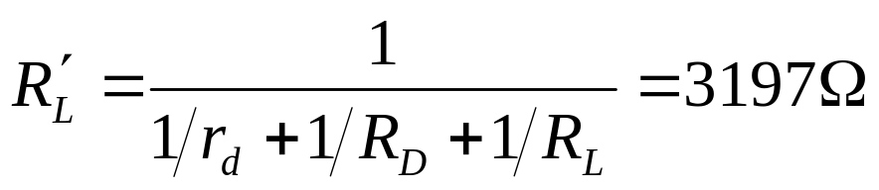
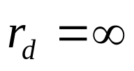
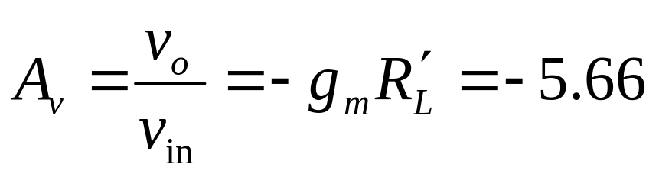
Example 12.4
Analyze the following circuit. KP=50uA/V², V_{to}=2 V, L=10um, W=400um (identical to example 12.2).
AC Analysis
Fine g_{m}(see Ch 12.4)
Equivalent load resistance
( )
Voltage Gain

Slide 15
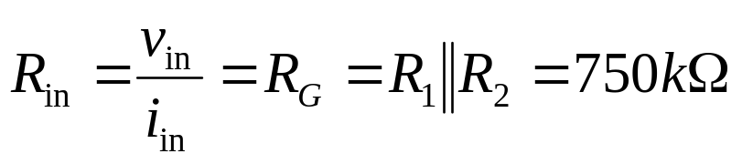
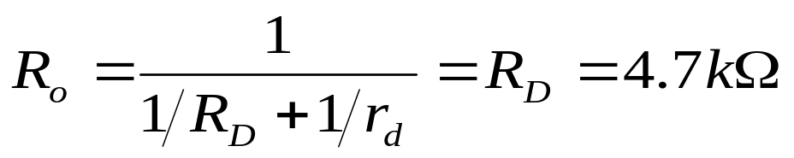
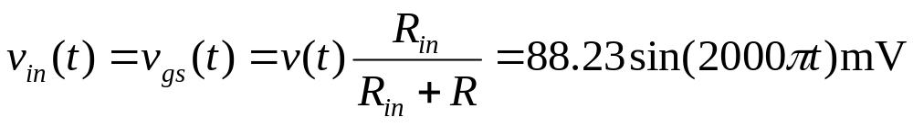
Example 12.4
Analyze the following circuit. KP=50uA/V², V_{to}=2 V, L=10um, W=400um (identical to example 12.2).
Input Resistance
Output Resistance
Input voltage
Output voltage

Slide 16
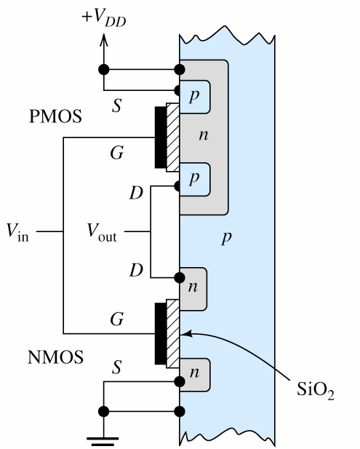
12.7 CMOS Logic Gate
CMOS: Complementary Metal-Oxide- Semiconductor (互補式金氧半導體是一種積體電路製程，可在矽晶圓上製作出PMOS（P-channel MOSFET）和NMOS（N-channel MOSFET）元件，由於PMOS與NMOS在特性上為互補性，因此稱為CMOS。

Slide 17
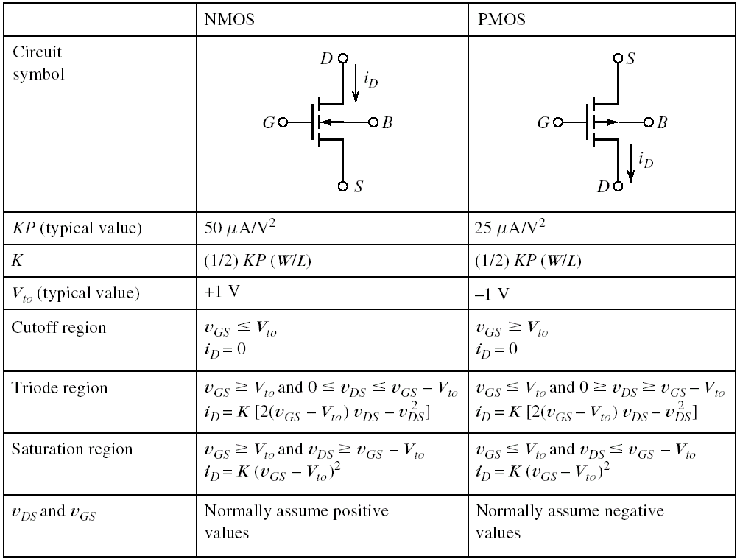
MOSFET Summary
V_{GS}=V_{DD} (high)
NMOS ON
V_{GS}=0 (low)
NMOS OFF
V_{GS}= −V_{DD}
PMOS ON
V_{GS}=0
PMOS OFF

Slide 18
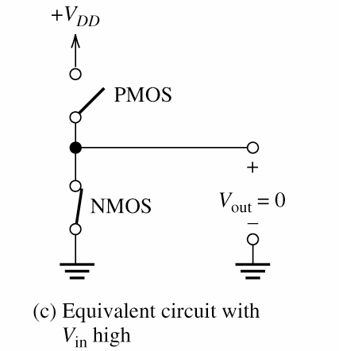
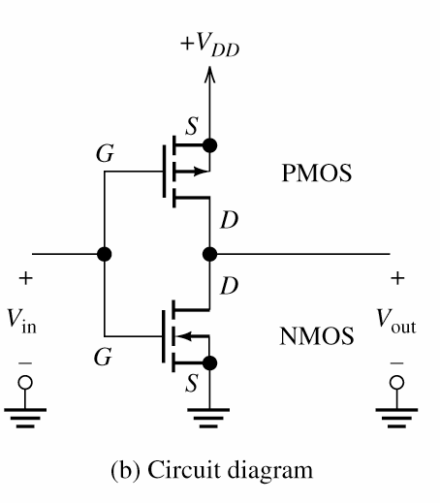
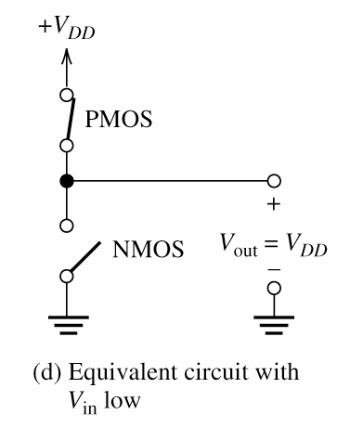
CMOS Inverter
NMOS V_{GS}=V_{in}
PMOS V_{GS}= V_{in} -V_{DD}
V_{in}=V_{DD} (high)
NMOS V_{GS}= V_{DD} ON,
PMOS V_{GS}= 0 OFF,
V_{out}=0 (low)
V_{in}=0 (low)
NMOS V_{GS}= 0 OFF
PMOS V_{GS}= -V_{DD} ON,
V_{out}= V_{DD} (high)

Slide 19
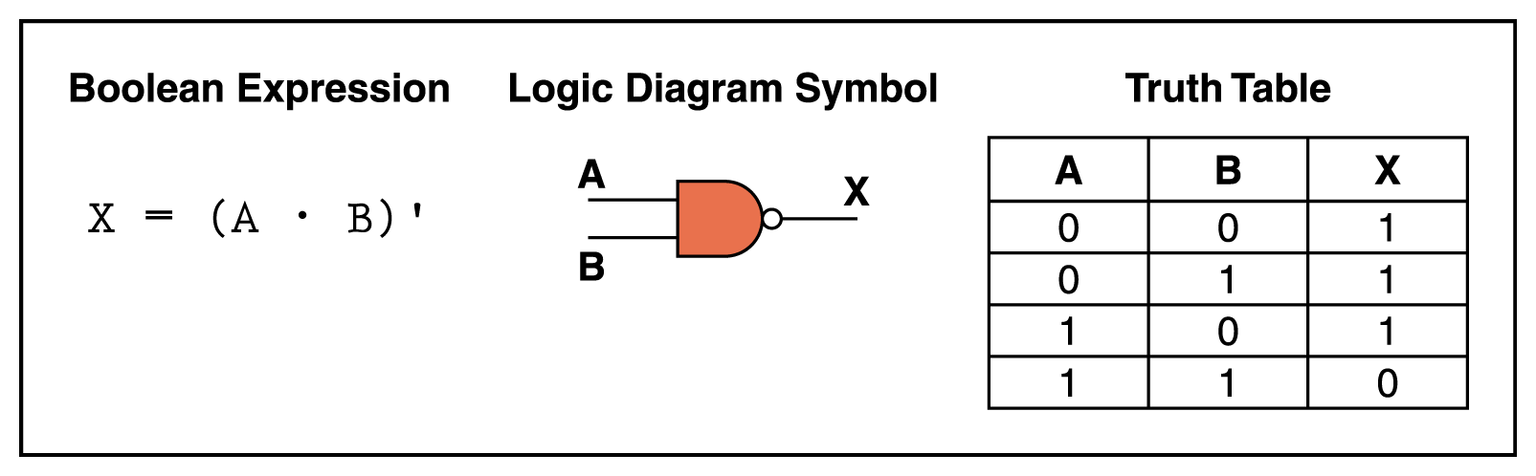
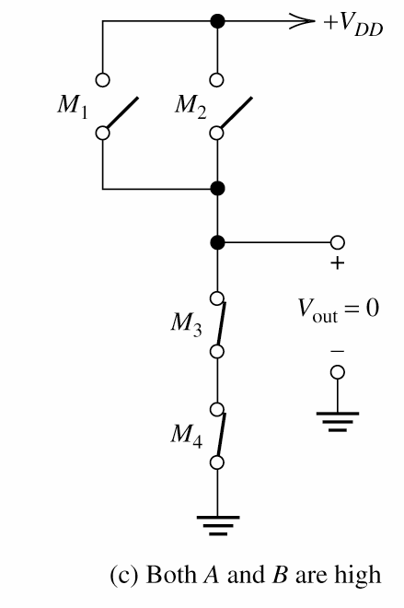
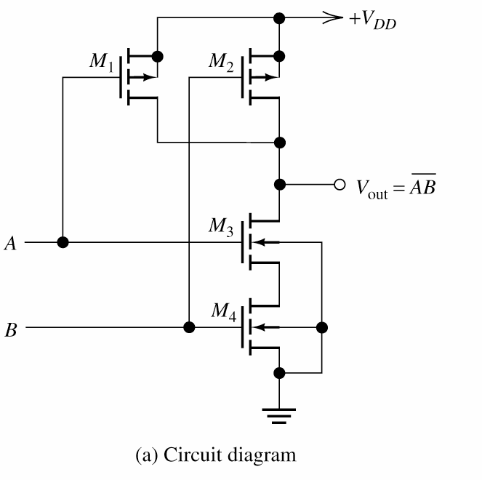
CMOS NAND Gate
1. A= high & B= high
M1 and M2 OFF
M3 and M4 ON
V_{out} low
2. A= low & B= low
M1 and M2 ON
M3 and M4 OFF
V_{out} high

Slide 20
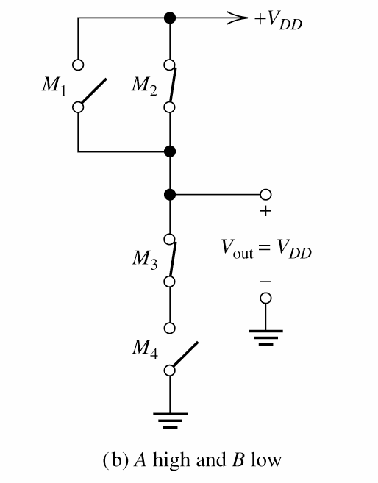
CMOS NAND Gate
3. A= high & B= low
M1 OFF and M2 ON
M3 ON and M4 OFF
V_{out} high
4. A= low & B= high
M1 ON and M2 OFF
M3 OFF and M4 ON
V_{out} high

Slide 21
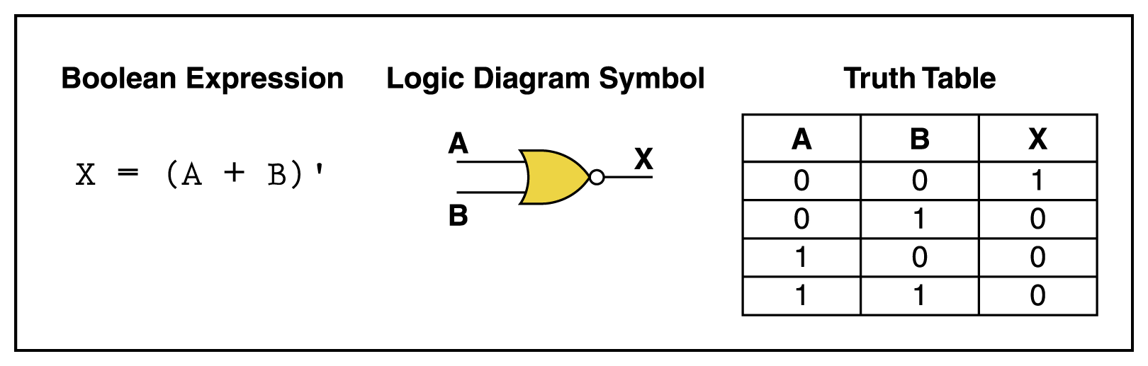
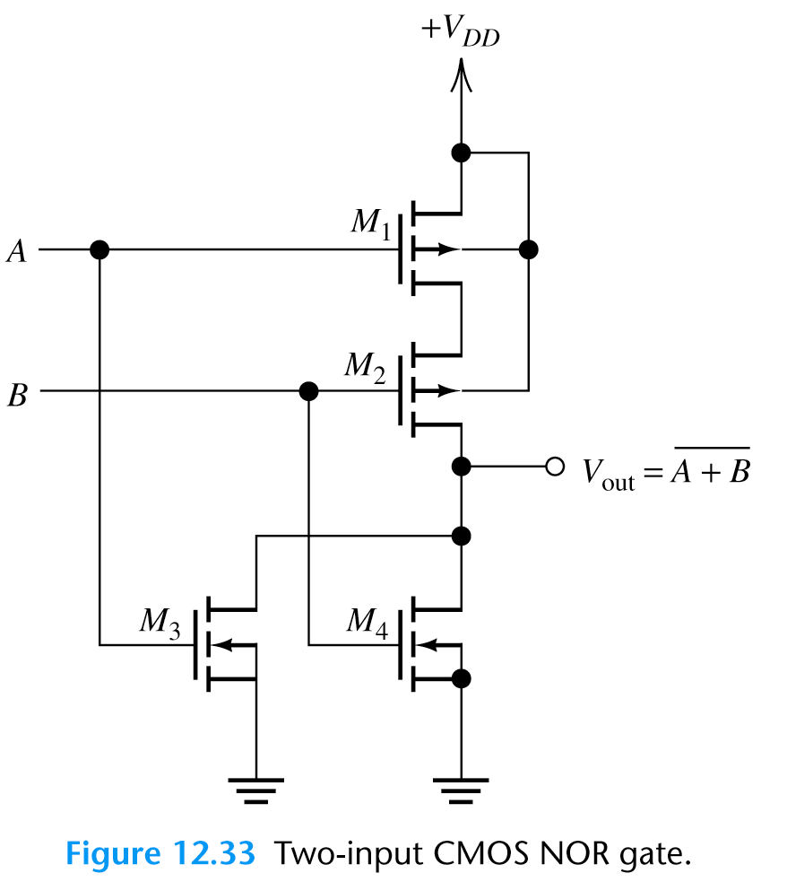
CMOS NOR Gate
1. A= low & B= low
M1 and M2 ON
M3 and M4 OFF
V_{out} high
3. A= high & B= high
M1 and M2 OFF
M3 and M4 ON
V_{out} low
2. A= high & B= low
M1 and M4 OFF
M2 and M3 ON
V_{out} low

