Slide 1
Mid Exam
考試日期 :
10/08(四)
考試方式 : 以個人為單位
考試時間 : 50 min
考試注意事項：可帶一張A4紙大小的參考資料(只限一張)，如晶片編號等有助於考試資訊皆可印在參考資料中，內容是手寫或影印都可以，正反面皆可有資料。

Slide 2
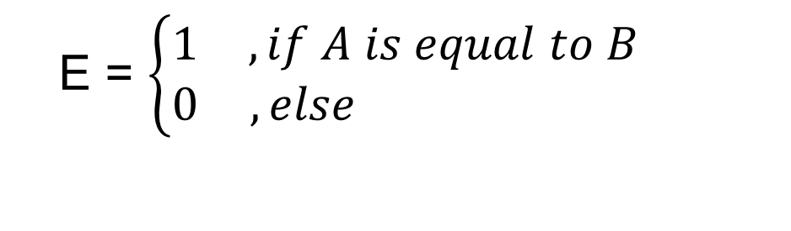
Comparator (1/2)
There are two inputs denoted as A and B. Both A and B are 1-bit value. A comparator is designed to determine whether A is equal to B or not. The output results are represented with E .
The function and truth table of the comparator is described as follows.
A | B | E
0 | 0 | 1
0 | 1 | 0
1 | 0 | 0
1 | 1 | 1
E =

Slide 3
Comparator (2/2)
Please
(a) implement the circuit on the breadboard.
Suggested Boolean algebra of the comparator.
E = AB + A’B’

Slide 4

XOR (1/2)
1. Boolean Algebra
2. Truth Table
F = A + B
A | B | F
0 | 0 | 0
0 | 1 | 1
1 | 0 | 1
1 | 1 | 0
=> F = A’B + AB’
3. Circuit Diagram
A
F
B

Slide 5
XOR (2/2)
Please
(a) implement the circuit on the breadboard.

Slide 6
Constant Multiplier (1/2)
MSB
There is a 2-bit input X (represented as X1 and X0). A constant multiplier is designed to multiply the input by 3. Finally, show the result with decimal format (0, 1, 2, …..,9) on Digital Display in the breadboard.
Hint-1:
The output digital number is 0, 3, 6 or 9, respectively, for four different inputs (0, 1, 2, 3).

Slide 7
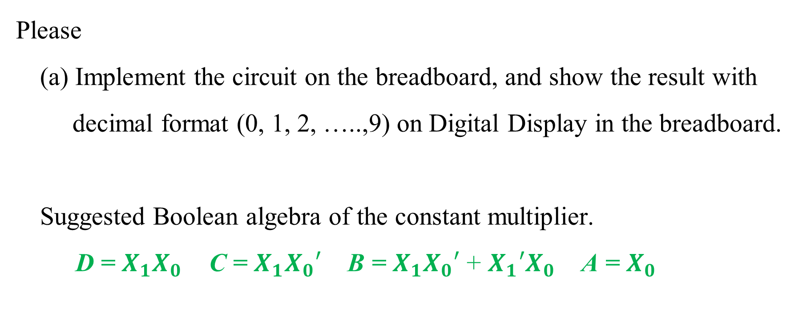
Constant Multiplier(1/2)

