Slide 1
Chapter 4: Recurrences
Chi-Yeh Chen
陳奇業
成功大學資訊工程學系

Slide 2
Overview
Recall that in divide-and-conquer, we solve a problem recursively, applying three steps at each level of the recursion:
Divide the problem into a number of subproblems that are smaller instances of same problem.
Conquer the subproblems by solving them recursively. If the subproblem sizes are small enough, however, just solve the subproblems in a straightforward manner.
Combine the solutions to the subproblems into the solution for the original problem.

Slide 3
Overview (cond’t)
When the subproblems are large enough to solve recursively, we call that the recursive case.
Once the subproblems become small enough that we no longer recurse, we call that the base case.

Slide 4
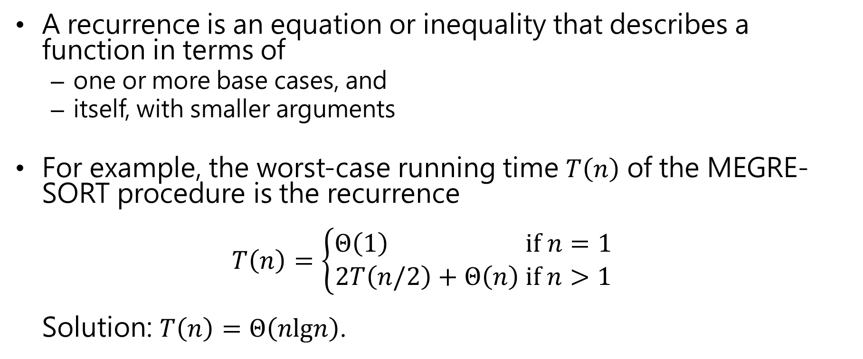
Overview (cond’t)
A recurrence is an equation or inequality that describes a function in terms of
one or more base cases, and
itself, with smaller arguments
For example, the worst-case running time $T\left(n\right)$ of the MEGRE-SORT procedure is the recurrence $T\left(n\right)=\left\{\begin{aligned}Θ\left(1\right) if n=1 \\ 2T\left(n/2\right)+Θ\left(n\right) if n>1\end{aligned}\right.$ Solution: $T\left(n\right)=Θ\left(nlgn\right)$.

Slide 5
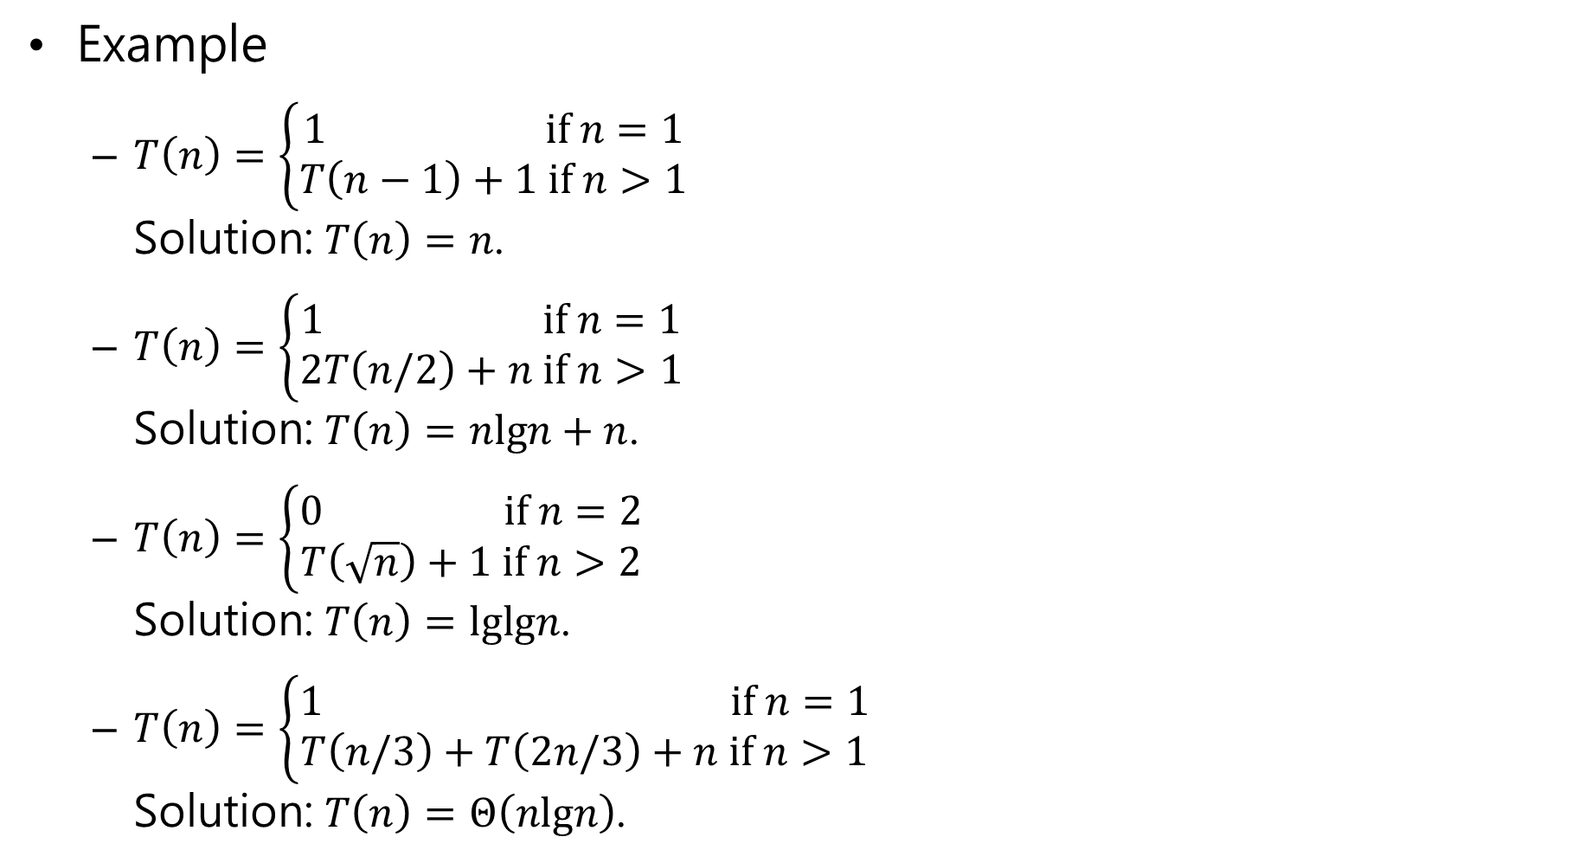
Example
$T\left(n\right)=\left\{\begin{aligned}1 if n=1 \\ T\left(n−1\right)+1 if n>1\end{aligned}\right.$ Solution: $T\left(n\right)=n$.
$T\left(n\right)=\left\{\begin{aligned}1 if n=1 \\ 2T\left(n/2\right)+n if n>1\end{aligned}\right.$ Solution: $T\left(n\right)=nlgn+n$.
$T\left(n\right)=\left\{\begin{aligned}0 if n=2 \\ T\left(\sqrt{n}\right)+1 if n>2\end{aligned}\right.$ Solution: $T\left(n\right)=lglgn$.
$T\left(n\right)=\left\{\begin{aligned}1 if n=1 \\ T\left(n/3\right)+T\left(2n/3\right)+n if n>1\end{aligned}\right.$ Solution: $T\left(n\right)=Θ\left(nlgn\right)$.
A recursive version of linear search
A recursive algorithm might divide subproblems into unequal size.

Slide 6

Example
$T\left(n\right)=\left\{\begin{aligned}1 if n=1 \\ T\left(n−1\right)+1 if n>1\end{aligned}\right.$
$T\left(n\right)=$ $T\left(n−1\right)+1$
$=$ $T\left(n−2\right)+1+1$
$=T\left(1\right)+1+⋯+1$
$=n$

Slide 7

Example
$T\left(n\right)=\left\{\begin{aligned}1 if n=1 \\ T\left(n−1\right)+\frac{1}{n} if n>1\end{aligned}\right.$
$T\left(n\right)=$ $T\left(n−1\right)+\frac{1}{n}$
$=$ $T\left(n−2\right)+\frac{1}{n−1}+\frac{1}{n}$
$=1+\frac{1}{2}+⋯+\frac{1}{n}$
$=O\left(lgn\right)$

Slide 8

Euler’s constant $γ$ is defined by $γ=\lim_{n⟶∞}\left(\sum_{k=1}^{n}{\frac{1}{k}}−\log{n}\right)$
$\sum_{k=1}^{n}{\frac{1}{k}}≈\log{n}+γ+⋯$

Slide 9





Example
$T\left(n\right)=\left\{\begin{aligned}1 if n=1 \\ 2T\left(n/2\right)+n if n>1\end{aligned}\right.$ Solution: $T\left(n\right)=nlgn+n$.
n
n
n
(n/2)
(n/2)
n
T(n)
T(n/2)
T(n/2)
lg n
(a)
(b)
(n/4)
(n/4)
(n/4)
(n/4)
n
n
1
1
1
1
1
1
1
1
n
(n/2)
(n/2)
n
Total: n lg n + n
T(n/4)
T(n/4)
T(n/4)
T(n/4)
(d)

Slide 10
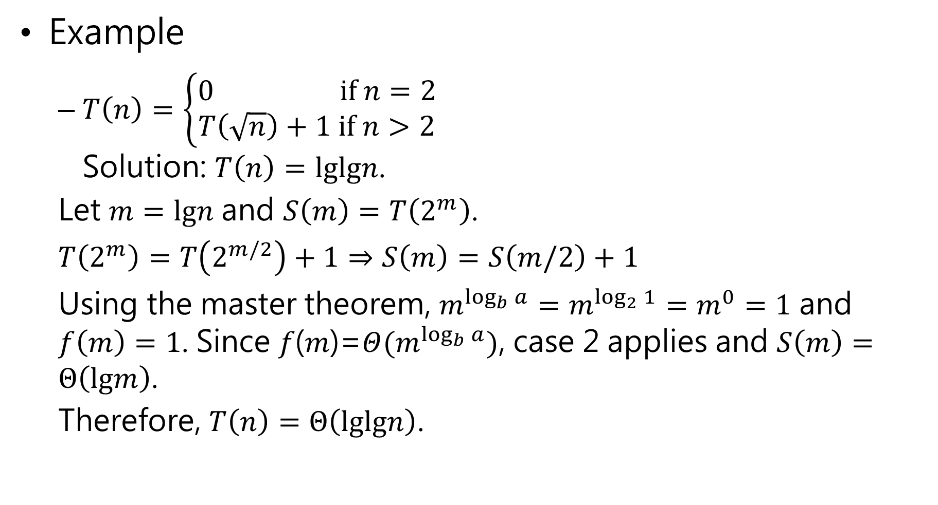
Example
$T\left(n\right)=\left\{\begin{aligned}0 if n=2 \\ T\left(\sqrt{n}\right)+1 if n>2\end{aligned}\right.$ Solution: $T\left(n\right)=lglgn$.
Let $m=lgn$ and $S\left(m\right)=T\left(2^{m}\right)$.
$T\left(2^{m}\right)=T\left(2^{m/2}\right)+1⇒S\left(m\right)=S\left(m/2\right)+1$
Using the master theorem, $m^{\log_{b}{a}}=m^{\log_{2}{1}}=m^{0}=1$ and $f\left(m\right)=1$. Since 𝑓(𝑚)=$Θ(m^{\log_{b}{a}})$, case 2 applies and $S\left(m\right)=Θ\left(lgm\right)$.
Therefore, $T\left(n\right)=Θ\left(lglgn\right)$.

Slide 11
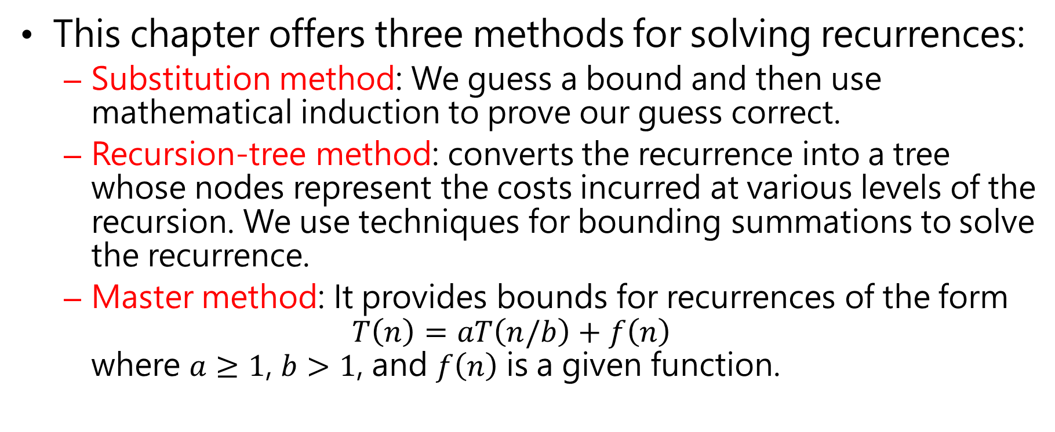
Overview (cond’t)
This chapter offers three methods for solving recurrences:
Substitution method: We guess a bound and then use mathematical induction to prove our guess correct.
Recursion-tree method: converts the recurrence into a tree whose nodes represent the costs incurred at various levels of the recursion. We use techniques for bounding summations to solve the recurrence.
Master method: It provides bounds for recurrences of the form $T\left(n\right)=aT\left(n/b\right)+f\left(n\right)$ where $a≥1$, $b>1$, and $f\left(n\right)$ is a given function.

Slide 12
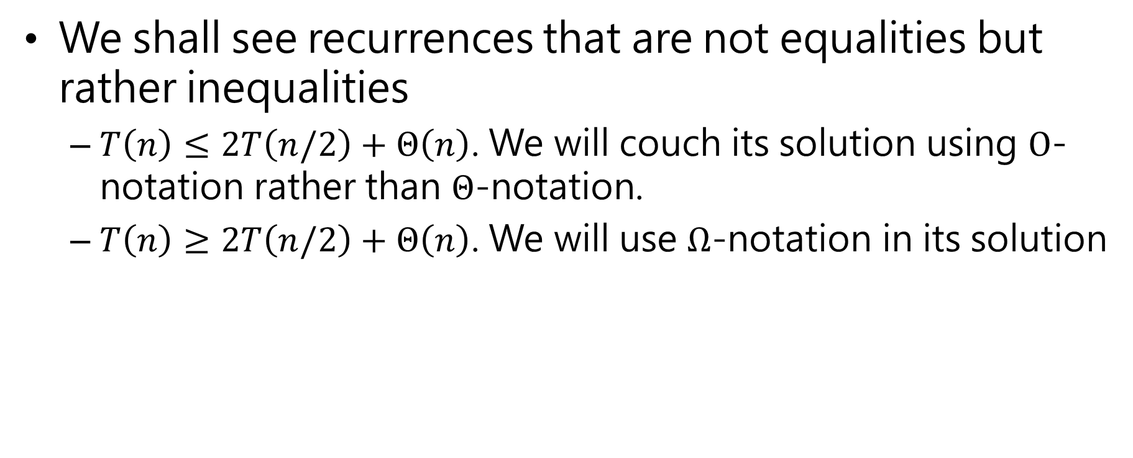
Overview (cond’t)
We shall see recurrences that are not equalities but rather inequalities
$T\left(n\right)≤2T\left(n/2\right)+Θ\left(n\right)$. We will couch its solution using $O$-notation rather than $Θ$-notation.
$T\left(n\right)≥2T\left(n/2\right)+Θ\left(n\right)$. We will use $Ω$-notation in its solution

Slide 13
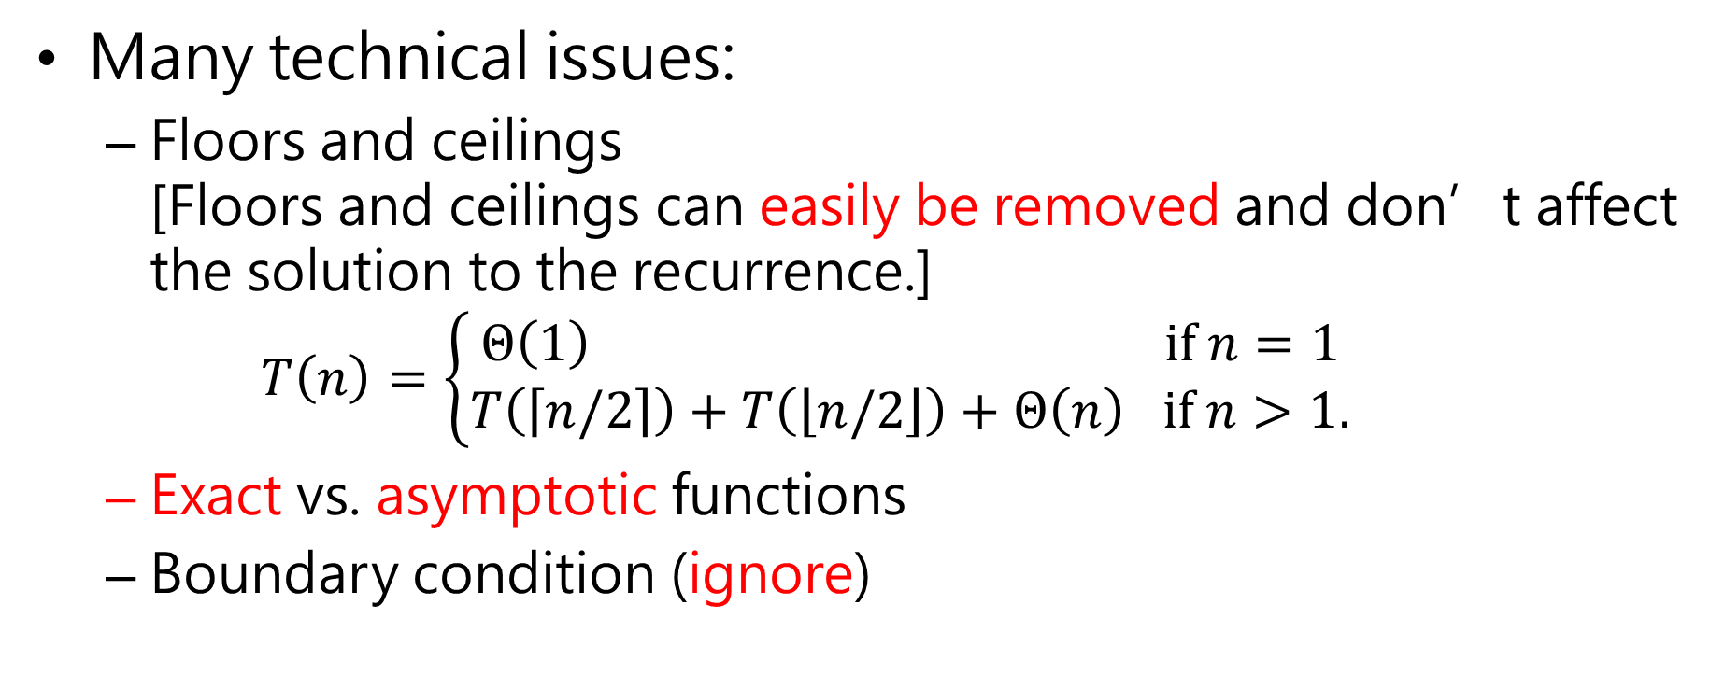
Many technical issues:
Floors and ceilings [Floors and ceilings can easily be removed and don’t affect the solution to the recurrence.] $T\left(n\right)=\left\{\begin{aligned}Θ\left(1\right) if n=1 \\ T\left(\left\lceil n/2\right\rceil \right)+T\left(\left\lfloor n/2\right\rfloor \right)+Θ\left(n\right) if n>1.\end{aligned}\right.$
Exact vs. asymptotic functions
Boundary condition (ignore)

Slide 14
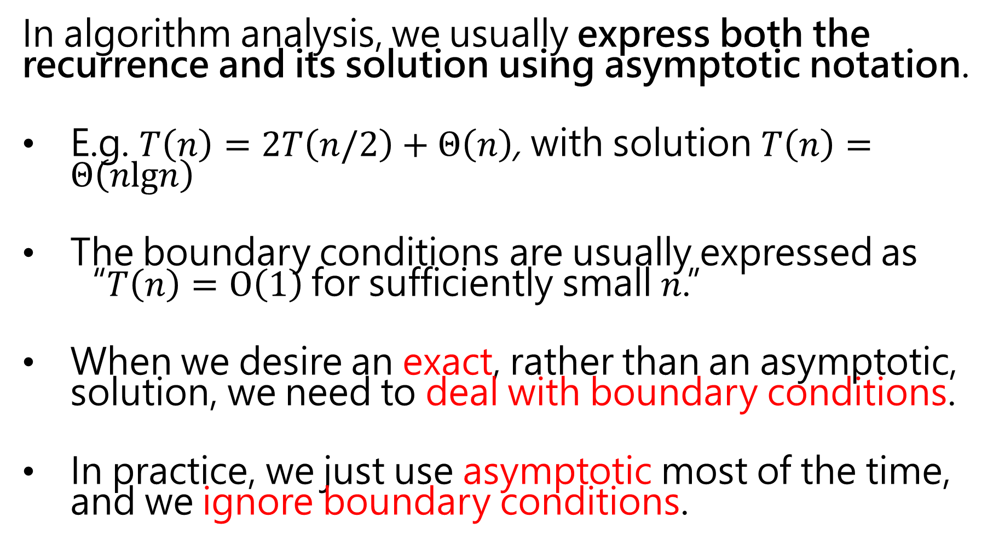
In algorithm analysis, we usually express both the recurrence and its solution using asymptotic notation.
E.g. $T\left(n\right)=2T\left(n/2\right)+Θ\left(n\right)$, with solution $T\left(n\right)=Θ\left(nlgn\right)$
The boundary conditions are usually expressed as “$T\left(n\right)=O\left(1\right)$for sufficiently small $n$.”
When we desire an exact, rather than an asymptotic, solution, we need to deal with boundary conditions.
In practice, we just use asymptotic most of the time, and we ignore boundary conditions.

Slide 15
The maximum-subarray problem
You are allowed to buy one unit of stock only one time and the sell it at a later date.
Sell at the highest possible price
Buy at the lowest possible price

Slide 16
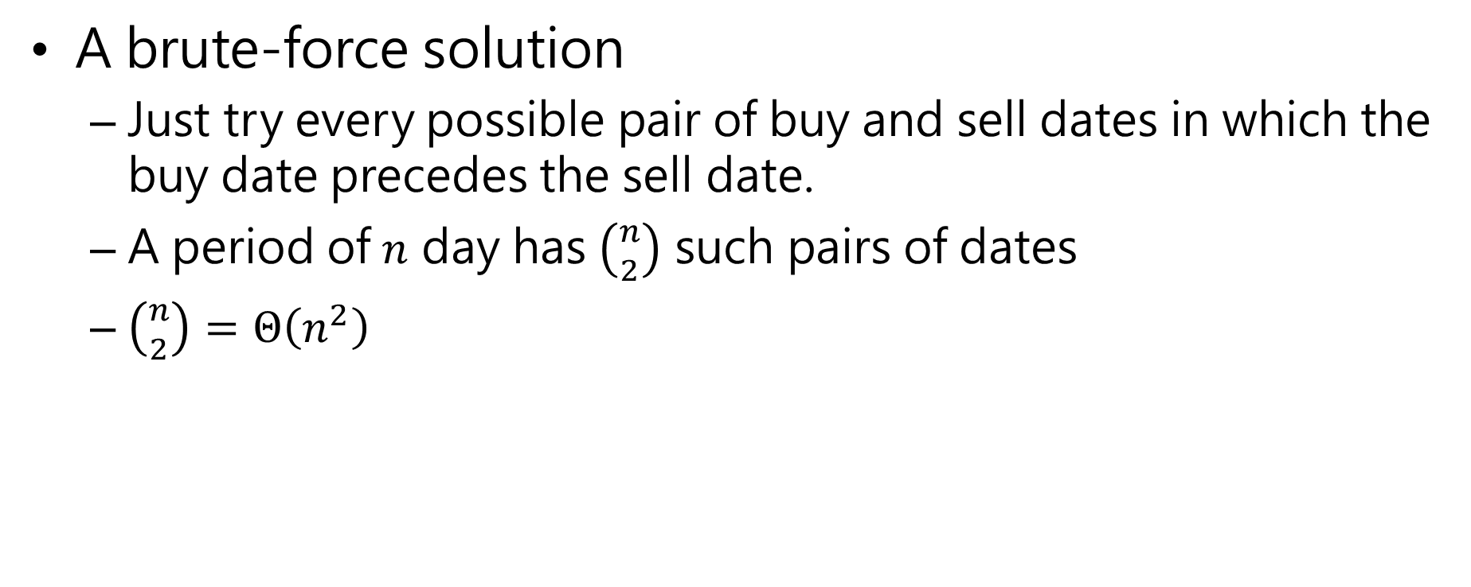
The maximum-subarray problem (cond’t)
A brute-force solution
Just try every possible pair of buy and sell dates in which the buy date precedes the sell date.
A period of $n$ day has $\left({n \atop 2}\right)$ such pairs of dates
$\left({n \atop 2}\right)=Θ\left(n^{2}\right)$

Slide 17
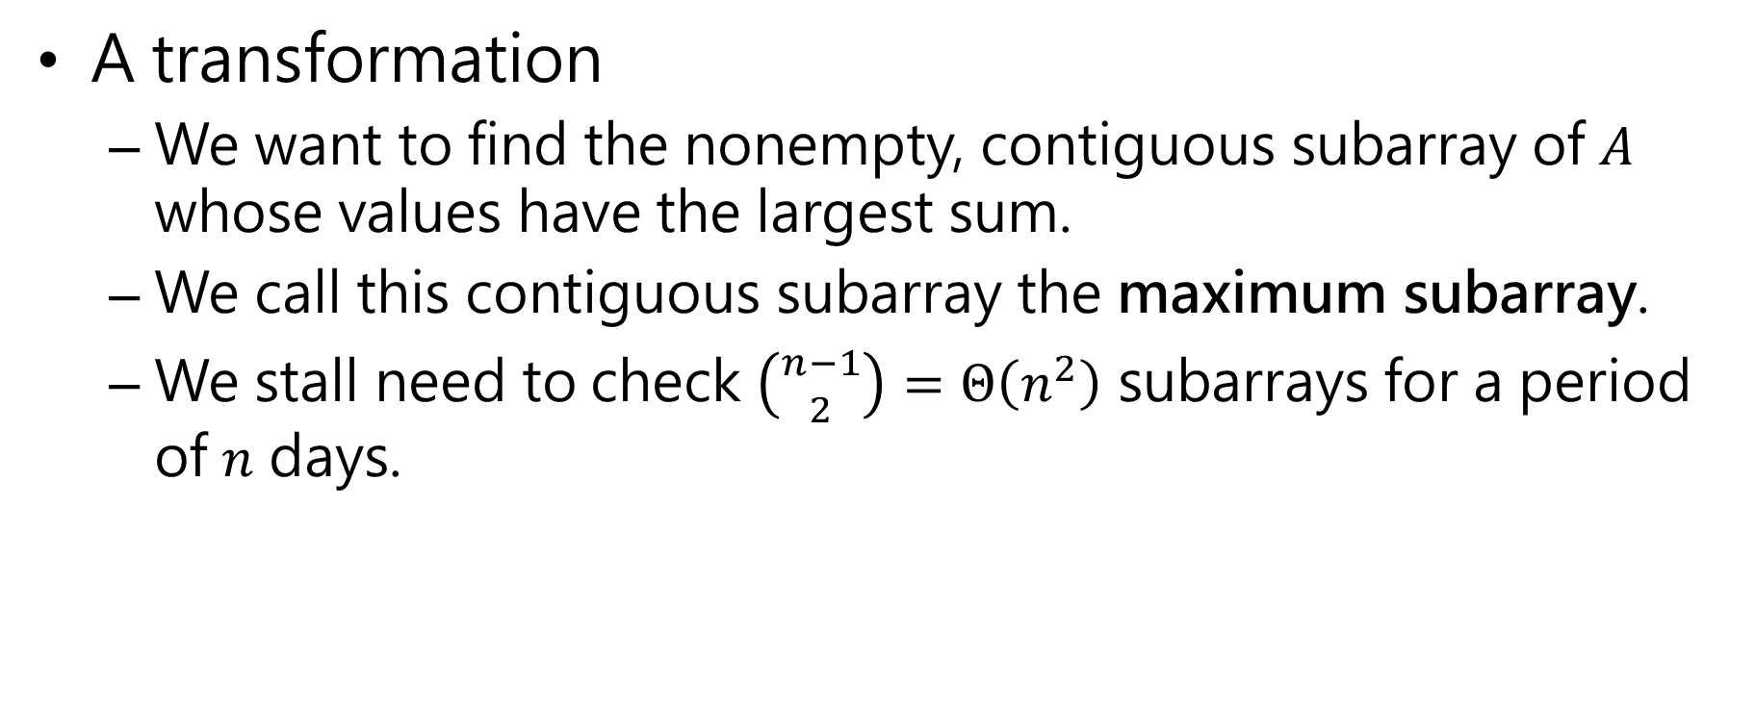
The maximum-subarray problem (cond’t)
A transformation
We want to find the nonempty, contiguous subarray of $A$ whose values have the largest sum.
We call this contiguous subarray the maximum subarray.
We stall need to check $\left({n−1 \atop 2}\right)=Θ\left(n^{2}\right)$ subarrays for a period of $n$ days.
buy
sell

Slide 18
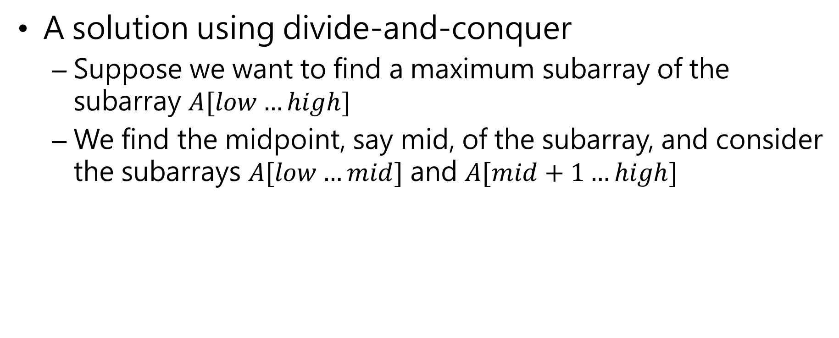
The maximum-subarray problem (cond’t)
A solution using divide-and-conquer
Suppose we want to find a maximum subarray of the subarray $A[low…high]$
We find the midpoint, say mid, of the subarray, and consider the subarrays $A[low…mid]$ and $A[mid+1…high]$

Slide 21
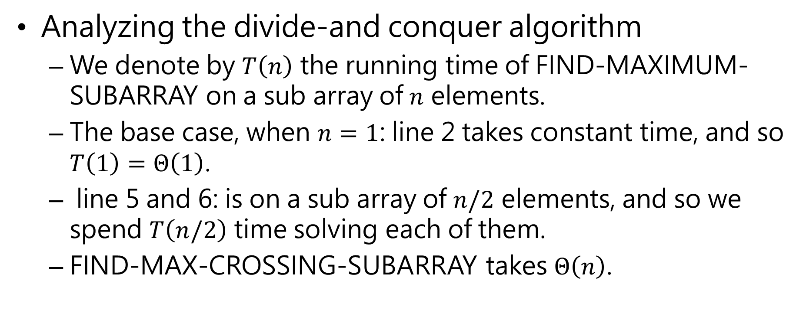
The maximum-subarray problem (cond’t)
Analyzing the divide-and conquer algorithm
We denote by $T\left(n\right)$ the running time of FIND-MAXIMUM-SUBARRAY on a sub array of $n$ elements.
The base case, when $n=1$: line 2 takes constant time, and so $T\left(1\right)=Θ\left(1\right)$.
line 5 and 6: is on a sub array of $n/2$ elements, and so we spend $T\left(n/2\right)$ time solving each of them.
FIND-MAX-CROSSING-SUBARRAY takes $Θ\left(n\right)$.

Slide 22

The maximum-subarray problem (cond’t)
Analyzing the divide-and conquer algorithm
$T\left(n\right)=\left\{\begin{aligned}Θ\left(1\right) if n=1 \\ 2T\left(n/2\right)+Θ\left(n\right) if n>1.\end{aligned}\right.$
$T\left(n\right)=Θ\left(nlgn\right)$

Slide 23
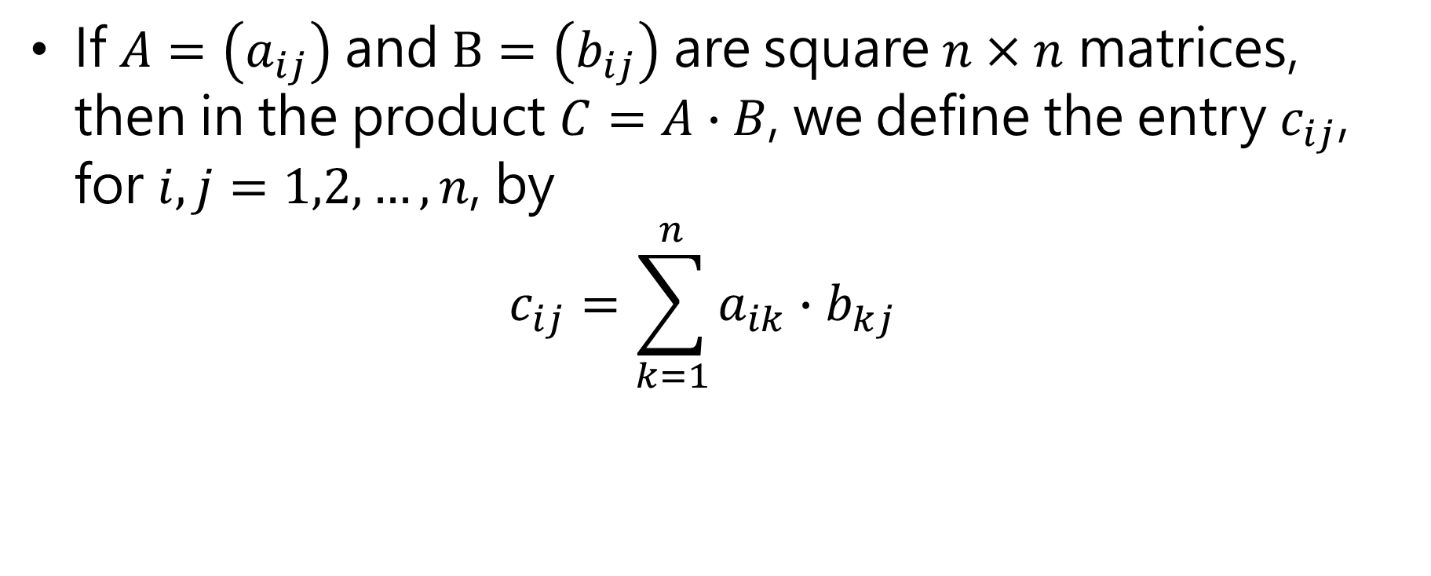
Matrix Multiplication
If $A=\left(a_{ij}\right)$ and $B=\left(b_{ij}\right)$ are square $n×n$ matrices, then in the product $C=A∙B$, we define the entry $c_{ij}$, for $i,j=1,2,…,n$, by $c_{ij}=\sum_{k=1}^{n}{a_{ik}}∙b_{kj}$

Slide 24
Matrix Multiplication (cond’t)

Slide 25
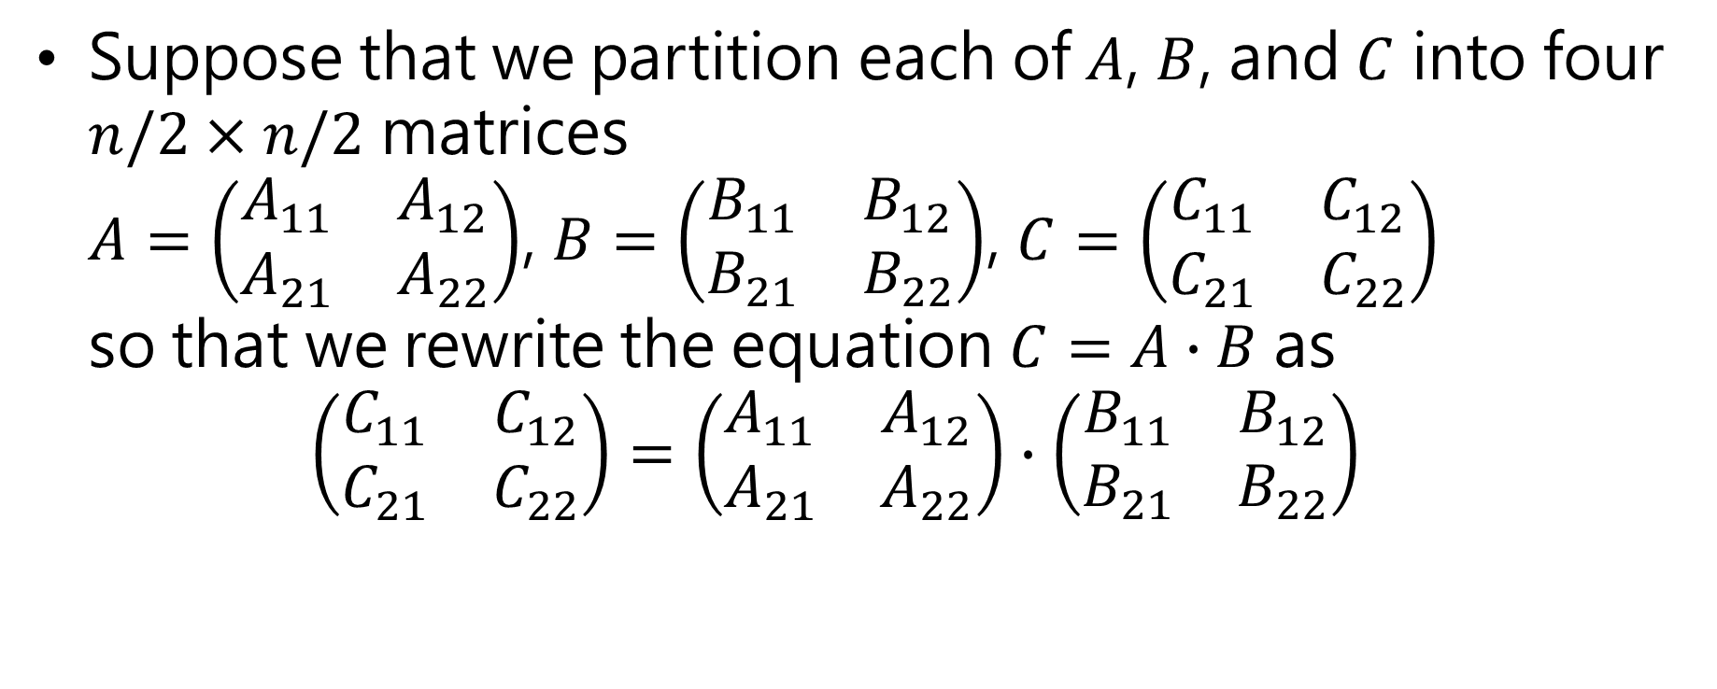
Divide-and-Conquer Algorithm
Suppose that we partition each of $A$, $B$, and $C$ into four $n/2×n/2$ matrices $A=\left(\begin{matrix}A_{11} & A_{12} \\ A_{21} & A_{22}\end{matrix}\right)$, $B=\left(\begin{matrix}B_{11} & B_{12} \\ B_{21} & B_{22}\end{matrix}\right)$, $C=\left(\begin{matrix}C_{11} & C_{12} \\ C_{21} & C_{22}\end{matrix}\right)$ so that we rewrite the equation $C=A∙B$ as $\left(\begin{matrix}C_{11} & C_{12} \\ C_{21} & C_{22}\end{matrix}\right)=\left(\begin{matrix}A_{11} & A_{12} \\ A_{21} & A_{22}\end{matrix}\right)∙\left(\begin{matrix}B_{11} & B_{12} \\ B_{21} & B_{22}\end{matrix}\right)$

Slide 26

Divide-and-Conquer Algorithm (cond’t)
$C_{11}=A_{11}∙B_{11}+A_{12}∙B_{21}$
$C_{12}=A_{11}∙B_{12}+A_{12}∙B_{22}$
$C_{21}=A_{21}∙B_{11}+A_{22}∙B_{21}$
$C_{22}=A_{21}∙B_{12}+A_{22}∙B_{22}$

Slide 27












$$T\left(n/2\right)$$
$$Θ\left(n^{2}\right)$$
$$T\left(n/2\right)$$
$$T\left(n/2\right)$$
$$Θ\left(n^{2}\right)$$
$$T\left(n/2\right)$$
$$T\left(n/2\right)$$
$$Θ\left(n^{2}\right)$$
$$T\left(n/2\right)$$
$$T\left(n/2\right)$$
$$Θ\left(n^{2}\right)$$
$$T\left(n/2\right)$$

Slide 28
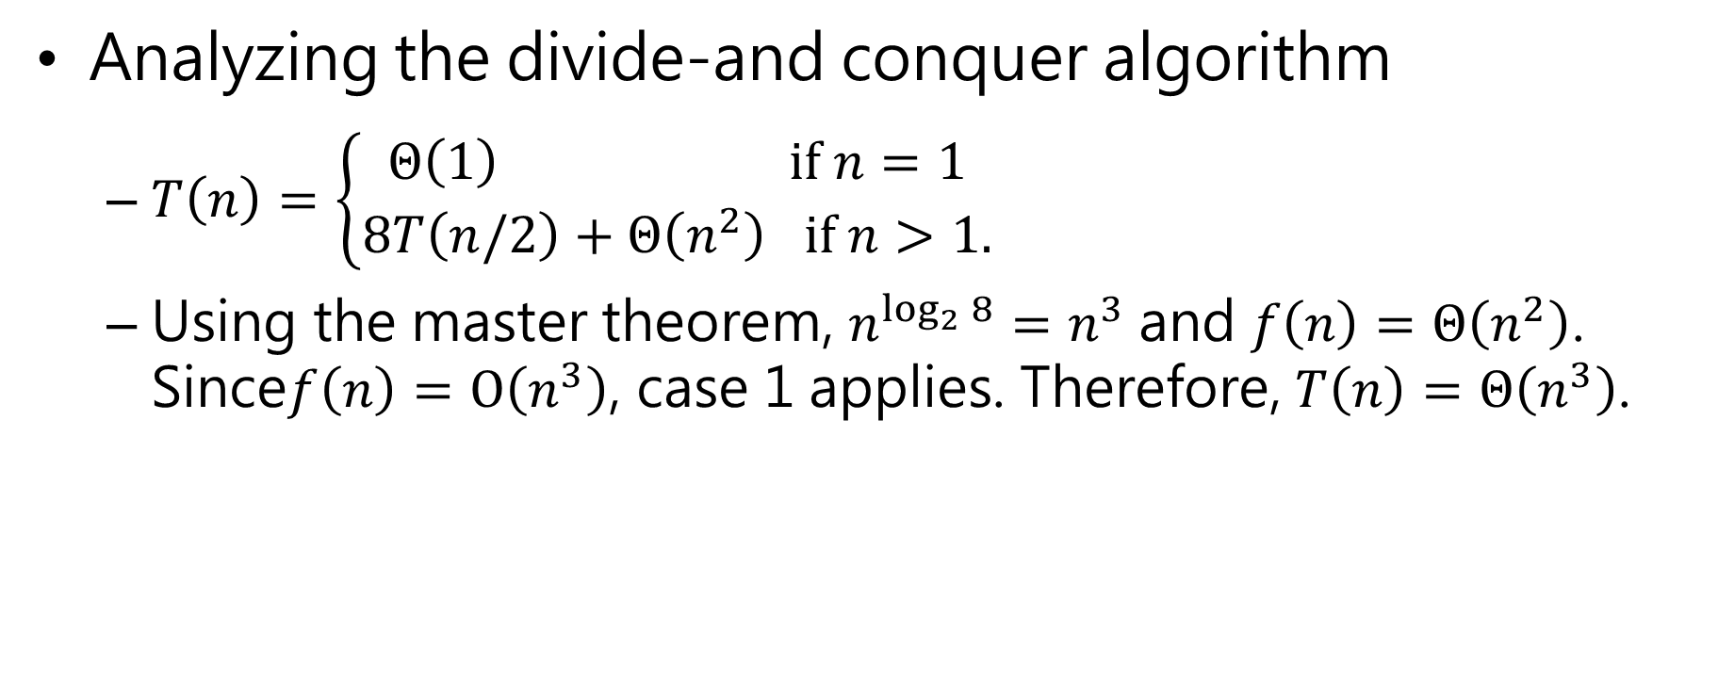
Divide-and-Conquer Algorithm (cond’t)
Analyzing the divide-and conquer algorithm
$T\left(n\right)=\left\{\begin{aligned}Θ\left(1\right) if n=1 \\ 8T\left(n/2\right)+Θ\left(n^{2}\right) if n>1.\end{aligned}\right.$
Using the master theorem, $n^{\log_{2}{8}}=n^{3}$ and $f\left(n\right)=Θ\left(n^{2}\right)$. Since$f\left(n\right)=O\left(n^{3}\right)$, case 1 applies. Therefore, $T\left(n\right)=Θ\left(n^{3}\right)$.

Slide 29
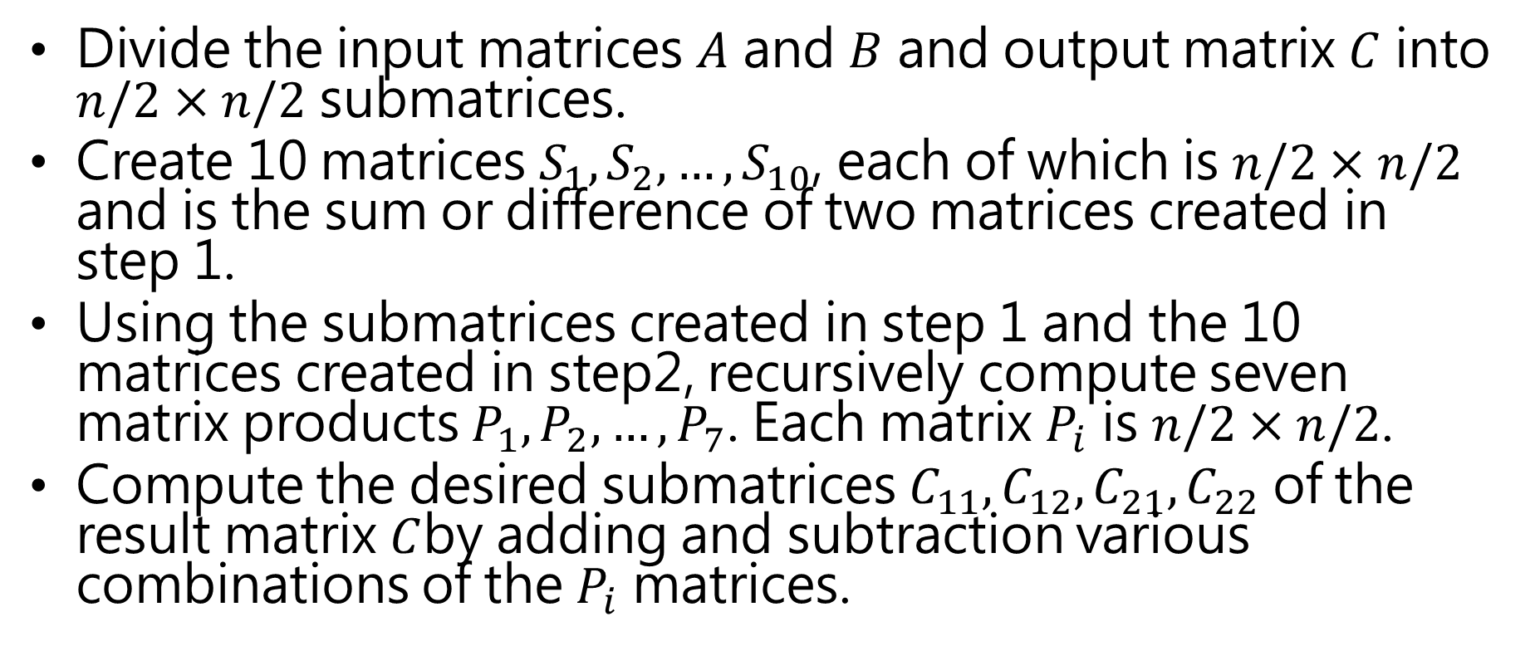
Strassen’s method
Divide the input matrices $A$ and $B$ and output matrix $C$ into $n/2×n/2$ submatrices.
Create 10 matrices $S_{1},S_{2},…,S_{10}$, each of which is $n/2×n/2$ and is the sum or difference of two matrices created in step 1.
Using the submatrices created in step 1 and the 10 matrices created in step2, recursively compute seven matrix products $P_{1},P_{2},…,P_{7}$. Each matrix $P_{i}$ is $n/2×n/2$.
Compute the desired submatrices $C_{11},C_{12},C_{21},C_{22}$ of the result matrix $C$by adding and subtraction various combinations of the $P_{i}$ matrices.

Slide 30

$S_{1}=B_{12}−B_{22}$
$S_{2}=A_{11}+A_{12}$
$S_{3}=A_{21}+A_{22}$
$S_{4}=B_{21}−B_{11}$
$S_{5}=A_{11}+A_{22}$
$S_{6}=B_{11}+B_{22}$
$S_{7}=A_{12}−A_{22}$
$S_{8}=B_{21}+B_{22}$
$S_{9}=A_{11}−A_{21}$
$S_{10}=B_{11}+B_{12}$

Slide 31
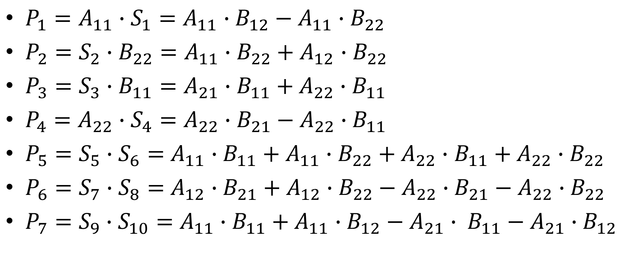
Strassen’s method (cond’t)
$P_{1}=A_{11}∙S_{1}={A_{11}∙B}_{12}−A_{11}∙B_{22}$
$P_{2}=S_{2}∙B_{22}=A_{11}∙B_{22}+A_{12}$ $∙B_{22}$
$P_{3}=S_{3}∙B_{11}=A_{21}∙B_{11}+A_{22}∙B_{11}$
$P_{4}=A_{22}∙S_{4}={A_{22}∙B}_{21}−{A_{22}∙B}_{11}$
$P_{5}=S_{5}∙S_{6}=$ $A_{11}∙B_{11}+A_{11}∙B_{22}+A_{22}∙$ $B_{11}+A_{22}∙B_{22}$
$P_{6}=S_{7}∙S_{8}=$ $A_{12}∙B_{21}+A_{12}∙B_{22}−A_{22}∙B_{21}−A_{22}∙B_{22}$
$P_{7}=S_{9}∙S_{10}=$ $A_{11}∙B_{11}+A_{11}∙B_{12}−A_{21}∙ B_{11}−A_{21}∙B_{12}$

Slide 32

Strassen’s method (cond’t)
$C_{11}=P_{5}+P_{4}−$ $P_{2}$+ $P_{6}$
$C_{12}=P_{1}+P_{2}$
$C_{21}=P_{3}+P_{4}$
$C_{22}=P_{5}+P_{1}−$ $P_{3}−P_{7}$

Slide 33
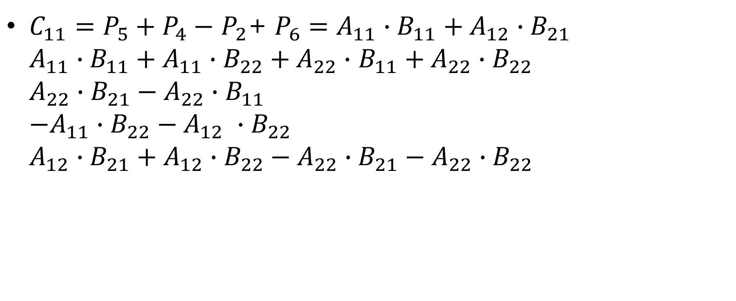
Strassen’s method (cond’t)
$C_{11}=P_{5}+P_{4}−$ $P_{2}$+ $P_{6}=A_{11}∙B_{11}+A_{12}∙B_{21}$ $A_{11}∙B_{11}+A_{11}∙B_{22}+A_{22}∙$ $B_{11}+A_{22}∙B_{22}$ ${A_{22}∙B}_{21}−{A_{22}∙B}_{11}$ $−A_{11}∙B_{22}−A_{12} ∙B_{22}$ $A_{12}∙B_{21}+A_{12}∙B_{22}−A_{22}∙B_{21}−A_{22}∙B_{22}$

Slide 34

Strassen’s method (cond’t)
$C_{12}=P_{1}+P_{2}={A_{11}∙B}_{12}+A_{12} ∙B_{22}$ ${A_{11}∙B}_{12}−A_{11}∙B_{22}$ $A_{11}∙B_{22}+A_{12}$ $∙B_{22}$

Slide 35

Strassen’s method (cond’t)
$C_{21}=P_{3}+P_{4}=A_{21}∙B_{11}+{A_{22}∙B}_{21}$ $A_{21}∙B_{11}+A_{22}∙B_{11}$ ${A_{22}∙B}_{21}−{A_{22}∙B}_{11}$

Slide 36
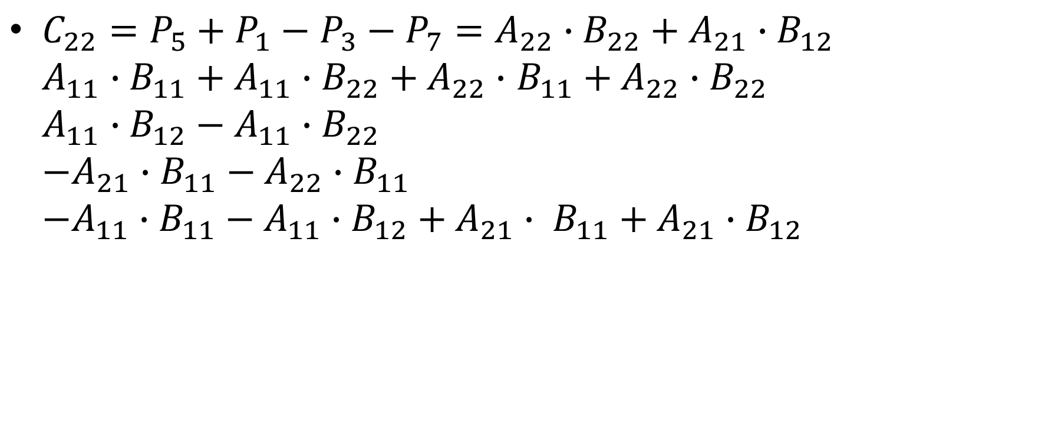
Strassen’s method (cond’t)
$C_{22}=P_{5}+P_{1}−$ $P_{3}−P_{7}=A_{22}∙B_{22}+A_{21}∙B_{12}$ $A_{11}∙B_{11}+A_{11}∙B_{22}+A_{22}∙$ $B_{11}+A_{22}∙B_{22}$ ${A_{11}∙B}_{12}−A_{11}∙B_{22}$ $−A_{21}∙B_{11}−A_{22}∙B_{11}$ $−A_{11}∙B_{11}−A_{11}∙B_{12}+A_{21}∙ B_{11}+A_{21}∙B_{12}$

Slide 37













$$Θ\left(n^{2}\right)$$
$$Θ\left(n^{2}\right)$$
$$T\left(n/2\right)$$
$$T\left(n/2\right)$$
$$T\left(n/2\right)$$
$$T\left(n/2\right)$$
$$T\left(n/2\right)$$
$$T\left(n/2\right)$$
$$T\left(n/2\right)$$
$$Θ\left(n^{2}\right)$$
$$Θ\left(n^{2}\right)$$
$$Θ\left(n^{2}\right)$$
$$Θ\left(n^{2}\right)$$

Slide 38
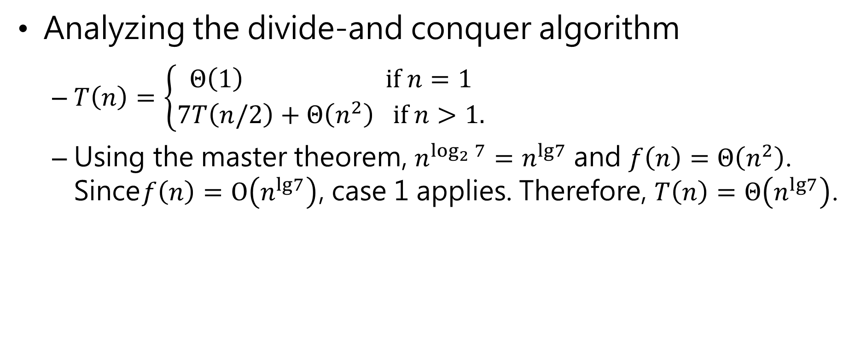
Strassen’s method (cond’t)
Analyzing the divide-and conquer algorithm
$T\left(n\right)=\left\{\begin{aligned}Θ\left(1\right) if n=1 \\ 7T\left(n/2\right)+Θ\left(n^{2}\right) if n>1.\end{aligned}\right.$
Using the master theorem, $n^{\log_{2}{7}}=n^{lg7}$ and $f\left(n\right)=Θ\left(n^{2}\right)$. Since$f\left(n\right)=O\left(n^{lg7}\right)$, case 1 applies. Therefore, $T\left(n\right)=Θ\left(n^{lg7}\right)$.

Slide 39
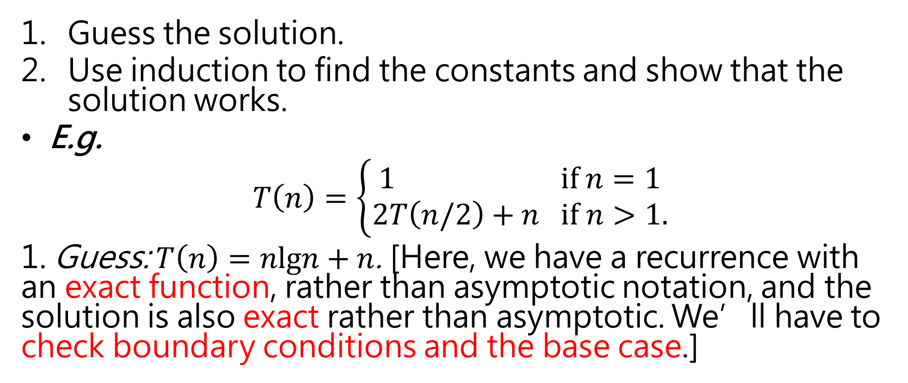
Substitution Method
Guess the solution.
Use induction to find the constants and show that the solution works.
E.g.
$$T\left(n\right)=\left\{\begin{aligned}1 if n=1 \\ 2T\left(n/2\right)+n if n>1.\end{aligned}\right.$$
1. Guess: $T\left(n\right)=nlgn+n$. [Here, we have a recurrence with an exact function, rather than asymptotic notation, and the solution is also exact rather than asymptotic. We’ll have to check boundary conditions and the base case.]

Slide 40
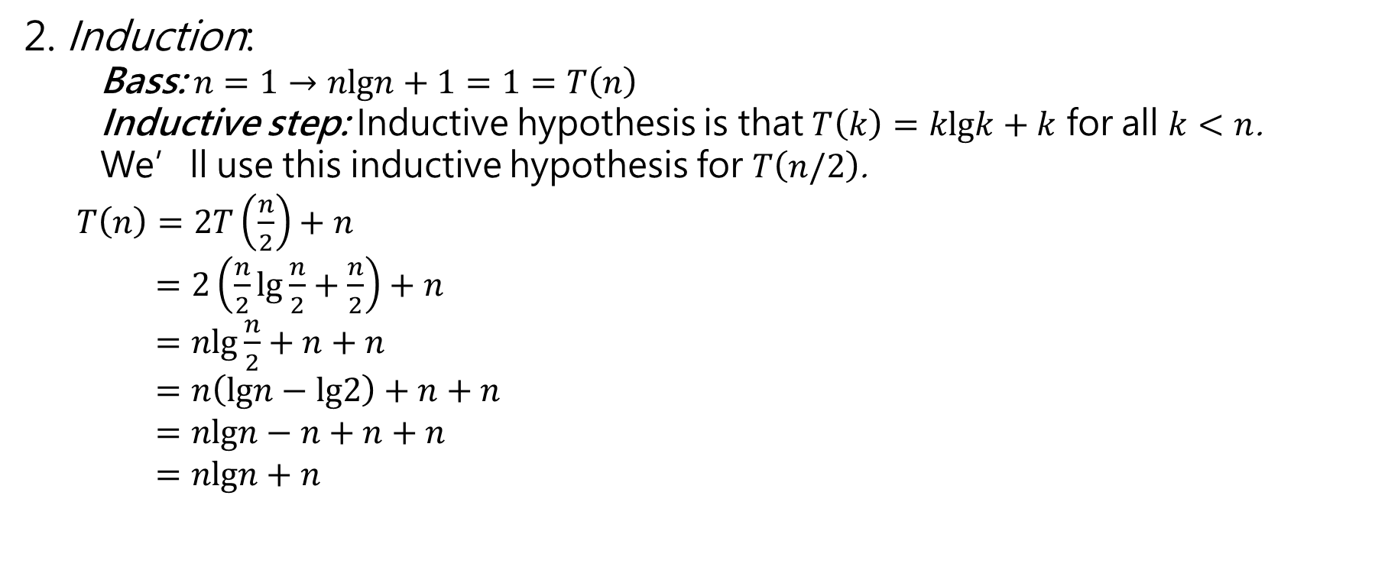
Substitution Method (cont’d)
2. Induction:
Bass: $n=1→nlgn+1=1=T\left(n\right)$
Inductive step: Inductive hypothesis is that $T\left(k\right)=klgk+k$ for all $k<n$.
We’ll use this inductive hypothesis for $T\left(n/2\right)$.
$T\left(n\right)=2T\left(\frac{n}{2}\right)+n$
$=2\left(\frac{n}{2}lg\frac{n}{2}+\frac{n}{2}\right)+n$
$=nlg\frac{n}{2}+n+n$
$=n\left(lgn−lg2\right)+n+n$
$=nlgn−n+n+n$
$=nlgn+n$

Slide 41
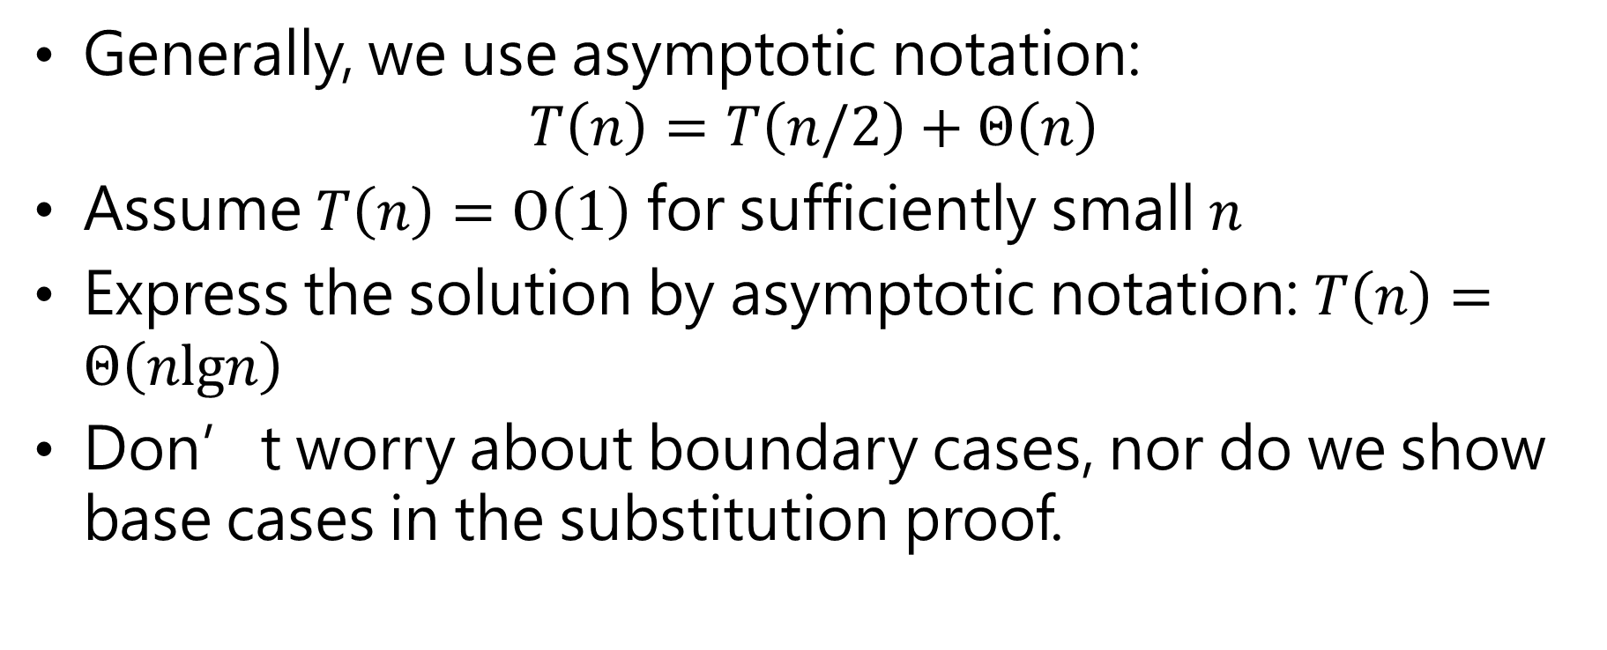
Substitution Method (cont’d)
Generally, we use asymptotic notation:
$$T\left(n\right)=T\left(n/2\right)+Θ\left(n\right)$$
Assume $T\left(n\right)=O\left(1\right)$ for sufficiently small $n$
Express the solution by asymptotic notation: $T\left(n\right)=Θ\left(nlgn\right)$
Don’t worry about boundary cases, nor do we show base cases in the substitution proof.

Slide 42
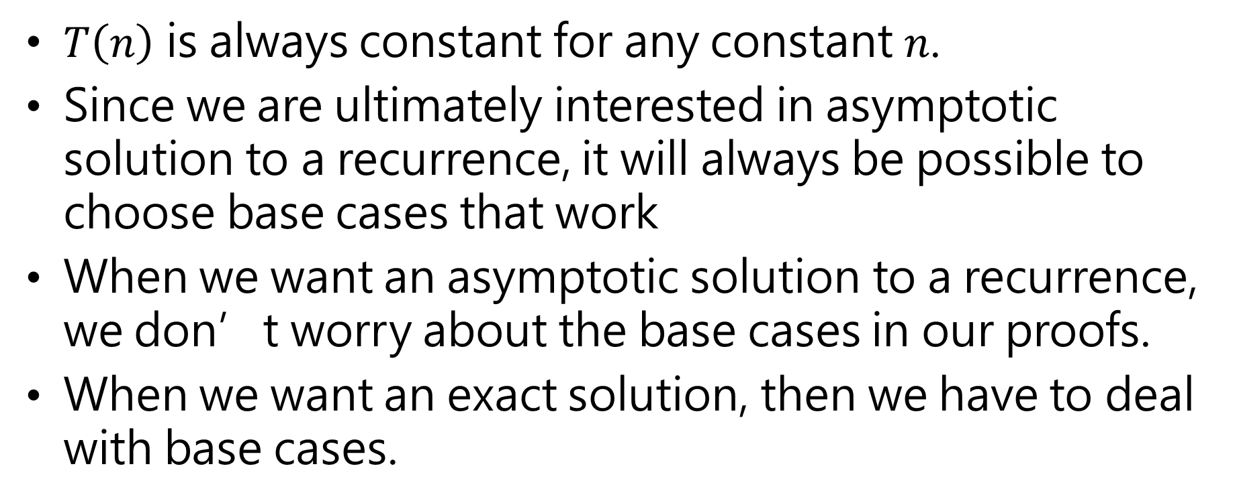
Substitution Method (cont’d)
$T\left(n\right)$ is always constant for any constant $n$.
Since we are ultimately interested in asymptotic solution to a recurrence, it will always be possible to choose base cases that work
When we want an asymptotic solution to a recurrence, we don’t worry about the base cases in our proofs.
When we want an exact solution, then we have to deal with base cases.

Slide 43
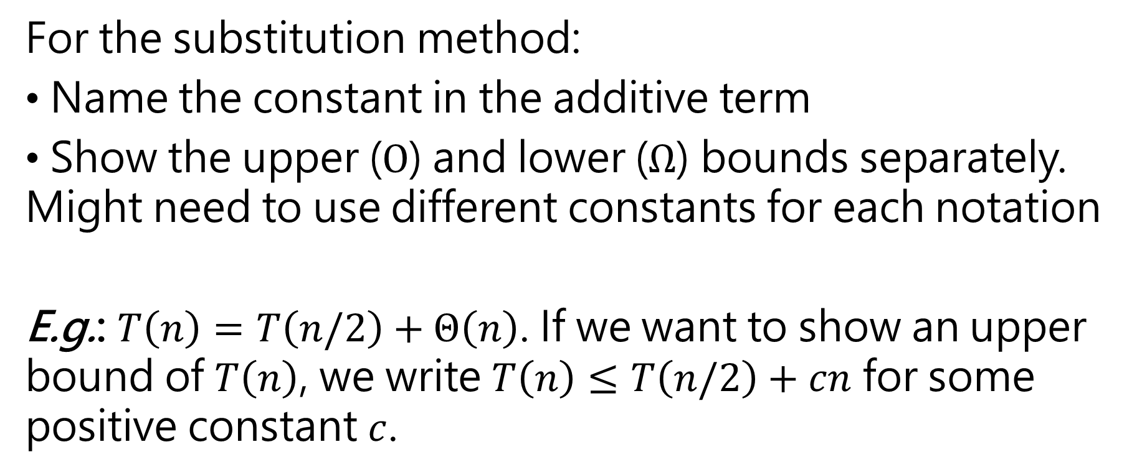
Substitution Method (cont’d)
For the substitution method:
Name the constant in the additive term
Show the upper ($O$) and lower ($Ω$) bounds separately. Might need to use different constants for each notation
E.g.: $T\left(n\right)=T\left(n/2\right)+Θ\left(n\right)$. If we want to show an upper bound of $T\left(n\right)$, we write $T\left(n\right)≤T\left(n/2\right)+cn$ for some positive constant $c$.

Slide 44
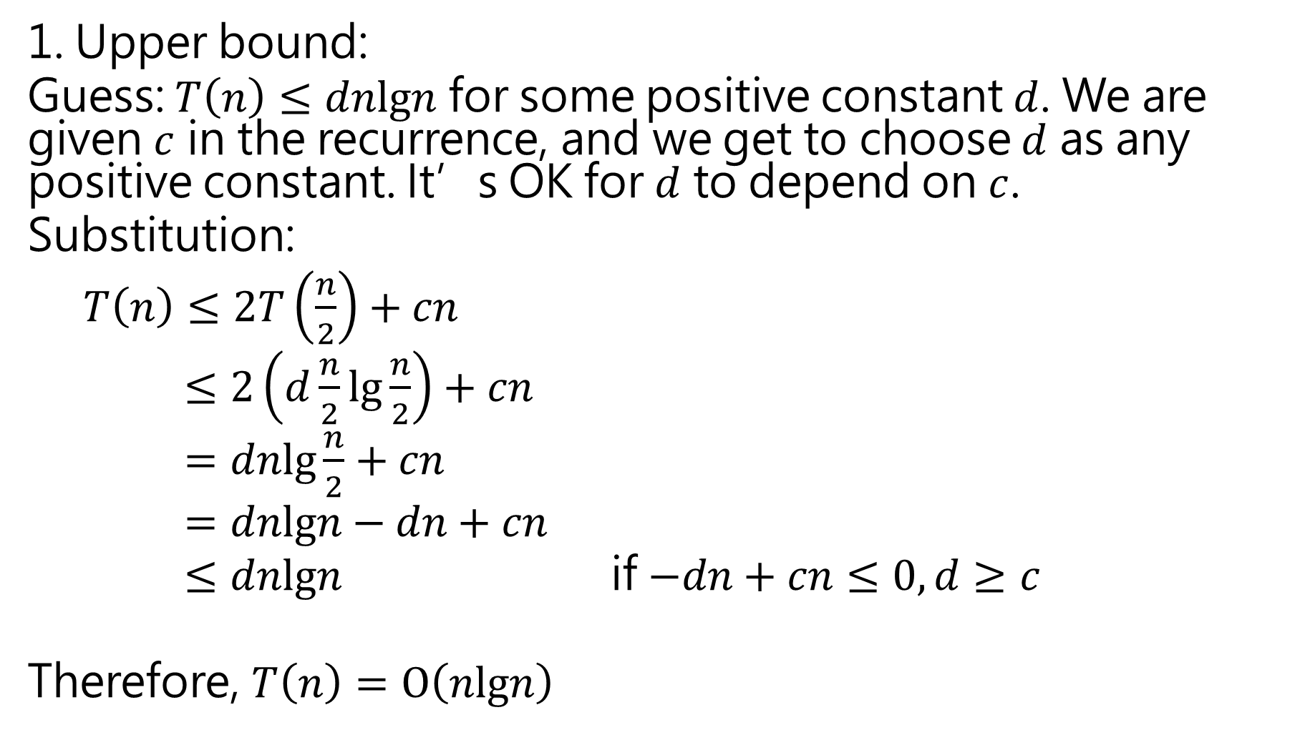
1. Upper bound:
Guess: $T\left(n\right)≤dnlgn$ for some positive constant $d$. We are given $c$ in the recurrence, and we get to choose $d$ as any positive constant. It’s OK for $d$ to depend on $c$.
Substitution:
$T\left(n\right)≤2T\left(\frac{n}{2}\right)+cn$
$≤2\left(d\frac{n}{2}lg\frac{n}{2}\right)+cn$
$=dnlg\frac{n}{2}+cn$
$=dnlgn−dn+cn$
$≤dnlgn$ if $−dn+cn≤0, d≥c$
Therefore, $T\left(n\right)=O\left(nlgn\right)$

Slide 45
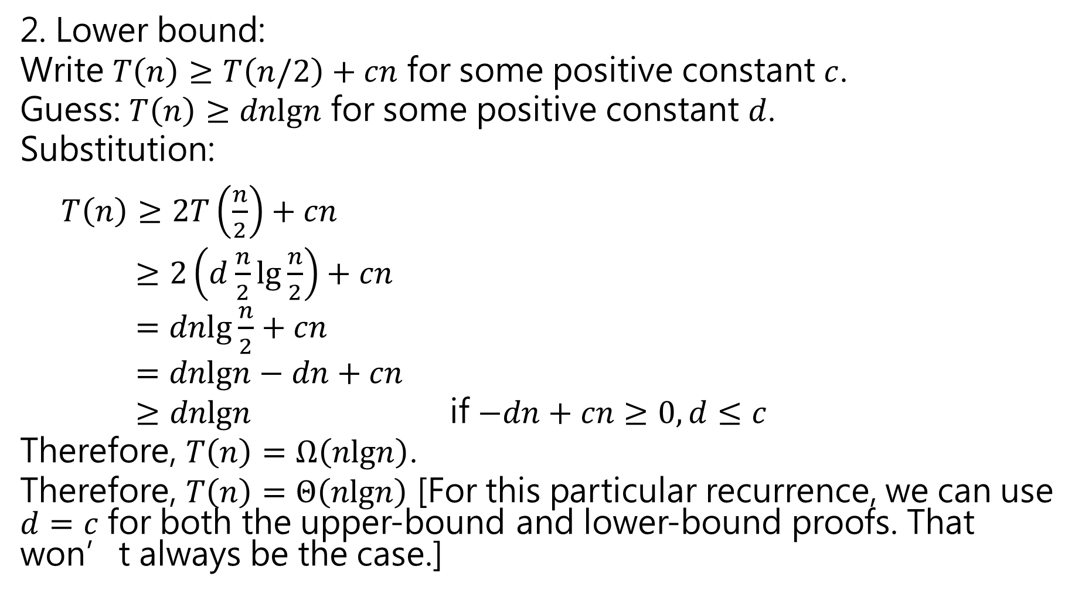
2. Lower bound:
Write $T\left(n\right)≥T\left(n/2\right)+cn$ for some positive constant $c$.
Guess: $T\left(n\right)≥dnlgn$ for some positive constant $d$.
Substitution:
$T\left(n\right)≥2T\left(\frac{n}{2}\right)+cn$
$≥2\left(d\frac{n}{2}lg\frac{n}{2}\right)+cn$
$=dnlg\frac{n}{2}+cn$
$=dnlgn−dn+cn$
$≥dnlgn$ if $−dn+cn≥0, d≤c$
Therefore, $T\left(n\right)=Ω\left(nlgn\right)$.
Therefore, $T\left(n\right)=Θ\left(nlgn\right)$ [For this particular recurrence, we can use $d=c$ for both the upper-bound and lower-bound proofs. That won’t always be the case.]

Slide 46
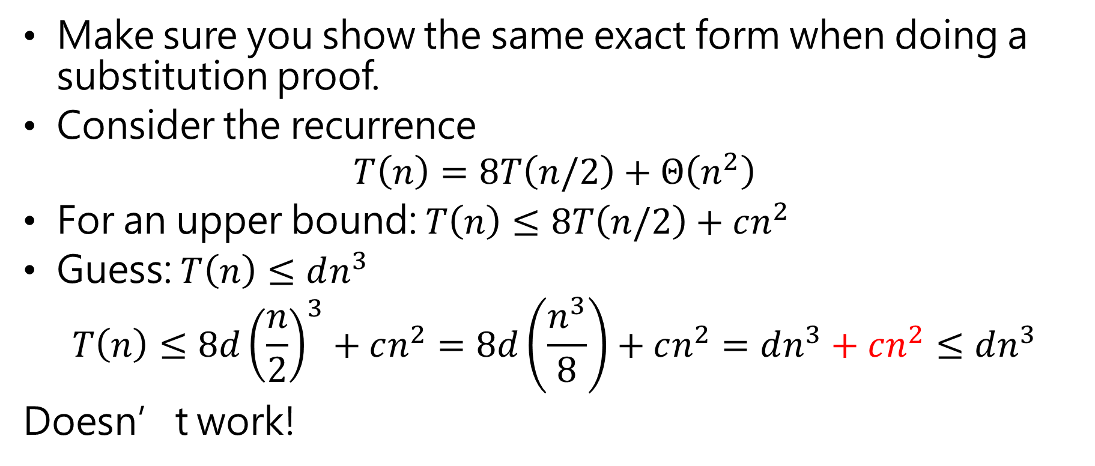
Substitution Method (cont’d)
Make sure you show the same exact form when doing a substitution proof.
Consider the recurrence
$$T\left(n\right)=8T\left(n/2\right)+Θ\left(n^{2}\right)$$
For an upper bound: $T\left(n\right)≤8T\left(n/2\right)+cn^{2}$
Guess: $T\left(n\right)≤dn^{3}$
$$T\left(n\right)≤8d{\left(\frac{n}{2}\right)}^{3}+cn^{2}=8d\left(\frac{n^{3}}{8}\right)+cn^{2}=dn^{3}+cn^{2}≤dn^{3}$$
Doesn’t work!

Slide 47
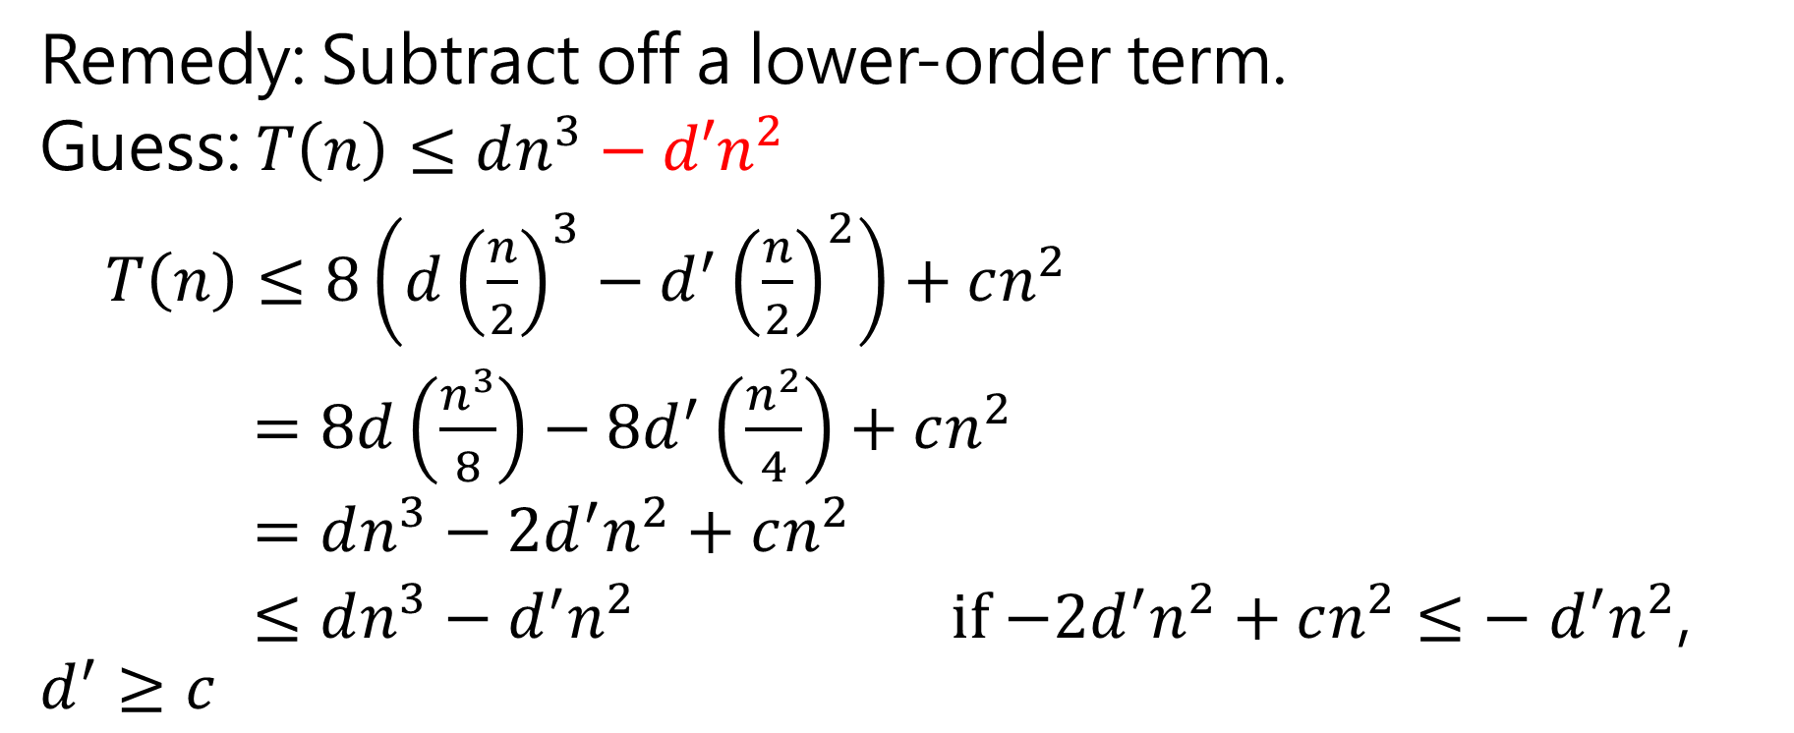
Substitution Method
Remedy: Subtract off a lower-order term.
Guess: $T\left(n\right)≤dn^{3}−d′n^{2}$
$T\left(n\right)≤8\left(d{\left(\frac{n}{2}\right)}^{3}−d^{′}{\left(\frac{n}{2}\right)}^{2}\right)+cn^{2}$
$=8d\left(\frac{n^{3}}{8}\right)−8d^{′}\left(\frac{n^{2}}{4}\right)+cn^{2}$
$=dn^{3}−2d^{′}n^{2}+cn^{2}$
$≤dn^{3}−d^{′}n^{2}$ if $−2d^{′}n^{2}+cn^{2}≤− d^{′}n^{2}$, $d^{′}≥c$

Slide 48
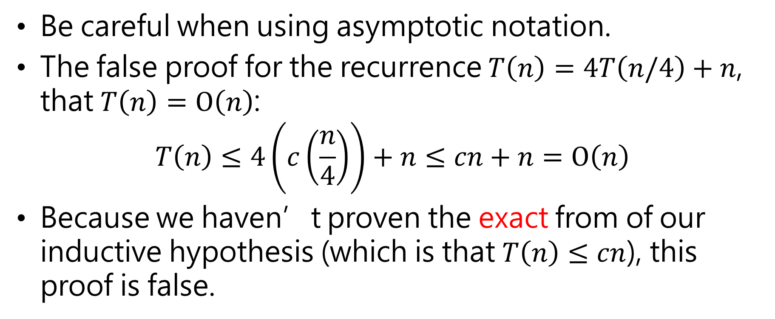
Substitution Method (cont’d)
Be careful when using asymptotic notation.
The false proof for the recurrence $T\left(n\right)=4T\left(n/4\right)+n$, that $T\left(n\right)=O\left(n\right)$:
$$T\left(n\right)≤4\left(c\left(\frac{n}{4}\right)\right)+n≤cn+n=O\left(n\right)$$
Because we haven’t proven the exact from of our inductive hypothesis (which is that $T\left(n\right)≤cn$), this proof is false.
Wrong!

Slide 49
Recurrence Trees
Goal of the recursion-tree method
a good guess for the substitution method
a direct proof of a solution to a recurrence (provided by carefully drawing a recursion tree)

Slide 50
Recurrence Trees (cont’d)

Slide 51
Recurrence Trees (cont’d)

Slide 52
Recurrence Trees (cont’d)
The cost of the entire tree

Slide 53
Recurrence Trees (cont’d)

Slide 54
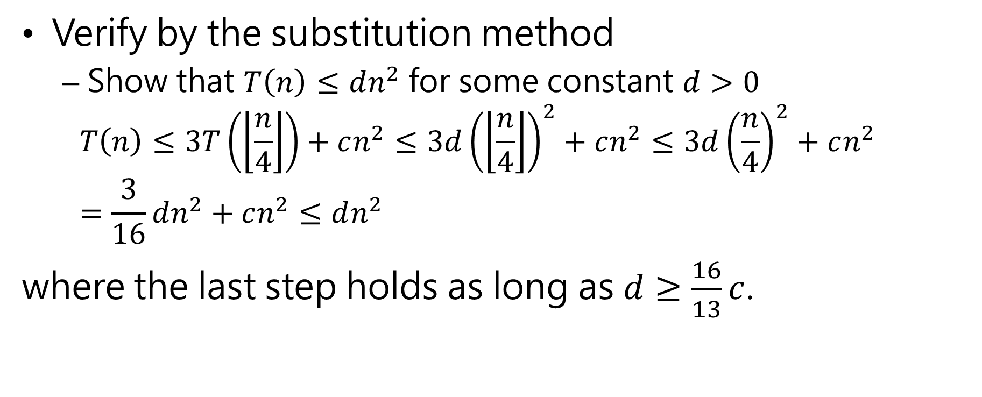
Recurrence Trees (cont’d)
Verify by the substitution method
Show that $T\left(n\right)≤dn^{2}$ for some constant $d>0$
$$T\left(n\right)≤3T\left(\left\lfloor \frac{n}{4}\right\rfloor \right)+cn^{2}≤3d{\left(\left\lfloor \frac{n}{4}\right\rfloor \right)}^{2}+cn^{2}≤3d{\left(\frac{n}{4}\right)}^{2}+cn^{2}=\frac{3}{16}dn^{2}+cn^{2}≤dn^{2}$$
where the last step holds as long as $d≥\frac{16}{13}c$.

Slide 55
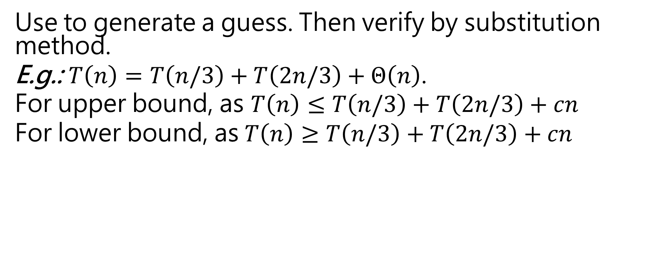
Recurrence Trees (cont’d)
Use to generate a guess. Then verify by substitution method.
E.g.: $T\left(n\right)=T\left(n/3\right)+T\left(2n/3\right)+Θ\left(n\right)$.
For upper bound, as $T\left(n\right)≤T\left(n/3\right)+T\left(2n/3\right)+cn$
For lower bound, as $T\left(n\right)≥T\left(n/3\right)+T\left(2n/3\right)+cn$

Slide 56












Recurrence Trees (cont’d)
By summing across each level, the recursion tree shows the cost at each level of recursion (minus the costs of recursive calls, which appear in subtrees):
$$cn$$
$$cn$$
$$c\left(n/3\right)$$
$$c\left(2n/3\right)$$
$$cn$$
$$c\left(n/9\right)$$
$$c\left(2n/9\right)$$
$$c\left(2n/9\right)$$
$$c\left(4n/9\right)$$
$$cn$$
leftmost branch peters out after $\log_{3}{n}$ levels
rightmost branch peters out after $\log_{3/2}{n}$ levels

Slide 57
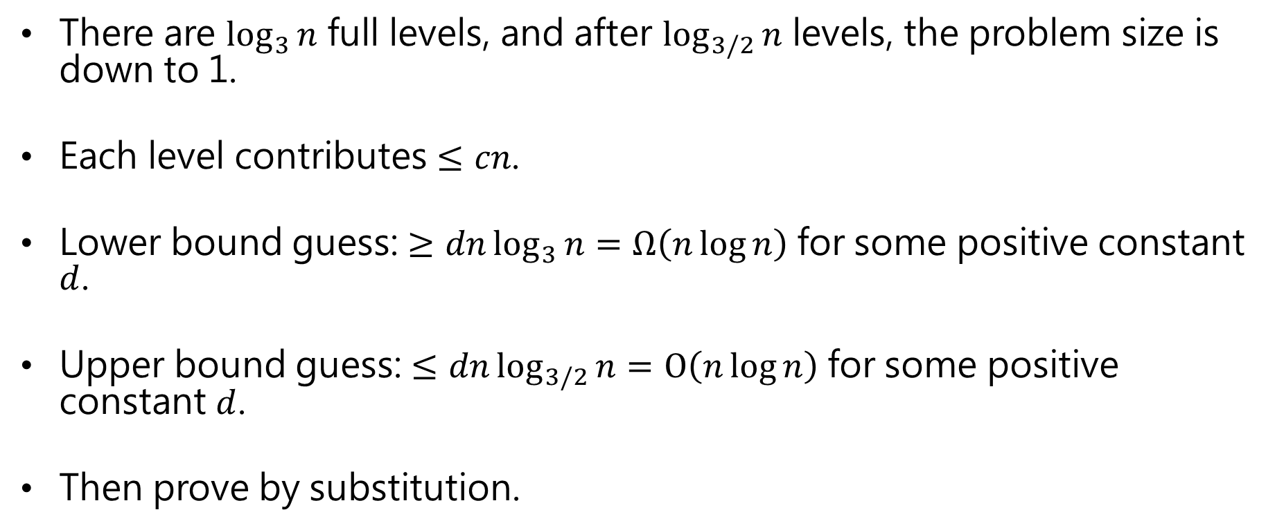
Recurrence Trees (cont’d)
There are $\log_{3}{n}$ full levels, and after $\log_{3/2}{n}$ levels, the problem size is down to 1.
Each level contributes $≤cn$.
Lower bound guess: $≥dn\log_{3}{n}=Ω\left(n\log{n}\right)$ for some positive constant $d$.
Upper bound guess: $≤dn\log_{3/2}{n}=O\left(n\log{n}\right)$ for some positive constant $d$.
Then prove by substitution.

Slide 58
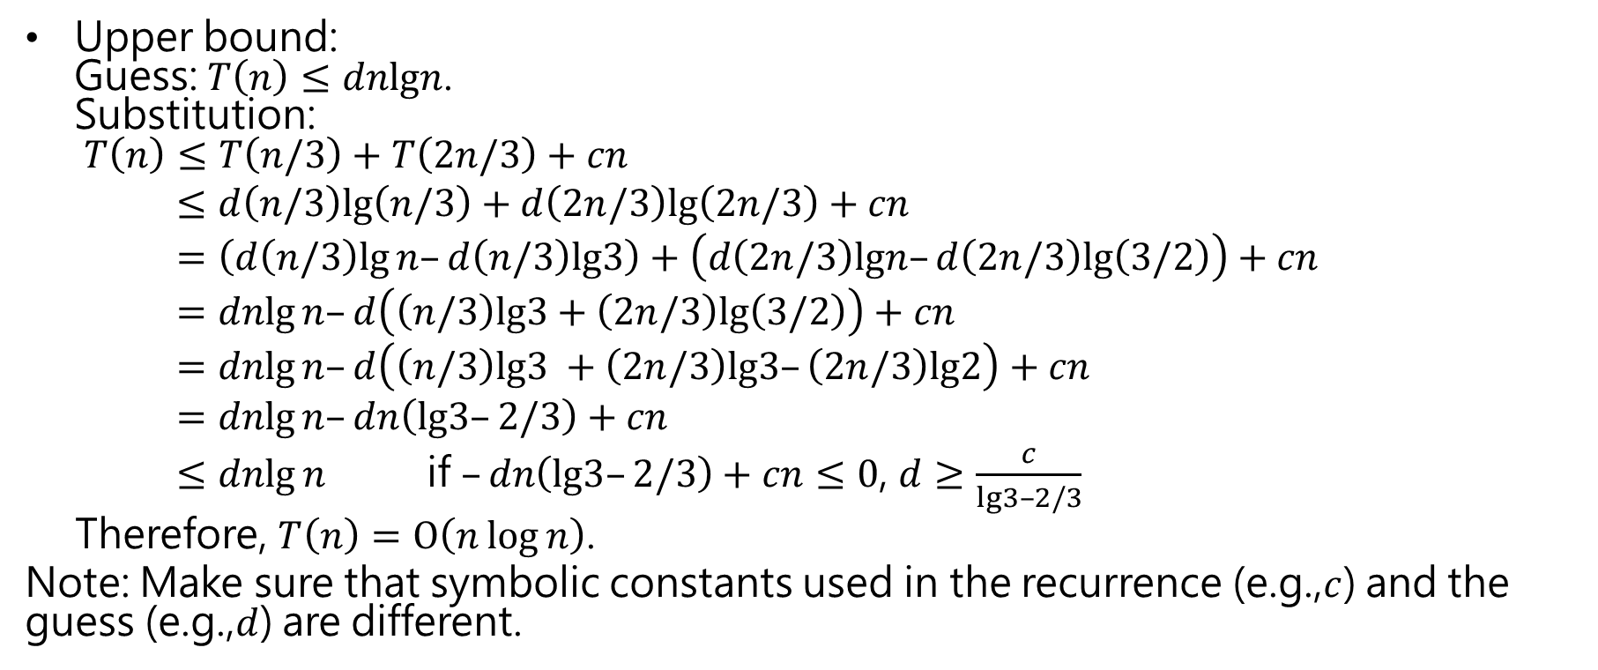
Recurrence Trees (cont’d)
Upper bound: Guess: $T\left(n\right)≤dnlgn$. Substitution: $T\left(n\right)≤T\left(n/3\right)+T\left(2n/3\right)+cn$
$≤d\left(n/3\right)lg\left(n/3\right)+d\left(2n/3\right)lg\left(2n/3\right)+cn$
$=\left(d\left(n/3\right)lg⁡n–d\left(n/3\right)lg3\right)+\left(d\left(2n/3\right)lgn–d\left(2n/3\right)lg⁡\left(3/2\right)\right)+cn$
$=dnlg⁡n–d\left(\left(n/3\right)lg3+\left(2n/3\right)lg⁡\left(3/2\right)\right)+cn$
$=dnlg⁡n–d\left(\left(n/3\right)lg3 +\left(2n/3\right)lg3–\left(2n/3\right)lg2\right)+cn$
$=dnlg⁡n–dn\left(lg3–2/3\right)+cn$
$≤dnlg⁡n$ if $–dn\left(lg3–2/3\right)+cn≤0$, $d≥\frac{c}{lg3–2/3}$
Therefore, $T\left(n\right)=O\left(n\log{n}\right)$.
Note: Make sure that symbolic constants used in the recurrence (e.g.,$c$) and the guess (e.g.,$d$) are different.

Slide 59
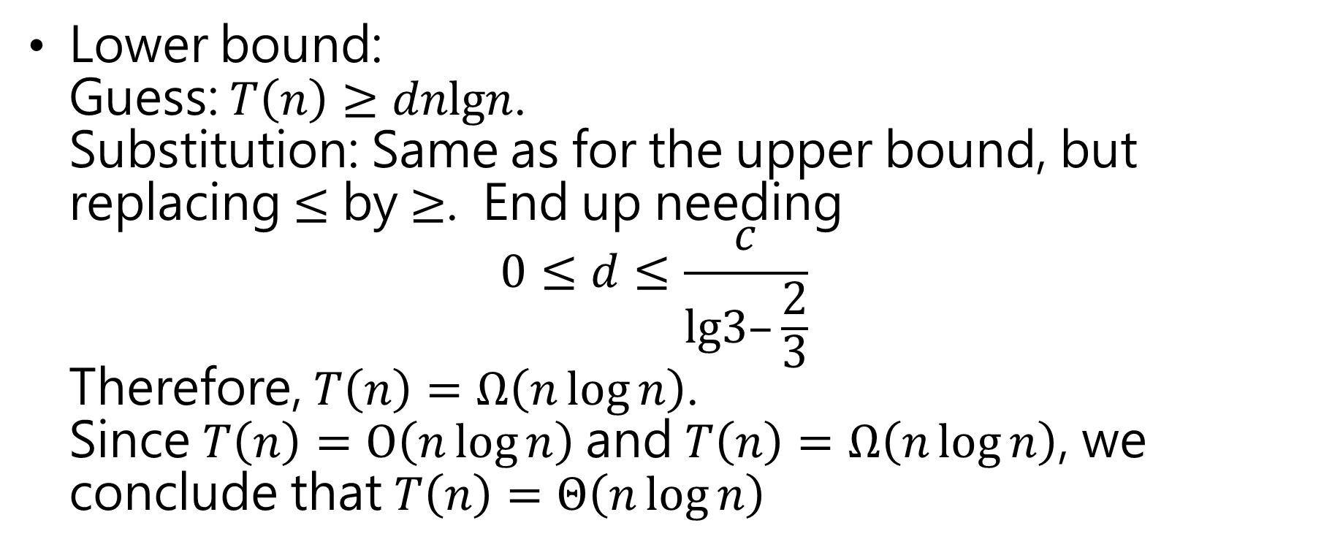
Recurrence Trees (cont’d)
Lower bound: Guess: $T\left(n\right)≥dnlgn$. Substitution: Same as for the upper bound, but replacing $≤$ by $≥$. End up needing $0≤d≤\frac{c}{lg3–\frac{2}{3}}$ Therefore, $T\left(n\right)=Ω\left(n\log{n}\right)$. Since $T\left(n\right)=O\left(n\log{n}\right)$and $T\left(n\right)=Ω\left(n\log{n}\right)$, we conclude that $T\left(n\right)=Θ\left(n\log{n}\right)$

Slide 60
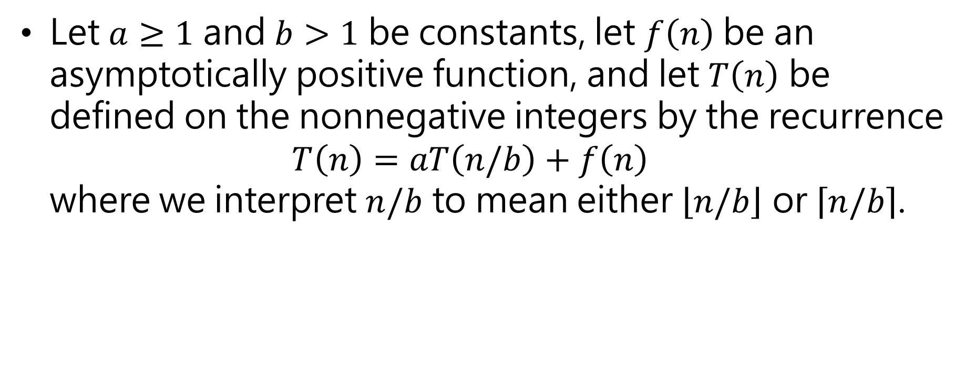
Master Theorem
Let $a≥1$ and $b>1$ be constants, let $f\left(n\right)$ be an asymptotically positive function, and let $T\left(n\right)$ be defined on the nonnegative integers by the recurrence $T\left(n\right)=aT\left(n/b\right)+f\left(n\right)$ where we interpret $n/b$ to mean either $\left\lfloor n/b\right\rfloor$ or $\left\lceil n/b\right\rceil$.

Slide 61
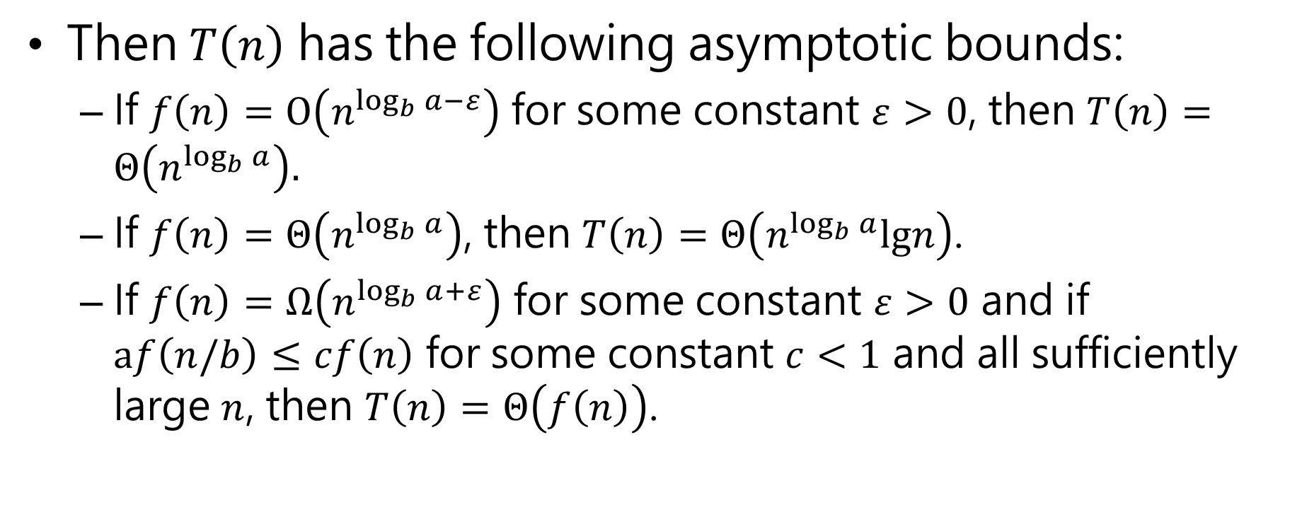
Master Theorem (cond’t)
Then $T\left(n\right)$ has the following asymptotic bounds:
If $f\left(n\right)=O\left(n^{\log_{b}{a}−ε}\right)$for some constant $ε>0$, then $T\left(n\right)=Θ\left(n^{\log_{b}{a}}\right).$
If $f\left(n\right)=Θ\left(n^{\log_{b}{a}}\right)$, then $T\left(n\right)=Θ\left(n^{\log_{b}{a}}lgn\right)$.
If $f\left(n\right)=Ω\left(n^{\log_{b}{a}+ε}\right)$ for some constant $ε>0$ and if $af\left(n/b\right)≤cf\left(n\right)$ for some constant $c<1$ and all sufficiently large $n$, then $T\left(n\right)=Θ\left(f\left(n\right)\right)$.

Slide 62
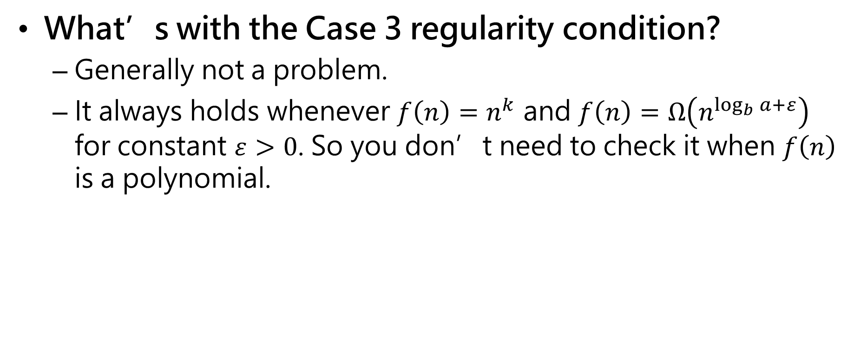
Master Theorem (cond’t)
What’s with the Case 3 regularity condition?
Generally not a problem.
It always holds whenever $f\left(n\right)=n^{k}$ and $f\left(n\right)=Ω\left(n^{\log_{b}{a}+ε}\right)$ for constant $ε>0$. So you don’t need to check it when $f\left(n\right)$ is a polynomial.

Slide 63
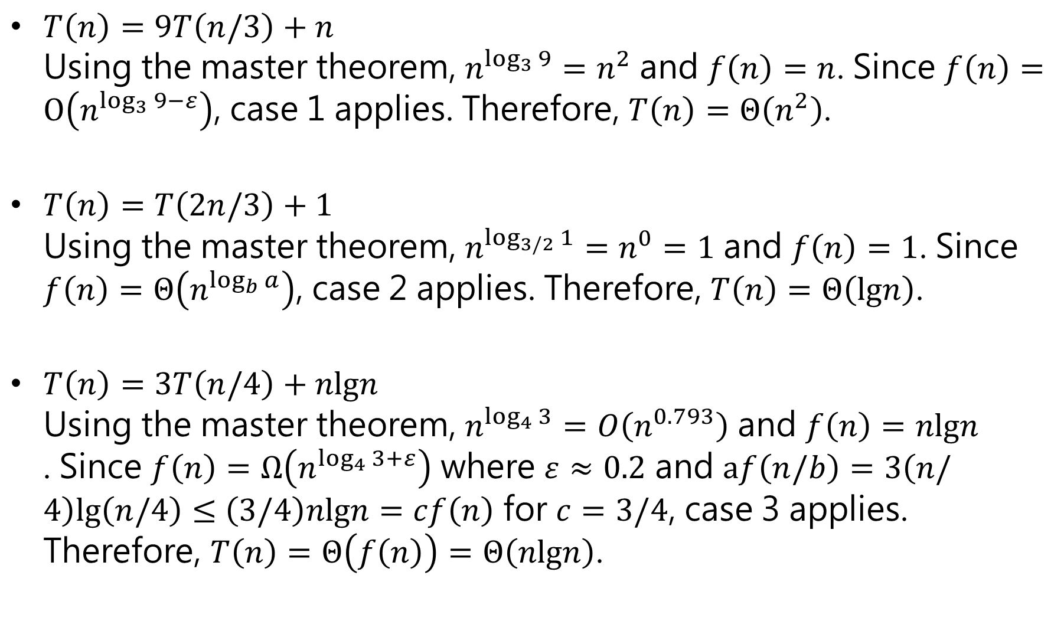
$T\left(n\right)=9T\left(n/3\right)+n$ Using the master theorem, $n^{\log_{3}{9}}=n^{2}$ and $f\left(n\right)=n$. Since $f\left(n\right)=O\left(n^{\log_{3}{9}−ε}\right)$, case 1 applies. Therefore, $T\left(n\right)=Θ\left(n^{2}\right)$.
$T\left(n\right)=T\left(2n/3\right)+1$ Using the master theorem, $n^{\log_{3/2}{1}}=n^{0}=1$ and $f\left(n\right)=1$. Since $f\left(n\right)=Θ\left(n^{\log_{b}{a}}\right)$, case 2 applies. Therefore, $T\left(n\right)=Θ\left(lgn\right)$.
$T\left(n\right)=3T\left(n/4\right)+nlgn$ Using the master theorem, $n^{\log_{4}{3}}=O\left(n^{0.793}\right)$ and $f\left(n\right)=nlgn$ . Since $f\left(n\right)=Ω\left(n^{\log_{4}{3}+ε}\right)$ where $ε≈0.2$ and $af\left(n/b\right)=3\left(n/4\right)lg\left(n/4\right)≤$ $\left(3/4\right)nlgn=cf\left(n\right)$ for $c=3/4$, case 3 applies. Therefore, $T\left(n\right)=Θ\left(f\left(n\right)\right)=Θ\left(nlgn\right)$.

Slide 64
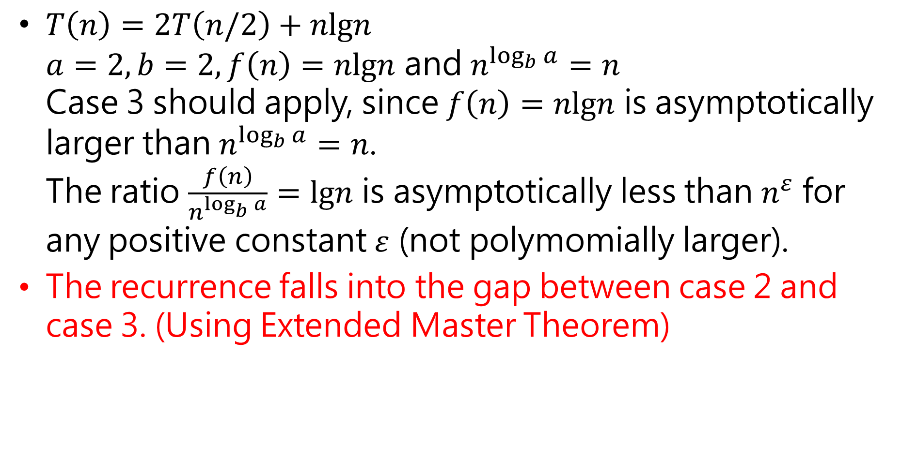
$T\left(n\right)=2T\left(n/2\right)+nlgn$ $a=2,b=2, f\left(n\right)=nlgn$ and $n^{\log_{b}{a}}=n$ Case 3 should apply, since $f\left(n\right)=nlgn$ is asymptotically larger than $n^{\log_{b}{a}}=n$. The ratio $\frac{f\left(n\right)}{n^{\log_{b}{a}}}=lgn$ is asymptotically less than $n^{ε}$ for any positive constant $ε$ (not polymomially larger).
The recurrence falls into the gap between case 2 and case 3. (Using Extended Master Theorem)
Wrong!

Slide 65
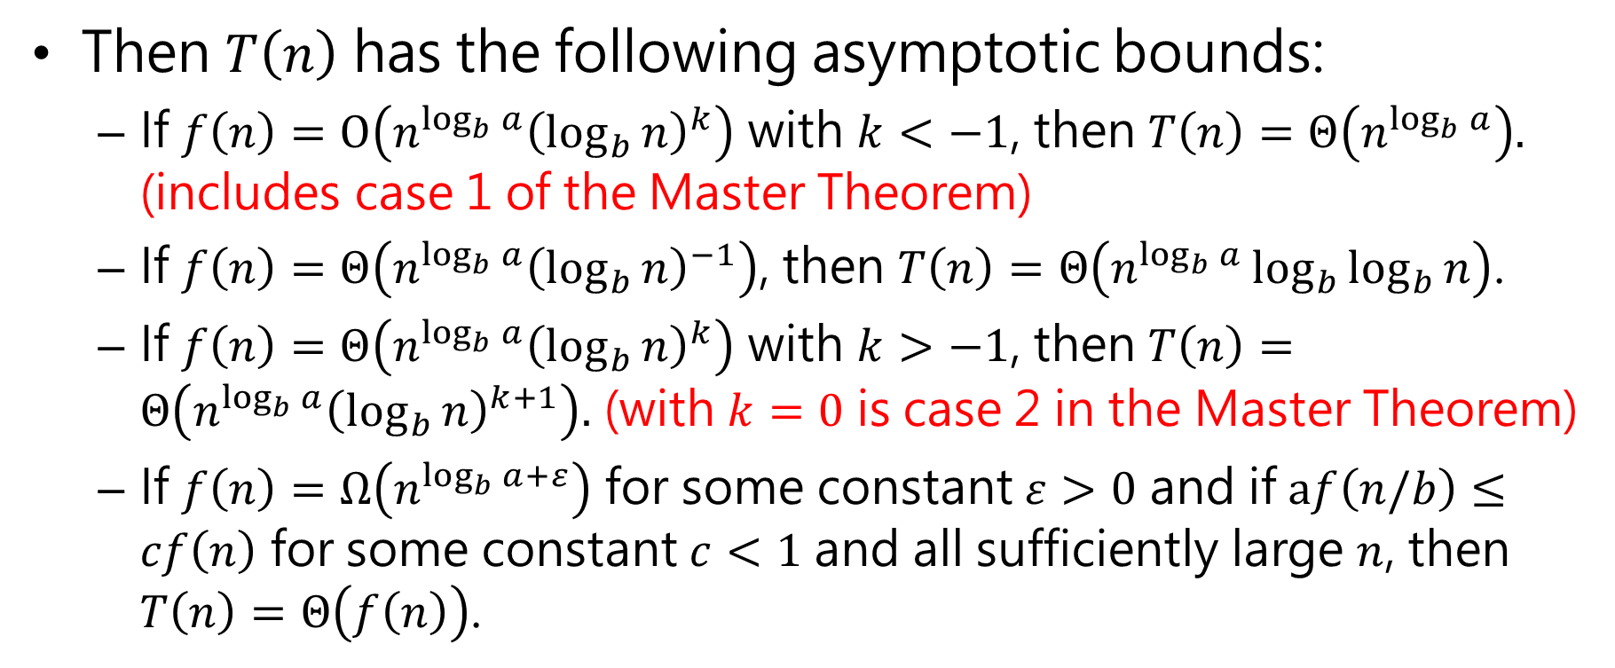
Extended Master Theorem
Then $T\left(n\right)$ has the following asymptotic bounds:
If $f\left(n\right)=O\left(n^{\log_{b}{a}}{\left(\log_{b}{n}\right)}^{k}\right)$ with $k<−1$, then $T\left(n\right)=Θ\left(n^{\log_{b}{a}}\right).$ (includes case 1 of the Master Theorem)
If $f\left(n\right)=Θ\left(n^{\log_{b}{a}}{\left(\log_{b}{n}\right)}^{−1}\right)$, then $T\left(n\right)=Θ\left(n^{\log_{b}{a}}\log_{b}{\log_{b}{n}}\right)$.
If $f\left(n\right)=Θ\left(n^{\log_{b}{a}}{\left(\log_{b}{n}\right)}^{k}\right)$ with $k>−1$, then $T\left(n\right)=Θ\left(n^{\log_{b}{a}}{\left(\log_{b}{n}\right)}^{k+1}\right).$ (with $k=0$ is case 2 in the Master Theorem)
If $f\left(n\right)=Ω\left(n^{\log_{b}{a}+ε}\right)$ for some constant $ε>0$ and if $af\left(n/b\right)≤cf\left(n\right)$ for some constant $c<1$ and all sufficiently large $n$, then $T\left(n\right)=Θ\left(f\left(n\right)\right)$.

Slide 66

Extended Master Theorem (cond’t)
Examples:
$T\left(n\right)=5T\left(n/2\right)+Θ\left(n^{2}\right)$ $n^{\log_{2}{5}}$ vs. $n^{2}$ Since $\log_{2}{5}−ε=2$ for some constant $ε>0$, use Case 1$⇒T\left(n\right)=Θ\left(n^{lg5}\right)$
$T\left(n\right)=27T\left(n/3\right)+Θ\left(n^{3}lgn\right)$ $n^{\log_{3}{27}}=n^{3}$ vs. $n^{3}lgn$ Use Case 3 with $k=1⇒T\left(n\right)=Θ\left(n^{3}lg^{2}n\right)$

Slide 67

Extended Master Theorem (cond’t)
$T\left(n\right)=5T\left(n/2\right)+Θ\left(n^{3}\right)$ $n^{\log_{2}{5}}$ vs. $n^{3}$ Now $\log_{2}{5}+ε=3$ for some constant$ε>0$ Check regularity condition (don’t really need to since $f\left(n\right)$ is a polynomial): $af\left(n/b\right)=5{\left(n/2\right)}^{3}=5n^{3}/8≤cn^{3}$ for $c=\frac{5}{8}<1$ Use Case 4: $T\left(n\right)=Θ\left(n^{3}\right)$

Slide 68

Extended Master Theorem (cond’t)
$T\left(n\right)=27T\left(n/3\right)+Θ\left(n^{3}/lgn\right)$
$n^{\log_{3}{27}}$ vs. $n^{3}/lgn=n^{3}lg^{−1}n$ Since $f\left(n\right)=Θ\left(n^{\log_{b}{a}}{\left(\log_{b}{n}\right)}^{−1}\right)$, use Case 2. Therefore, $T\left(n\right)=Θ\left(n^{\log_{b}{a}}\log_{b}{\log_{b}{n}}\right)=Θ\left(n^{3}\log_{3}{\log_{3}{n}}\right)$.

