Slide 1
Chapter 15: Dynamic Programming (part II)
Chi-Yeh Chen
陳奇業
成功大學資訊工程學系

Slide 2
Optimal binary search trees

Slide 3
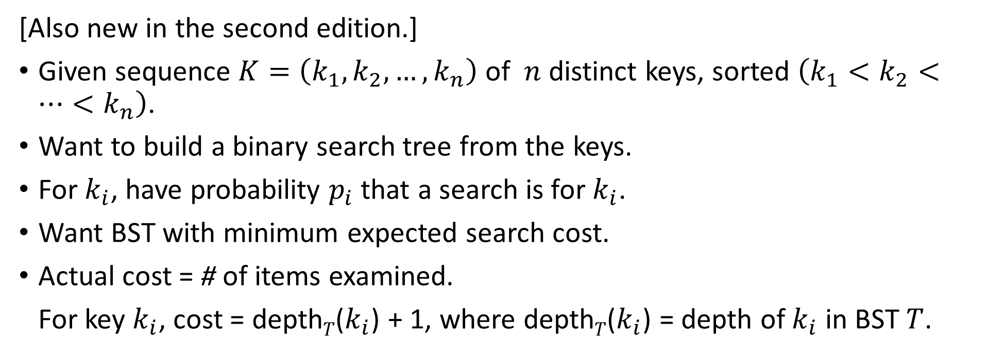
Optimal binary search trees
[Also new in the second edition.]
Given sequence $K=\left(k_{1},k_{2}, …,k_{n}\right)$ of $n$ distinct keys, sorted $\left(k_{1}<k_{2}<…<k_{n}\right)$.
Want to build a binary search tree from the keys.
For $k_{i}$, have probability $p_{i}$ that a search is for $k_{i}$.
Want BST with minimum expected search cost.
Actual cost = # of items examined.
For key $k_{i}$, cost = depth$T$($k_{i}$) + 1, where depth$T$($k_{i}$) = depth of $k_{i}$ in BST $T$.

Slide 4
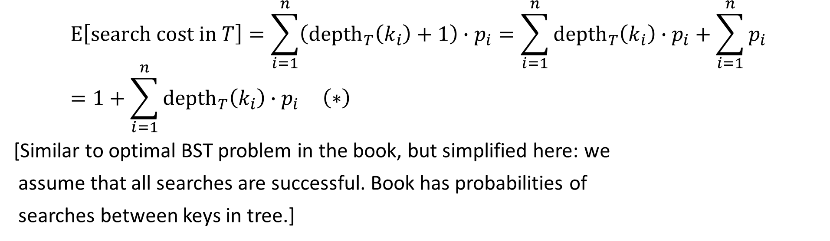
$$E\left[search cost in T\right]=\sum_{i=1}^{n}{\left({depth}_{T}\left(k_{i}\right)+1\right)∙p_{i}}=\sum_{i=1}^{n}{{depth}_{T}\left(k_{i}\right)∙p_{i}}+\sum_{i=1}^{n}{p_{i}}=1+\sum_{i=1}^{n}{{depth}_{T}\left(k_{i}\right)∙p_{i}} \left(∗\right)$$
[Similar to optimal BST problem in the book, but simplified here: we
assume that all searches are successful. Book has probabilities of
searches between keys in tree.]
(since probabilities sum to 1)

Slide 5
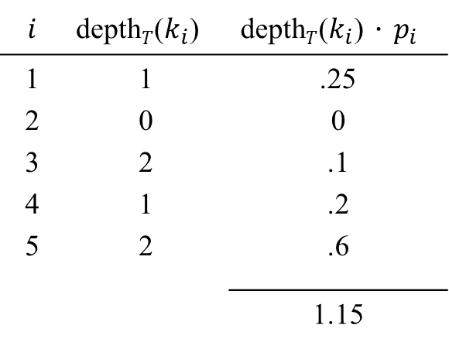
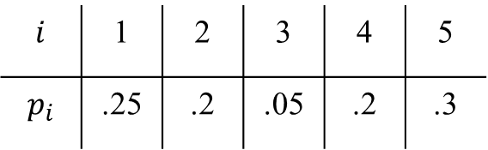

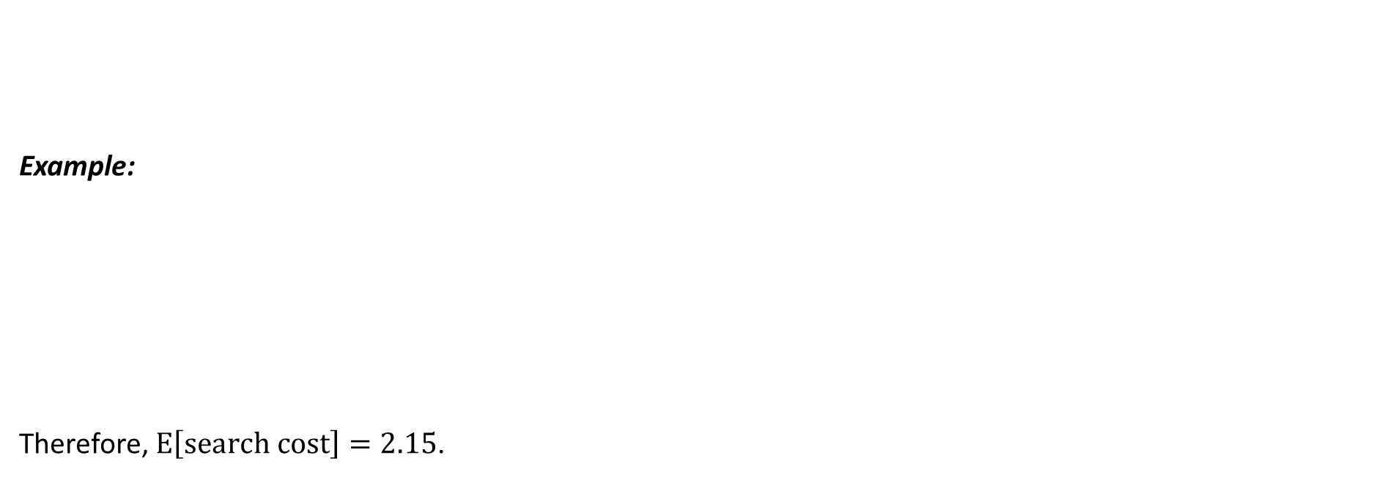



$$i$$ | 1 | 2 | 3 | 4 | 5
$$p_{i}$$ | .25 | .2 | .05 | .2 | .3
Example:
Therefore, $E\left[search cost\right]=2.15$.
$$i$$ | depth$T$($k_{i}$) | depth$T$($k_{i}$)．$p_{i}$
1 2 3 4 5 | 1 0 2 1 2 | .25 0 .1 .2 .6
 |  | 1.15
k₂
k₁
k₄
k₃
k₅

Slide 6
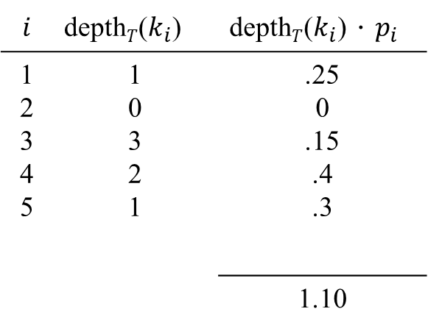
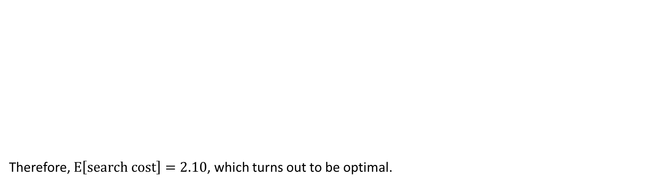
k₂
$$i$$ | depth$T$($k_{i}$) | depth$T$($k_{i}$)．$p_{i}$
1 2 3 4 5 | 1 0 3 2 1 | .25 0 .15 .4 .3
 |  | 1.10
Therefore, $E\left[search cost\right]=2.10$, which turns out to be optimal.
k₁
k₅
k₄
k₃

Slide 7
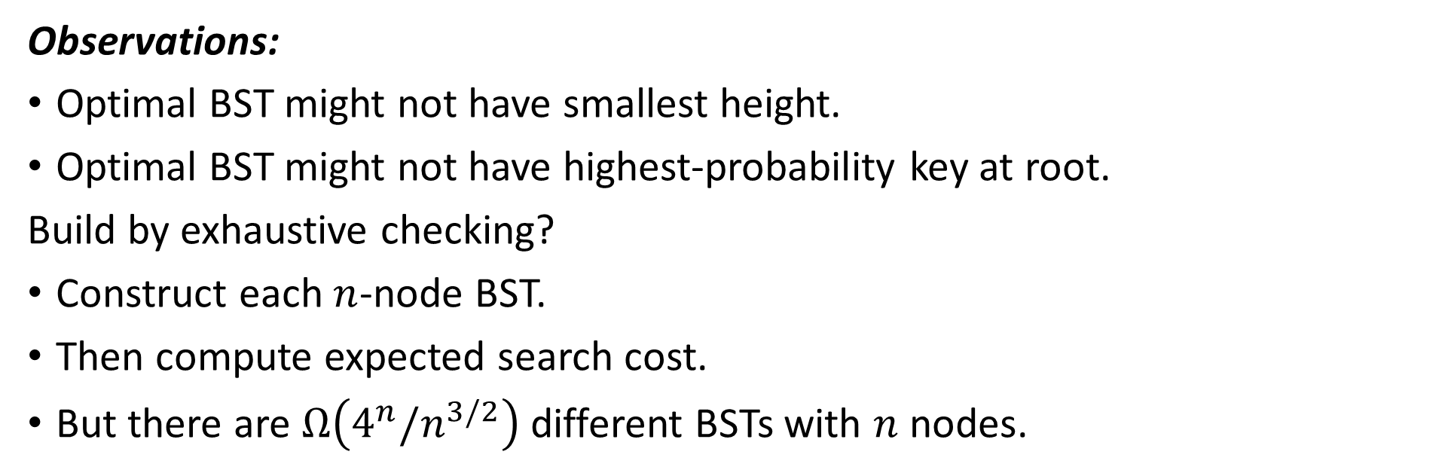
Observations:
Optimal BST might not have smallest height.
Optimal BST might not have highest-probability key at root.
Build by exhaustive checking?
Construct each $n$-node BST.
Then compute expected search cost.
But there are $Ω\left(4^{n}/n^{3/2}\right)$ different BSTs with $n$ nodes.

Slide 8


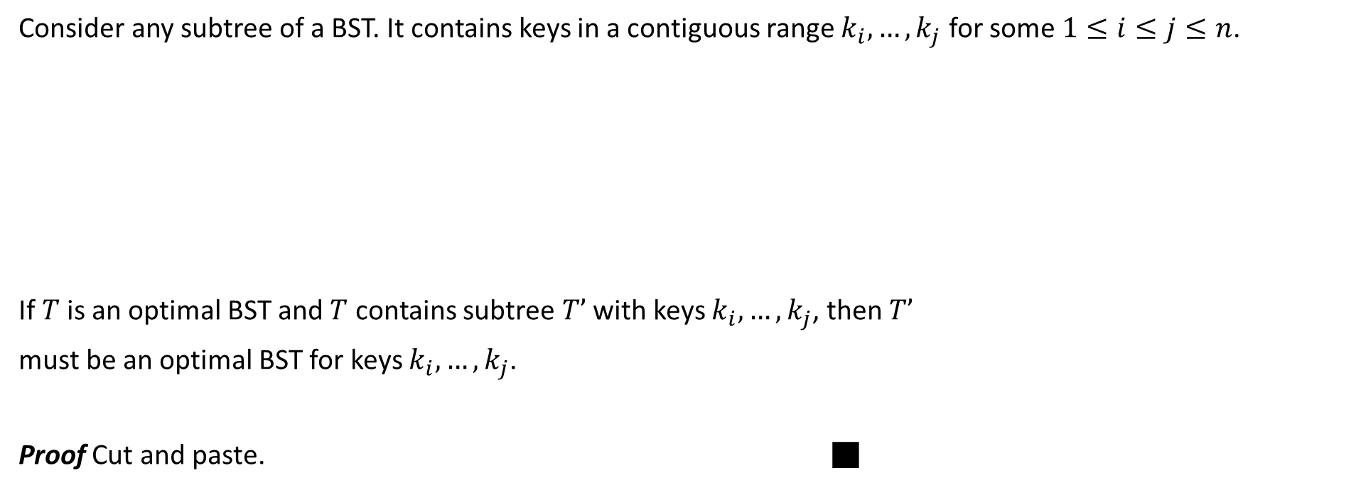
Optimal substructure
Consider any subtree of a BST. It contains keys in a contiguous range $k_{i}, …, k_{j}$ for some $1≤i≤j≤n$.
If $T$is an optimal BST and $T$ contains subtree $T’$ with keys $k_{i}, …, k_{j}$, then $T’$
must be an optimal BST for keys $k_{i}, …, k_{j}$.
Proof Cut and paste. ■
$$T$$
$$T’$$

Slide 9


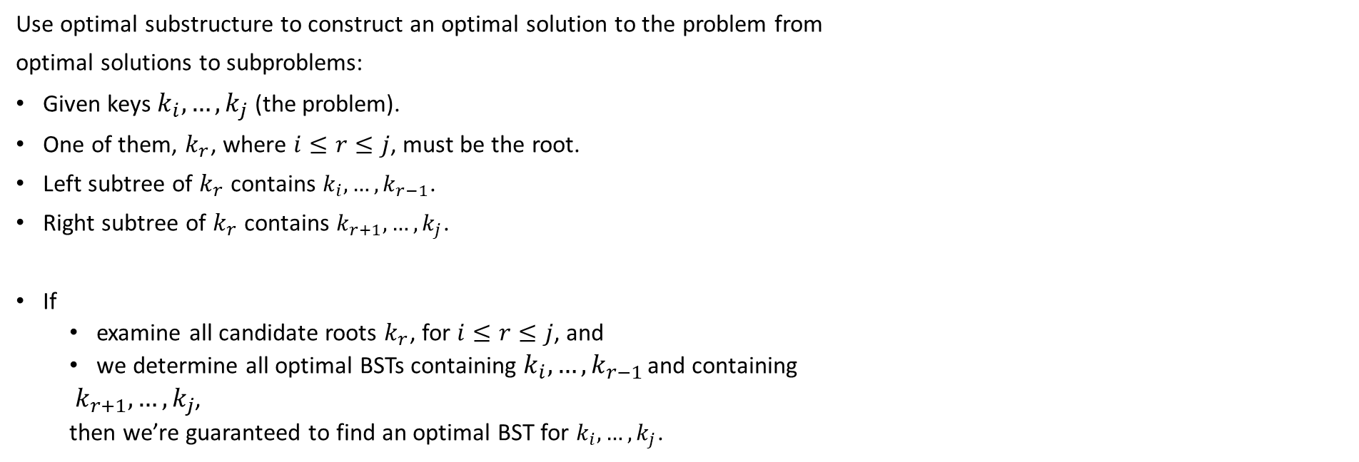

Use optimal substructure to construct an optimal solution to the problem from
optimal solutions to subproblems:
Given keys $k_{i}, …, k_{j}$ (the problem).
One of them, $k_{r}$, where $i≤r≤j$, must be the root.
Left subtree of $k_{r}$ contains $k_{i}, …, k_{r−1}$.
Right subtree of $k_{r}$ contains $k_{r+1}, …, k_{j}$.
If
examine all candidate roots $k_{r}$, for $i≤r≤j$, and
we determine all optimal BSTs containing $k_{i}, …, k_{r−1}$ and containing
$k_{r+1}, …, k_{j}$,
then we’re guaranteed to find an optimal BST for $k_{i}, …, k_{j}$.
$k_{r}$
$k_{i}$ $k_{r−1}$
$k_{r+1}$ $k_{j}$

Slide 10
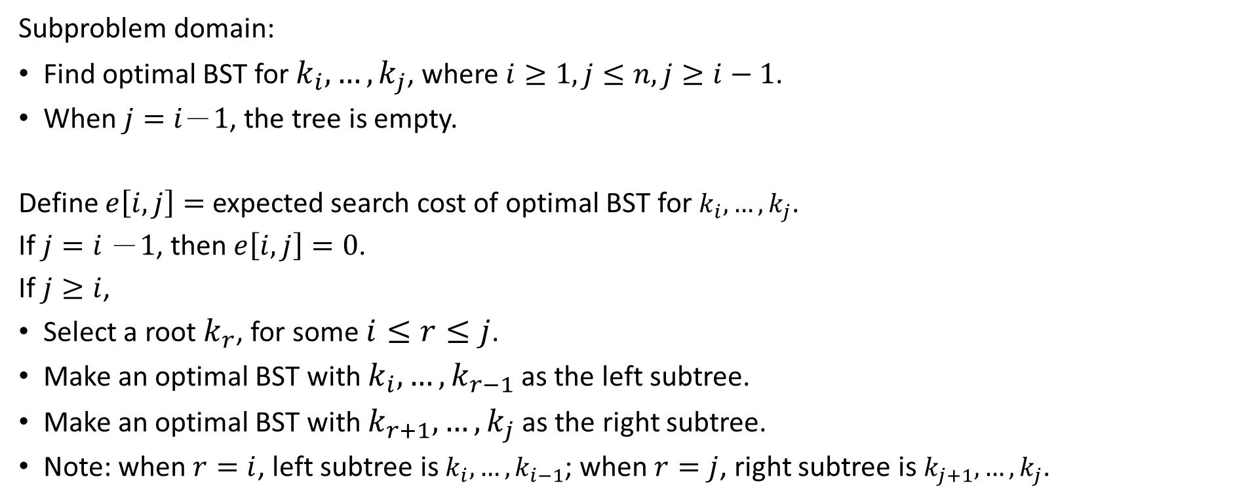
Recursive solution
Subproblem domain:
Find optimal BST for $k_{i}, …, k_{j}$, where $i≥1, j≤n, j≥i−1$.
When $j=i－1$, the tree is empty.
Define $e\left[i, j\right]=$ expected search cost of optimal BST for $k_{i}, …, k_{j}$.
If $j=i －1$, then $e\left[i, j\right]=0$.
If $j≥i$,
Select a root $k_{r}$, for some $i≤r≤j$.
Make an optimal BST with $k_{i}, …, k_{r−1}$ as the left subtree.
Make an optimal BST with $k_{r+1}, …, k_{j}$as the right subtree.
Note: when $r=i$, left subtree is $k_{i}, …, k_{i−1}$; when $r=j$, right subtree is $k_{j+1}, …, k_{j}$.

Slide 11
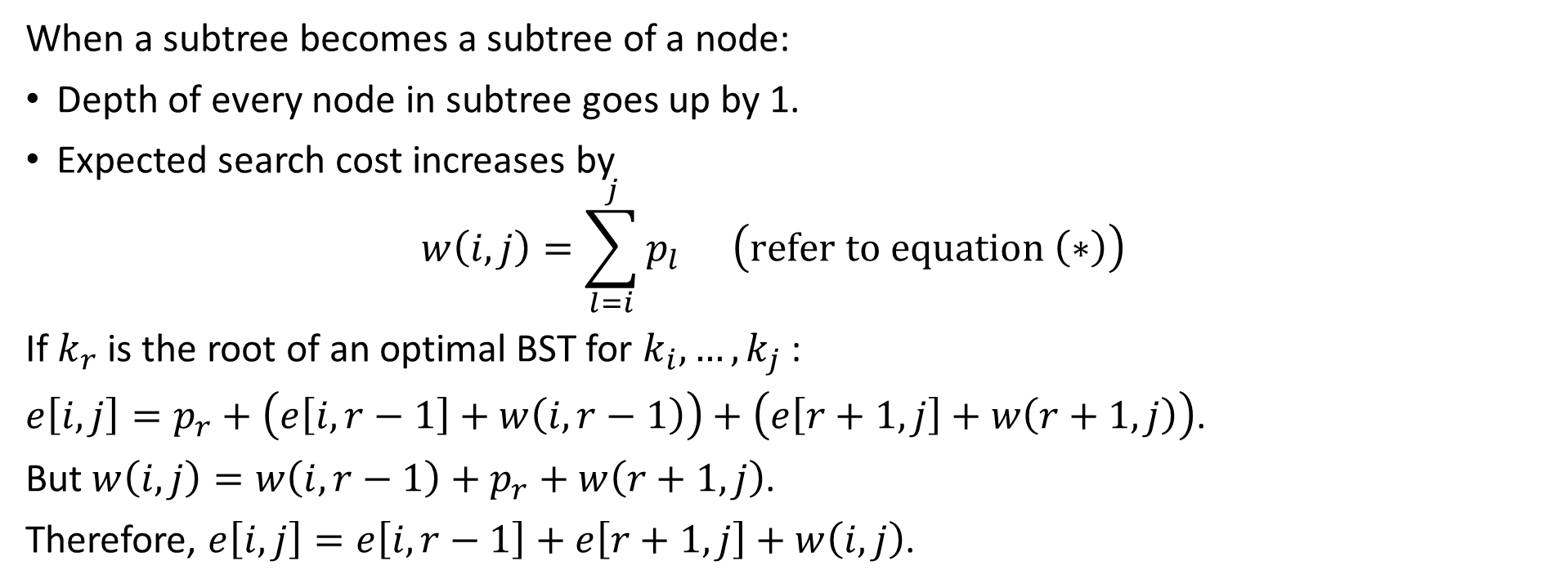
When a subtree becomes a subtree of a node:
Depth of every node in subtree goes up by 1.
Expected search cost increases by $w\left(i, j\right)=\sum_{l=i}^{j}{p_{l}} \left(refer to equation \left(∗\right)\right)$
If $k_{r}$ is the root of an optimal BST for $k_{i}, …, k_{j}$:
$e\left[i, j\right]=p_{r}+\left(e\left[i, r−1\right]+w\left(i, r−1\right)\right)+\left(e\left[r+1, j\right]+w\left(r+1, j\right)\right)$.
But $w\left(i, j\right)=w\left(i, r−1\right)+p_{r}+w\left(r+1, j\right)$.
Therefore, $e\left[i, j\right]=e\left[i, r−1\right]+e\left[r+1, j\right]+w\left(i, j\right)$.

Slide 12
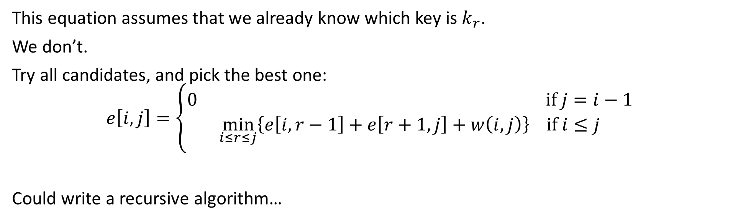
This equation assumes that we already know which key is $k_{r}$.
We don’t.
Try all candidates, and pick the best one: $$e\left[i, j\right]=\left\{\begin{aligned}0 if j=i−1 \\ \min_{i≤r≤j}\left\{e\left[i, r−1\right]+e\left[r+1, j\right]+w\left(i, j\right)\right\} if i≤j\end{aligned}\right.$$
Could write a recursive algorithm…

Slide 13
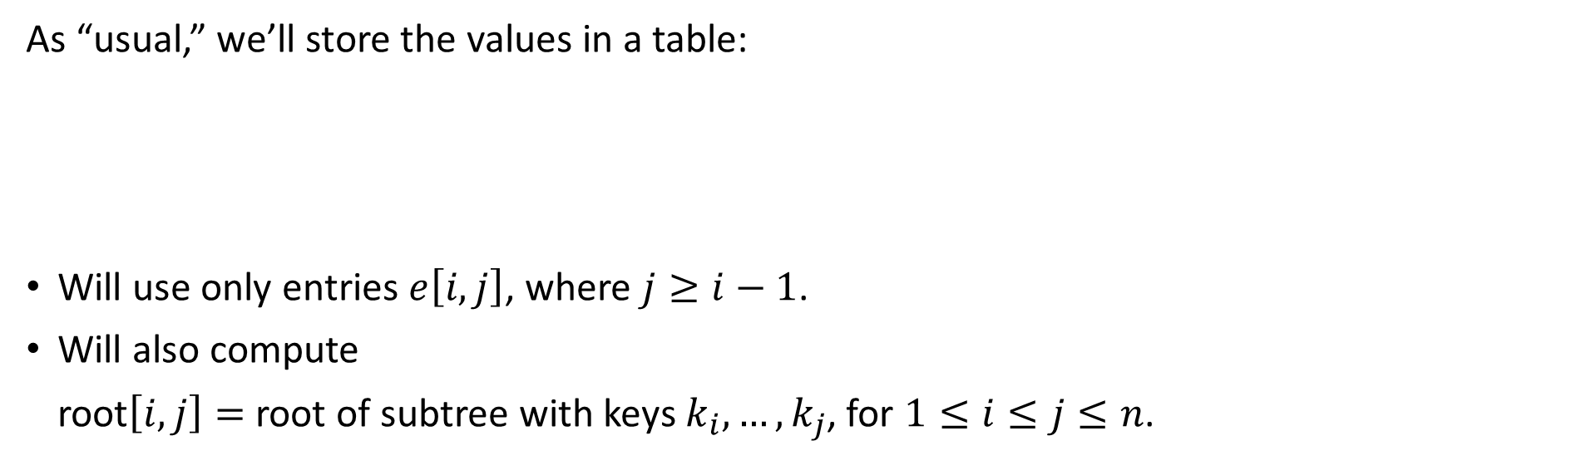
As “usual,” we’ll store the values in a table:
Will use only entries $e\left[i, j\right]$, where $j≥i−1$.
Will also compute
root$\left[i, j\right]=$ root of subtree with keys $k_{i}, …, k_{j}$, for $1≤i≤j≤n$.

Slide 14
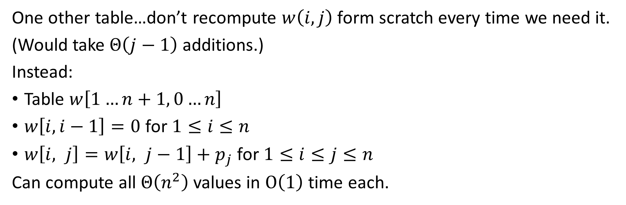
One other table…don’t recompute $w\left(i, j\right)$ form scratch every time we need it.
(Would take $Θ\left(j−1\right)$ additions.)
Instead:
Table $w\left[1…n+1, 0…n\right]$
$w\left[i, i−1\right]=0$ for $1≤i≤n$
$w\left[i, j\right]=w\left[i, j−1\right]+p_{j}$ for $1≤i≤j≤n$
Can compute all $Θ\left(n^{2}\right)$ values in $O\left(1\right)$ time each.

Slide 16
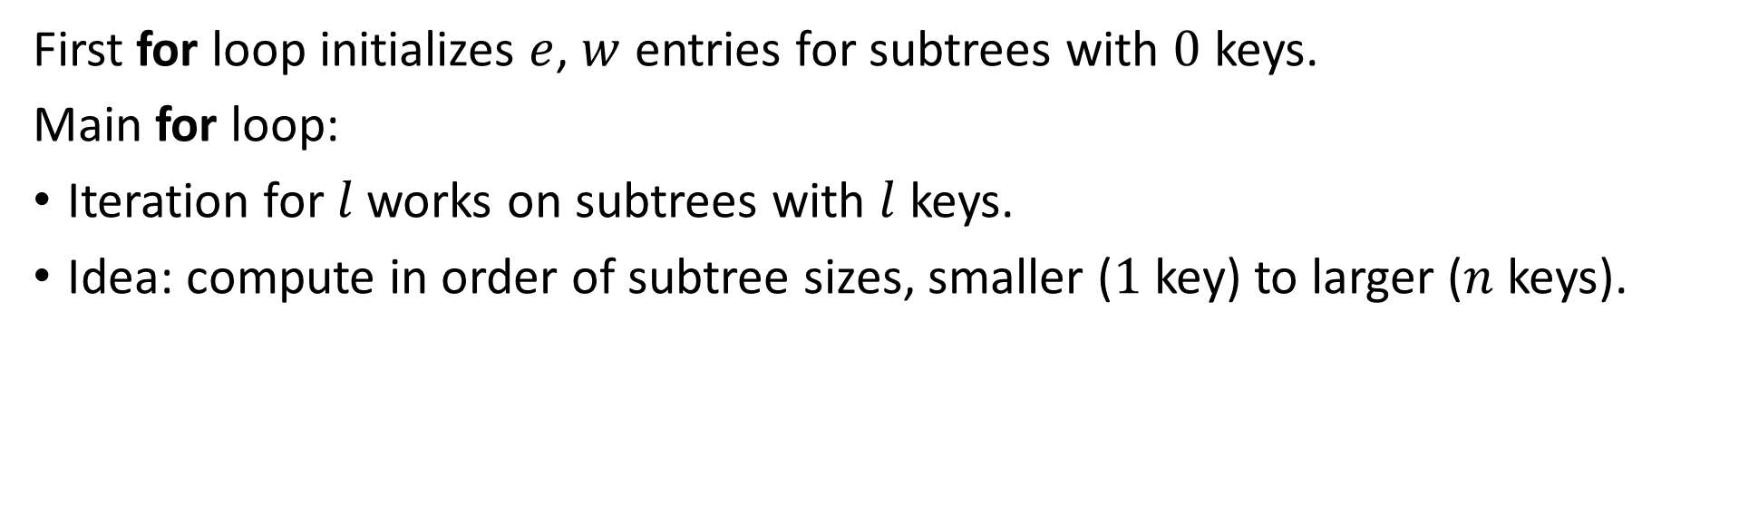
First for loop initializes $e$, $w$ entries for subtrees with $0$ keys.
Main for loop:
Iteration for $l$ works on subtrees with $l$ keys.
Idea: compute in order of subtree sizes, smaller ($1$ key) to larger ($n$ keys).

Slide 17
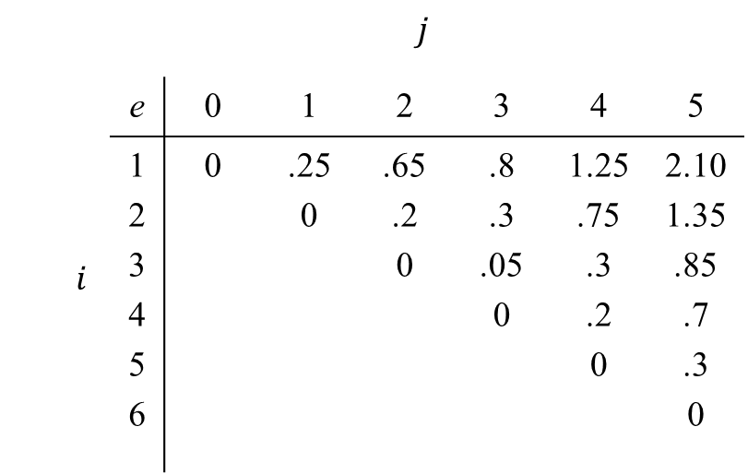
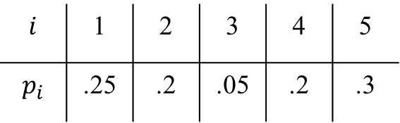
For example at beginning:
$i$ | $$j$$
 | e | 0 | 1 | 2 | 3 | 4 | 5
 | 1 2 3 4 5 6 | 0 | .25 0 | .65 .2 0 | .8 .3 .05 0 | 1.25 .75 .3 .2 0 | 2.10 1.35 .85 .7 .3 0
$$i$$ | 1 | 2 | 3 | 4 | 5
$$p_{i}$$ | .25 | .2 | .05 | .2 | .3

Slide 18
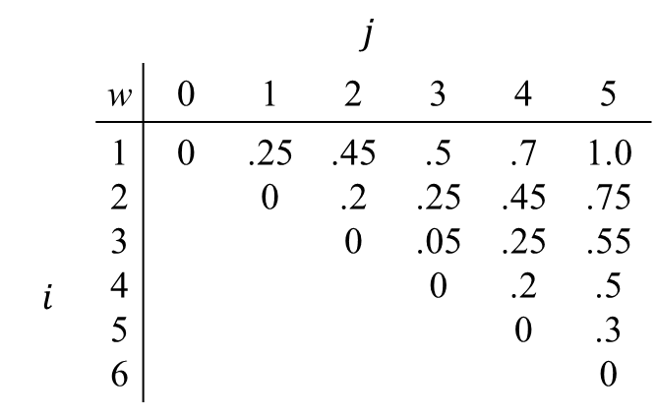
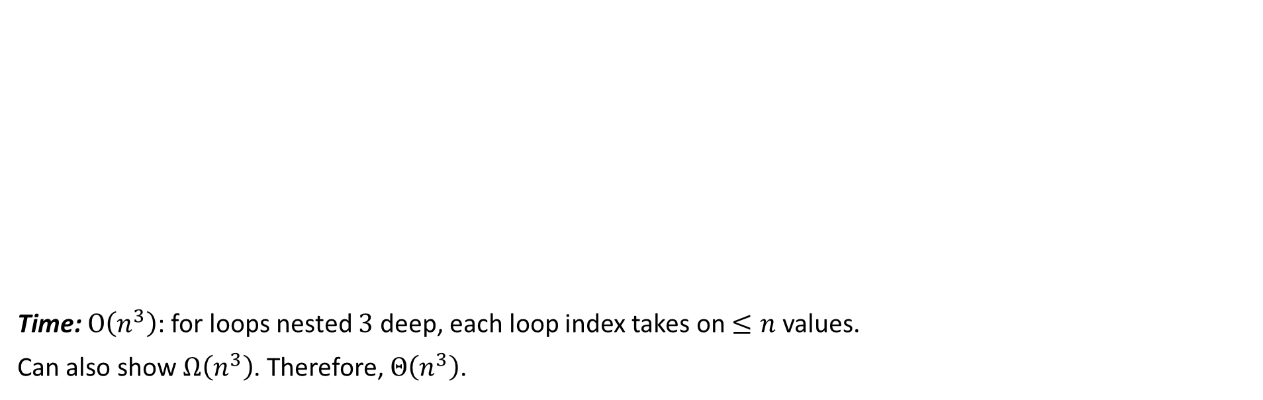
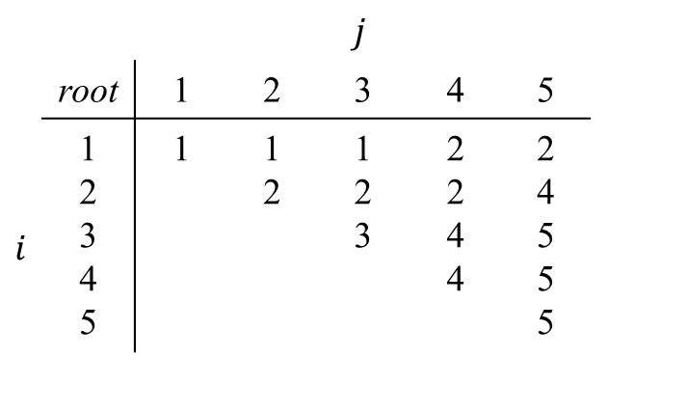
$i$ | $$j$$
 | w | 0 | 1 | 2 | 3 | 4 | 5
 | 1 2 3 4 5 6 | 0 | .25 0 | .45 .2 0 | .5 .25 .05 0 | .7 .45 .25 .2 0 | 1.0 .75 .55 .5 .3 0
$i$ | $$j$$
 | root | 1 | 2 | 3 | 4 | 5
 | 1 2 3 4 5 | 1 | 1 2 | 1 2 3 | 2 2 4 4 | 2 4 5 5 5
Time: $O\left(n^{3}\right)$: for loops nested $3$ deep, each loop index takes on $≤n$ values.
Can also show $Ω\left(n^{3}\right)$. Therefore, $Θ\left(n^{3}\right)$.

Slide 20
Longest common subsequence

Slide 21
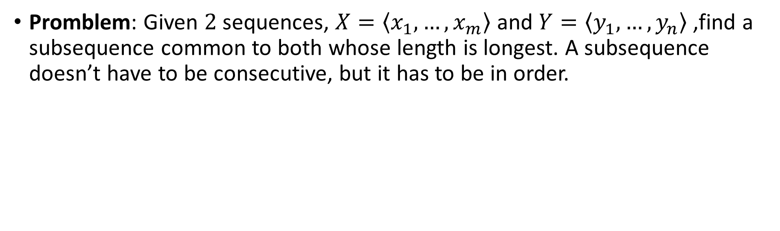
Longest common subsequence
Promblem: Given $2$ sequences, $X=\left\langle x_{1},…,x_{m}\right\rangle$ and $Y=\left\langle y_{1},…,y_{n}\right\rangle$ ,find a subsequence common to both whose length is longest. A subsequence doesn’t have to be consecutive, but it has to be in order.

Slide 22
Examples: [The examples are of different types of trees.]
s p r i n g t i m e
h o r s e b a c k
p i o n e e r
s n o w f l a k e
m a e l s t r o m
h e r o i c a l l y
b e c a l m
s c h o l a r l y

Slide 23
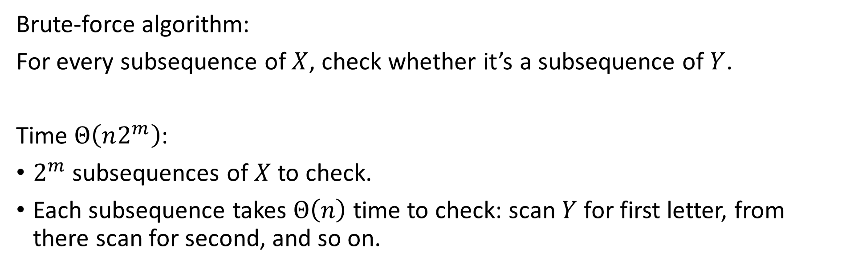
Brute-force algorithm:
For every subsequence of $X$, check whether it’s a subsequence of $Y$.
Time $Θ\left(n2^{m}\right)$:
$2^{m}$ subsequences of $X$ to check.
Each subsequence takes $Θ\left(n\right)$ time to check: scan $Y$ for first letter, from there scan for second, and so on.

Slide 24
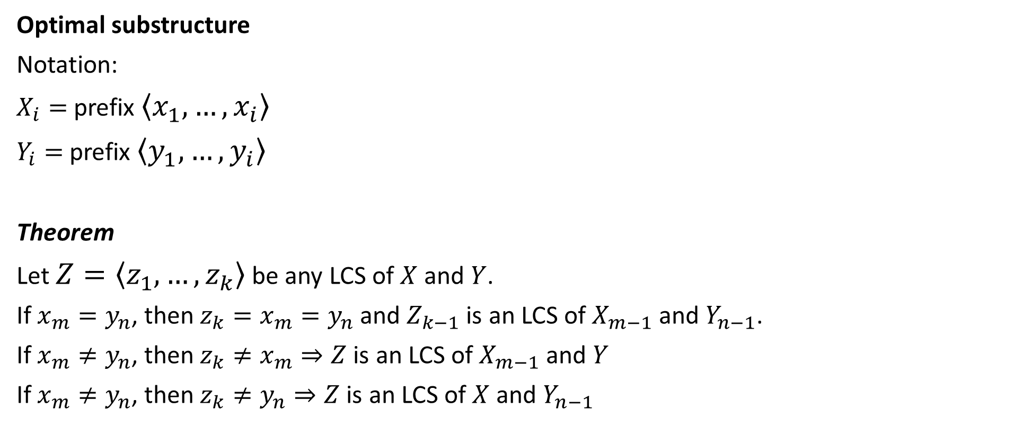
Optimal substructure
Notation:
$X_{i}=$ prefix $\left\langle x_{1},…,x_{i}\right\rangle$
$Y_{i}=$prefix $\left\langle y_{1},…,y_{i}\right\rangle$
Theorem
Let $Z=\left\langle z_{1},…,z_{k}\right\rangle$ be any LCS of $X$ and $Y$.
If $x_{m}=y_{n}$, then $z_{k}=x_{m}=y_{n}$ and $Z_{k−1}$ is an LCS of $X_{m−1}$ and $Y_{n−1}$.
If $x_{m}≠y_{n}$, then $z_{k}≠x_{m}⇒Z$ is an LCS of $X_{m−1}$ and $Y$
If $x_{m}≠y_{n}$, then $z_{k}≠y_{n}⇒Z$ is an LCS of $X$ and $Y_{n−1}$

Slide 25
If x_{m} = y_{n}, then z_{k} = x_{m} = y_{n}
If x_{m} ≠ y_{n}, then z_{k} ≠ x_{m}
X
X_{m–1} | x_{m}
X
X_{m–1}
X_{m–2} | x_{m–1} | x_{m}
Y
Y_{n–1} | y_{n}
Y
Y_{n–1} | y_{n}
Z
Z_{k–1} | z_{k}
Z
Z_{k–1} | z_{k}
If x_{m} ≠ y_{n}, then z_{k} ≠ y_{n}
X
X_{m–1} | x_{m}
Y
Y_{n–2} | y_{n–1} | y_{n}
Y_{n–1}
Z
Z_{k–1} | z_{k}

Slide 26
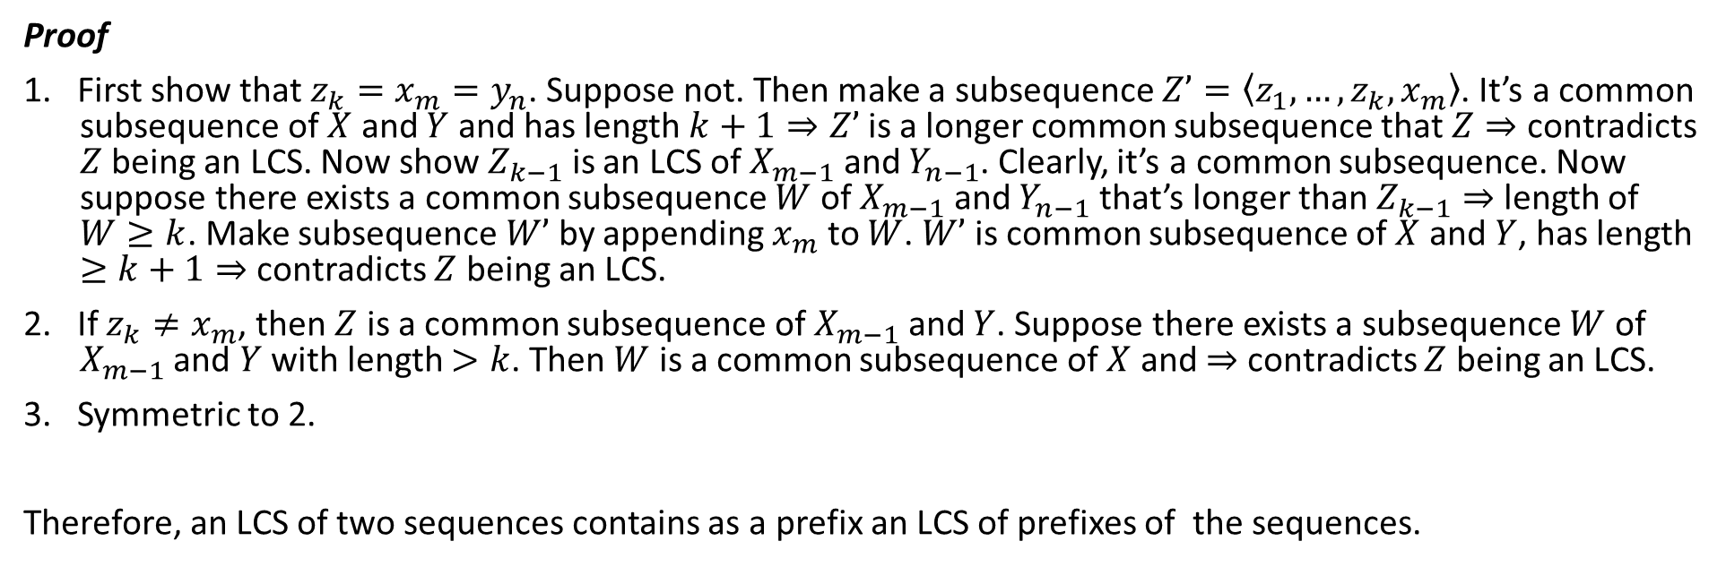
Proof
1. First show that $z_{k}=x_{m}=y_{n}$. Suppose not. Then make a subsequence $Z’=\left\langle z_{1},…,z_{k},x_{m}\right\rangle$. It’s a common subsequence of $X$ and $Y$ and has length $k+1⇒Z’$ is a longer common subsequence that $Z⇒$ contradicts $Z$ being an LCS. Now show $Z_{k−1}$ is an LCS of $X_{m−1}$ and $Y_{n−1}$. Clearly, it’s a common subsequence. Now suppose there exists a common subsequence $W$ of $X_{m−1}$ and $Y_{n−1}$ that’s longer than $Z_{k−1}⇒$ length of $W≥k$. Make subsequence $W’$ by appending $x_{m}$ to $W$. $W’$ is common subsequence of $X$ and $Y$, has length $≥k+1⇒$ contradicts $Z$ being an LCS.
2. If $z_{k}≠x_{m}$, then $Z$ is a common subsequence of $X_{m−1}$ and $Y$. Suppose there exists a subsequence $W$ of $X_{m−1}$ and $Y$ with length $>k$. Then $W$ is a common subsequence of $X$ and $⇒$ contradicts $Z$ being an LCS.
3. Symmetric to 2.
Therefore, an LCS of two sequences contains as a prefix an LCS of prefixes of the sequences.

Slide 27
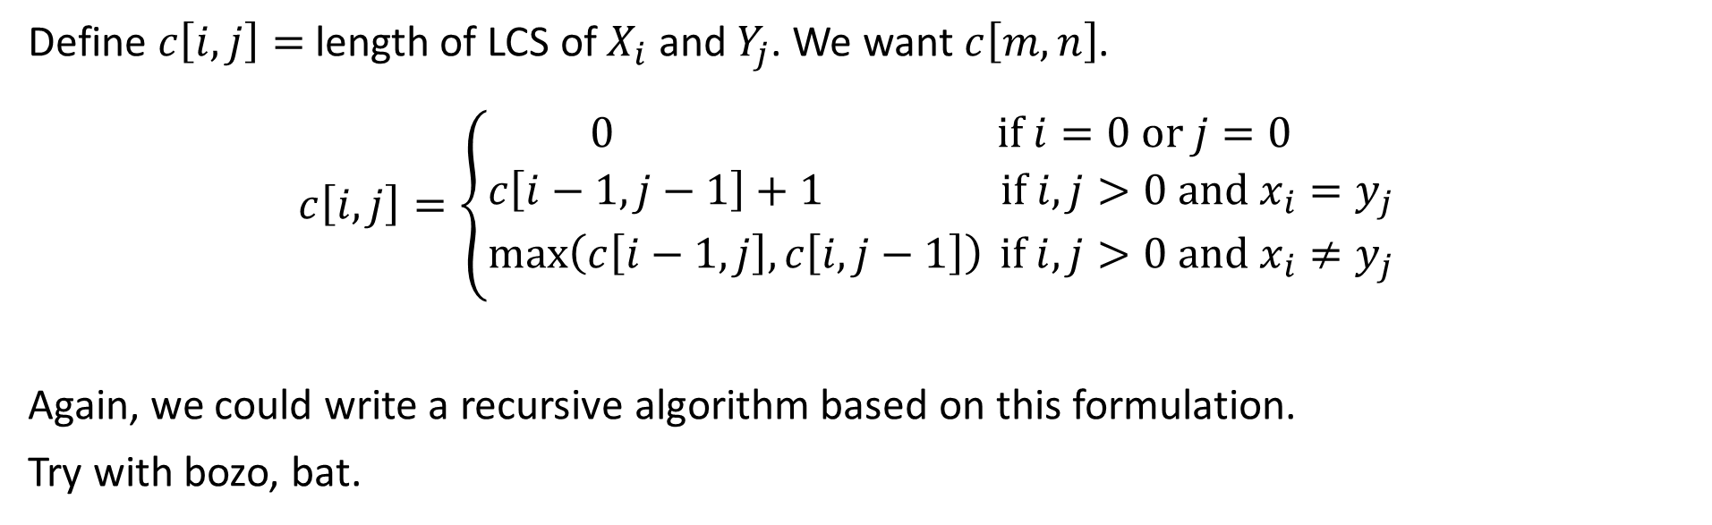
Recursive formulation
Define $c\left[i, j\right]=$ length of LCS of $X_{i}$ and $Y_{j}$. We want $c\left[m, n\right]$. $$c\left[i, j\right]=\left\{\begin{aligned}0 if i=0 or j=0 \\ c\left[i−1, j−1\right]+1 if i,j>0 and x_{i}=y_{j} \\ \max_{}\left(c\left[i−1, j\right],c\left[i, j−1\right]\right) if i,j>0 and x_{i}≠y_{j}\end{aligned}\right.$$
Again, we could write a recursive algorithm based on this formulation.
Try with bozo, bat.

Slide 28
4,3
3,3
4,2
Lots of repeated subproblems
Instead of recomputing, store in a table.
2,3
3,2
3,2
4,1
1,3
2,2
2,2
3,1
2,2
3,1
3,1
4,0
0,3
1,2
1,2
2,1
1,2
2,1
2,1
3,0

Slide 29
Compute length of optimal solution

Slide 30

Initial call is PRINT-LCS($b$, $X$, $m$, $n$).
$b\left[i, j\right]$ points to table entry whose subproblem we used in solving LCS of $X_{i}$ and $Y_{j}$.
When $b\left[i, j\right]=↖$, we have extended LCS by one character. So longest common subsequence = entries with $↖$ in them.

Slide 31
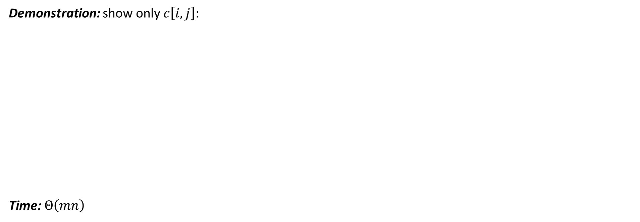
 |  | a | m | p | u | t | a | t | i | o | n
 | 0 | 0 | 0 | 0 | 0 | 0 | 0 | 0 | 0 | 0 | 0
s | 0 | 0 | 0 | 0 | 0 | 0 | 0 | 0 | 0 | 0 | 0
p | 0 | 0 | 0 |  | 1 | 1 | 1 | 1 | 1 | 1 | 1
a | 0 | 1 | 1 | 1 | 1 | 1 |  | 2 | 2 | 2 | 2
n | 0 | 1 | 1 | 1 | 1 | 1 | 2 | 2 | 2 | 2 | 3
k | 0 | 1 | 1 | 1 | 1 | 1 | 2 | 2 | 2 | 2 | 3
i | 0 | 1 | 1 | 1 | 1 | 1 | 2 | 2 |  | 3 | 3
n | 0 | 1 | 1 | 1 | 1 | 1 | 2 | 2 | 3 | 3
g | 0 | 1 | 1 | 1 | 1 | 1 | 2 | 2 | 3 | 3 | 4
 |  |  |  | p |  |  | a |  | i |  | n
Demonstration: show only $c\left[i, j\right]$:
Time: $Θ\left(mn\right)$
1
2
3
4

Slide 32
Elements of dynamic programming

Slide 33
Elements of dynamic programming
Mentioned already:
optimal substructure
overlapping subproblems

Slide 34
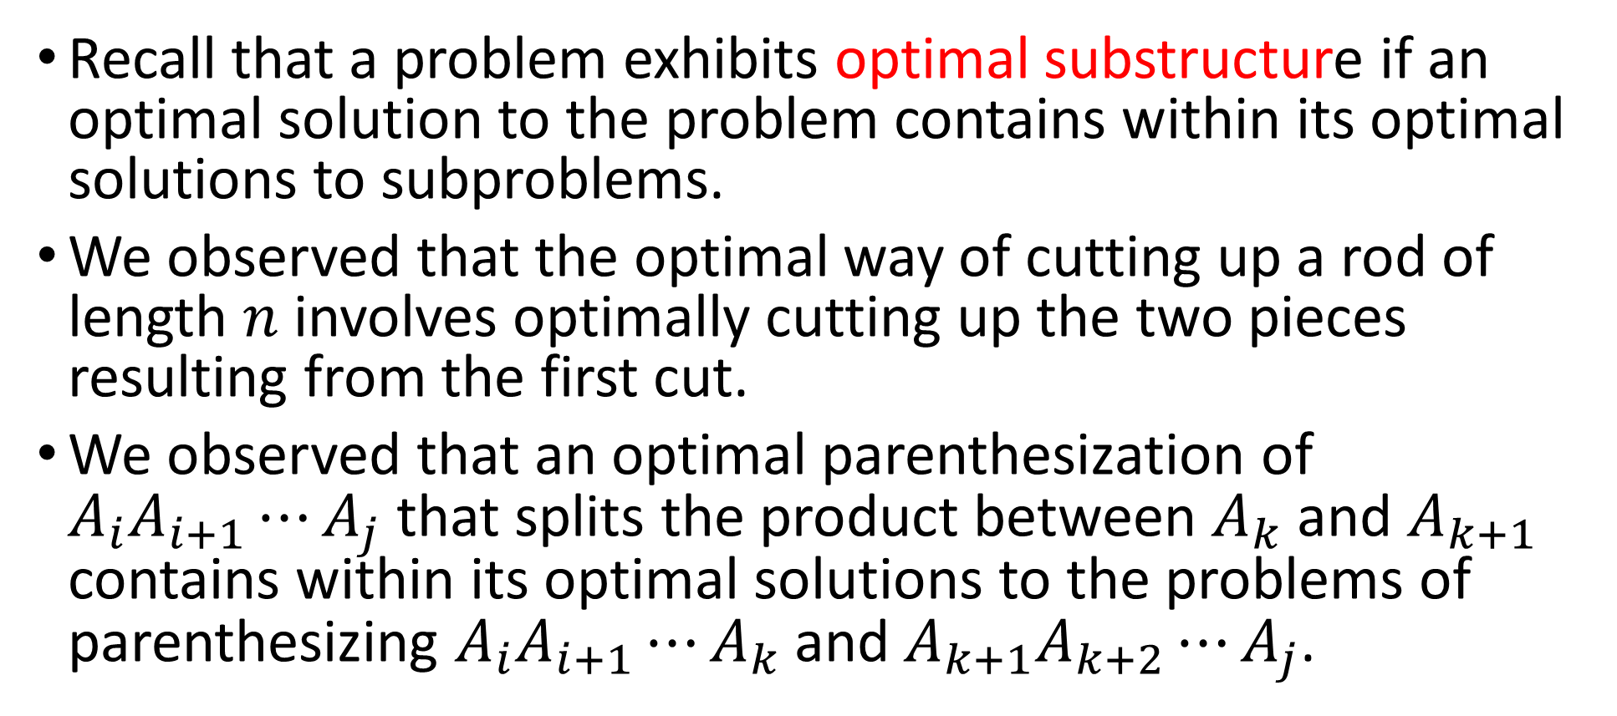
Optimal substructure
Recall that a problem exhibits optimal substructure if an optimal solution to the problem contains within its optimal solutions to subproblems.
We observed that the optimal way of cutting up a rod of length $n$ involves optimally cutting up the two pieces resulting from the first cut.
We observed that an optimal parenthesization of $A_{i}A_{i+1}⋯A_{j}$ that splits the product between $A_{k}$ and $A_{k+1}$ contains within its optimal solutions to the problems of parenthesizing $A_{i}A_{i+1}⋯A_{k}$ and $A_{k+1}A_{k+2}⋯A_{j}$.

Slide 35
Optimal substructure
You will find yourself following a common pattern in discovering optimal substructure:
You show that a solution to the problem consists of making a choice, such as choosing an initial cut in a rod.
You suppose that for a given problem, you are given the choice that leads to an optimal solution.
Given this choice, you determine which subproblems ensue and how to best characterize the resulting space of subproblems.
You show that the solutions to the subproblems used within an optimal solution to the problem must themselves be optimal by using a “cut-and-paste” technique.

Slide 36
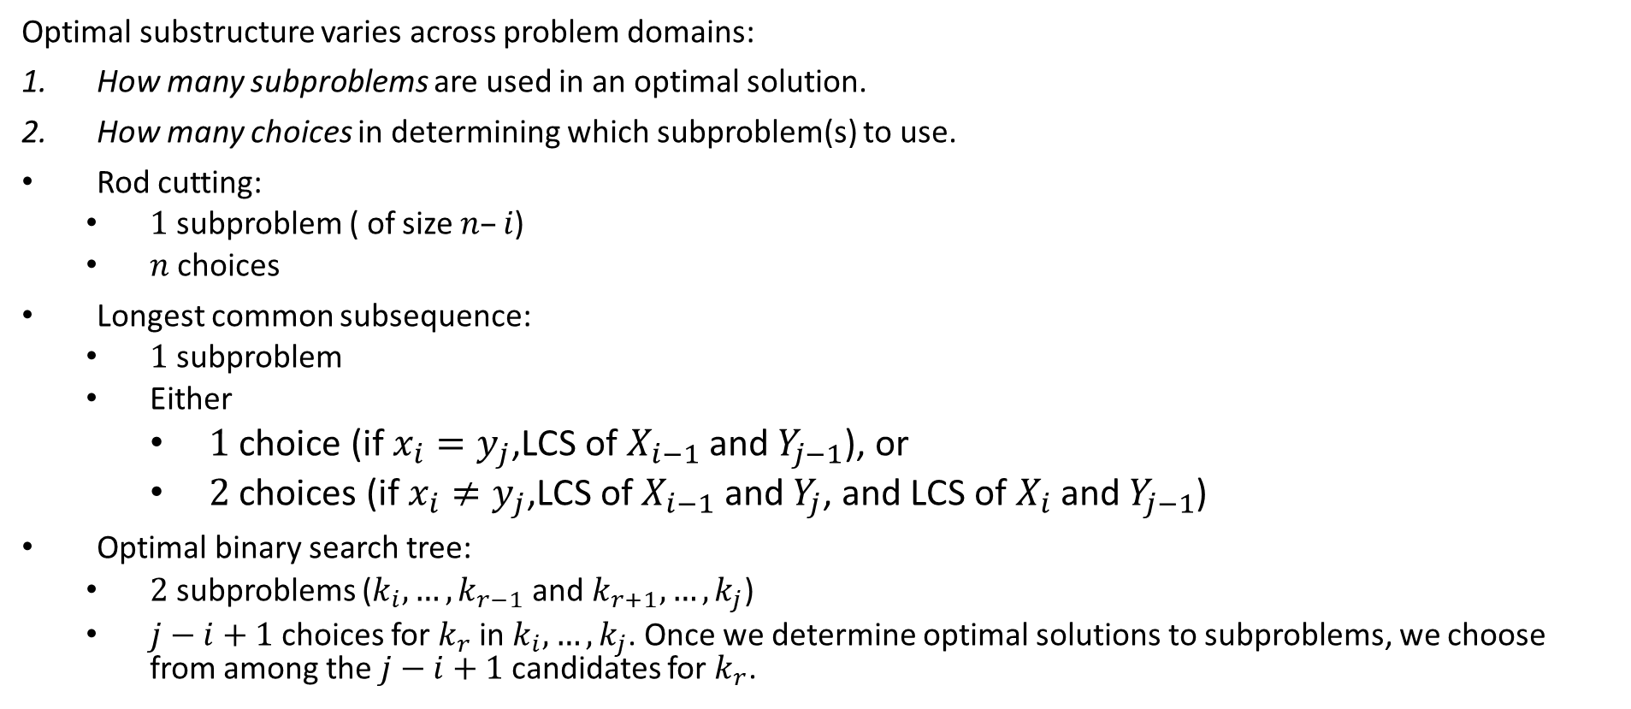
Optimal substructure varies across problem domains:
How many subproblems are used in an optimal solution.
How many choices in determining which subproblem(s) to use.
Rod cutting:
$1$ subproblem ( of size $n–i$)
$n$ choices
Longest common subsequence:
$1$ subproblem
Either
$1$ choice (if $x_{i}=y_{j}$,LCS of $X_{i−1}$ and $Y_{j−1}$), or
$2$ choices (if $x_{i}≠y_{j}$,LCS of $X_{i−1}$ and $Y_{j}$, and LCS of $X_{i}$ and $Y_{j−1}$)
Optimal binary search tree:
$2$ subproblems ($k_{i}, …,k_{r−1}$ and $k_{r+1}, …,k_{j}$)
$j−i+1$ choices for $k_{r}$ in $k_{i}, …,k_{j}$. Once we determine optimal solutions to subproblems, we choose from among the $j−i+1$ candidates for $k_{r}$.

Slide 37
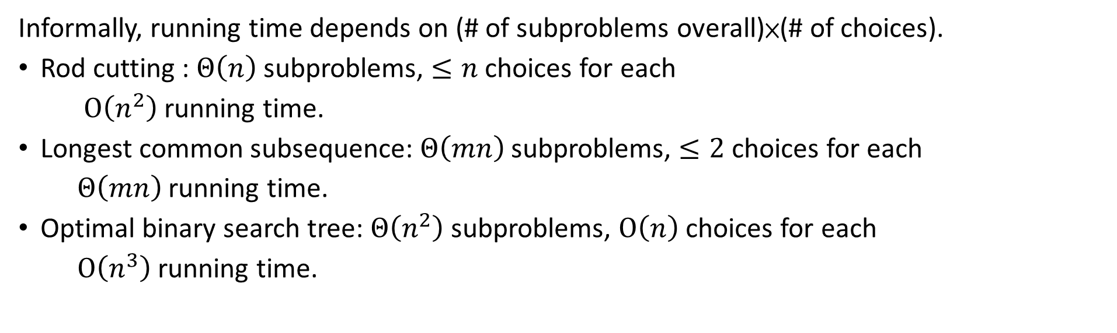
Informally, running time depends on (# of subproblems overall)×(# of choices).
Rod cutting : $Θ\left(n\right)$ subproblems, $≤n$ choices for each
$O\left(n^{2}\right)$ running time.
Longest common subsequence: $Θ\left(mn\right)$ subproblems, $≤2$ choices for each
$Θ\left(mn\right)$running time.
Optimal binary search tree: $Θ\left(n^{2}\right)$subproblems, $O\left(n\right)$ choices for each
$O\left(n^{3}\right)$running time.

Slide 38
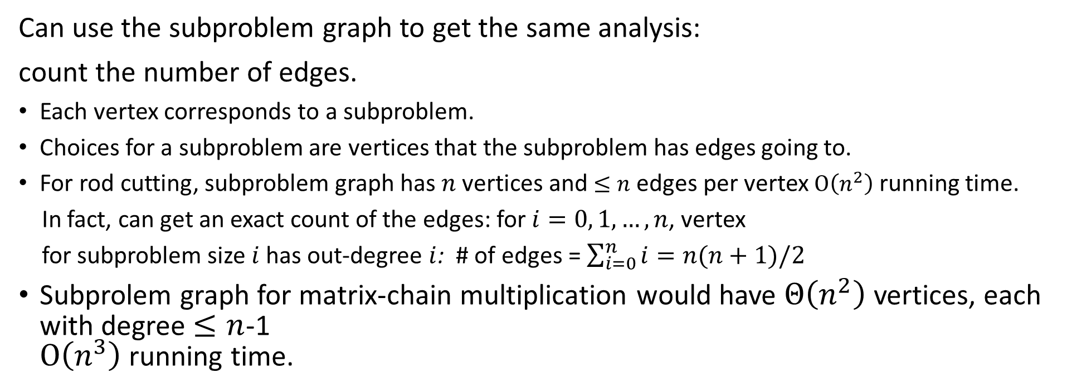
Can use the subproblem graph to get the same analysis:
count the number of edges.
Each vertex corresponds to a subproblem.
Choices for a subproblem are vertices that the subproblem has edges going to.
For rod cutting, subproblem graph has $n$ vertices and $≤n$ edges per vertex $O\left(n^{2}\right)$ running time.
In fact, can get an exact count of the edges: for $i=0, 1, …,n$, vertex
for subproblem size $i$ has out-degree $i$: # of edges = $\sum_{i=0}^{n}{i=n(n+1)/2}$
Subprolem graph for matrix-chain multiplication would have $Θ\left(n^{2}\right)$vertices, each with degree $≤n$-1 $O\left(n^{3}\right)$ running time.

Slide 39
Dynamic programming uses optimal substructure bottom up.
First find optimal solutions to subproblems.
Then choose which to use in optimal solution to the problem.
When we look at greedy algorithms, we’ll see that they work top down:
First make a choice that looks best.
Then solve the resulting subproblem.

Slide 40
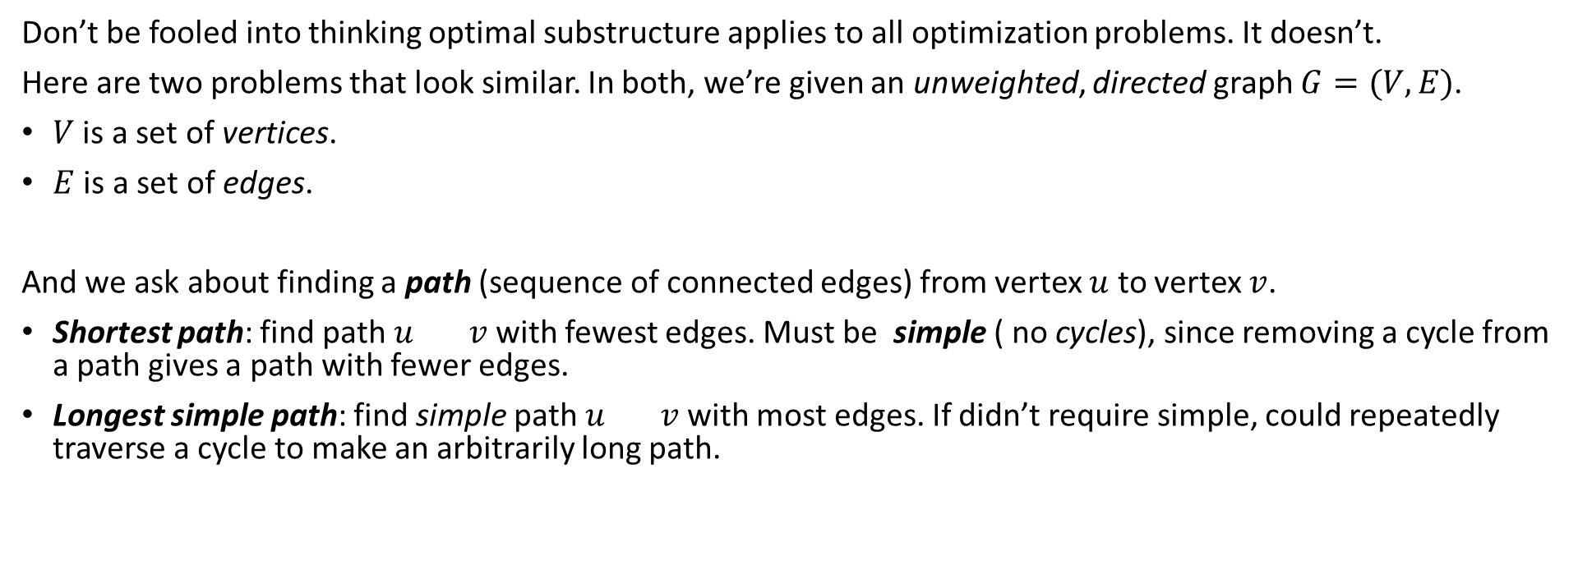
Don’t be fooled into thinking optimal substructure applies to all optimization problems. It doesn’t.
Here are two problems that look similar. In both, we’re given an unweighted, directed graph $G=(V, E)$.
$V$ is a set of vertices.
$E$ is a set of edges.
And we ask about finding a path (sequence of connected edges) from vertex $u$ to vertex $v$.
Shortest path: find path $u$ $v$ with fewest edges. Must be simple ( no cycles), since removing a cycle from a path gives a path with fewer edges.
Longest simple path: find simple path $u$ $v$ with most edges. If didn’t require simple, could repeatedly traverse a cycle to make an arbitrarily long path.

Slide 41
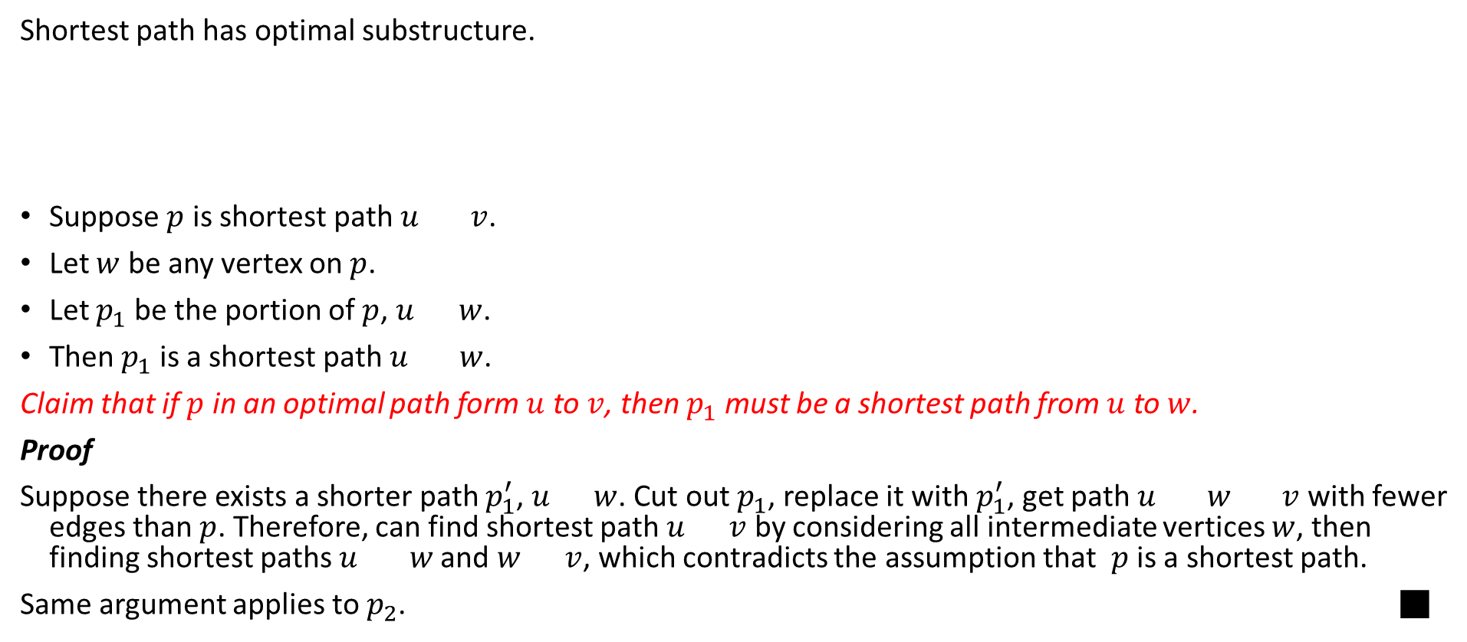
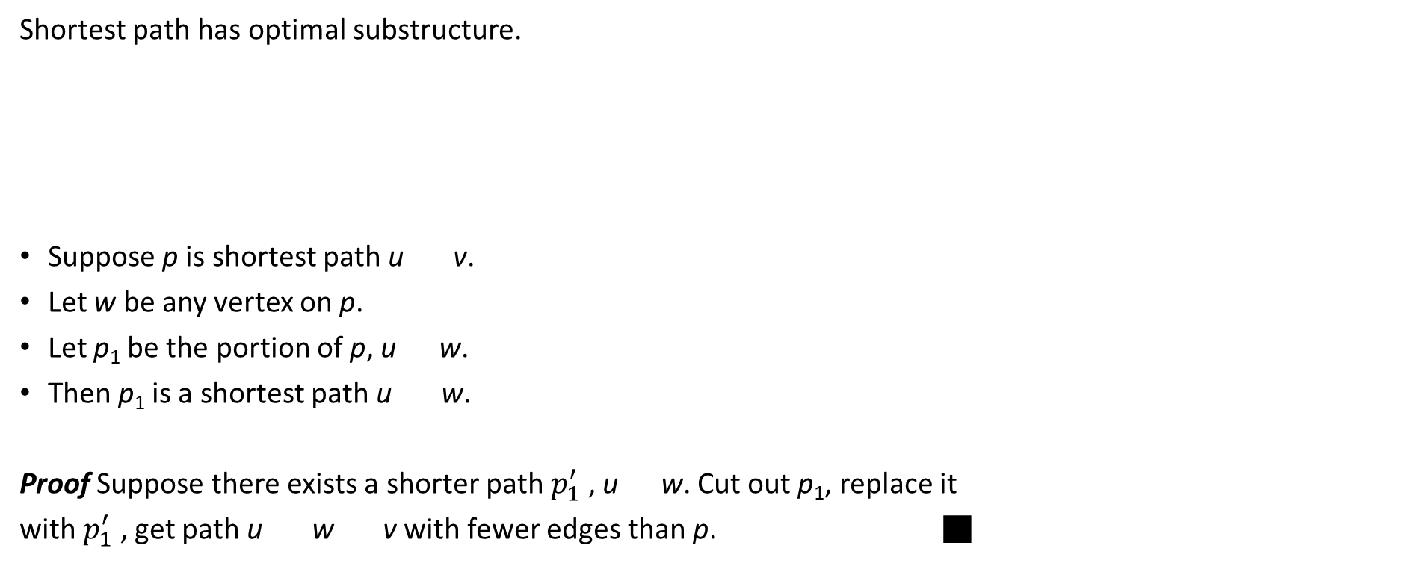
Shortest path has optimal substructure.
Suppose $p$ is shortest path $u$ $v$.
Let $w$ be any vertex on $p$.
Let $p_{1}$ be the portion of $p$, $u$ $w$.
Then $p_{1}$ is a shortest path $u$ $w$.
Claim that if $p$ in an optimal path form $u$ to $v$, then $p_{1}$ must be a shortest path from $u$ to $w$.
Proof
Suppose there exists a shorter path $p_{1}^{′}$, $u$ $w$. Cut out $p_{1}$, replace it with $p_{1}^{′}$, get path $u$ $w$ $v$ with fewer edges than $p$. Therefore, can find shortest path $u$ $v$ by considering all intermediate vertices $w$, then finding shortest paths $u$ $w$ and $w$ $v$, which contradicts the assumption that $p$ is a shortest path.
Same argument applies to $p_{2}$. ■
p₁
p₂
u
w
v
p

Slide 42

Does longest path have optimal substructure?
It seems like it should.
It does not.
Consider $q→r→t=$ longest path $q$ $t$. Are its subpaths longest paths?
No!
q
r
s
t

Slide 43
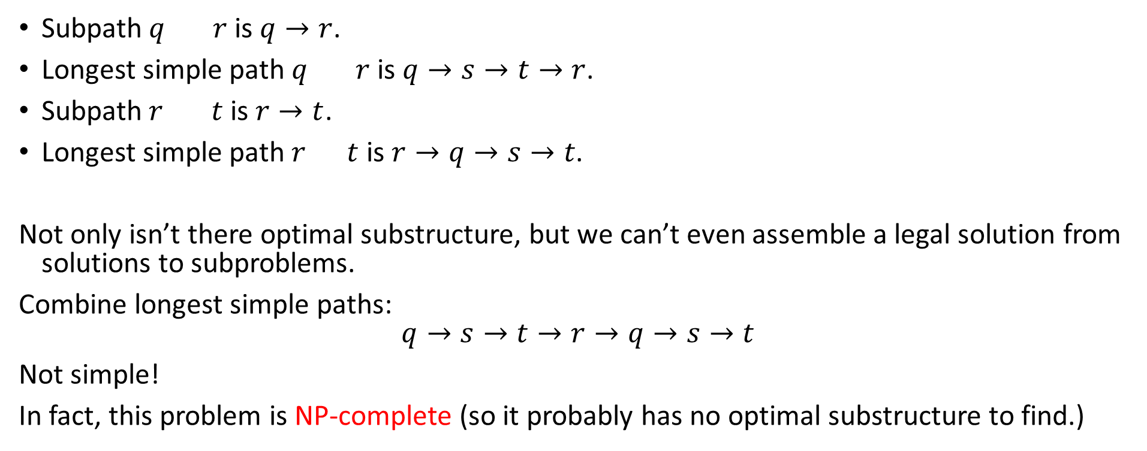
Subpath $q$ $r$ is $q→r$.
Longest simple path $q$ $r$ is $q→s→t→r$.
Subpath $r$ $t$ is $r→t$.
Longest simple path $r$ $t$ is $r→q→s→t$.
Not only isn’t there optimal substructure, but we can’t even assemble a legal solution from solutions to subproblems.
Combine longest simple paths:
$$q→s→t→r→q→s→t$$
Not simple!
In fact, this problem is NP-complete (so it probably has no optimal substructure to find.)

Slide 44
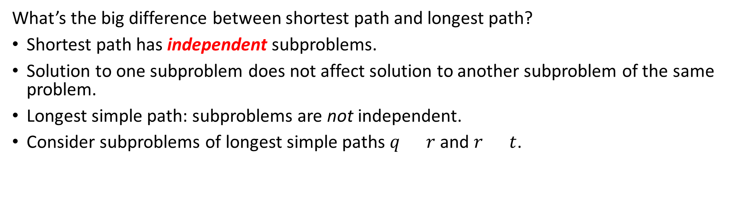
What’s the big difference between shortest path and longest path?
Shortest path has independent subproblems.
Solution to one subproblem does not affect solution to another subproblem of the same problem.
Longest simple path: subproblems are not independent.
Consider subproblems of longest simple paths $q$ $r$ and $r$ $t$.

Slide 45
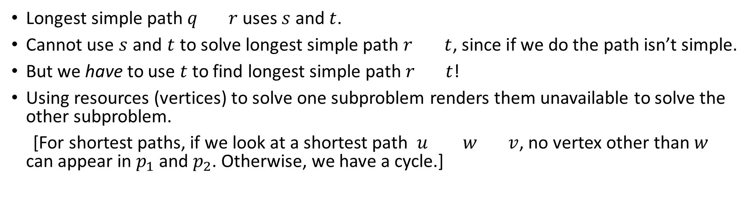
Longest simple path $q$ $r$ uses $s$ and $t$.
Cannot use $s$ and $t$ to solve longest simple path $r$ $t$, since if we do the path isn’t simple.
But we have to use $t$ to find longest simple path $r$ $t$!
Using resources (vertices) to solve one subproblem renders them unavailable to solve the other subproblem.
[For shortest paths, if we look at a shortest path $u$ $w$ $v$, no vertex other than $w$ can appear in $p_{1}$ and $p_{2}$. Otherwise, we have a cycle.]

Slide 46
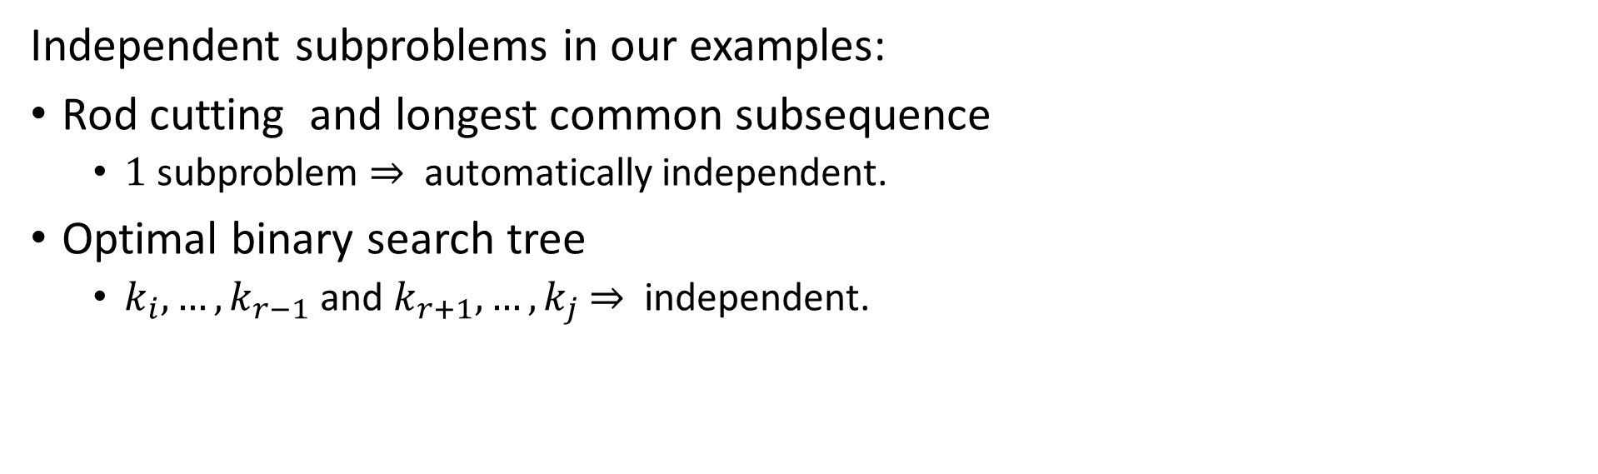
Independent subproblems in our examples:
Rod cutting and longest common subsequence
$1$ subproblem $⇒$ automatically independent.
Optimal binary search tree
$k_{i}, …,k_{r−1}$ and $k_{r+1}, …,k_{j}$ $⇒$ independent.

Slide 47
Overlapping subproblems
These occur when a recursive algorithm revisits the same problem over and over. Good divide-and-conquer algorithms usually generate a new problem at each stage of recursion.
Example: merge sort
1..8
1..4
5..8
1..2
3..4
5..6
7..8
3..3
4..4
5..5
6..6
7..7
8..8
1..1
2..2

Slide 48
Alternative approach: memoization
“Store, don’t recompute.”
Make a table indexed by subproblem.
When solving a subproblem:
Lookup in table.
If answer is there, use it.
Else, compute answer, then store it.
In dynamic programming, we go one step further. We determine in what order we’d want to access the table, and fill it in that way.

