Slide 1




Jheng-Huang Hong
Department of Computer Science and Information Engineering
National Cheng Kung University
Tainan, Taiwan
NCKU CSIE Programming Contest Training Course
made by ai281918

Slide 2
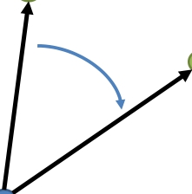
Line intersection
• The vector V2 is clockwise/counterclockwise from V1 ?
1
V1 2
V2
0
made by ai281918

Slide 3
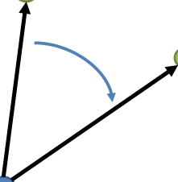
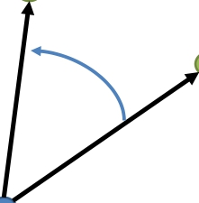
Line intersection
• Cross Product :
1 × 2 = det
1
1
2
2
= 1 2 − 2 1 = 1
2
1
V1
2
V2
2
1
V2
1 × 2 < 0
V1
1 × 2 > 0
0
0
made by ai281918

Slide 4
Line intersection
• Cross Product :
1 × 2 = ( 1 − 0) × ( 2 − 0) = ( 1 − 0)( 2 − 0) − ( 2 − 0)( 1 − 0)
1
V1
2
V2
2
1
V2
1 × 2 < 0
V1
1 × 2 > 0
0
0
made by ai281918

Slide 5

Line intersection
• Cross Product :
1(2, 4)
V1 2(4, 2)
V2
0(0, 0)
1 × 2 = ( 1 − 0) × ( 2 − 0) = (2 − 0)(2 − 0) − (4 − 0)(4 − 0) = -12
made by ai281918

Slide 6
Line intersection
• Line intersection problem
3 2
4
1
made by ai281918

Slide 7
Line intersection
• Two situation
3 2 3
2
4 4
1 1
made by ai281918

Slide 8
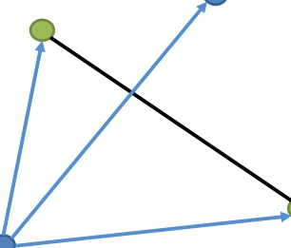
Line intersection
• Cross Product :
0
1
2
0 × 1 ∙ 0 × 2 = ?
made by ai281918

Slide 9
Line intersection
• Cross Product :
0
1
2
0 × 1 ∙ 0 × 2 < 0
made by ai281918

Slide 10
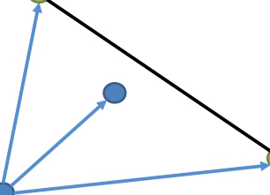
Line intersection
• Cross Product :
1
0
2
0 × 1 ∙ 0 × 2 < 0
made by ai281918

Slide 11
Line intersection
• Cross Product :
3 2
4
1
( 2 − 1) × ( 3 − 1) ∙ ( 2 − 1) × ( 4 − 1) < 0 && ( 4 − 3) × ( 1 − 3) ∙ ( 4 − 3) × ( 2 − 3) < 0
made by ai281918

Slide 12
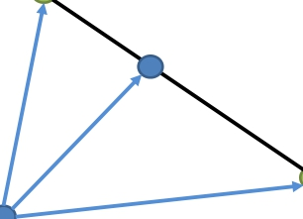
Line intersection
• Cross Product :
3
2
4
1
4 − 3) × ( 2 − 3 = 0
made by ai281918

Slide 13

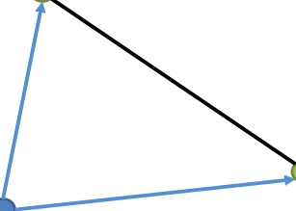
Line intersection
• Cross Product :
2
3
4
1
4 − 3) × ( 2 − 3 = 0
made by ai281918

Slide 14
Line intersection
• Cross Product :
2
3
4
1
xmin(3, 4) ≤ x2 ≤ xmax(3,4) && ymin(3, 4) ≤ y2 ≤ ymax(3,4)

Slide 15
Line intersection
• Two situation
3 2 3
2
4 4
1 1
made by ai281918

Slide 16
Practice - 1
UVa 191 - Intersection
made by ai281918

Slide 17
Convex Hull
•
中譯「凸包」或「凸殼」。在多維空間中有一群散佈各處的點，「凸包」是包覆這群點的所有外殼當中，表面積暨容積最小的一個外殼，而最小的外殼一定是凸的。
•
「凸」的定義是：圖形內任意兩點的連線不會經過圖形外部。「凸」
並不是指表面呈弧狀隆起，事實上凸包是由許多平坦表面組成的。
演算法筆記 – Convex Hull
made by ai281918

Slide 18
Convex Hull
•
Algorithm
– Brute Force
– Graham-Scan
– Andrew’s Monotone Chain
made by ai281918

Slide 19
Andrew’s Monotone Chain
• Step1 : Sort by x
1
7
5
3
0
4
2 6
made by ai281918

Slide 20
Andrew’s Monotone Chain
• Step2 : Connect points
1
7
5
3
0
4
2 6
made by ai281918

Slide 21
Andrew’s Monotone Chain
• Step2 : Connect points
1
7
5
3
0
4
2 6
made by ai281918

Slide 22
Andrew’s Monotone Chain
• Step3 : Use cross product 01× 02 < 0
1
7
5
3
0
4
2 6
made by ai281918

Slide 23
Andrew’s Monotone Chain
• Step3 : Use cross product
1
7
5
3
0
4
2 6
made by ai281918

Slide 24
Andrew’s Monotone Chain
• Step3 : Use cross product
1
7
5
3
0
4
2 6
made by ai281918

Slide 25
Andrew’s Monotone Chain
• Step3 : Use cross product
1
7
5
3
0
4
2 6
made by ai281918

Slide 26
Andrew’s Monotone Chain
• Step3 : Use cross product
1
7
5
3
0
4
2 6
made by ai281918

Slide 27
Andrew’s Monotone Chain
• Step3 : Use cross product
1
7
5
3
0
4
2 6
made by ai281918

Slide 28
Andrew’s Monotone Chain
• Step3 : Use cross product
1
7
5
3
0
4
2 6
made by ai281918

Slide 29
Andrew’s Monotone Chain
• Step3 : Use cross product
1
7
5
3
0
4
2 6
made by ai281918

Slide 30
Andrew’s Monotone Chain
• Step3 : Use cross product
1
7
5
3
0
4
2 6
made by ai281918

Slide 31
Andrew’s Monotone Chain
• Step3 : Use cross product
1
7
5
3
0
4
2 6
made by ai281918

Slide 32
Andrew’s Monotone Chain
• Step3 : Use cross product
1
7
5
3
0
4
2 6
made by ai281918

Slide 33
Andrew’s Monotone Chain
• Step3 : Use cross product
1
7
5
3
0
4
2 6
made by ai281918

Slide 34
Andrew’s Monotone Chain
• Step3 : Use cross product
1
7
5
3
0
4
2 6
made by ai281918

Slide 35
Andrew’s Monotone Chain
• Step3 : Use cross product
1
7
5
3
0
4
2 6
made by ai281918

Slide 36
Andrew’s Monotone Chain
• Step3 : Use cross product
1
7
5
3
0
4
2 6
made by ai281918

Slide 37
Andrew’s Monotone Chain
• Step3 : Use cross product
1
7
5
3
0
4
2 6
made by ai281918

Slide 38
Andrew’s Monotone Chain
• Step4 : Delete starting point
1
7
5
3
0
4
2 6
made by ai281918

Slide 39
Practice - 1
UVa 218 - Moth Eradication
made by ai281918

