Slide 1
LAB - 05
陳培殷
國立成功大學 資訊工程系

Slide 2
Outline
Video preview for HDL介紹(Parts I~IV)
Combinational circuit
Lab I-- 4-Bit Adder Subtractor
Lab II-- 8 to 3 encoder
Appendix
Notes:
HDL介紹建議到part V

Slide 3
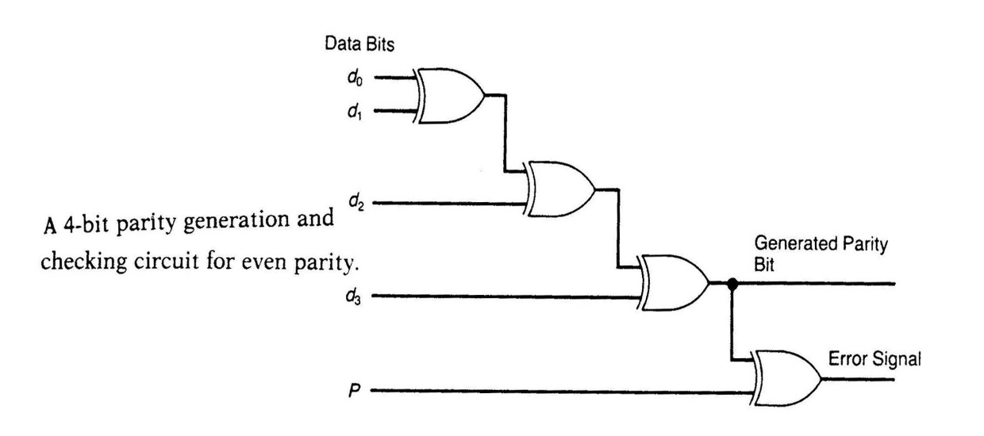
Combinational Circuit
組合電路是一種邏輯電路，它任一時刻的輸出值，僅與目前的(present)輸入值有關，而與先前的(previous)輸入值無關
在電路結構上，組合電路由各種邏輯閘組成，電路中無記憶元件與反饋線
與之相對的則是循序邏輯電路，循序邏輯電路的輸出結果與目前的輸入及先前的輸入都有關係

Slide 4
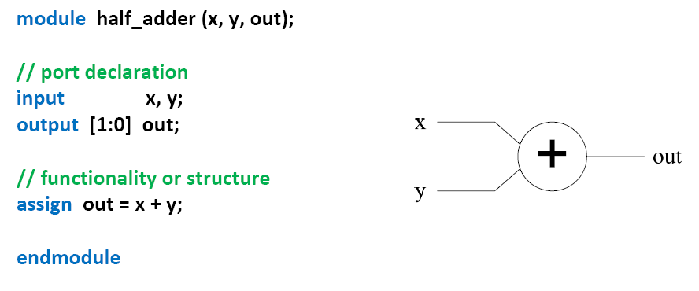

Continuous assignment
The first way to define a combinational circuit.

Slide 5
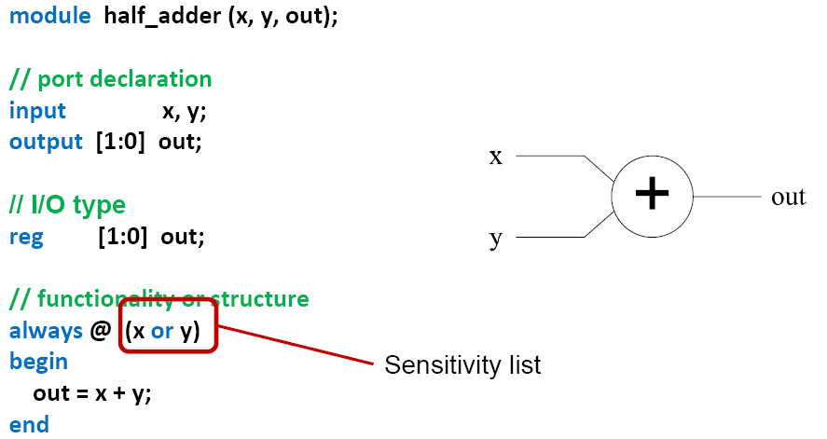
always block
The second way to define a combinational circuit.
Notes:
@(x)

Slide 6
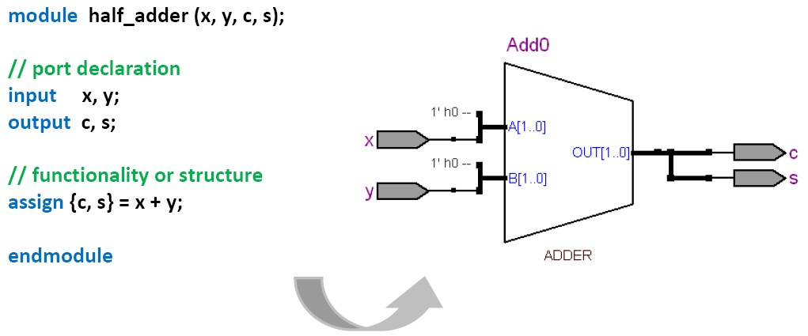
Example: half adder (1/3)
Data flow description

Slide 7
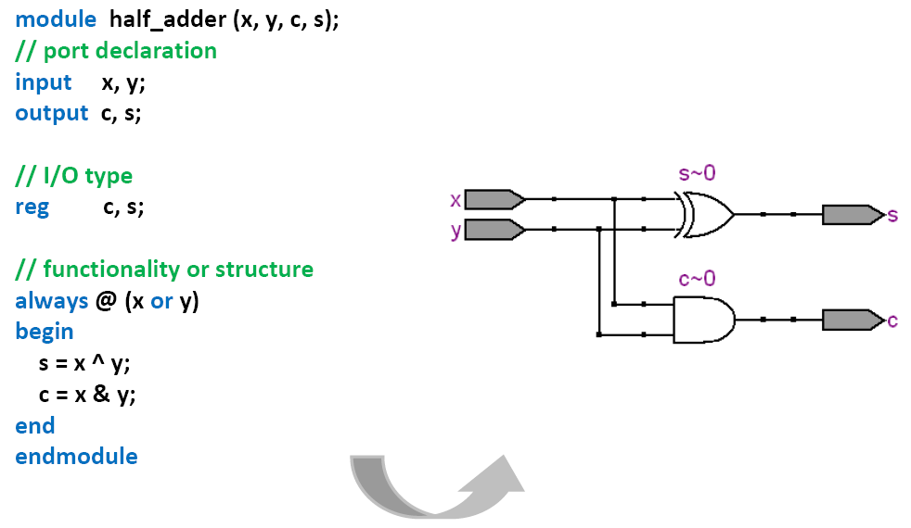
Example: half adder (2/3)

Slide 8
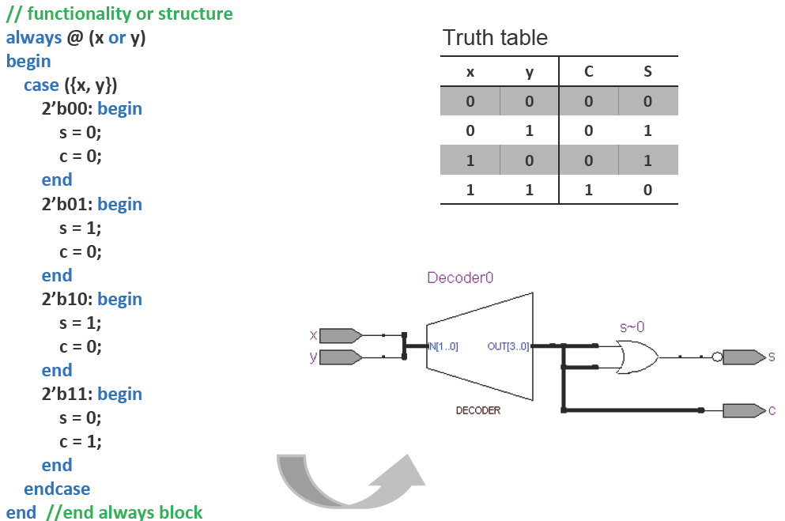
Example: half adder (3/3)

Slide 9
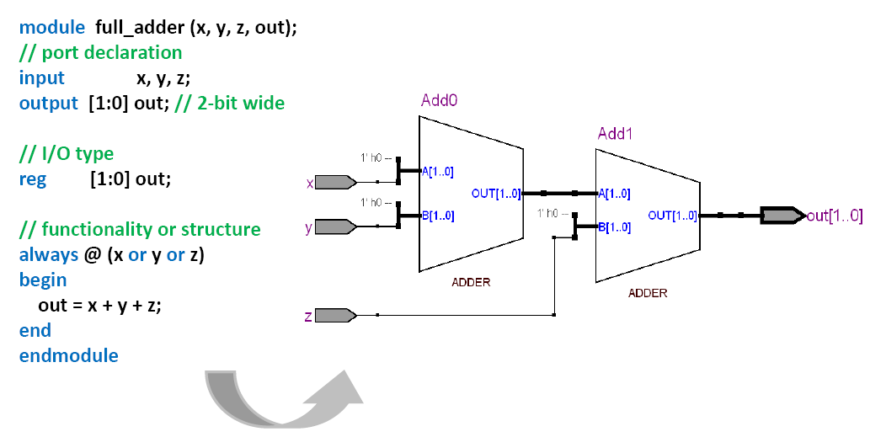
Example: full adder (1/2)

Slide 10
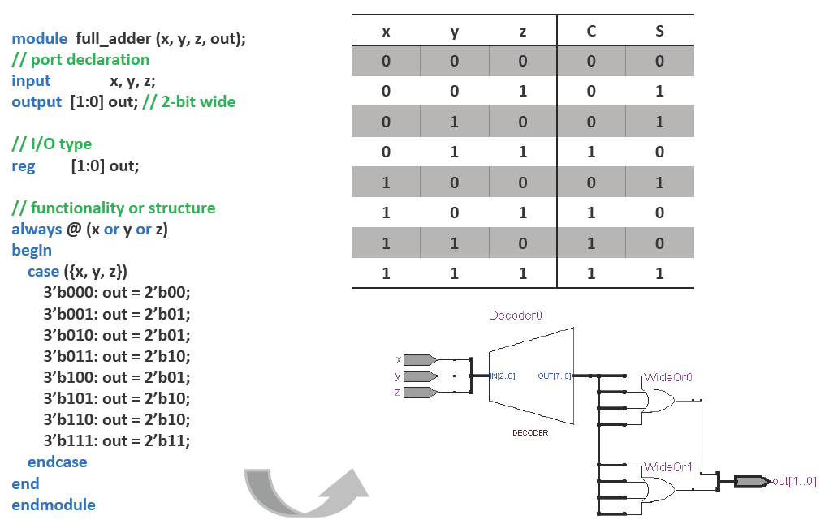
Example: full adder (2/2)

Slide 11
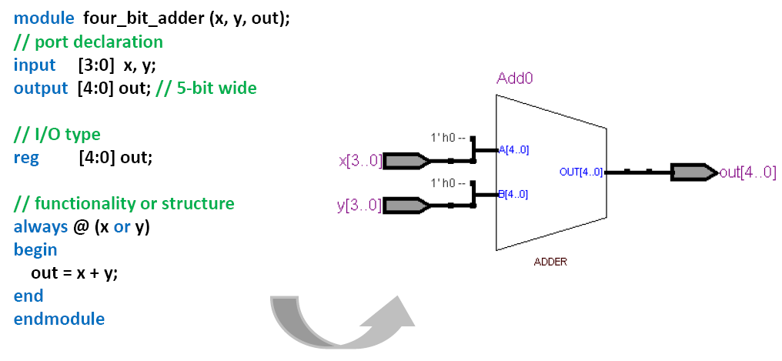
Example: 4-bit adder

Slide 12
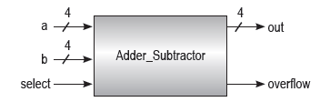
Lab I
SW0~SW3
LED0~LED3
Please design a 4-Bit Adder Subtractor.
無號數加減法器藉由選擇 (select) 訊號決定目前是做加法或減法運算：選擇線為 1 時做加法，選擇線為 0 時做減法，而溢位 (overflow) 訊號則是用來判斷加法有無進位或減法有無借位。
Reference: 1-bit Adder Subtractor
SW4~SW7
SW9
LED4
Notes:
http://www.barrywatson.se/dd/dd_adder_subtractor.html

Slide 13
Notice for Lab I
加減法器裝置模擬
select=1
加法
Ex: 9+10=19 (overflow)
9 =1001
10=1010
19(overflow) = 10011
select=0
減法
Ex: 4-7= 3 (overflow)
4=0100
7=0111
3 (overflow) = 10011

Slide 14
Lab II
Please design an 8 to 3 encoder
編碼器可以將 2^{n} 個輸入訊號轉換成 n 位元輸出訊號。假設有 m 個輸入與 n 個輸出，則稱
為 m 對 n 編碼器。
LED0~LED2
SW0~SW7
LED3
Notes:
A2 = Y7 + Y6 + Y5 + Y4
A1 = Y7 + Y6 + Y3 + Y2
A0 = Y7 + Y5 + Y3 + Y1

Slide 15
Notice
請勿命名中文資料夾
Device family 請確認與 FPGA Chip 符合 (5CEBA4F23C7)
Top module name & Project name 需要一致
確認 module … endmodule 為keyword 變成藍色字體

Slide 16
Appendix

Slide 17
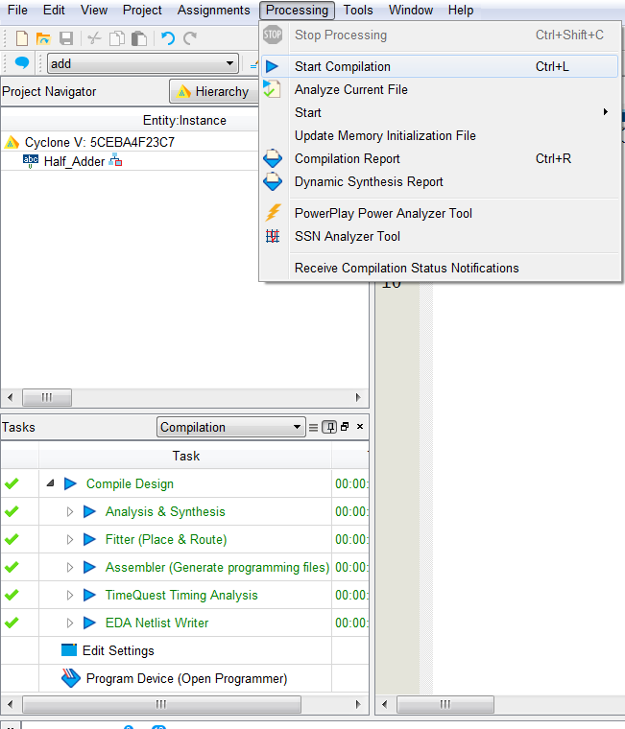
Programming DE0-CV (1/12)
Start compilation

Slide 18
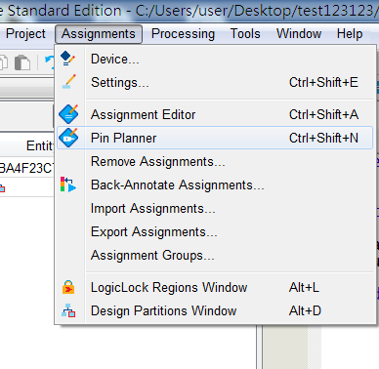
Programming DE0-CV (2/12)
Open Pin Planner

Slide 19
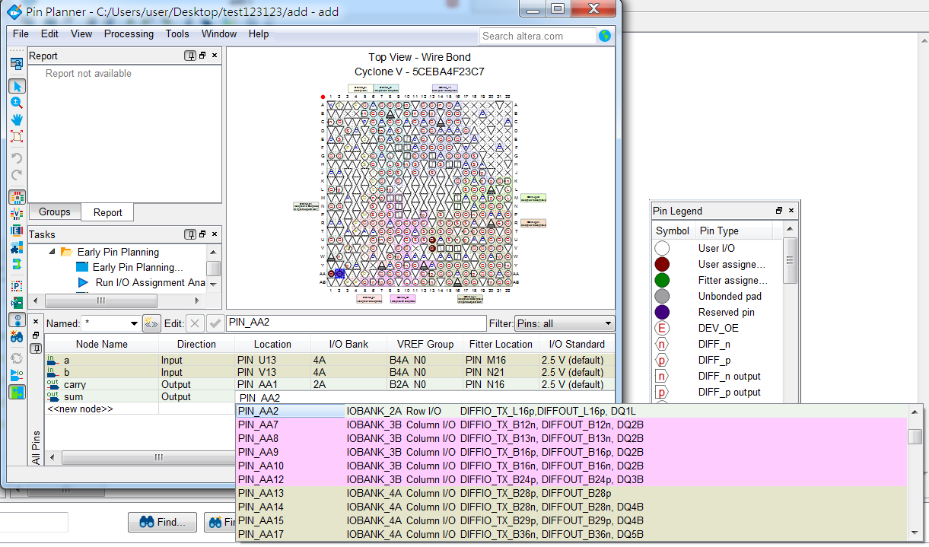
Programming DE0-CV (3/12)
Pin assignment
Double click

Slide 20
Programming DE0-CV (4/12)
Assign pin location to all inputs and outputs
Please refer to DE0_pin.xls for pin location assignment
SW0
SW1
LED1
LED0

Slide 21
Programming DE0-CV (5/12)
Start compilation

Slide 22
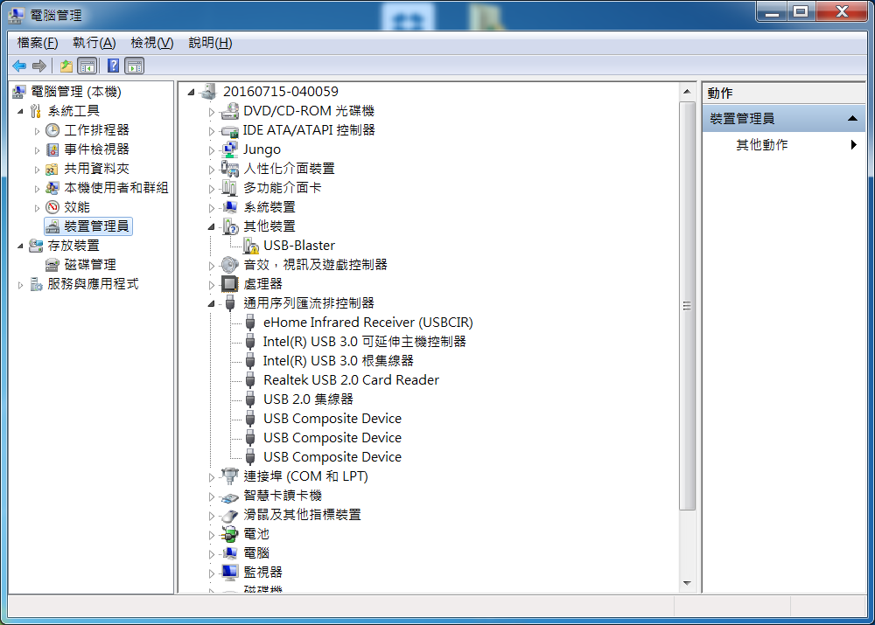
Programming DE0-CV (6/12)
右鍵選更新驅動程式軟體

Slide 23
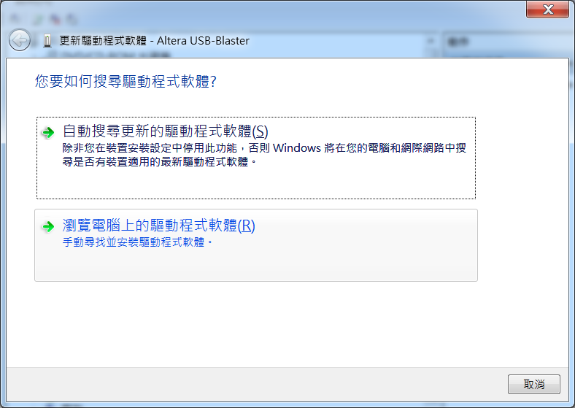
Programming DE0-CV (7/12)

Slide 24
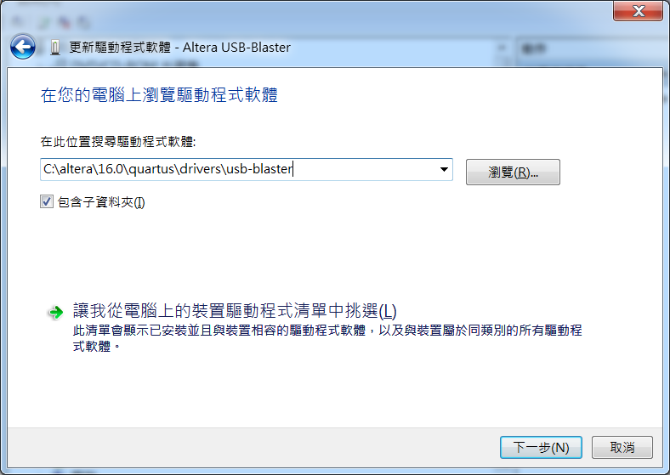
Programming DE0-CV (8/12)

Slide 25
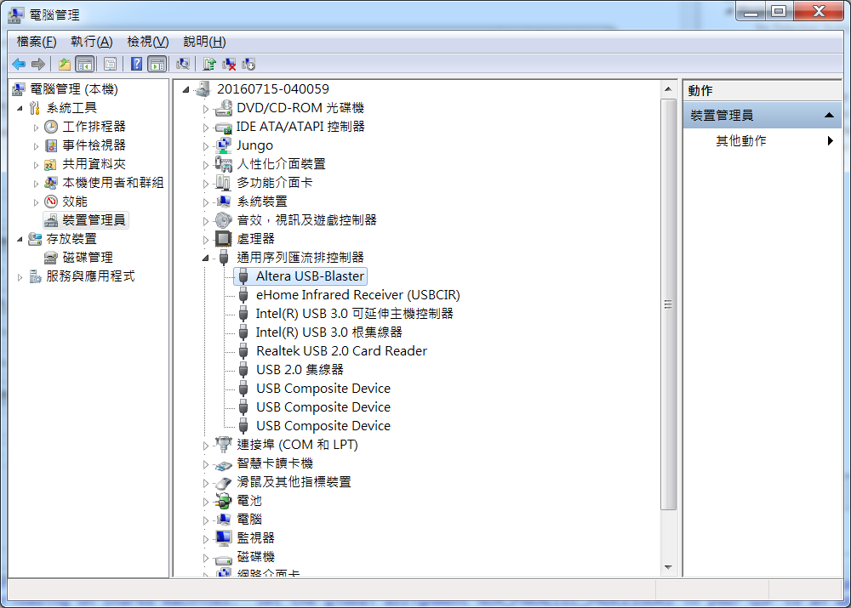
Programming DE0-CV (9/12)

Slide 26
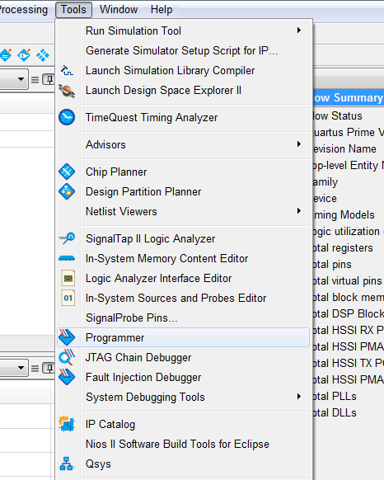
Programming DE0-CV (10/12)
Programming device

Slide 27
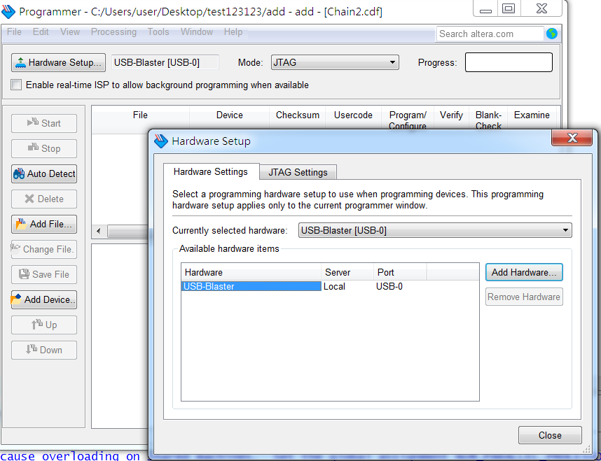
Programming DE0-CV (11/12)
Hardware setup: add USB-Blaster
1
3
2
Double click

Slide 28
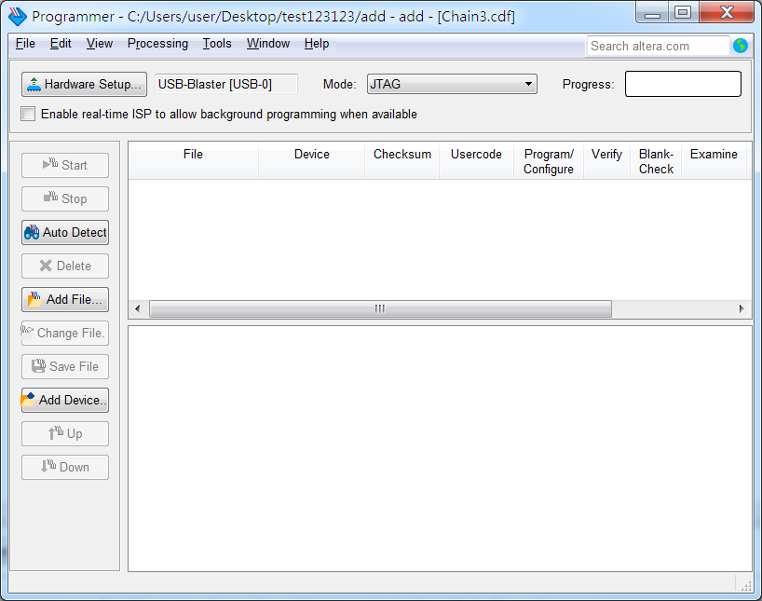
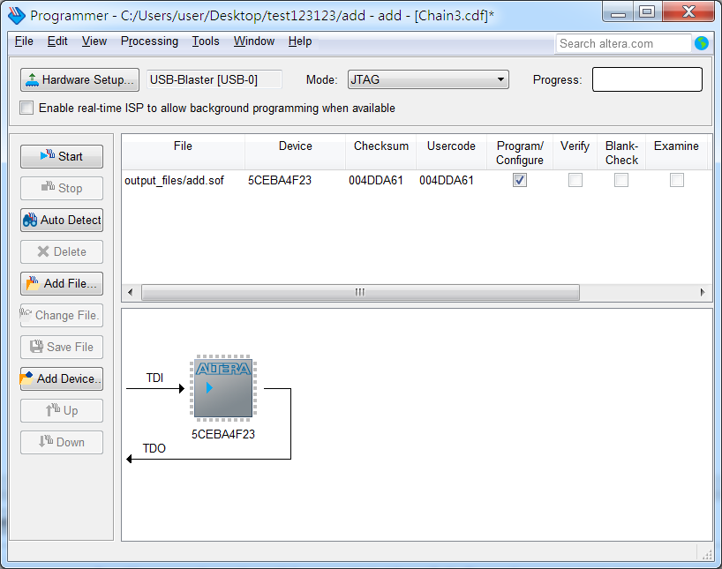
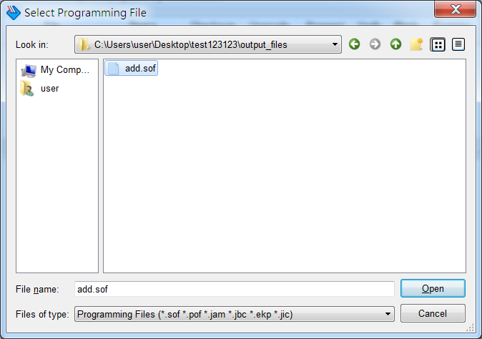
Programming DE0-CV (12/12)
Programming device

