Slide 1
LAB - 9
陳培殷
國立成功大學 資訊工程系

Slide 2
Lab: Design a Traffic Light System

Slide 3
Traffic Light System (1/2)
Please design a traffic light system by using the following components:
1 Seven-Segment Displays
1 LED Dot Matrix Display
1 reset button
Notes:
做不太完，可以考慮先不做點矩陣

Slide 4
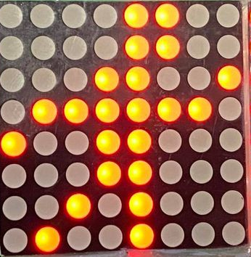
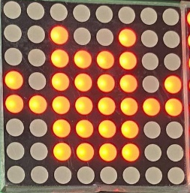
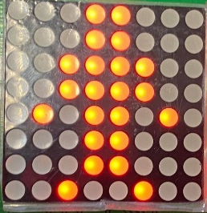
Traffic Light System (2/2)
Seven-Segment Displays:
Count up from 1 to 15 when the light is green
Count up from 1 to 5 when the light is yellow
Count up from 1 to 10 when the light is red
LED Dot Matrix Display:
Show image 1 when the light is green
Show image 2 when the light is yellow
Show image 3 when the light is red
Reset button:
Reset the system to the initial state – Set light to green, display 1 on Seven-Segment Displays, and show image 1.
image1
image 2
image 3

Slide 5
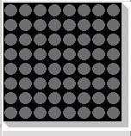
LED Dot Matrix Display (1/4)
In DE0-CV external board
column
[7][6][5][4][3][2][1][0]
[7][6][5][4][3][2][1][0]
row[7]
row[6]
row[5]
row[4]
row[3]
row[2]
row[1]
row[0]
DM1
DM0

Slide 6
LED Dot Matrix Display (2/4)
The dot matrix is controlled by 8 column lines and 8 row lines.
When the signal of column is 1 and the row is 0, the dot will be turned on.
LED
column
Your Design
Row Line
Dot Matrix
module …(…);
output [7:0]col;
output [7:0]row;
.
.
.
.
.
0 0 1 0 0 0 0 0
……
1 1 1 0 1 1 1 1
Column Line
……
row

Slide 7
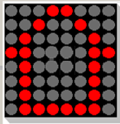
LED Dot Matrix Display (3/4)
Scan the rows each by each frequently and control the column lines, thus the image will be shown due to Persistence of vision.
Step 1
Step 2
Step 3
Step 4
0 0 0 1 1 0 0 0
0 0 1 0 0 1 0 0
0 1 0 0 0 0 1 0
1 1 0 0 0 0 1 1
0 1 1 1 1 1 1 1
1 0 1 1 1 1 1 1
1 1 0 1 1 1 1 1
1 1 1 0 1 1 1 1
→
→
→
→ …
Clock must be as 10000 Hz for display !!!
=>

Slide 8
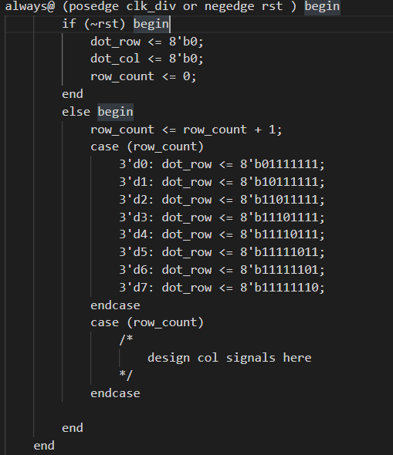
LED Dot Matrix Display (4/4)
The example for dot matrix control

