Slide 1
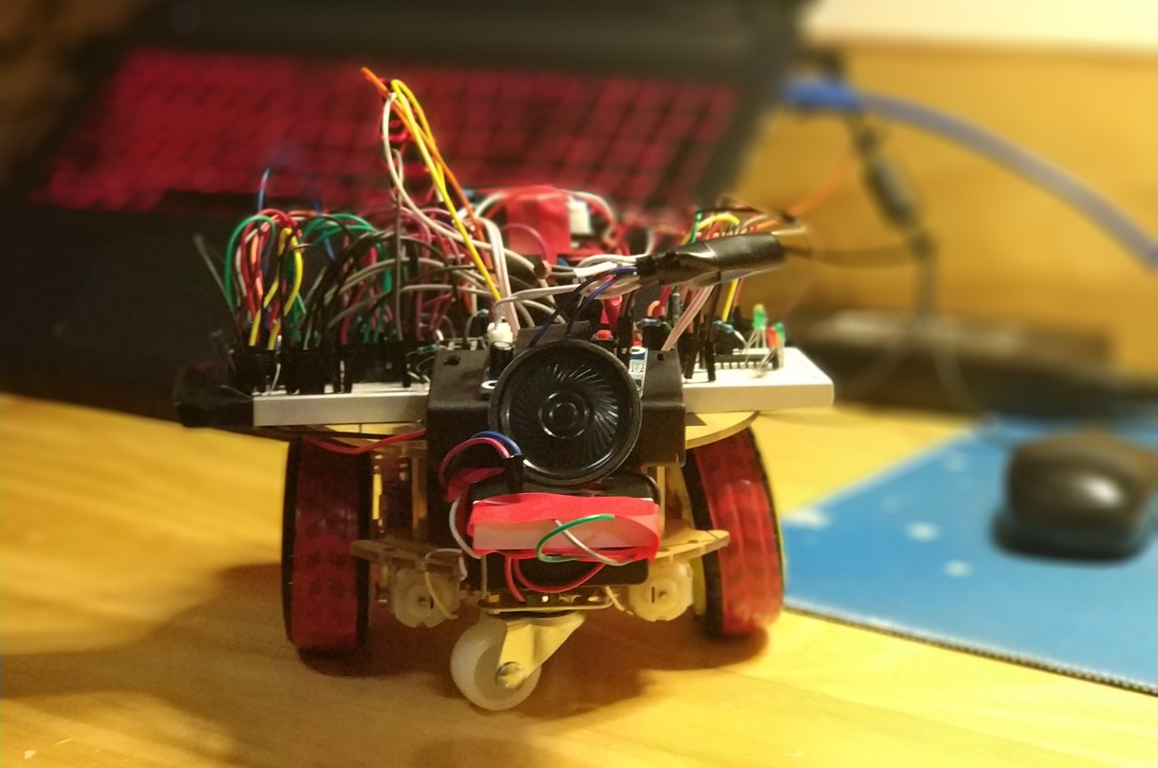
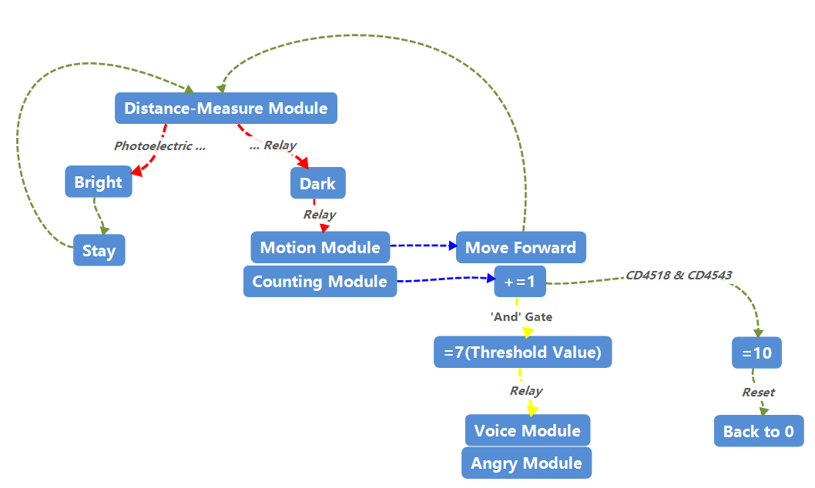
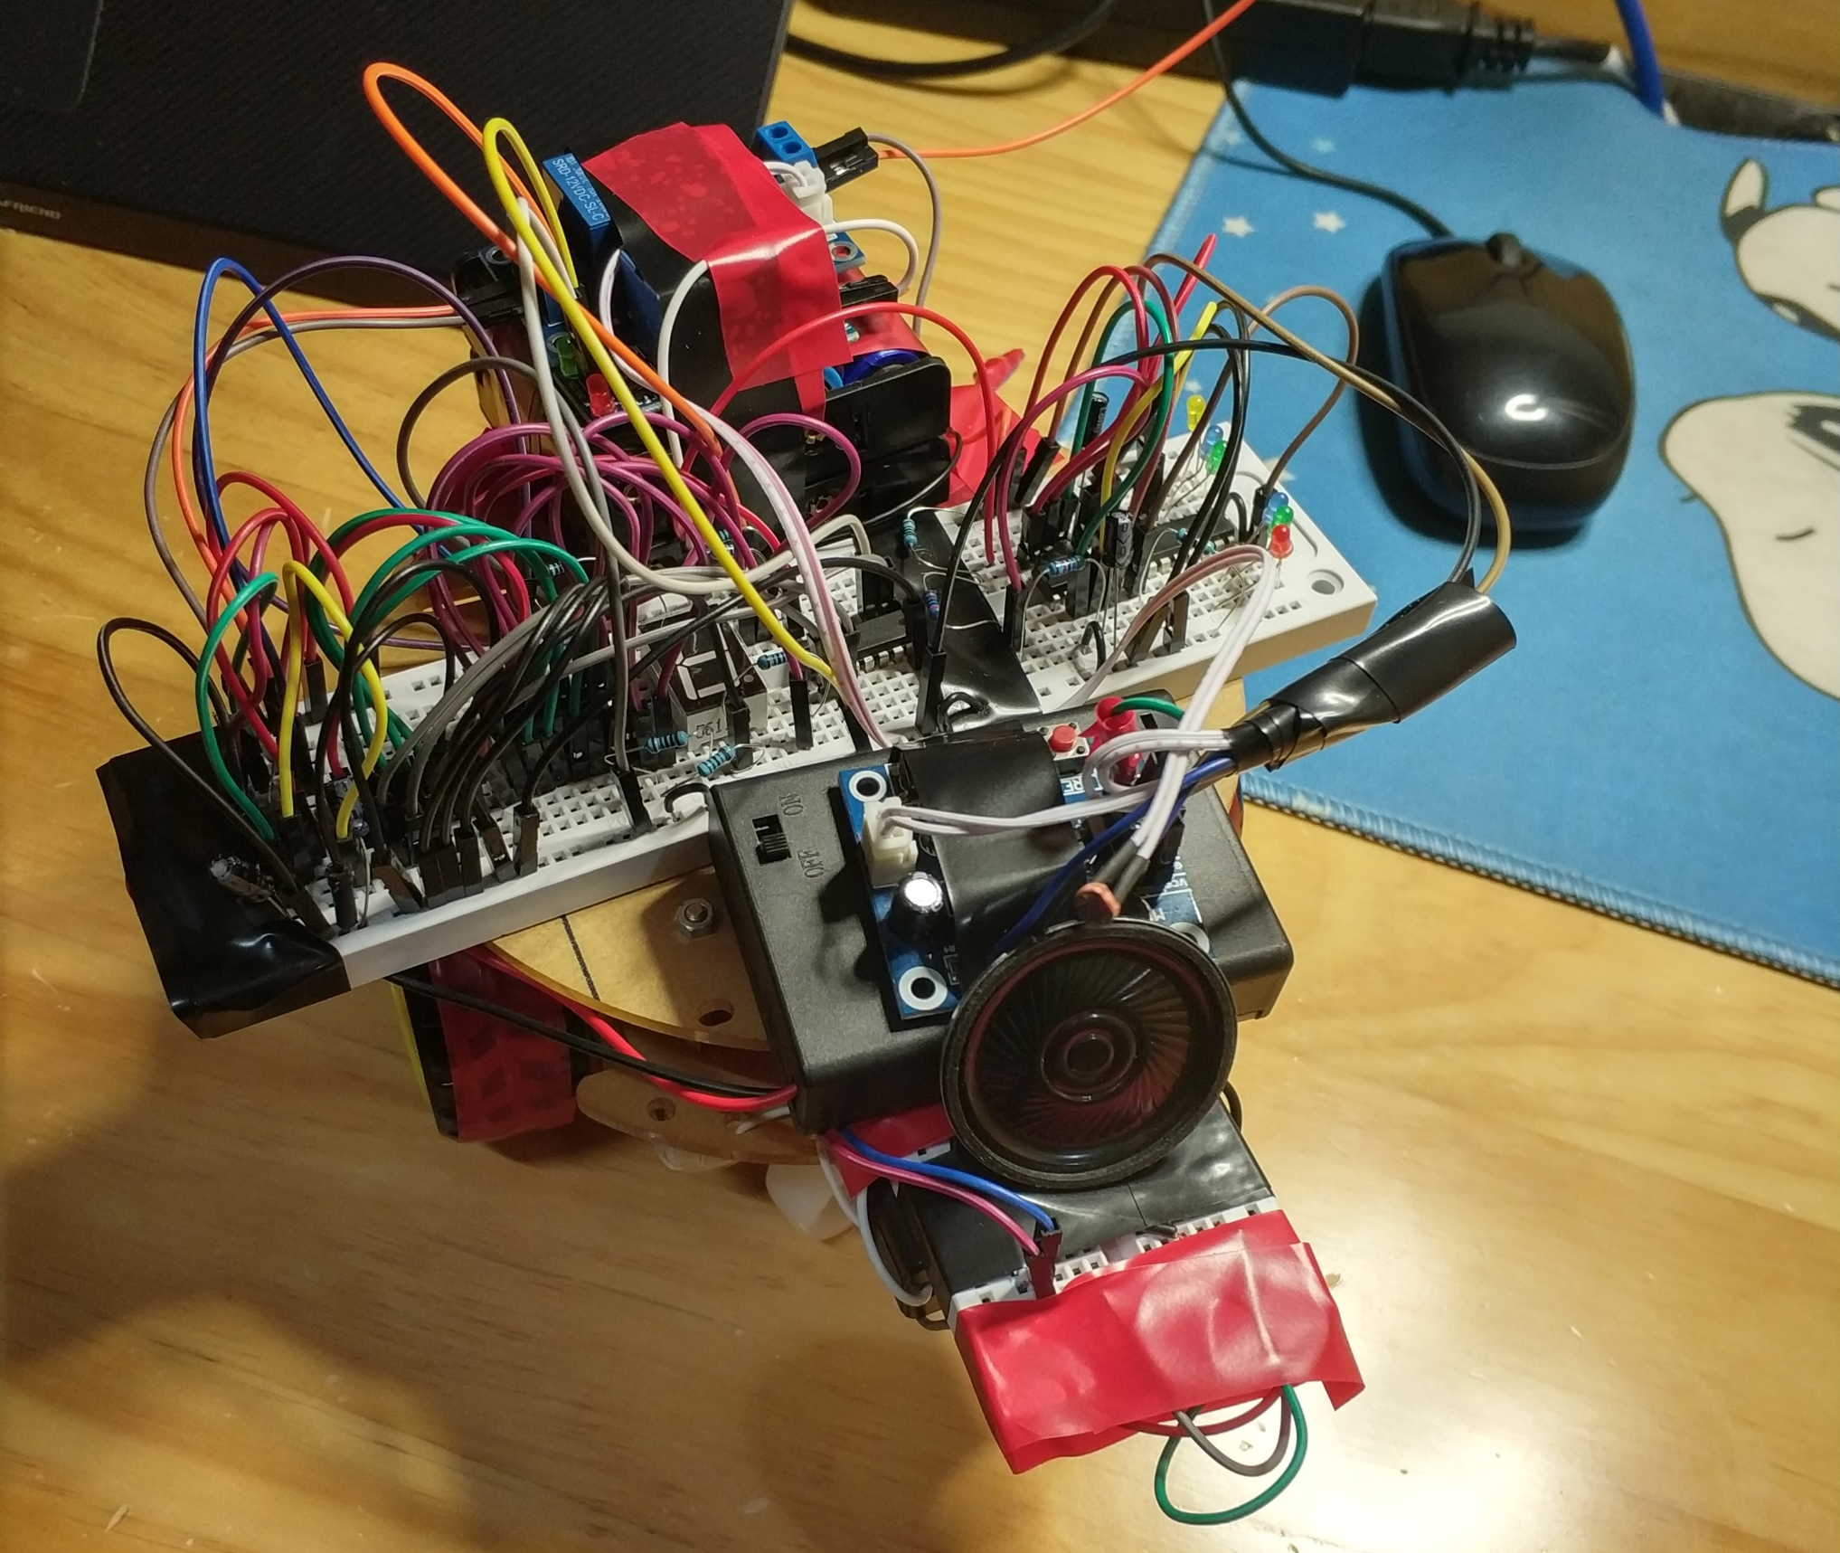
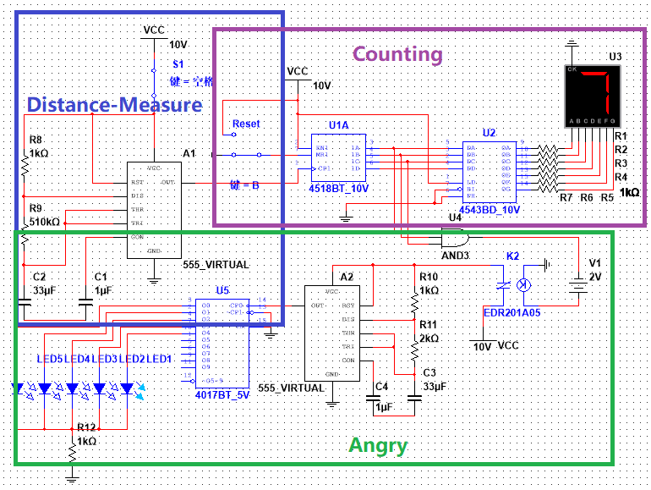
Don’t-Touch-Me Robot
梁家伟 姚进
Shanghaitech University SIST EE111 Project 7
INTRODUCTION & ABSTRACT
IMPLEMENTATION
Design a Don't-Touch-Me robot which says "DO NOT TOUCH ME" and try to run away when attempted to touch it. 1. When touched, the robot yells "DO NOT TOUCH ME" (at least urgent sound to indicate) or runs away. 2. The robot counts the number of times being touched and display it with LED display device, like Digital tube. 3. The robot gets angry when the number hits a threshold value. (The behavior of "getting angry" can be defined by ourselves.)
Block schematic
Distance-Measure Module: We use photoelectric resistor and relay to build a photo switch circuit. The trigger signals controls motion module, which makes robot move forward.
Counting Module: We use CD4518 as counter, which is a Decimal Adder. It can represent "0~9" by 4-bit binary numbers, and showed by the level of output voltage. Since it only accept SQUARE WAVE SIGNAL, We use 555Timer to solve this problem. After that, we use CD4543 as encoder. Encodes 4-bit-number into 7 outputs, and connect them to 7-Seg LED Nixie tube (Common cathode) to show numbers in a readable way.
Angry Module: We use AND gate to check the binary threshold number. Its output signal is connected to voice module (recording module) and a horse race lamp constructed by a 555Timer and Counter CD4017.
Result
When Distance-Measure Module is triggered (Dark), robot will move forward and the recording number plus one. When the times of being triggered adds to 7, it will trigger the Voice Module and Angry Module. Robot yells "Don't touch me!", and the horse race lamp starts to work.
Simulation
Components
Counting Module
555Timer
Capacitor: 1uF, 33uF
Resistor: 1kΩ * 7, 510kΩ
Counter: CD4518
Encoder: CD4543
7-Seg LED Nixietube: 5611AH
Electric relay
Angry Module
And Gate
555Timer
Capacitor: 1uF * 2
Resistor: 510kΩ, 50kΩ, 1kΩ, 2kΩ
Counter: CD4017
LED * 7
Electric relay
Resistor: 1kΩ
Distance-Measure Module
Photoelectric relay
Battery * 8 (12V)
Motion Module and Voice Module
Battery * 3 (4.5V)
Electric motor * 2
Electric relay
Recording Module
General
Battery * 3 (4.5V)
Thanks for our TA : 苏隽岩

