Slide 1
Stick diagram representation for nanomagnetic logic based combinational circuits

Slide 2
CSE460 : VLSI DESIGN
GROUP 5
Tahiatun Nazi (20301008)
Moinul Hossain Bhuiyan (20301002)
Shouvik Banerjee Argha (20301118)
Sheikh Yasir Hossain Katib (20301013)
Faculty : Asif Hossain & Purbayan Das

Slide 3
Author’s Goal
Exploring NML(Nanomagnetic Logic Gate) as a Post-CMOS Technology & overcoming CMOS challenges
Utilizing Single-Domain Behavior for Logic
Utilizing ML based full adder circuit in OOMMF & Stick Diagram Representation
Contributing to Future Design Paradigms

Slide 4
Proposed Approach By the Author
The author's proposed approach combines theoretical exploration, practical design, simulation, and innovative representation techniques to establish the viability of Nanomagnetic Logic as a promising technology for overcoming CMOS challenges and designing energy-efficient digital circuits.

Slide 5
Introduction
Challenges of Shrinking CMOS Transistors
Nanomagnetic Logic (NML) is an alternative to CMOS for digital circuits
NML uses magnetostatic interactions among nanomagnets to achieve desired domain orientation
Single domain nanomagnets, with varying domain orientations, act as bistable logic output levels.
The paper utilizes ferromagnetic nanodots single domain behaviour to create combinational circuits.

Slide 6

Design on Full bit adder circuit utilization in OOMMF
Full adder is a widely used component in operations like multiplication and subtraction within computer systems.
An ML-based one bit full adder circuit is crafted using the open-source micromagnetic simulation tool, OOMMF which utilizes a given magnetic pattern to solve the Landau-Lifshitz equation , determining magnetization and spin direction within the structure.
Here, M is pointwise magnetization (A/m) γ is gyromagnetic ratio (m/(A.s)) α is the damping coefficient (dimensionless) Heff is the pointwise effective field (A/m) μ0 is magnetic permeability in vacuum E(M) is Landau-Lifshitz energy where: E(M) = E_{exchange}(M) + E_{anisotropy}(M) + E_{applied}(M) + E_{stray}(M)

Slide 7
Design on Full bit adder circuit utilization in OOMMF
Default value of γ set as 2.21 × 10⁵ in the simulator; damping coefficient (α) configured at 0.5
Permalloy chosen for adder circuit design due to its fast switching response and low demagnetizing energy property.
Saturation magnetization, crystalline anisotropy constant, and exchange stiffness set as 860 × 10³ A/m, 13 × 10⁻¹² J/m, and 0 J/m³ respectively.
Solver utilizes exchange stiffness and crystalline anisotropic constant to compute exchange energy and anisotropy energy, contributing to Landau-Lifshitz energy E(M).
Solver evolves steady state spin moments, reaching minimum energy to induce individual pointwise magnetization over time.
One-bit and two-bit full adder (FA) circuits designed in OOMMF, employing dot spacing of 22 nm.
One-bit FA circuit consists of two inputs (A₀ ,B₀), a carry-in (C₀) for generating sum (S₀), and a carry-out (C₁) bit.
Rectangular permalloy dots designed at 50 nm width, 100 nm length, and 22 nm spacing.
Aspect ratios of dots chosen to facilitate easy magnetic domain switching along the easy axis.

Slide 8
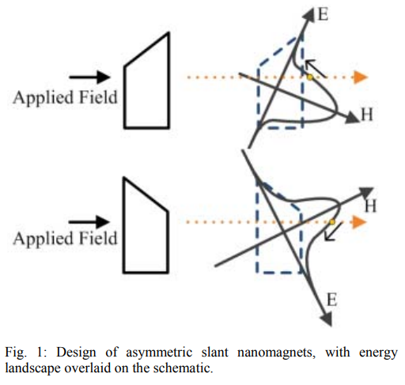
Design on Full bit adder circuit utilization in OOMMF
Input dots designed asymmetrically with slanted magnets to reduce footprint and enhance domain switching efficiency.
Slanted edge magnets create titled energy landscape (Figure 1), causing a shift in energy barrier.
Unlike symmetric magnets, slant magnets don't have the energy barrier at maximum when dot is magnetized horizontally.
Domains settle at minimum energy position after removing magnetic field, achieving equivalent input logical state compared to symmetric dot design.

Slide 9
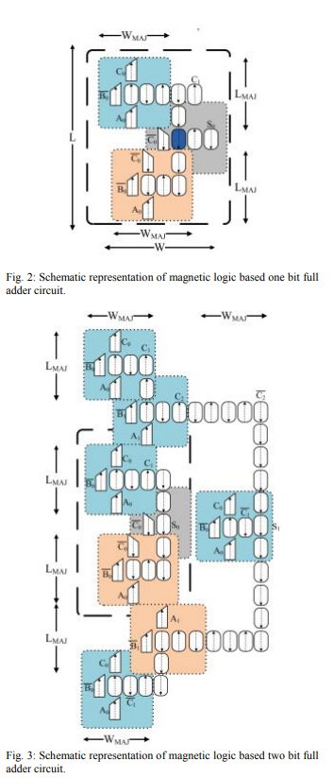
Circuit Design & Observation
For one bit FA circuit, (S₀) and (C₁) bits defined by EXOR and majority gate operations (MAJ)
Sum (S₀) bit represented as Recursive expression of (S₀): ܵS₀= MAJ(MAJ( A₀ ,B₀ , C₀ ' , C₁ ', C₀ ) using MAJ symbol.
Carryout (C₁ ) bit: C₁ = MAJ(B₀ ,B₀ ,C₀ ).
Recursive Sum bit representation enables visualization of higher order of n bit adder subsystem with MAJ blocks.
One bit adder circuit designed in OOMMF, reaching global minimum energy state through transient analysis.
Energy dissipation and delay for logical S₀ bit evaluation: 0.51 × 10⁻¹⁶ J and 6.50 ns respectively.
Similarly, two bit adder circuit designed and simulated in OOMMF (Figure 3).
Energy dissipation and computational delay for logical S₁ bit: 1.82 × 10⁻¹⁶ J and 16.68 ns respectively.

Slide 10
DEVELOPMENT OF STICK DIAGRAM MODELS
What is Development of stick diagram models?
In the context of Nanomagnetic Logic (NML) technology, the "Development of Stick Diagram Models" refers to the procedure of employing stick diagrams to provide a streamlined graphical representation of complicated circuits. In order to facilitate design planning, optimisation, and comprehension, this method seeks to graphically describe the logical arrangement and architecture of circuits, in particular adder circuits.In essence, it's a graphical tool that offers a roadmap for understanding and enhancing the performance of complex circuitry.

Slide 11
DEVELOPMENT OF STICK DIAGRAM MODELS
In Figure 2, a one-bit FA circuit employs two basic MAJ blocks to generate separate output of MAJ(A₀ ,B_{0,}C₀ ' . These blocks are color-coded to reflect logical changes in inputs and generate distinct outputs. The results from these two blocks are then magnetically guided to a final MAJ block, ultimately producing the output S₀ bit.
A two bit FA circuit generating C₂ and S₁ bits are shown in Figure 3. In addition, the two bit adder design included three regenerate MAJ blocks producing C₁’ , and C₁ bits separately, and three generate MAJ blocks for the 2nd bit operations with similar or compliment of A₁, B₁ , and C₁ inputs.

Slide 12
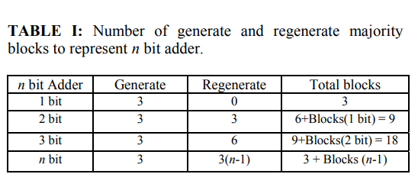
DEVELOPMENT OF STICK DIAGRAM MODELS
Regenerate MAJ Blocks for Lower Significant Bits (LSB)
Preventing Magnetic Disturbances
Generalized MAJ Block Formula 3n+Blocks(n-1), where n represents the number of bits in the adder.
Useful Information for Higher-Order FA Subsystem

Slide 13
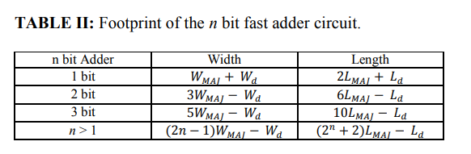
DEVELOPMENT OF STICK DIAGRAM MODELS
Importance of Footprint Approximation
Footprint of n-bit FA Circuit
Stick Diagram Simplification
Visualization of Spacing
Stick Diagram for Two-Bit FA Circuit
Conservative Approach to Design
Signal Generation and Propagation Model

Slide 14
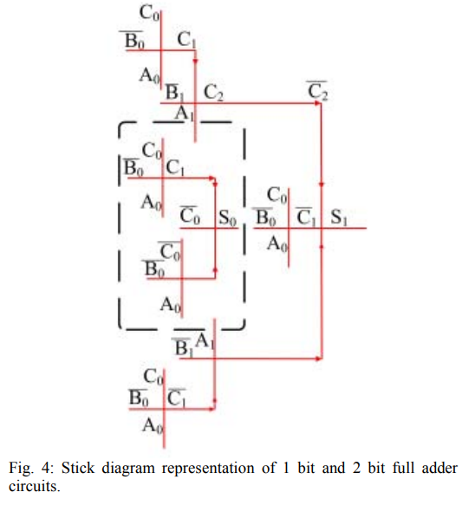
DEVELOPMENT OF STICK DIAGRAM MODELS
A stick diagram representation of two bit FA circuit derived from the dot level schematic is presented in Figure 4. The MAJ blocks shown in the dot level schematic is substituted by intersecting orthogonal lines in the stick diagram representation. A quick footprint estimation model following one bit, and two bit FA circuit is expressed as where ܰN_{V} , and N_{H} are the number of intersections in the vertical and horizontal collinear input lines that has the highest number of intersections respectively and n is the number of bits in FA circuit.The expression is,

Slide 15
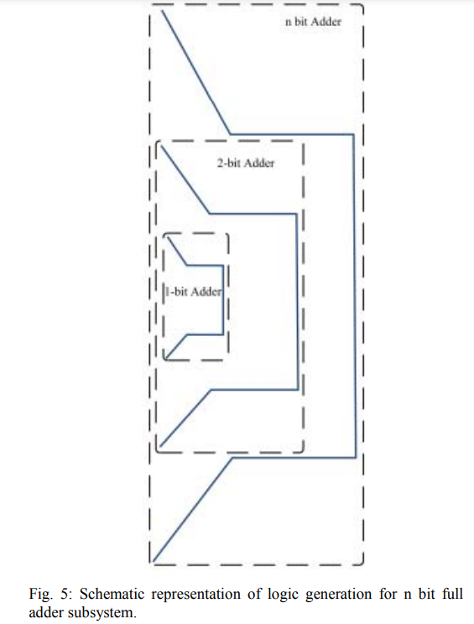
DEVELOPMENT OF STICK DIAGRAM MODELS
Based on the stick diagram representation for 1 bit and 2 bit FA subsystem, a peripheral outline with signal generation and propagation sketch for n bit FA subsystem is shown in the Figure 5. The box shown in black dotted lines signifies the designed footprint occupied by the higher order n bit subsystem.

Slide 16
Conclusion
A micromagnetic simulator was used to design and simulate one-bit and two-bit Nanomagnetic Logic (NML) full adder subsystems.
The approach extended the majority blocks from the higher-order n-bit adder to estimate circuit footprint.
A stick diagram derived from the majority gate model aided in quick combinatorial subsystem design.
To simplify system planning and routing, a footprint model for the n-bit adder subsystem was proposed.
A logic generation and propagation model for higher-order n-bit adders was designed to share design information.
The stick diagram provides rapid footprint estimation for NML subsystem, ideal for non-real-time and ultra low power uses.

Slide 17
Thank You

