Slide 1
















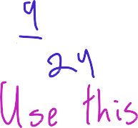
















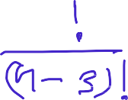


























Slide 2














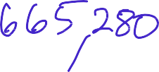
























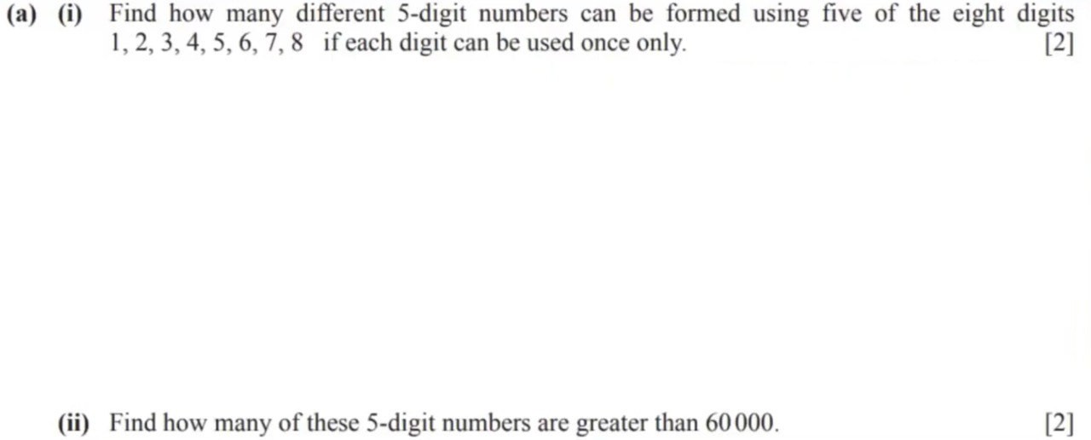










Slide 3





Slide 4



















































A 5-digit numbers can be formed using the digits 1, 3, 5, 6, 8 and U. No digit may be used more than once in any 5-digit number. How many of these 5-digit numbers are even and less than 60000?
A 5-digit numbers can be formed using the digits 1, 3, 5, 6, 8 and U. No digit may be used more than once in any 5-digit number. How many of these 5-digit numbers are odd and less than 60000?

Slide 5













A 5-digit numbers can be formed using the digits 1, 3, 5, 6, 8 and U. No digit may be used more than once in any 5-digit number. How many of these 5-digit numbers are odd and less than 60000?

Slide 6










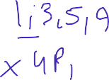








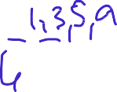

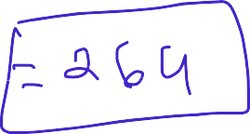







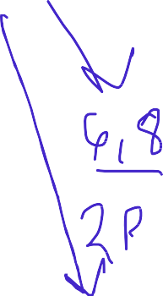


















Slide 7

















Slide 8









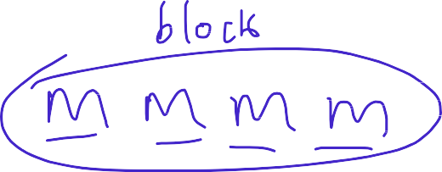
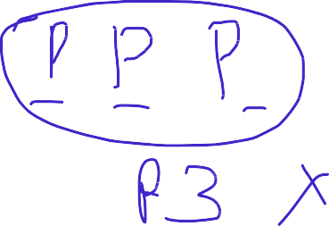





















Slide 9



















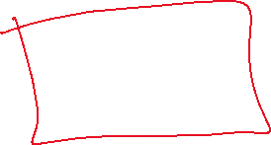






Slide 10




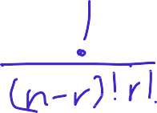

































Slide 11





Slide 12


































Slide 13








Slide 14

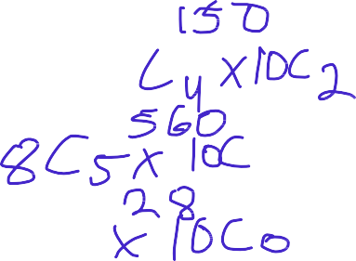






































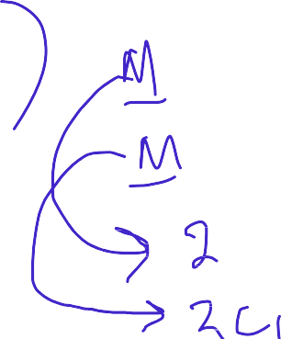













Slide 15









































Slide 16























Slide 17


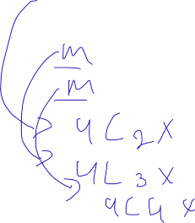


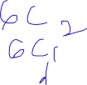




























Slide 18


























Slide 19













