Slide 1
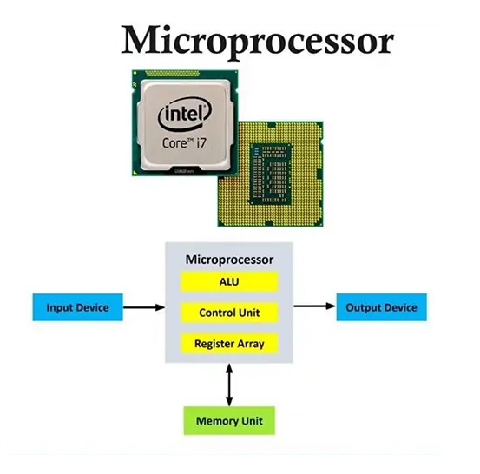



THE FOURTH GENERATION: 1970S–PRESENT

Slide 2
THE FOURTH GENERATION: 1970S–PRESENT
The development of the microprocessor was a key milestone in computing because it integrated the entire CPU onto a single chip. This reduced the size, cost, and power consumption of computers while improving performance and reliability.
As a result, microcomputers were created, making computers smaller, more powerful, and affordable for a wider range of users, including individuals and small businesses. Continuous improvements in microprocessor design later enabled faster processing and supported the growth of modern devices such as personal computers and smartphones.

Slide 3
THE FOURTH GENERATION: 1970S–PRESENT
Advantages:
Microprocessors make computers much smaller, cheaper, and more energy efficient because all CPU functions are integrated onto a single chip. They are more reliable since there are fewer physical connections that can fail, and they allow faster processing and mass production. This made computers accessible to individuals, schools, and small businesses instead of only large organizations.
Disadvantages:
Because everything is integrated into one chip, upgrading or repairing individual CPU components is difficult or impossible. High performance microprocessors can also generate significant heat and require advanced cooling. In early stages, microprocessors were less powerful than large mainframe systems designed for specialized, heavy workloads.

