Slide 1
two types of psychological research
by Chernousov Denis TI-92 TEF

Slide 2
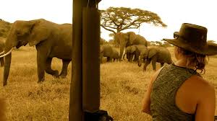

Field research is a type of data collection where some events or responses are systematically recorded in their own environment. For example, a savannah zoologist collects data on sick animals and their diseases. Then the collected information is analyzed by an infectionist.
As you understand, field researches are also used to study people relations and behavior. The only difference is that a typical human environment is schools, offices, public places and so on.

Slide 3
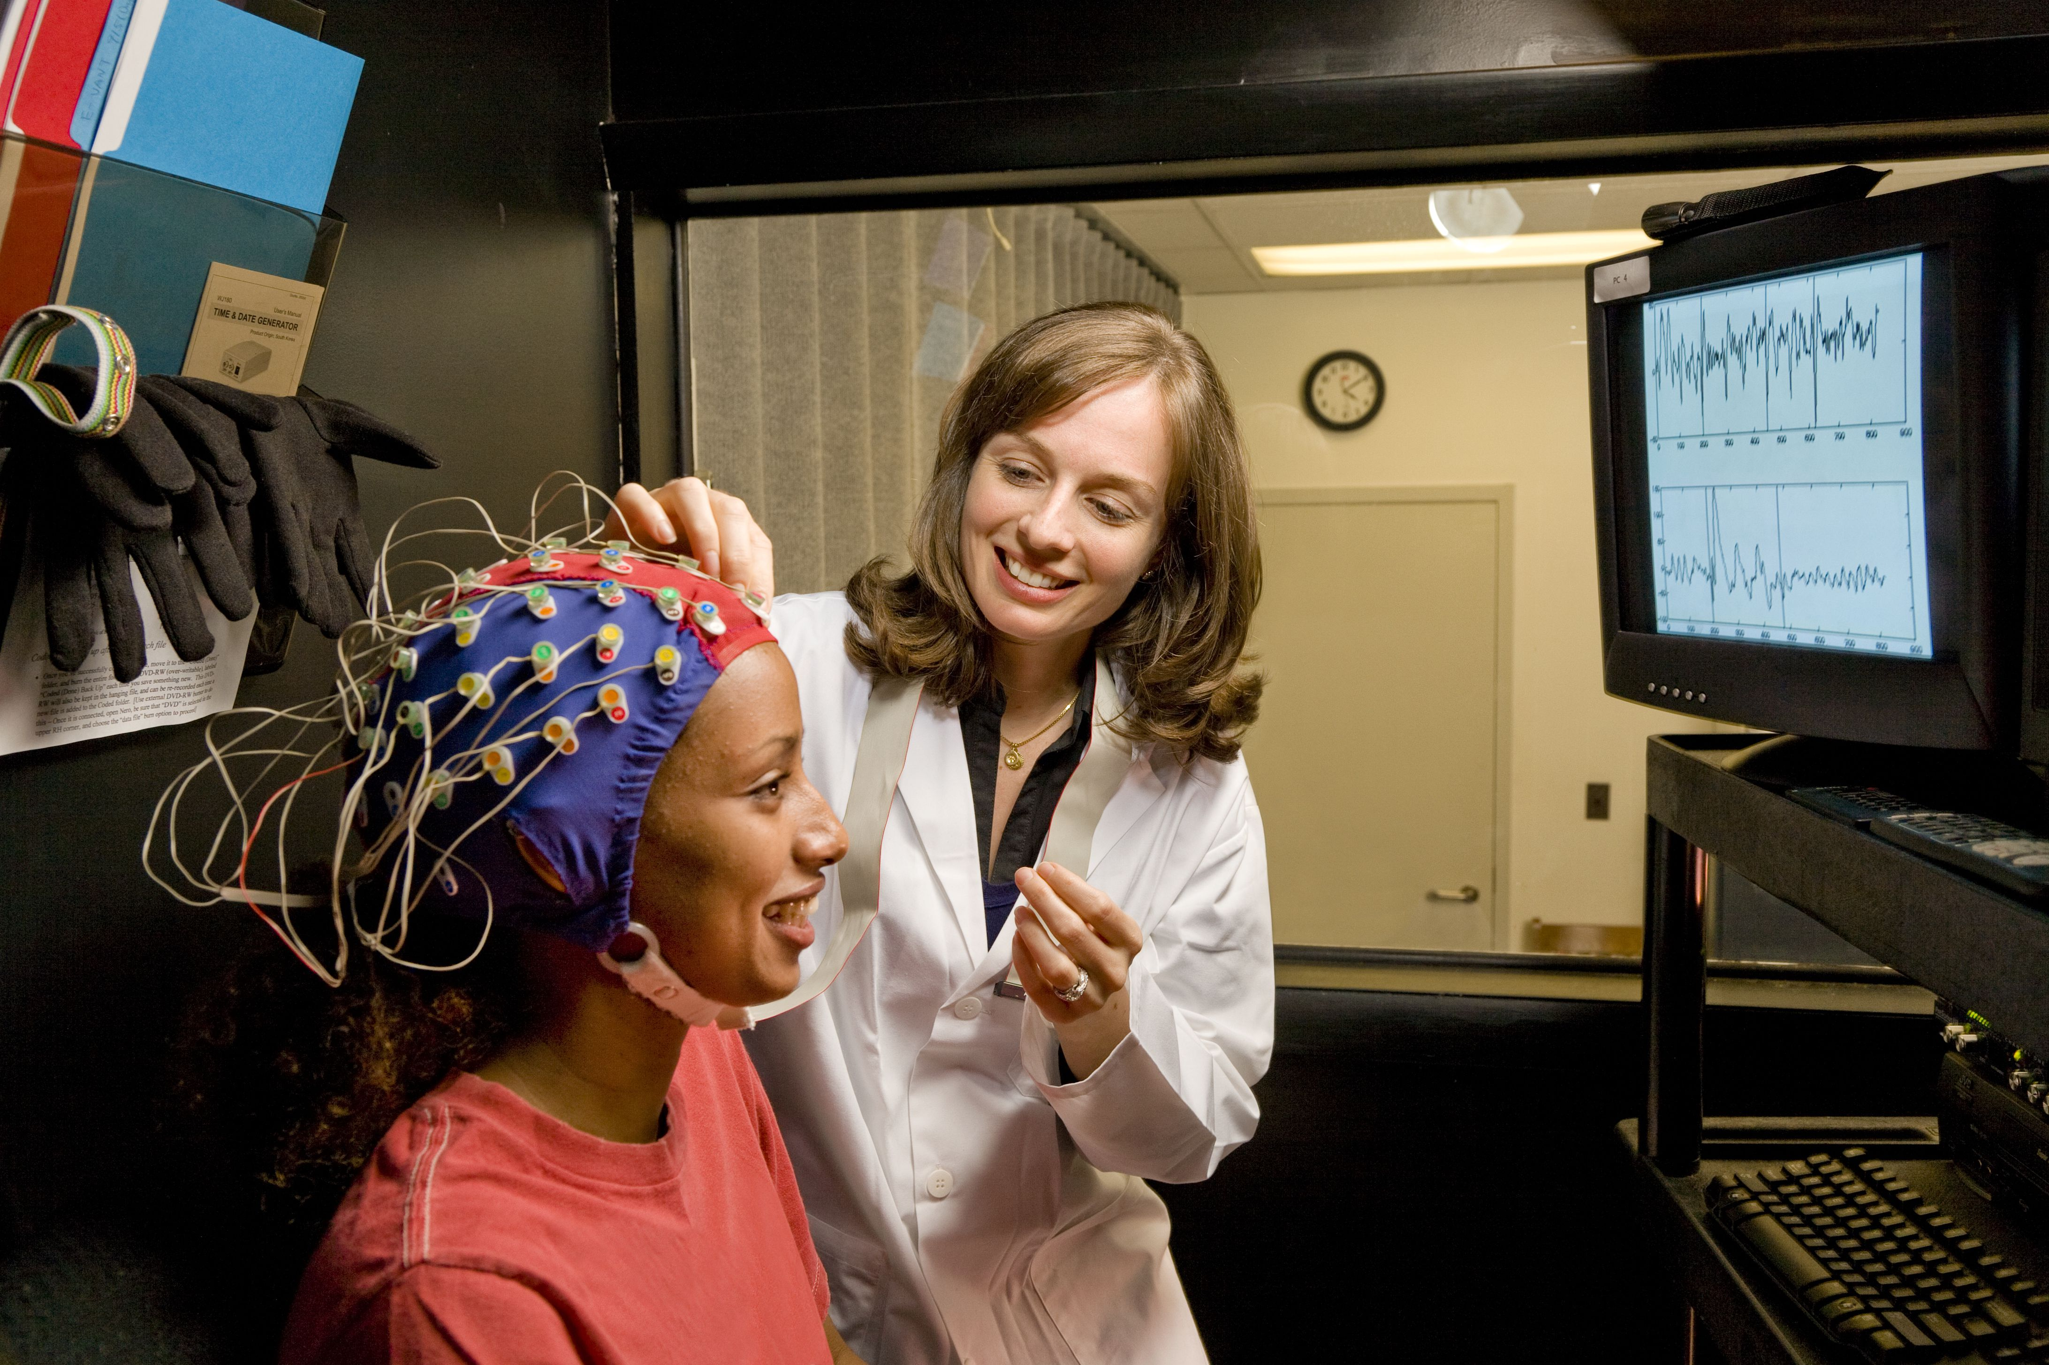
Laboratory research is a type of data collection where a phenomenon is observed in an artificial environment so it is fully controlled by scientists. For instance, you have to study brain activity, so in this case, it is appropriate to use expensive scientific tools for laboratory testing
Summary
The type of research depends only on the purpose of the research. However, field research is more revealing because many people are involved. On the other hand, scientific instruments are used in laboratory experiments, therefore, the method has its advantages.

Slide 4
Thank you for attention

