Slide 1
Intention
by Chernousov Denis TI-92 TEF

Slide 2
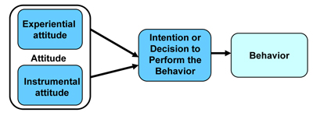
In fact, intention is a mental state that means a commitment to take a certain action or actions in the future. In social Psychology, intention is an important mediator of the attitude - behavior link according Madden theory.
In 1992, scientists Madden, Ellen, and Eisen came to the idea that attitudes and behaviors are linked by behavioral intentions, through a series of experiments. The result of tests helped researchers to understand intentions that increased their ability to predict actions.

Slide 3
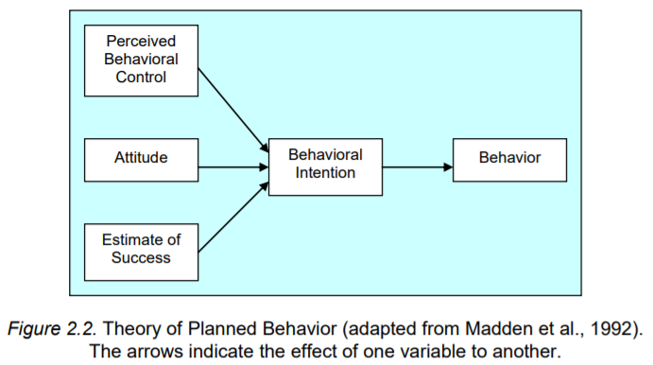
In the modern model, behavior is the result of people's behavioral intentions, which in turn are caused people's attitudes and assessments of what a particular action will lead to result.
This means that the individual is affected not only by the attitude to the problem, but also the vision of the situation, social norms and perceived behavioral control. Theoretically if we know participants' attitudes, intentions, perceived capabilities, and so forth, we can predict human actions.

Slide 4
Thank you for attention

