Slide 1
Which design choices actually matter in RAG over Indian IPO documents?
A reproducible ablation study with an evaluation framework
12 IPO filings, 6,718 pages
121 questions with page evidence
5 ablation studies
Sarvesh | Minor specialization, Big Data Analytics
Notes:
One-line pitch: we built a RAG system for SEBI offer documents, but the main result is a set of measurements that say which of its design choices matter. Scope in one line: 12 filings, 121 questions with page-level evidence, 5 single-factor studies. About 15 minutes plus questions.

Slide 2
Offer documents are long, full of tables and sometimes incomplete
400-700
pages per filing
The same figure appears in the summary, the statements and the discussion.
A question the pipeline answers correctly
Question
What was the profit for the year achieved by Hyundai in Fiscal 2022 compared to Fiscal 2021?
Tables
carry the answers
Profit, borrowings, share capital and pay sit in tables.
Answer
₹29,015.91 million (up from ₹18,811.56 million in Fiscal 2021)
[●]
marks undecided values
A draft has no final price, so a good system must say so.
Hyundai Motor India, page 314-315
Every figure is found on the cited pages.
Motivation
2
Notes:
Why this is hard. DRHPs and RHPs run 400-700 pages and the same figure appears in the summary, the financial statements and the discussion. Investors need the exact figure and the page it came from. In a draft the final price is printed as [●], so a useful system must also say 'not in the document'. On the right is a real test question the pipeline answers correctly, with the page it cites.

Slide 3
Two research questions guide the whole study
RQ1
RQ2
Which pipeline components improve retrieval and answer quality?
Where is the bottleneck, in retrieval or in generation?
Why it matters
Pipelines have many choices: how to cut text, how to write tables, which search, which embedding model, whether to check figures.
Most are chosen by habit, and each costs time or compute: a larger embedding model is about 8 times slower to index.
On Indian offer documents nobody has measured which choices pay off.
Why it matters
It decides where to spend effort: better search, or a bigger model.
A bigger generator costs more: the 550B model is about twice as slow as the 30B one.
If the right page is never found, no model can answer correctly.
How we answer it Five studies, each changing one choice against one baseline.
How we answer it A ceiling test: give the model the correct pages and see how far the score rises.
Research questions
3
Notes:
RQ1 asks which of the many design choices in a RAG pipeline are worth it. Most teams pick them by habit and each has a cost. We answer it with five one-factor-at-a-time ablations against a single baseline. RQ2 asks where the bottleneck is. If retrieval is the problem, a bigger model is a waste; if generation is the problem, better search is a waste. We answer it with a ceiling test that gives the model the correct pages.

Slide 4
Related work
RAG pipelines
RAG evaluation
Financial QA
Hybrid search with rank fusion, cross-encoder reranking and context ordering are well studied.
RAGAS, ARES and RAGChecker score answers, mostly with an LLM judge.
FinanceBench tests questions on US filings and finds that searching across many companies is much harder than searching one.
What is missing
Which of these choices matter on long financial filings has not been measured.
What is missing
None checks retrieval against annotated evidence pages.
What is missing
It covers US filings only, not Indian offer documents.
Our gap
No benchmark and no ablation study exists for Indian IPO offer documents, and existing evaluations do not check which page the evidence came from.
Related work
4
Notes:
Three strands. Pipelines: hybrid search, reranking and context ordering are well studied, but not measured on long financial filings. Evaluation: RAGAS, ARES and RAGChecker score answers, mostly with an LLM judge; none of them checks retrieval against annotated evidence pages. Financial QA: FinanceBench covers US filings and shows that searching across many companies is far harder than searching one. Our gap: no benchmark or ablation study for Indian IPO documents with page-level evidence. We use annotated evidence pages and add rule-based checks that do not rely on a judge.

Slide 5
The pipeline: eight stages, each one a setting we can switch
Once per filing: build the index
12 PDF filings
the input
Parse
text, chapters, tables
Chunk
pieces and sections
Embed
384 numbers each
Saved index
searched later
1
2
3
the index is searched for every question
For every question
Question
typed by the user
Retrieve
meaning + keyword
Rerank
best 5 kept
Assemble
widen, order
Generate
cites pages
Verify
figures, pages
Answer
with page citations
4
5
6
7
8
Slate stages run once per filing. Teal stages run for every question. Search covers all 12 filings at once.
System
5
Notes:
Walk left to right. The slate stages run once per filing and are saved to disk as an index. The teal stages run for every question: two searches are merged, a second model reranks the shortlist, each hit is widened to its section, the language model answers with page citations, and an optional check verifies the figures. Search runs over all 12 filings at once, so the system must also pick the right company.

Slide 6
How the 121-question gold set was built
Sample
Draft and filter
Select
Review
Expand evidence
Add special cases
366
227
102
97
2.8
121
pages from the 12 filings
LLM questions that pass the automatic checks
chosen to balance question types
left after 15 are removed by hand
evidence pages per question on average
with 12 two-filing and 12 unanswerable
One gold item
Evidence groups
Dev and test split
Question What was the total expenses amount for Zomato in Fiscal 2020 compared to Fiscal 2019?
Answer ₹50,063.11 million, up from ₹36,081.51 million
A two-filing question has one group per filing. A page from each group is needed.
dev 53
test 68
Zomato
Delhivery
Split by filing: 5 filings for dev, 7 for test.
p. 83
p. 85
Evidence pages (any one counts)
group 1
group 2
7 question types: table, fact, number, list, definition, two-filing, unanswerable.
p. 76
p. 224
p. 319
p. 322
Unanswerable questions have no group.
Evaluation framework
6
Notes:
A gold set is the answer key. We sampled 366 pages across the 12 filings and had an LLM draft one question per page; 227 passed automatic checks (the quote is on the page, the question is self-contained, the company is named, no copying, a second LLM agrees). 102 were chosen to balance question types, 15 were removed by hand, leaving 97. We then looked for every other page that supports each answer: 478 pages were judged and the average question ended up with 2.83 evidence pages. Finally 12 two-filing and 12 unanswerable questions were added, giving 121. Evidence is stored in groups: any page in a group counts, and every group must be hit. The set was audited by the author only, and the split between dev and test is by filing. The caveats are on the limitations slide.

Slide 7
How each answer is scored
Retrieval
fixed rules
Pages the system retrieved
Evidence pages in the gold set
Did the right page come back?
Recall, nDCG and MRR at the page level
vs
Grounding
fixed rules
The answer
The retrieved text
Are the figures and citations real?
Also: did it decline when it should, and only then
vs
Judge
an LLM compares
The answer
The gold answer
Is it complete, accurate and concise?
Scores coverage, faithfulness and redundancy
vs
Retrieval and grounding follow fixed rules, so they score the same every time. Only the judge uses an LLM.
Evaluation framework
7
Notes:
Three checks, each comparing two things. Retrieval: do the pages the system retrieved include the evidence pages from the gold set? Grounding: are the figures in the answer in the retrieved text, are the cited pages real, and did the system decline when it should (and only then)? The judge: an LLM compares the answer with the gold answer and scores coverage, faithfulness and redundancy. Retrieval and grounding follow fixed rules, so they give the same score every time; only the judge uses an LLM. The judge agrees with a rule-based key-fact check on 84% of 83 answers.

Slide 8
Five single-factor ablations against one baseline
Each study changes one factor. Everything else stays at the baseline (filled chip).
Chunking
How text is cut, and what the model reads around a match
Fixed-size windows
By chapter
By chapter + parent section
Also chapter name in each chunk
Table format
How a table is turned into text
Left in page text
Own chunk, rows a | b | c
Own chunk, markdown + caption
Retrieval mode
How passages are found
Meaning only
Keyword only
Hybrid
Verification
Check figures and pages in the answer
Off
On
Embedding model
The model that turns text into numbers
bge-small
bge-large
e5-large
Generators compared: bolt (small, 4B class), nano (30B reasoning) and ultra (550B). The answer judge is gpt-oss-120b.
Experiments
8
Notes:
One factor varies at a time; everything else stays at the baseline (the filled chip). Chunking: fixed-size windows, cutting by chapter, adding the parent section the model reads, and adding the chapter name to each chunk (the 'header'). Table format: inline leaves tables as ordinary page text; flat makes one chunk per table with rows written as 'a | b | c'; markdown adds the caption and a header row. Retrieval: meaning only (dense), keyword only (BM25) or both (hybrid). Verification checks figures and cited pages. Embedder: bge-small, bge-large or e5-large. Held fixed: equal-weight merge, MiniLM reranker, context ordering, parent size cap, no query rewriting.

Slide 9
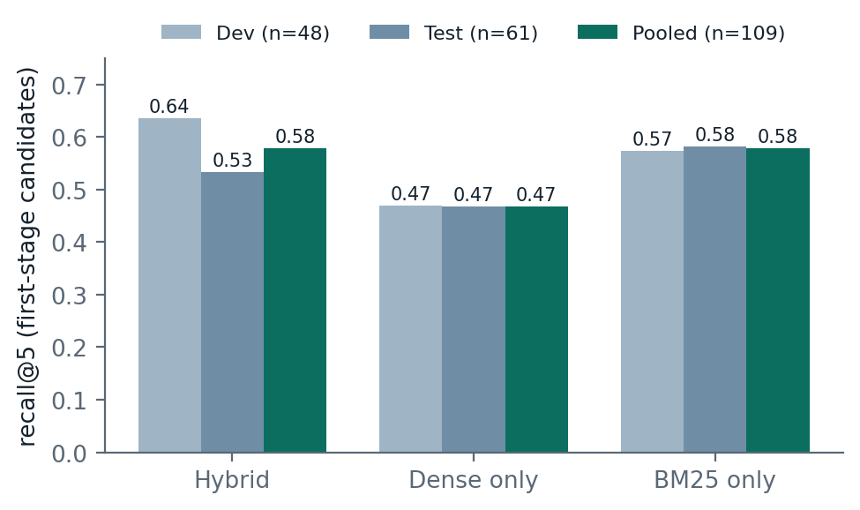
Hybrid search beats dense-only search; keyword search alone is just as good
What recall@5 means
The share of questions where the top 5 pages include the evidence needed.
0.578 vs 0.468 hybrid vs dense-only, pooled over dev and test
The only clear effect found in the whole study
Keyword search alone scores 0.578 too: lower on dev, higher on test
Results
9
Notes:
Pooled over 109 questions, dense is 0.11 below hybrid, McNemar p = 0.015. BM25 alone matches hybrid pooled, so we can say hybrid is better than dense, not that it is better than keyword search. This is the only significant effect in the study.

Slide 10
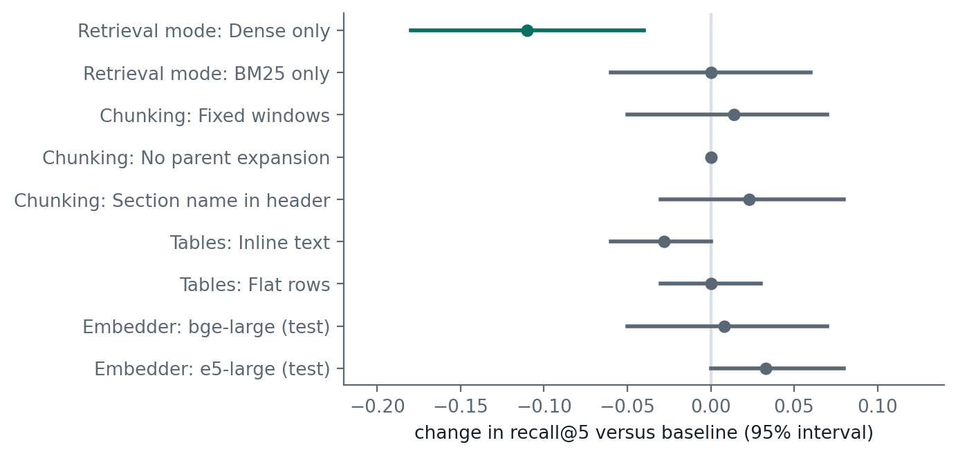
The other four choices made no reliable difference
How to read the chart
Each row changes one thing against the baseline. The dot is the change in recall@5. The bar is the 95% range for the true change. A bar that crosses zero could be chance. Only dense-only search is clearly below zero.
Parent section helps the small generator: 0.50 to 0.59 (bolt)
Verification unsupported figures fall from 5.8% to 1.9%; the score is unchanged
Results
10
Notes:
Each row is the change in recall at 5 versus the baseline with a 95% interval. Only dense retrieval excludes zero. These are 'no effect large enough to detect with 109 questions', not proof of no effect. Larger embedders cost about eight times more to index.

Slide 11
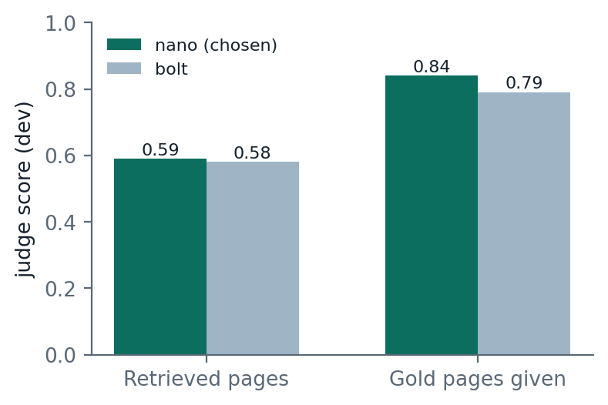
Giving the generator the right pages lifts the score from 0.59 to 0.84
The ceiling test
Hand the model the correct pages and skip retrieval. The gap to the normal score is what retrieval loses.
Retrieval is the bottleneck the gap to 0.84 is mostly pages that were never found
Generators are tied bolt 0.58, nano 0.59, ultra 0.57 on dev
Chosen: nano by a rule fixed in advance; on test ultra scores 0.650 and nano 0.643
Results
11
Notes:
Ceiling experiment on dev: the model is handed the gold evidence pages instead of the retrieved ones. The retrieval loss is +0.27 with a 95% interval of 0.10 to 0.43. Largest losses on two-filing and numeric questions. Generator choice: nano by the dev rule fixed before the final run; on test ultra is nominally higher but within noise and twice as slow.

Slide 12
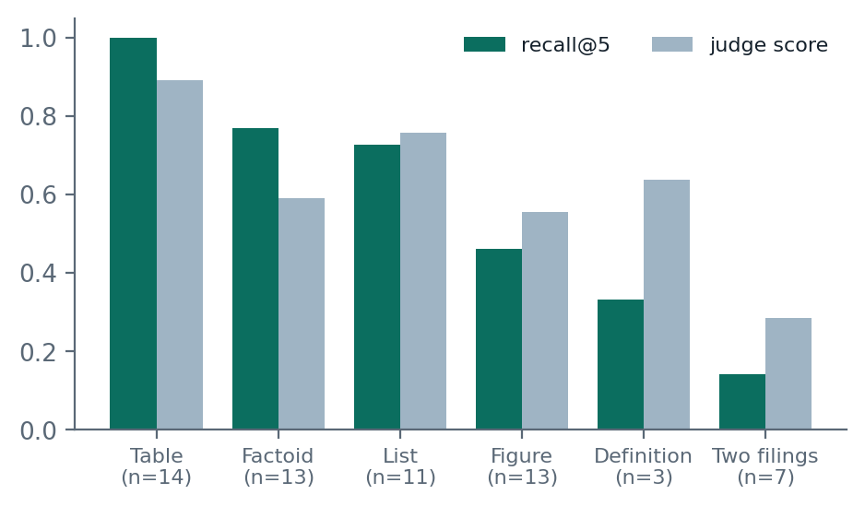
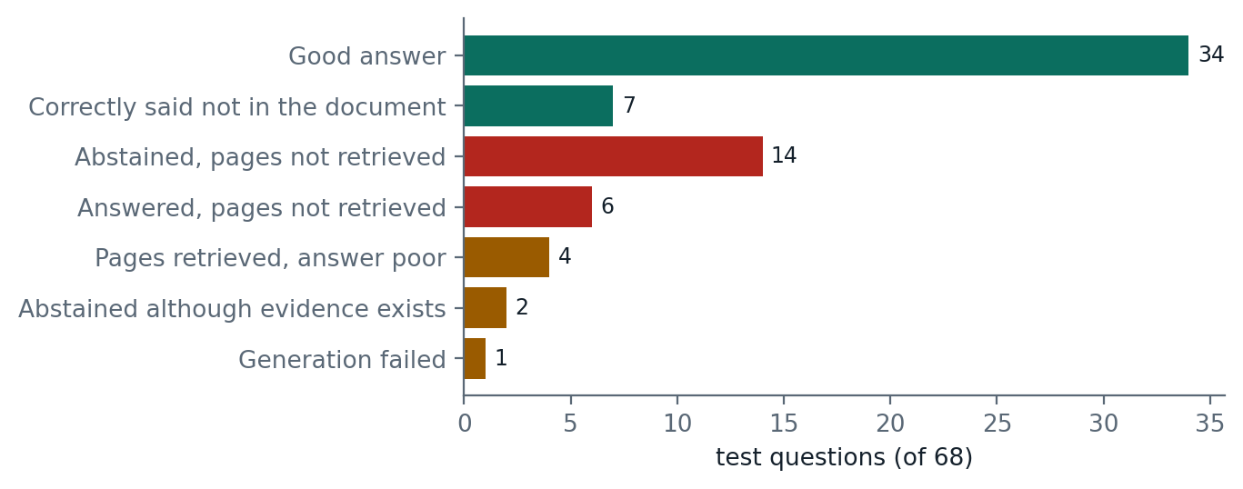
On the held-out test, tables are solved and two-filing questions fail
recall@5 0.656 judge score 0.651, faithfulness 0.824, correct refusal on 7 of 7 unanswerable questions
Most failures start in retrieval 20 of 27 failures had no evidence retrieved; searching only the right filing lifts recall to 0.787
Results
12
Notes:
Final one-shot run, 68 questions, nano. 34 good answers and 7 correct abstentions. 20 failures start with evidence not retrieved. Only 7 fail with the evidence in hand. Oracle retrieval (right filing only) gives 0.787 recall.

Slide 13
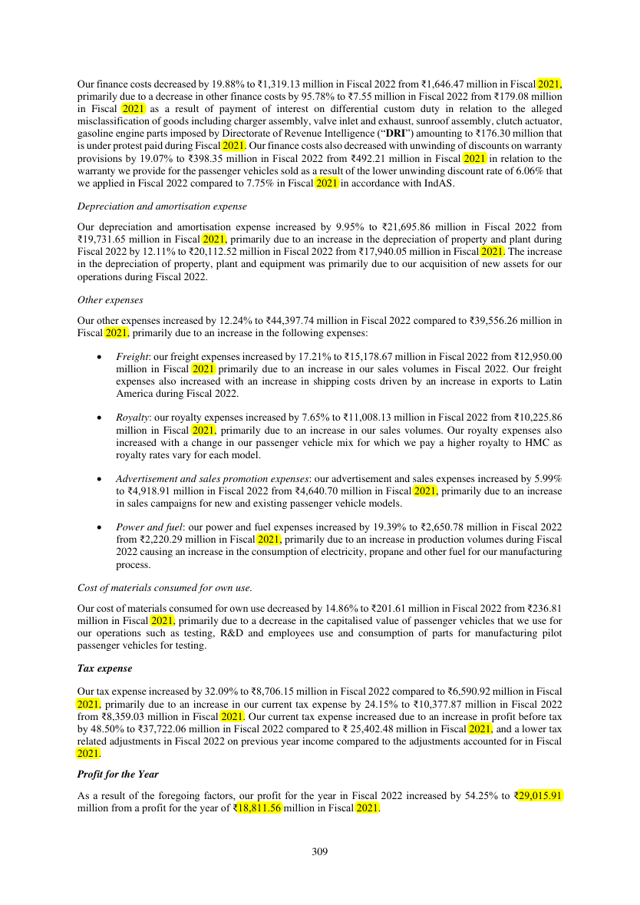
Prospectus Desk: read the answer, then check it on the source page
Ask answer with citation buttons; figures highlighted on the source page
How the system found it the five steps, and the passages used with which search found each
Compare hybrid vs dense, figure check on or off, with and without surrounding text
Results the charts from this talk
Honest examples six test questions, including a wrong figure and a missed two-filing question
Demo
13
Notes:
Live demo: run python -m demo.server. Show Ask with the Hyundai profit question, click the citation to open page 314 with the figures highlighted, open the retrieval trace, then Compare hybrid vs dense on the two-filing question, then Results. Examples are cached so the demo works offline.

Slide 14
Limitations
The gold set
One judge
One corpus
LLM-drafted and checked by the author only; no second annotator. It is small, so a null result means no effect large enough to detect. The drafting model is also one of the three generators tested.
Answer quality comes from a single LLM (gpt-oss-120b). It agrees only moderately with a rule-based check and was never compared with human graders.
12 filings from one regulator, and no comparison with another published RAG system, so the findings are for this setting.
Limitations
14
Notes:
Three limits to state before the questions. First, the gold set: LLM-drafted, checked by one person, small, so small effects cannot be ruled out, and the drafting model is also a tested generator. Second, one judge: the answer-quality score comes from one LLM that agrees with a rule-based check only moderately and was never compared with human graders. Third, scope: 12 filings from one regulator and no comparison with other published systems.

Slide 15
Future work
Human checks
Table-aware retrieval
Compare a random sample of the gold set and of the judge's scores with human annotators, with agreement figures.
Keep row and column headers with each figure, rewrite computed questions, and train a reranker on financial text.
Questions across filings
Broader evaluation
Add multi-hop retrieval and an explicit document router for the weakest category.
More filings, final prospectuses with the offer price, other published RAG systems and an outside benchmark such as FinanceBench.
Future work
15
Notes:
Order by value: check the gold set and the judge against people first, then table retrieval.

Slide 16
Conclusions
Hybrid search beat dense-only search
Recall@5 is 0.58 against 0.47 for dense-only search. The other four choices made no reliable difference.
Retrieval limits quality
With the right pages the judge score rises from 0.59 to 0.84, and questions that span two filings almost always fail.
Evidence for this setting
One corpus and an author-audited gold set: the results show what works here, not that other corpora behave the same way.
Conclusions
16
Notes:
Three takeaways. Hybrid search is the only one of the five choices with a measurable effect, and it beats dense-only search but not keyword search. Retrieval, not generation, limits answer quality: with the right pages the score rises from 0.59 to 0.84, and questions that span two filings almost always fail. All of this is evidence for this corpus and this gold set, not a claim about other corpora.

Slide 17
Backup: generator comparison
 | Dev overall | Dev fail | Dev median s | Test overall | Test fail | Test median s
bolt | 0.580 | 0% | 1.05 | 0.597 | 0% | 1.87
nano (chosen) | 0.594 | 4% | 4.83 | 0.643 | 1% | 3.36
ultra | 0.566 | 0% | 8.54 | 0.650 | 0% | 6.48
Judge: gpt-oss-120b, comparing the predicted answer with the gold answer. Selection rule, fixed before the final run: highest dev judge score among generators with a failure rate of at most 10%.
Backup
17
Notes:
Reference table for questions about generator choice.

